Slide 1


Young Innovators 2009
On-Line Microfluidic Extraction using Molecularly Imprinted Polymers for Analysis of Urinary Tobacco Specific Nitrosamines – A Potential Tool to Assess Cancer Risks
Kumar Shah*¹, Michael Peoples², Matthew Halquist¹ and H Thomas Karnes¹
1 – Virginia Commonwealth University, Department of Pharmaceutics. Richmond, VA. USA.
2 – Pfizer Inc., Richmond, VA. USA

Slide 2
Abstract
Purpose. (i) To develop an on-line microfluidic sample extraction technique using molecularly imprinted polymers (MIPs) combined with LC-MS/MS for analysis of tobacco specific nitrosamine NNAL (carcinogen) and its glucuronide detoxification product in human urine by direct injection. (ii) To study patterns in the extent of NNAL metabolism among smokers which can be used as a potential tool to study cancer risks.
Methods. Prototype micro-columns were constructed based on a method developed in our laboratory.¹ Micro-columns were constructed from PEEK tubing with dimensions of 500 μm i.d. × 1/16 in. o.d. and were slurry packed with MIP beads specific to NNAL obtained from a commercial source. Urine samples spiked with NNAL were injected directly onto the MIP micro-column coupled on-line with a Waters Quattro-LC triple quadruple mass spectrometer in the positive ESI mode through a switching valve configuration. The on-column capacity of a 19 mm MIP micro-column (smallest possible configuration), was in excess of 1.5 μg of NNAL per mg of the packing material. Post-column infusion studies were performed to investigate the presence of ion suppression matrix effects. The method was validated and used for analysis of urine samples from moderate to heavy smokers. Principal component analysis and hierarchical cluster analysis was performed to study data patterns among these subjects based on the extent of NNAL glucuronidation.

Slide 3
Abstract
Results. The method was optimized for several parameters including wash step flow-rate (~0.25 mL/min), wash time(~3 minutes), sample pH (5-7) and injection volume (200 μL). A post-column infusion study with undiluted urine as the matrix revealed the presence of a matrix effect which caused a drop in response when compared with neat solutions. In order to reduce the ion suppression, a reverse phase C18 column was introduced in line with the MIP micro-column to further resolve the analyte peak from the region of suppression. The method was validated according to the FDA method validation guidance and was found to be selective, precise and accurate [Intra-run accuracy and precision were within ±14.8% (%DFN) and 11.3% (%RSD) respectively]. Real sample data analysis revealed patterns in the extent of NNAL metabolism. Four separate clusters for potential cancer risk were observed based on the levels of NNAL, NNAL-glucuronide and the ratio of NNAL-glucuronide to NNAL levels.
Conclusions. An on-line Microfluidic sample extraction method using MIPs combined with LC-MS/MS was developed for determination urinary NNAL and its glucuronide conjugate in human urine. The method demonstrated high throughput, was automated with minimal sample handling, required a low sample volume (5 mL in conventional SPE format v/s 200 μL), no degradation can occur due to an evaporation step, the method is low cost with reusable cartridges (~300 injections). The method is suitable for the study of the relationship between NNAL metabolic patterns among smokers and the potential cancer risks.

Slide 4
Tobacco Specific Nitrosamines (TSNAs)
  Worldwide Tobacco Problem
  TSNAs - important groups of carcinogens in tobacco products
  Important role in cancer induction by tobacco products
  Occur only in tobacco products
  NNK considered carcinogenic to humans by IARC.
  Most important lung carcinogen
NNK: 4-(methylnitrosamino)-1-(3-pyridyl)-1-butanone;
NNN: N'-Nitrosonornicotine
S.S.Hecht. Nat. Rev. Cancer. (2003) 3, pp:733

Slide 5
TSNAs and Cancer Risk
NNK extensively reduced to NNAL in human body which is also carcinogenic
α-hydroxylation activation pathway for NNK and NNAL to form DNA adducts is non-specific
NNAL forms glucuronide detoxification products
Ratio of NNAL and NNAL-Gluc in urine may be related to cancer risk (Both < 1 ng/mL in urine)
(Carcinogenic)
Extensive metabolism
(Carcinogenic)
(Detoxification product)
(Detoxification product)
S.S.Hecht. Nat. Rev. Cancer. (2003) 3, 733;
Byrd GD et al. J. Mass Spec. 2003; 38:98

Slide 6
Molecularly Imprinted Polymers (MIPs) for Sample Extraction
  Retention mechanism based on molecular recognition – more specific compared to typical SPE
  Overcome drawbacks in development of immunosorbent
  High physical and chemical robustness
  Compound specific commercial availability
  Opportunities for miniaturization

Slide 7
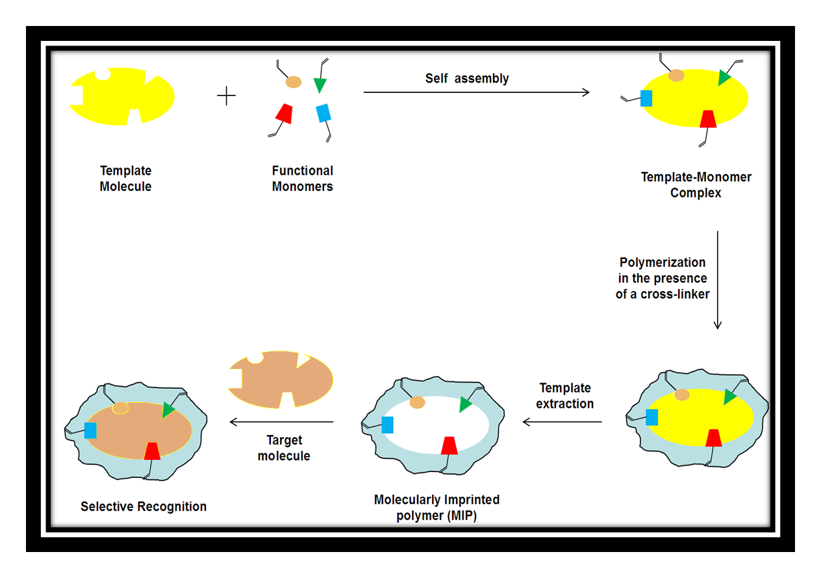
Principle of MIPs for NNAL

Slide 8
Objective of Work
  Development of an On-Line Capillary Microfluidic Sample Extraction Method using MIP coupled with tandem MS for analysis of Free and Total Urinary NNAL
210.1 → 180.2
  Total NNAL = Free NNAL + NNAL-Gluc
  converted to Free NNAL (Enz. Hydrolysis)
  Method Development on Waters QuattroMicro
  Validation and Sample Analysis on Applied Biosystems 4000 QTrap
213.0 → 183.2

Slide 9
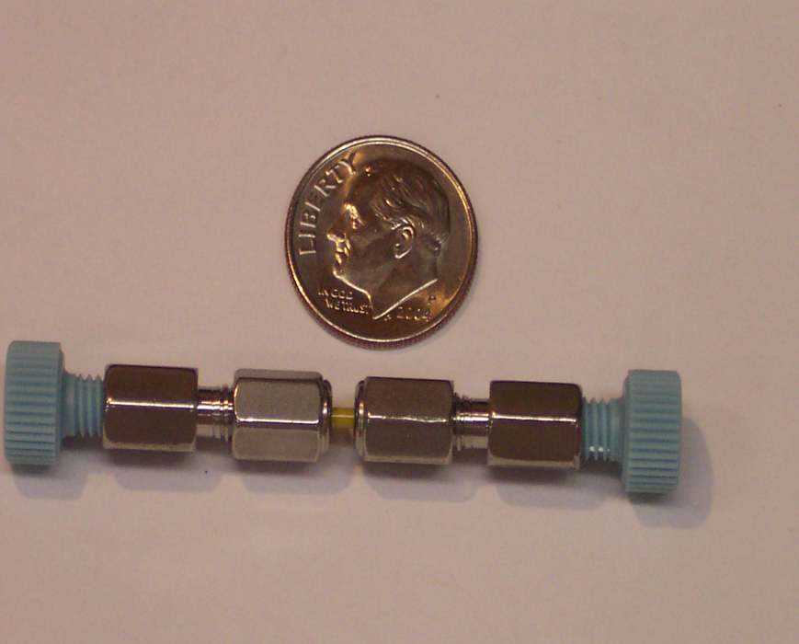
Construction of MIP Micro-column
Commercially available NNAL MIP cartridge
1 mg MIP beads packed in a micro-column v/s
25 mg MIP bed weight in SPE cartridge

Slide 10
On-Line Schematic Diagram
Pump A
H₂O
Pump B
Methanol
Pump A
H₂O
Pump B
Methanol
2
2
Inject Urine
1
3
Inject Urine
1
3
6
4
6
4
5
5
Waste
MS/MS
Waste
MS/MS
A: Loading and Washing
B: Elution
Time (min) | Mobile Phase A (mL/min) | Mobile Phase B (mL/min) | Valve Position
0.01 | 0.25 | 0.75 | A
3.20 | 0.25 | 0.75 | B
4.51 | 0.25 | 0.75 | A
6.00 | 0.25 | 0.75 | A
Mobile phase:
A: Water
B: Methanol
Injection volume = 20 μL

Slide 11
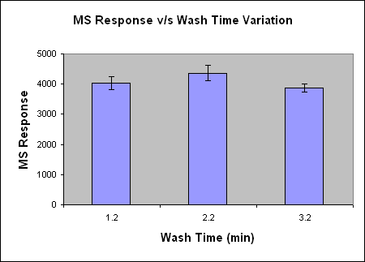
Wash Time Optimization
30 ng/mL NNAL in
Urine; 20 mcl Inj vol
p<0.05
  No significant decrease in response was observed as the wash time was increased.
  Wash time of 3.2 minutes was selected in order to wash off the maximum amount of matrix components.

Slide 12
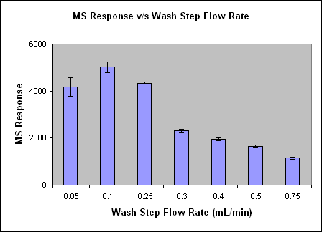
Wash Step Flow Rate Optimization
30 ng/mL NNAL in urine; 20 mcl Inj vol
  The wash step flow rate was optimized and selected as 0.25 mL/min.
  At lower flow-rates, the variability was higher
  The response dropped as the flow rate was increased.

Slide 13
Sample pH Optimization
Retention of NNAL on MIP depends on selective interaction based on hydrogen bonding, ionic and hydrophobic effects
pH Study
50000
40000
30000
MS Response
20000
  Highest recovery was seen at pH 5-7
  pH of samples were adjusted if outside this range prior to injection
10000
0
2 to 3
3 to 4
4 to 5
5 to 6
6 to 7
7 to 8
8 to 9
9 to 10
100 ng/mL NNAL in urine; 20 mcl Inj vol
pH

Slide 14
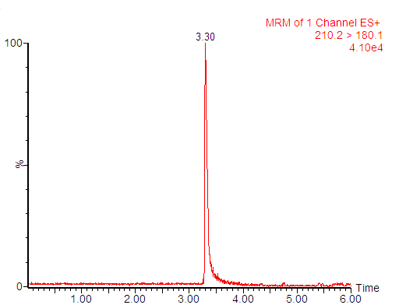
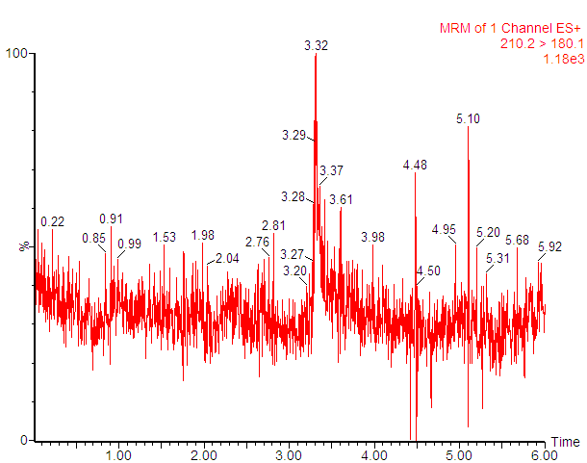
Encouraging Results Initially?
500 ng/mL NNAL spiked in urine
Blank Urine

Slide 15
Evaluation of Column Loadability
  Concentration required to achieve 90% binding is ~1.5 μg NNAL per mg of MIP sorbent
Software:
GraphPad Prism (ver: 5.0)
Three parameter curve: Y=[B_{max}* X^{h} / (Kd^{h} + X^{h})]
B_{max} = 1.75 x 10⁶ (0.52 x 10⁵)
kd = 695.0 (47.5)
h = 0.939 (0.007)
Note: Quantities in parantheses indicate std.error; n=3 replicates. 1/Y² Weighting

Slide 16
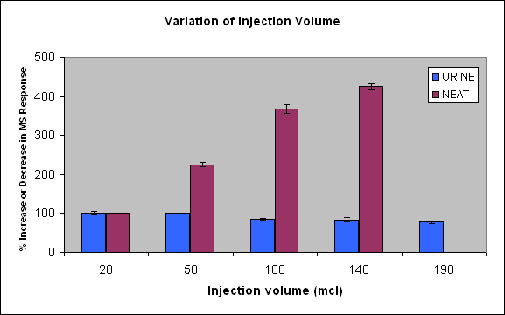
Concentrating On-Column: Effect of Increasing Injection Volume
While the response increases with increasing injection volume for neat solutions, similar situation is not observed in case of matrix samples
100 ng/mL NNAL
In the presence of excess matrix, two situations might occur.
Binding sites might be depleted in the presence of matrix, or
Ionization suppression due to matrix effects is taking place.

Slide 17
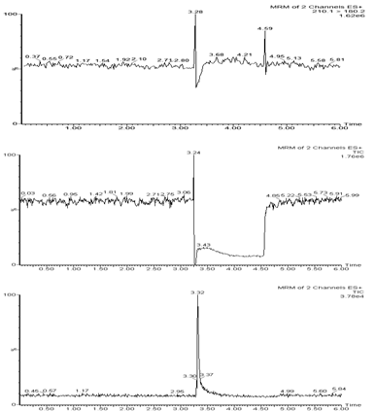
Post Column Infusion Study – Reveal Matrix Effects
i
Post column NNAL infusion
ii
Post column NNAL infusion with injection of Blank extract
iii
Standard injection

Slide 18
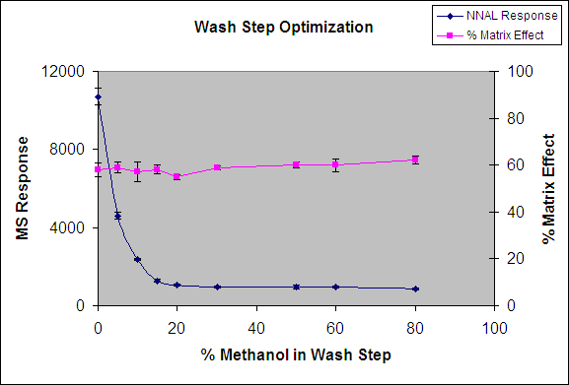
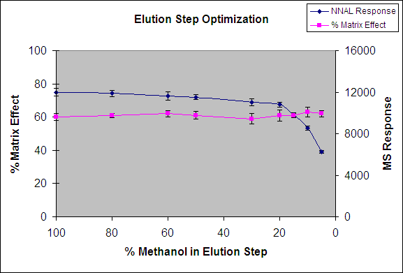
Wash and Elution Step Optimization
n=3 replicates
n=3 replicates
Wash with strongest possible solvent to remove maximum matrix components without losing analyte of interest
Elute analyte with weakest possible solvent to retain back maximum matrix components

Slide 19
Resolution of Matrix Components by Integration of Analytical Column
Pump B
Methanol:H₂O (1:1)
Pump B
Methanol:H₂O (1:1)
Pump A
H₂O
MS/MS
Pump A
H₂O
MS/MS
2
2
1
3
1
3
Inject Urine
Inject Urine
4
HPLC
4
HPLC
6
5
6
5
Waste
Pump C
Amm Form Buffer
Waste
Pump C
Amm Form Buffer
A: Loading and Washing
B: Separation on Analytical Column and Elution
A: Water
B: Methanol:Water (1:1)
C: 10 mM Ammonium Formate (pH 6.1)
Injection volume = 20 mcl
HPLC Column: Phenomenox Gemini C18 (5 μ, 2.0 X 100 mm)
Time (min) | Mobile Phase A mL/min | Mobile Phase B mL/min | Mobile Phase C mL/min | Valve Position
0.01 | 0.24 | 0.18 | 0.18 | A
3.50 | 0.24 | 0.18 | 0.18 | B
3.70 | 0.24 | 0.18 | 0.18 | A
7.00 | 0.24 | 0.18 | 0.18 | A

Slide 20
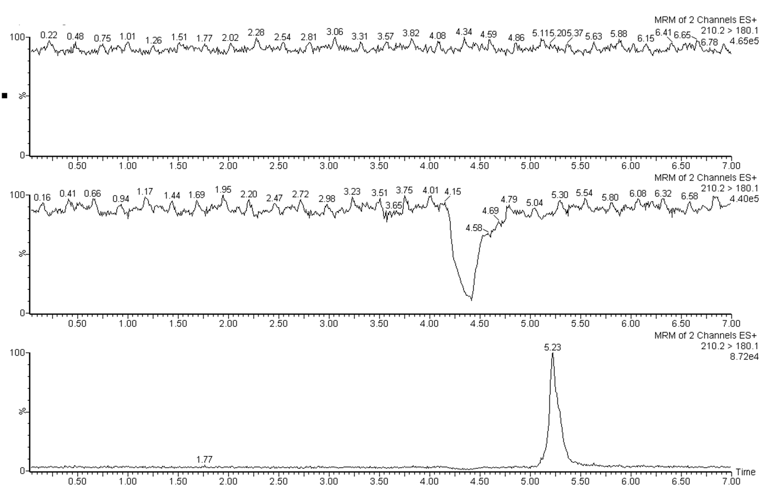
Post Column Infusion Results - After Integration of Analytical Column
i
Post column NNAL infusion
ii
Post column NNAL infusion with injection of Blank extract
Resolution of ion suppression after integration of analytical column
iii
Standard injection
NEXT STEP: Increase injection volume for online sample concentration

Slide 21
On-column Concentration – Inj. Vol. as a function of a) s/n and b) resolution from region of ion suppression:
50 pg/ml NNAL in urine
Injection volume was optimized as 200 mcl

Slide 22
Method Validation – FDA Guidance
Method was linear from 20-2500 pg/mL (R² > 0.998; 1/x weighting)
LLOQ was 20 pg/mL
Method was selective for free and total NNAL ( 6 lots of blank urine)
Intra-run accuracy and precision were within ±14.8% (%DFN) and 11.3% (%RSD)
Inter-run accuracy and precision were within ±9.6% (%DFN) and 11.4% (%RSD)
Method showed adequate post-preparative, freeze-thaw and bench-top stability.
Extraction Recovery was ~35%

Slide 23
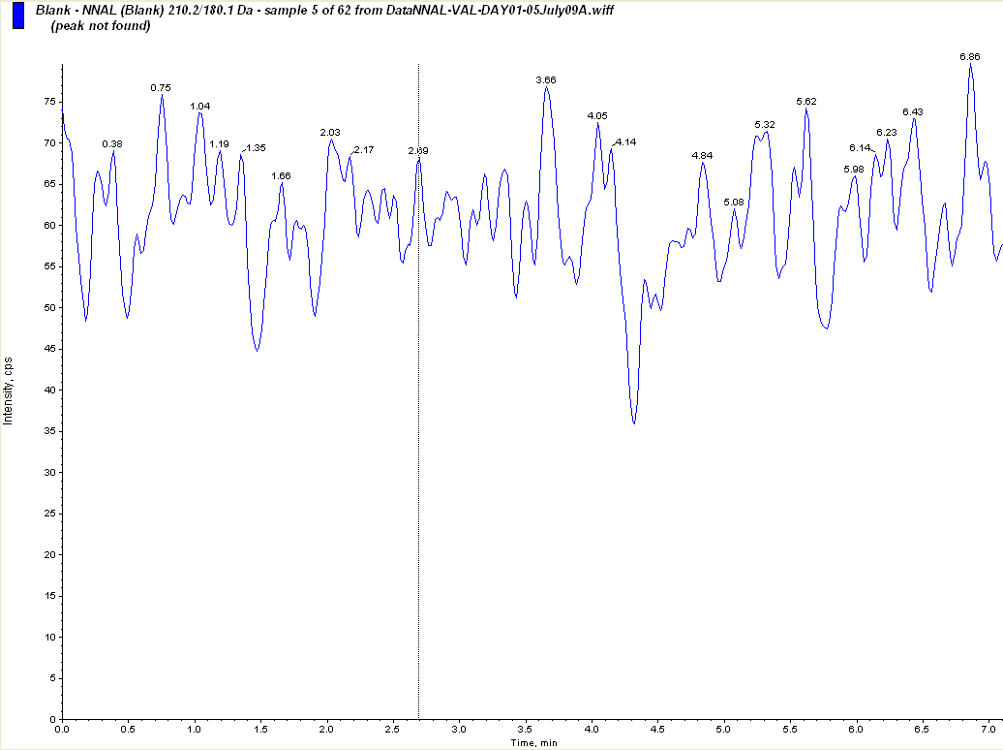
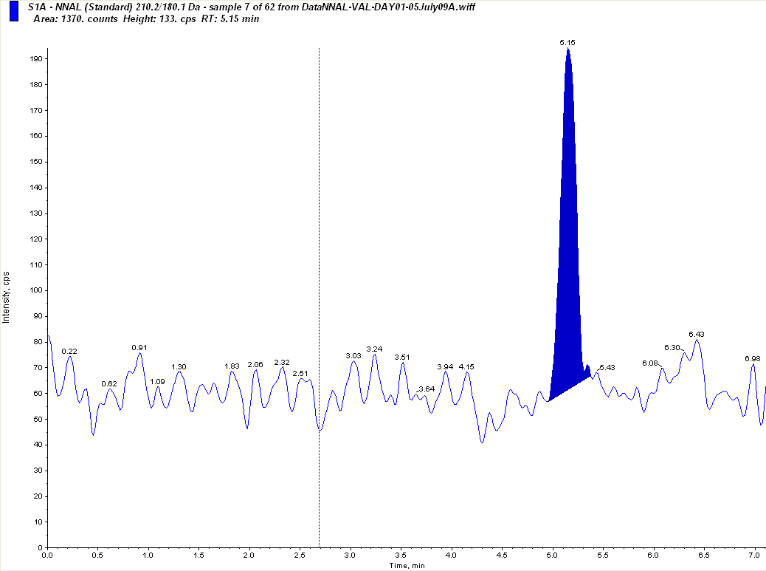
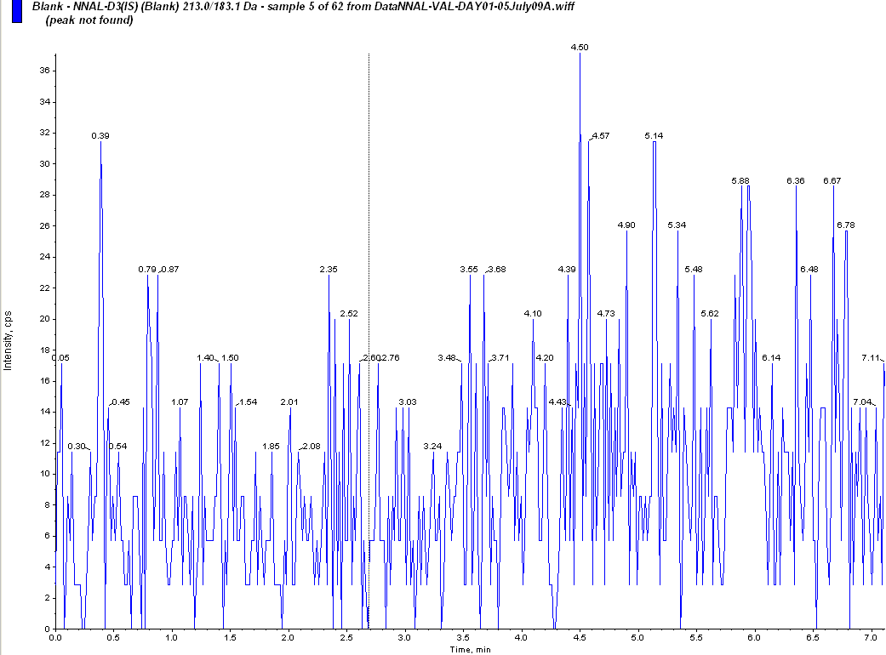
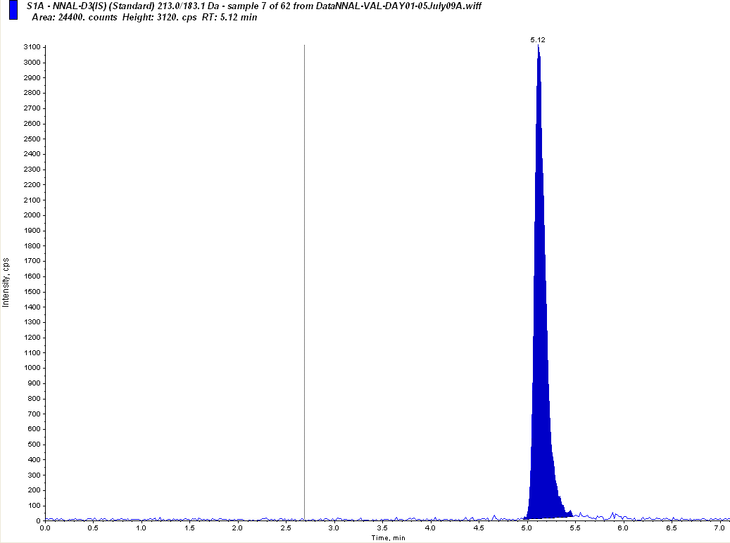
Chromatograms
NNAL
210.1 → 180.2
NNAL-d3
213.0 → 183.2
Urine Spiked with 20 pg/mL NNAL and 250 pg/mL IS
Blank Urine

Slide 24
MIP Column Packing Reproducibility
~300 injections on a single packed MIP micro column

Slide 25
Principal Component Analysis Results
43 Smokers (Avg 26.8 cig/day)
Free NNAL levels ranged from BLOQ to 1.26 pmol/mg creatinine
NNAL-Gluc levels ranged from from BLOQ to 0.501 pmol/mg creatinine
LOADINGS - Features selected:
*1 → NNAL ;
*2 → NNAL-Gluc ;
*3 → Ratio of NNAL-Gluc to NNAL
Classification of Clusters
Possible High Risk Group
RED: High Free NNAL, Low ratio ( detoxification)
BLUE: High Ratio ( detoxification)
GREEN: Similar extent of metabolism
YELLOW: BLOQ Group
Possible Low Risk Group

Slide 26
Summary and Conclusion
  On-Line Micro-column MIP Approach for Sample Extraction of Urinary NNAL was developed
  Method was validated
  Advantages compared to off-line SPE format (published method):
    High throughput,
    Automation and Minimal sample handling,
    Low sample volume (5 mL in conventional SPE format v/s 200 μL),
    No degradation due to evaporation step
    Low cost – Reusable cartridge (~300 injections)
  Issues of Ion Suppression Matrix Effects were addressed
  Real Sample Analysis was performed

Slide 27
Acknowledgments
PhD Advisor
H Thomas Karnes, PhD
PhD Committee Members
Sarah Rutan, PhD
John R James, PhD
Les Edinboro, PhD
John Hackett, PhD
VCU Bioanalytical Core Lab Service Center
Matthew Halquist
Michael Peoples, PhD
VCU Nephrology Core Lab
Christine Farthing
Supelco
An Trinh, PhD
Georgianne Fenchak

Slide 28

BIOS/Contact info
Kumar Shah, M.Tech., is currently pursuing his PhD in Pharmaceutics at Virginia Commonwealth University (VCU), Richmond, VA, USA. He also works as a research assistant in the VCU Bioanalytical Core Laboratory and Research Center. Kumar has completed his M.Tech and B.Tech in Pharmaceuticals and Fine Chemicals from the Institute of Chemical Technology, University of Mumbai. Presently, Kumar is working on the analysis of tobacco specific nitrosamines in biological matrices based on microfluidic sample extraction using molecularly imprinted polymers and LC/MS-MS. His current research interests include pharmaceutical applications of bioanalytical chemistry, biological sample preparation, validation and control of bioanalytical methods, matrix effects in mass spectrometry. Apart from these, Kumar also has interest in the area of drug delivery technology, particularly development of colloidal drug delivery and nanoparticle based systems. Kumar is affiliated to various professional bodies including American Association of Pharmaceutical Scientists (AAPS), Indian Pharmaceutical Association (IPA) and UICT Alumni Association.
Email: shahka2@mymail.vcu.edu
kumar_vcu@hotmail.com

