Slide 1
Innovators 2010
Bioanalysis: Past, Present and Future
APQ Research Achievement Award
Michael G. Bartlett
University of Georgia

Slide 2
Oligonucleotides

Slide 3
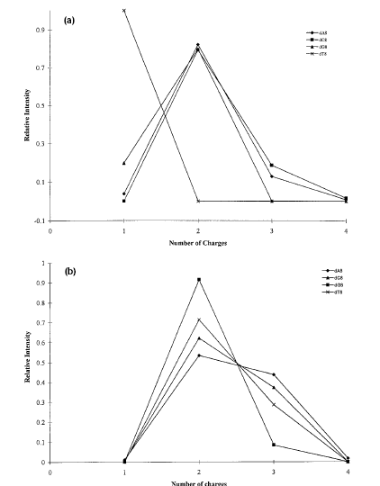
Comparison of homopolymer
oligonucleotide charge-state
distributions in positive-ion
mode and negative-ion mode
using electrospray ionization
mass spectrometry.
P.P. Wang, L.B. Martin, M.G. Bartlett
Rapid Commun. Mass Spectrom. (1997)

Slide 4
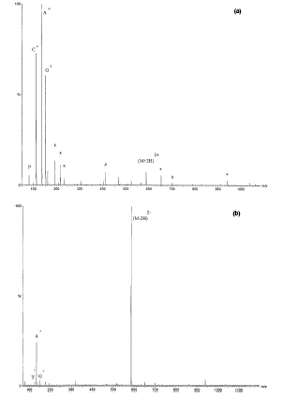
Comparison of collision-
induced mass spectra from
a DNA mixed base 10-mer
under identical conditions
in positive-ion mode and
negative ion mode

Slide 5
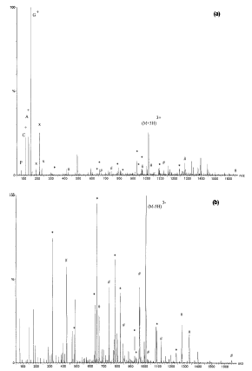
Comparison of mixed base DNA 20-mer in positive-ion and negative ion mode under optimized conditions. Major sequence ions ( W & A-base) are highlighted.

Slide 6
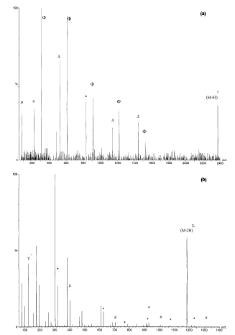
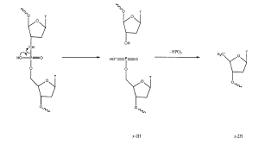
Comparison of Collision-induced dissociation mass spectra of dT₈ in positive ion mode and negative ion mode.

Slide 7
Cardiovascular Biomarkers

Slide 8
Nitric Oxide Pathway
ADMA
O₂.
(-)
(-)
(-)
L-ARG
NO
NOS
(+)
(+)
VASODILATION

Slide 9
Methylarginines
X=Y=Z=H for Arginine
X=CH₃ Y=Z=H for Monomethyl arginine
X=H Y=Z=CH₃ for Symmetric dimethyl arginine
X=Y=CH₃ Z=H for Asymmetric dimethyl arginine

Slide 10
2
1. Citrulline
2. Arginine and IS
3. Monomethylarginine
4. SDMA
5. ADMA
Sample Prep: Protein Precip.
Chromatography: HILIC
4
3
1
5
0
Time (min)
15
Vishwanathan, Stewart, Tackett and Bartlett
J. Chrom. B (2000)

Slide 11
ADMA Levels

Slide 12
Drugs of Abuse

Slide 13
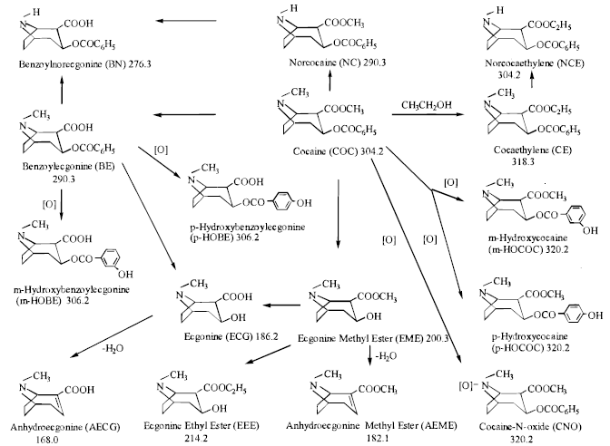

Slide 14
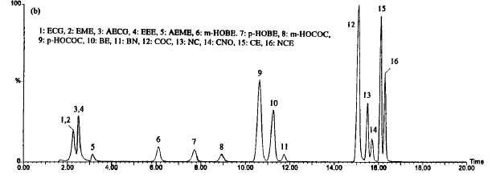
LC-MS/MS of Cocaine from Meconium
Sample Prep: Mixed-mode SPE
Chromatography: C₈ RPLC
Xia, Wang, Solomon, Busch and Bartlett
Anal. Chem. (2000)

Slide 15
Clinical Meconium Samples
1 – ECG
2 – EME
3 – AECG
4 – EEE
5 – AEME
6 – mHOBE
7 – pHOBE
8 – mHOC
9 – pHOC
10 – BE
11 – BN
12 – COC
13 – NC
14 – CNO
15 – CE
16 – NCE

Slide 16
Fetal Exposure

Slide 17
Maternal Plasma
 | AZT 25 mg/kg | AZT 60 mg/kg
Half-life (hr) | 1.37 +/- 0.2 | 1.26 +/- 0.3
Clearance (L/hr-kg) | 0.58 +/- 0.09 | 0.77 +/- 0.18
Vss (L/kg) | 1.13 +/- 0.15 | 1.34 +/- 0.27
AUC (mg-hr/L) | 43.3 +/- 7.2 | 81.4 +/- 21
Mean +/- SD generated by non-compartmental analysis

Slide 18
Fetal and Placental Pharmacokinetics
 | Fetus | Fetus | Placenta | Placenta
 | AZT 25 | AZT 60 | AZT 25 | AZT 60
Half-life (hr) | 1.89 +/- 0.66 | 1.11 +/- 0.78 | 1.29 +/- 0.37 | 3.86 +/- 2.8
AUC (ug-hr/L) | 19.4 +/- 5.1* | 59.4 +/- 33* | 18.7 +/- 4.0* | 72.9 +/- 23*
T_{max} (hr) | 0.43+/-0.1 | 0.50+/-0.40 | 0.24+/-0.1 | 0.36+/-0.3
C_{max} (ug/g) | 6.29+/-1.0* | 28.9+/-5.3* | 8.37+/-0.9* | 24.2+/-8.5*
Relative Exposure (AUCtissue/AUCplasma) | 0.48+/-0.05* | 0.70+/-0.2* | 0.44+/-0.06* | 0.98+/-0.5*
Mean +/- SD generated by non-compartmental analysis
* Indicates a significant difference between the 2 doses (P < 0.05)

Slide 19
Conclusions
Plasma kinetics correspond to literature values
Increase in relative exposure to placenta and fetus
Accumulation in placenta suggests saturation of an uptake process by the fetus
Accumulation in fetus suggests saturation of an efflux transport system

Slide 20
Combination Therapies
Zidovudine and Acyclovir
Pyrimidine and Purine
IV bolus dose of 25 mg/kg
Clinically used to treat patients with HIV and HSV
Literature precedent for interaction
Cooper et al., AIDS (1991) 5, 933-943.
Mamede et al., Gen. Pharmacol. (1995) 26, 523-526.
SD Brown, MG Bartlett, CA White
Antimicrobial Agents & Chemotherapy (2003)

Slide 21
Plasma Results
Therapy | Half-life (hr) | AUC (h-mg/L) | Clearance (L/hr-kg) | Vss (L/kg) | Cmax (mg/L)
ACV | 9.12+/-1.1 | 467+/-183 | 0.14+/-0.05 | 1.61+/-0.26 | 148.4+/-88
ACV-AZT | 2.48+/-1.9* | 241+/-165* | 0.34+/-0.2* | 0.80+/-0.1* | 196.7+/-27
AZT | 1.39+/-0.3 | 80+/-21 | 0.78+/-0.2 | 1.52+/-0.42 | 72.1+/-14
AZT-ACV | 2.69+/-1.2* | 240+/-130 | 0.31+/-0.2* | 1.02+/-0.2 | 59.5+/-10
Mean +/- SD generated from compartmental analysis
* Indicates a significant difference (P<0.05)

Slide 22
Relative Exposure (AUC_{tissue}/AUC_{plasma})
Tissue | ACV | ACV-AZT | AZT | AZT-ACV
Placenta | 0.42+/-0.1 | 0.43+/-0.3 | 1.00+/-0.5 | 0.76+/-0.2
Fetus | 0.20+/-0.05 | 0.56+/-0.2* | 0.72+/-0.2 | 0.59+/-0.2
Amniotic Fluid | 0.09+/-0.02 | 0.26+/-0.1* | 0.48+/-0.3 | 0.40+/-0.40
Mean +/- SD generated from noncompartmental analysis* Indicates a significant difference (P<0.05)

Slide 23
Relative Exposure (AUC_{tissue}/AUC_{plasma})
Tissue | 3TC | 3TC-AZT
Placenta | 0.46+/-0.08 | 0.86+/-0.38
Fetus | 0.26+/-0.09* | 0.86+/-0.46*
Amniotic Fluid | 0.29+/-0.10 | 0.35+/-0.07
Mean +/- SD generated from noncompartmental analysis
* Indicates a significant difference (P<0.05)

Slide 24
Model
Fetal
Circulatory
System
Maternal
Circulatory
System
Basolateral
Membrane
Placenta
Apical
Membrane

Slide 25
Placental Transporters
Apical Membrane
Equilibrative Nucleoside Transporters (ENT 1 & 2)
Carnitine Transporter (OCTN2)
Organic Anion Transporters (OAT 3 & 12)
P-Glycoprotein Transporter (MDR1)
Basolateral Membrane
Organic Cation Transporters (OCT 3)

Slide 26
Macromolecular Therapeutics

Slide 28
Challenges
Mass Discrimination Effects
Higher Mass = Lower Sensitivity
Resolving Power
Separations, Mass Spectrometric
Sample Preparation
Salts, Buffers, Related Molecules
Separations Stability
Adsorption

Slide 29
Peptides
Stock Solutions (plasma versus water)
Protein Precipitation (speed of ACN addition)
Ultracentrifugation
Column Preconditioning
D.C. Delinsky, K.T. Hill, C.A. White, M.G. Bartlett
Rapid Commun. Mass Spectrom. (2004).
D.C. Delinsky, K.T. Hill, C.A. White, M.G. Bartlett
Biomed. Chromatogr. (2004).

Slide 30
m/z = 675.8
100
8.26
%
0
100
%
0
1.00
2.00
3.00
4.00
5.00
6.00
7.00
8.00
9.00
Time

Slide 31
Therapeutic Oligonucleotides
Structure of the phosphodiester (A), phosphorothioate (B), and phosphoramidate (C).

Slide 32
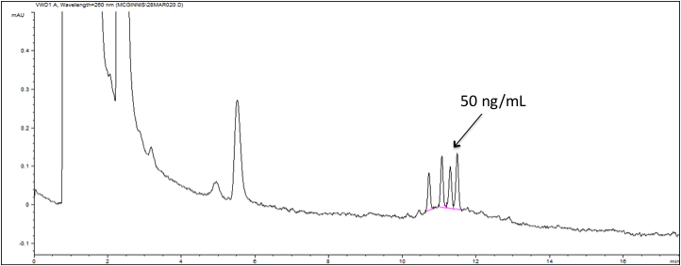
Pooled siRNA LPA₃ Receptor
M.K. Altman, V. Gopal, G.B Mills, A.C. McGinnis, M.G. Bartlett,
G.B Prestwich, M.M Murph
Mol. Cancer (2010)

Slide 33
Memory and Cognition

Slide 34
Memory and Cognition
Chronic Exposure
Antipsychotics
Chemical Warfare Agents
Pesticides
Determine Plasma and Brain Concentrations
Correlate to Behavioral Tests
Determine Mechanism

Slide 35
Brain Sample Preparation
Liquid-Liquid Extraction
2x Isopropyl Ether
Evaporation and Reconstitution
LC-MS/MS
Haloperidol, Risperidone, Paliperidone, Olanzipine, Clozapine, Ziprasidone, Midazolam (IS)
G. Zhang, A.V. Terry and M.G. Bartlett
J. Chrom. B (2007)

Slide 36
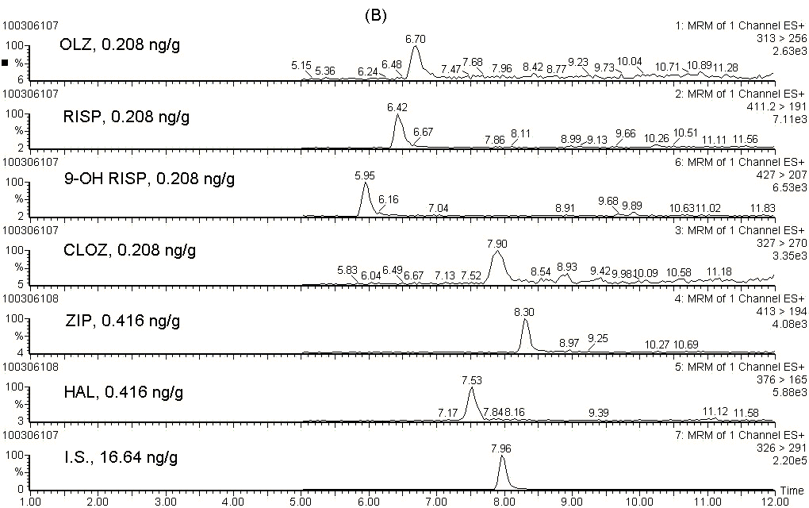
LC-MS/MS from Brain

Slide 37
Plasma Antipsychotic Levels
Treatment Group | Dose / 24 hr | Compound Measured | Plasma Conc. (ng/mL) | Therapeutic Range (ng/mL)
Haloperidol | 2.0 mg/kg | Haloperidol | 14.7 ± 2.2 | 5.0 – 20.0
Risperidone | 2.5 mg/kg | Risperidone 9-HO-Risperidone | 10.9 ± 5.7 31.0 ± 10.2 41.9 ± 15.6 | 20.0 – 60.0
Chlorpromazine | 10.0 mg/kg | Chlorpromazine | 19.7 ± 6.6 | 25.0 – 350.0
Olanzapine | 10.0 mg/kg | Olanzapine | 28.1 ± 6.6 | 9.0 – 80.0
Ziprasidone | 12.0 mg/kg | Ziprasidone | 103.6 ± 35.4 | 50.0 – 130.0
AV Terry, DA Gearhart, A. Pillai, G. Zhang and MG Bartlett
Int. J. Neuropsychopharmacol. (2010)

Slide 38
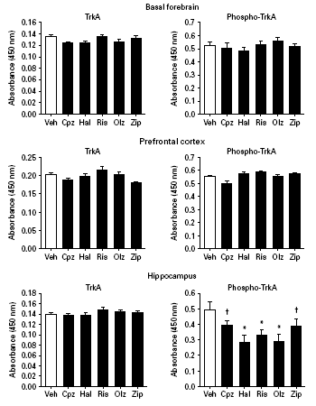
Effects on Memory and Cognition
Observed Time Dependent Behavioral and Neurochemical Effects
Doses Achieved Therapeutically Relevant D₂ receptor occupancy
NGF levels were significant reduced in Basal Forebrain, Prefrontal Cortex and Hippocampus

Slide 39
Acknowledgements
National Institutes of Health
NIMH, NIEHS, NCRR
Johnson & Johnson
Pfizer

