Slide 1
Cancer Insight Summary Slides for
Patients with Metastatic Triple-Negative Breast Cancer Receiving an
ANTIBODY-DRUG CONJUGATE (ADC)
August 2025

Slide 2
Introduction
The goal of this slide presentation is to equip you with information to make the treatment of your triple-negative breast cancer with an antibody-drug conjugate a bit easier
The information provided here is designed to support and supplement information provided by your oncology team
Website links to helpful and reliable resources are included on the last slide
Thank you for the opportunity to share this information

Slide 3
Shared Decision-Making
A process in which you, your caregiver, and your health care team discuss options and agree upon a treatment plan that aligns with your goals, preferences, and expectations
Make sure that you understand your disease and treatment plan:
  Keep a list of questions to ask your team prior to each follow-up appointment
  Ask about treatment options, including clinical trials, and the benefits and risks of each treatment

Slide 4
Antibody-Drug Conjugate Treatment: Definitions
Here are some common abbreviations and terms you may encounter while receiving an antibody-drug conjugate:
                ADC: antibody-drug conjugate (eg, sacituzumab govitecan)
                ICI: immune checkpoint inhibitor, a drug that fights cancer by allowing immune cells to become activated
                PD-(L)1 inhibitor: programmed death (ligand)1 inhibitor, a type of immune checkpoint inhibitor drug (eg, pembrolizumab)
                TNBC: triple-negative breast cancer (ie, breast cancer that does not have significant levels of estrogen or progesterone hormone receptors or HER2 protein)
                TROP2: a protein often found on breast cancer cells that is targeted by some antibody-drug conjugates, such as sacituzumab govitecan

Slide 5
Antibody-Drug Conjugates
Should I get this treatment for my triple-negative breast cancer?
  Patients with inoperable or metastatic triple-negative breast cancer who have already received at least 1 anti-cancer drug for metastatic disease may be eligible to receive an antibody-drug conjugate called sacituzumab govitecan or trastuzumab deruxtecan
  You may receive a different antibody-drug conjugate (eg, datopotamab deruxtecan or sacituzumab tirumotecan) for your metastatic triple-negative breast cancer alone or in combination with an immune checkpoint inhibitor drug (eg, pembrolizumab, durvalumab) as part of a clinical trial
  Information to consider when deciding if a clinical trial is appropriate for you is available at: https://www.cancer.org/content/dam/cancer-org/cancer-control/en/booklets-flyers/clinical-trials.pdf
FDA. News Release. Updated April 8, 2021. Accessed August 29, 2025. https://www.fda.gov/drugs/resources-information-approved-drugs/fda-grants-regular-approval-sacituzumab-govitecan-triple-negative-breast-cancer#:~:text=FDA%20grants%20regular%20approval%20to%20sacituzumab%20govitecan%20for%20triple%2Dnegative%20breast%20cancer,-Resources%20for%20Information&text=On%20April%207%2C%202021%2C%20the,(Trodelvy%2C%20Immunomedics%20Inc.)

Slide 6
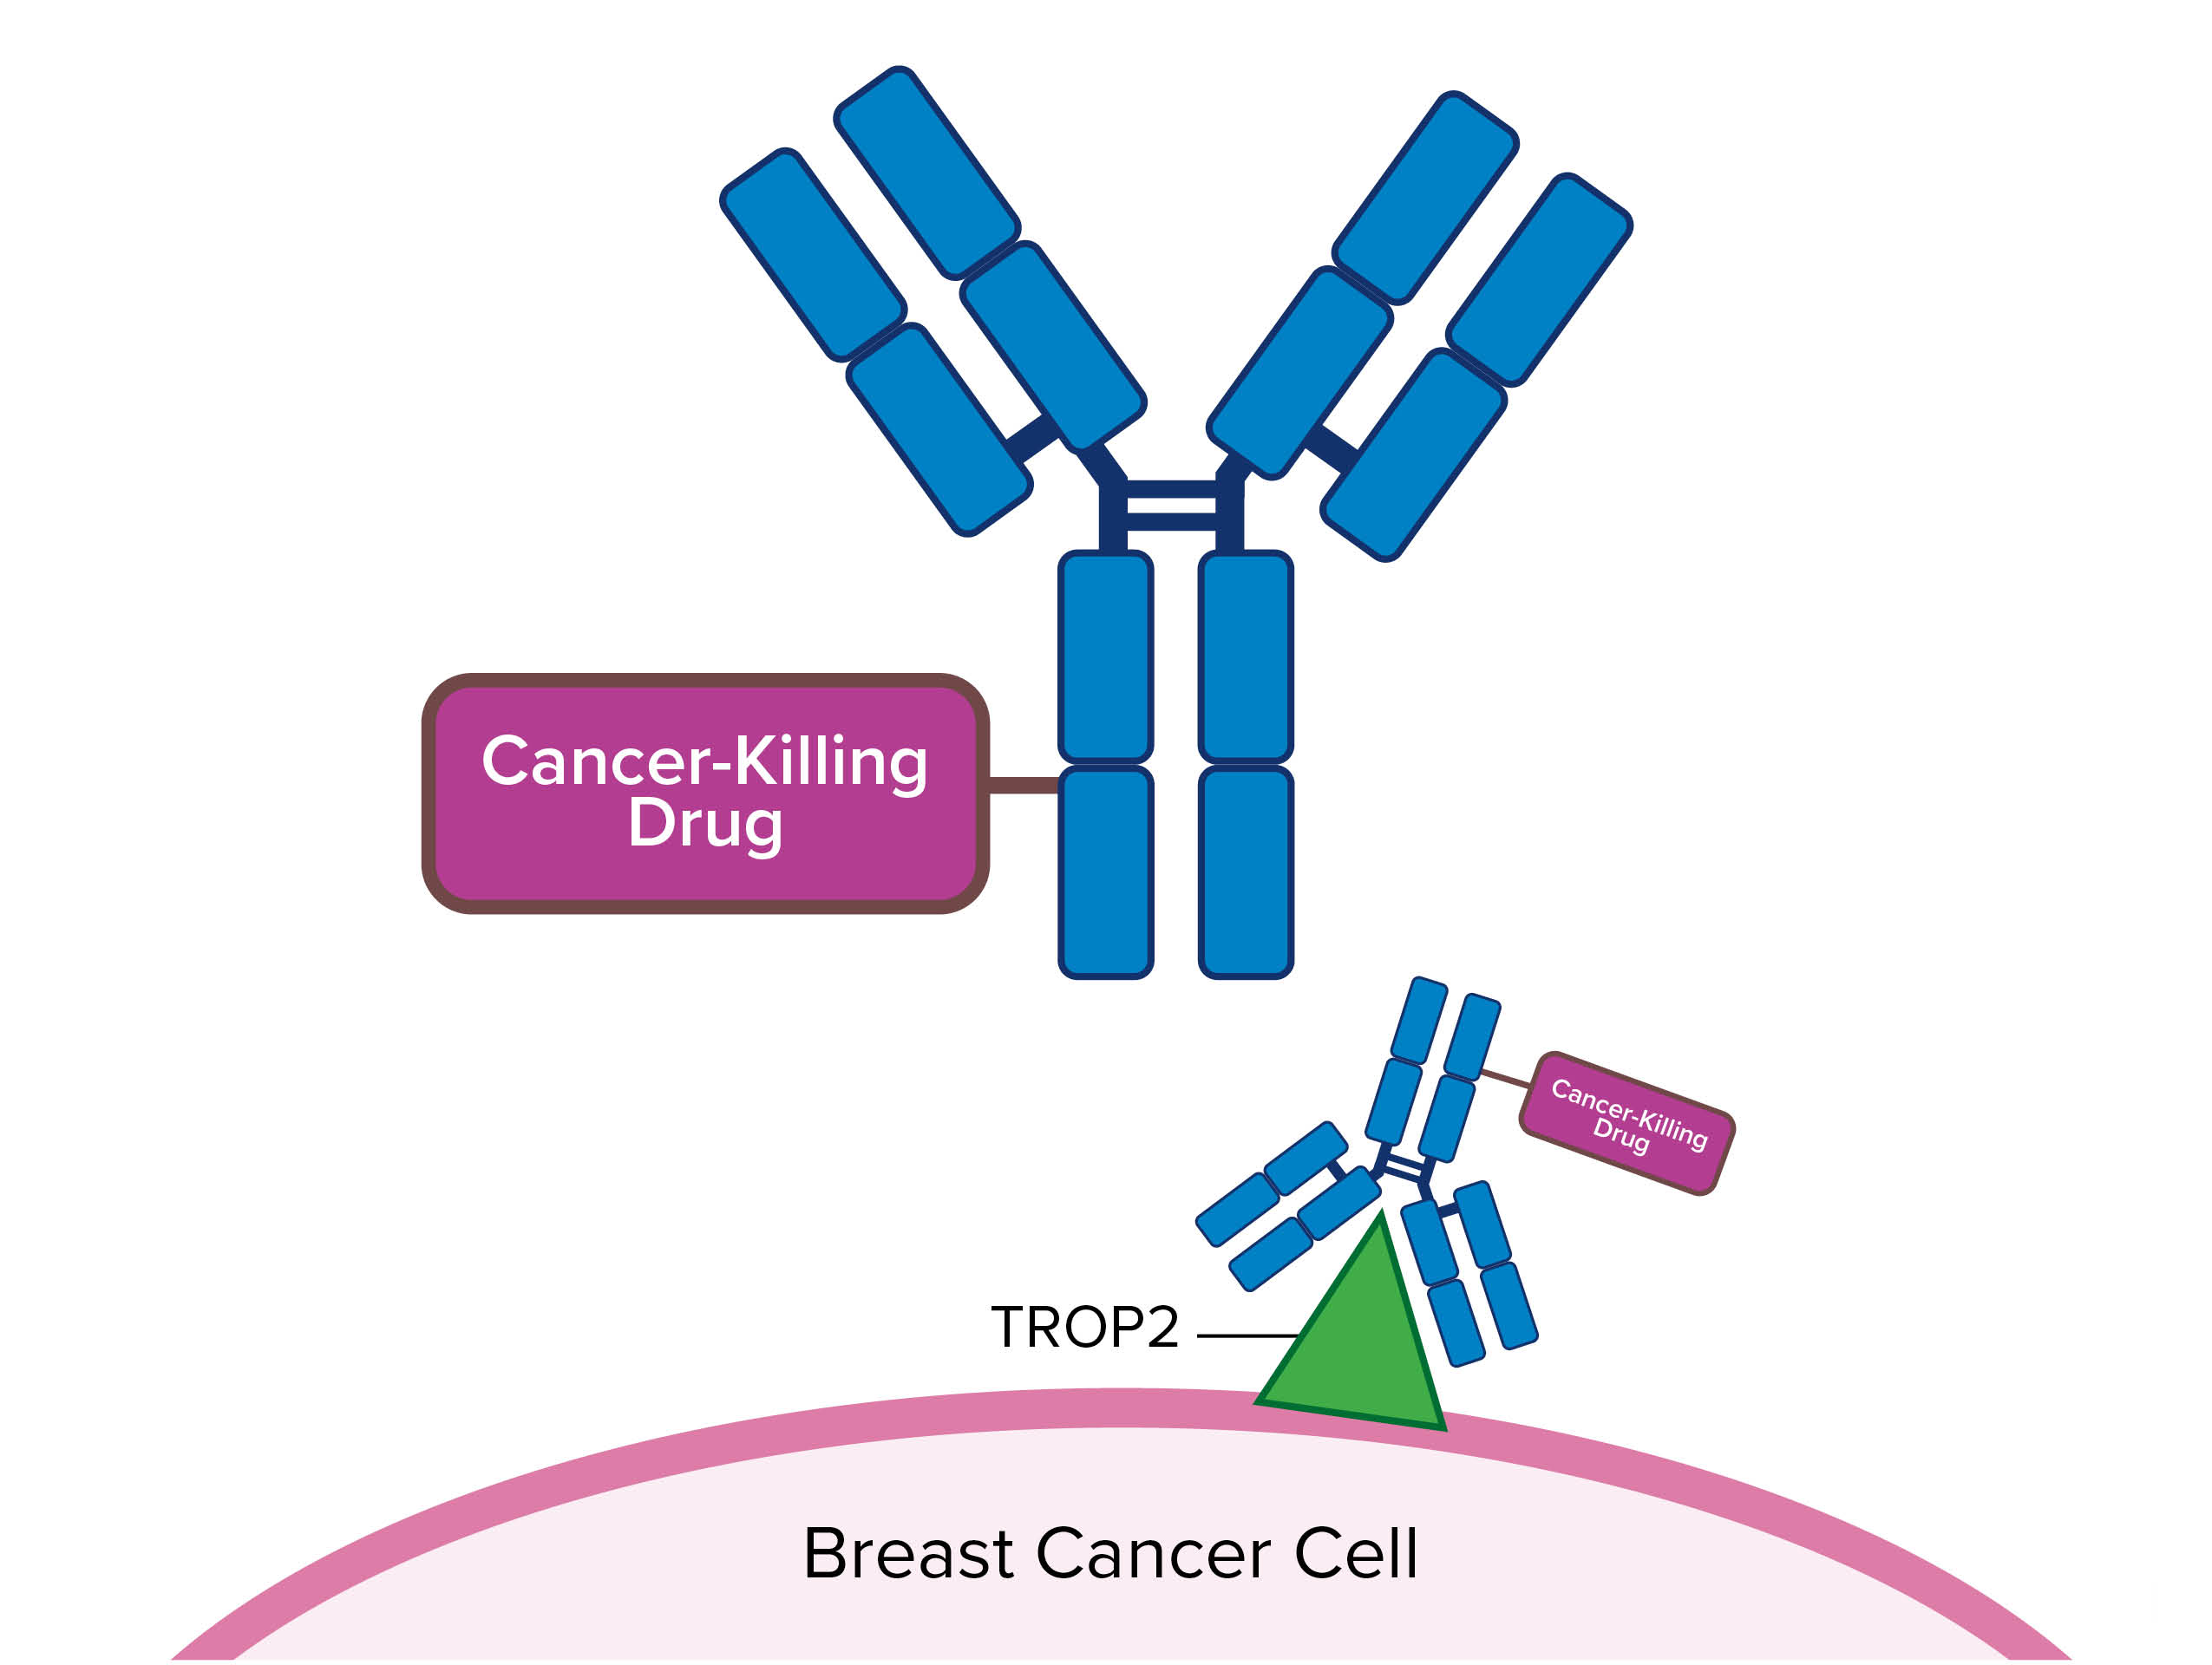
Antibody-Drug Conjugates
How do they work?
TROP2 is a molecule found, or “expressed”, on many breast cancer cells. Some antibody-drug conjugates, such as sacituzumab govitecan, have a part that binds to TROP2 on breast cancer cells, and another part that is a cancer-killing drug. These 2 parts are bound together, or “conjugated”, so that the cancer-killing drug is delivered directly to breast cancer cells.

Slide 7
Antibody-Drug Conjugates: Side Effects
  Low blood counts (including an increased risk of infection and fever), diarrhea, mouth sores, nausea, hair loss, fatigue, rash, eye problems, trouble breathing
  Your oncology team may discuss additional side effects
  Make sure to ask your oncology providers who to contact with concerns and which side effects need to be reported immediately versus at your next visit
  Make sure that you have the contact information for your oncology providers, including a way to contact them outside of regular business hours, if needed
Bardia A et al. N Engl J Med. 2021;384(16):1529-1541.

Slide 8
Reliable Online Resources
National Cancer Institute cancer-related terminology: https://www.cancer.gov/publications/dictionaries/cancer-terms
National Cancer Institute drug dictionary: https://www.cancer.gov/publications/dictionaries/cancer-drug
American Cancer Society:
https://www.cancer.org/cancer/types/breast-cancer/treatment/targeted-therapy-for-breast-cancer.html
National Comprehensive Cancer Network Metastatic Breast Cancer Guidelines:
https://www.nccn.org/patients/guidelines/content/PDF/stage_iv_breast-patient.pdf

