Slide 1


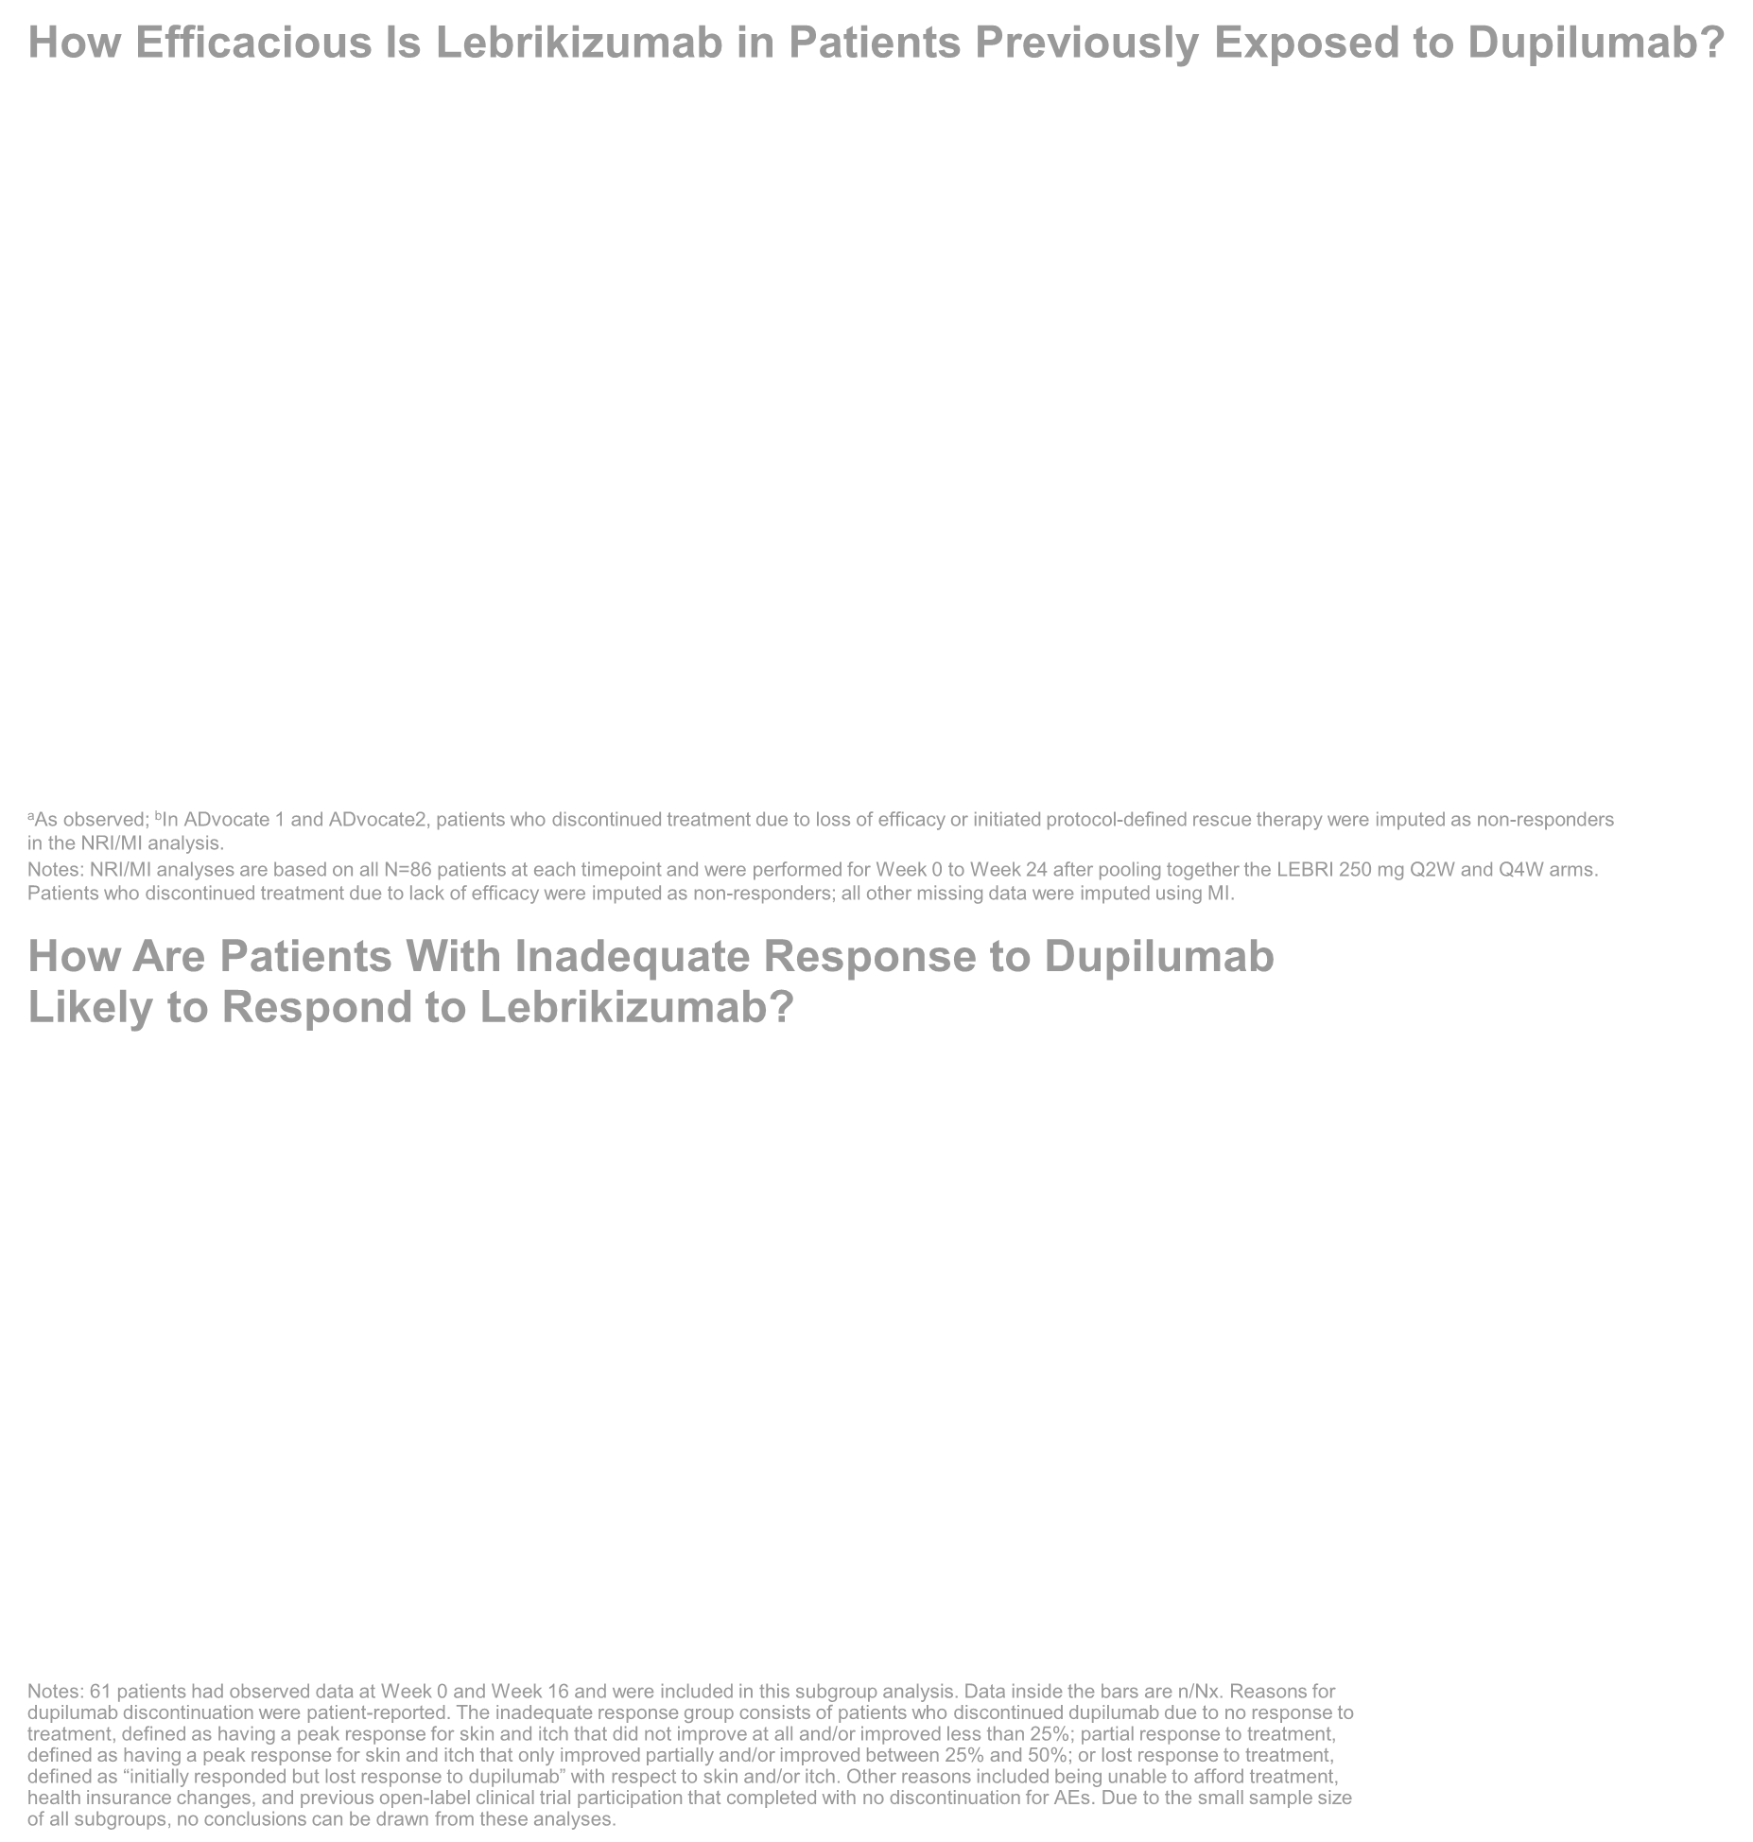
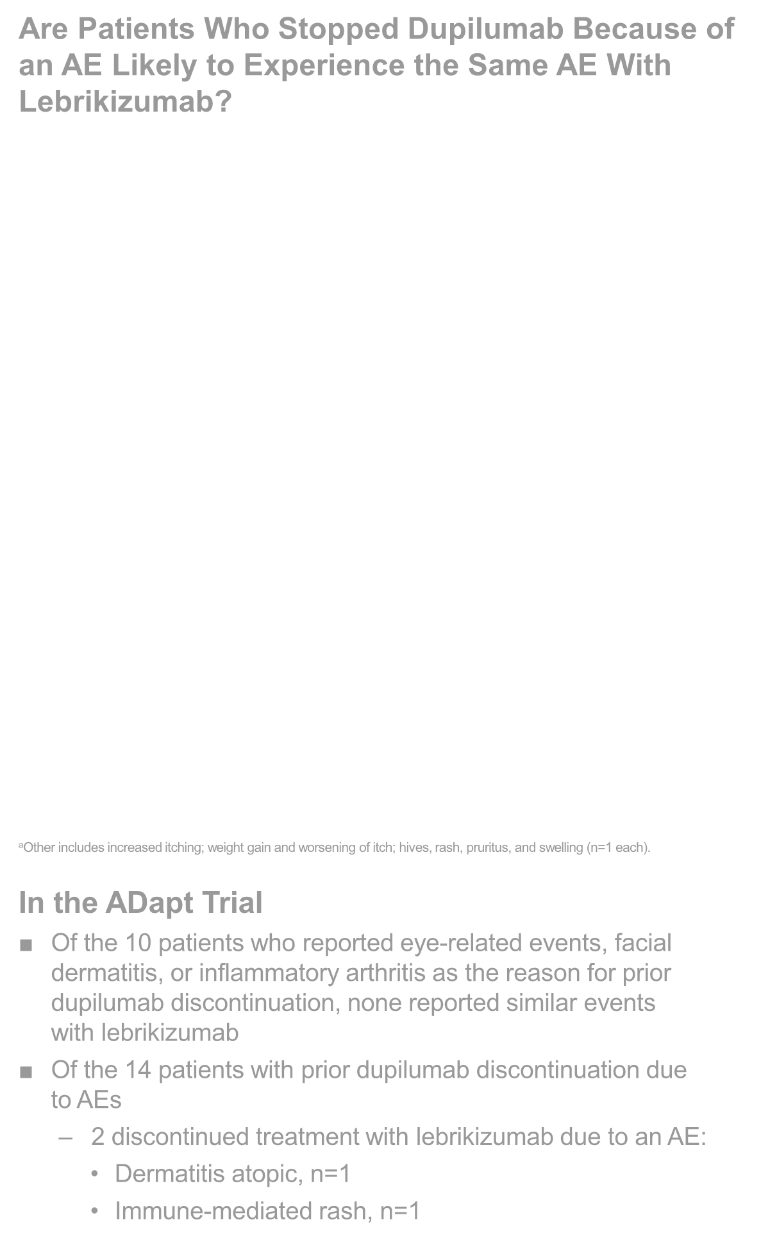

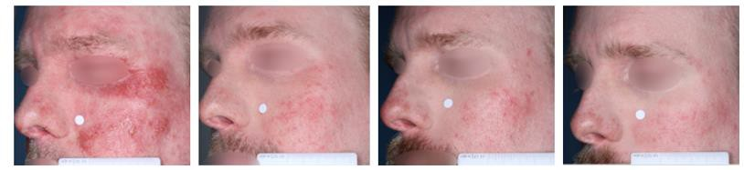


Lebrikizumab Improves Atopic Dermatitis and Quality of Life in Patients With Moderate-to-Severe Atopic Dermatitis Previously Treated With Dupilumab: Results From the ADapt Trial
Jonathan Silverberg¹, Lindsay Ackerman², Jerry Bagel³, Linda Stein Gold⁴, Andrew Blauvelt⁵, David Rosmarin⁶, Raj Chovatiya (Presenter)⁷,
Matthew Zirwas⁸,Gil Yosipovitch⁹, Jill Waibel¹⁰, Jenny E. Murase¹¹,
Ben Lockshin¹², Jamie Weisman¹³, Amber Reck Atwater¹⁴,
Jennifer Proper¹⁴, Maria Silk¹⁴, Evangeline Pierce¹⁴, Maria Lucia Buziqui Piruzeli¹⁴, Sonia Montmayeur¹⁴, Christopher Schuster¹⁴, Jinglin Zhong¹⁵, Maria Jose Rueda¹⁴, Sreekumar Pillai¹⁴, Eric Simpson¹⁶
¹George Washington University School of Medicine and Health Sciences, Washington, DC, USA; ²U.S. Dermatology Partners, Phoenix, USA; ³Psoriasis Treatment Center of Central New Jersey, East Windsor, USA; ⁴Henry Ford Hospital, Detroit, USA; ⁵Blauvelt Consulting, LLC, Portland, USA; ⁶Indiana University School of Medicine, Indianapolis, USA; ⁷Chicago Medical School, Rosalind Franklin University of Medicine and Science, North Chicago, USA, and Center for Medical Dermatology + Immunology Research, Chicago, USA; ⁸Dermatologists of the Central States, Probity Medical Research, and Ohio University, Bexley, USA; ⁹University of Miami Miller School of Medicine, Miami, USA; ¹⁰Miami Dermatology and Laser Institute, Miami, USA; ¹¹University of California, San Francisco,
San Francisco, USA, and Palo Alto Foundation Medical Group, Mountain View, USA; ¹²DermAssociates, Silver Spring, USA; ¹³Medical Dermatology Specialists, Atlanta, USA; ¹⁴Eli Lilly and Company, Indianapolis, USA; ¹⁵IQVIA, Durham, USA; ¹⁶Oregon Health & Science University, Portland, USA
How Efficacious Is Lebrikizumab in Patients Previously Exposed to Dupilumab?
EASI 75
Are Patients Who Stopped Dupilumab Because of an AE Likely to Experience the Same AE With Lebrikizumab?
Primary Intolerance or AE
Leading to Prior Dupilumab Discontinuation
N=14
These results are similar to Phase 3 monotherapy trials of lebrikizumab in patients with moderate- to-severe AD without prior dupilumab exposure:
The EASI 75
response rate at Week 16 using pooled
ADvocate 1 & 2 data was 55.4%^{4,b}
100
F-IGA (0,1) With ≥2-Point Improvementª
100
/
/
LEBRI Induction LEBRI Maintenance
(pooled Q2W and Q4W arms)
57%
/
/
LEBRI Induction LEBRI Maintenance
(pooled Q2W and Q4W arms)
80
60%
Patients (%)
80
Patients (%)
60
as observed NRI/MI
53%
60
54%
^{52%} as observed
40
51%
40
50%
47%
NRI/MI
Not reported
New onset/worsening of facial dermatitis
20
20
n=1
n=2
New onset/ worsening of inflammatory arthritis
0
0 2 4
8
16
24
0
0 2 4
8
Weeks
16
24
Otherª
n=3
Weeks
Nx^{b} 69 69 67 62 48 44
ªITT population with baseline F-IGA ≥2; ^{b}As observed.
Notes: NRI/MI analyses are based on all N=69 patients at each timepoint and were performed for Week 0 to Week 24 after pooling together the LEBRI 250 mg Q2W and Q4W arms. Patients who discontinued treatment due to lack of efficacy were imputed as non-responders; all other missing data were imputed using MI.
n=2
Nxª 86 86 83 76 61 55
ªAs observed; ^{b}In ADvocate 1 and ADvocate2, patients who discontinued treatment due to loss of efficacy or initiated protocol-defined rescue therapy were imputed as non-responders in the NRI/MI analysis.
Notes: NRI/MI analyses are based on all N=86 patients at each timepoint and were performed for Week 0 to Week 24 after pooling together the LEBRI 250 mg Q2W and Q4W arms. Patients who discontinued treatment due to lack of efficacy were imputed as non-responders; all other missing data were imputed using MI.
n=1
How Are Patients With Inadequate Response to Dupilumab Likely to Respond to Lebrikizumab?
Achievement of EASI 75 at Week 16 by Reason for Prior Dupilumab Discontinuation
In a Patient Who Discontinued Dupilumab Due to Loss of Response, Lebrikizumab Shows Improvement in Facial Atopic Dermatitis
Eye irritation
n=1
n=4
100
80
60
40
20
0
Baseline Week 4 Week 16 Week 24
F-IGA 4 3 3 2
Eyes were burning and itching
New onset/worsening of ocular surface disease/conjunctivitis
Patients (%)
80.0%
68.8%
45.7%
8/10
11/16
ªOther includes increased itching; weight gain and worsening of itch; hives, rash, pruritus, and swelling (n=1 each).
16/35
In the ADapt Trial
Of the 10 patients who reported eye-related events, facial dermatitis, or inflammatory arthritis as the reason for prior dupilumab discontinuation, none reported similar events with lebrikizumab
Of the 14 patients with prior dupilumab discontinuation due to AEs
Inadequate Response*
Intolerance or AE
Other Reason
©2024 Eli Lilly and Company. All rights reserved. ©2024 Eli Lilly and Company. All rights reserved. ©2024 Eli Lilly and Company. All rights reserved. ©2024 Eli Lilly and Company. All rights reserved.
Lebrikizumab Improved Hand Dermatitis Through Week 24
In dupilumab-experienced patients with moderate-to-severe hand dermatitis at baseline (N=41), defined by mTLSS ≥12, mTLSS decreased by an average of 69% (as observed; NRI/MI, 64%) at Week 16 and by 75% (as observed; NRI/MI, 68%) at Week 24
Notes: NRI/MI analyses are based on all N=41 patients at each timepoint and were performed for Week 0 to Week 24 after pooling together the LEBRI 250 mg Q2W and Q4W arms. Patients who discontinued treatment due to lack of efficacy were imputed as non-responders; all other missing data were imputed using MI.
Sponsored by Eli Lilly and Company
*Dupilumab inadequate response subgroup (n/Nx): 2/3 had no response to dupilumab; 7/21 had partial response to dupilumab; and 7/11 lost response to dupilumab
Notes: 61 patients had observed data at Week 0 and Week 16 and were included in this subgroup analysis. Data inside the bars are n/Nx. Reasons for dupilumab discontinuation were patient-reported. The inadequate response group consists of patients who discontinued dupilumab due to no response to treatment, defined as having a peak response for skin and itch that did not improve at all and/or improved less than 25%; partial response to treatment, defined as having a peak response for skin and itch that only improved partially and/or improved between 25% and 50%; or lost response to treatment, defined as “initially responded but lost response to dupilumab” with respect to skin and/or itch. Other reasons included being unable to afford treatment, health insurance changes, and previous open-label clinical trial participation that completed with no discontinuation for AEs. Due to the small sample size of all subgroups, no conclusions can be drawn from these analyses.
2 discontinued treatment with lebrikizumab due to an AE:
  Dermatitis atopic, n=1
  Immune-mediated rash, n=1
OBJECTIVES
In real-world settings, approximately 18-20% of patients with moderate-to-severe AD discontinue dupilumab within 3-4 years of treatment, and the primary reasons are loss of efficacy (26-40%), AEs (20%), and cost issues and insurance coverage (18%)^{1,2}
The open-label, Phase 3b, 24-week ADapt trial (NCT05369403) aims to assess the efficacy and safety of lebrikizumab in patients previously exposed to dupilumab
  Other clinical questions include:
    How are patients with inadequate response to dupilumab likely to respond to lebrikizumab?
    Are patients who stopped dupilumab because of an AE likely to experience the same AE with lebrikizumab?
This analysis reports the efficacy and safety of lebrikizumab following 24 weeks of treatment in patients with moderate-to-severe AD previously treated with dupilumab in the ADapt trial
Study Design
Baseline Demographics and Disease Characteristics
AEsª Through Week 24
References: 1. Kimball AB, et al. Dermatol Ther (Heidelb). 2023;13:2107-2120. 2. Kang DH, et al. J Dermatol. 2024;51:e63-e65. 3. Silverberg JI, et al. N Engl J Med. 2023;388:1080-1091. 4. Blauvelt A, et al. Br J Dermatol. 2023;188:740-748. 5. Paller AS, et al. Dermatol Ther (Heidelb). 2023;13:1517-1534. 6. Simpson EL, et al. JAMA Dermatol. 2023;159:182-191.
Abbreviations: AD=atopic dermatitis; AE=adverse event; BMI=body mass index; BSA=body surface area; cDLQI=Children’s DLQI; DLQI=Dermatology Life Quality Index; EASI=Eczema Area and Severity Index; EASI 75=≥75% improvement from baseline in EASI; F-IGA=Face-IGA; IGA=Investigator’s Global Assessment; IGA (0,1)=IGA response of clear or almost clear; ITT=intent-to-treat; JAK=Janus kinase; LD=loading dose; LEBRI=lebrikizumab; mTLSS=modified Total Lesion Symptom Score; MI=multiple imputation; NMSC=non-melanoma skin cancer; NRI=non-responder imputation; NRS=Numeric Rating Scale; Nx=number of patients with non-missing values; PDE-4=phosphodiesterase-4; Q2W=every 2 weeks; Q4W=every 4 weeks; QoL=quality of life; SAE=serious adverse event; SC=subcutaneous; SD=standard deviation; TCI=topical calcineurin inhibitor; TCS=topical corticosteroids; TEAE=treatment-emergent adverse event; W=Week
Disclosures: J. Silverberg has received grants and/or personal fees from: AbbVie, AFYX Therapeutics, Arena Pharmaceuticals, Asana BioSciences, Bluefin Biomedicine, Boehringer Ingelheim, Celgene, Dermavant, Dermira, Eli Lilly and Company, Galderma, GlaxoSmithKline, Incyte Corporation, Kiniksa Pharmaceuticals, LEO Pharma, Luna Pharma, Menlo Therapeutics, Novartis, Pfizer, RAPT Therapeutics, Regeneron, and Sanofi; L. Ackerman has received honoraria as an advisory board member, consultant, and/or speaker and served as an investigator for: AbbVie, Amgen, Apollo Therapeutics, argenx, AstraZeneca, Biofrontera, Bristol Myers Squibb, Castle Biosciences, ChemoCentryx, CorEvitas, Corrona, DermTech, Eli Lilly and Company, Exact Sciences, GlaxoSmithKline, Helsinn Healthcare, IgGenix, Incyte Corporation, Janssen, Kymera Therapeutics, Kyowa Kirin, LEO Pharma, Lilly ICOS, Mindera, Novartis, Regeneron, Replimune, Sanofi, Sun Pharma, Takeda, Timber Pharmaceuticals, Trevi Therapeutics, and UCB Pharma; J. Bagel has received research funds payable to the Psoriasis Treatment Center of New Jersey from: AbbVie, Amgen, Arcutis, Boehringer Ingelheim, Brickell Biotech, Bristol Myers Squibb, Celgene, Corrona, Dermavant, Dermira, Eli Lilly and Company, Janssen, Kadmon Corporation, LEO Pharma, Menlo Therapeutics, Mindera, Novartis, Pfizer, Regeneron, Sanofi, Sun Pharma, TARGET PharmaSolutions, Taro Pharmaceutical Industries, UCB Pharma, and Valeant Pharmaceuticals; and has received consultant fees or speaker fees from: AbbVie, Amgen, Arcutis, Bristol Myers Squibb, Dermavant, Eli Lilly and Company, Incyte Corporation, Janssen, Mindera, Novartis, and UCB Pharma; L. Stein Gold is an investigator, consultant and/or speaker for: AbbVie, Amgen, Arcutis, Bristol Myers Squibb, Dermavant, Eli Lilly and Company, Galderma, Incyte Corporation, Janssen, Novartis, Ortho Dermatologics, Pfizer, Regeneron, Sanofi, and UCB Pharma; A. Blauvelt has received consulting fees, speaker honoraria, and/or served as a clinical study investigator for: AbbVie, Abcentra, ACELYRIN, Aclaris Therapeutics, Affibody, Aligos Therapeutics, Allakos Therapeutics, Almirall, Alumis, Amgen, AnaptysBio, Apogee Therapeutics, Arcutis, Arena Pharmaceuticals, ASLAN Pharmaceuticals, Athenex, Bluefin Biomedicine, Boehringer Ingelheim, Bristol Myers Squibb, Cara Therapeutics, Concert Pharmaceuticals, CTI BioPharma, Dermavant, EcoR1 Capital, Eli Lilly and Company, Escient Pharmaceuticals, Evelo Biosciences, Evommune, Forte Biosciences, Galderma, HighlightII Pharma, Incyte Corporation, Innovent Bio, Janssen, Landos Biopharma, LEO Pharma, Lipidio Pharma, Microbion Biosciences, Merck, Monte Rosa Therapeutics, Nektar, Novartis, Overtone Therapeutics, Paragon Therapeutics, Pfizer, Q32 Bio, Rani Therapeutics, RAPT Therapeutics, Regeneron, Sanofi, Sanofi Genzyme, Spherix Global Insights, Sun Pharma, Takeda, TLL Pharmaceutical, TrialSpark, UCB Pharma, UNION Therapeutics, Ventyx Biosciences, Vibliome Therapeutics, and Xencor; D. Rosmarin has received honoraria as a consultant, received research support, conducted trials, and/or served as a speaker for: AbbVie, Abcuro, AltruBio, Amgen, Arena Pharmaceuticals, Boehringer Ingelheim, Bristol Myers Squibb, Celgene, Concert Pharmaceuticals, CSL Behring, Dermavant, Dermira, Eli Lilly and Company, Galderma, Incyte Corporation, Janssen, Kyowa Kirin, Merck, Nektar, Novartis, Pfizer, RAPT Therapeutics, Recludix Pharma, Regeneron, Revolo Biotherapeutics, Sanofi, Sun Pharma, UCB Pharma, Viela Bio, and Zura Bio; R. Chovatiya has served as an advisory board member, consultant, and/or investigator for: AbbVie, Apogee Therapeutics, Arcutis, Arena Pharmaceuticals, argenx, ASLAN Pharmaceuticals, Beiersdorf, Boehringer Ingelheim, Bristol Myers Squibb, Cara Therapeutics, Dermavant, Eli Lilly and Company, EPI Health, Incyte Corporation, LEO Pharma, L’Oréal, National Eczema Association, Pfizer, Regeneron, Sanofi, and UCB Pharma, and as a speaker for: AbbVie, Arcutis, Dermavant, Eli Lilly and Company, EPI Health, Incyte Corporation, LEO Pharma, Pfizer, Regeneron, Sanofi, and UCB Pharma; M. Zirwas has served as a consultant, investigator, and/or speaker for: AbbVie, Acrotech Biopharma, Advanced Derm Solutions, Aldeyra Therapeutics, all® free clear, Amgen, AnaptysBio, Apogee Therapeutics, Arcutis, Bausch + Lomb, Biocon, Bristol Myers Squibb, Cara Therapeutics, Castle Biosciences, Concert Pharmaceuticals, Dermavant, Edesa Biotech, Elli Lilly and Company, Evelo Biosciences, Galderma, Genentech, Incyte Corporation, Janssen, L’Oréal, LEO Pharma, Level Ex, LUUM, Meta, Nimbus Therapeutics, Novan, Novartis, Pfizer, Sanofi Regeneron, Trevi Therapeutics, UCB Pharma, Verrica Pharmaceuticals, and WCG Trifecta; G. Yosipovitch has conducted clinical trials for or received research funds and/or honoraria for serving on the scientific advisory boards of: AbbVie, Arcutis, Eli Lilly and Company, Escient Pharmaceuticals, Galderma, Kiniksa Pharmaceuticals, LEO Pharma, Novartis, Pfizer, Regeneron, and Sanofi; J. Waibel has served as a consultant and/or investigator and/or on scientific advisory boards for: Allergan, Amgen, argenx, BellaMia Technologies, Bristol Myers Squibb, Candela Healthcare, Cytrellis Biosystems, Eli Lilly and Company, Emblation, Galderma, Horizon Therapeutics, Janssen/Johnson & Johnson, Lumenis, Neuronetics, Pfizer, Procter & Gamble, RegenX, Sanofi, SkinCeuticals, Shanghai Biopharma, and Port Wine Birthmark; and is a recipient of a: VA Merit Grant for Amputated Veterans; J. E. Murase is on the speaker’s board for non-branded disease state management talks for: UCB Pharma; has served on advisory boards for: Eli Lilly and Company, LEO Pharma, Sanofi Genzyme, and UCB Pharma; and provided dermatologic consulting services for: AbbVie and UpToDate; B. Lockshin has received grants and/or research support from: AbbVie, Dermira, Franklin Bioscience, Galderma, Incyte Corporation, Pfizer, Regeneron, and Sanofi; J. Weisman has been a speaker and/or investigator for and/or has received grants and/or honoraria from: AbbVie, Amgen, Biogen, Boehringer Ingelheim, Celgene, Eli Lilly and Company, Janssen, LEO Pharma, Merck, Novartis, Pfizer, Regeneron, Stiefel, and Valeant Pharmaceuticals; A. Reck Atwater is a former employee of: Eli Lilly and Company; J. Proper, M. Silk, E. Pierce, M. L. B. Piruzeli, S. Montmayeur, C. Schuster, M. J. Rueda, and S. Pillai are employees and shareholders of: Eli Lilly and Company; J. Zhong is an employee of: IQVIA; E. Simpson reports personal fees from: AbbVie, Advances in Cosmetic Medical Dermatology Hawaii, Amgen, AOBiome, Arcutis, Arena Pharmaceuticals, ASLAN Pharmaceuticals, Bristol Myers Squibb, CorEvitas, Dermira, Eli Lilly and Company, Evelo Biosciences, Excerpta Medica, FIDE, Forte Bio RX, Galderma, GlaxoSmithKline, Impetus Healthcare, Incyte Corporation, Innovaderm Research, Janssen, Johnson & Johnson, Kyowa Kirin, LEO Pharma, Maui Derm, Medscape, Merck, MJH Holding, MLG Capital, Pfizer, Physicians World, Prime Pharmaceuticals, Recludix Pharma, Regeneron, Revolutionizing Atopic Dermatitis, Roivant Sciences, Sanofi Genzyme, Trevi Therapeutics, Valeant Pharmaceuticals, Vindico Medical Education, and WebMD; and has received grants or serves as principal investigator for: AbbVie, Acrotech Biopharma, Amgen, Arcutis, ASLAN Pharmaceuticals, Castle Biosciences, CorEvitas, Dermira, Dermavant, Eli Lilly and Company, Incyte Corporation, Kymab, Kyowa Kirin, National Jewish Health, LEO Pharma, Pfizer, Regeneron, Sanofi, Target, and VeriSkin. These potential conflicts of interest have been reviewed and managed by Oregon Health & Science University.
Medical writing assistance was provided by Heidi Tran, PhD, of ProScribe – Envision Pharma Group, and was funded by Eli Lilly and Company
Previously presented at the Fall Clinical 2024; Las Vegas, USA; 24-27 October 2024
ADapt
Treatment Period
Safety Follow-up
Characteristic | All LEBRI (N=86) | Reason for Dupilumab Discontinuationª
 |  | Inadequate Response (N=48) | Intolerance or AE (N=14) | Other Reason (N=24)
Age, years | 46.4 (20.0) | 43.0 (20.8) | 53.1 (15.8) | 49.1 (20.0)
Adult (≥18 years), n (%) | 77 (89.5) | 40 (83.3) | 14 (100.0) | 23 (95.8)
Adolescent (≥12 to <18 years), n (%) | 9 (10.5) | 8 (16.7) | 0 | 1 (4.2)
Female, n (%) | 41 (47.7) | 21 (43.8) | 7 (50.0) | 13 (54.2)
BMI, kg/m² | 27.9 (6.0) | 27.2 (5.5) | 29.3 (6.7) | 28.7 (6.7)
Age at AD onset, years | 26.6 (25.9) | 22.3 (25.2) | 27.4 (25.4) | 34.7 (26.6)
Duration since AD onset, years | 20.2 (19.9) | 21.1 (20.8) | 26.2 (21.6) | 14.8 (16.2)
IGA, n (%)
3 (Moderate) | 65 (75.6) | 33 (68.8) | 13 (92.9) | 19 (79.2)
4 (Severe) | 21 (24.4) | 15 (31.3) | 1 (7.1) | 5 (20.8)
F-IGA, n (%)
2 (Mild) | 21 (24.4) | 15 (31.3) | 2 (14.3) | 4 (16.7)
3 (Moderate) | 40 (46.5) | 25 (52.1) | 6 (42.9) | 9 (37.5)
4 (Severe) | 8 (9.3) | 3 (6.3) | 3 (21.4) | 2 (8.3)
Pruritus NRS | 6.6 (2.4) | 6.5 (2.5) | 7.0 (2.4) | 6.6 (2.2)
≥4, n (%) | 62 (87.3) | 32 (84.2) | 11 (91.7) | 19 (90.5)
EASI | 24.1 (10.7) | 25.8 (12.2) | 20.2 (4.3) | 22.8 (9.6)
BSA % affected | 32.2 (18.5) | 35.3 (19.9) | 24.8 (11.5) | 30.3 (17.7)
DLQI^{b} | 14.4 (7.0) | 15.1 (6.9) | 15.4 (7.2) | 12.7 (6.8)
mTLSS^{c} | 10.0 (5.0) | 10.4 (5.0) | 9.0 (4.4) | 9.8 (5.3)
Number of prior systemic treatments,^{d} n (%)
1 | 50 (58.1) | 27 (56.2) | 6 (42.9) | 17 (70.8)
2 | 22 (25.6) | 13 (27.1) | 4 (28.6) | 5 (10.8)
≥3 | 14 (16.3) | 8 (16.7) | 4 (28.6) | 2 (8.3)
 | Pooled LEBRI 250 mg Q2W and Q4W (N=86)
TEAE^{b} | 46 (53.5)
Mild | 26 (30.2)
Moderate | 17 (19.8)
Severe | 3 (3.5)
SAE | 2 (2.3)
Death | 0
AE leading to treatment discontinuation^{c} | 5 (5.8)
TEAE within special safety topics
Infections | 19 (22.1)
Skin infections | 1 (1.2)
Potential hypersensitivity^{d} | 5 (5.8)
Dermatitis atopic | 4 (4.7)
Urticaria | 1 (1.2)
Injection site reactions^{e} | 4 (4.7)
Conjunctivitis cluster^{f} | 3 (3.5)
Malignancies | 1 (1.2)
NMSC | 1 (1.2)
Malignancies excluding NMSC | 0
AD exacerbation | 7 (8.1)
Hepatic events | 1 (1.2)
Alanine aminotransferase increased | 1 (1.2)
Aspartate aminotransferase increased | 1 (1.2)
Screening
LDª
Week 16
IGA (0,1) or
EASI 75
Responders
LEBRI 250 mg
Q4W
LEBRI 250 mg Q2W (N=86)
N=48 Inadequate Response N=14 Intolerance or AE N=24 Other Reason
LEBRI 250 mg Q2W
Chronic AD Age ≥12 years
Adolescents ≥40 kg Prior dupilumab experience
Week -4^{b} Week 0
Week 16 Non- responders
Safety follow-up at approximately 12 weeks after last dose
Week 16 Week 24 Week 34 Primary Endpoint
ªPatients received LD of 500 mg given SC at Week 0 and Week 2; ^{b}Screening window was up to 30 days. Notes: The use of low- and/or mid-potency TCS, TCIs, topical PDE-4 inhibitors, or high-potency TCS up to 10 days was permitted. Patients requiring rescue therapy (high-potency TCS >10 days, topical JAK inhibitors, phototherapy, systemic medication) were discontinued from the study.
Results
Lebrikizumab Improved QoL and Symptoms of Itch Through Week 24
Of dupilumab-experienced patients with baseline DLQI ≥4 (N=77), 83% (as observed) achieved ≥4-point improvement in DLQI from baseline at Weeks 16 and 24 (NRI/MI, 81% and 80%, respectively)
Of dupilumab-experienced patients with baseline Pruritus NRS ≥4 (N=62), 53% and 62% (as observed) achieved
≥4-point improvement in Pruritus NRS from baseline at Week 16 and 24 (NRI/MI, 49% and 48%), respectively
Notes: NRI/MI analyses are based on all N=77 or N=62 patients at each timepoint and were performed for Week 0 to Week 24 after pooling together the LEBRI 250 mg Q2W and Q4W arms. Patients who discontinued treatment due to lack of efficacy were imputed as non-responders; all other missing data were imputed using MI.
CONCLUSIONS
Lebrikizumab provides meaningful improvements in skin (including face and hand) clearance, itch, and QoL in patients with
moderate-to-severe AD who were previously treated with dupilumab
The ADapt safety profile is consistent with other lebrikizumab phase 3 trials³⁻⁶
3 participants reported TEAEs of conjunctivitis, which were mild or moderate and did not lead to discontinuation
ªAssessed in patients who received ≥1 dose of LEBRI; ^{b}Patients with multiple events with different severity were counted under the highest severity; ^{c}Determined to be due to dermatitis atopic, drug eruption, immune-mediated dermatitis, rash morbilliform, and headache (n=1 each); ^{d}Events that occurred on the day of drug administration identified using a narrow algorithm search; ^{e}Injection site reactions are defined using MedDRA high-level term of injection site reactions excluding joint-related Preferred Terms; ^{f}Defined using the following MedDRA Preferred Terms: conjunctivitis, conjunctivitis allergic, conjunctivitis bacterial, conjunctivitis viral, and giant papillary conjunctivitis.
Note: Data are n (%).
ªReasons for dupilumab discontinuation were patient-reported. The dupilumab inadequate response subgroup consists of patients who discontinued dupilumab due to no response to treatment, defined as having a peak response for skin and itch that did not improve at all and/or improved less than 25%; partial response to treatment, defined as having a peak response for skin and itch that only improved partially and/or improved between 25% and 50%; or lost response to treatment, defined as “initially responded but lost response to dupilumab” with respect to skin and/or itch. Other reasons included being unable to afford treatment, health insurance changes, previous open-label clinical trial participation that completed with no discontinuation for adverse events; ^{b}Patients <16 years of age at baseline completed the cDLQI and continued to complete the cDLQI for the duration of the study; ^{c}41 patients in the all lebrikizumab cohort had mTLSS ≥12, and the mean (SD) score among these patients was 14.0 (2.0); 1=dupilumab only, 2=dupilumab and 1 other prior systemic treatment, 3=dupilumab and ≥2 other prior systemic treatments.
Notes: Data are mean (SD) unless stated otherwise. Number of patients with non-missing data was used as the denominator.
Revolutionizing Atopic Dermatitis (RAD) - Virtual Symposium 2024; December 08, 2024
d
Supplemental Materials
Scan the QR code for additional Methods and Results
  Click the QR code for a list of all Lilly content presented at the congress. Other company and product names are trademarks of their respective owners.
Copyright ©2024 Eli Lilly and Company. All rights reserved.
This study was funded by Eli Lilly and Company. Almirall, S.A. has licensed the rights to develop and commercialize lebrikizumab for the treatment of dermatology indications, including atopic dermatitis, in Europe. Lilly has exclusive rights for development and commercialization of lebrikizumab in the United States and the rest of the world outside of Europe.

