Slide 1
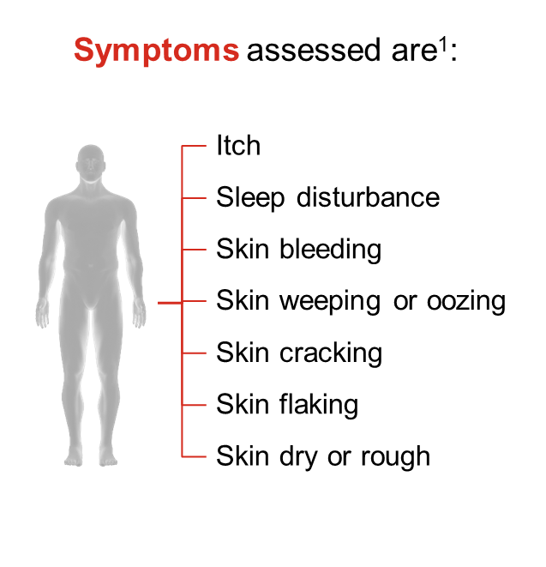
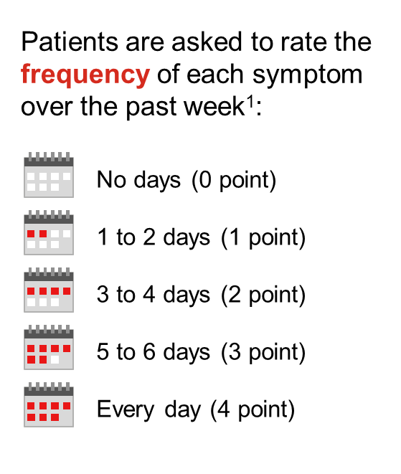
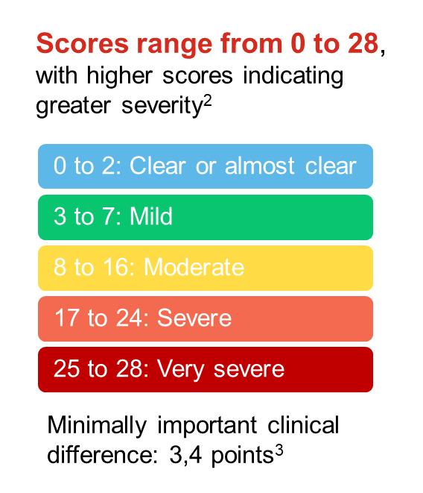
Patients with lebrikizumab reported long-term improvement of symptoms from POEM in moderate-to-severe atopic dermatitis
RESULTS
Patient-Oriented Eczema Measure 0
Patient-Oriented Eczema Measure 0/1
Peter Lio^{1,2}, Jenny Murase³, Vivian Shi⁴, Andreas Wollenberg⁵, Sebastien Barbarot⁶, Evangeline Pierce⁷, Sonia Montmayeur⁷, Chao Yang⁷, Meihua Qiao⁸, Helena Agell⁹, Marjolein de Bruin-Weller¹⁰
¹Northwestern University Feinberg School of Medicine, Illinois, USA; ²Medical Dermatology Associates of Chicago, Illinois, USA; ³University of California San Francisco, San Francisco, USA and Palo Alto Foundation Medical Group, Mountain View, USA; ⁴Department of Dermatology, University of Washington, Seattle, Washington, USA; ⁵Ludwig Maximilian University of Munich, Munich, Germany and Augsburg University Hospital, Augsburg, Germany; ⁶Centre Hospitalier Universitaire de Nantes, Service de Dermatologie, Nantes, France; ⁷Eli Lilly and Company, Indianapolis, USA; ⁸Tigermed, USA; ⁹Almirall, S.A., Barcelona, Spain; ¹⁰University Medical Center Utrecht, Utrecht, Netherlands.
Figure 1. Response rate for patients achieving a POEM item score of 0 (no days) for itch, sleep disturbance, and skin dry or rough from Week 16 to 152 in patients treated with lebrikizumab Q4W and Q2W.
POEM = Patient-oriented Eczema Measure; pmMPP = Pooled Modified Maintenance Primary Population; LEB = Lebrikizumab; Q4W = 250mg lebrikizumab every 4 weeks; Q2W = 250mg lebrikizumab every 2 weeks.
Nx = number of patients with non-missing values
Figure 2. Response rate for patients achieving a POEM item score of 0/1 (no days or 1-2 days) for itch, sleep disturbance, and skin dry or rough from Week 16 to 152 in patients treated with lebrikizumab Q4W and Q2W.
POEM = Patient-oriented Eczema Measure; pmMPP = Pooled Modified Maintenance Primary Population; LEB = Lebrikizumab; Q4W = 250mg lebrikizumab every 4 weeks; Q2W = 250mg lebrikizumab every 2 weeks.
Nx = number of patients with non-missing values
RESULTS
METHODS
Study design
→
Sponsored by Eli Lilly and Company
Baseline Demographics and Disease Characteristics
 | ADvocate1&2 → ADjoinª
 | LEBRI 250 mg Q4W (N=99)^{b} | LEBRI 250 mg Q2W (N=82)^{b}
Age, years | 35.8 (17.2) | 35.5 (16.2)
Adolescent (≥12 to <18), n (%) | 14 (14.1) | 11 (13.4)
Female, n (%) | 60 (60.6) | 42 (51.2)
Region, n (%)
USA | 41 (41.4) | 32 (39.0)
Europe | 33 (33.3) | 32 (39.0)
Rest of the world | 25 (25.3) | 18 (22.0)
Disease duration since AD onset, years | 22.4 (14.2) | 23.6 (14.7)
IGA, n (%)
3 (Moderate) | 63 (63.6) | 50 (61.0)
4 (Severe) | 36 (36.4) | 32 (39.0)
EASI | 28.9 (12.2) | 29.2 (11.2)
Pruritus NRS | 6.8 (2.1) | 7.1 (1.7)
≥4, n (%) | 89 (90.8) | 79 (96.3)
Sleep-Loss Scale | 2.0 (1.0) | 2.2 (0.8)
≥2, n(%) | 50 (51.5) | 58 (70.7)
ª Data at Week 0 of ADvocate1&2 are reported here as baseline data ^{b} Patients were week 16 lebrikizumab responders who were re-randomized from Q2W to Q2W and Q4W, and enrolled in ADjoin with the same dose regimen Note: Data are mean (SD) unless stated otherwise IGA = Investigator’s global assessment; EASI = Eczema Area and Severity Index; NRS = Numeric rating scale
Patient-Oriented Eczema Measure (POEM)
ADvocate1&2
ADjoin
Induction
Maintenance
ADjoin: Long-Term Extension
Objective
    To report the patient’s perspective of disease severity as assessed using the POEM, in patients with moderate-to-severe AD after 152 weeks of treatment with lebrikizumab in the ADjoin study.
LDª
R 2:2:1
LEBRI 250 mg Q2W
LEBRI 250 mg Q2W
R 2:1
LEBRI 250 mg
Q2W
Week 16 Responders^{b}
re-randomized
LEBRI 250 mg Q4W
LEBRI 250 mg Q4W
0 to 2: Clear or almost clear
Screening
PBO Q2W
PBO Q2W (LEBRI Withdrawal)
3 to 7: Mild
    Analysis population^{c}
Weeks 0
Use of TCS prohibited
8 to 16: Moderate
16
Intermittent use of TCS permitted^{d}
52
Intermittent use of
TCS permitted^{d}
152
17 to 24: Severe
ª LEBRI-treated patients received a 500-mg LD at Weeks 0 and 2; ^{b} Responders in ADvocate1&2 were defined as those patients who achieved either EASI 75 or IGA (0,1) following 16 weeks of LEBRI 250 mg Q2W treatment without the use of rescue therapy; ^{c} LEBRI responders randomized to LEBRI 250 mg Q2W or LEBRI 250 mg Q4W at Week 16 (ADvocate1&2), and enrolled into ADjoin with the same dosage regimen at Week 52; ^{d} Patients who required short-term systemic treatment for AD in the Maintenance Period were assessed on a case-by-case basis
Conclusions
    Long-term treatment with lebrikizumab led to improvements in itch, sleep disturbance, and skin symptoms as reported from a patient’s perspective using POEM.
    Most patients reported two or less days per week of POEM symptoms related to itch, sleep disturbance and skin dryness.
25 to 28: Very severe
Disclosures
Figure 3. POEM is an instrument used to assess disease severity from a patient’s perspective.
Patients report the frequency of their symptoms by responding to the seven items.
Individual item score ranges from 0 to 4, with higher scores indicating greater severity.
Descriptive analyses reporting the response rate of individual POEM item scores are based on all observed data (regardless of the use of rescue medications).
P. Lio reports being on the speaker's bureau for AbbVie, Arcutis, Eli Lilly, Galderma, Hyphens Pharma, Incyte, La Roche-Posay/L’Oreal, Pfizer, Pierre-Fabre Dermatologie, Regeneron/Sanofi Genzyme, Verrica; reports consulting/advisory boards for Alphyn Biologics (stock options), AbbVie, Almirall, Amyris, Arcutis, ASLAN, Astria Therapeutics, Bristol-Myers Squibb, Burt’s Bees, Castle Biosciences, Codex Labs (stock options), Concerto Biosci (stock options), Dermavant, Eli Lilly, Galderma, Janssen, LEO Pharma, Lipidor, L’Oreal, Merck, Micreos, MyOR Diagnostics, Pelthos Therapeutics, Regeneron/Sanofi Genzyme, Sibel Health, Skinfix, Suneco Technologies (stock options), Soteri Skin (stock options), Theraplex, UCB, Unilever, Verdant Scientific (stock options), Verrica, Yobee Care (stock options). In addition, Dr. Lio has a patent pending for a Theraplex product with royalties paid and is a Board member and Scientific Advisory Committee Member emeritus of the National Eczema Association. J. Murase has participated in advisory boards for Genzyme/Sanofi, Eli Lilly,AbbVie LeoPharma, and UCB, participated in disease statement management talks for Regeneron and UCB, and provided dermato-logic consulting services for UpToDate. V. Shi is on the board of directors for the Hidradenitis Suppurativa Foundation (HSF), is an advisor for the National Eczema Association, is a stock shareholder of Learn Health, and has served as an advisory board member, investigator, or speaker for and/or received research funding from Sanofi Genzyme, Regeneron, AbbVie, Genentech, Eli Lilly, Novartis, SUN Pharma, LEO Pharma, Pfizer, Incyte, Boehringer Ingelheim, Almirall, Alumis, Aristea Therapeutics, Menlo Therapeutics, Dermira, Burt’s Bees, Gal-derma, Kiniksa, UCB, Bain Capital, Target-PharmaSolutions, Altus Lab/cQuell, MYOR, Polyfins Technology, GpSkin, and Skin Actives Scien-tific. A. Wollenberg is a consultant for AbbVie, Aileens, Almirall, Beiersdorf, Bristol Myers Squibb, Eli Lilly, Galderma, GlaxoSmithKline, LEO Pharma, L'Oréal, MedImmune, MSD, Novartis, Pfizer, Pierre Fabre, Regeneron and Sanofi; an investigator for AbbVie, Almirall, Anacor Pharmaceuticals, Eli Lilly, Galapagos, Galderma, Glenmark, LEO Pharma, MedImmune, Novartis, Pfizer, Regeneron, Sanofi and UCB; and has received research grants from Beiersdorf, LEO Pharma and Pierre Fabre. S. Barbarot declares payment or honoraria for lectures, presentations, speakers’ bureaus, manuscript writing or educational events and support for attending meetings and/or travel from AbbVie, Alexion, Almirall, AstraZeneca, Chiesi, Eli Lilly, Galderma, Janssen, LEO Pharma, Novartis, Pfizer, Sanofi-Genzyme and UCB Pharma. E. Pierce, S. Montmayeur, and C. Yang are employees and shareholders of: Eli Lilly and Company. M. Qiao is an employee of: Tigermed; and is a paid contractor of: Eli Lilly and Company. H. Agell is an employee of Almirall S.A. M. de Bruin-Weller has served as a consultant, speaker, advisor, and/or advisory board member for: AbbVie, Almirall, Amgen, ASLAN Pharmaceuticals, Eli Lilly and Company, Galderma, LEO Pharma, Pfizer, Regeneron, and Sanofi.
The POEM is a combined measure of signs (skin appearance) and symptoms (itch and sleep).
Image (© 2015 3dman_eu) is freely available from: https://pixabay.com/en/magnifying-glass-search-to-find-1020142/ (Accessed December 2018). Image is licensed under the CC0 Creative Commons: https://creativecommons.org/choose/zero/.
1. Charman CR, et al. Arch Dermatol. 2004;140(12):1513-1519. 2. Charman CR, et al. Br J Dermatol. 2013;169(6):1326-1332. 3. Schram ME, et al. Allergy. 2012;67(1):99-106.
Revolutionizing Atopic Dermatitis (RAD) virtual conference; 8 December 2024

