Slide 1
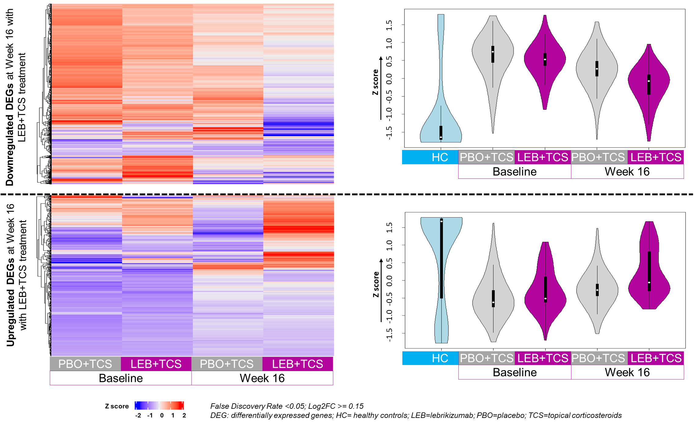
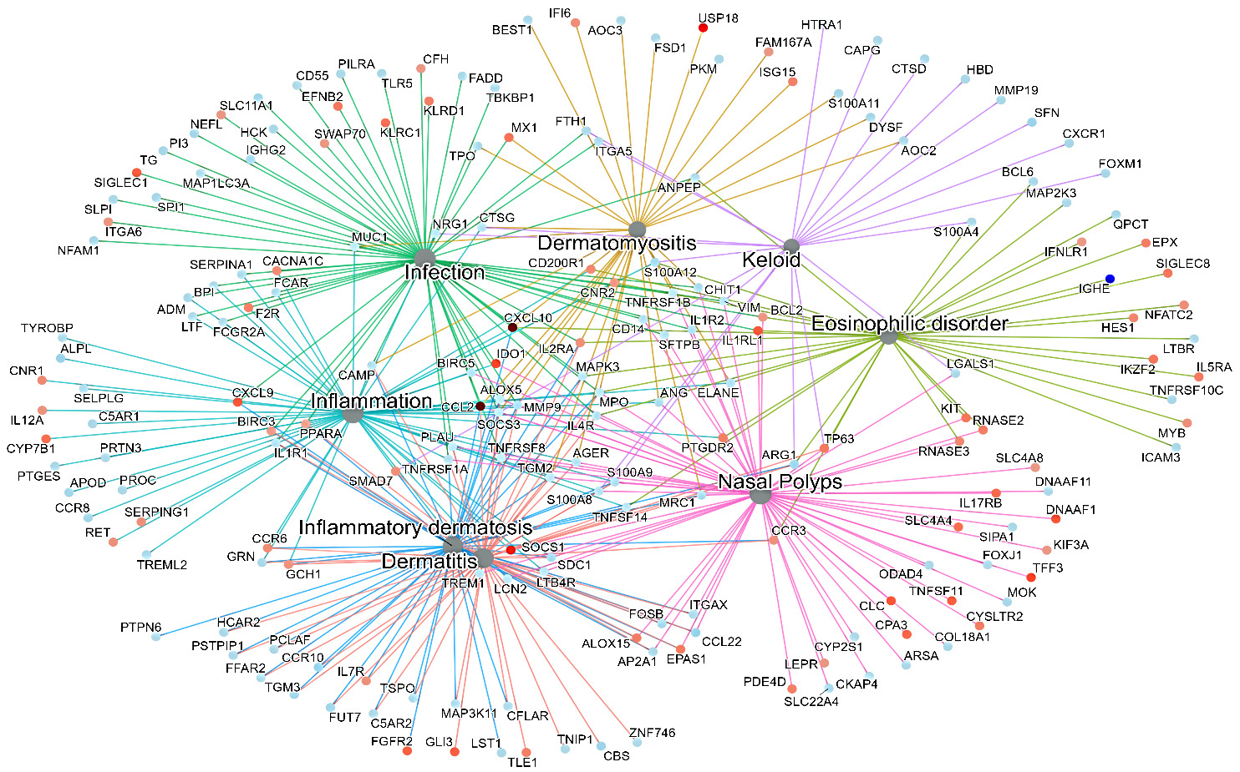
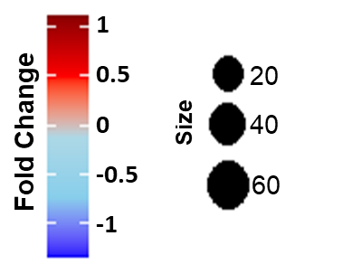
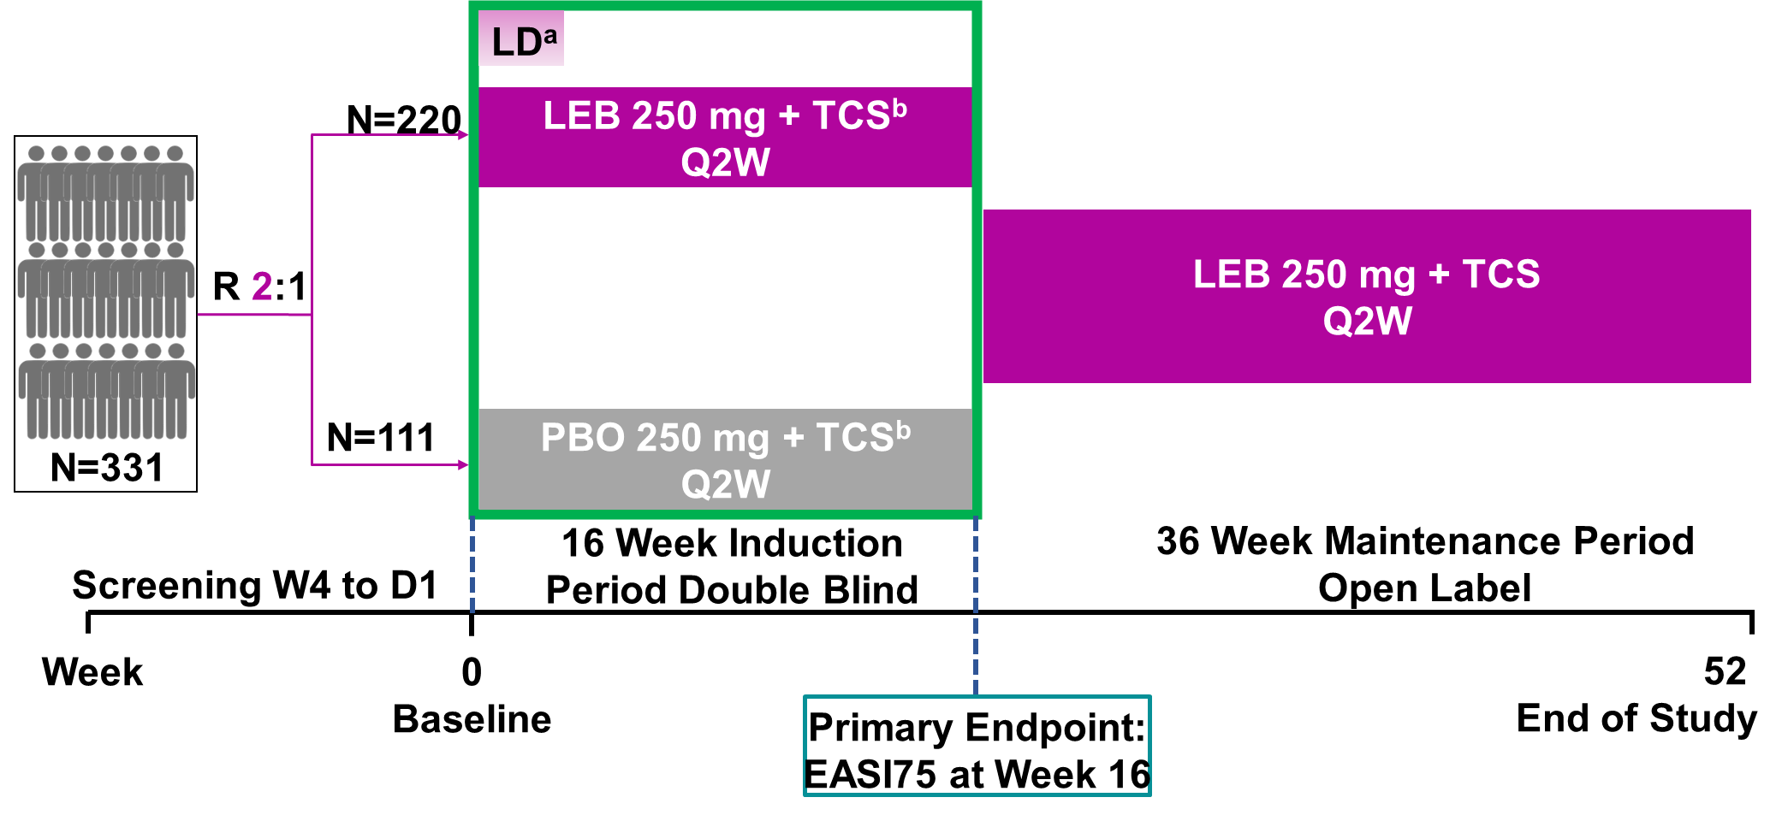

Lebrikizumab Normalizes the Systemic Transcriptomic Signature When Administered in Combination With Topical Corticosteroids in Patients With Moderate to Severe
Atopic Dermatitis
RESULTS
Baseline & Demographic characteristics of patients in lebrikizumab and placebo arm
Transcriptomic Changes in Patients Treated With LEB+TCS
Disease Ontology Semantic Enrichment of DEGs
Characteristics | Full ADvantage cohort |  | ADvantage transcriptomic subcohort
 | PBO Q2W + TCS (N=111) | LEB 250 mg Q2W + TCS (N=220) | PBO Q2W + TCS (N=66) | LEB 250 mg Q2W + TCS (N=135)
Age (years) | 34.1 (15.2) | 33.7 (14.9) | 33.10 (14.1) | 32.14 (13.6)
Male, n (%) | 55 (49.5) | 120 (54.5) | 32 (48.5) | 73 (54)
White, n (%) | 104 (93.7) | 206 (93.6) | 62 (93.9) | 126 (93.3)
BMI (kg/m²) | 24.9 (5.6) | 25.0 (5.1) | 24.9 (6.1) | 24.75 (5.3)
Disease duration (years) | 23.2 (14.0) | 25.4 (14.6) | 22 (12.8) | 23.5 (13)
EASI | 27.1 (9.8) | 28.7 (10.6) | 26.7 (9.5) | 29.65 (10.6)
IGA, n (%)​
3, moderate | 68 (61.3) | 135 (61.4) | 40 (60.6) | 74 (54.8)
4, severe | 43 (38.7) | 85 (38.6) | 26 (39.4) | 61 (45.2)
% BSA involvement | 44.5 (20.3) | 45.8 (19.4) | 43.4 (20.4) | 46.9 (19.8)
Pruritus NRS | 6.9 (2.1) | 6.9 (1.9) | 7 (2.1) | 6.86 (1.8)
≥4, n (%) | 102 (91.9) | 199 (90.5) | 61 (92.4) | 123 (91.1)
DLQIª | 16.4 (7.5) | 15.2 (6.9) | 13.12 (9.9) | 12.25 (8.8)
Abhishek A. Singh (Presenter)¹, Kilian Eyerich², Mercè Pont¹, Elisabet Cantó³, Meritxell Falqués¹, Ignasi Pau-Charles¹, Esther Garcia Gil¹, Peter Hein¹
¹Almirall S.A., Barcelona, Spain; ²Department of Dermatology and Venerology, Medical Center, University of Freiburg, Germany; ³Institut de Recerca Sant Pau (IR SANTPAU), Barcelona, Spain
  Lebrikizumab+TCS treatment at week 16 resulted in the normalization of dysregulated genes​ in blood of AD patients.
  In placebo+TCS arm at week 16, insignificant changes were observed in transcriptomic signature.
  Normalization of gene expression in lebrikizumab+TCS treated patients was more towards healthy subjects as compared to AD patients under placebo+TCS treatment
  Lebrikizumab+TCS treatment resulted in the normalization of genes related to infection, inflammatory disorders, T-cell related diseases and dermatological conditions based on the DOSE analysis.
Sponsored by Eli Lilly and Company
OBJECTIVE
  To assess the impact of lebrikizumab treatment in normalization of the pathology as assessed by evaluating systemic transcriptomic signatures in patients with
  atopic dermatitis (AD).
Data are mean (SD) unless stated otherwise. Percentages are based on the number of patients in each treatment group of the FAS. ªOnly in those who completed DLQI at Baseline (N=92 for PBO and N=185 for LEB 250 Q2W).
BMI=Body mass index; BSA=body surface area; DLQI=Dermatology Life Quality Index; EASI=Eczema Area and Severity Index; IGA=Investigator’s Global Assessment; LEB=lebrikizumab; NRS=Numeric Rating Scale; PBO=placebo; Q2W=every 2 weeks; TCS=topical corticosteroids.
  BACKGROUND
STUDY DESIGN
References
Langan S.M., et al. Lancet Lond Engl. 2020;396:345–360.
Barbarot S., et al. Allergy. 2018;73:1284–1293.
Okragly A.J., et al. Dermatol Ther. 2023;13:1535–1547.
Ultsch M., et al. J Mol Biol. 2013;3:1330-1339.
  AD is a common, chronic and inflammatory skin disease characterized by intense pruritus and recurrent dry, red and excoriated patches.^{1,2}
  Lebrikizumab (LEB) is a novel monoclonal antibody that binds with high affinity and slow off-rate to interleukin (IL)-13, blocking the downstream effects of IL-13 with high potency.^{3,4}
  Blockade of IL-13 signaling is expected to be of benefit in IL-13 dominant diseases, such as atopic dermatitis (AD) ^{2, 3}
  In the placebo-controlled, randomized phase 3 clinical study (ADvantage, M-17923-30, EudraCT Number: 2021-002967-23), lebrikizumab administered on top of TCS for
  16 weeks led to rapid and clinically meaningful improvements in the signs and symptoms in patients with moderate-to-severe AD
CONCLUSIONS
  In the ADvantage study, where participants were allowed to use topical corticosteroids (TCS), treatment with lebrikizumab for 16 weeks shifted the transcriptomic AD landscape more towards a healthy signature compared to placebo.
  Blood transcriptome normalization by lebrikizumab occurred in genes related to infection, inflammatory disorders, type-2 immune diseases and dermatological conditions in alignment with the selective targeting of
  interleukin (IL)-13.
  These results suggest that lebrikizumab in combination with TCS treatment improves the systemic transcriptomic dysregulation in AD in line with lebrikizumab’s efficacy profile.
Disclosures
A. A. Singh, M. Pont, M. Falques, I. Pau-Charles,
E. G. Gil, and P. Hein are employees of Almirall S.A.;
K. Eyerich served as an investigator, speaker, consultant, and/or advisor for AbbVie, Almirall, Boehringer Ingelheim, Bristol Myers Squibb, Eli Lilly and Company, Galderma, Incyte, Janssen, LEO Pharma, Novartis, Pfizer, Sanofi, and UCB; E. Canto has received funding from Almirall S.A.
Previously presented at the European Society for Dermatological Research; Lisbon, Portugal;
4-7 September, 2024.
  METHODS
  ªPatients were randomized 2:1 to LEB 250 mg with a loading dose of LEB 500 mg at baseline and week 2, or PBO every 2 weeks (Q2W).
  ^{b}All patients were to receive concomitant mid-potency TCS through week 16 until lesions were clear or almost clear. Low-potency TCS could be used from baseline visit in place of mid-potency TCS on sensitive areas. Once lesions were clear or almost clear, patients switched to low-potency TCS for 7 days and then stopped. If lesions reappeared, patients had to resume mid-potency TCS or low-potency TCS as described above. High-potency TCS, topical calcineurin inhibitors or systemic treatments were considered rescue medication. There was a 1-week washout period required for TCS prior to baseline.
  D=day; EASI=Eczema Area and Severity Index Score; LD=loading dose; LEB=lebrikizumab; PBO=placebo; Q2W=every 2 weeks; R=randomization; TCS=topical corticosteroids; CsA=Cyclosporin A; W=week.
  RNA sequencing (RNA-seq) from consenting patients with available samples at baseline and week 16.
  Transcriptomic changes measured using bulk mRNA-seq in whole blood cells.
  A transcriptomic signature in blood samples from a healthy control group
  (n=10 subjects) was used as reference.
  Raw counts obtained by genome alignment per sample.
  A linear model R package (DESeq2) was applied to detect differentially expressed genes (DEGs) in lebrikizumab+TCS and placebo+TCS arms from baseline to Week 16.
  Disease Ontology Semantic and Enrichment (DOSE) analyses was performed on differentially expressed genes to determine their complex association with disease ontologies.
This study was funded by Dermira, a wholly owned subsidiary of Eli Lilly and Company. Almirall, S.A. has licensed the rights to develop and commercialize lebrikizumab for the treatment of dermatology indications, including atopic dermatitis, in Europe. Lilly has exclusive rights for development and commercialization of lebrikizumab in the United States and the rest of the world outside of Europe.
  Patients eligible for ADvantage trial were:
    adults and adolescents (≥12 to <18 years weighting ≥40 kg) with an
      Eczema Area and Severity Index (EASI) ≥16
      Investigator’s Global Assessment (IGA) ≥3
      ≥10% Body Surface Area (BSA) of AD involvement
    inadequate response to TCS
    not adequately controlled by or ineligible for cyclosporin A
Scan the QR code for a list of all Lilly content presented at the congress.
Other company and product names are trademarks of their respective owners.
Revolutionizing Atopic Dermatitis (RAD) - Virtual Symposium 2024; December 08, 2024
Copyright © 2024 Almirall , S. A. All rights reserved

