Slide 1


PSMA-Targeting Radioligand Therapy: Step-by-Step Guide
Arrive at treatment center
Undergo pre-treatment physical exam, blood tests, and safety questionnaire
Once cleared for treatment, your infusion nurse will place an IV (or access a central venous catheter, such as a port or picc line, if you have one)
You will receive some fluids and anti-nausea medications through your IV line(s)
You will receive the radioligand therapy through an IV line
You will need to remain in the treatment center for monitoring (typically 15 to 30 minutes) after you have received your radioligand therapy infusion
Please see the reverse side of this guide for radiation safety precautions that you must observe while receiving radioligand therapy- remember, this drug contains radiation!

Slide 2
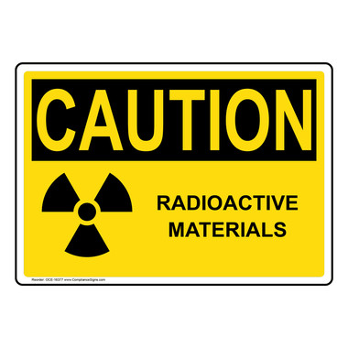
PSMA-Targeting Radioligand Therapy: Radiation Safety Precautions
Remember, PSMA-targeting radioligand therapies are radioactive drugs!
Limit close contact (less than 3 feet) with others for 2 to 7 days following each dose (your treatment center will give you more specific instructions based on who is in your household)
Sleep in separate rooms from other people for 3 to 15 days (your treatment center will give you more specific instructions based on who is in your household)
Use effective contraception during treatment and for 14 weeks after the last dose
Avoid sexual activity for 7 days after each dose
https://us.pluvicto.com/

