Slide 1
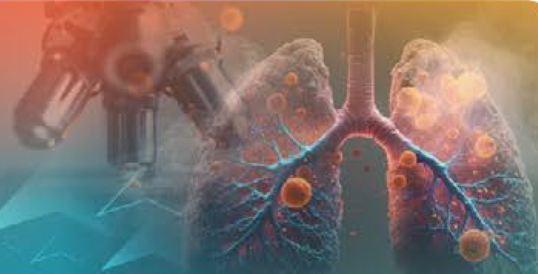
A Nursing Guide to Optimize
Patient Communication in
Extensive-Stage Small Cell Lung Cancer
With a focus on DLL3-targeting treatments

Slide 2
Goals of This Presentation
Review currently available therapies for the initial treatment of your extensive-stage small cell lung cancer (ES-SCLC)
Learn about options to treat your ES-SCLC when it gets worse (called “progression” or “relapse”)
Empower you to ask important questions and participate in your care
Connect you with trusted resources

Slide 3

What is Extensive-Stage Small Cell Lung Cancer?
The Basics
Small cell lung cancer, or SCLC, is a fast-growing type of lung cancer.
SCLC accounts for about 15% of all lung cancers.
Most patients are diagnosed at an advanced, or extensive stage (ES), meaning the SCLC has spread beyond the lung where it started.
ES-SCLC often spreads to the lymph nodes, brain, liver, “pleural” fluid surrounding the lungs, bones, and/or adrenal glands.

Slide 4
What is the Initial Treatment for ES-SCLC?
Chemoimmunotherapy
Initial treatment for ES-SCLC is also called “frontline” or “first-line” treatment.
Initial treatment often combines chemotherapy (eg, carboplatin or cisplatin, etoposide) and immune checkpoint inhibitor drugs (eg, atezolizumab or durvalumab) given intravenously.
This combination is called chemoimmunotherapy.

Slide 5

Managing Side Effects of Chemoimmunotherapy
What are some of the side effects that may occur?
How common are serious side effects?
Decreased appetite
Diarrhea, nausea, or vomiting
Infections, including sepsis
Low blood counts
Lung inflammation that may impair breathing
~30% to 60%
…of patients experienced serious or high-grade adverse events while receiving chemotherapy plus an immune checkpoint inhibitor.
Tips for safe treatment:
Alert your care team immediately (or seek emergency care) if you develop a fever, light-headedness, new or worsening difficulty in breathing, or any other concerning symptoms.
Have a friend or family member check in with you regularly and frequently during treatment.

Slide 6





The Challenge: When Cancer Comes Back
Although most patients initially respond to first-line treatment, ES-SCLC typically comes back (relapses). Finding second-line therapies that work is a major challenge in SCLC.
~50%
1st 2nd
DLL3
About half of patients are eligible to start a second course of treatment after their lung cancer relapses.
Multiple second-line treatment options are available for
relapsed ES-SCLC.
Drugs targeting the DLL3 cancer protein are more effective than older drugs were for treating relapsed ES-SCLC.

Slide 7

What is DLL3? A Key Target on Cancer Cells
What is DLL3?
~85%
DLL3 (Delta-like Ligand 3) is a protein found on the surface of cancer cells.
In healthy tissue, DLL3 is mostly absent or hidden inside cells.
In SCLC, DLL3 appears on the outer surface of the tumor cells — making cancer cells easy to identify and target.
DLL3 is involved in signaling that helps cancer cells grow and survive.
…of SCLC tumors express
DLL3 on their cell surface.
Why this matters:
Because DLL3 appears mainly on cancer cells (and not healthy cells), drugs that target DLL3 can attack the tumor while leaving normal tissue largely unharmed.
New treatments targeting specific proteins on cancer cells are very important.

Slide 8

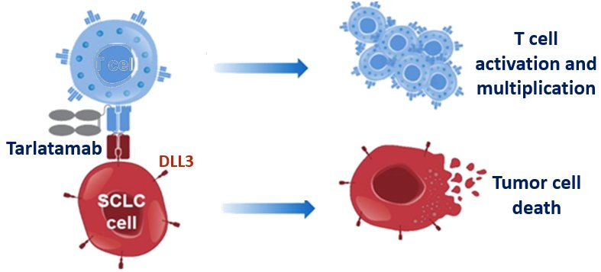

What is Tarlatamab? How Does It Work?
1
2
3
4
Finds the cancer cell
Grabs an immune cell
Brings the cancer cell and the immune cell together
Immune cells destroy the cancer
One end of tarlatamab locks onto DLL3, a protein sitting on the surface of SCLC cells.
The other end of tarlatamab grabs a T cell (a type of immune cell your body uses to fight infections and cancer).
Tarlatamab physically connects the T cell and the cancer cell, holding them close together.
The T cell multiplies and releases substances that kill the cancer cell.
Tarlatamab is a
“bispecific T-cell engager” (BiTE) — a drug with two grabbing arms, one for cancer cells and one for
immune cells.
T cell
Notes:
Figure adopted from: Amgen. Phase 1 study of AMG 757, a DLL3-targeted bispecific T-cell engager (BiTE), in small cell lung cancer (SCLC). Paper presented at: ASCO Annual Meeting; June 4–8, 2021; Virtual.

Slide 9





Tarlatamab Clinical Trial Results: DeLLphi-301
The DeLLphi-301 study tested tarlatamab in patients with ES-SCLC whose cancer had come back after prior treatment. It led to FDA approval of tarlatamab (brand name: Imdelltra).
Tumor response rate
Disease control rate
Median duration of response
40%
70%
9.7
months
…of patients saw their
cancer shrink.
…of patients gained control of their cancer.
…was how long responses typically lasted.
What this means for patients:
These results were better than other second-line treatments. Tarlatamab was approved by the FDA for ES-SCLC that has progressed during or after at least 1 prior therapy.

Slide 10
Tarlatamab vs Standard Treatment: DeLLphi-304
A larger study (DeLLphi-304) compared tarlatamab head-to-head against the doctor's choice of standard chemotherapy in patients with relapsed ES-SCLC.
Tarlatamab
Standard Chemotherapy
Given as an intravenous infusion once every 2 weeks
Targets DLL3 on cancer cells
Patients lived longer on average
Topotecan, lurbinectedin, or other agents
Traditional chemotherapy approach
Fewer patients responded
VS
✓ Result: Tarlatamab significantly improved overall survival — a major milestone for SCLC treatment.

Slide 11

Am I Eligible to Receive Tarlatamab?
If your ES-SCLC has worsened during or after 1 or more prior lung cancer treatments, then you may be eligible to receive tarlatamab.
Your oncologist will consider multiple factors, including your overall fitness and features of your ES-SCLC, to determine if tarlatamab is right for you.
Your ES-SCLC does not need to be tested for DLL3 levels before you receive tarlatamab.
Ask your doctor if you are eligible to receive tarlatamab.

Slide 12
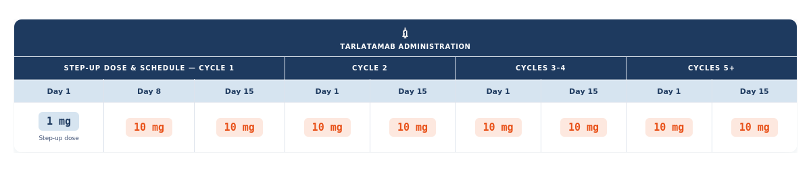
How is Tarlatamab Given?
Tarlatamab infusions are given in a monitored setting, such as a hospital or clinic.
You may be observed for up to 24 hours after you first dose(s) of tarlatamab, with your post-infusion observation time decreasing with subsequent doses.
Here is a sample schedule of how you might receive your tarlatamab:
The first dose of tarlatamab is lower to help your body get used to the drug.

Slide 13
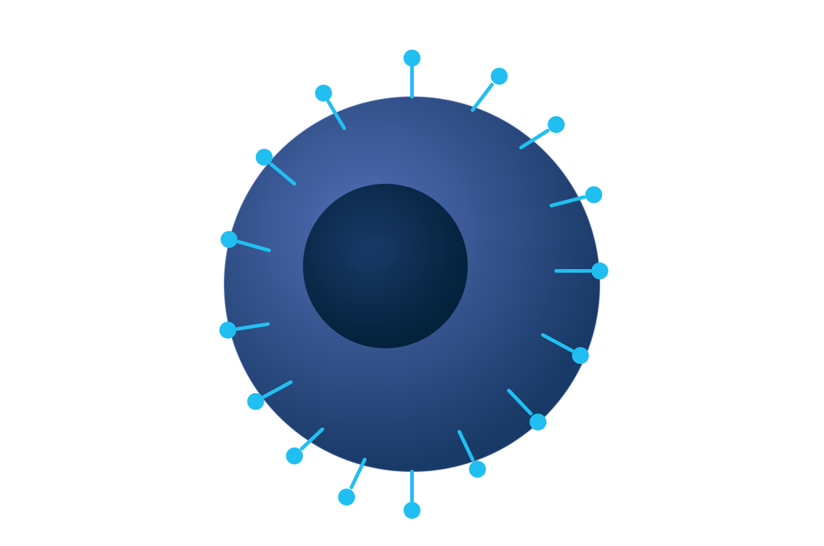
What are the Side Effects of Tarlatamab?
Common tarlatamab side effects and their frequencies:
  Dysgeusia (loss of taste), 32% of patients
  Neutropenia (low infection-fighting blood cells), 16% of patients
  Abnormal liver function blood tests (LFTs), about 11% of patients
Unique Side Effects:
  Cytokine release syndrome (CRS)
  Immune effector cell-associated neurotoxicity syndrome (ICANS)
Tarlatamab has some unique side effects because of how it affects your body’s immune system.
Notes:
Sands JM et al. Cancer. 2025;131(3):e35738.

Slide 14
What is CRS?
CRS is an important side effect of tarlatamab
How common?
~53%
CRS stands for cytokine release syndrome. It occurs when tarlatamab activates your immune cells to fight cancer, leading to inflammation. The inflammation may cause a flu-like syndrome, which can become severe. Most cases of CRS occur during the first 2 infusions of tarlatamab and are mild.
…of patients experience CRS while receiving tarlatamab for their SCLC.
CRS affects your entire body.

Slide 15

CRS: Symptoms and Management
Symptoms to watch for:
Fever, chills, or sweating
Fatigue or feeling unwell
Difficulty in breathing
Heart racing or light headedness
Rash
How it's managed:
You may need to be admitted to the hospital.
Medications like corticosteroids and tocilizumab can quickly reverse CRS.

Slide 16
What is ICANS?
ICANS is an important side effect of tarlatamab
How common?
ICANS stands for Immune Effector Cell Associated Neurotoxicity Syndrome. It occurs when inflammation disrupts the blood brain barrier that normally protects your brain. This results in neurologic symptoms.
~10%
…of patients experience ICANS while receiving tarlatamab for their SCLC.
ICANS affects your brain.

Slide 17
ICANS: Symptoms and Management
Symptoms to watch for:
How it’s managed:
You may need to be admitted to the hospital.
Your care team may use medications such as steroids (eg, dexamethasone), anakinra (a powerful anti-inflammatory drug), or anti-seizure drugs if needed.
Trouble speaking, memory loss, personality changes
Confusion or disorientation, delayed or unclear thinking
Weakness or numbness
Problems with walking, balance, or coordination
Headache
Tremors
Fainting
Low energy
Seizures

Slide 18

What if I’m Not Eligible to Receive Tarlatamab?
If your ES-SCLC has progressed, or relapsed, despite prior anti-cancer treatment(s) and you are not eligible to receive tarlatamab, then you may be eligible to receive a different systemic treatment, such as:
  (Another) course of cis- or carbo-platin plus etoposide (with or without an immune checkpoint inhibitor drug)
  Lurbinectedin
  Paclitaxel
  Topotecan
  Temozolomide
Medications to improve your cancer-related symptoms, which can be given with or without anti-cancer treatments, may improve your quality of life.

Slide 19

Considerations Throughout ES-SCLC Treatment
Am I eligible to receive a “systemic” treatment through an IV or by mouth, such as chemotherapy or immunotherapy (including immune checkpoint inhibitors or tarlatamab)?
What side effects related to my treatments do I need to look out for and how do I know when these side effects require immediate attention?
Will I need to be admitted to the hospital for any of my treatments?
Would a “local” treatment, such as radiation, help treat my cancer or make me feel better?
Is there a clinical trial that I might benefit from enrolling in?
Clinical trials are available for the initial treatment of ES-SCLC and for relapsed disease!

Slide 20

Patient Resources for Information and Support
National Cancer Institute (NCI) patient page on SCLC: https://www.cancer.gov/types/lung/patient/small-cell-lung-treatment-pdq
Cancer Care (free support services): https://www.cancercare.org/diagnosis/lung_cancer
ClinicalTrials.gov (database of clinical trials): https://clinicaltrials.gov/
Ask your care team for local support and clinical trial options
Staying informed and connected can make a big difference in your journey.

Slide 21

Key References for Providers
NCCN Guidelines. Small Cell Lung Cancer. 2.2026.
Tarlatamab FDA approval
Tarlatamab Prescribing Information
Studies
  CASPIAN
  DeLLphi-301
  DeLLphi-304
  IMpower133
Notes:
Key References (online references accessed 5/9/2026):
NCCN Guidelines: https://www.nccn.org/professionals/physician_gls/pdf/sclc.pdf
Tarlatamab FDA approval: https://www.fda.gov/drugs/resources-information-approved-drugs/fda-grants-traditional-approval-tarlatamab-dlle-extensive-stage-small-cell-lung-cancer
Tarlatamab prescribing information: https://www.imdelltra.com/
CASPIAN: https://pubmed.ncbi.nlm.nih.gov/35279527/
DeLLphi-301: https://www.jto.org/article/S1556-0864(24)00931-6/pdf
DeLLphi-304: https://pubmed.ncbi.nlm.nih.gov/40454646/
IMpower133: https://pubmed.ncbi.nlm.nih.gov/30280641/
Other References:
Mechanisms of small cell lung cancer metastases: https://pubmed.ncbi.nlm.nih.gov/33296145/
Treatment and outcome of 432 patients with extensive-stage small cell lung cancer in first, second and third line – Results from the prospective German TLK cohort study: https://pubmed.ncbi.nlm.nih.gov/30885347/

