Slide 1
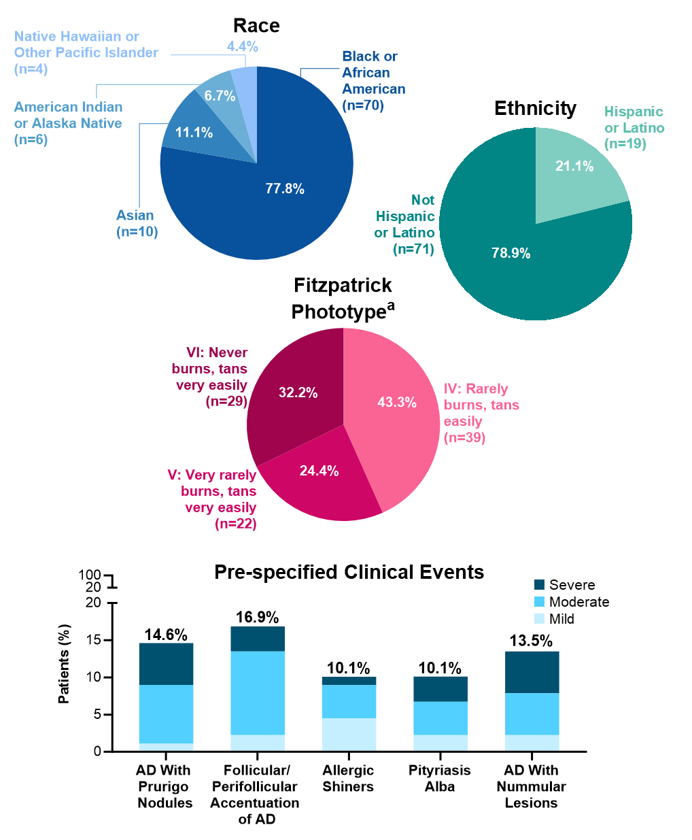
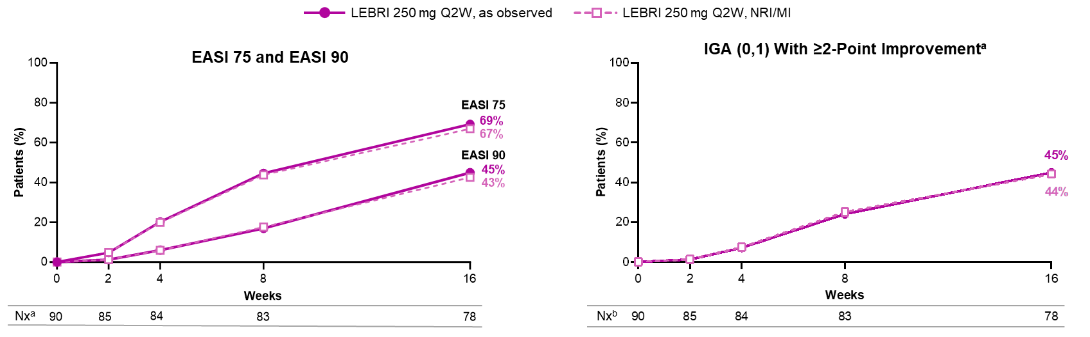
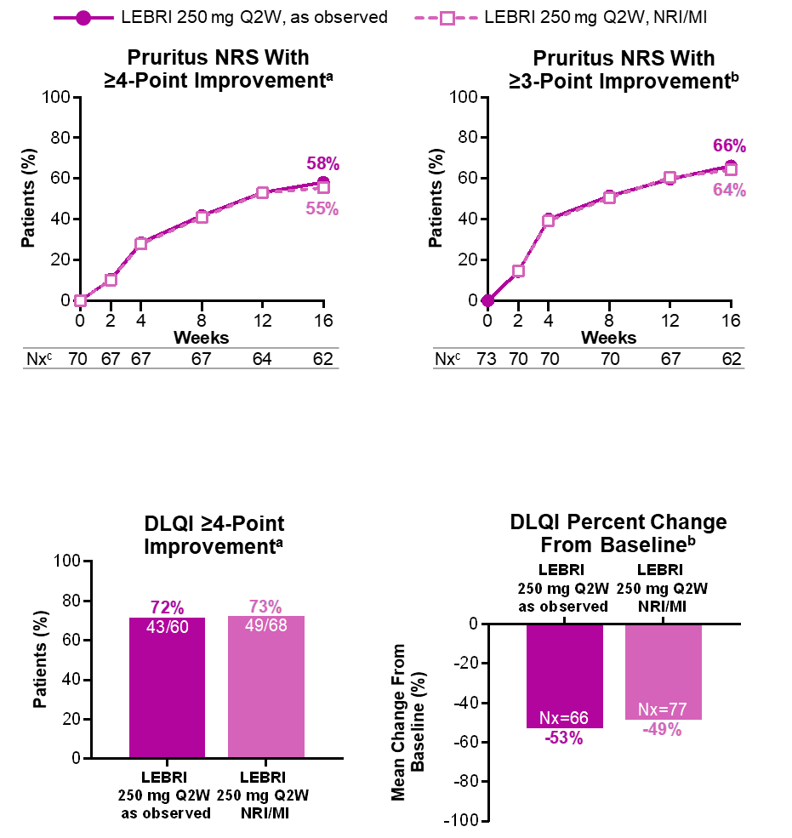
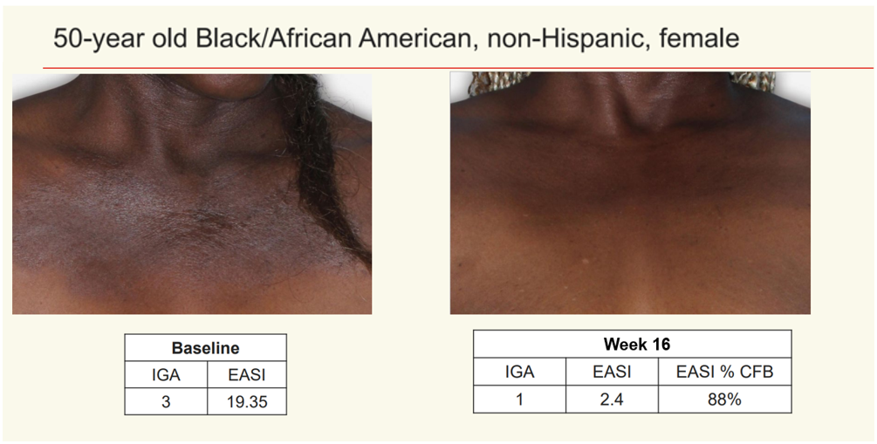


Lebrikizumab Improves Atopic Dermatitis in Adult and Adolescent Patients With Skin of Color: 16-Week Results From the ADmirable Study
  45% of Patients Achieved IGA (0,1) With ≥2-Point Improvement From Baseline at Week 16
  Baseline Demographics and Disease Characteristics
  69% of Patients Achieved EASI 75 (Primary Endpoint),
  and 45% of Patients Achieved EASI 90 at Week 16
 | LEBRI 250 mg Q2W (N=90)
Age, years | 40.7 (19.6)
Adult (≥18 years), n (%) | 76 (84.4)
Adolescent (≥12 to <18 years), n (%) | 14 (15.6)
Female, n (%) | 39 (43.3)
BMI, kg/m² | 30.1 (7.7)
BMI category, n (%)
Underweight (<18.5 kg/m²) | 3 (3.3)
Normal (≥18.5 and <25 kg/m²) | 19 (21.1)
Overweight (≥25 and <30 kg/m²) | 30 (33.3)
Obese (≥30 and <40 kg/m²) | 26 (28.9)
Extreme obese (≥40 kg/m²) | 12 (13.3)
Duration since AD onset, years | 19.7 (16.1)
IGA^{b}
3 (Moderate), n (%) | 62 (68.9)
4 (Severe), n (%) | 27 (30.0)
EASI | 26.4 (12.2)
BSA % affected | 37.8 (20.5)
POEM | 17.3 (6.5)
Pruritus NRS^{c} | 7.0 (2.2)
≥3, n (%) | 73 (93.6)
≥4, n (%) | 70 (89.7)
Sleep-Loss scale^{c} | 2.0 (1.1)
DLQI^{d} | 13.2 (7.4)
cDLQI^{d} | 12.2 (8.2)
PO-SCORADe | 57.1 (17.8)
PDCA-Derm™^{,f}
Hypopigmented lesion(s), n (%) | 16 (17.8)
Hyperpigmented lesion(s), n (%) | 52 (57.8)
Andrew Alexis¹, Ali Moiin², Jill Waibel³, Paul Wallace⁴, David Cohen⁵, Vivian Laquer⁶, Pearl Kwong⁷, Amber Reck Atwater⁸, Jennifer Proper⁸, Maria Silk⁸, Evangeline Pierce⁸, Sreekumar Pillai⁸,
Maria Jose Rueda (Presenter)⁸, Angela Moore⁹
  ¹Weill Cornell Medicine, New York, USA; ²Comprehensive Dermatology Center, Detroit, USA; ³Miami Dermatology and Laser Institute, Miami, USA; ⁴Wallace Skin Research Center, Los Angeles, USA; ⁵Skin Care Physicians of Georgia, Macon, USA; ⁶First OC Dermatology Research, Fountain Valley, USA; ⁷Solutions Through Advanced Research, Jacksonville, USA; ⁸Eli Lilly and Company, Indianapolis, USA; ⁹Baylor University Medical Center, Dallas, Arlington Research Center, Arlington, and Arlington Center for Dermatology, Arlington, USA
          ªAs observed.
          Notes: NRI/MI analyses are based on all N=90 patients at each timepoint. Patients who discontinued treatment due to lack of efficacy were imputed as non-responders; all other missing data were imputed using MI.
          ªITT population with baseline IGA ≥2; ^{b}As observed.
          Notes: NRI/MI analyses are based on all N=90 patients at each timepoint. Patients who discontinued treatment due to lack of efficacy were imputed as non-responders; all other missing data were imputed using MI.
  33% of Patients Showed Improved Hypopigmentation and 63% Showed Improved Hyperpigmentation at Week 16, as measured by PDCA-Derm™
At Week 16:
33%
17%
20%
63%
Improved
hypopigmented
lesionsª
Hypopigmented
lesions improved to
normal skin toneª
Hyperpigmented
lesions improved to
normal skin tone^{b}
Improved
hyperpigmented
lesions^{b}
Sponsored by Eli Lilly and Company
ªBased on the patient’s reported cutaneous reaction to sun exposure; ^{b}1 patient inadvertently enrolled with IGA=2 and discontinued when discovered they did not meet enrollment criteria; ^{c}Nx=78; ^{d}Patients <16 years of age at baseline completed cDLQI [Nx=10]; others completed DLQI [Nx=77]; ^{e}Nx=87; ^{f}A scale used to compare post-inflammatory lesions to unaffected, adjacent normal skin.
Notes: Data in table are mean (SD) unless stated otherwise. Percent values for pre-specified clinical events were calculated using 86 as the denominator.
ªThe analysis was performed on patients with a hypopigmentation lesion at baseline and non-missing data at Week 16 (N=12); ^{b}The analysis was performed on patients with a hyperpigmentation lesion at baseline and non-missing data at Week 16 (N=46).
Notes: For patients with multiple hypopigmented or hyperpigmented lesions at baseline, only the lesion with the most severe score was included in the analysis for each lesion type. In the event of a tie, the lesion reflecting a smaller improvement or worsening in condition from baseline to Week 16 was included.
ObjectiveS
    Results on efficacy and safety outcomes from ADmirable (NCT05372419), the first Phase 3, open-label, 24-week trial of lebrikizumab in adult and adolescent patients with moderate-to-severe AD and skin of color, a historically under-represented patient population, were first reported at
    AAD 2024¹
    This analysis reports the 16-week efficacy and safety outcomes, including innovative measures of post-inflammatory hyperpigmentation
    and hypopigmentation
  58% of Patients Achieved ≥4-Point Improvement, and 66% Achieved ≥3-Point Improvement in Pruritus NRS at Week 16
Results
  Photographs Showing Improvement in AD With Lebrikizumab in a Patient With Skin of Color
  Adverse Events
 | LEBRI 250 mg Q2W (N=90)
TEAEª | 21 (23.3)
Mild | 11 (12.2)
Moderate | 9 (10.0)
Severe | 1 (1.1)
SAE | 0
Death | 0
TEAE related to study treatment^{b} | 4 (4.4)
AE leading to treatment discontinuation^{b} | 0
TEAE within special safety topics
Infections^{c} | 6 (6.7)
Skin infections | 2 (2.2)
Potential hypersensitivity^{d} | 1 (1.1)
Injection site reactions | 0
Keratitis cluster | 0
Conjunctivitis cluster^{e} | 0
Malignancies^{f} | 0
AD exacerbation | 1 (1.1)
Hepatic events | 0
ªPatients with multiple events with different severity are counted under the highest severity; ^{b}As assessed by investigator; ^{c}No cases of herpes infection or helminthic infection were reported; ^{d}Events that occurred on the day of drug administration and captured using the Hypersensitivity, Angioedema, and Anaphylaxis Standardized MedDRA Queries. The Preferred Term for the potential hypersensitivity event was dermatitis atopic; ^{e}Defined using the following MedDRA Preferred Terms: conjunctivitis, conjunctivitis allergic, and conjunctivitis bacterial; ^{f}Includes cases with and without NMSC. Notes: Data are n (%). Severe TEAE includes back pain.
References:
1. Alexis A, et al. Oral presentation at: AAD 2024. Presentation number LEBPT3.
2. Eichenfield LF, et al. J Am Acad Dermatol. 2014;70:338-351.
3. Blauvelt A, et al. Br J Dermatol. 2023;188:740-748.
4. Paller AS, et al. Dermatol Ther (Heidelb). 2023;13:1517-1534.
5. Silverberg JI, et al. N Engl J Med. 2023;388:1080-1091.
6. Simpson EL, et al. JAMA Dermatol. 2023;159:182-191.
50-year-old Black/African American, non-Hispanic female
Disclosures: A. Alexis has received grant support from: AbbVie, Amgen, Arcutis, Castle Biosciences, Dermavant, Galderma, and LEO Pharma; has served as a consultant and/or advisor for: AbbVie, Allergan, Almirall, Alphyn Biologics, Amgen, Apogee Therapeutics, Arcutis, Avita Medical, Bausch Health, Beiersdorf, Bristol Myers Squibb, Canfield Scientific, Cara Therapeutics, Castle Biosciences, Cutera, Dermavant, Eli Lilly and Company, EPI Health, Galderma, Genentech, Incyte Corporation, Janssen, LEO Pharma, L’Oréal, Ortho Dermatologics, Pfizer, Sanofi Genzyme, Sanofi Regeneron, Swiss American CDMO, UCB Pharma, and VisualDx; has served as a speaker for: Bristol Myers Squibb, Janssen, Johnson & Johnson, L’Oréal, Regeneron, and Sanofi Genzyme; has received royalties from: Springer Science+Business Media, Wiley Blackwell, and Wolters Kluwer Health; and has received equipment from: Aerolase; A. Moiin has received reimbursement for travel costs from and conducted clinical trials for: Eli Lilly and Company; J. Waibel has served as a consultant and/or investigator and/or on scientific advisory boards for: Allergan, Amgen, argenx, BellaMia Technologies, Bristol Myers Squibb, Candela Healthcare, Cytrellis, Eli Lilly and Company, Emblation, Galderma, Horizon Therapeutics, Janssen/Johnson & Johnson, Lumenis, Neuronetics, Pfizer, Procter & Gamble, REGENXBIO, Sanofi, SkinCeuticals, Shanghi Biopharma, and Port Wine Birthmark; and is a recipient of a: VA Merit Grant for Amputated Veterans; P. Wallace has served as a principal investigator, advisor, and/or speaker for: AbbVie, Amgen, Arcutis, Biogen, Bristol Myers Squibb, Celgene, Centocor, Cynosure, Eli Lilly and Company, Genentech, GlaxoSmithKline, Merck, Novartis, Pfizer, Sanofi-Aventis, and UCB Pharma; and has received equipment (loan to institution) from: Cynosure; D. Cohen reports no financial conflicts of interest; V. Laquer has served as a researcher for: AbbVie, ACELYRIN, Acrotech Biopharma, Amgen, Arcutis, argenx, ASLAN Pharmaceuticals, Biofrontera, Bristol Myers Squibb, Cara Therapeutics, Dermavant, Eli Lilly and Company, Galderma, Horizon Therapeutics, Incyte Corporation, Janssen, LEO Pharma, Novartis, Padagis, Pfizer, Q32 Bio, Rapt Therapeutics, Sun Pharma, UCB Pharma, and Ventyx Biosciences; P. Kwong is a principal investigator for: AbbVie, Amgen, Arcutis, Castle Creek Biosciences, Dermavant, Eli Lilly and Company, Galderma, Incyte Corporation, Novartis, Pfizer, and UCB Pharma; a consultant/advisor for: Bristol Myers Squibb, Eli Lilly and Company, EPI Health, Galderma, Incyte Corporation, LEO Pharma, Novan, Ortho Pharmaceutical, Pfizer, Sanofi Regeneron, UCB Pharma, and Verrica Pharmaceuticals; and a speaker for: AbbVie, Arcutis, EPI Health, Incyte Corporation, L’Oréal, Ortho Pharmaceutical, Sanofi Regeneron, Sun Pharma, and Verrica Pharmaceuticals; A. Reck Atwater is a former employee of: Eli Lilly and Company; J. Proper, M. Silk, E. Pierce, S. Pillai, and M. J. Rueda are employees and shareholders of: Eli Lilly and Company; A. Moore has received research grants or honoraria from: AbbVie, Acrotech, Arcutis, Bristol Myers Squibb, Cara Therapeutics, Eli Lilly and Company, Galderma, Incyte Corporation, Janssen, Johnson & Johnson, Pfizer, Rapt Therapeutics, and Sanofi Regeneron
Medical writing assistance was provided by Heidi Tran, PhD, of ProScribe – Envision Pharma Group, and was funded by Eli Lilly and Company
Previously presented at the Fall Clinical 2024; Las Vegas, USA; 24-27 October 2024
Baseline
IGA | EASI
3 | 19.35
CONCLUSIONS
    ADmirable is the first clinical trial to report data from patients with moderate-to-severe AD and skin of color (78% Black or African American patients) using novel tools and scales to evaluate signs and symptoms that matter to patients
    Lebrikizumab improved AD signs and symptoms after 16 weeks of treatment
      The majority of patients achieved 75% or greater improvement in skin clearance and showed improved symptoms of itch and quality of life
    Based on the novel PDCA-Derm™ scale, lebrikizumab improved hypopigmented and hyperpigmented lesions
    Lebrikizumab’s safety profile was consistent with that reported in Phase 3 trials³⁻⁶
      No SAEs were reported
©2024 Eli Lilly and Company. All rights reserved.
ªITT population with baseline Pruritus NRS ≥4; ^{b}ITT population with baseline Pruritus NRS ≥3; ^{c}As observed. Notes: NRI/MI analyses are based on all N=70 (Pruritus NRS with ≥4-point improvement) or N=73 (Pruritus NRS with ≥3-point improvement) patients at each timepoint. Patients who discontinued treatment due to lack of efficacy were imputed as non-responders; all other missing data were imputed using MI.
Week 16
IGA | EASI | EASI % CFB
1 | 2.4 | 88%
  72% of Patients Achieved ≥4-Point Improvement in DLQI, and DLQI Scores Decreased by an Average of 53% at Week 16
©2024 Eli Lilly and Company. All rights reserved.
    Information on the ADmirable Study Design, Key Eligibility Criteria, Methods, and Use of Concomitant Topical and Systemic Therapy are described in Supplemental Materials
Abbreviations: AAD=American Academy of Dermatology; AD=atopic dermatitis; AE=adverse event; BMI=body mass index; BSA=body surface area; cDLQI=Children’s DLQI; CFB=change from baseline; DLQI=Dermatology Life Quality Index; EASI=Eczema Area and Severity Index; EASI 75/90=≥75/90% improvement from baseline in EASI; IGA=Investigator’s Global Assessment; IGA (0,1)=IGA response of clear or almost clear; ITT=intent-to-treat; IP=investigational product; JAK=Janus kinase; LD=loading dose; LEBRI=lebrikizumab; MedDRA=Medical Dictionary for Regulatory Activities; MI=multiple imputation; NMSC=non-melanoma skin cancer; NRI=non-responder imputation; NRS=Numeric Rating Scale; Nx=number of patients with non-missing values; PDE-4=phosphodiesterase 4; POEM=Patient-Oriented Eczema Measure; PO-SCORAD=Patient-Oriented SCORing of Atopic Dermatitis; Q2W=every 2 weeks; Q4W=every 4 weeks; QoL=quality of life; SAE=severe adverse event; SD=standard deviation; TCI=topical calcineurin inhibitor; TCS=topical corticosteroids; TEAE=treatment-emergent adverse event
  Click the QR code for a list of all Lilly content presented at the congress. Other company and product names are trademarks of their respective owners.
  Supplemental Materials
  Scan the QR code for additional Methods
  and Results
Revolutionizing Atopic Dermatitis (RAD) - Virtual Symposium 2024; December 08, 2024
ªITT population with baseline DLQI ≥4; ^{b}ITT population with baseline DLQI score.
Notes: Data inside bars are n/Nx unless stated otherwise. Participants <16 years of age at baseline completed the cDLQI [Nx=10]; others completed the DLQI [Nx=77]. Patients who discontinued treatment due to lack of efficacy were imputed as non-responders; all other missing data were imputed using MI.
This study was funded by Eli Lilly and Company. Almirall, S.A. has licensed the rights to develop and commercialize lebrikizumab for the treatment of dermatology indications, including atopic dermatitis, in Europe. Lilly has exclusive rights for development and commercialization of lebrikizumab in the United States and the rest of the world outside of Europe.

