Slide 1


Cancer Insight Summary Slides for
Patients with Prostate Cancer Receiving PSMA-TARGETING RADIOLIGAND THERAPY

Slide 2
Introduction
The goal of this slide presentation is to equip you with information to make the treatment of your prostate cancer with a PSMA-targeting radioligand therapy a bit easier.
The information provided here is designed to support
and supplement information provided by your oncology team.
Website links to helpful and reliable resources are included on the last slide.
Thank you for the opportunity to share this information!

Slide 3
Shared Decision-Making
A process in which you, your caregiver, and your health care team discuss options and agree upon a treatment plan that aligns with your goals, preferences, and expectations.
Make sure that you understand your disease and treatment plan:
              - Keep a list of questions to ask your team prior to each follow up appointment.
      - Ask about treatment options, including clinical trials, and the benefits and
      risks of each treatment.

Slide 4
PSMA-Targeting Radioligand Therapy: Abbreviations
Here are some common abbreviations you may encounter while receiving PSMA-targeting treatment:
                ARPI: androgen receptor pathway inhibitor (for example, abiraterone, apalutamide, darolutamide, or enzalutamide)
                CRPC: castrate-resistant prostate cancer
                Lu-177: lutetium-177 (a drug that kills cancer cells with radiation)
                PSMA: prostate-specific membrane antigen
                RLT: radioligand therapy (also called “radiopharmaceutical therapy”)

Slide 5
PSMA-Targeting Radioligand Therapy
Should I get this treatment for my prostate cancer?
  Patients with metastatic castrate-resistant prostate cancer that is determined to be “PSMA-positive” by a PSMA PET scan may be eligible to receive a PSMA-targeting drug if they have already received an androgen receptor pathway inhibitor drug such as abiraterone, apalutamide, darolutamide, or enzalutamide.

Slide 6
PSMA PET Scans
  A PSMA PET scan, which is performed along with a CT or MRI, is a picture of all the places in your body where there are prostate cancer cells that express PSMA; this scan tells your doctors if a PSMA-targeting drug might effectively treat your prostate cancer.
  You will receive a radioactive dye, or “radiotracer”, through an IV at the time of this test; these radiotracers (such as flotufolastat F18 [brand name POSLUMA®], 68Gallium PSMA-11 “gozetotide” [brand names Illuccix® or Locametz®], or piflufolastat F18 [brand name Pylarify®]) will make areas of cancer appear on the scan but they do not treat the cancer.
  The most common places for prostate cancer to travel (or “metastasize”) to are the bones, liver, lungs, and lymph nodes.
Gandaglia G. Prostate. 2014;74(2):210-6.

Slide 7
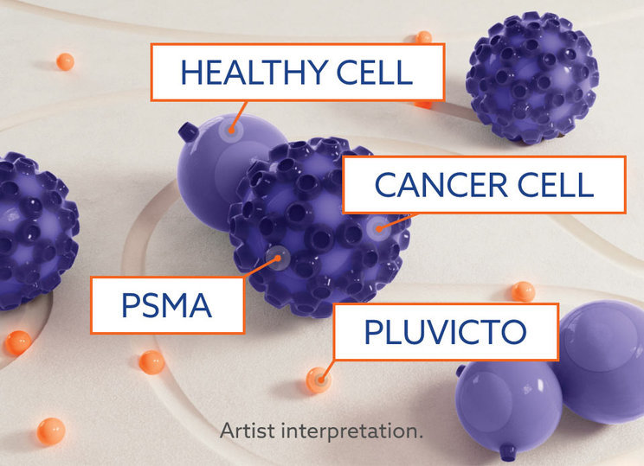
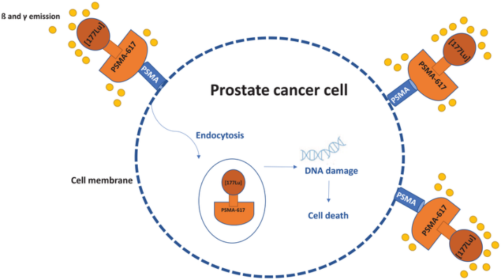
PSMA-Targeting Radioligand Therapy
How do they work?
  PSMA is a molecule found, or “expressed”, on some prostate cancer cells. PSMA-targeting treatments are given to patients through an IV and deliver a radioactive cancer-killing radioligand drug (such as lutetium-177) directly to prostate cancer cells that express PSMA.
Notes:
Image Sources:
Heidegger I, Kesch C, Kretschmer A, et al. Biomarkers to personalize treatment with 177Lu-PSMA-617 in men with metastatic castration-resistant prostate cancer - a state of the art review. Therapeutic Advances in Medical Oncology. 2022;14:17588359221081922. doi:10.1177/17588359221081922
https://us.pluvicto.com/about-pluvicto/how-pluvicto-works

Slide 8
PSMA-Targeting Radioligand Therapy (cont’d)
What are they called?
  PSMA-targeting treatments may also be referred to as radiopharmaceutical or radioligand therapies.
  Lutetium Lu-177 vipivotide tetraxetan (or “177Lu-PSMA-617”, brand name, Pluvicto®) is an FDA-approved PSMA-targeting treatment for prostate cancer.
  There are other PSMA-targeting treatments in development, including 177Lu-PNT2002, 177Lu-PSMA-I&T, and Lu-rhPSMA-10.1, that you may receive as part of a clinical trial. Information to consider when deciding if a clinical trial is appropriate for you is available at: https://www.cancer.org/content/dam/cancer-org/cancer-control/en/booklets-flyers/clinical-trials.pdf.
FDA expands Pluvicto’s metastatic castration-resistant prostate cancer indication. Accessed July 15, 2025.

Slide 9
PSMA-Targeting Radioligand Therapy: Side Effects
  Fatigue, dry mouth, nausea, back/joint pain, diarrhea or constipation, low blood counts
  Your oncology team may discuss additional side effects
  Make sure to ask your oncology providers who to contact with concerns and which side effects need to be reported immediately versus at your next visit
  Make sure that you have the contact information for your oncology providers, including a way to contact them outside of regular business hours if needed
  Make sure that you review and observe the special radiation safety instructions provided by your treatment center
Sartor O. New Engl J Med. 2021;385(12):1091-1103..

Slide 10
Reliable Online Resources
National Cancer Institute cancer-related terminology:
  https://www.cancer.gov/publications/dictionaries/cancer-terms
National Cancer Institute drug dictionary:
https://www.cancer.gov/publications/dictionaries/cancer-drug
American Cancer Society: https://www.cancer.org/cancer/types/prostate-cancer/treating/radiation-therapy.html
NCCN Prostate Cancer Guidelines for Patients:
    Early stage: https://www.nccn.org/patientresources/patient-resources/guidelines-for-patients/guidelines-for-patients-details?patientGuidelineId=49
    Advanced stage: https://www.nccn.org/patientresources/patient-resources/guidelines-for-patients/guidelines-for-patients-details?patientGuidelineId=50

