Slide 1




emergence insurance
CYBER INSURANCE EXPERTS
Alex Kerti
Tanya Dasgupta
Strategic Partnership Manager
Chief Executive officer

Slide 2








award-winning cyber underwriter
OVER A DECADE OF EXPERIENCE
Brisbane
Newcastle
Auckland
Sydney
Perth
Melbourne

Slide 3
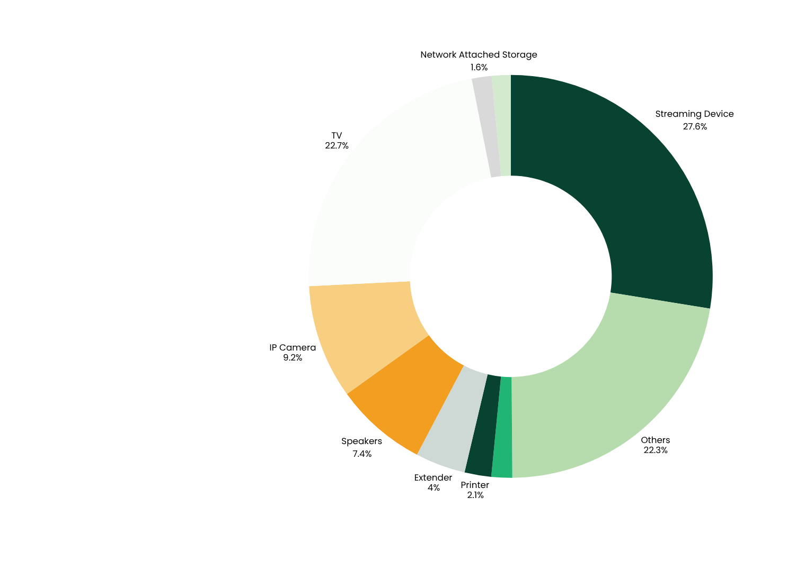
IOT DEVICES
vulnerable home devices
Average of 22 connected devices per household. Average of 29+ attacks per day.
Streaming devices dominate households, accounting for more than a quarter of all detected vulnerabilities, followed by smart TVs and IP cameras. Together, entertainment and surveillance products represent over half of all exposed device.
Notes:
SOURCE: 2025_iot_security_report.pdf
TOP VULNERABLE DEVICES
The distribution of vulnerable IoT devices paints a different picture of the modern smart home.
Streaming devices now dominate, accounting for more than a quarter of all detected vulnerabilities, followed by smart TVs and IP cameras. Together, entertainment and surveillance gear represent over half of all exposed devices – yet another sign of how easily everyday consumer electronics can become security liabilities.
Printers, extenders, and network - attached storage systems also feature prominently, bridging the gap between leisure and infrastructure.
These categories have been abused in large - scale malware campaigns such as BADBOX, which turn ordinary smart home gadgets into coordinated botnets that target networks far beyond the living room.

Slide 4
personal cyber policy
WHAT WE INSURE
CYBER ESPIONAGE
HACKING
MALWARE
DOS ATTACKS
VIRUSES
CYBER BULLYING
CYBER HARASSMENT
IDENTITY THEFT
CYBER THEFT
CYBER STALKING
Notes:
Hacking, cyber espionage, malware, viruses, Denial of Service attacks, cyber theft, cyber stalking, cyber bullying, cyber harassment, identity theft

Slide 5

CYBER IN NUMBERS
identity theft
133,000
Identity theft has affected as many as 133,000 New Zealanders annually
Annually costing the economy as much as
$209,000,000
Notes:
Stats source: IBM

Slide 6
identity theft
METHODS CRIMINALS USE TO STEAL AN IDENTITY
PHISHING SCAMS
Thieves send people emails that looks like they come from a reputable source such as a bank and ask people for passwords/details they can use to unlawfully access their accounts.
SOCIAL MEDIA AND DATA SCRAPING
They look for personal information on social media profiles such as name, address etc. and use this info to steal their identity.
ONLINE SCAMS
Fake websites and online retailers aim to steal credit card information.
THE COST OF IDENTITY THEFT
22%
of the population has been a victim of identity crime
ID theft costs each victim
$3,696
Notes:
Source: Emergence Personal Cyber Whitepaper
Identity theft involves unauthorised use of someone’s personal data such as their name, address, and a date of birth and using this information to create a false identity or pose as the victim. The criminal can then use this information to steal money from the person’s bank account, take out credit cards in their name or shop online pretending to be the victim.
Criminals use a variety of means to steal people’s identity:
Phishing scams: thieves send people emails that look like they come from a reputable source such as a bank and ask people for details such as passwords or any information they can then use to unlawfully access their bank accounts.
Social media data scraping: criminals look for personal information on social media profiles such as their names and addresses and use this information to steal their identity or pretend to be them.
Online scams: criminals can set up fake websites that look like big name retailers. When people ‘shop’ there the criminals can collect details such as their credit card information and then spend up to the card’s limit. The fallout for the victim can be devastating. It can destroy their credit score; they can be locked out of their bank account and large debts can be incurred in their name. Not to mention the psychological and reputational damage that can happen, with identity theft causing substantial pain and suffering. It can take years and thousands of dollars to re-establish the person’s identity

Slide 7
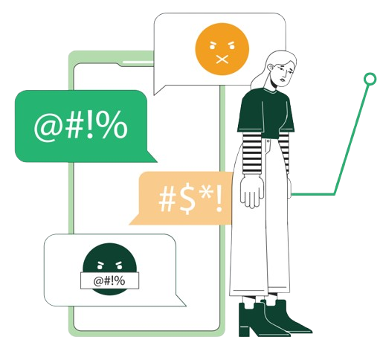
cyberbullying
EXAMPLES
1 in 5
Young people aged 8-17 reported being socially excluded, threatened or abused online
Cyberbullying involves the misuse of power with technology.
Examples include;
Threatening to publish explicit photos online
Encouraging others to bully or ignore
Vilifying and spreading rumors on social media
Notes:
Source for stat: Cyberbullying-factsheet_0.pdf
Source for copy: Emergence personal cyber whitepaper

Slide 8
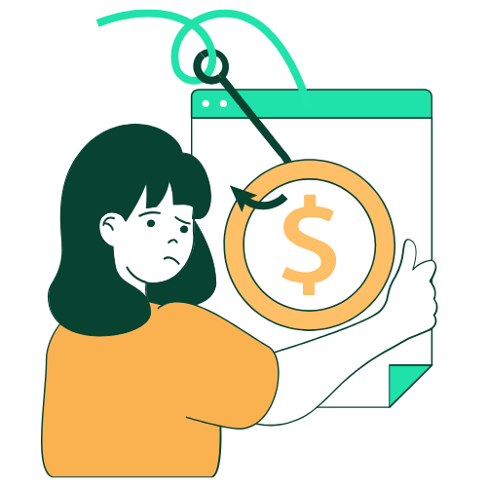
contacts
CYBER BULLYING
15-year-old female received an unusual volume of notifications on social media. A deepfake image of her face had been repurposed and shared widely.
claim example
She was then contacted by a fake account. They Threatened to share explicit images with all followers unless funds were paid.
IR team provided detailed family briefing, family cyber awareness, reported the incident, liaised with police, coordinated guidance counselling sessions.
Cyber bullying guidance sessions: $750
Wage replacement benefit: $915
Family cyber consultation: free
Total covered: $1,665
CONTACTS + RESOURCES

Slide 9
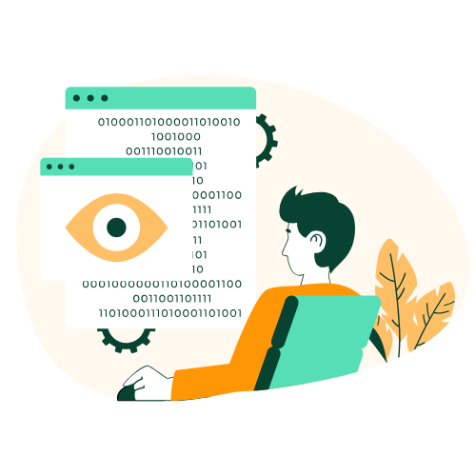
contacts
IDENTITY THEFT
Insured received several letters confirming credit and loan approvals.
One week earlier, the insured clicked on a malicious link via email. Malware was downloaded onto their laptop and phone
claim example
The malware harvested stored credentials, identification documents, and tax records.
Insureds accounts frozen due to suspicious activity.
DFIR confirmed sensitive data exfil. Legal counsel liaised with creditors, banks, telco and debt collectors. Devices secured. Identity documents replaced. Credit ID monitoring for the family.
IT securing: $6,400
Legal advice: $12,200
ID replacement: $1,400
CM: $360
Wage benefit: $2,600
Total covered: $22,960
CONTACTS + RESOURCES

Slide 10



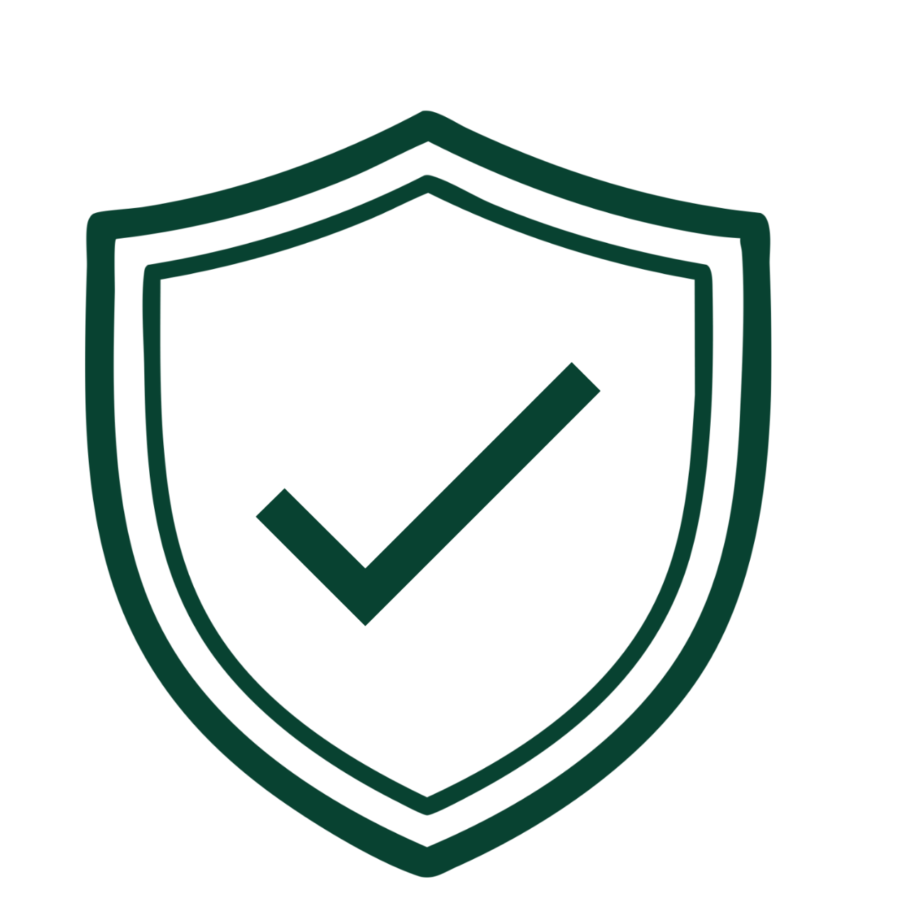
one incident, one team
PERSONAL CYBER RESPONSE
INCIDENT
INVESTIGATE
HOTLINE CALL
PROTECT
IMMEDIATE RESPONSE
RECOVER
4
4

Slide 11








five behaviours that protect
LOW COST, HIGH IMPACT
PAUSE
VERIFY
PROTECT
HANDLE
REPORT
Notes:
Pause; Rushed mistakes, phishing, scams
Verify; Payment fraud, impersonation, data leakage
Protect; Account takeover, email compromise
Handle: Privacy breach, confidentiality leak
Report: Ransomware, account takeover, unusual activity

