Slide 1
Visiting Murray Art Museum Albury (MAMA) for a school tour.
Social Story
Left: view of the Museum from the Dean Street entrance.

Slide 2
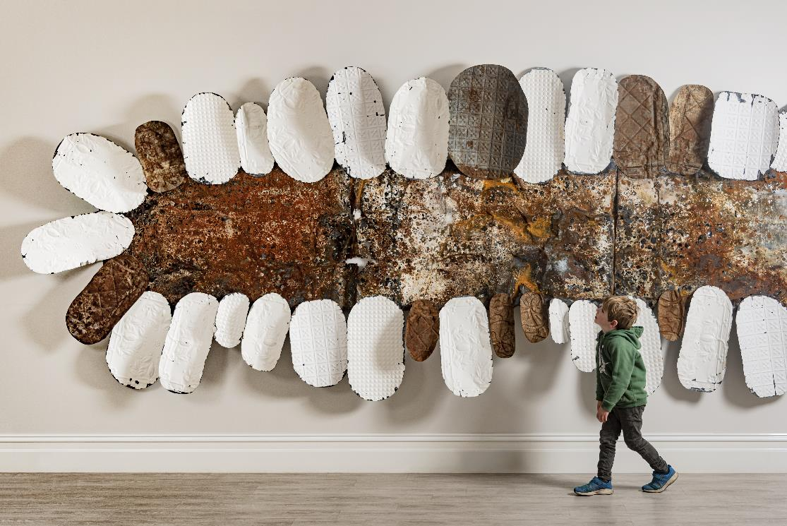
The Museum is located on Wiradjuri Country. We pay our respects to all Elders past, present and emerging.
Left: Lorraine Connelly-Northey On Country, 2017

Slide 3
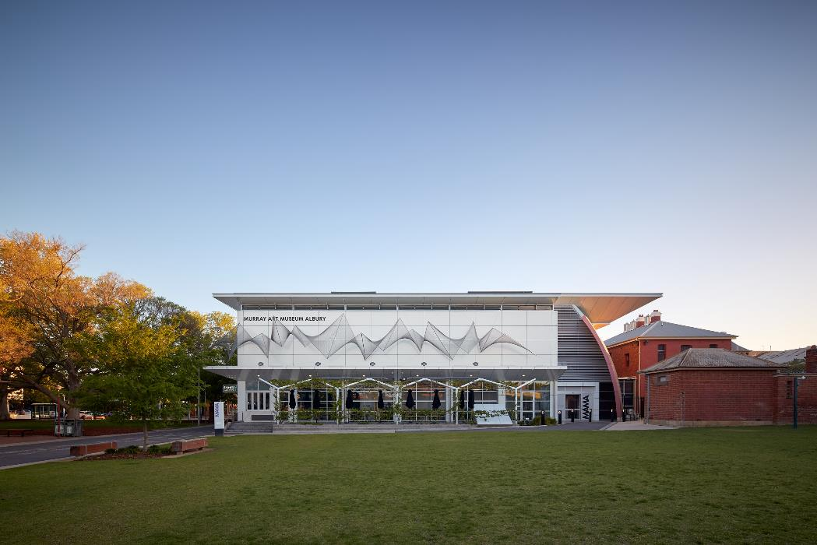
This is what the back of the building looks like from QEII Square.
Left: view of the Museum from QEII Square.

Slide 4
If you are catching a bus, you will see the Museum from the bus stop.
Left: view of the Museum from the Dean Street entrance.

Slide 5
We can enter the Museum through the front entrance on Dean street.
Left: a person wearing a backpack walking towards the Museum entrance.

Slide 6
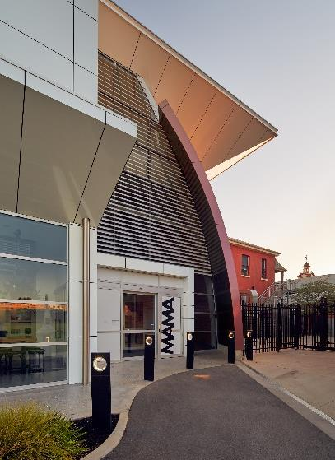
We can also enter the Museum via the QEII Square rear entrance.
We will use this entrance if walking from the Library.
Left: view of the Museum from the QEII Square entrance.

Slide 7
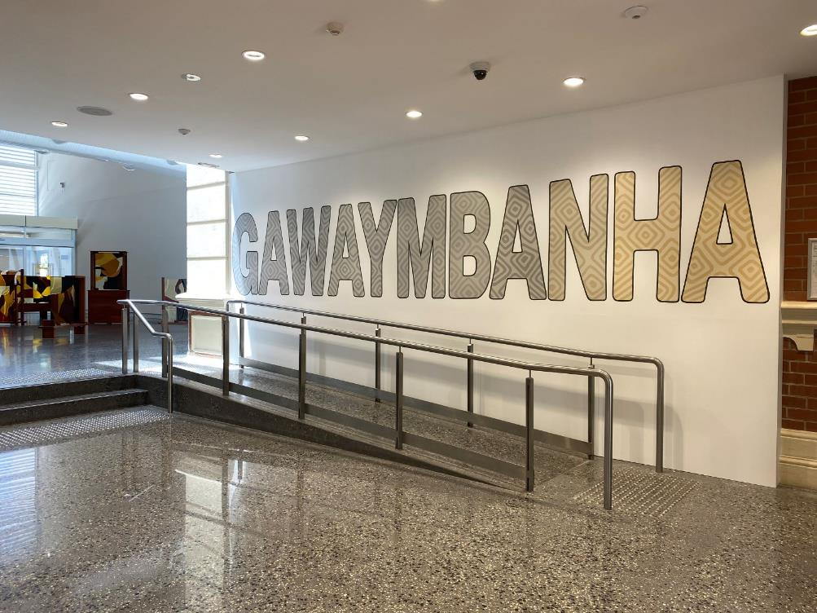
Gawaymbanha is Wiradjuri for welcome, to come, to tell to come.
This is the front entrance. There are two levels (level 1 & 2). Inside there are galleries filled with artworks, art studios, bathrooms, a Kids Gallery and places to sit down and rest.
We are going to have fun.
Left: a mural painted by Uncle Darren Wighton featuring the word GAWAYMBANHA, located at the Museum’s entrance.

Slide 8
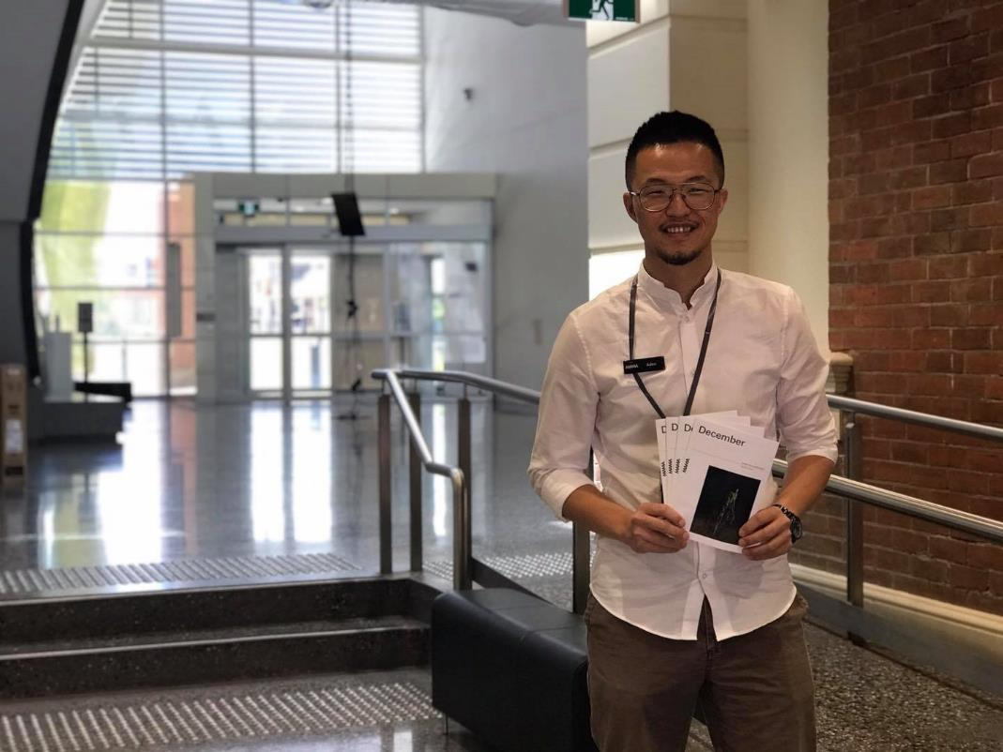
Once we enter through the doors, we will be greeted by a friendly staff member.
They will tell us where to go and help us during our tour.
Left: a Museum staff member standing and smiling at the entrance.

Slide 9
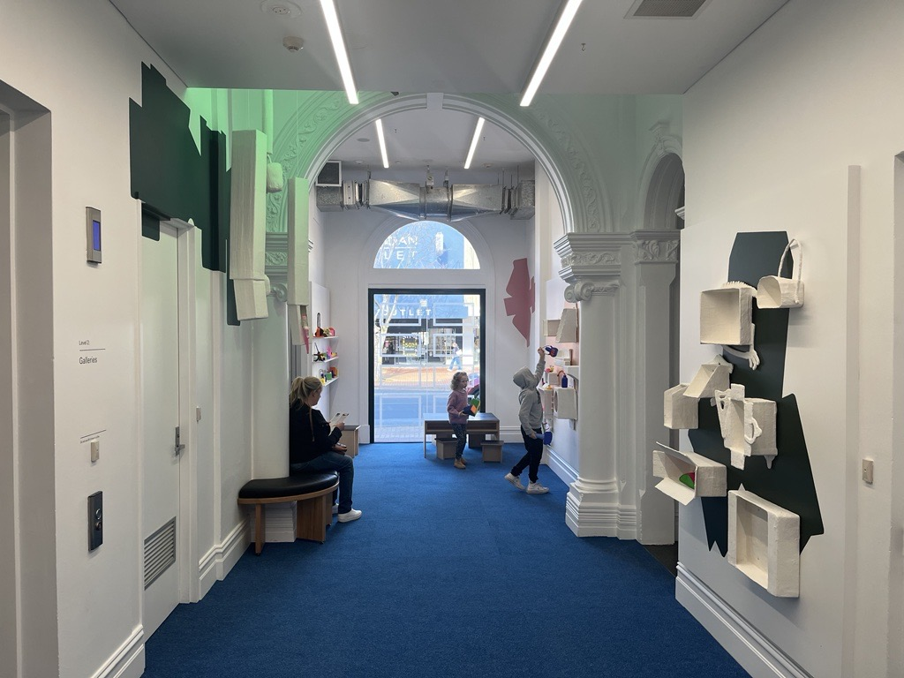
We might walk through the Kids Gallery on the way to the Studios.
Left: Shelfie by Susie Losch, Kids Gallery installation 2023

Slide 10
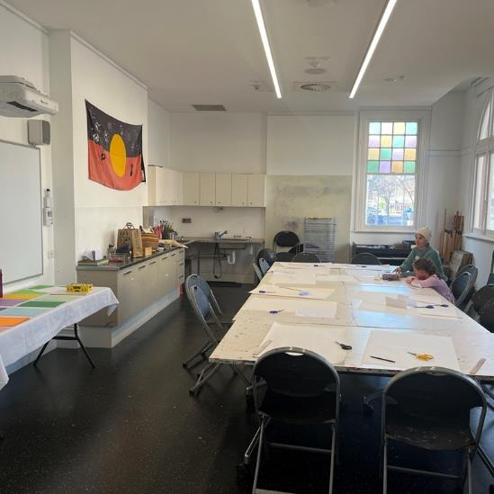
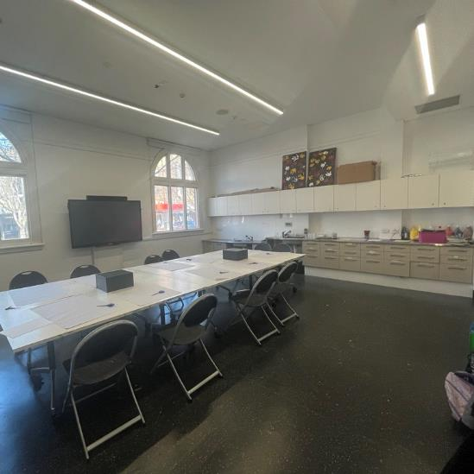
The two Studios (Studio A & Studio B) are used for art activities and for storing our school bags.
Left: view of the two Studio spaces off the Kids Gallery.

Slide 11
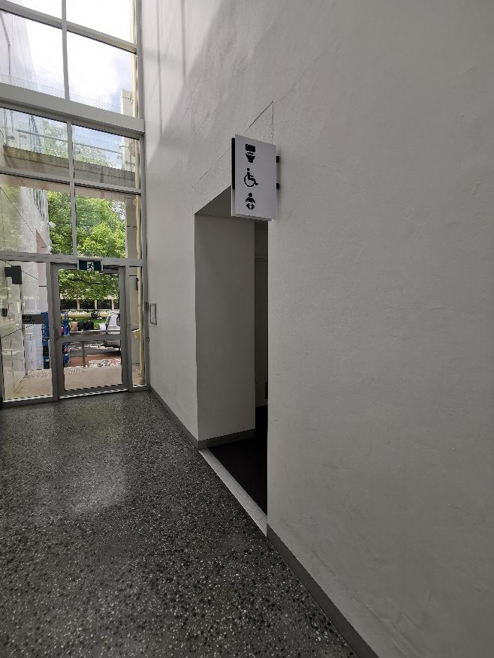
The bathrooms are located on the ground floor at the end of the hallway.
Left: view of the hallway with bathroom signs on the right and a glass door at the end.

Slide 12
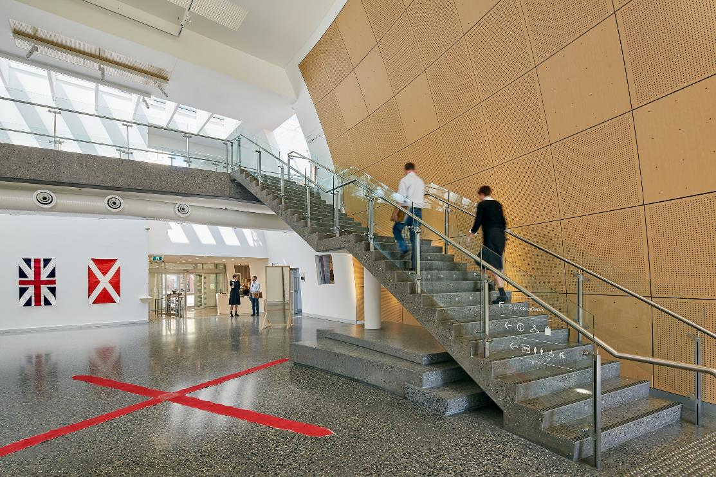
There are two levels in the museum. To see the exhibitions upstairs we will need to walk up the stairs or take the lift.
Left: two figures climbing the stairs to level 2.

Slide 13
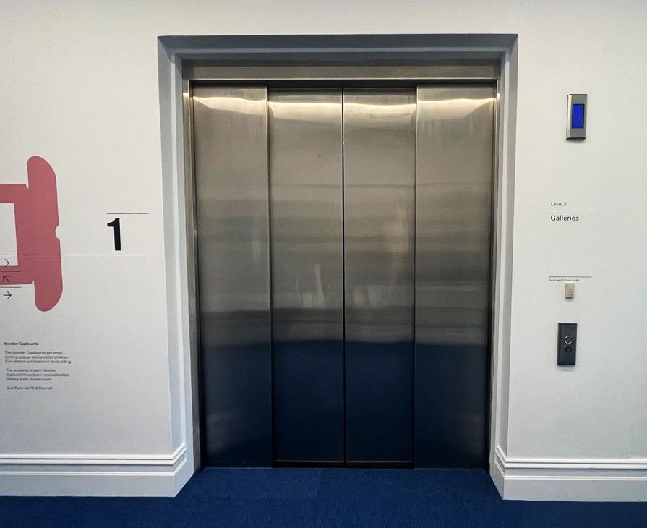
This is what the lift looks like from the outside.
Left: the lift (doors closed) on level 1.

Slide 14
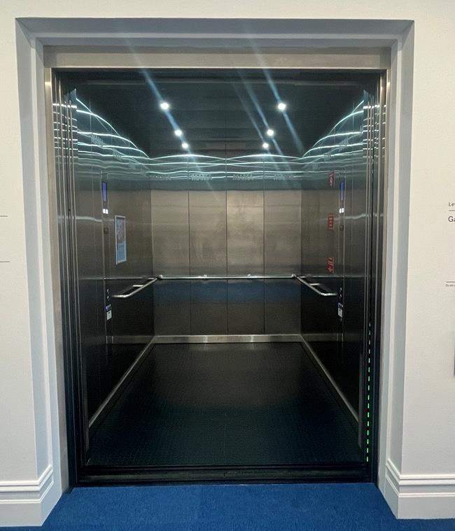
This is what the lift looks like from the inside.
Left: the lift (doors open) on level 1.

Slide 15
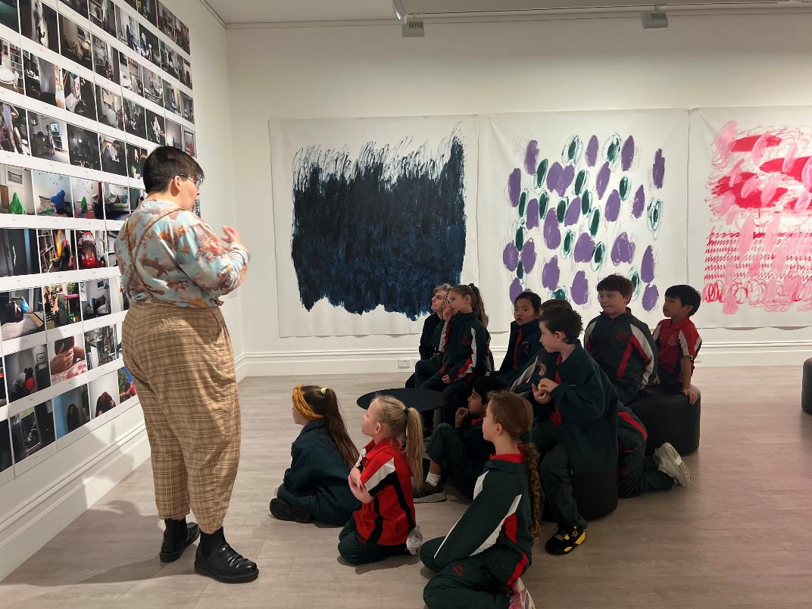
We will look at some of the artworks. Our guide will ask us questions about what we see and what it makes us think about. We need to remember a few important rules to ensure we (and other visitors) can enjoy our visit.
Left: a group of students looking at artworks in our Collection exhibition Home, June 2023

Slide 16
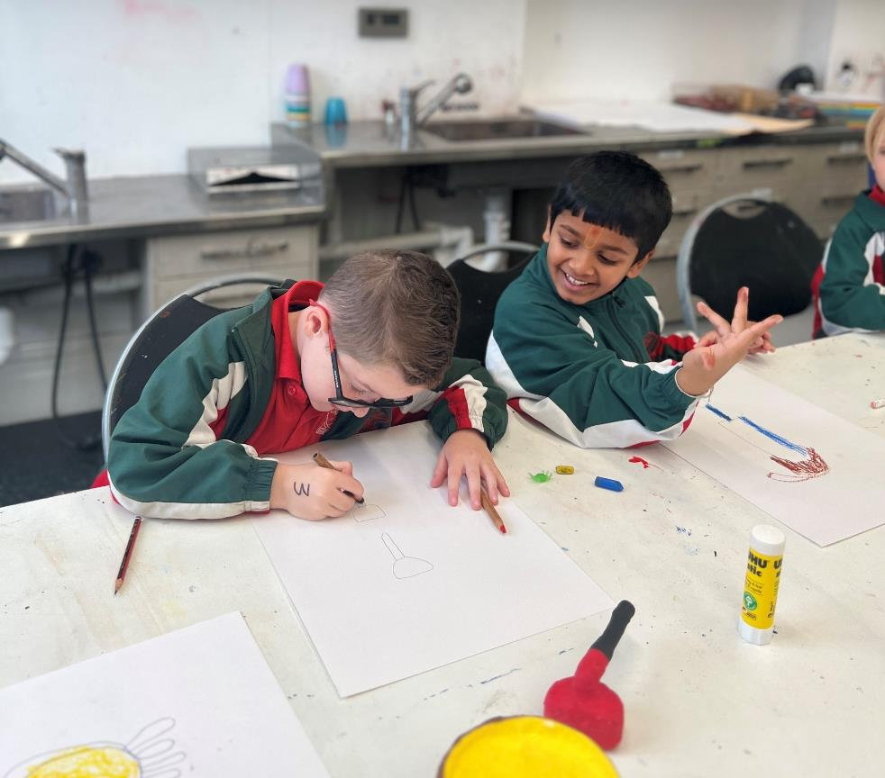
1. We speak in our quiet voice used for inside spaces. Speaking loudly can make it hard for others to enjoy looking at artworks.
Left: two students drawing in the Studio, 2023

Slide 17
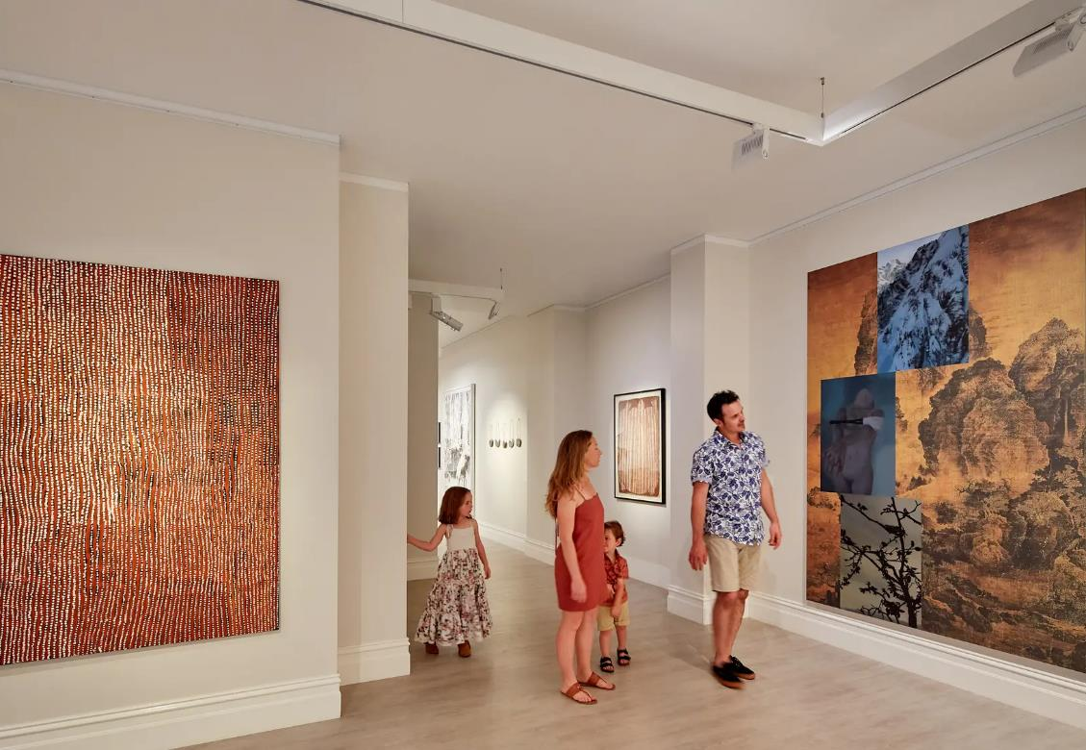
2. We stay close to our guide, teacher or grown up. Make sure that you remain in a group when walking around the spaces. We walk (not run!) to avoid hurting ourselves, others and our surroundings.
Left: a group of adults and children walking through a gallery.

Slide 18
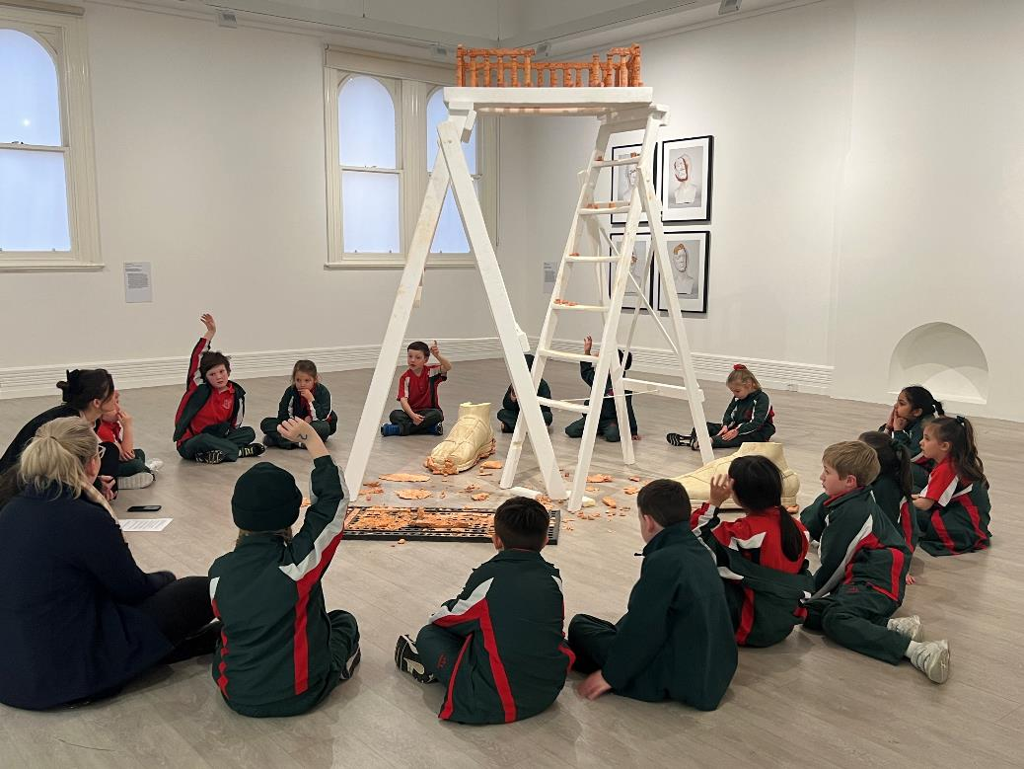
3. We look with our eyes and don’t touch the artwork.
We leave space between us and the artwork to avoid hurting the artwork and ourselves. A giant step is a good amount of space to leave.
Left: students sitting in a circle around an artwork in form / function, 2023.

Slide 19
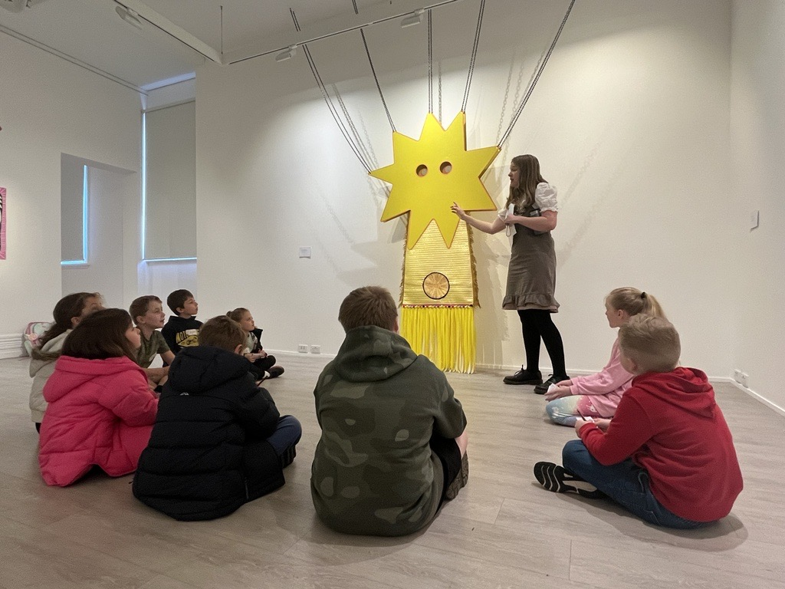
4. We are aware of our surroundings.
If you find an artwork that you really like and want to have a good look at it, make sure everyone else can see too!
Let your guide know if you need a quiet space.
Left: students sitting in a circle around an artwork in Sarah McEwan’s exhibition Unrequited Love (The Great Magpesis), 2023.

Slide 20
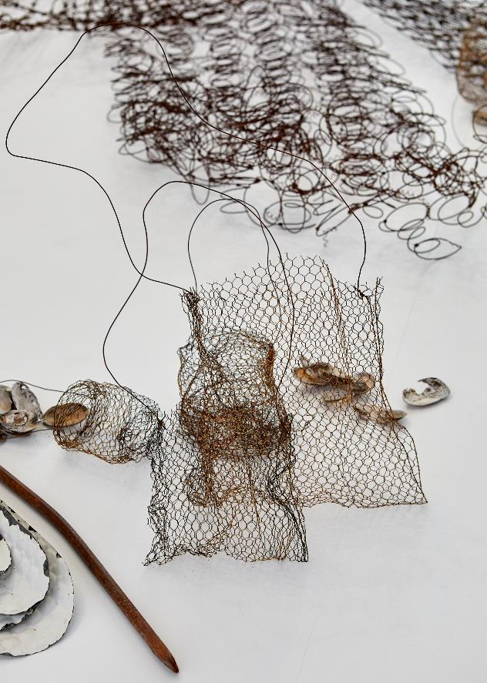
5. We have fun! All artworks are different. You may see paintings, photographs, videos and sculptures. Some of the works will be small, others may be very big! You will see art created by local artists and art by artists from around the world.
Left: Lorraine Connelly-Northey On Country (detail), 2017, MAMA, Photo: Jeremy Weihrauch, 2020.

Slide 21
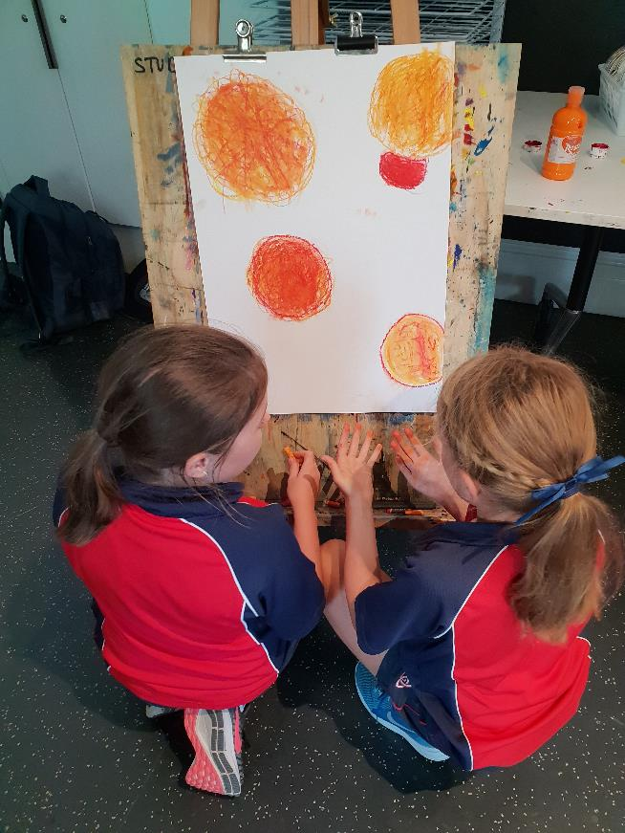
We might also do an art activity in the Studio after our tour. You can also continue to make art back at school that is inspired by your visit!
Left: two students at an easel painting orange shapes.

Slide 22
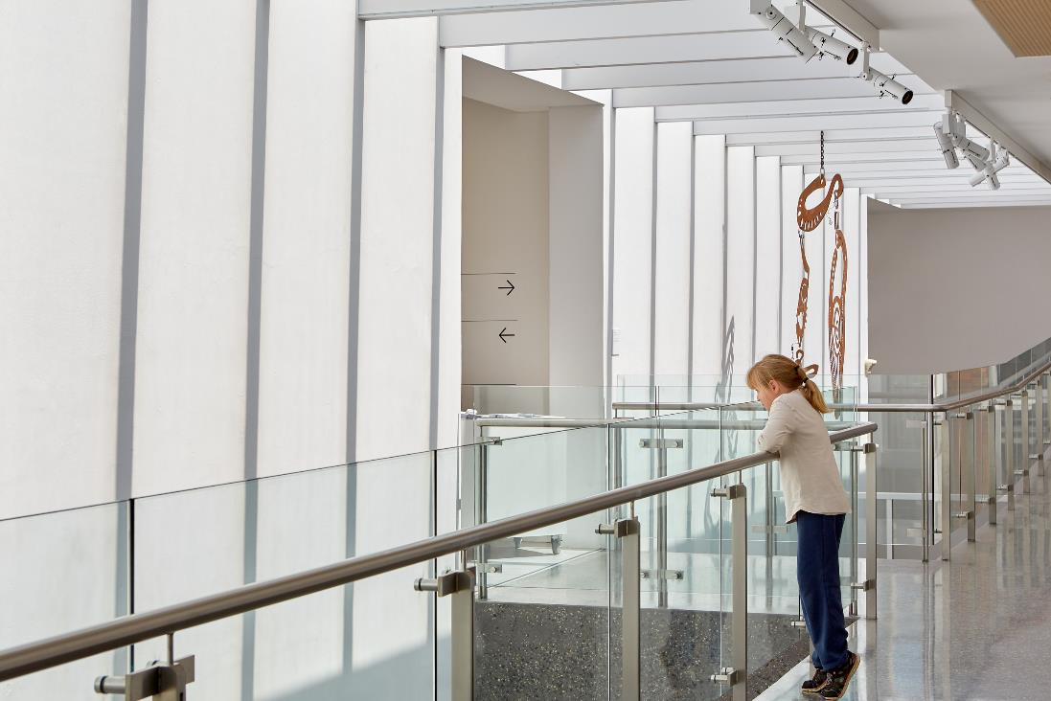
When we go upstairs there is glass on both sides so that we can see the art below. It may make us feel like we are up very high, but we are safe.
Left: someone standing on the Mezzanine, holding the handrail and looking down through the glass barrier at an artwork.

Slide 23
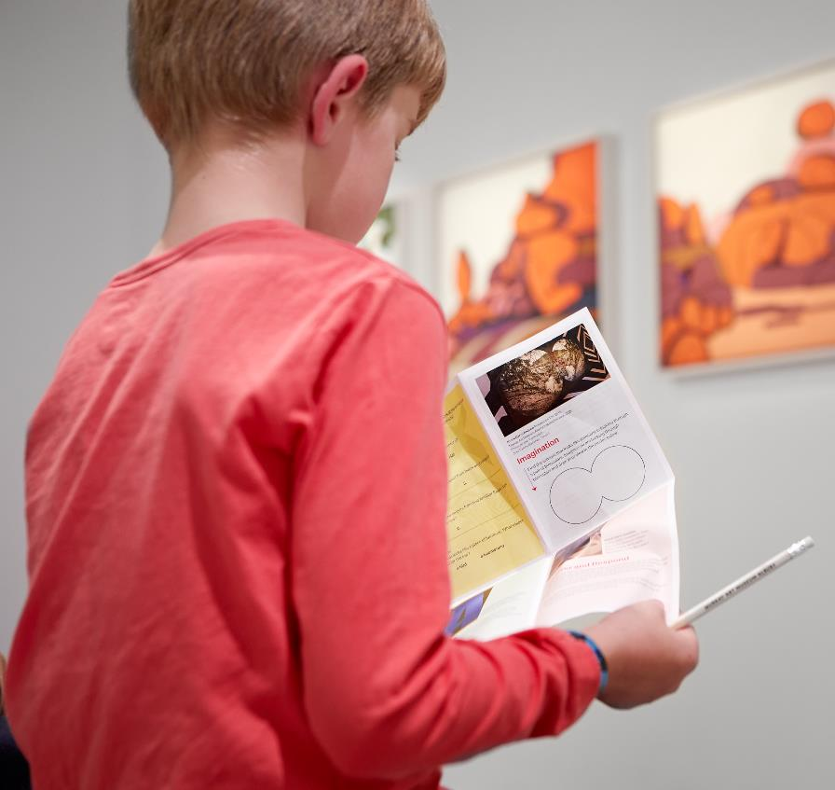
There are lots of fun things to do when visiting the Museum. There is a Kids Activity Trail that you can collect from the front desk with fun activities inside.
Left: somebody standing in front of an artwork, holding an activity sheet and a pencil.

Slide 24
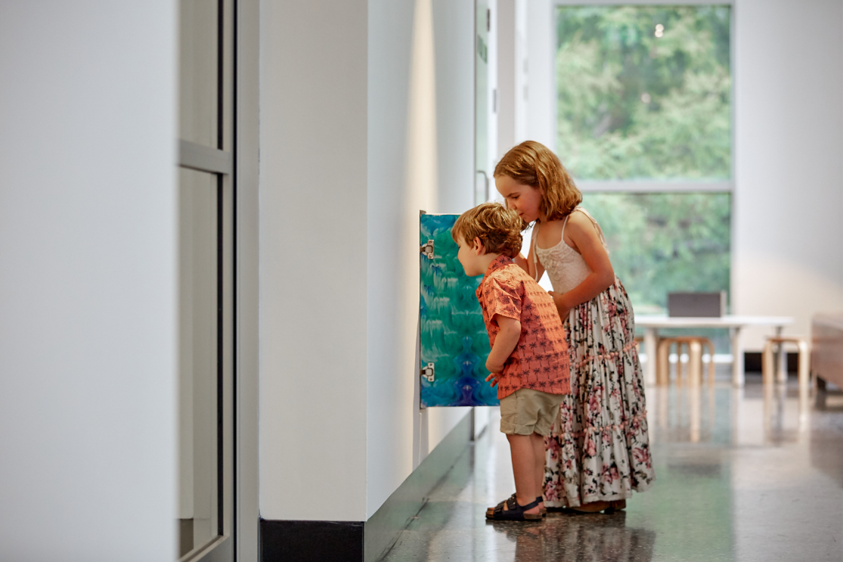
There are 5 hidden Wonder Cupboards in the Museum containing artwork especially for kids!
You are allowed to open the Wonder Cupboards.
Left: two children looking inside a Wonder Cupboard.

Slide 25
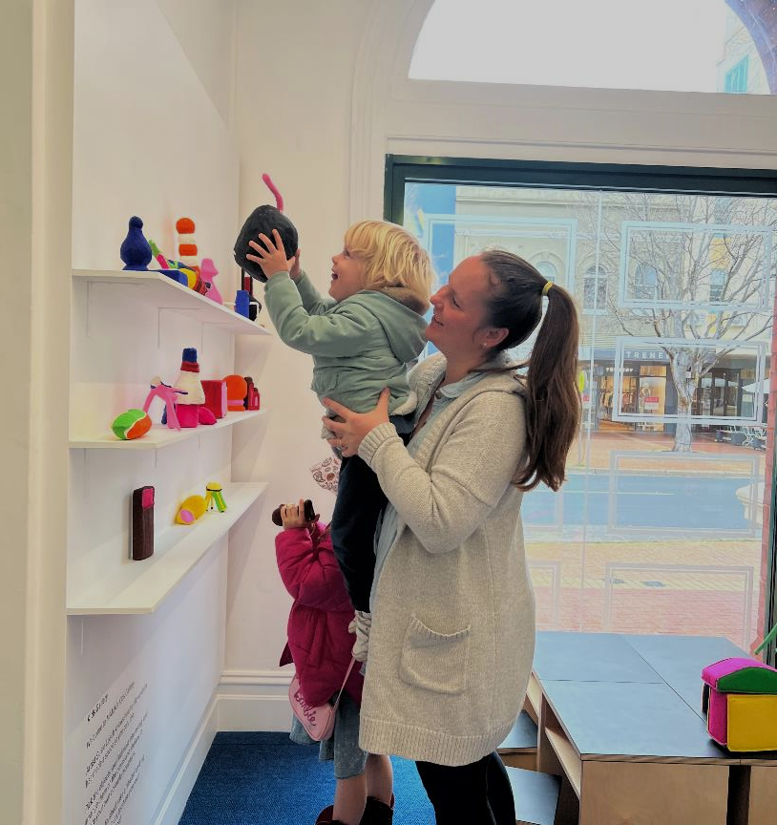
There is a bright and colourful permanent Kids Gallery that you can play in and touch the artworks. There are seats for you and for grown ups.
Left: a woman and two small children picking up sculptures from the Kids Gallery installation Shelfie by Susie Losch.

Slide 26
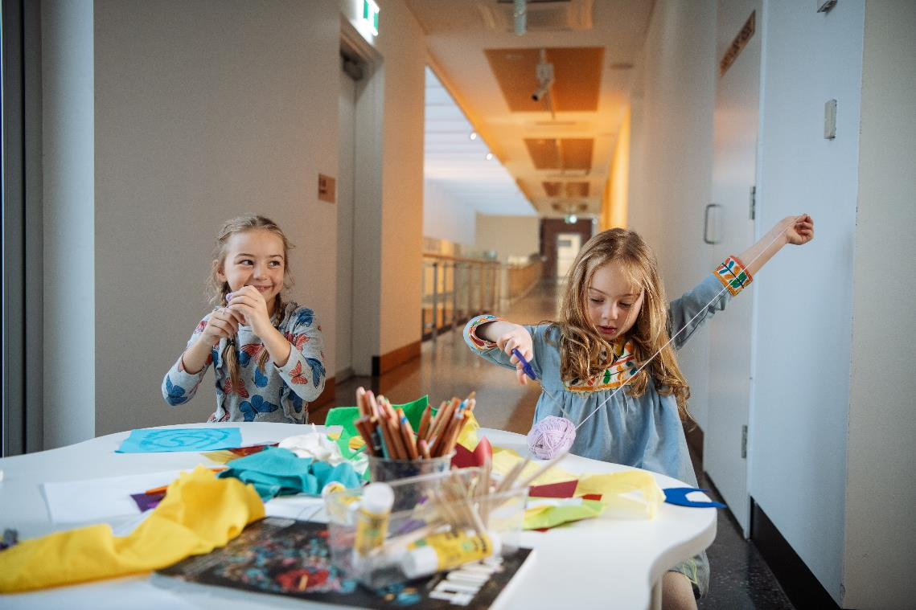
There is a Kids Activity Table where you are welcome to create your own artwork using the materials provided. You can take this artwork home with you.
Left: two children seated at a table, smiling and cutting wool .

Slide 27
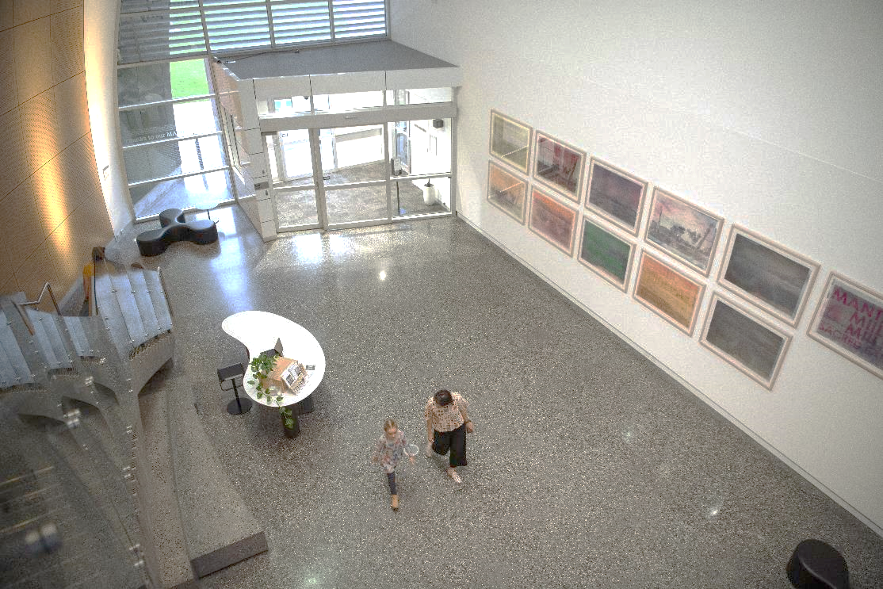
After we have finished out tour our guide will take us back to the entrance. We will collect our bags and wait for our teacher. It is time to say goodbye to the Museum. We can visit again another time.
Left: two people walking through the Atrium on the ground floor.

Slide 28
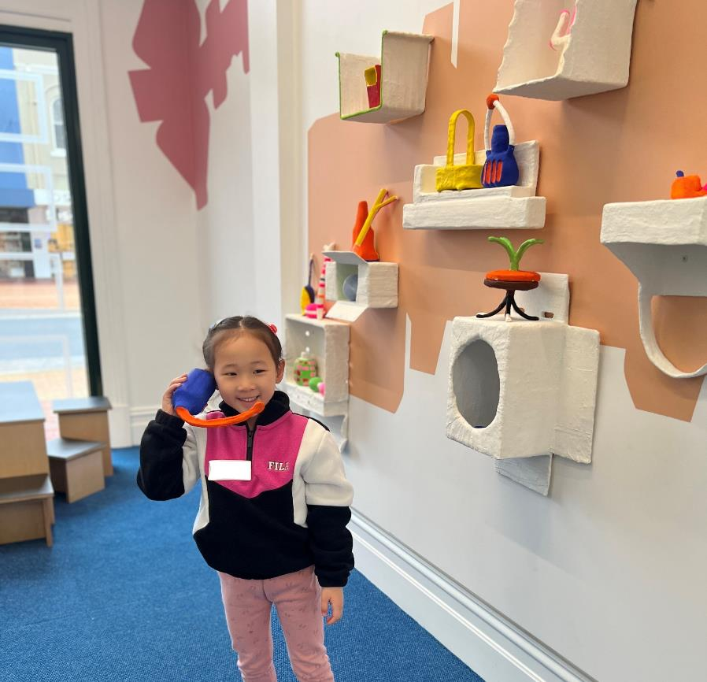
Please let us know if you have any questions before your visit, or feedback afterwards.
Left: a young visitor standing in the Kids Gallery pretending to speak on a telephone.

Slide 29
please add your own optional slide(s) here!
Left: (description)

