Slide 1
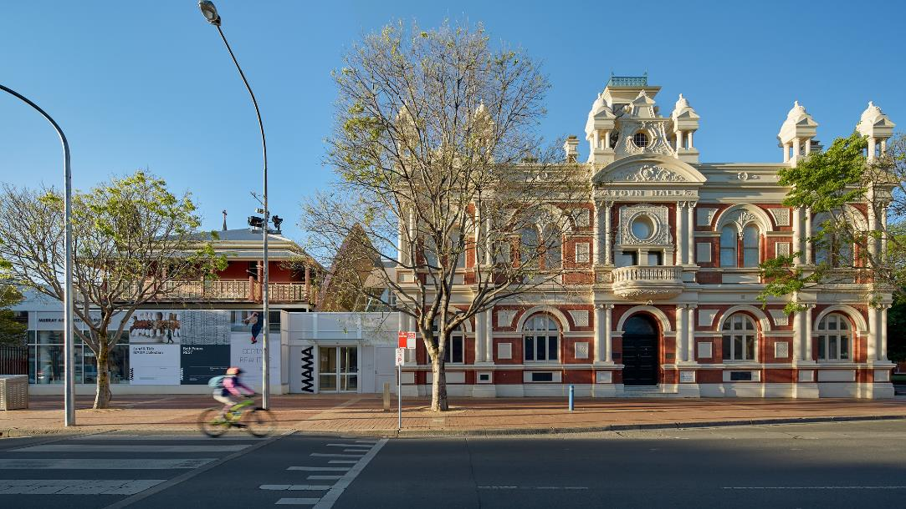

Visiting Murray Art Museum Albury (MAMA) for a school tour.
Visual Story
Left: view of the Museum from the Dean Street entrance.
Photo: Jeremy Weihrauch

Slide 2
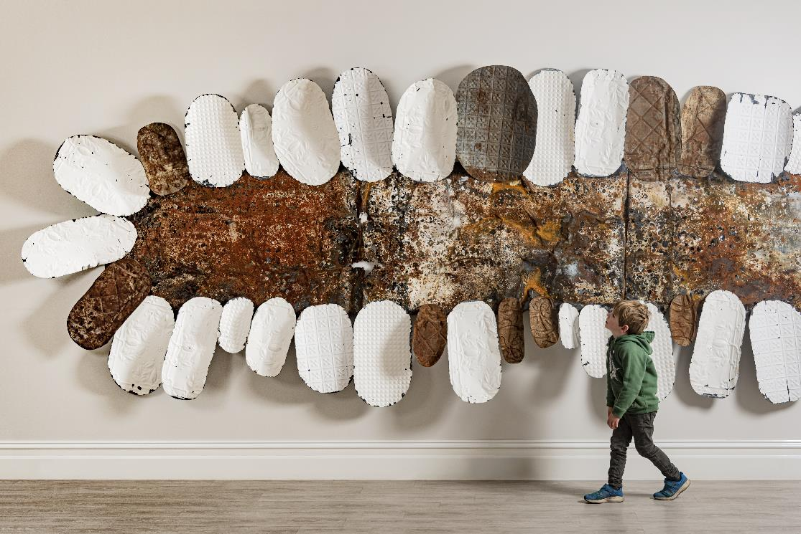
The Museum is located on Wiradjuri Country. We pay our respects to all Elders past, present and emerging.
Left: Lorraine Connelly-Northey, On Country, 2017
Photo: Jeremy Weihrauch

Slide 3
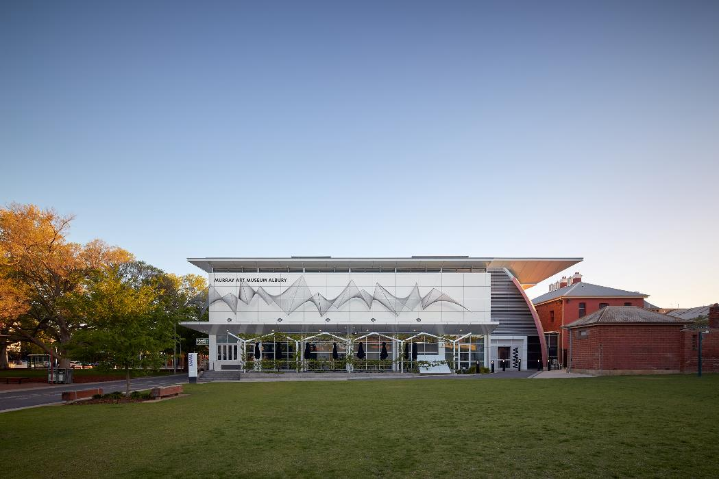
This is what the back of the building looks like from QEII Square.
Left: view of the Museum from QEII Square.

Slide 4
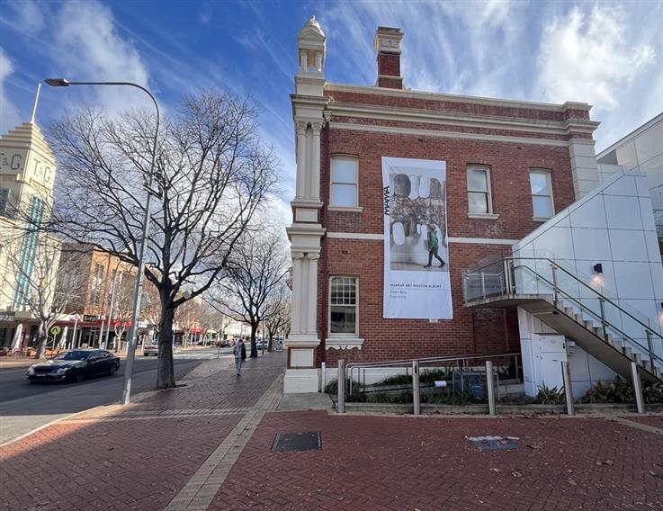
If you are catching a bus, you will see the Museum from the bus stop.
Left: looking at the Museum from the Dean Street bus stop.

Slide 5
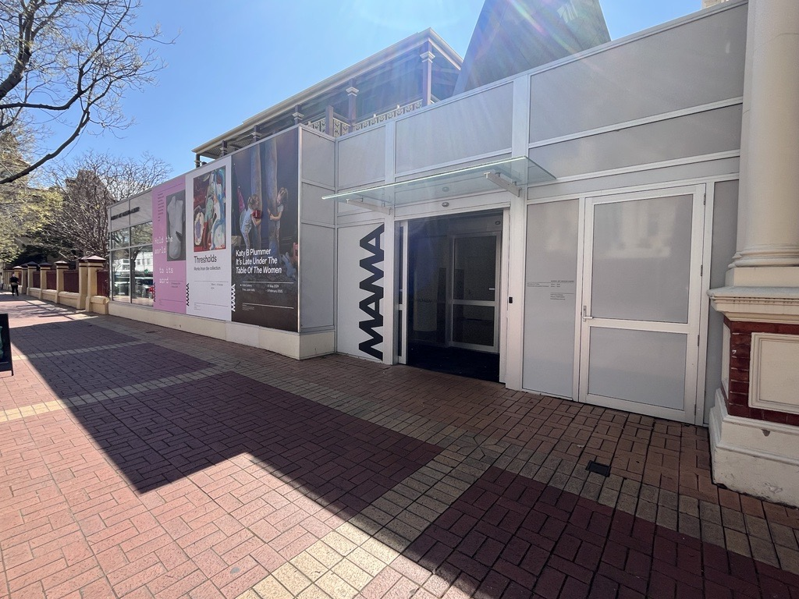
We can enter the Museum through the front doors on Dean street.
Left: the Dean Street Museum entrance.

Slide 6
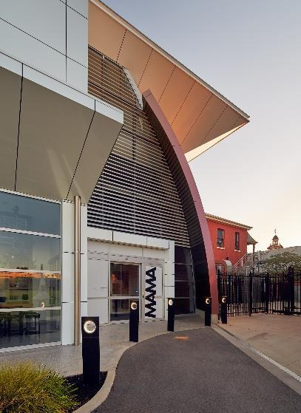
We can also enter the Museum via the QEII Square rear entrance.
We will use this entrance if walking from the LibraryMuseum.
Left: view of the Museum from the QEII Square entrance.

Slide 7
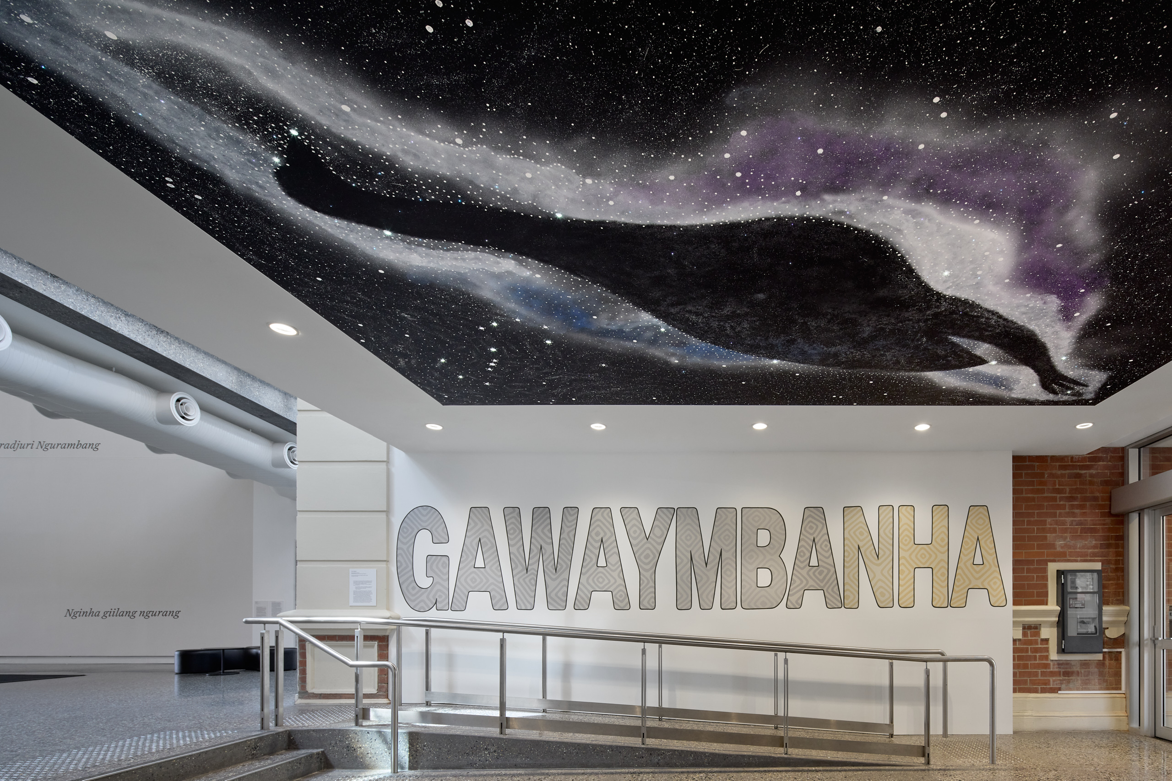
Gawaymbanha is Wiradjuri for welcome, to come, to tell to come.
This is the front entrance. There are two levels (Ground Floor & Level 1). Inside there are galleries filled with artworks, art studios, bathrooms, a Kids Gallery and places to sit down and rest. We are going to have fun.
Left: a mural painted by Uncle Darren Wighton featuring the word GAWAYMBANHA, located at the Museum’s entrance.
Photo: Jeremy Weihrauch 2025

Slide 8
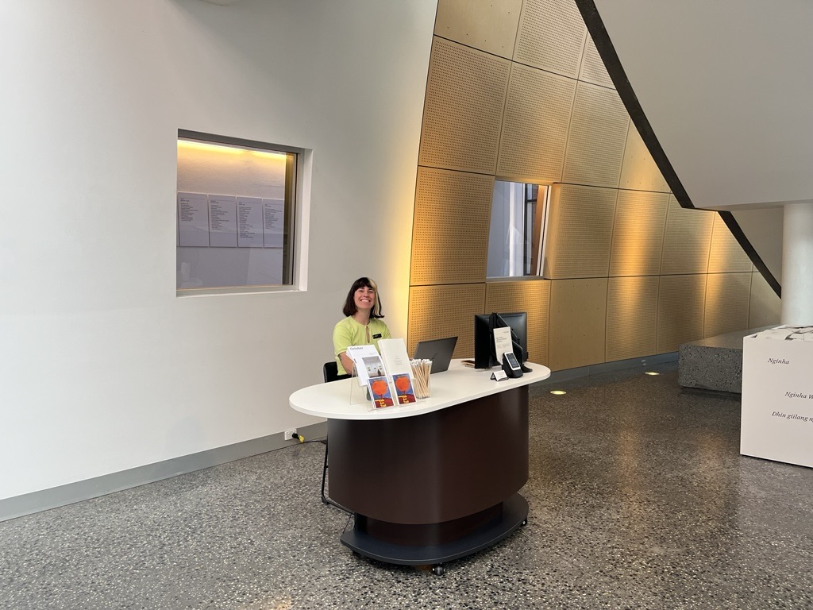
Once we enter through the doors, we will be greeted by a friendly staff member.
They will tell us where to go and help us during our visit.
Left: a Museum staff member sitting and smiling at the Visitor Experience desk.

Slide 9
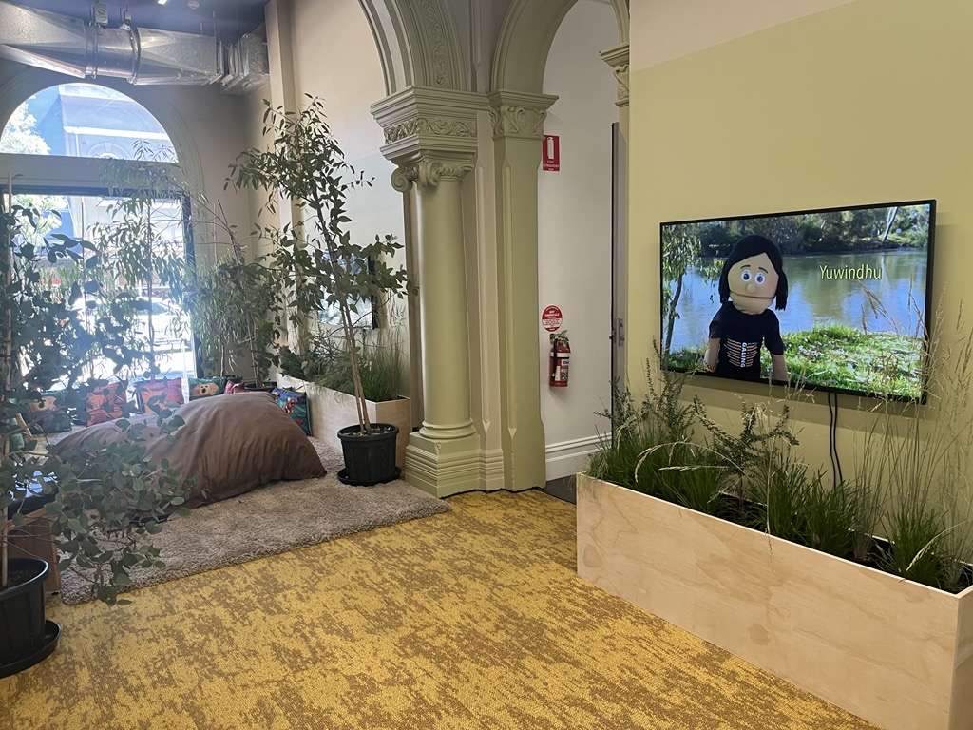
We walk through the Kids Gallery on the way to the Studios.
Left: Ruth Davys, Yamandhu wudhagarbinya?
Kids Gallery installation, 2025 - 2026

Slide 10
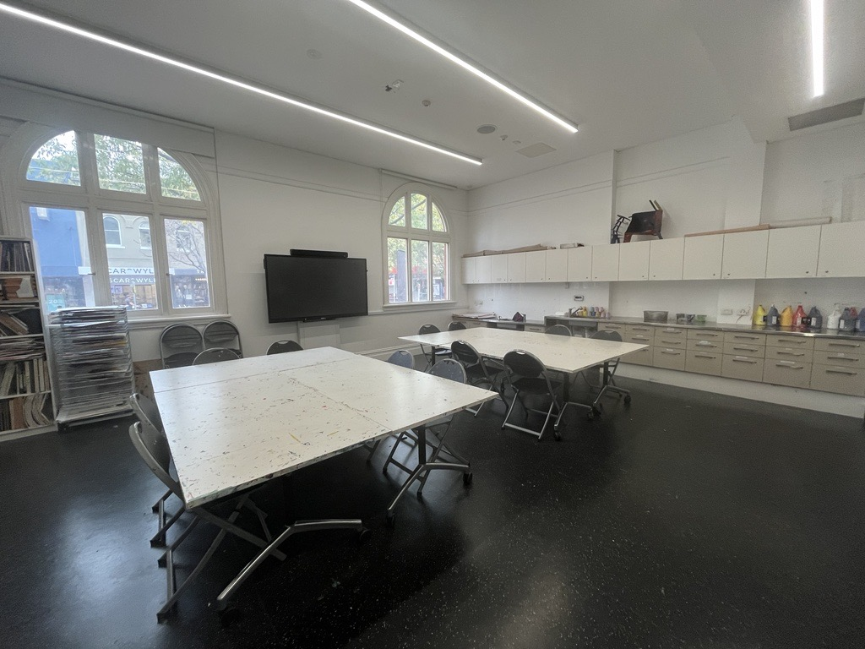
The two Studios (Studio A & Studio B) are used for art activities and for storing our school bags.
Left: view of Studio B.

Slide 11
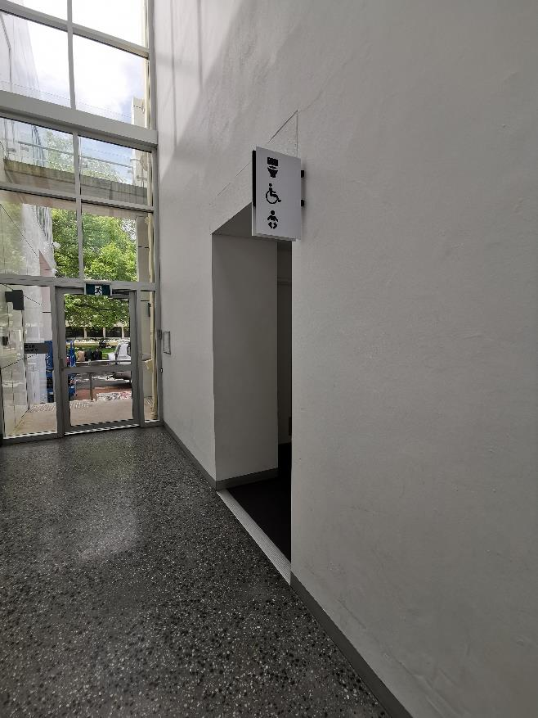
The bathrooms are located on the ground floor at the end of the hallway. There is an accessible toilet for visitors to use.
Left: view of the hallway with bathroom signs on the right and a glass door at the end.

Slide 12
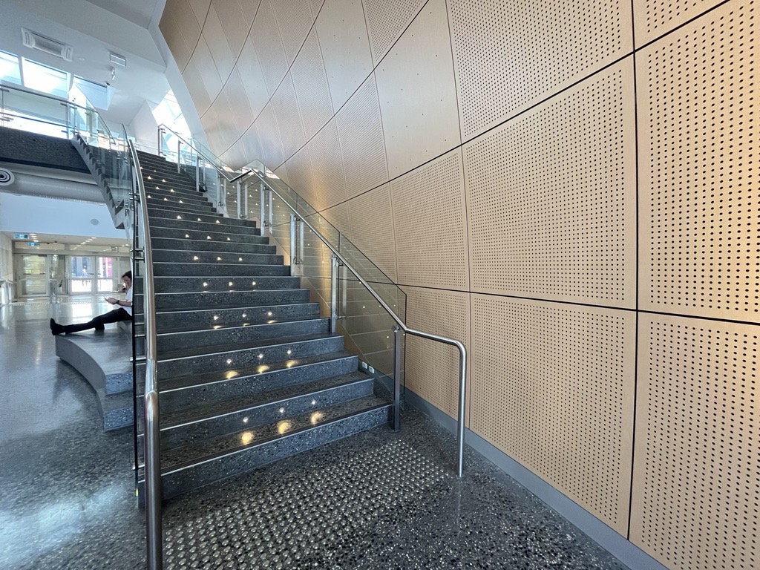
There are two levels in the museum. To see the exhibitions upstairs we will need to walk up the stairs or use the lift.
Left: two figures climbing the stairs to level 1.

Slide 13
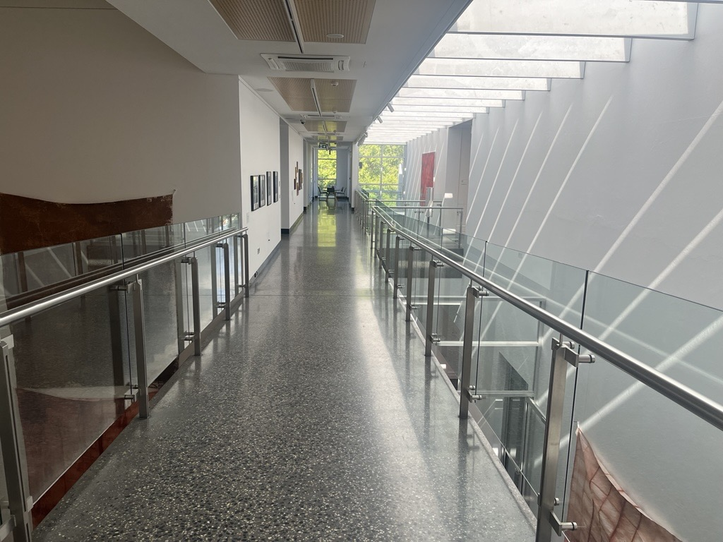
We will walk along the Mezzanine to enter the galleries on Level 1.
Left: the Mezzanine leading to Ramsay Gallery, Brindley Gallery, Quest Gallery and the Maurice Chick Family and MacLeod-Miller Adamshurst Gallery.

Slide 14
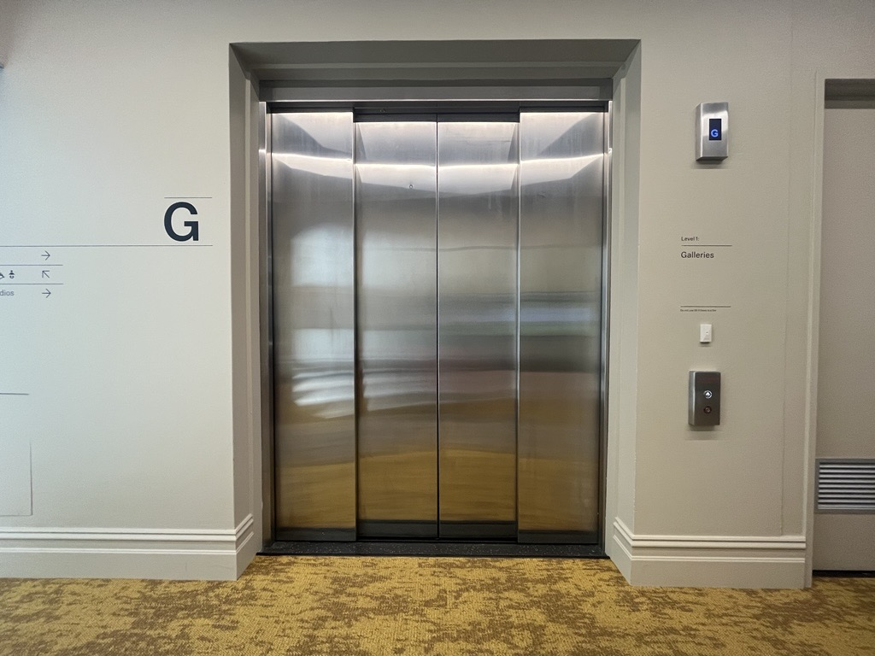
This is what the lift looks like from the outside.
Left: the lift (doors closed) on level 1.

Slide 15
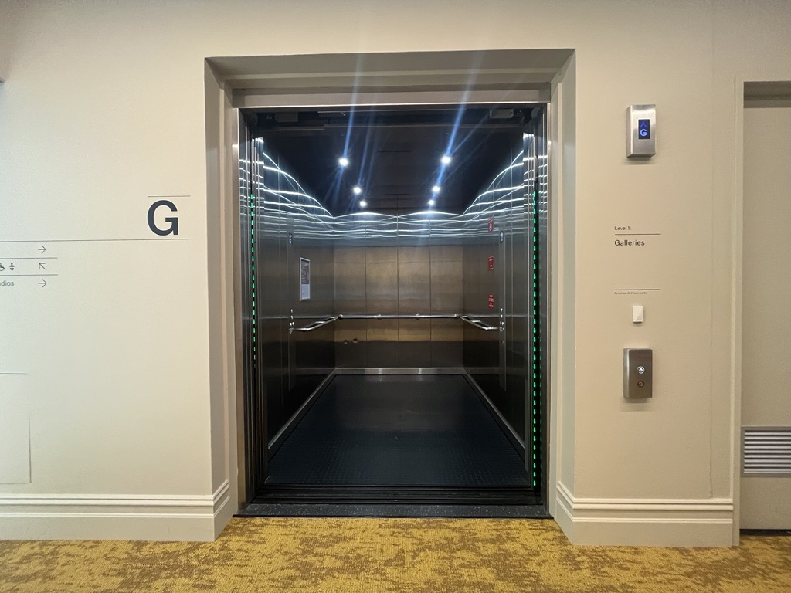
This is what the lift looks like from the inside. Our whole class can fit!
Left: the lift (doors open) on the Ground Floor.

Slide 16
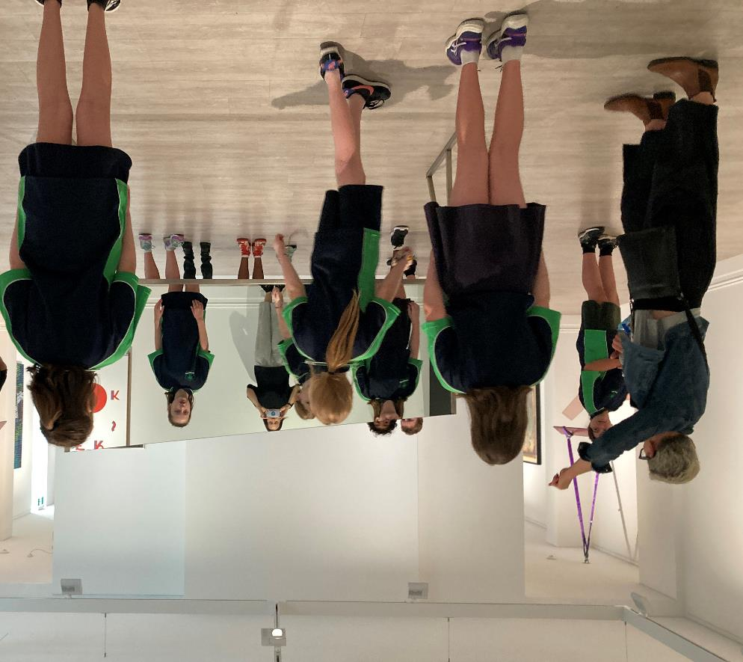
We will look at artworks in different galleries. Our guide will ask us questions about what we see and what it makes us think about.
We need to remember a few important rules to ensure we (and other visitors) can enjoy our visit.
Left: a group of students looking at artwork in the 2021 – 2022 Collection exhibition Gut Feeling.

Slide 17
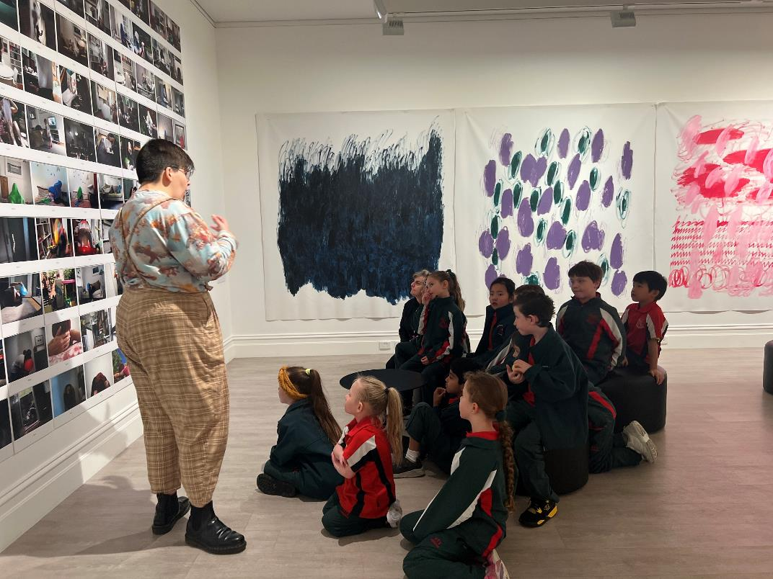
1. We speak in our quiet voice used for inside spaces.
Speaking loudly can make it hard for others to enjoy looking at artworks.
Left: a group of students discussing an artwork with a MAMA educator in the 2023 Collection exhibition Home.

Slide 18
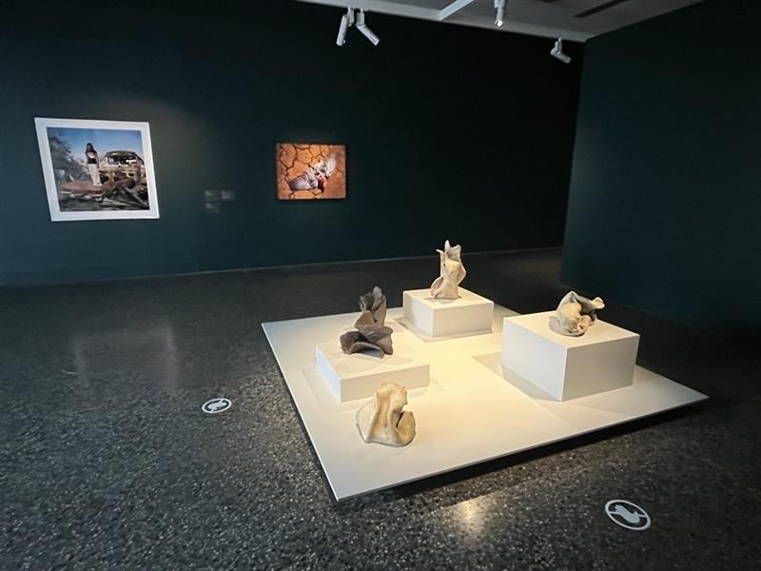
Some artworks will look familiar, others will look unfamiliar. The gallery spaces might be light and others might be dark. We will enter the spaces slowly so we have time to get used to our surroundings. We are safe.
Left: A fever of a memory, curated by Talia Smith. Level 1.

Slide 19
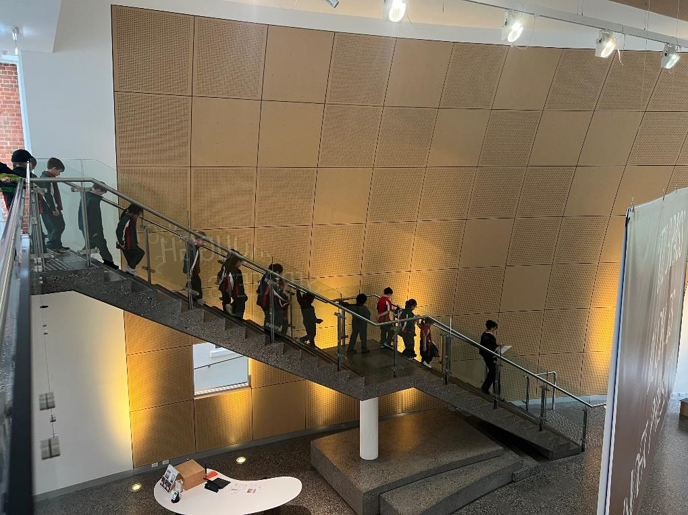
2. We stay close to our guide, teacher or grown up.
Make sure that you remain in a group when walking around the spaces. We walk (not run!) to avoid hurting ourselves, others and our surroundings.
Left: a group of school students in one line, following a MAMA educator down the stairs.

Slide 20
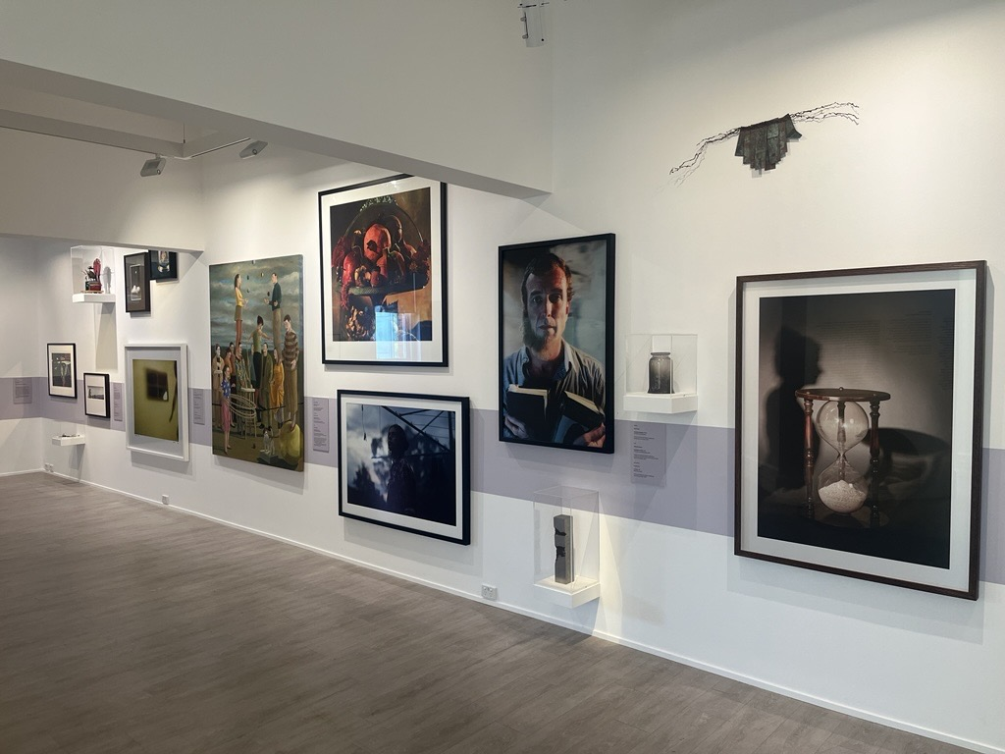
3. We look with our eyes and don’t touch the artwork.
We leave space between us and the artwork to avoid hurting the artwork and ourselves. A giant step is a good amount of space to leave.
Left: George Street installation view, Murray Art Museum Albury 2025.

Slide 21
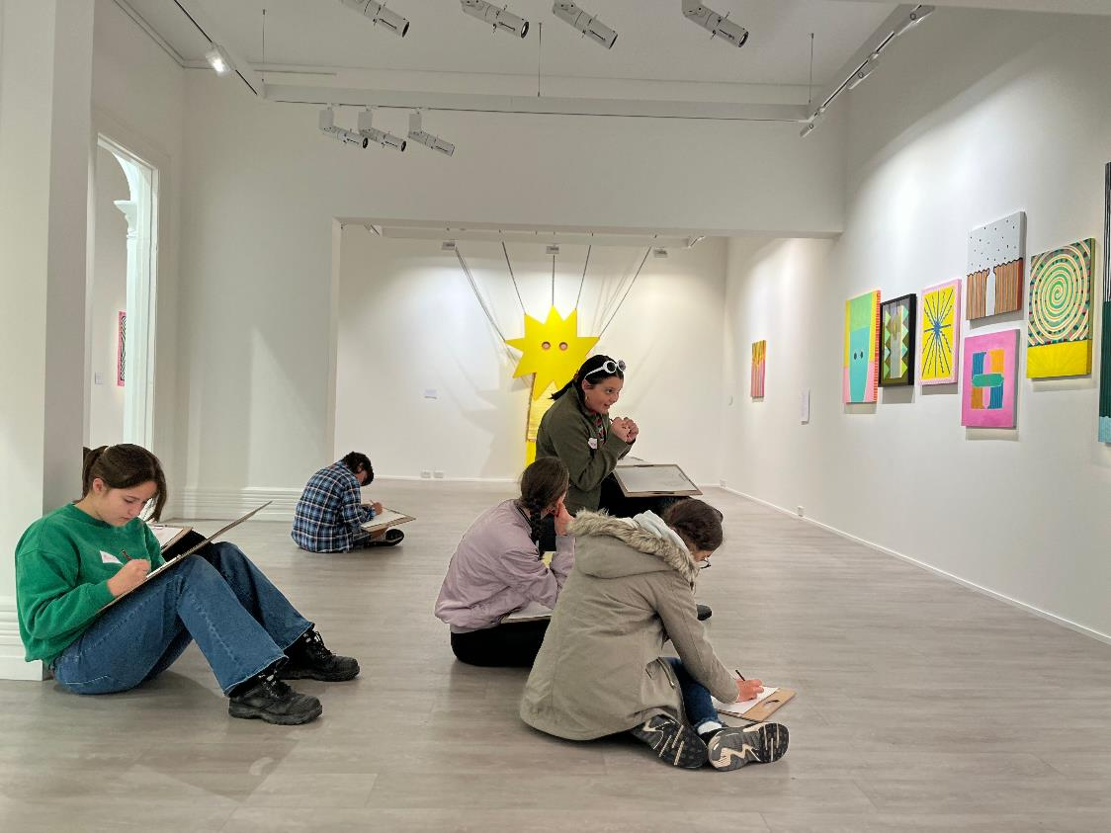
4. We are aware of our surroundings.
If you find an artwork that you really like and want to have a good look at it, make sure everyone else can see too!
Let your guide know if you need a quiet space.
Left: students sitting in the gallery looking at Sarah McEwan’s exhibition Unrequited Love (The Great Magpesis), 2023.

Slide 22
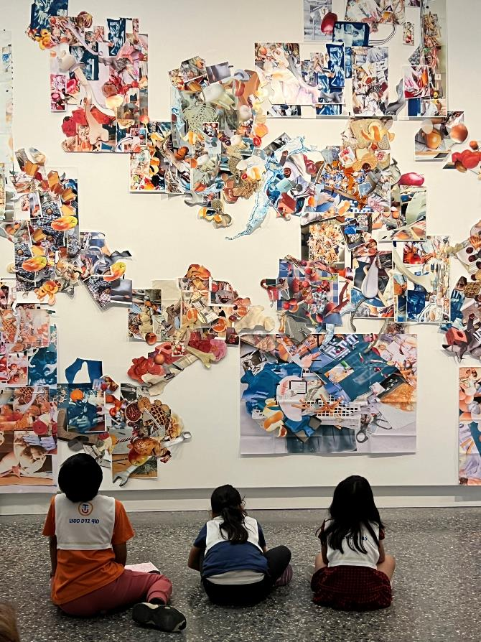
5. We have fun!
All artworks are different. You may see paintings, photographs, videos and sculptures. Some of the works will be small, others may be very big! You will see art created by local artists and art by artists from around the world.
Left: students sitting in front of Skye Wagner’s artwork Before Orange Peel, After Loose Teeth, Now Peanuts, 2023 in the National Photography Prize 2024.

Slide 23
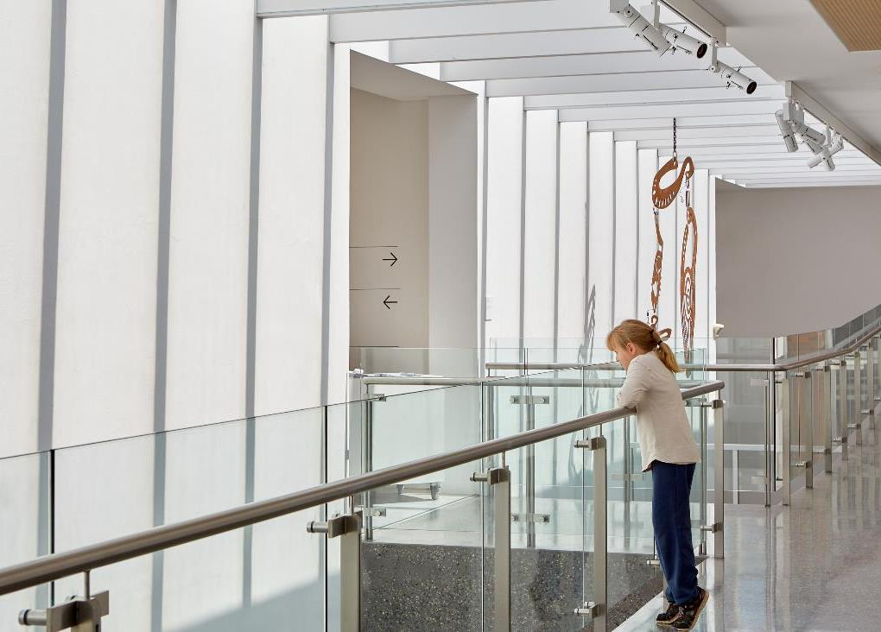
When we go upstairs there is glass on both sides so that we can see the art below. It may make us feel like we are up very high, but we are safe.
Left: someone standing on the Mezzanine, holding the handrail and looking down through the glass barrier at an artwork.
Photo: Jeremy Weihrauch

Slide 24
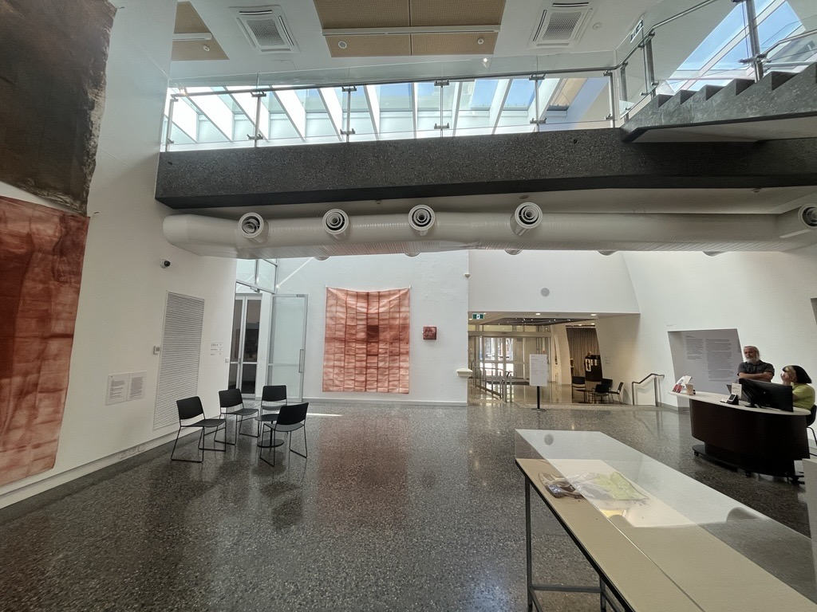
After we have finished out tour our guide will take us back to the entrance. We will collect our bags and wait for our teacher.
It is time to say goodbye to the Museum. We can visit again another time.
Left: the Atrium on the ground floor, looking towards the Dean Street exit.

Slide 25
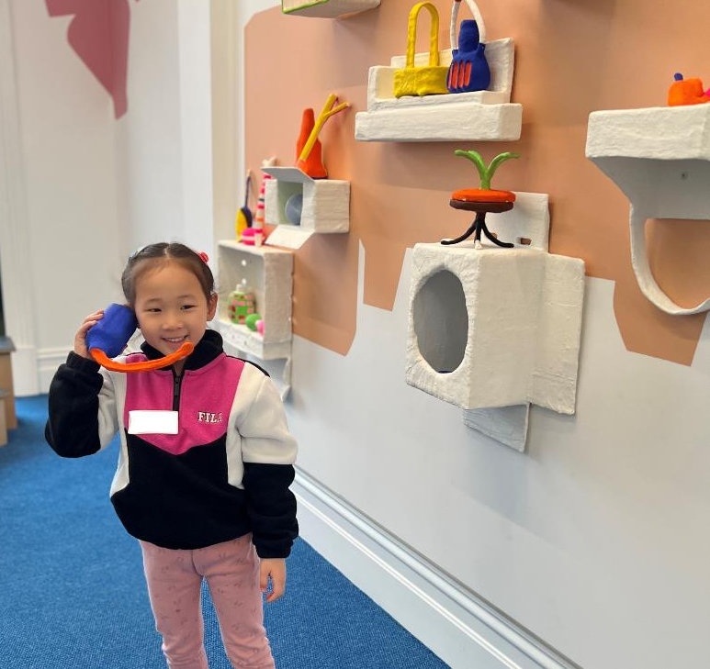
Please let us know if you have any questions before your visit, or feedback afterwards.
Left: a young visitor standing in the Kids Gallery pretending to speak on a telephone. Photo: Jeremy Weihrauch

Slide 26
please add your own optional slide(s) here!
Left: (description)

