Slide 1
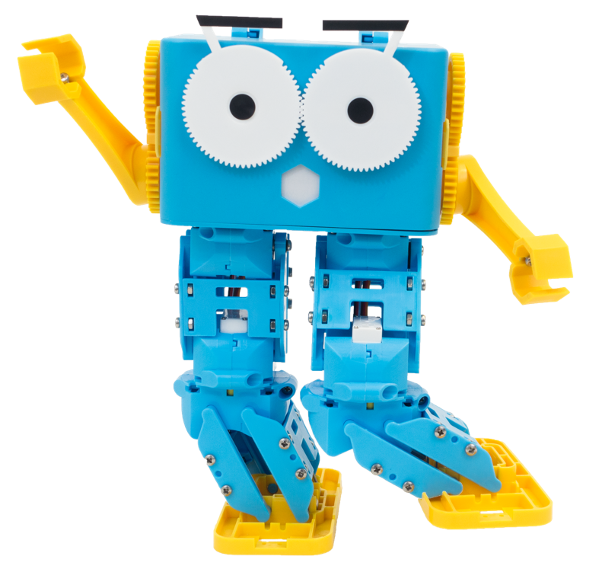
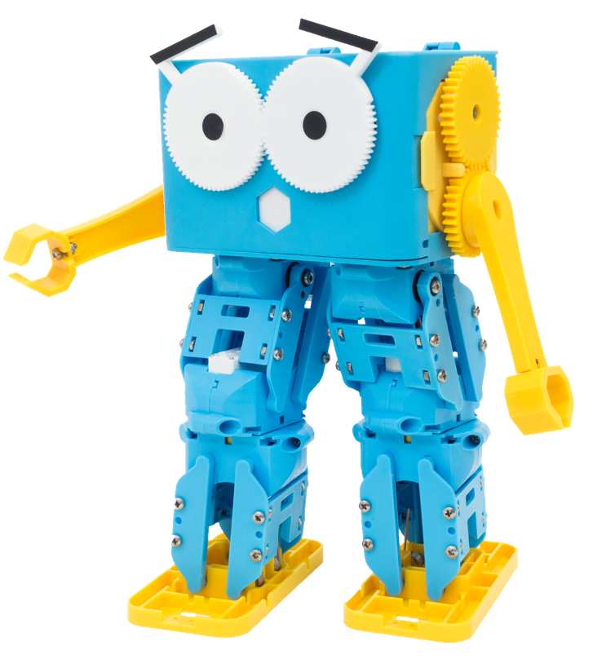
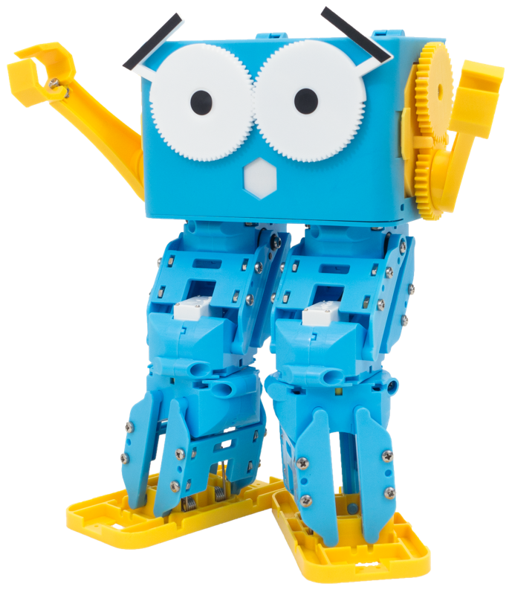
Marty the Robot

Slide 2
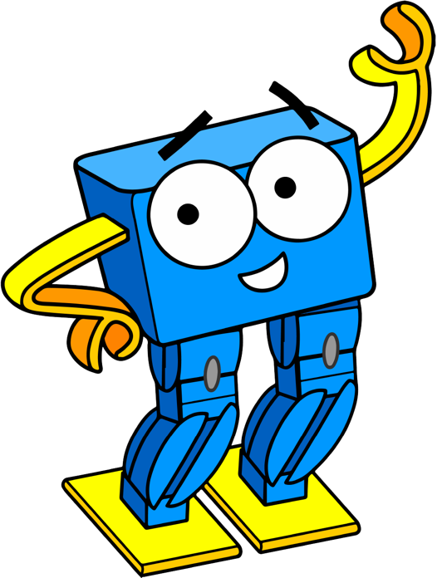
Lesson 1 – Bump Switches
By the end of this lesson you will be able to,
Describe bump switches as a way to add a sense of touch
Program Marty to respond to an obstacle in front of him and stop walking
Describe different ways we can attach bump switches and what they can help us with

Slide 3
What are the following examples of?

Slide 4
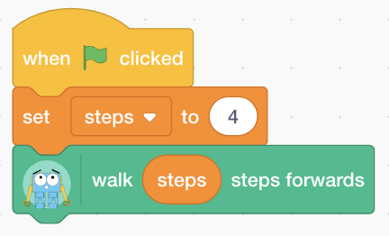
Notes:
Variables
What do they do? Store a value and remember it for us so that we can use it later on

Slide 5
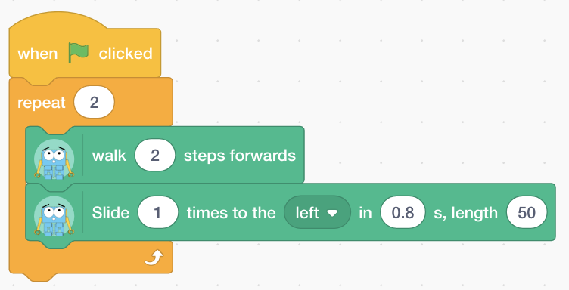
Notes:
Loops!
What do they do? Repeat some statements for us a certain number of times

Slide 6
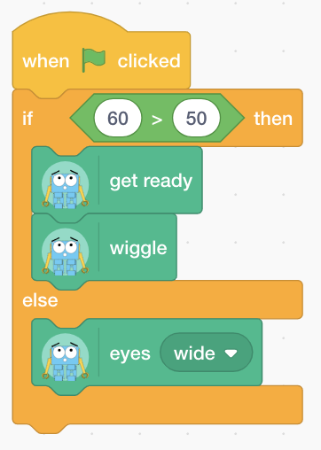
Notes:
If Statements
What do they do? Help us to make decisions by analyzing a condition and deciding what to do based on that

Slide 7
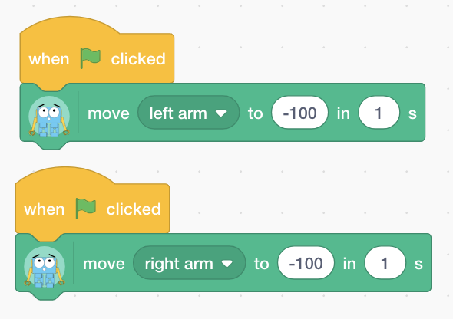
Notes:
Running in Parallel
What does this do? We can run two or more things at the same time by running them in parallel

Slide 8
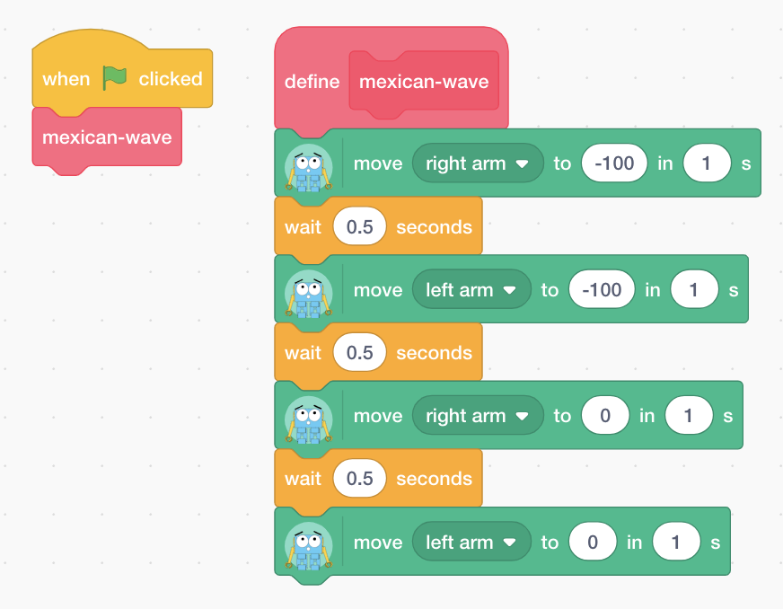
Notes:
Functions
What do they do? Functions are responsible usually for one thing so we can call that function to do something for us without having to repeat it every time in our code that we want to reproduce it

Slide 9
How do I get Marty to walk from…
Unknown Distance!
A
B
Notes:
How would we program Marty to walk from A to B when we don’t know how far that distance is? Usually we would test it out by walking Marty through the path and counting the number of steps.
All we know is that there is a wall at the end of the path but how do we tell Marty when to stop walking?

Slide 10
How do you decide when you have reached a spot or come across an obstacle? What about if you were blindfolded?
Notes:
Usually we would use our eyes to see what is around us to make decisions about what obstacles are around or whether we have reached where we wanted to be. However, Marty doesn’t have vision. So how would we do this if we were blindfolded, for example? We would use our sense of touch to feel around and work out what is in our way

Slide 11
Bump Switches!

Slide 12
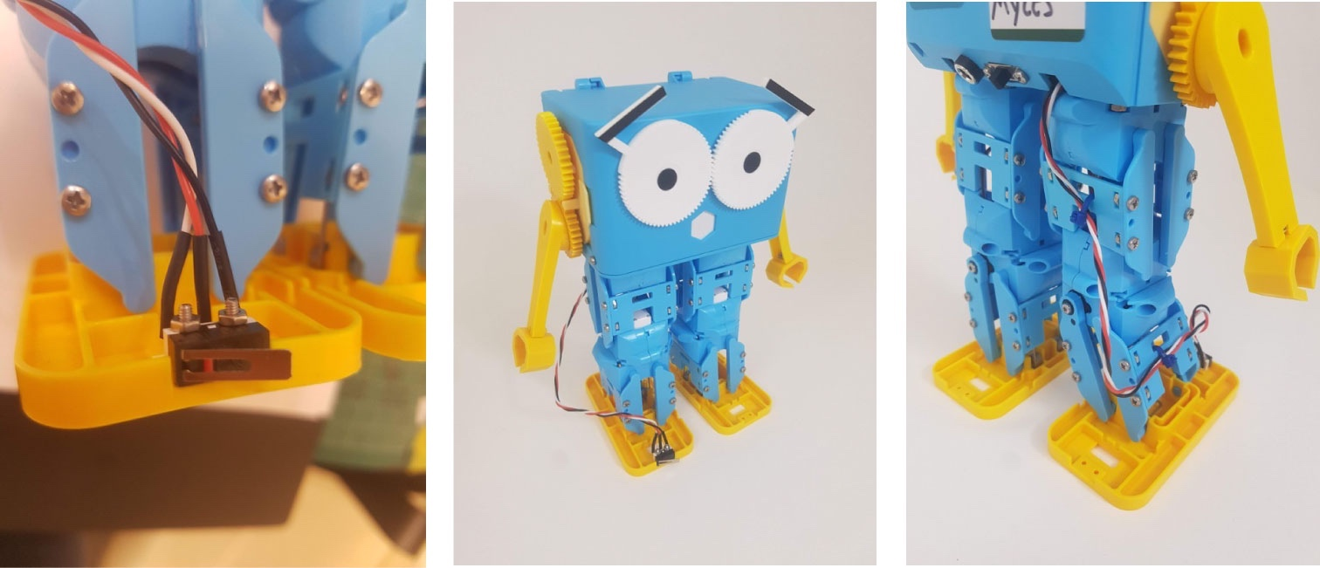
Clicking the switch will let us know that something has touched Marty, giving us a chance to respond!
Notes:
We attach the switch to a one of Marty’s body parts, when it is clicked then we know that he has touched something/something is in the way meaning that we can program him to respond!

Slide 13
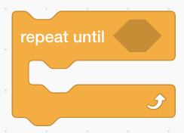
Try programming Marty to keep walking until the bump switch is clicked
When the bump switch reads 1 then that means it has been clicked!
HINT: you will need to use these blocks!
Notes:
Students should break up into groups and try programming Marty so that when the bump switch is clicked (and equals 1 on the GPIO input) then he should stop walking! Once students have completed this they should then move on to the card game where they need to think about different areas that we could attach the bump switch onto and what we could test for then!

Slide 14
Lesson 2 – Obstacle Course 2
By the end of this lesson you will be able to,
Create and select an appropriate obstacle course based on Marty’s size and functionality
Program Marty to go around an obstacle course using bump switches and sensing instead of using exact values and number of steps

Slide 15
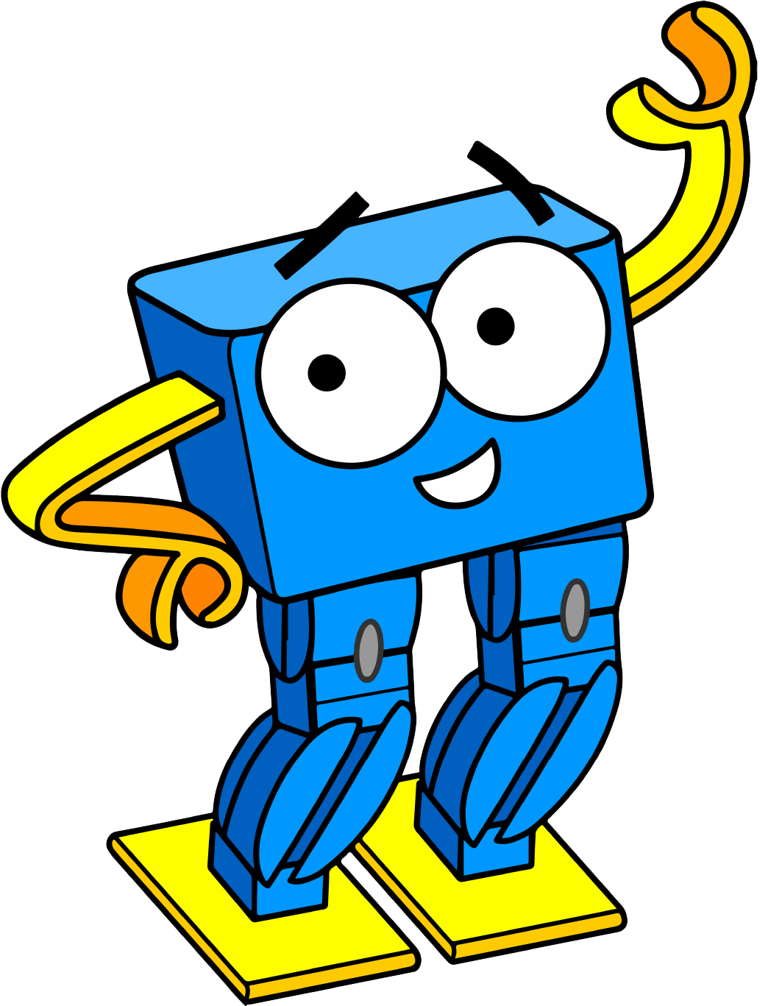
What are Bump Switches used for?
How do you think we could use them in an obstacle course?
Notes:
Last time we discussed how to give Marty a sense of touch by adding in bump switches so that when we collide with objects, the switch will be clicked and we will be able to react. In this lesson, we will be using this new sense of touch to go around an obstacle course where we don’t know the exact lengths of paths between sections so will have to use logic and bump switches to get around!

Slide 16
Try Designing your Own Obstacle Course!
Don’t forget to think about my size and what I can do!!
Notes:
Students should now have a shot at designing their own obstacle course in their workbooks whilst taking into consideration Marty’s size and functionalities

Slide 17
Now it’s your turn to program Marty!
Based on the obstacle course that we are using, plan and program a route for Marty to take that uses bump switches to help him to make decisions and respond to objects in the way!
Notes:
Students should break up into small groups and program Marty to walk until he bumps into an obstacle ; after students have finished this then they should experiment with placing the bump switch in different spots to see what other things we can look out for – there is a card game to help with this activity!

Slide 18
Lesson 3 – Secret Handshake
By the end of this lesson you will be able to,
Explore values that can be read from the motor sensors during different movements/forces
Understand when pressure is placed on the motor, then the value increases
Program Marty to carry out a handshake when someone places a small force on Marty’s arm

Slide 19
What will happen if we put force on the following objects?
Notes:
We encounter forces everyday with most of our actions. Anything that we push or pull has a force placed on it somewhere.

Slide 20
Notes:
When we kick a football, we apply a force onto it which makes it move – in the opposite direction that the force was from. For example, when I kick the ball it will roll away from my foot

Slide 21
Notes:
What about when we click a button? Usually something happens for example, maybe it turns lights or objects on/off

Slide 22
What did we use last time to give a sense of touch?
Notes:
Bump switches! Ask students how they worked and what we did with them?

Slide 23
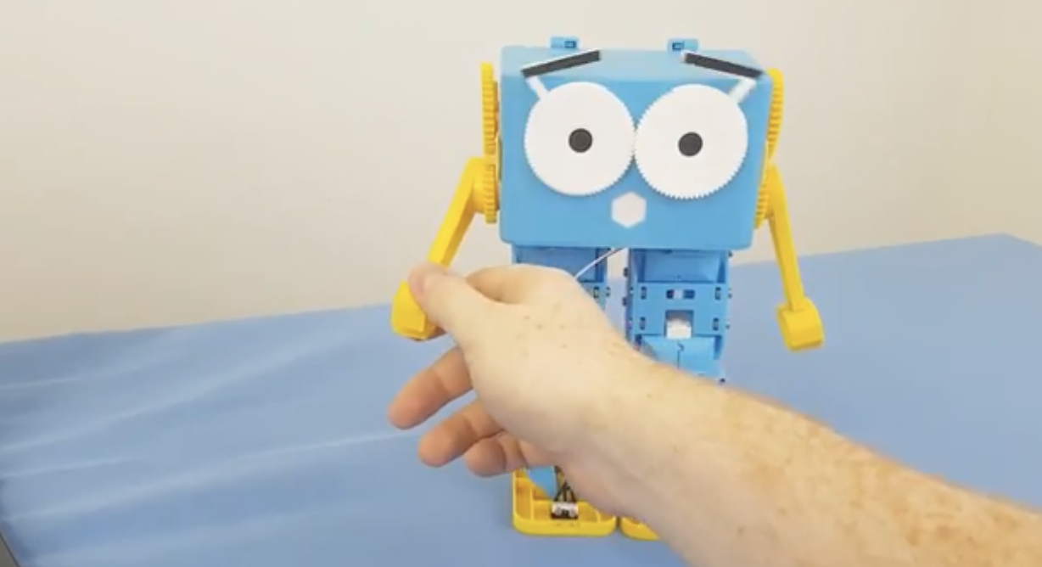
Some of Marty’s motors have sensors so we can monitor how much pressure is on some of the joints
Notes:
Some of Marty’s motors have sensors built in to measure the amount of pressure being placed on the joint so when we place a small bit of pressure on somewhere like Marty’s arms then the value in that sensor will increase so we know that something has happened and can respond!

Slide 24
Fill in the table below in your workbooks by storing the values as a variable to see how it changes when Marty does different things
Motor | Standing Still | Walking | Applying Small Force to Joint
Left Arm
Right Arm
You Decide
You Decide
Notes:
In your workbooks there is a table with the left and right arm and two spaces for additional joints to be investigated. Get students to store the values from the motor sensors into variables and monitor the values when Marty does different things. They will need to multiply the value by something like 1000 to get a more sensible number.

Slide 25
Now it’s your turn to program Marty!
When there is a small pressure applied to the right arm then raise the arm up and down for a handshake
Notes:
Now that students know roughly what values to expect when applying a force to the joints, create a small program where when Marty feels this pressure then move the arm up and down to carry out a handshake. Extensions could include adding in some emotion, lifting the arm up at the start to offer a handshake, …

Slide 26
Extend your program to create a secret handshake like the one below…
Notes:
Students should then plan and program a secret handshake that only their Marty and group knows. Encourage students to break it down into different movements that make up the handshake where each move in the handshake has its own function

Slide 27
Lesson 4 – Accelerometers
By the end of this lesson you will be able to,
Understand what an accelerometer is and what devices may use them
Monitor the values stored by the accelerometer in Marty
Create a small game where moving Marty around will move the sprite around on the screen

Slide 28
What is an Accelerometer?

Slide 29
A sensor that detects movement But what devices use accelerometers?
Notes:
Accelerometers are sensors that can help detect and measure movement across X, Y and Z axis. What devices use accelerometers? Students should complete the activity in their workbooks first before moving on to discuss as a class what everyone put!

Slide 30
Notes:
Mobile phones? YES! They can detect when you move them around. For example, when you lift up some phones they turn the screen on because they know you’ve tiled them upwards towards you!

Slide 31
Notes:
Washing Machines? YES! They have accelerometers included so that they can measure whether the load is balanced or not!

Slide 32
Notes:
Robots? SOME! There’s an accelerometer in Marty. They help robots to stay balanced when walking so that they don’t put too much weight over to one side and fall over!

Slide 33
Notes:
Games Controllers? SOME! If the controller can detect motion such as the wii remote then definitely yes! This is how they know that you have moved around to play games!

Slide 34
Notes:
Smart Watches? YES! Just like phones they can detect movement. Same example of lifting your wrist will usually light up the screen!

Slide 35
Notes:
Televisions? The TV itself probably won’t however, their REMOTE CONTROL will!

Slide 36
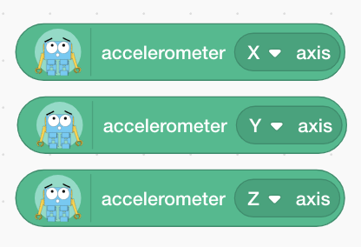
Fill in the table in your workbooks by storing the values as variables to see how it changes when Marty does different things

Slide 37
Which of the accelerometer values change when Marty moves from left to right?

Slide 38
Which of the accelerometer values change when Marty is moved up and down?

Slide 39
Which of the accelerometer values change when Marty is tilted forwards and backwards?

Slide 40
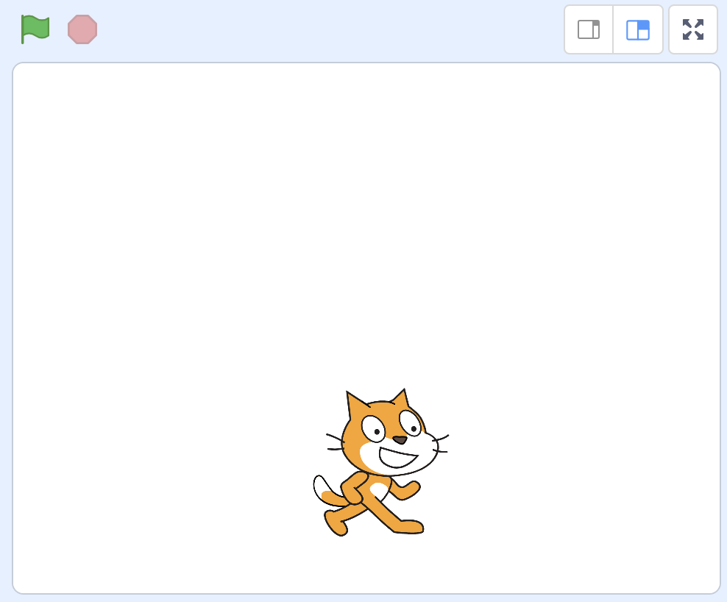
Challenge!
Create a small game in Scratch using Marty’s movements as input to the game.
Notes:
Students should now, working in their small groups, create a small game where when we move Marty a certain way then the sprite moves on the screen. For example moving Marty left will move the sprite left to catch or avoid something falling from the sky!

