Slide 1
Getting Loopy
Using Python
© 2020 Robotical Ltd. All Rights Reserved.
You may print copies of this document but please do not redistribute or alter.

Slide 2
Lesson 1 A Loopy Introduction
By the end of this lesson you will be able to,
Highlight where a loop/repeat statement could be used to reduce repetition
Examine the flow of your programs and draw flowchart diagrams
Write a for loop in Python with the correct parameters for the purpose

Slide 3
import martypy
marty = martypy.Marty(‘socket://192.168.8.122’)
marty.celebrate()
marty.walk(2)
marty.celebrate()
marty.walk(2)
Do any of your Python programs end up looking like this with repeating commands?
What could we use to reduce the amount of repetition in our Python programs?
Notes:
How many students have written something like this in Python where they have repeating pieces of code? What can we do to make our code simpler with less repetition?

Slide 4
Example
In your workbooks, write instructions in English for someone to walk in a square
Now highlight where the repetition is in your instructions
Notes:
Ask students to write instructions for someone to walk in a square using the space in their workbooks. Once they have done this and tested it out, ask them to highlight where the repetition occurs in the instructions

Slide 5
Introduction to Loops In English
REPEAT 4:
Wiggle
Take 2 steps forward
Repeat these actions 4 times
Re-write your instructions to make use of a loop
Notes:
Introduction to the theory behind loops where we basically tell a group of movements/actions to repeat a specific number of times, in the example in the slide the 2 actions will be repeated 4 times

Slide 6
Match the Shape to the Correct Instructions
Notes:
Students are tasked with deciding as a class which instruction matches to the shape…

Slide 7
REPEAT 6:
Take 3 steps forward
Turn left by 1$20°$
REPEAT 3:
Take 3 steps forward
Turn left by 60$°$
REPEAT 5:
Take 3 steps forward
Turn left by 1$08°$
Notes:
Students are tasked with deciding as a class which instruction matches to the shape…

Slide 8
How does it look in Python?
for x in range(4):
marty.walk(2)
marty.walk(7, ‘auto’, 120, 0, 1500)
What does this second walk command do?
Notes:
Like if statements, Python uses the indentation to understand what is happening when the program is translated into a language that the computer understands
Note that the second walk block is for turning on the spot only therefore the size of the step is 0 because we want Marty to do a turn without taking forwards/backwards steps

Slide 9
Write out your own definition of a loop & consider when you might need to use one
Notes:
In their workbooks, students should write down their own definition of a loop and describe some examples of when they think they might need to use a loop when coding (especially when using Marty)

Slide 10
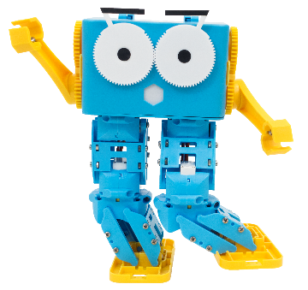
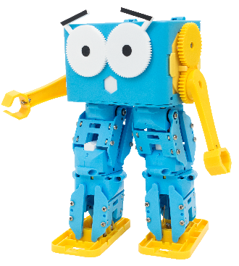
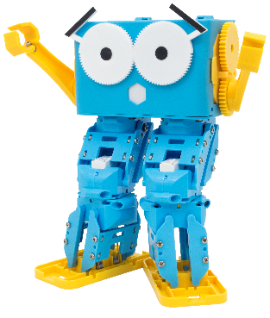
Live Demonstration Shape Guessing Program
Notes:
Run the example script with one of the Martys in your class to show the students that they will be creating a shape guessing program today

Slide 11
But first, planning
Do you think we should plan our programs before we start coding?
How do you think we could do this?
What kind of information do you think we would need to plan?
Notes:
Discuss with students whether they think we should be planning our programs before we start coding, how do they think we could do this and what information would we need to plan out?
Ideally students should start to recognize the need for testing their programs to work out the sequence of events to pick out what sections of the program rely on other sections and so on

Slide 12
Flowcharts
Start
Boil water
Remove tea bag
Add milk
Yes
Is tea strong enough?
Pour water into cup with tea bag
Stop
No
Notes:
Ask students what they think this chart shows, what process is it illustrating?
Ask students what they would change about this diagram, for example, does everybody have milk in their tea? Is this the order that they would make a cup of tea in

Slide 13
What makes a flowchart?
INPUT/OUTPUT
DECISION
PROCESS
START/STOP
Notes:
Ask students to match the types of symbols to the kind of thing that they represent based on the last example (note that the input/output symbol was not used but once they have guessed the others it will be the only one left over)
START/STOP blocks are to declare the start and end of a program
PROCESS blocks represent something that happens/an action or a procedure such as boiling water
DECISION represents when we need to check a condition like whether the tea has brewed
INPUT/OUTPUT represents asking the user for information (input) or presenting a message to the user (output)

Slide 14
Write your own definition of a flowchart

Slide 15
Draw a flowchart for your shape guessing program There is space in your workbooks

Slide 16
End of Lesson Reflection
One thing I enjoyed
What I found challenging

Slide 17
Lesson 2 Remotely Operated Marty
By the end of this lesson you will be able to,
Explain the flow of a program that has a while loop
Write a Python script using a while loop to repeat until a condition is met
Draw a flowchart for a program with a while loop
Explain why we might use robots for exploring new environments

Slide 18
How might you describe what a remotely operated robot is?
Write down your description in your workbooks
Notes:
Class discussion on what a remotely operated robot is and thinking about some examples
Use the pictures as prompts (for all three questions across the next couple of slides)

Slide 19
Why might we use robots to explore and do tasks instead of humans? Write down some reasons in your workbooks
Notes:
We have thought about some things robots could do for us, but why would we use robots instead of humans?
Safety? Time? Efficiency?

Slide 20
Describe environments better suited for robots to explore? Write down some keywords in your workbooks
Notes:
Are there certain environments that are better for robots to explore rather than humans?
Think about space or deserts or underwater to prompt students

Slide 21
Live Demonstration Text-Based Remote Control
Notes:
Run the example script for the text-based remote control for Marty and discuss with students that they are going to be creating a remote control where you enter text commands in to control Marty’s movements

Slide 22
What coding concepts do you think we will need?
If Statements? Loops? Variables?
Notes:
Discussion with students about how they think the program works and what coding concepts they suspect will be needed to complete the program

Slide 23
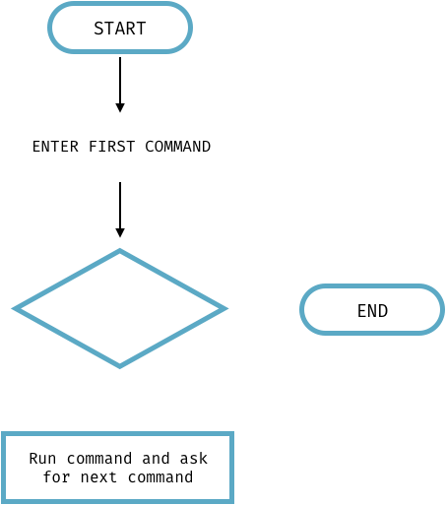
Let’s break it down…
Notes:
Lets look at the flow of the program to help us out.. So what is the first thing that happened when we started the program? We got asked to INPUT some information, so what shape should be around that first piece of text?

Slide 24
Let’s break it down…
Notes:
INPUT/OUTPUT block
Then what do we check each time? What condition is met?

Slide 25
Let’s break it down…
Has the user entered ‘STOP’
Notes:
Has the user entered STOP?
Where do the arrows go?

Slide 26
Let’s break it down…
YES
Has the user entered ‘STOP’
NO
Notes:
If the user HAS entered STOP then we END the program otherwise we run the command and ask for the next command

Slide 27
But! Do we know how many times this cycle is going to happen? Is the user going to enter exactly 5 commands each time then stop?
A FOR loop wouldn’t be possible here because we don’t know how many times to run the loop for
YES
Has the user entered ‘STOP’
NO
Notes:
BUT! Do we know how many times this cycle is going to happen?
We can’t use a for loop here because we don’t know how many times the loop will run for

Slide 28
A new kind of loop
number = 0
WHILE number < 5
Add 1 to number
print the number
Notes:
How would this kind of loop work? When will it stop running?
This loop will keep running until the number equals 5 (it is then no longer less than 5) and will print the number each time it loops through. It would be useful for students to write out what number gets printed during each iteration of the loop

Slide 29
Back to our remote control
WHILE command doesn’t equal ‘STOP’
Run command on Marty
Ask for the next command
Notes:
How would this kind of loop work? When will it stop running?
This loop is similar to what we will need to use in our remote control program where it will keep running until the command that is entered is STOP

Slide 30
In Python
import martypy
mymarty = martypy.Marty(‘socket://192.168.8.122’)
mymarty.hello()
steps = 0
while steps < 5:
marty.walk()
steps = steps + 1
Notes:
Here is one example of writing a while loop in Python, what do students think will happen if we run this? How many steps will Marty take?
Marty will keep walking until our variables has reached 5 as it’s stored value (6 steps in total)

Slide 31
Over to you…
Grab a device and a Marty and code your own text-based remote control using the flowchart we completed as a class earlier as a guide!

Slide 32
End of Lesson Reflection
One thing I learned
Something to ask next time
One thing I want to research about remotely operated vehicles/robots

Slide 33
Lesson 3 Guess the Number
By the end of this lesson you will be able to,
Describe examples of when a for loop is needed
Describe examples of when a while loop is needed
Design and build a program that uses both a for and while loop
Draw a flowchart for a program with nested loops

Slide 34
So far…
FOR loops vs WHILE loops
What’s the difference?
Notes:
Ask students to recap from the last couple of lessons where we have used a mixture of for and while loops but what are the difference between these two kinds of loops? What have we used them for so far? When might you prefer to use one over the other?

Slide 35
In pairs, decide which kind of loop would be used in the following examples
Notes:
Following the workbooks (and examples in the next slide) in pairs students should decide whether a for or a while loop would be best to use based on the context of the program

Slide 36
Scenario 1
Repeatedly asking the user to enter the correct password
WHILE
Notes:
What did students select for this answer? The correct answer is that you would need a WHILE loop because you don’t know how many times it will take a user to guess the password correctly (although students could argue that there should only be a set limit of guesses before the user shouldn’t be allowed to enter any more guesses…)

Slide 37
Scenario 2
Repeating arm movements to recreate a handshake motion
FOR
Notes:
What did students select for this answer? The correct answer is that you would need a FOR loop because you know how long you want the handshake to last for so you can decide how many times the arms will need to do the up and down movement

Slide 38
Scenario 3
Letting the user enter commands a specific number of times
FOR
Notes:
What did students select for this answer? The correct answer is that you would need a FOR loop and the hint here is that we mention that the user will get to enter commands a SPECIFIC number of times so we know how many times to loop and ask for input from users

Slide 39
Scenario 4
Asking the user for input until they enter stop
WHILE
Notes:
What did students select for this answer? The correct answer is that you would need a WHILE loop as we found out in our last lesson as we created a program like this as we are waiting for a condition to become true and we don’t know beforehand how many times the user will enter a command before they enter ‘stop’

Slide 40
Live Demonstration Guess the Number
Notes:
Run the example script for the guess the number game where a random number is selected and the player guesses the number, Marty will respond and let the user know whether they have entered a number that is lower or higher than the selected number
You might want to play the games a few different times to demonstrate that it is a different number selected randomly each time and so that students understand how the game works

Slide 41
Over to you…
Design a flowchart diagram for guess the number
Code your game in Python
Notes:
Students will need to design a flowchart diagram in their workbooks for guess the number game before grabbing a Marty and device to start coding the game with

Slide 42
End of Lesson Reflection
One thing I didn’t understand
One thing I like about my game so far

Slide 43
Lesson 4 Guess the Number Continued
By the end of this lesson you will be able to,
Describe examples of when a for loop is needed
Describe examples of when a while loop is needed
Design and build a program that uses both a for and while loop
Draw a flowchart for a program with nested loops
Differentiate between a for and while loop

Slide 44
Guess the Number
What problems are you facing?
How are you going to extend the game?
How can you make the game more challenging?
Use the space in your workbooks to keep planning
Notes:
Students should reflect on the game that they started coding in the last lesson by considering what problems they are facing and if they have any ideas on how to extend the game or make it more challenging for the players

Slide 45
Struggling to think of extension ideas?
Handling text input from the user instead of numbers
Only allow the player a limited number of chances to guess correctly
Try changing the range the random number could be selected from
Give the player a fact about the select number like if it’s an odd/even

Slide 46
End of Lesson Reflection
One thing I’m proud of in my game
One challenge that I tackled

