Slide 1
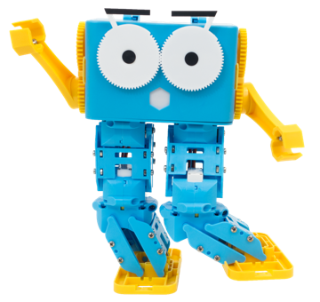
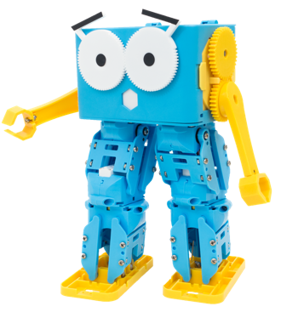
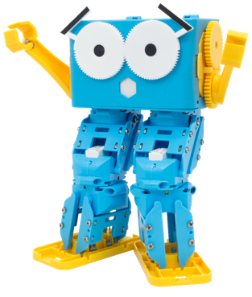
Marty the Robot

Slide 2
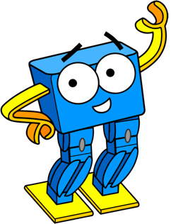
Lesson 1 – Programming Marty with Python
By the end of this lesson you will be able to,
Run Python commands to move different Marty body parts
Describe the outcome different commands will have on Marty and the environment

Slide 3
Is a Printer a Robot??
Notes:
Ask students what they think a robot is
Some may say a machine or something that does something/follows instructions
So does that make a printer a robot??

Slide 4
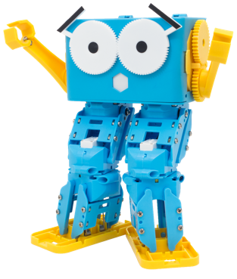
What is a Robot?
A robot is a machine that can carry out a number of tasks automatically that can usually be programmed by a computer.
Notes:
Explain to students that there isn’t one single definition of what a robot is, lots of people can’t seem to agree on the term and robotics keeps developing every single day so the definition changes very frequently based on new research and findings

Slide 5
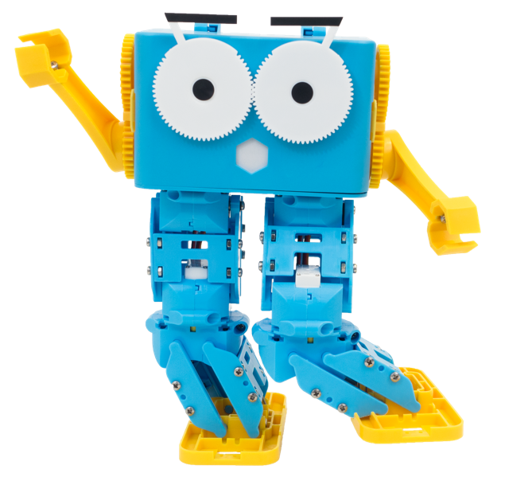
What movements do you think Marty can do?

Slide 6
Predict what you think the following commands will do…

Slide 7
mymarty.walk()
Notes:
Marty will take some steps (2 to be precise)

Slide 8
mymarty.kick(‘right’)
Notes:
Marty will kick the right foot

Slide 9
mymarty.stop()
Notes:
Marty will stop moving

Slide 10
mymarty.lean(‘forward’,200,3000)
Notes:
Marty will lean forwards

Slide 11
mymarty.sidestep(‘left’,26,3000)
Notes:
Marty will take a sidestep to the left

Slide 12
mymarty.circle_dance(‘right’,3000)
Notes:
Marty will do a circle dance going from right to left

Slide 13
In groups, you will be programming Marty to get into different poses. But first, we need to set-up and connect to Marty

Slide 14
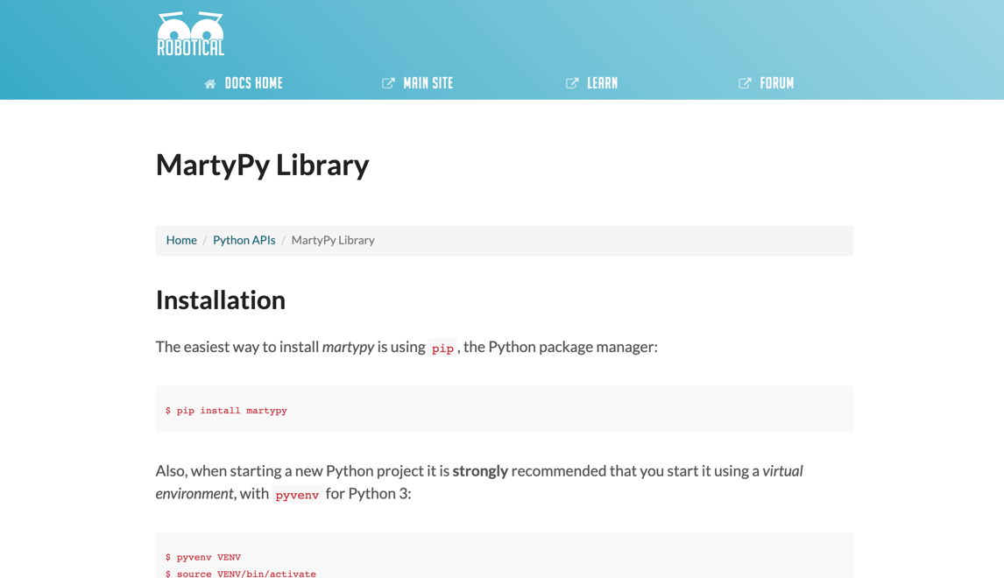
Grab the MartyPy documentation
Notes:
This can be found online https://martytherobot.com/users/using-marty/program/python/

Slide 15
Open up IDLE

Slide 16
Import MartyPy
import martypy

Slide 17
Connect to Marty Make sure to change the IP address
mymarty = martypy.Marty(‘socket://192.168.8.XXX’)
Notes:
You may need to use our getting started guide on how to find Marty’s IP address – the easiest way, however, is to scan for Martys on the command hub using the Marty the Robot mobile app

Slide 18
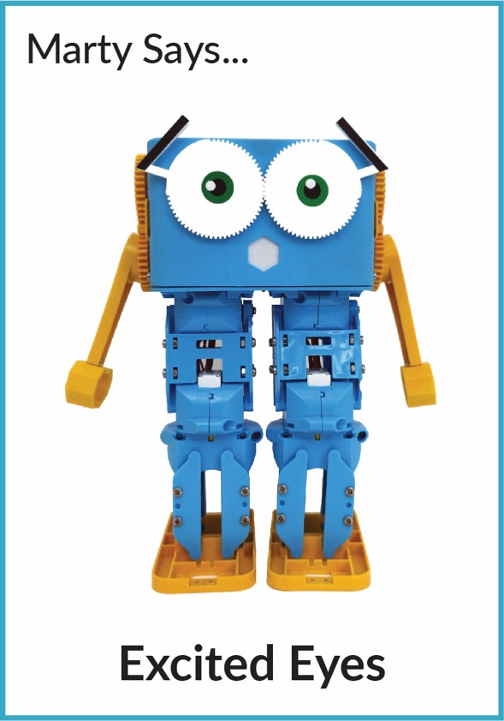

Slide 19
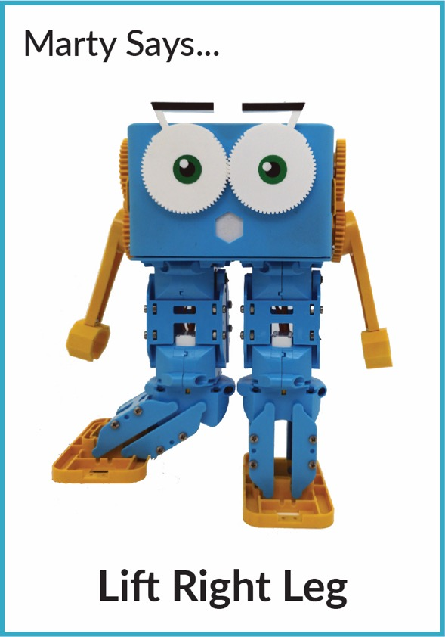

Slide 20
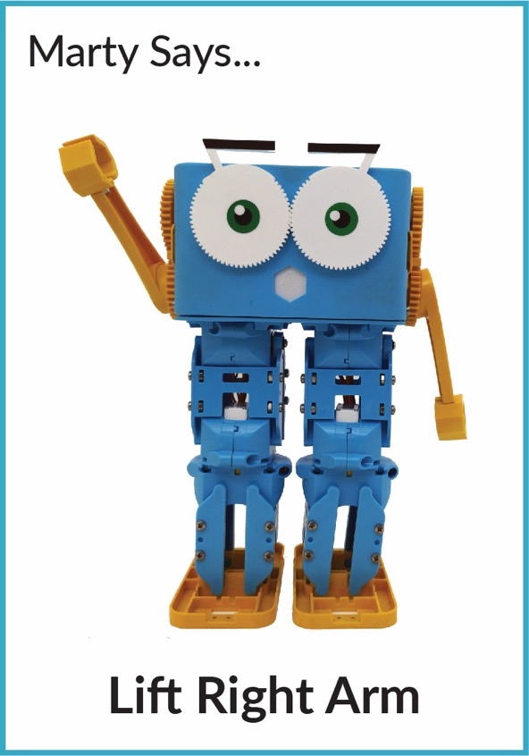

Slide 21
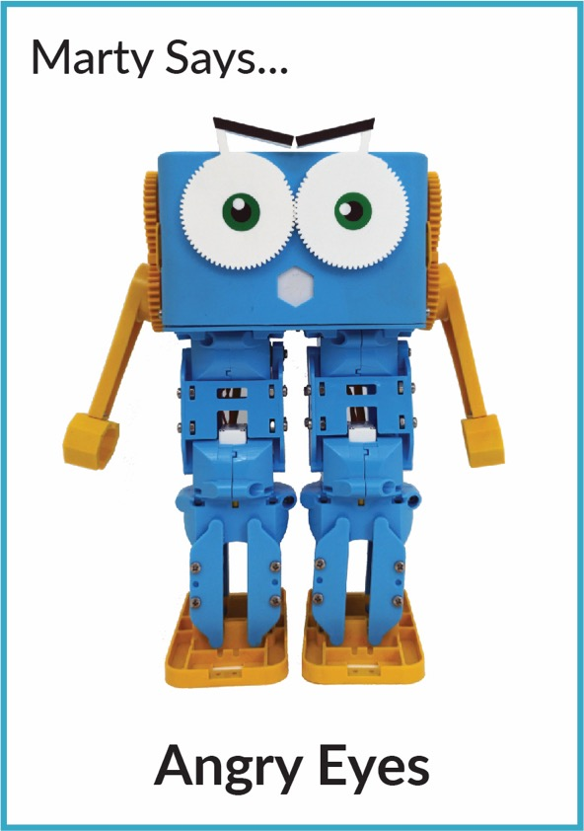

Slide 22
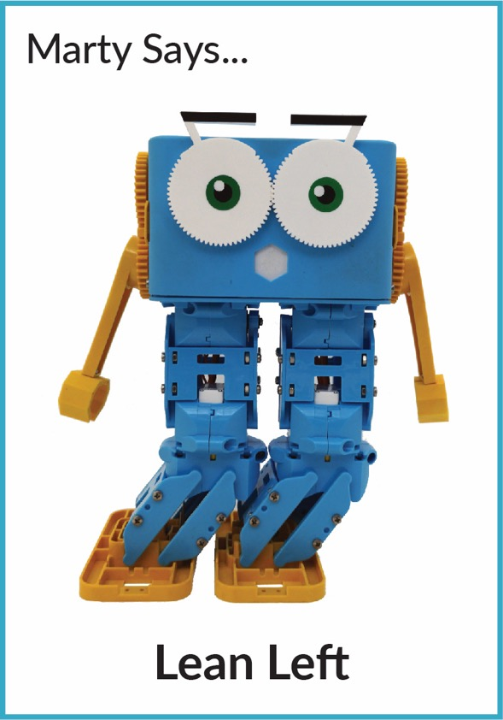
Notes:
Students should then try some others and draw their own Marty Says card and challenge other teams to complete the pose

Slide 23
Lesson 2 – Exploring MartyPy Documentation
By the end of this lesson you will be able to,
Build upon knowledge of movements and the functionality that Marty has
Create their own version of the MartyPy documentation
Explore the importance of documentation

Slide 24
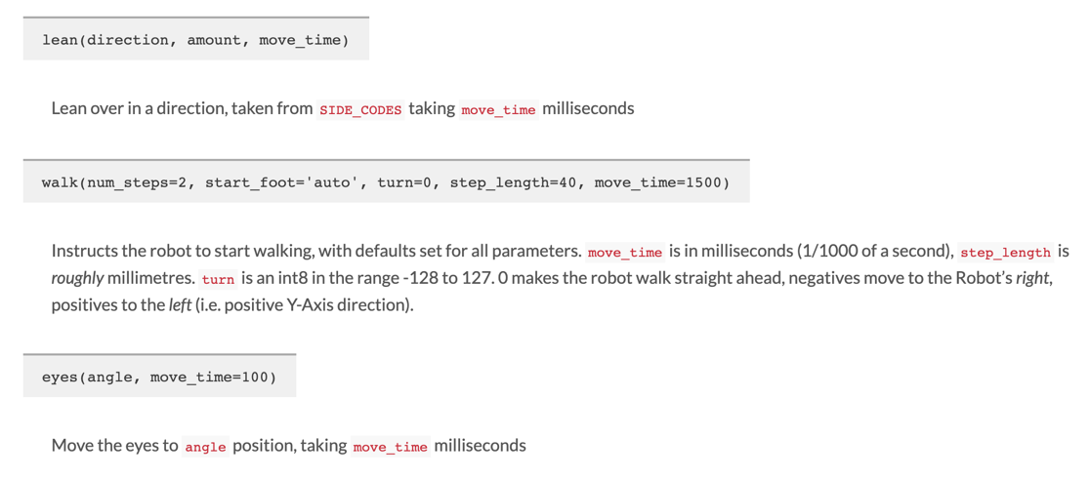
Why do we need instructions and documentation?
Notes:
Give students some time to look at the two programs below and write down in their workbooks what they immediately spot as being different

Slide 25
What makes good instructions & documentation?
Notes:
Ask students what makes good instructions and what makes bad, unhelpful instructions

Slide 26
Notes:
Looking at the two images, how helpful do students think they are for documenting some programming langages/libraries

Slide 27
Notes:
Looking at the two images, how helpful do students think they are for documenting some programming langages/libraries

Slide 28
Try making your own MartyPy Handbook!
Notes:
Students should then try to make their own handbooks – focusing on clear instructions on how each method works and including some example programs using that command

Slide 29
Lesson 3 – Marty Python Dance-Off
By the end of this lesson you will be able to,
Create small Python scripts using IDLE or an equivalent editor
Explore the use of combining multiple commands to get a sequence of movements happening

Slide 30
Quick Quiz!

Slide 31
marty.lean(‘left’,200,1500)
marty.walk(5)
marty.eyes(-90,100)
Notes:
Which of these commands will move marty into the pose on the left?

Slide 32
marty.move_joint(3,10,1500)
marty.lean(‘left’,100,1500)
marty.eyes(90,100)
Notes:
Which of these commands will move marty into the pose on the left?

Slide 33
To create a Python file you need to do the following
Select File -> New File
Should should create a new small window – this is where you will type in your program
Select File -> Save and pick a sensible place to save the file
To run the file, select Run -> Run Module
Notes:
We have so far only been running commands one at a time but for our dance routine we’re going to need to save a script that we can run all in one go
These are some instructions for how to create a file to save python scripts in and then student groups can start to play the movement dice game!

Slide 34
In groups, choreograph a dance routine for Marty

Slide 35
Lesson 4 – Shoot a Music Video
By the end of this lesson you will be able to,
Create small Python scripts using IDLE or an equivalent editor
Explore the use of combining multiple commands to get a sequence of movement happening
Plan, design and choreograph movement, scenery and music to create a music video

Slide 36
Shoot a Music Video!

