Slide 1
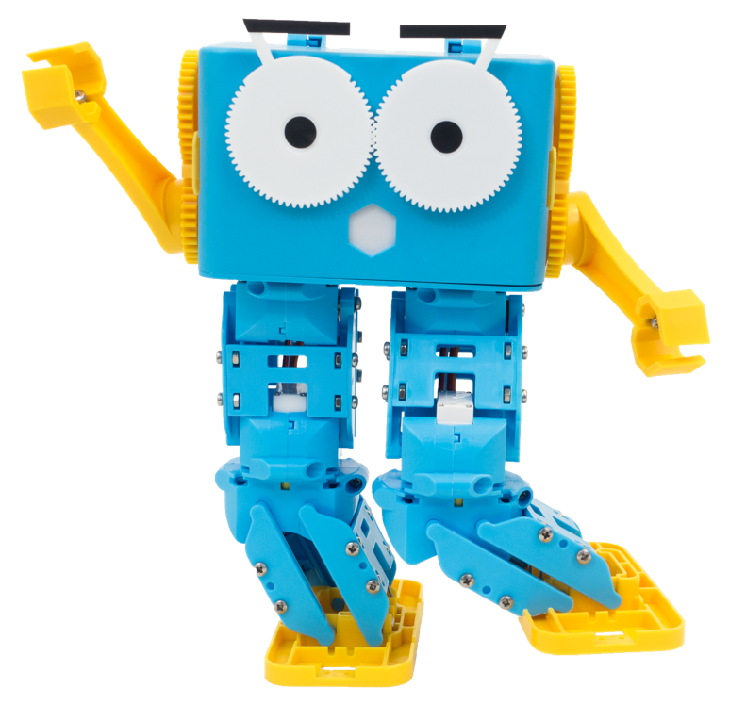
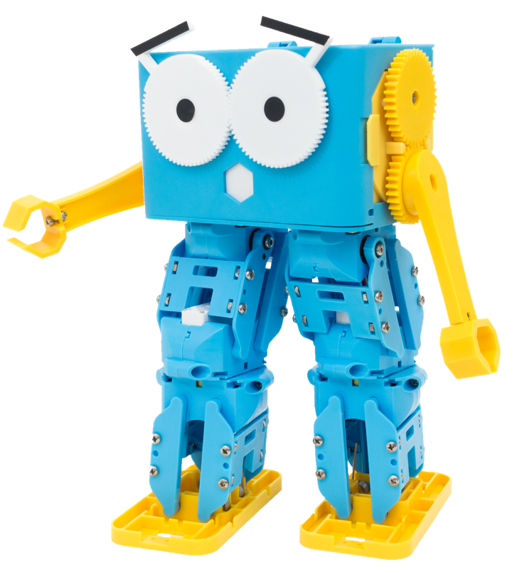
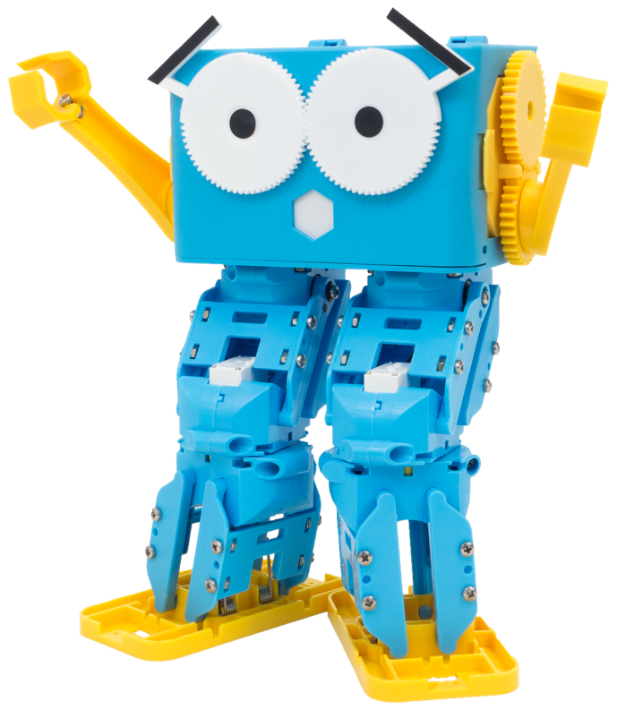
Marty the Robot

Slide 2
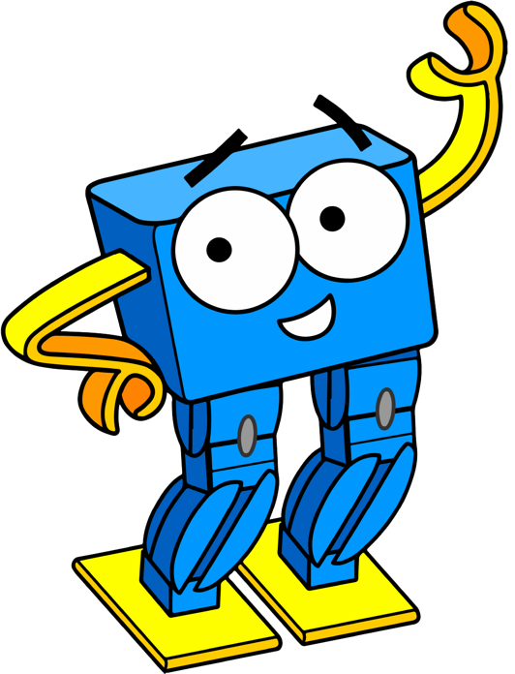
Lesson 1 – Scratch Revision
By the end of this lesson you will be able to,
  Describe the functionality of some Scratch blocks, particularly from the Control menu
  Create a small personal project of your choice, featuring a specific Scratch block

Slide 3
Write down as many Scratch blocks as you can think of in your workbook!
On green flag clicked
Repeat
If then else
Ask
Wait until
Repeat until
Variables
Functions
Forever
Wait
Any more?
Notes:
Give students a few minutes to write down some scratch blocks that they can think of – you can make it more challenging and only give them 20 seconds or so… afterwards you can go over different ones people got and check to see what ones on the board people did/didn’t get!

Slide 4
Try connecting the programming concept to the short description in your workbooks!
Notes:
We’re going to recap some of the different programming concepts that we’ve covered so far in previous Scratch lesson packs
Students should first have a go in their workbooks before going over it as a class

Slide 5
If Statements
Helps us to make decisions using logic
Notes:
If statements

Slide 6
Repeat Statements (Or Loops!)
A way to do the same thing a number of times
Notes:
Repeat statements/loops

Slide 7
User Input
Asking someone questions in our program
Notes:
User input

Slide 8
Variables
For storing and remembering values for us
Notes:
Variables

Slide 9
Functions
Makes our programs a lot more modular
Notes:
Functions

Slide 10
In your groups, you will receive one of the five programming concepts we just talked about. Your challenge is to create a program that uses that concept with Marty!

Slide 11
Lesson 2 – Scratch vs. Python
By the end of this lesson you will be able to,
  Describe what the main differences are between Scratch and Python
  Draw links between Scratch blocks and Python commands
  Put together printed out programming blocks to guide someone out of a maze

Slide 12
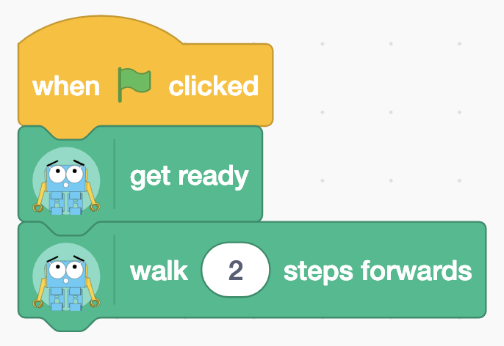
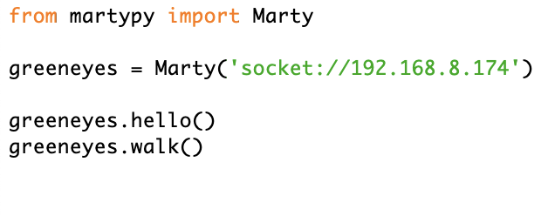
What’s different about these 2 programs?
Write the differences down in your workbooks
Notes:
Give students some time to look at the two programs below and write down in their workbooks what they immediately spot as being different

Slide 13
Scratch
Block-based programming
Colours represent different action themes
Requires an event to run the connected blocks
Edit things like the number of steps by changing the value of the white labels
Drag and drop to create programs
Notes:
Scratch overview

Slide 14
Python
Colours represent different keywords
Text-based programming
Connecting to Marty is part of our program now
Commands are typed
Change values in brackets to have more control over movements/what happens
Notes:
Python overview

Slide 15
What’s other programming languages do you know?
Write them down in your workbooks
Notes:
Ask students to think about what other programming languages they have used and write them down in their workbooks – maybe they have used the micro:bit and makecode to code it? Or done some other block based programming with something like tynker

Slide 16
Using the printed out Scratch blocks as a guide, write down the algorithm to getting out of the maze in your workbooks!
Notes:
Solve the maze with the printed scratch blocks

Slide 17
Now swap with another group and get them to check over your algorithm and make sure it works!
Notes:
Move around and test another teams algorithm to make sure that it works

Slide 18
Repeat the task but this time using the printed out Python commands and think about what values you need to use to go different ways!
Notes:
Repeat again but this time with the printed python commands – solve the maze and test another group’s solution!

Slide 19
Answer the following questions in your workbooks
Did you come across any problems whilst designing an algorithm to get out of the maze?
How did you solve those problems?
How similar were your two algorithms for solving the maze?
Notes:
Ask students to answer the three reflection questions in the workbooks and leave some time for them to share what they have put with the class

Slide 20
Lesson 3 – Introducing Python
By the end of this lesson you will be able to,
  Become familiar with the IDLE editor so that students can start the program and interact with the Python shell
  Describe how to connect to a Marty
  Use Marty commands from the MartyPy library to control Marty

Slide 21
Hold up the matching Python command for these Scratch blocks…

Slide 22
Notes:
Marty.celebrate()

Slide 23
Notes:
Marty.walk(2,’auto’,0’-40,1500)

Slide 24
Notes:
Marty.hello()

Slide 25
Notes:
Marty.walk(5,’auto’,-100,0,1500)

Slide 26
Notes:
Marty.walk(1)

Slide 27
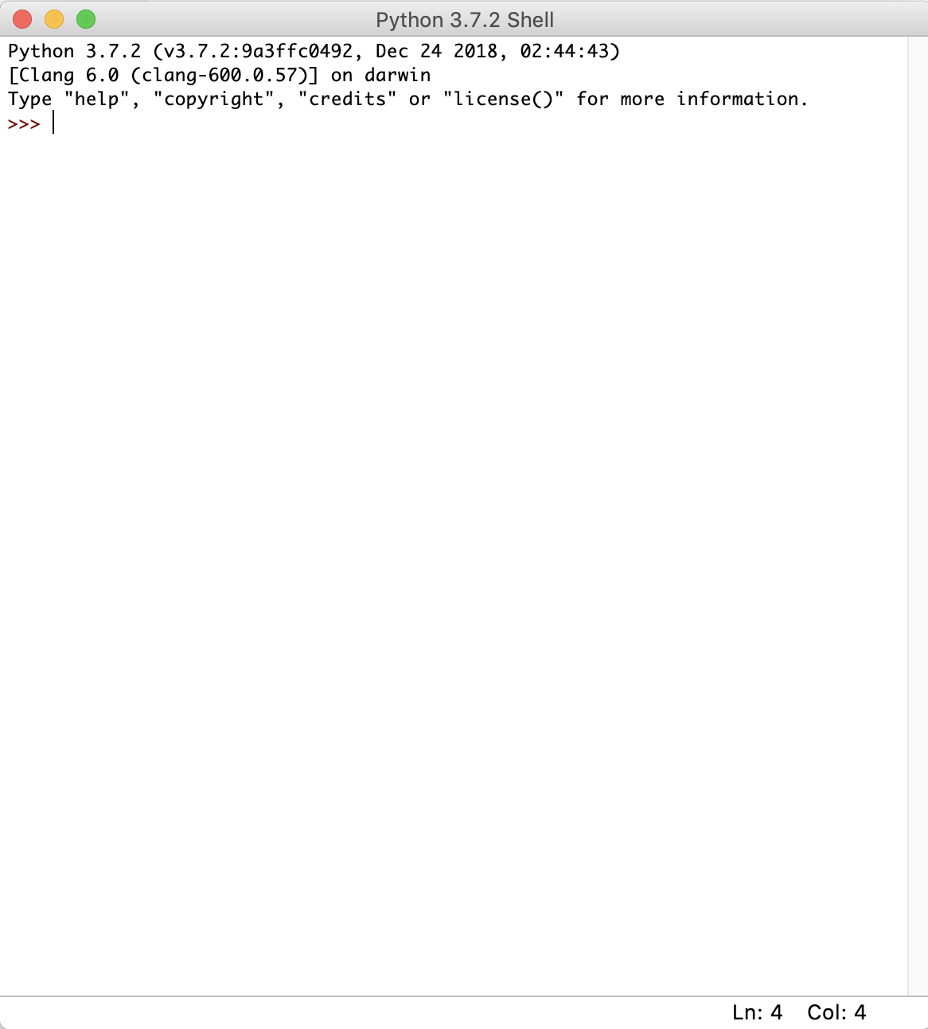
Open up IDLE
You should see this screen
This is the Python shell – we can type commands directly into it, hit enter and the command will be run straight away

Slide 28
Import MartyPy and connect to your Marty
from martypy import Marty
marty = Marty(‘socket://192.168.8.x’)
# Change IP Address to connect to your Marty
Notes:
Get students to enter the next two lines into their shell but ensure that they enter the correct IP address for the Marty that their team is working with

Slide 29
Can you program Marty into the following poses?
You may want to check out the MartyPy documentation

Slide 30
Notes:
Marty.walk(1)

Slide 31
Notes:
Marty.walk(1)

Slide 32
Notes:
Marty.walk(1)

Slide 33
To create a Python file you need to do the following
Select File -> New File
Should should create a new small window – this is where you will type in your program
Select File -> Save and pick a sensible place to save the file
To run the file, select Run -> Run Module
Notes:
These are some instructions for how to create a file to save python scripts in and then student groups can start to play the movement dice game!

Slide 34
In groups, roll the dice and see if you can complete all of the challenges!

Slide 35
Lesson 4 – Debugging Python
By the end of this lesson you will be able to,
  Describe the different techniques that we can use to debug programs in Python
  Given a short Python script, analyse and debug so that it runs as expected

Slide 36
What’s wrong with this piece of Python code?
from martypy import Marty
marty = Marty(‘socket://192.168.8.174’)
marty.hello()
greeneyes.celebrate()
Notes:
Greeneyes hasn’t been defined – we have name our marty, marty!

Slide 37
What’s wrong with this piece of Python code?
from martypy import Marty
marty.hello()
marty.walk(4)
Notes:
We haven’t connected to any martys!

Slide 38
What’s wrong with this piece of Python code?
from martypy import Marty
marty = Marty(‘socket://192.168.8.174’)
marty.hello(1500)
Notes:
Marty.hello doesn’t take any values!

Slide 39

When programming, do your programs always work the first time you run them?
Why not?
How do you know when you have a bug in your code?
How do you fix them?
Why do we need to debug and test our programs anyway?

Slide 40
Working together as a team, decrypt the clues to debug the Python scripts and find the treasure!

