Slide 1
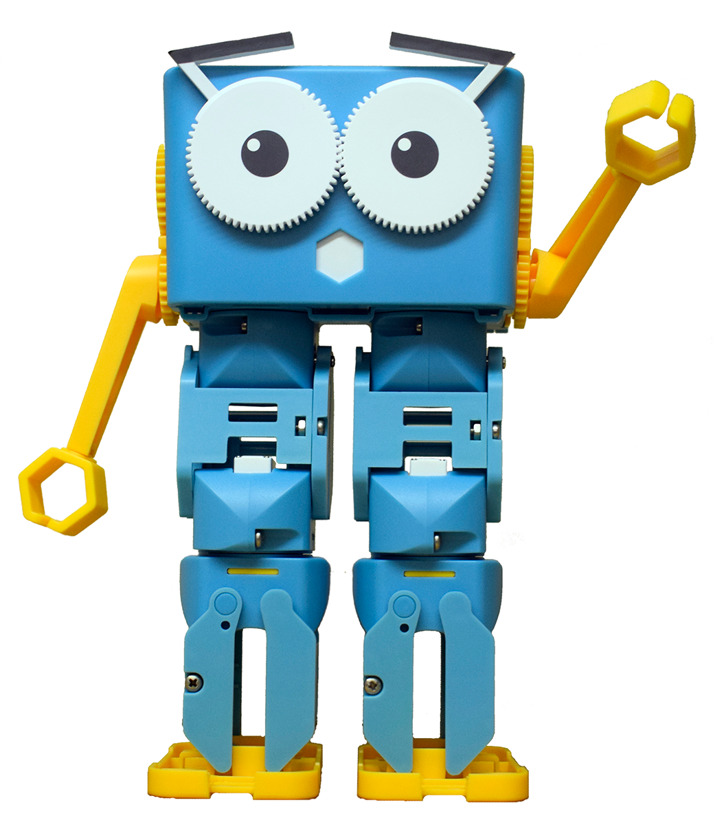
Marty the Robot

Slide 2
Starting with Python
By the end of this lesson, you will be able to:
Use the IDLE editor so that you can start the program and interact with the Python shell
Describe how to connect to a Marty
Use Marty commands from the MartyPy library to control Marty

Slide 3
Hold up the matching Python command for this Scratch block
Notes:
marty.celebrate()

Slide 4
Hold up the matching Python command for this Scratch block
Notes:
marty.walk(2,’auto’,0’-40,1500)

Slide 5
Hold up the matching Python command for this Scratch block
Notes:
marty.getready()

Slide 6
Hold up the matching Python command for this Scratch block
Notes:
marty.walk(5,’auto’,-100,0,1500)

Slide 7
Hold up the matching Python command for this Scratch block
Notes:
marty.walk(1)

Slide 8
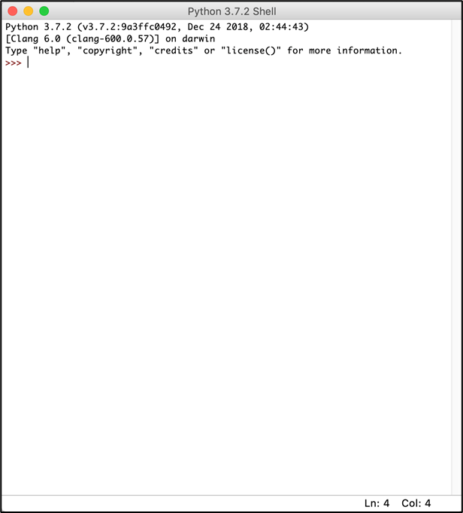
Open up IDLE
You should see this screen
This is the Python shell – we can type commands directly into it, hit enter and the command will be run straight away

Slide 9
Import MartyPy and connect to your Marty
from martypy import Marty
marty = Marty(‘wifi’, ‘192.168.8.x’)
# Change IP Address to connect to your Marty
Notes:
Get learners to enter the next two lines into their shell but ensure that they enter the correct IP address for the Marty that their team is working with

Slide 10
To create a Python file you need to do the following
Select File -> New File
You should create a new small window – this is where you will type in your program
Select File -> Save and pick a sensible place to save the file
To run the file, select Run -> Run Module
Notes:
These are some instructions for how to create a file to save python scripts in and then student groups can start to play the movement dice game! Ensure they have correct extension for the file.

Slide 11
In groups, roll the die and see if you can complete all of the challenges!

