Slide 1
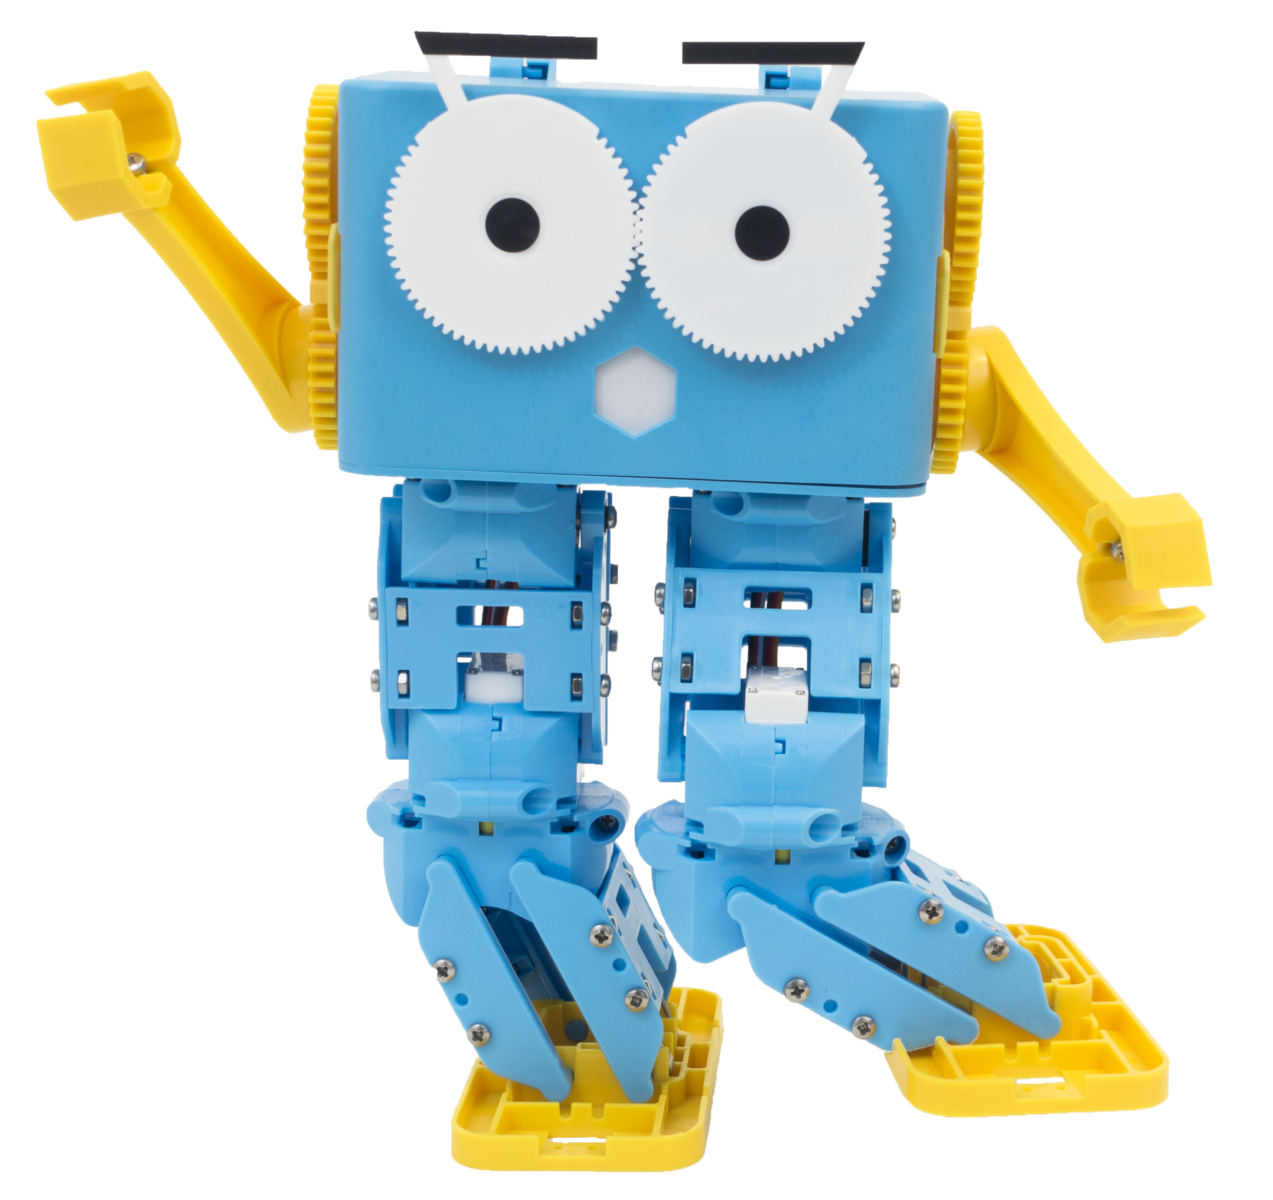
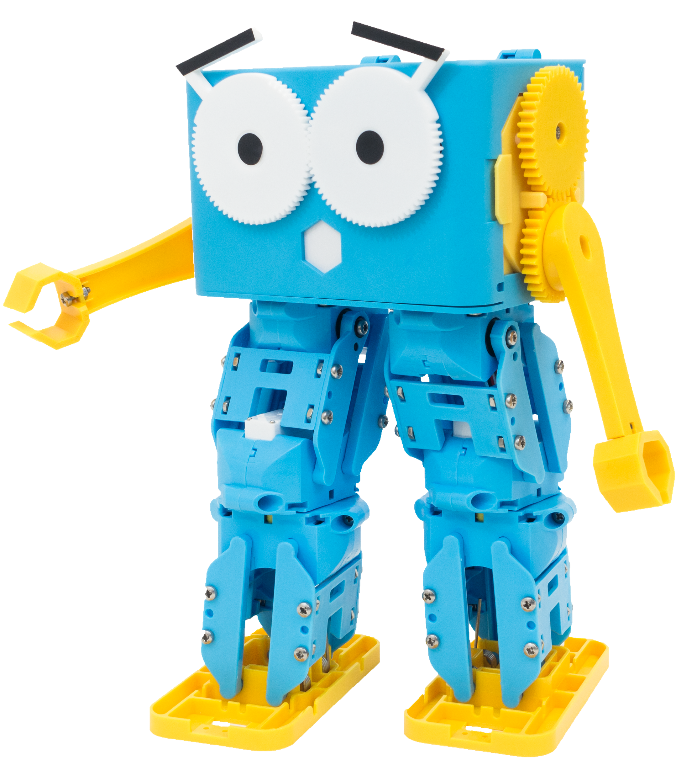
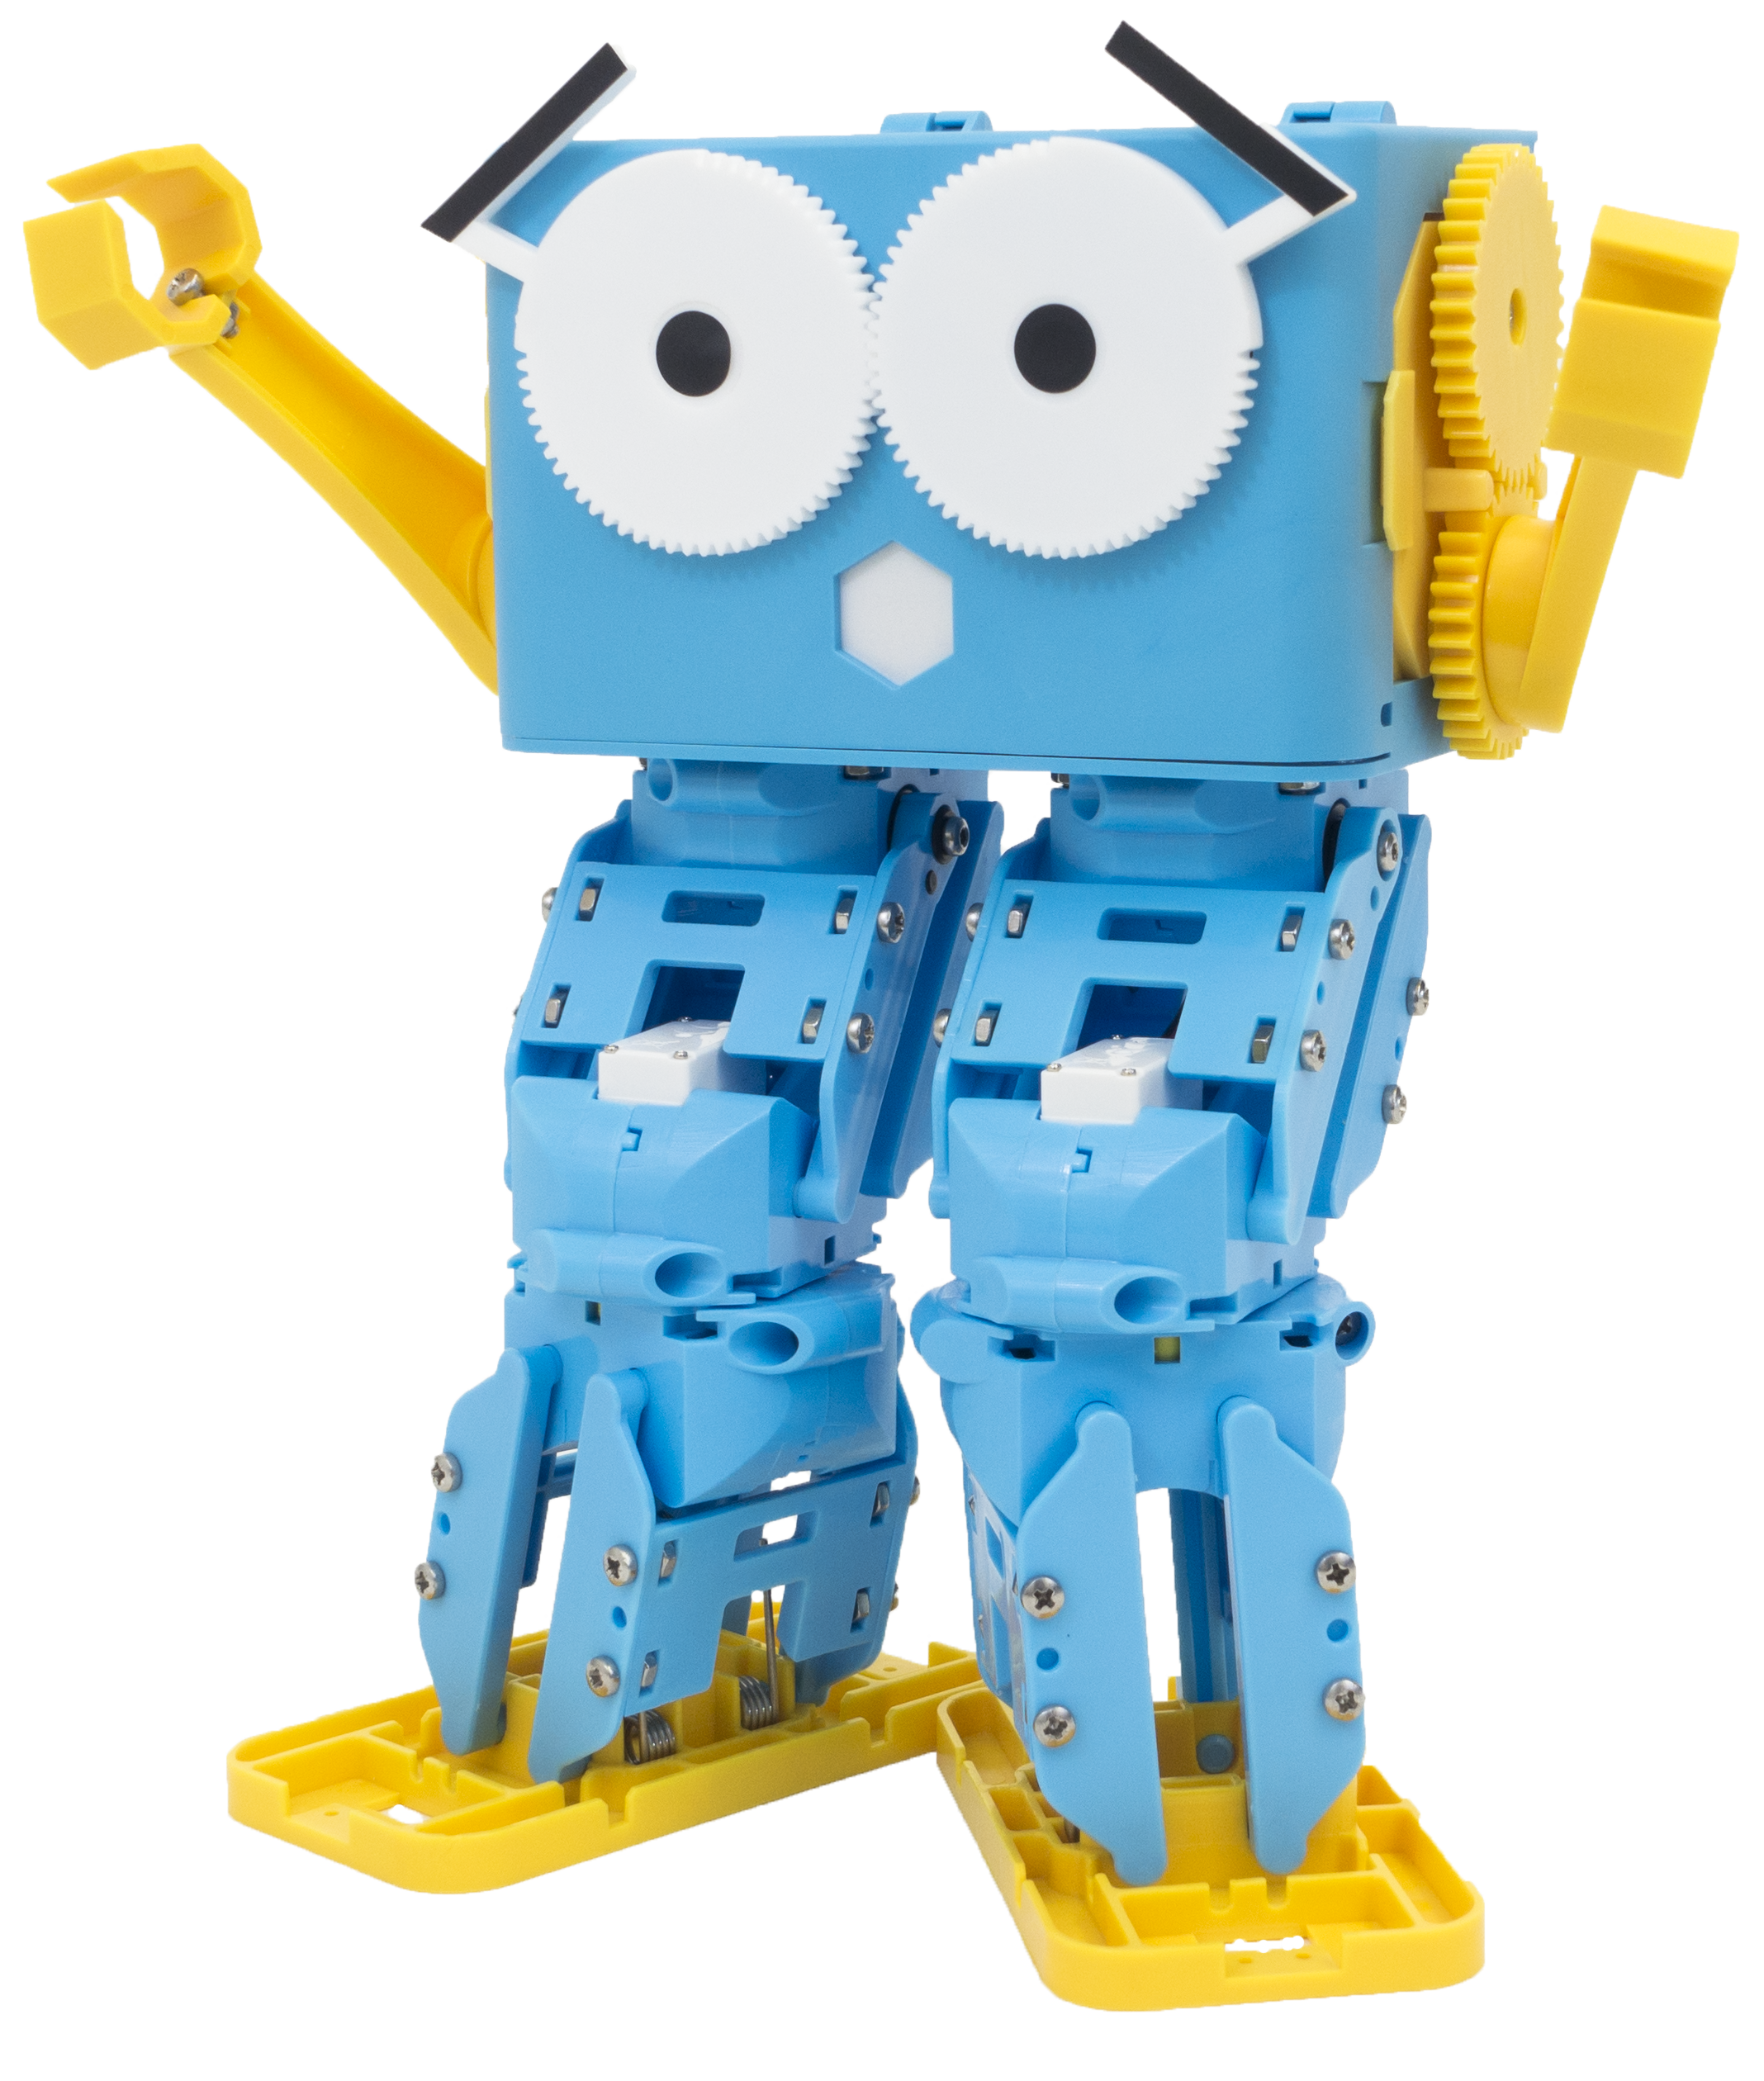
Marty the Robot

Slide 2
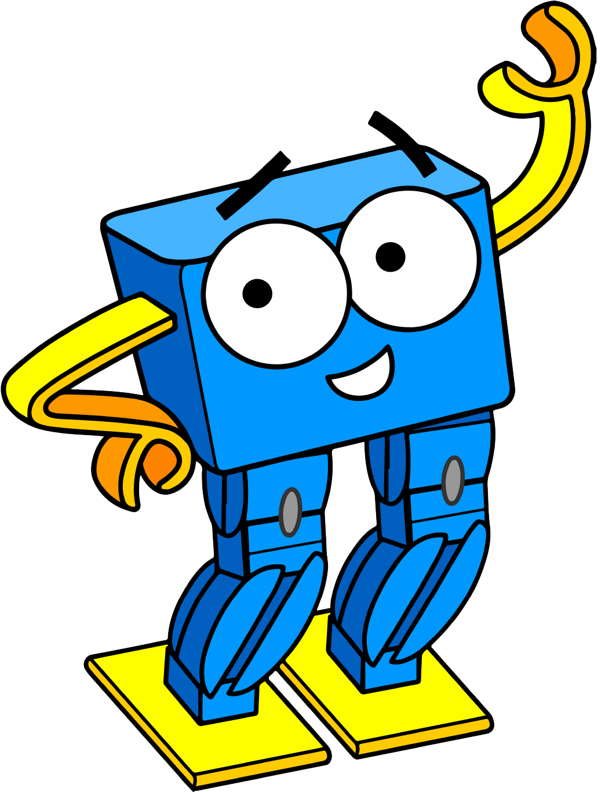
Lesson 1 – Introduction to Logic Operators
By the end of this lesson you will be able to,
Understand that we can do one thing in many different ways and think up some examples
Program Marty using AND, OR and NOT operators
Describe when to use AND, OR and NOT logical operators

Slide 3
What do you think will happen if we run the following code blocks?

Slide 4
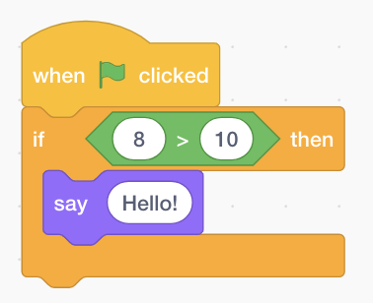
Notes:
When we click on the start button, if the number 8 is bigger than the number 10 then the sprite will say “Hello”, otherwise nothing will happen…

Slide 5
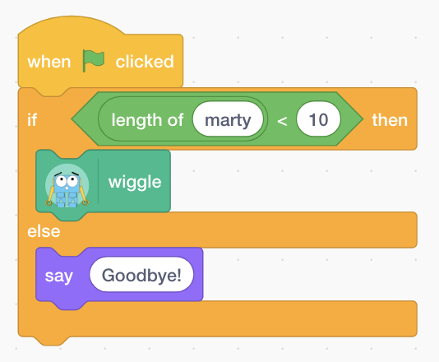
Notes:
When we click on the start button, if the length of the word “marty” is less than 10 characters long then Marty will do a little wiggle, otherwise, our sprite will say “Goodbye”

Slide 6
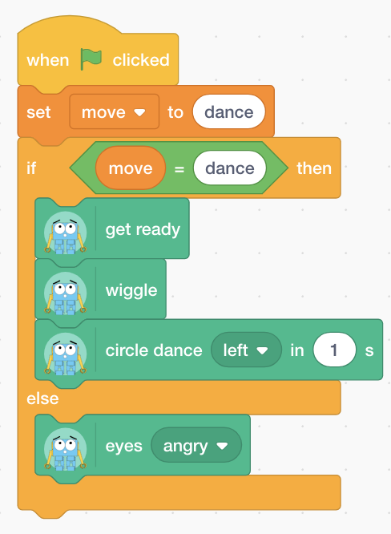
Notes:
When we click on the start button, set the move variable to the word “dance”. If what is being held in the variable move equals the word “dance” then Marty will get ready, do a little wiggle followed by a left circle dance for 1 second. Otherwise, Marty will set his eyes to be angry!

Slide 7
But not all of our decisions are based on one thing
Notes:
All of the previous if statement examples took only one thing into consideration, for example, the length of a single word or whether one number was smaller than another. But in reality, it isn’t always that simple. We don’t always just need one thing to take into consideration in order to make a decision. For example, to get into a kids club you might need to be aged between 7-11 so our if statement would be check the age is bigger than 7 AND also less than 11. We can use something called logical operators to help us to do this!

Slide 8
More Complicated If Statements
IF I eat all of my dinner AND I help to clear the table
THEN I can get ice cream for dessert
Notes:
The first example using the AND operator where both conditions must be true in order for it to return true. So if I eat my dinner and help to clear the table then and only then will I get ice cream. But if I only eat my dinner then I won’t get ice cream because I haven’t helped to clear the table

Slide 9
More Complicated If Statements
IF today is Monday OR today is Thursday
THEN I have coding club after school
Notes:
Another operator called OR where only one of the conditions have to be true. If it’s either Monday or Thursday then I have coding club

Slide 10
More Complicated If Statements
IF today is NOT Friday
THEN I have homework to do
Notes:
Finally, NOT. In this example we are saying that if it is NOT Friday (meaning it could be any other day of the week) then we will have homework to do

Slide 11
Can you think of any others?
Notes:
Ask students to come up with some more ideas. These could be age based getting into a film or a club, deciding whether it is too late to watch a film or how they decide whether they are allowed to watch tv or go out to play…

Slide 12
IF my age is less 15 AND greater than 10 THEN I can join the secret club
IF I can juggle OR I can hop on one leg THEN I can join the circus
IF the pencil is NOT orange THEN I can not use it
Notes:
Some more examples!

Slide 13
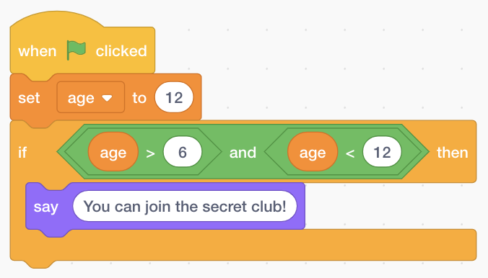
What do you think will happen when we run this?
Notes:
When we click on the start button, we set the value of the variable age to be number 12. If the value held in age is bigger than 6 AND it is smaller than 12 then our sprite will say ”You can join the secret club!”

Slide 14
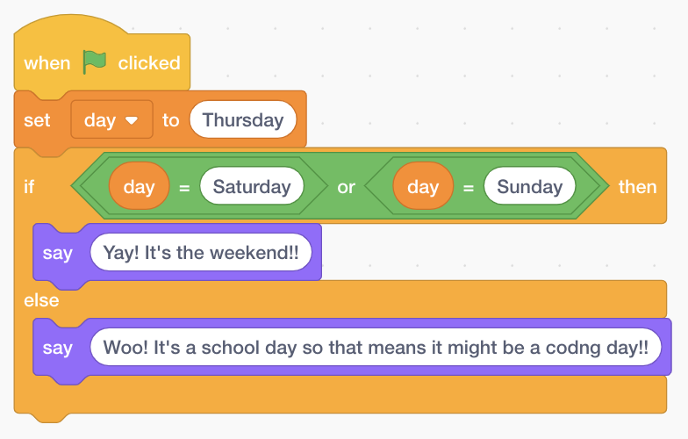
What do you think will happen when we run this?
Notes:
When we click on the start button, we set the value in our day variable to be the word ”Thursday”. If the value in day equals the word “Saturday” OR if it equals the word “Sunday” then our sprite will say “Yay! It’s the weekend!!”, otherwise it is not Saturday or Sunday so our sprite will say “Woo! It’s a school day so that means it might be a coding day!!”

Slide 15
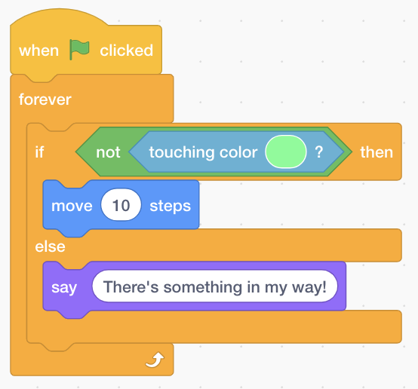
What do you think will happen when we run this?
Notes:
This one is a little bit more tricky. When we click on the start button we will forever check the following if statement. If our sprite is not touching the green colour then the sprite will keep moving 10 steps but when it does touch the colour then it will stop and say “There’s something in my way!”

Slide 16
Now it’s your turn to program Marty!
Ask the user how old they are and if they are aged between 7-11 then Marty should do a secret dance otherwise, he should show angry eyes!
Notes:
Students will now move to start programming Marty using Scratch. The first challenge is to use the AND operator to get check if the number entered by the user is bigger than 7 and less than 12

Slide 17
Now it’s your turn to program Marty!
Ask the user what their favourite colour is. If it is green or purple then program Marty to raise his right hand for a high five, otherwise, program him to take 4 steps backwards
Notes:
The second challenge using the OR operator where students have to check if the colour entered by the user was either green or purple

Slide 18
Now it’s your turn to program Marty!
Ask the user who their favourite robots are. If they do not mention Marty (using the contains block) then program Marty to show angry eyes, otherwise, do a happy dance!
Notes:
Finally, using the NOT operator. Check the answer entered by the user to see if they have mentioned Marty as their favourite robot and if they have not then Marty will put on his angry eyes!

Slide 19
Fill in the Blanks!
IF today is Monday ______ today is Wednesday
THEN I have lots of homework to do
Notes:
OR

Slide 20
Fill in the Blanks!
IF it is after 4pm ______ it is before 5pm
THEN I can watch TV
Notes:
AND

Slide 21
Fill in the Blanks!
IF today is ______ Saturday ______ today is ______ Sunday
THEN it is not the weekend
Notes:
NOT AND NOT

Slide 22
Lesson 2 – Introduction to Functions
By the end of this lesson you will be able to,
Describe what is meant by a function and why we use them whilst programming
Name some examples of functions we use everyday
Program Marty to do a dance routine using functions to represent different dance moves

Slide 23
What is a function?
A way to break down our programs into small chunks
Books are broken down into chapters where each chapter is about a specific subject
Songs are made up of different verses and a chorus that is repeated throughout
Notes:
Functions are an important concept whilst programming because they allow us to break down the task into small manageable chunks where each function is responsible for doing one thing. Here we give examples of other kinds of functions in real life like in books where each book is broken down into chapters and each chapter focuses on a specific topic. Songs are broken down into verses and chorus that are repeated at different points of the song

Slide 24
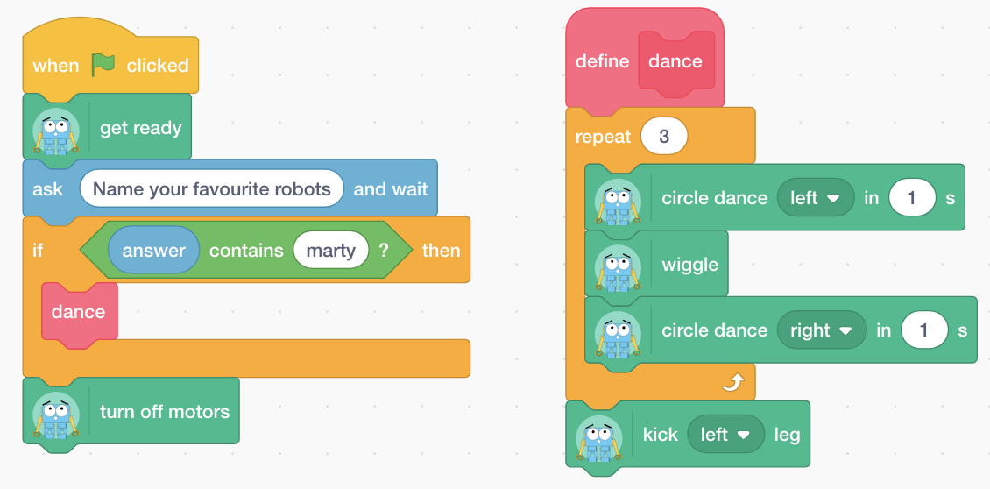
And our programs can be broken down into functions where each function is responsible for one thing!
Notes:
We can use functions to stop repeating things and also to make things easier to debug because there is one point to change our dance routine instead of lots of different places that have used the dance routine. See if students can work out what happens in the code above. The pink block is a function that is defined on the right hand side and called on the left hand side

Slide 25
But we use functions everyday!
Brushing your teeth
Eating and drinking
Can you think of some more?
Getting ready for bed
Notes:
Everyday we use things like functions, For example, when brushing your teeth you don’t have to think about detailed instructions like move brush up, move brush down, move brush left, then up and down and left and up and down…

Slide 26
Why do we use functions?
Functions reduce the amount of repeated code by assigning each function a single aim or action that it is responsible for!

Slide 27
Example: How would we break up this song?
Chorus
Old MacDonald had a farm ee-eye, ee-eye-oh
And on that farm he had a duck ee-eye, ee-eye-oh With a quack, quack here and a quack, quack there Here a quack, there a quack, everywhere a quack, quack
Old MacDonald had a farm ee-eye, ee-eye-oh.
Old MacDonald had a farm ee-eye, ee-eye-oh
And on that farm he had a cow ee-eye, ee-eye-oh With a moo, moo here and a moo, moo there Here a moo, there a moo, everywhere a moo, moo Quack, quack here and a quack, quack there Here a quack, there a quack, everywhere a quack, quack
Old MacDonald had a farm ee-eye, ee-eye-oh.
Verse 1
Chorus
Chorus
Verse 2
Chorus
Notes:
Here is a song broken down a little bit. Ask students to highlight where things are repeated and what they think would be different functions. We have then highlighted them so we have 3 functions here: chorus, verse1, verse2

Slide 28
Now it’s your turn to program Marty!
Program a new dance routine for Marty using functions to represent different dance moves

Slide 29
Lesson 3 – Introduction to Parameters
By the end of this lesson you will be able to,
Describe what a parameter is
Describe how we can use parameters to change the output of our programs
Build a shape generator function that takes in different values in order to program Marty to walk in different shapes

Slide 30
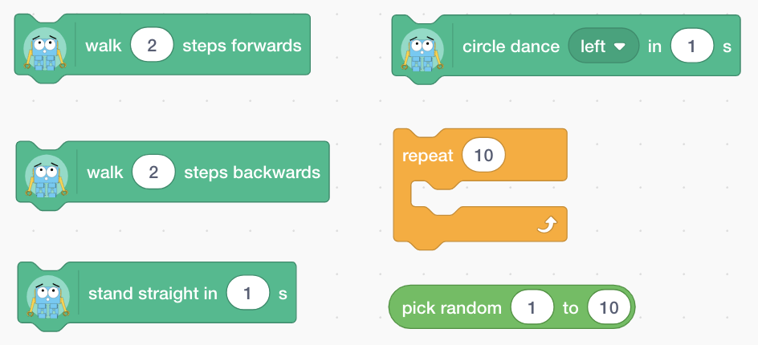
How can we change the output of the following blocks?
Notes:
These are some blocks that we have already used when programming with Scratch. But what do we change to change the behaviors for example how do we change the walk block to get Marty to walk more or less steps? How do we change the repeat block to get more or fewer loops?

Slide 31
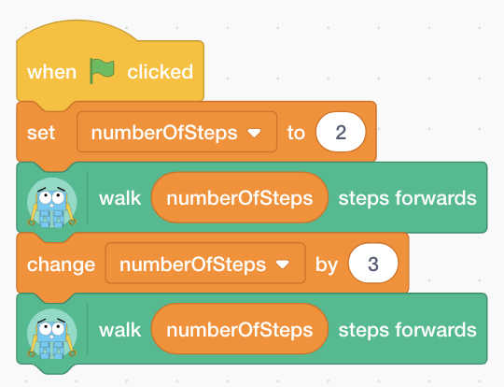
How did we change the output of this program?
In this example, we use variables as parameters to change the number of steps that I take!
Notes:
We have previously used variables instead of putting in the values ourselves, these are all examples of parameters

Slide 32
Using parameters, fill in the banks!

Slide 33
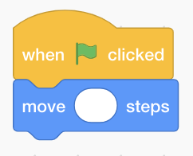
Move our sprite 20 steps

Slide 34
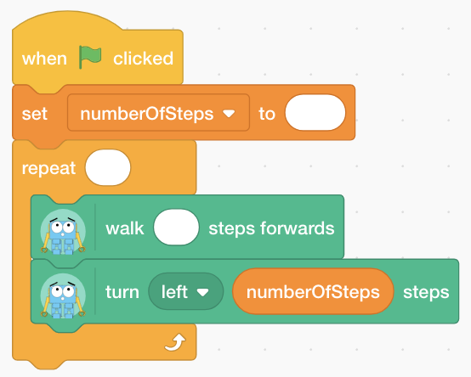
Walk in a square

Slide 35
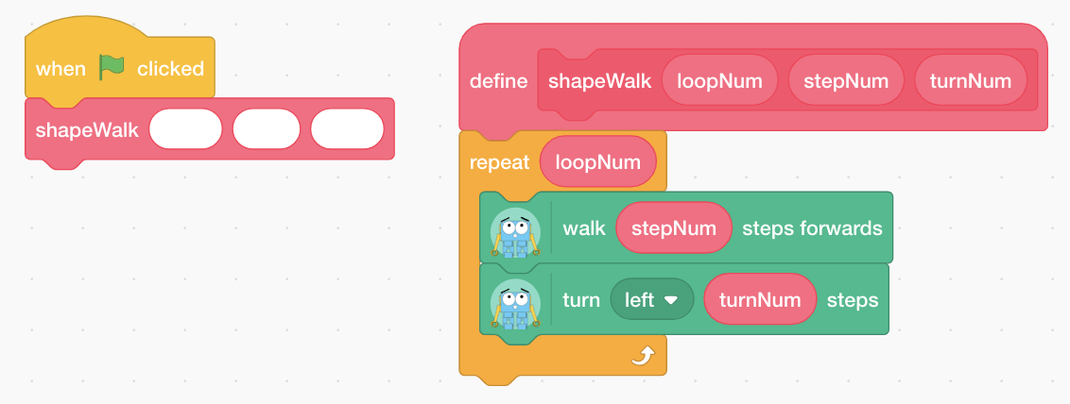
Walk in a square using our function

Slide 36
How would you change the parameters to get Marty to walk in a triangle instead of a square?

Slide 37
Now it’s your turn to program Marty!
Create a new function that when called will program Marty to walk in a square. Then try calling it with different values to get Marty to walk in different shapes!

Slide 38
Lesson 4 – Teaching Marty How to Walk
By the end of this lesson you will be able to,
Break down the steps that we take to walk by considering balancing and individual movements
Program Marty to walk without using the built-in command in Scratch

Slide 39
In your workbooks…
Colour in BLUE, the joints you think will move when Marty takes a step with his left foot
Colour in RED, where you think Marty’s weight will shift to when he takes a step with his left foot
Notes:
When we walk, we shift our weight to the side that isn’t stepping because otherwise we might fall forwards a little too quickly – especially if we walk really slow and just do tiny movements at a time with a break in between!

Slide 40
How do we walk? Can you break it down into small steps?

Slide 41
Try programming your friends to walk Lean to the LEFT/RIGHT Lift your LEFT/RIGHT leg Move your LEFT/RIGHT leg FORWARDS/BACKWARDS Lower your LEFT/RIGHT leg Stand straight

Slide 42
Now it’s your turn to program Marty!
Create a function to program Marty to take a step with his left foot
Create a function to program Marty to take a step with his right foot
Call them one after the other to get a walking movement
Keep track of which foot last stepped using a variable
Then based on this value we can decide what foot will step next to finish off our walking function!

Slide 43
Lesson 5 – Obstacle Course Challenge 1
By the end of this lesson you will be able to,
Think about what we use robots for and what kind of environments they work in
Describe the kind of environment that Marty could work in
Design an obstacle course for Marty
Program Marty to walk around an obstacle course

Slide 44
What do you think we can use robots for? And where do you think we would find them?
Notes:
Robots are everywhere! Get students to think about where they have seen robots being used or heard about or where they think robots are probably being used. Highlight the kinds of environments are usually controlled or are somewhere where humans are in more danger.

Slide 45
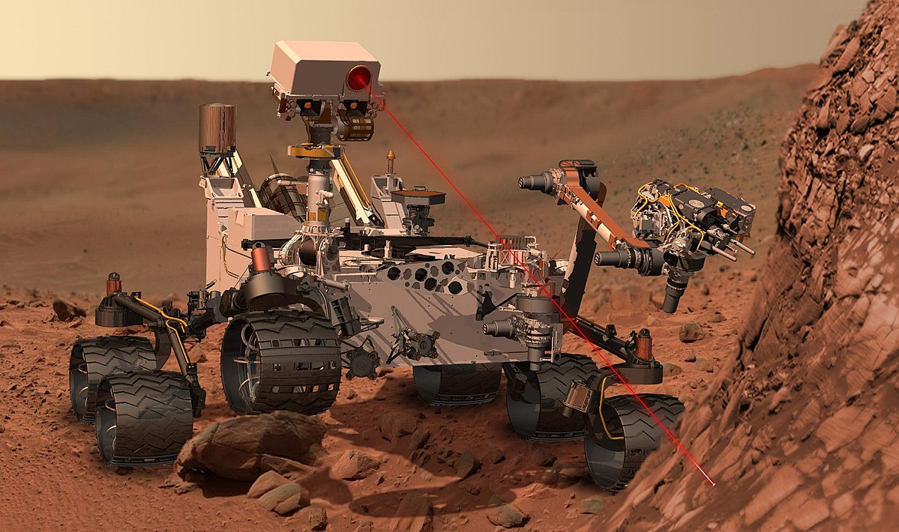
In your workbooks…
Draw pictures of 4 different robots and the environments that they work in

Slide 46
Try designing your own obstacle course!
Don’t forget to have a good think about what kind of obstacles I could tackle!

Slide 47
Now it’s your turn to program Marty!
Walk Marty around the obstacle course using your remote control program and take notes of obstacles
Program Marty to go around the course without help!
Use the space in your workbooks to plan our your program!
Notes:
This can be done either using obstacle student designs or by using ones provided.

