Slide 1

AI and nonprofits:
What boards need to know

Slide 2
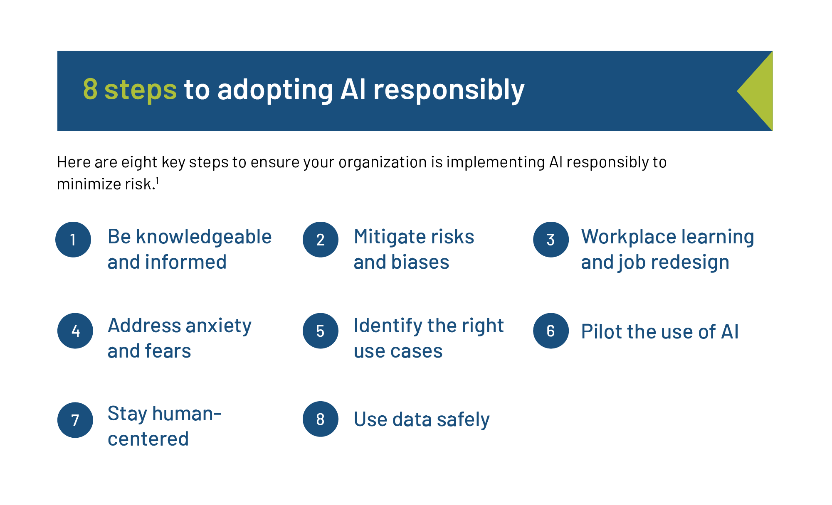
AI and nonprofits

Slide 3
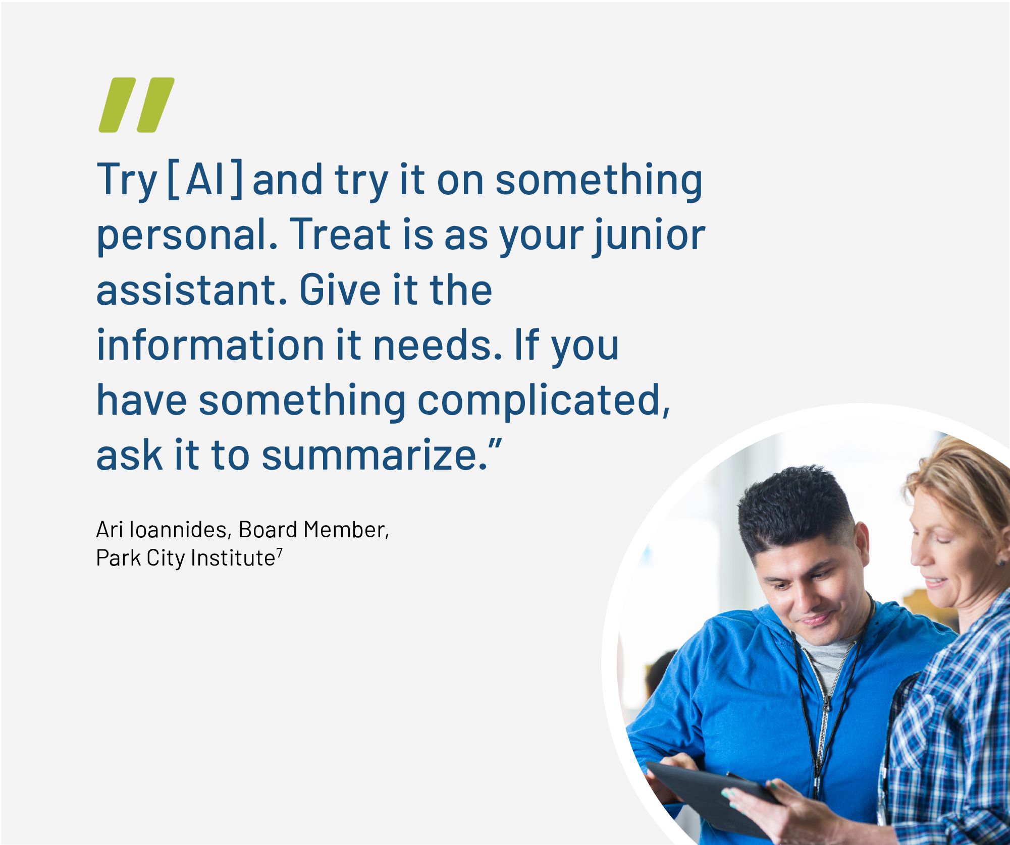

Slide 4
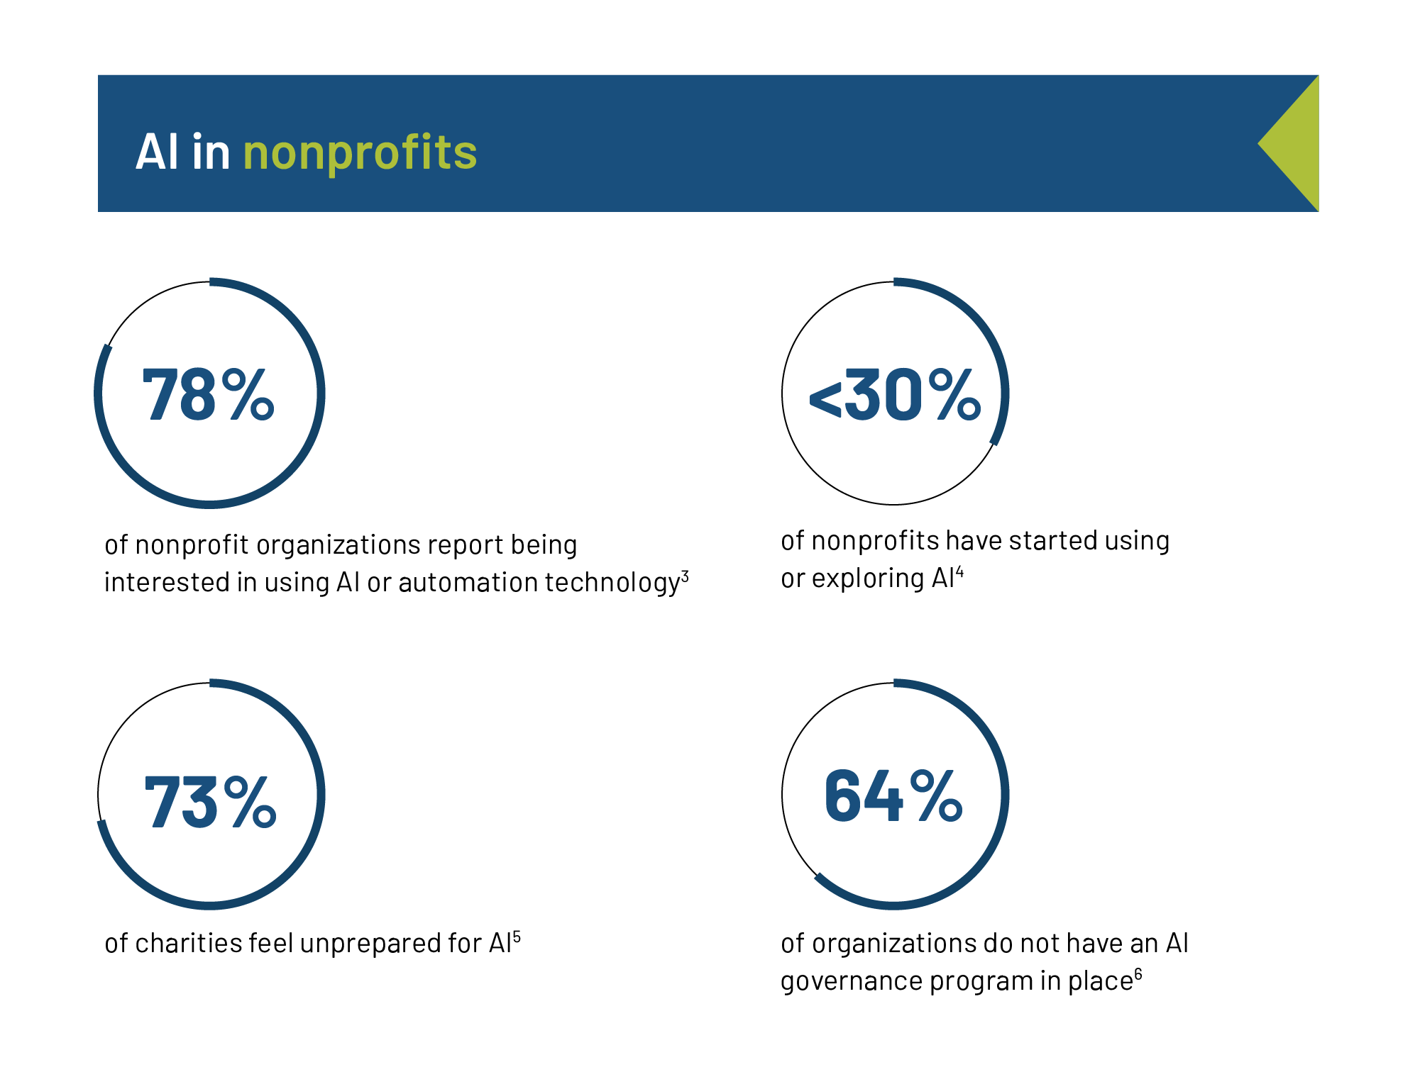
AI and nonprofits

Slide 5
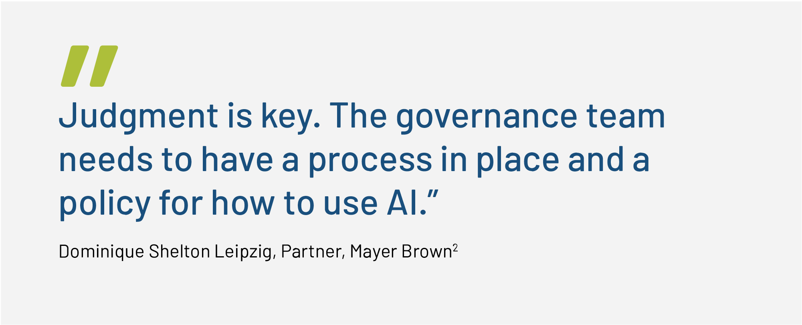

Slide 6
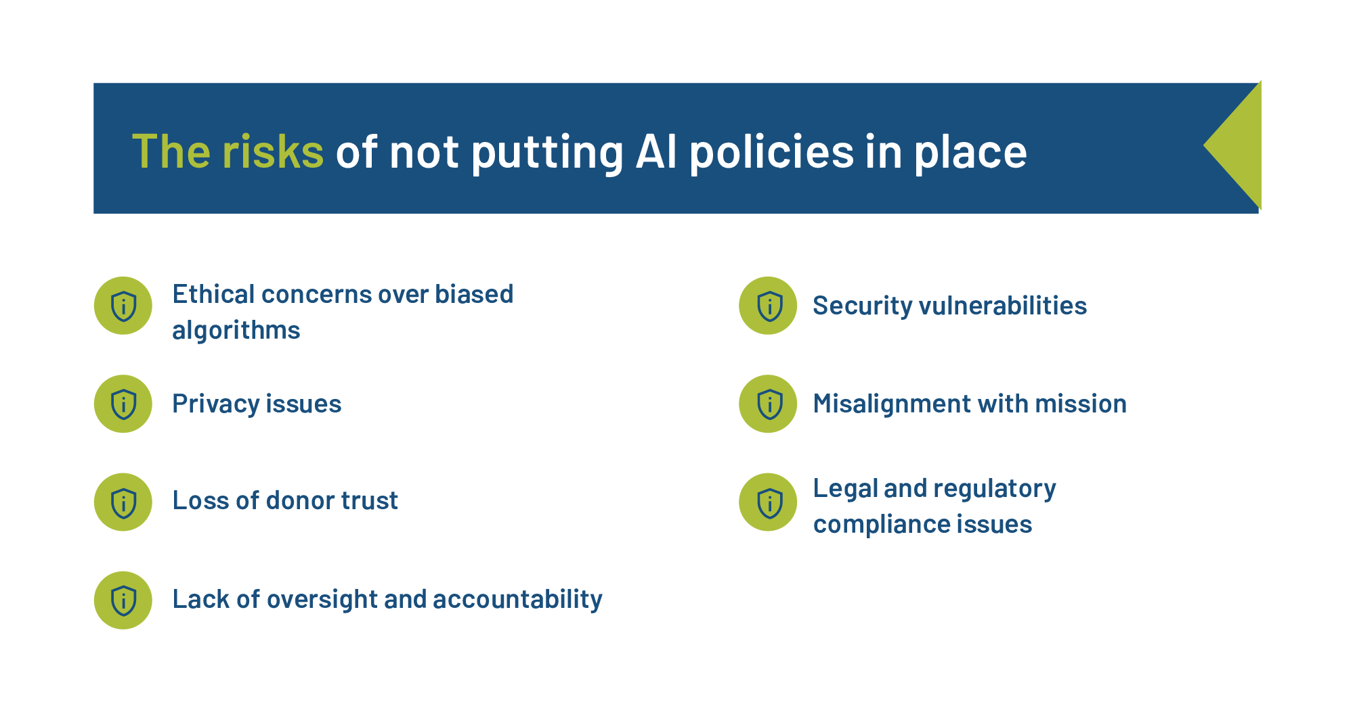
AI and nonprofits

Slide 7
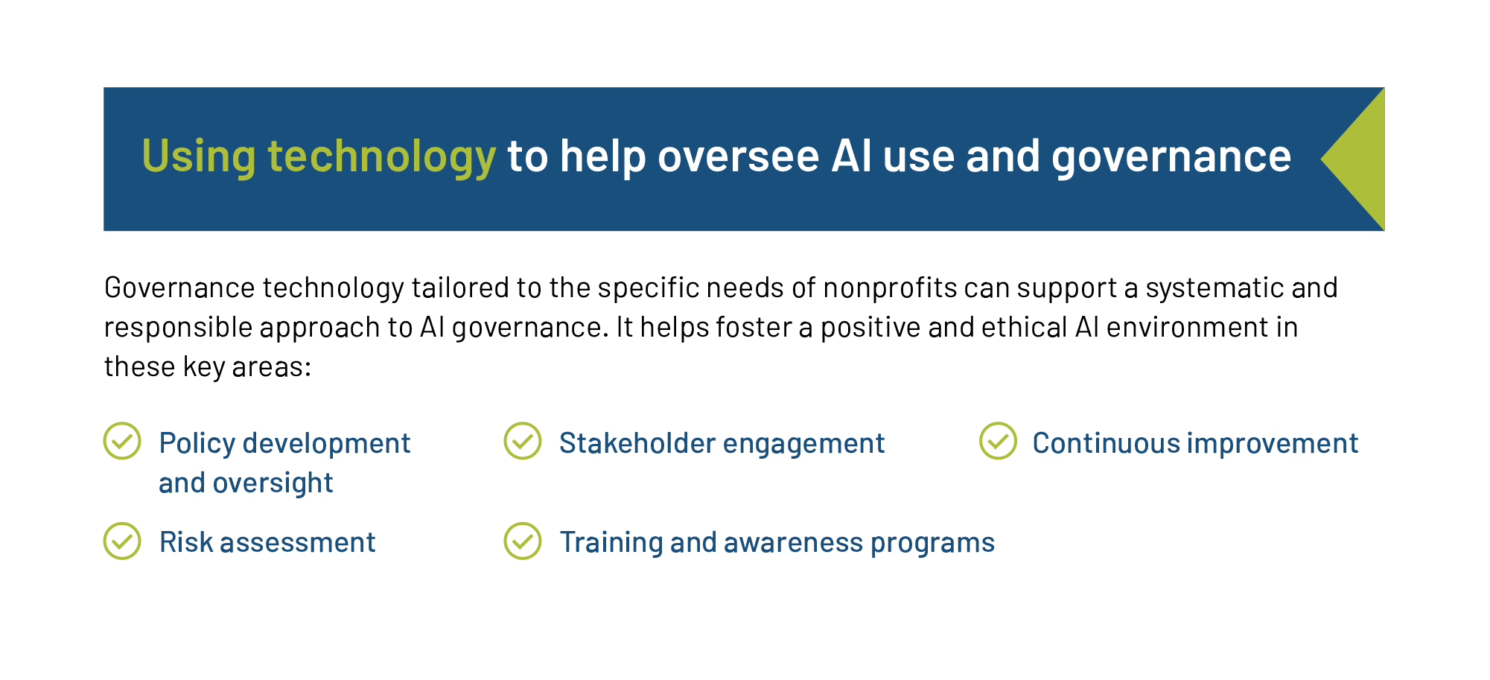
AI and nonprofits

Slide 8
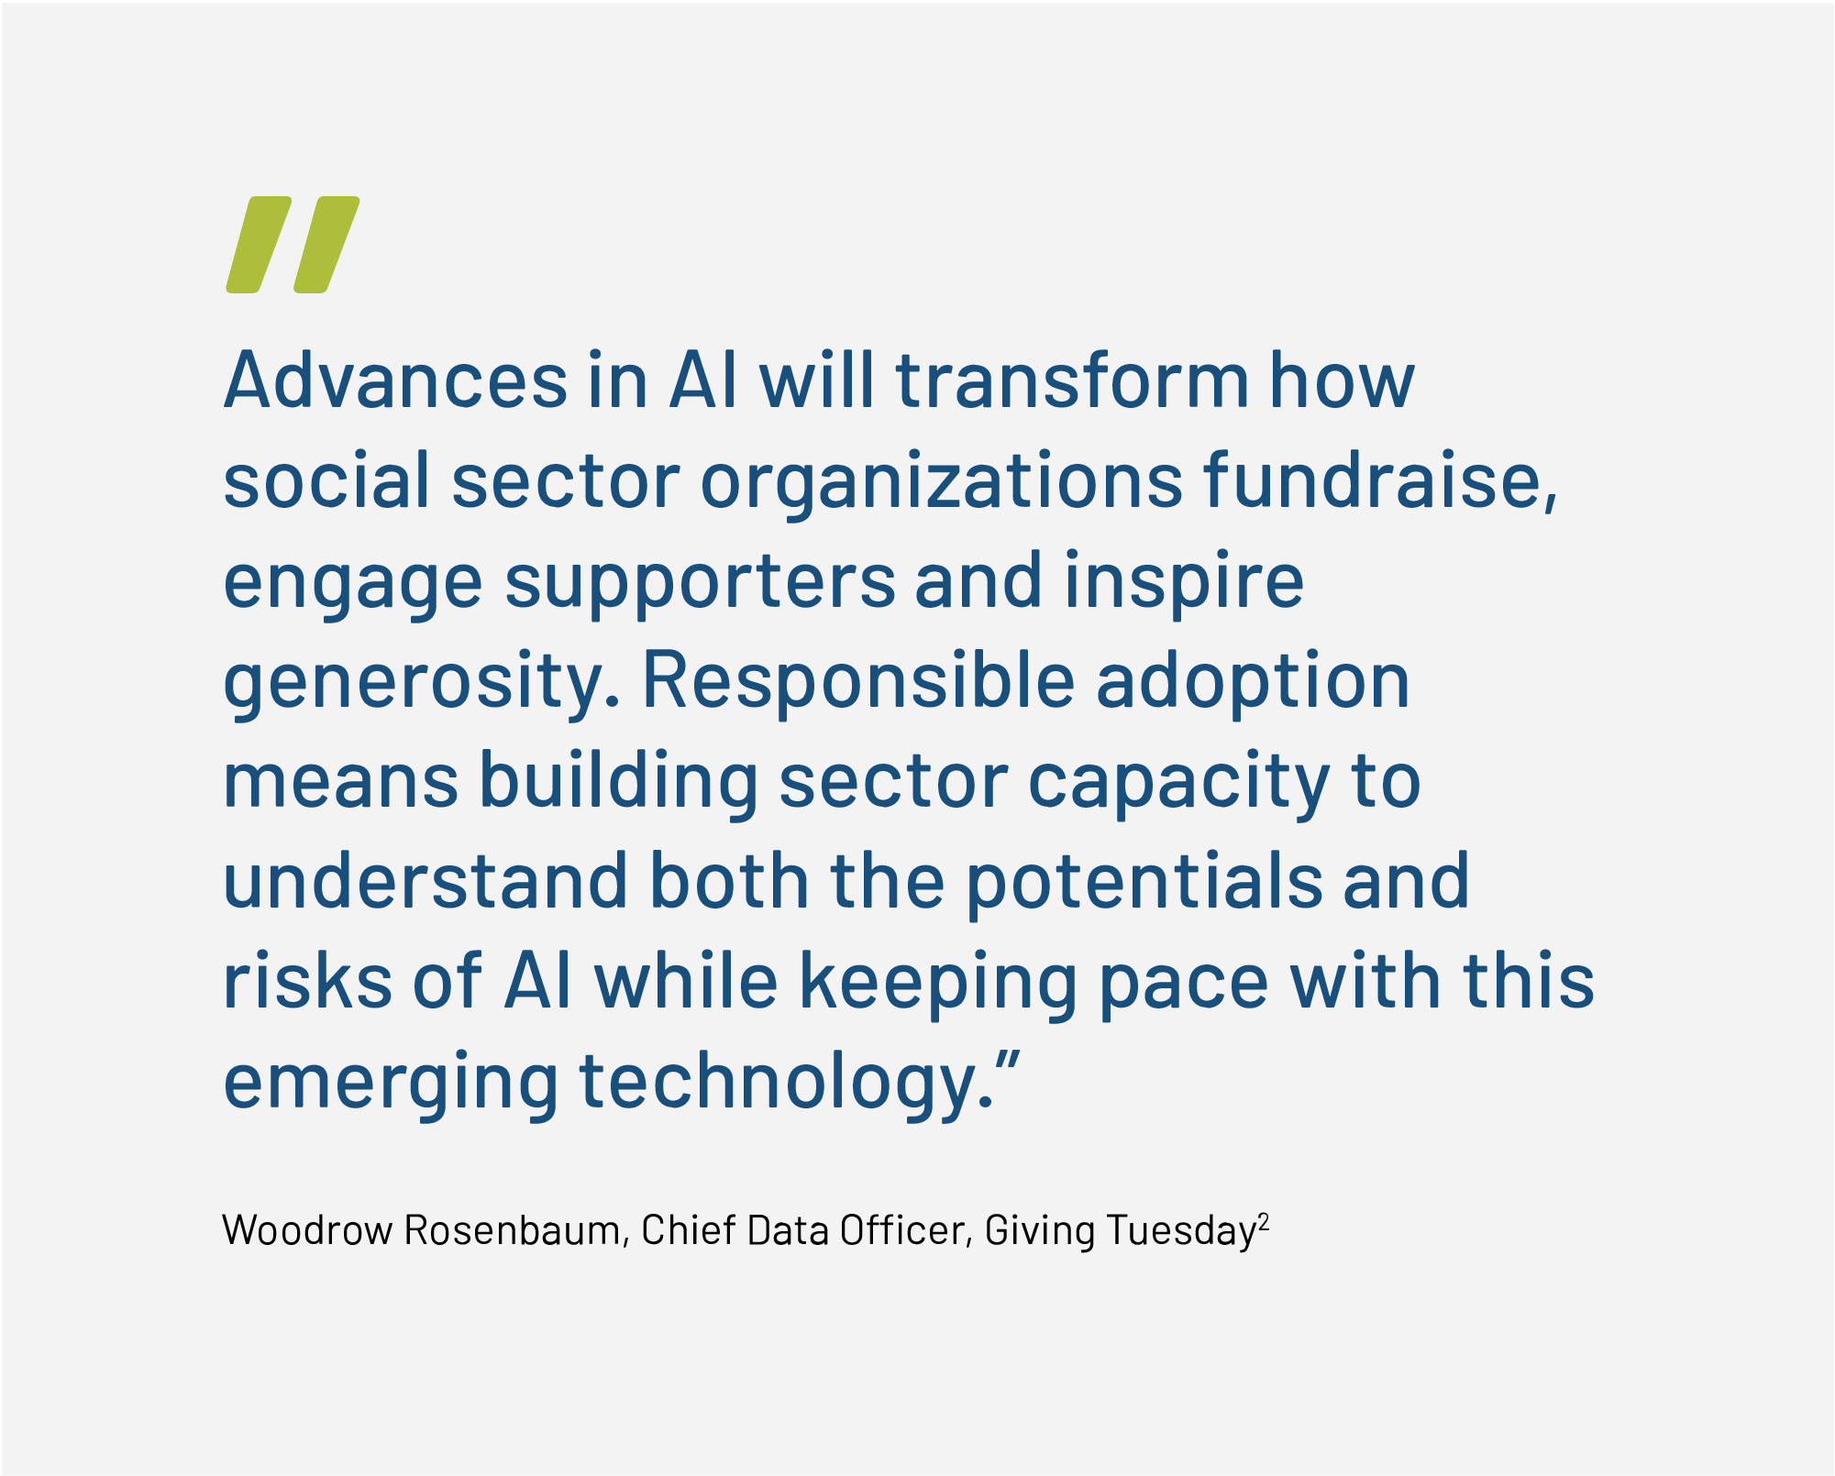

Slide 9

BoardEffect is the trusted board management solution
BoardEffect provides innovative boardroom technology to nonprofit organizations. As a Diligent brand helping to serve over 14,000 mission-driven organizations, we empower boards with the tools to drive positive change.
Our secure board management software helps to streamline operations, enhance governance practices and enable confident decision-making.
With BoardEffect, mission-driven organizations can unlock potential, accelerate mission delivery and make a lasting impact in their communities.

