Slide 1
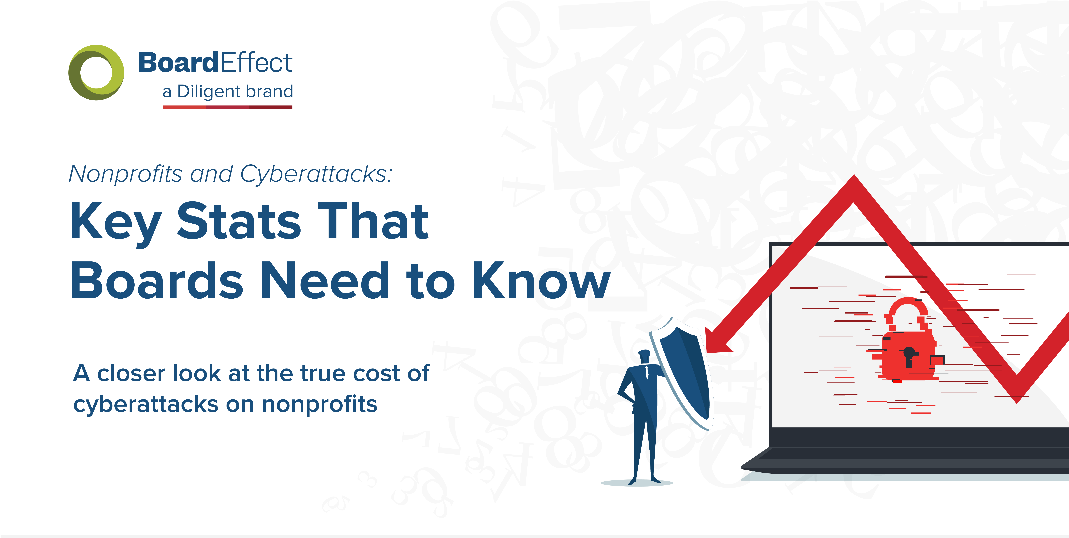
Nonprofits and Cyberattacks

Slide 2
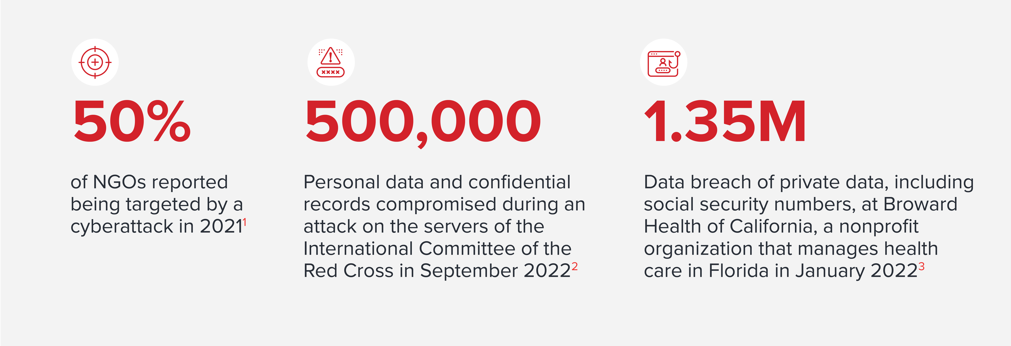
Nonprofits and Cyberattacks

Slide 3
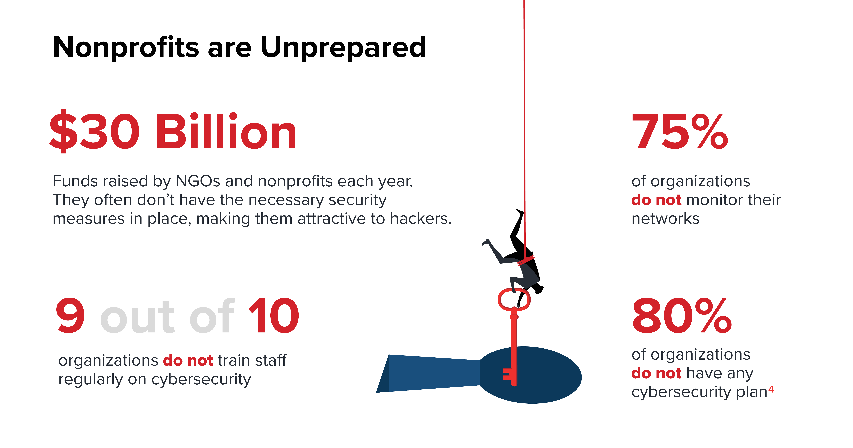
Nonprofits and Cyberattacks

Slide 4
Nonprofits and Cyberattacks

Slide 5
Nonprofits and Cyberattacks

Slide 6
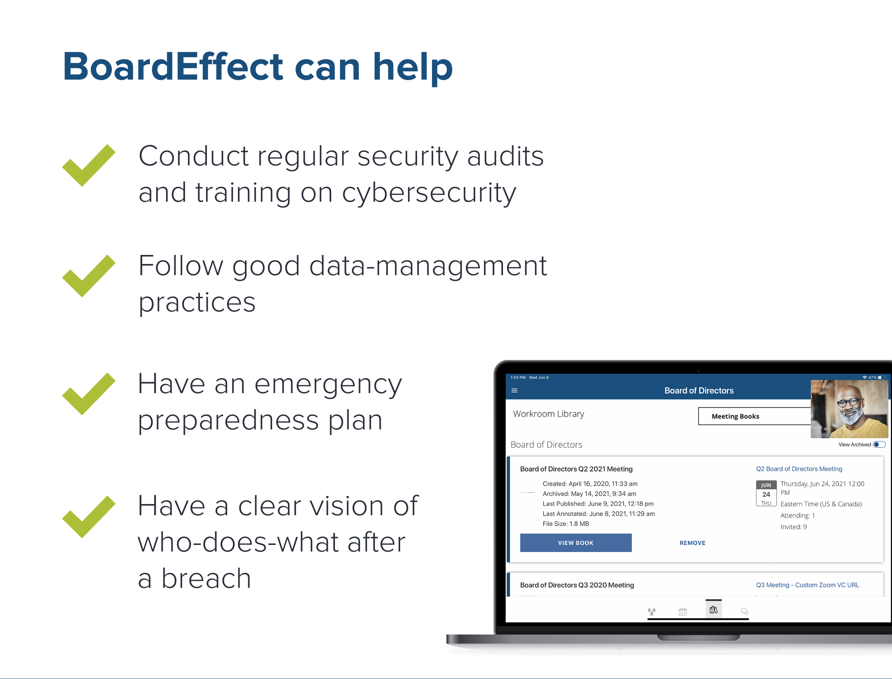
Nonprofits and Cyberattacks

Slide 7


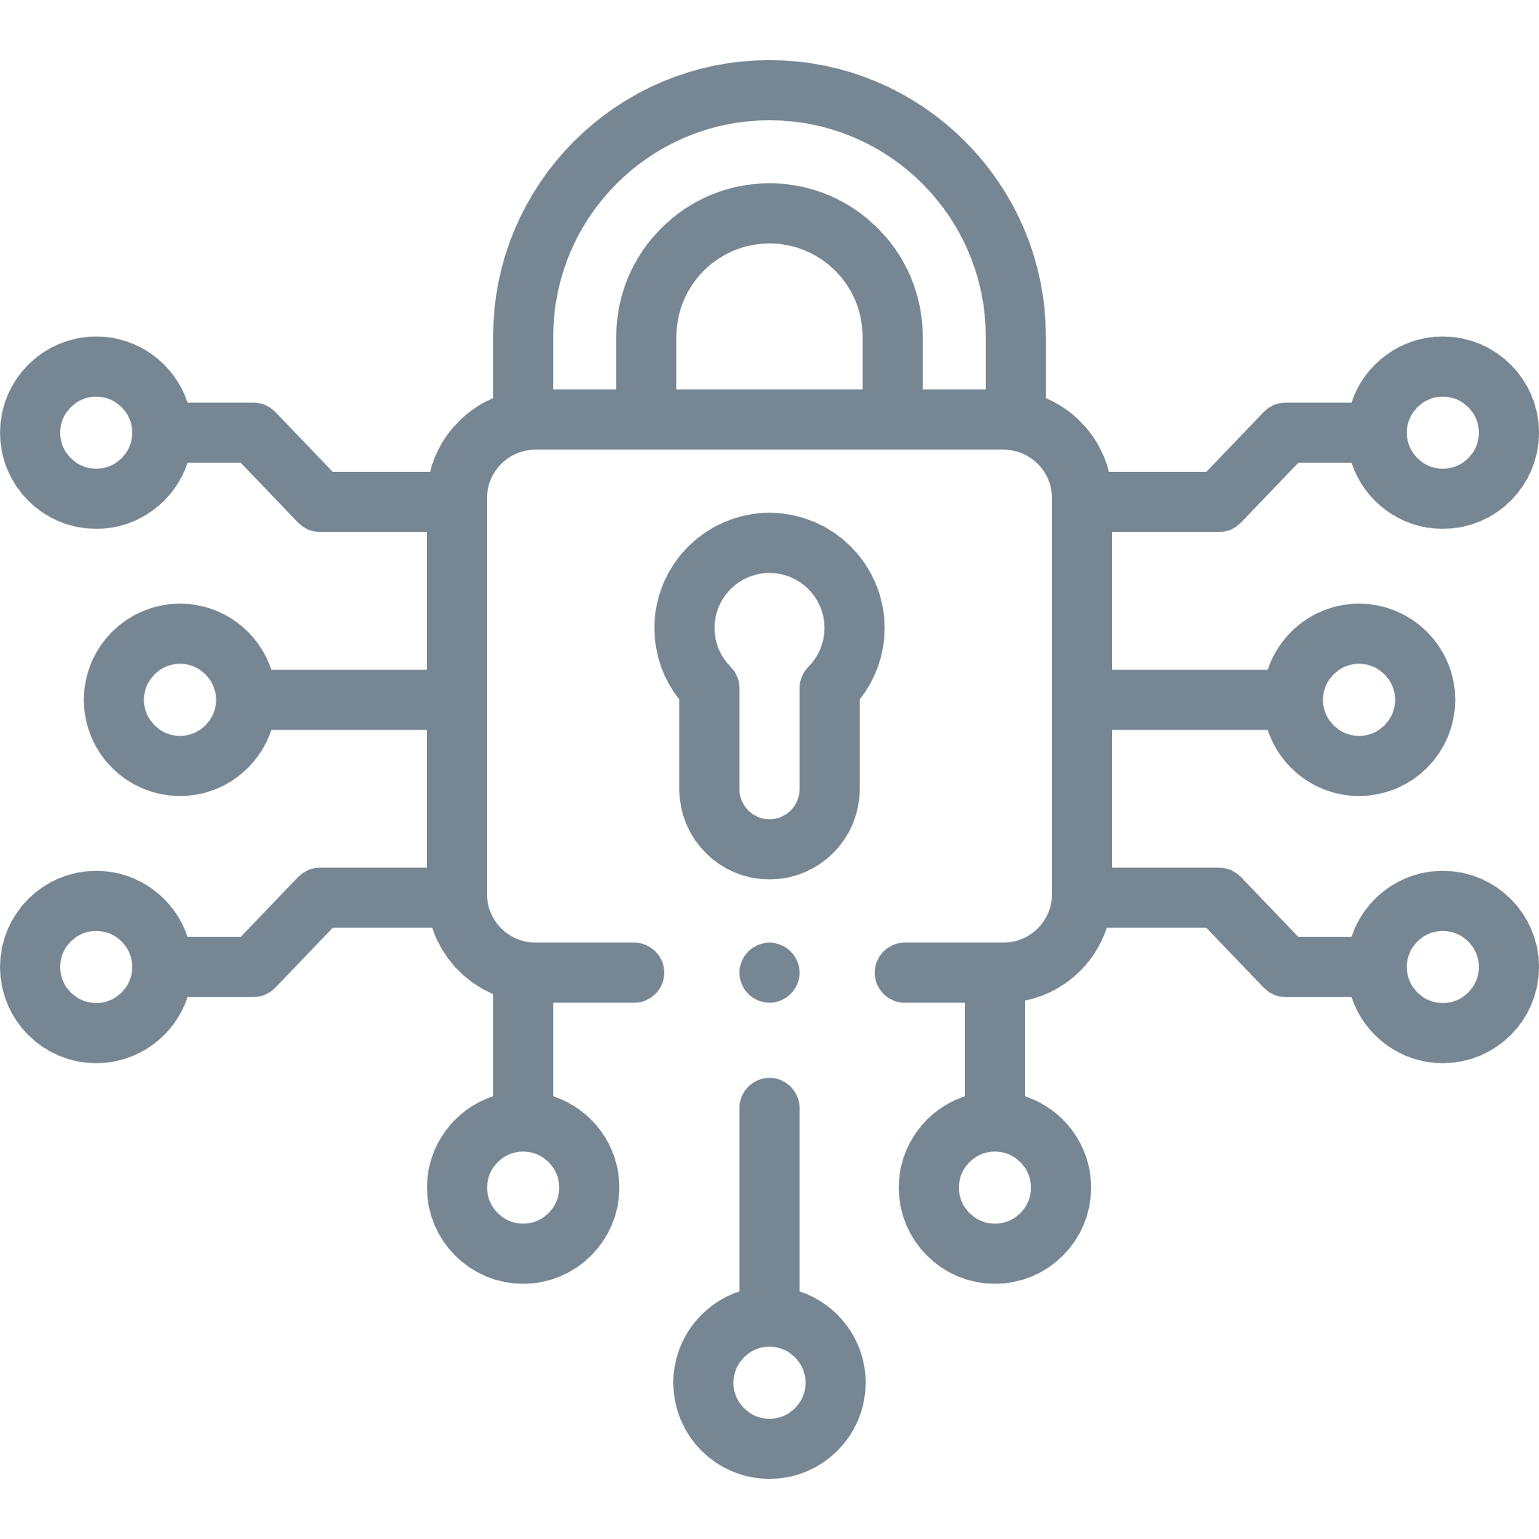

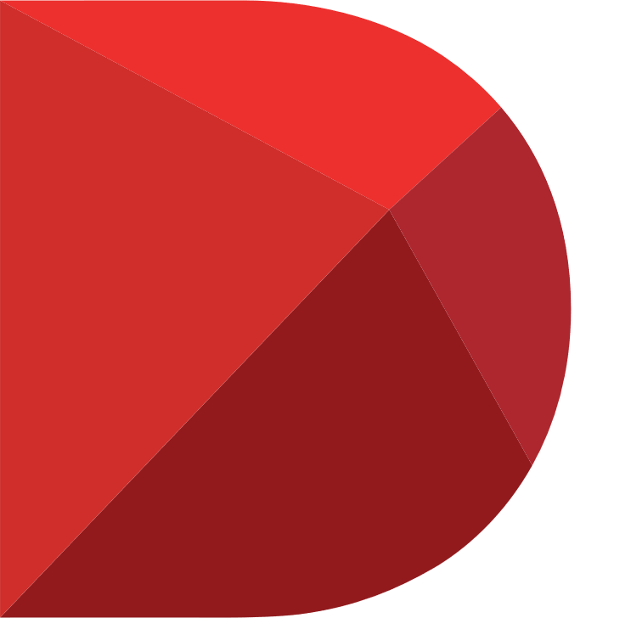

BoardEffect is the trusted board management solution
Intuitive and flexible board management solution
180,000+ users and 2,500 organizations globally
Best-in-class security
80% of customers are nonprofits
Backed by Diligent, the global leader in modern governance

