Slide 3
Connect Educate Inspire
Moemoeā V i s i o n
To leverage the energy, values, and mana of the One New Zealand Warriors as a platform for promoting positive social change that makes a difference in Aotearoa communities.
Tā tātou whāinga Our purpose
We tackle social issues with programmes and community initiatives that support mental health, anti-bullying, literacy, and other wellbeing skills that support success for our tamariki & rangatahi.

Slide 4
League in Libraries
Rīki i ngā Whare Pukapuka
UNICEF’s most recent report states that Covid-19 has wiped out 20 years of education gains with 9% of children in years 1-8 falling below the minimum reading proficiency levels in 2020.
Creative writing for tamariki & rangatahi
Reading is many kids’ biggest challenge. League in Libraries encourages children to rediscover the enjoyment of reading and literacy as essential life skills through the support of engaging mentors and role models.
Our programme aims to support tamariki and rangatahi to reconnect with their aroha for creative writing.

Slide 5
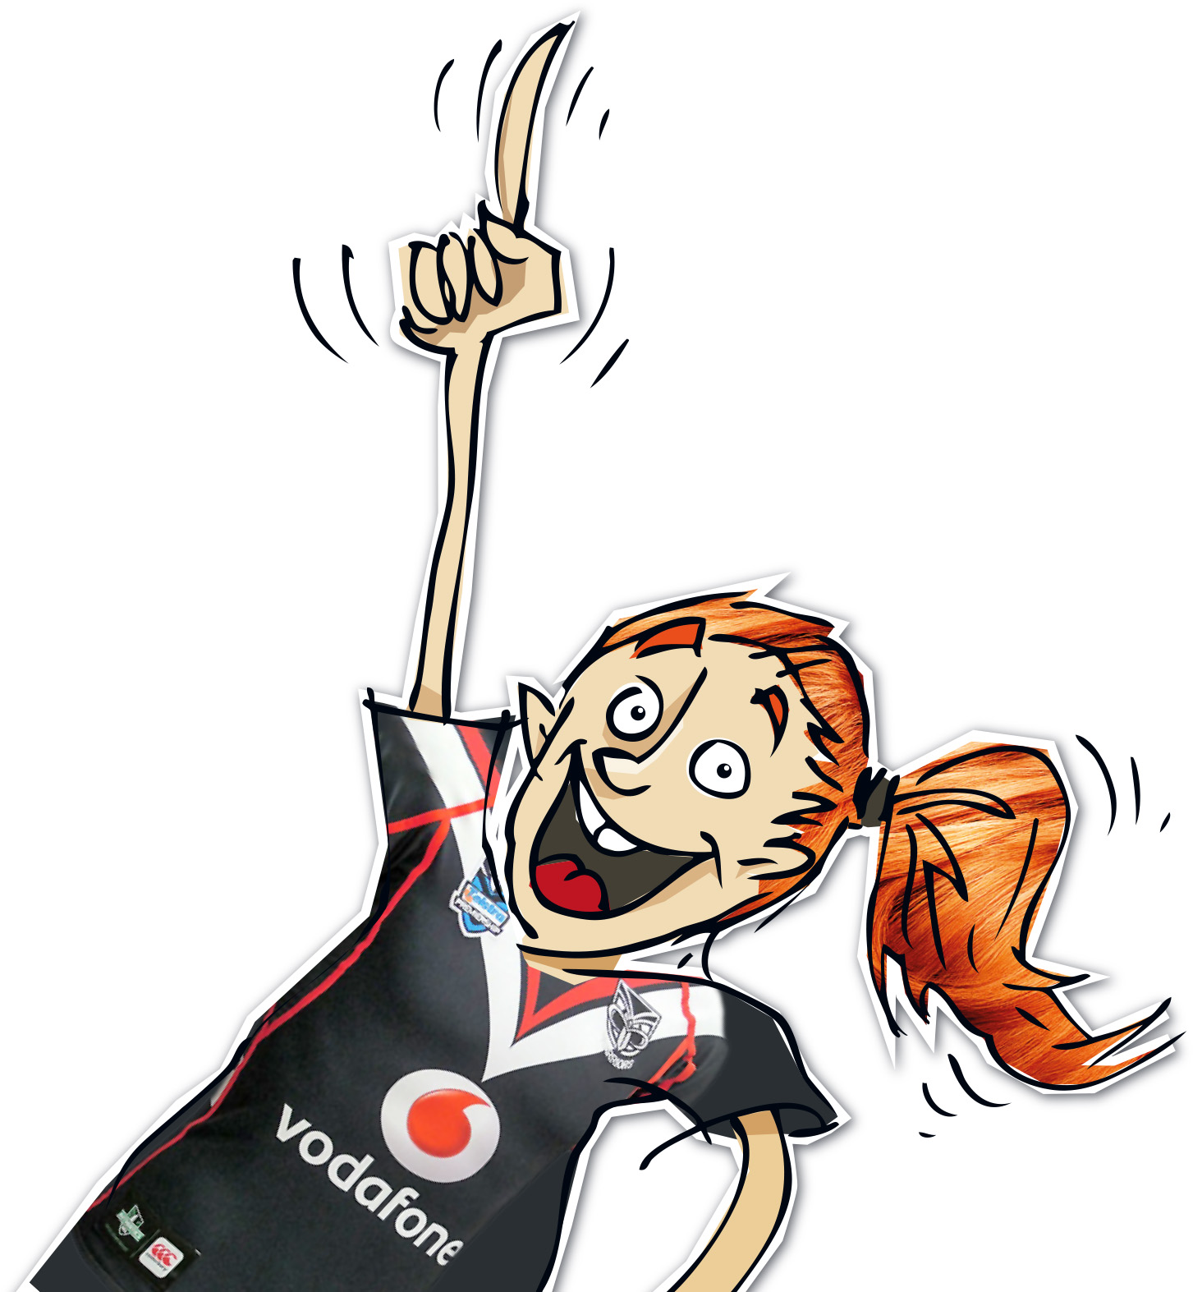
League in Libraries - Rīki i ngā Whare Pukapuka
Creative writing for tamariki & rangatahi
To date, League in Libraries has published 17 young authors and created meaningful connections with 10,869 children across 374 schools.
The programme incorporates a writing competition where students are invited to submit stories about their favorite Warriors for judging. The best primary and intermediate age student has their work professionally illustrated and published.

Slide 6
League in Libraries - Rīki i ngā Whare Pukapuka
Creative writing for tamariki & rangatahi
The 2024 competition will have three entry categories:
Years 4-6: Maximum word count 1,000 Ākonga (students) create their own Vodafone Warriors themed story inspired by their imagination
Years 7-8: Maximum word count 1,500 Ākonga create their own Vodafone Warriors themed story inspired by one or more of the core values of the club
Te Reo Māori: Ākonga will write their story in te reo Māori
Entries are judged by a panel made up of Kaiako (teachers), members of the Warriors Community Foundation, and One NZ Warriors staff and players. Four finalists from each category will be chosen, with one supreme winner in each category.

Slide 7
How To Use This Presentation
This presentation has been prepared by the Warriors Community Foundation to support kaiako in encouraging students to engage in literacy-based activities. While we hope it is used to support students in their writing for our ‘Rīki i ngā Whare Pukapuka - League in Libraries’ competition, our main goal is to promote a love for writing.
This presentation has:
Activities to spark ideas
Templates to help students plan their writing
Activities to help students improve and edit their writing
This is the first year that we have provided supporting material to kaiako for them to use when running the competition in schools. We hope to improve on this for next year - any feedback is welcome admin@wcf.kiwi
You can delete this slide when you’re done editing the presentation

Slide 8
Table of Contents
01
02
ACTIVITIES TO SPARK IDEAS
Ideas for activities to do before ākonga begin planning
PLANNING TEMPLATES
Templates ākonga can use to organise their ideas.
03
04
IMPROVING WRITING
Activities to improve the quality of the writing
EDITING
Editing techniques to ensure the writing can be understood.

Slide 9
01
ACTIVITIES TO SPARK IDEAS

Slide 10
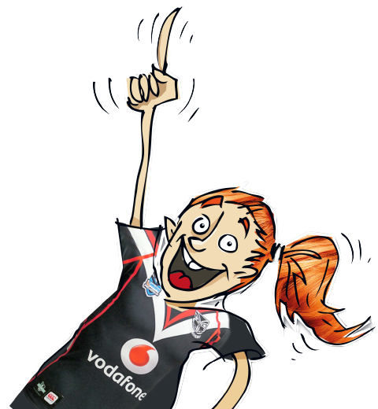
Visiting the Library
This week, we are going to visit the library to spark our writing ideas.
While we don’t want to copy someone else’s whole story, we can get ideas from
their books.

Slide 11
Visiting the Library
As you have a browse at the library,
ask yourself the following questions:
What made me pick this book in the first place?
What do I like about this book?
What makes me want to keep reading?
What was the most interesting part of the story and why?

Slide 12
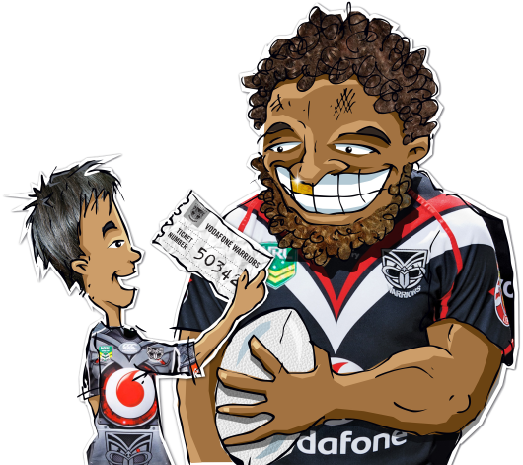
Timer Challenge
To help us brainstorm ideas for our story, we are now going to use a timer to help us write down a lot of ideas in a small amount of time.

Slide 13
Timer Challenge
For each section that comes up on the next slide, brainstorm as many ideas as you can.
FOR EXAMPLE:
The first section is characters. This means who is in our story. Here are some ideas:
A MAGIC EGG MAN
A GREEN NURSE
A MINI OGRE
AN ALIEN
A FLYING FROG

Slide 14
Timer Challenge
You have 2 minutes to brainstorm ideas for each of the three sections that comes up. Some ideas are provided for you.
CHARACTERS
SCENE
EVENTS
Brainstorm who could be in your story
A magic egg man
A mini ogre
A green nurse
Brainstorm where your story could take place
On the sun
In an upside down house
In a slime pool
Brainstorm what could happen in your story
It rains corn
Kea’s start talking
Monsters play league

Slide 15
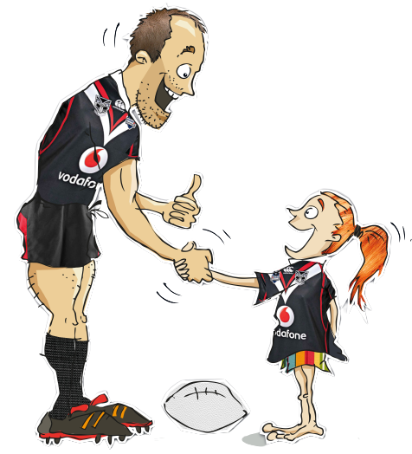
Interview Brainstorm
To help us brainstorm ideas for our story, we are going to interview other people for their ideas.

Slide 16
Interview Brainstorm
Find some time to interview a classmate
or a member of your whānau.
Here are some questions you could ask them:
What’s the weirdest character you can think of?
Where is your favourite place to go?
What do you think makes a good beginning and a good ending to a story?
What’s the craziest thing that could happen today?

Slide 17
Interview Brainstorm
Pick some of the ideas from your interviews to include in your story!

Slide 18
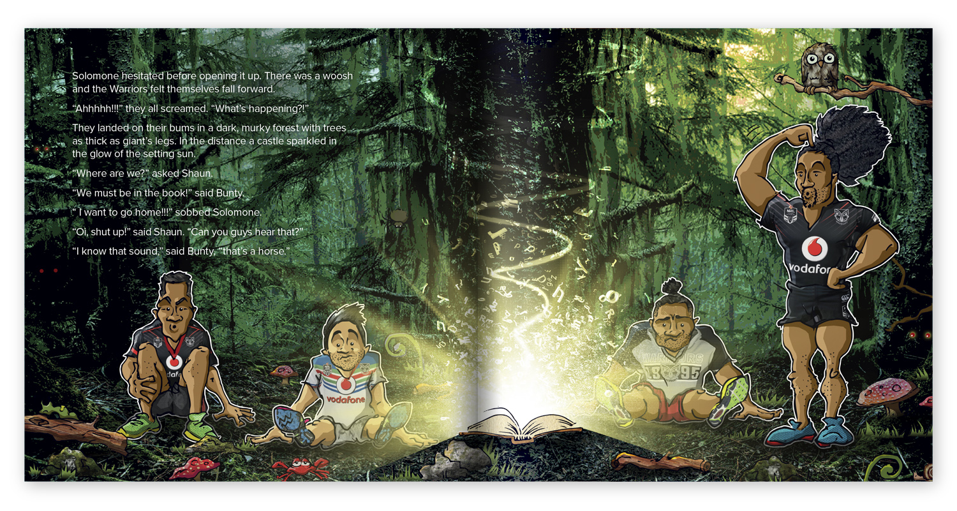
Extract from the 2018 winner Caspian Buxton Year 8, Eskdale School Napier

Slide 19
02
PLANNNING TEMPLATES

Slide 20
Alphabet Planner
Using the alphabet, make a list of words that you could use in your story
A | H | O | V
B | I | P | W
C | J | Q | X
D | K | R | Y
E | L | S | Z
F | M | T
G | N | U
lien
araglider
eti
oon

Slide 21
Interview Brainstorm
Answer the key questions below about your story
WHO?
is in your story?
else could you add?
WHERE?
does it happen?
could they go?
WHEN?
is your story taking place?
YOUR TOPIC HERE
WHAT?
happens?
is the main event?
HOW?
did things happen?
could problems
be fixed?
WHY?
are things happening?

Slide 22
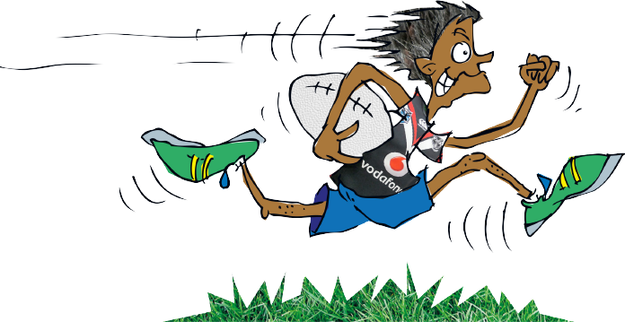
Hamburger Planner
To help us order the events in our story, we are going to use a hamburger planner.
Draw a hamburger in your books and fill in the details of your story.
See next slides for examples.

Slide 23
Hamburger Planner
First, draw the top bun.
In here we are going to write the setting, time, weather and characters
A dark forest
Stormy weather
Middle of the night
A flying frog and his mini ogre friend

Slide 24
Hamburger Planner
Then, draw the fillings.
In here we are going to write the events
of the story in order.
The flying frog and mini ogre stop to find shelter but the mini ogre gets caught in an underground trap.
The frog flies to Mt Smart Stadium and three of the Warriors agree to help and jump in the moon buggy.
The Warriors try to dig the mini ogre out of the trap, but then the get stuck after a slime flood.

Slide 25
Hamburger Planner
Last, draw the bottom bun.
In here we are going to write the solution to the problem, and the end of the story.
The mini ogre eats all the slime, and the flying frog build a ladder out of harakeke and sticks.
Then everyone goes to watch the Warriors game.

Slide 26
Hamburger Planner
Then, put your burger together.

Slide 27
03
IMPROVING WRITING

Slide 28
Improving Our Writing
We will now look at ways we can make our writing more interesting for the reader!

Slide 29
Improving Our Writing
Words we can use instead of good and nice:
Excellent
Amazing
Stupendous
Marvellous
Deluxe
Super
Tiptop
Exceptional
Wonderful
Superb

Slide 30
Improving Our Writing
Kīwaha we can use :
Kīwaha are slang/colloquial sayings that are used commonly in Te Reo Māori:
Ka mau te wehi!
Karawhiua!
Auē!
Wāwau ana!
Pahū!
Pākō!
Marvellous!
Give it your all!
Oh dear!
That's crazy/craycray!
Pop!
Bang!

Slide 31
Improving Our Writing
Kīwaha we can use :
Kīwaha are slang/colloquial sayings that are used commonly in Te Reo Māori:
Ēhe!/Whuuu!
Wī!
Kaha te kata "ktk"
Tino kino te pai!
Tūwhitia te hopo!
Wow!
Gee whiz!
Laugh out loud "lol"
Too much!
Feel the fear and do it anyway!

Slide 32
Improving Our Writing
Te reo māori we can use
Here are some kupu rīki (league words) in te reo māori that we could include in our stories:
pōro
kaitākaro
kaiwhakaako
kaitautoko
whare hākinakina
The Warriors
ball
player
coach
fan/supporter
stadium
Te Tīma Toa

Slide 33
04
EDITING

Slide 34
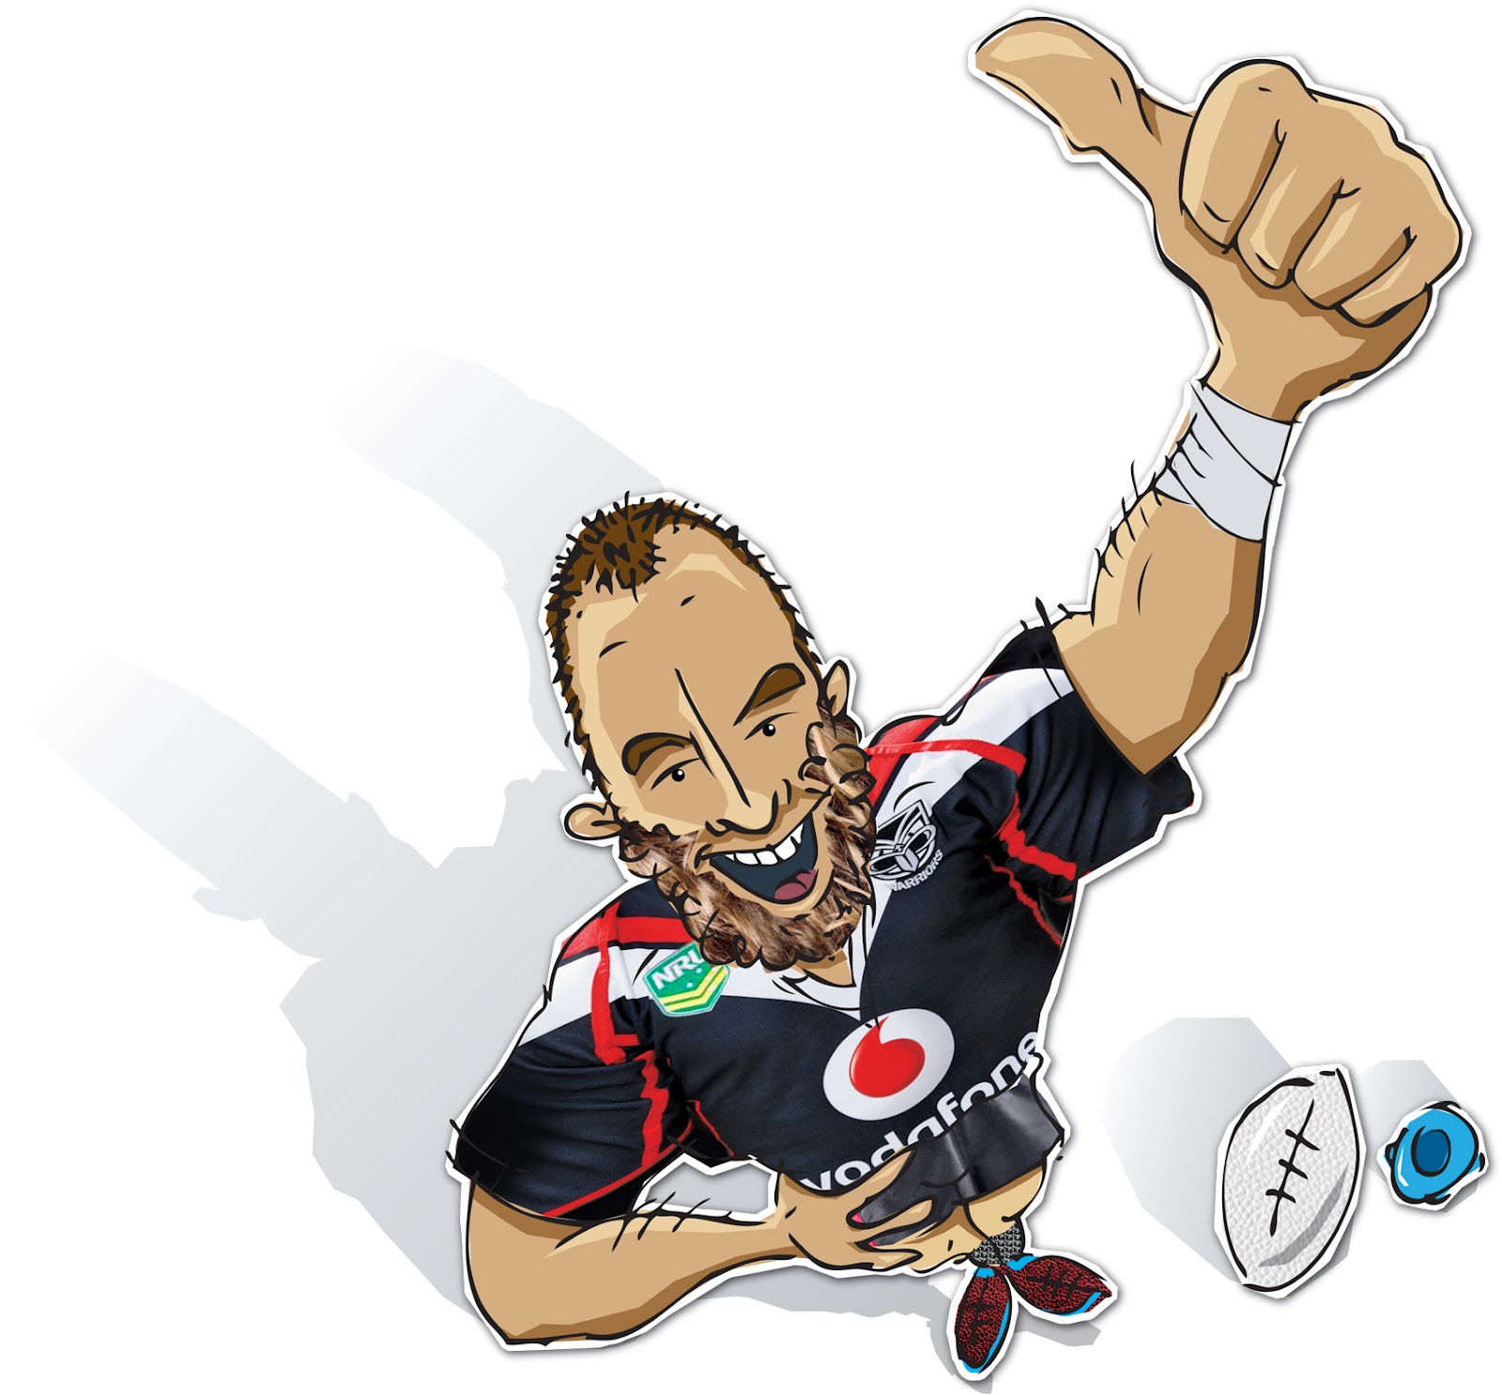
Editing Our Writing
We will now look at ways we can edit our writing to make more sense and flow better.

Slide 35
Paragraphs
Paragraphs make our writing easier for the reader to read and understand our story.
Paragraphs are a group of sentences about a similar idea.
You should break your story up into paragraphs to make it easier to see your different ideas.
You can have paragraphs for the beginning, middle parts and end of your story.

Slide 36
Grammar
Here are some ideas for editing the grammar of your story:
Check for capitals letters – they should be used at the start of a sentence, for peoples names, and place names.
Make sure you break up your ideas by creating sentences with full stops.
Use speech marks when someone is talking – “Oh no, watch out!” said Fred.

Slide 37
Grammar
Here are some ideas for editing the grammar of your story:
Type your story into a Word Document or a Google Doc and it will indicate any errors in grammar by underlining them.
Read your story out loud to yourself or a friend.
Ask a classmate to read over your story and highlight any errors.

Slide 38
Timeline
Term 1 and Term 2 2024 children create their stories in schools & kura.
Entries close 5 July 2024 (last day of Term 2) at 3pm.
Judges shortlist and choose winners.
Term 3 2024- 3 winning authors announced at their schools.
Artwork, editing and publishing ready for Go Media Stadium, Mt Smart Warriors game NRL Season 2024.
Winners hosted along with parents/carers and sponsors.
Books published and distributed across Aotearoa.

Slide 39
Thank you to our wonderful sponsors!
Email us at admin@wcf.kiwi for more information or programme feedback

Slide 40
Thank you to our creative teams!

