Slide 1
How Does One Define an
"Energy Efficient" HPC System? From Data to Action
Andreas Wierse, Julita Corbalan,
Jean-Olivier Gerphagnon, Bastian Koller,
Per Öster, Ondřej Vysocký
ANNOTATION

Slide 2

Our Panelists
Andreas Wierse, SICOS BW GmbH (Moderator)
Ondřej Vysocký, IT4Innovations
Jean-Olivier Gerphagnon, Eviden
Per Öster, CSC – IT-Center for Science
Julita Corbalan, Barcelona Supercomputing Center (BSC)
Bastian Koller, High Performance Computing Centre Stuttgart (HLRS)

Slide 3
Our Topic
How Does One Define an "Energy Efficient" HPC System?
From Data to Action!
Representatives of the European HPC value chain - HW, SW providers, infrastructure providers and organisations or companies involved in measuring the environmental footprint of HPC systems come together in this session to answer the following questions:

Slide 4
The Questions
What else apart from energy consumption should be measured, and to what detail?
To what extent should one look at factors other than energy consumption (e.g. SW) and include the broader environmental impact, spanning from the extraction of raw materials for component manufacturing to the expenses associated with decommissioning?
What is the minimum set of data or criteria that a reliable measurement should include?
Apart from the data-level, what are the expectations from the SW stack in terms of SW-level monitoring?
Are there any successful use cases of systems where such a model has been implemented?
Are there any existing examples of metrics that could serve as the skeleton of a standard?
Is there any simple way to establish a measurement that would enable comparisons?
Once such a model is established, how detailed should it be?
What approximate level of granularity should it be based on?

Slide 5
The Questions
What else apart from energy consumption should be measured, and to what detail?
To what extent should one look at factors other than energy consumption (e.g. SW) and include the broader environmental impact, spanning from the extraction of raw materials for component manufacturing to the expenses associated with decommissioning?
What is the minimum set of data or criteria that a reliable measurement should include?
Apart from the data-level, what are the expectations from the SW stack in terms of SW-level monitoring?
Are there any successful use cases of systems where such a model has been implemented?
Are there any existing examples of metrics that could serve as the skeleton of a standard?
Is there any simple way to establish a measurement that would enable comparisons?
Once such a model is established, how detailed should it be?
What approximate level of granularity should it be based on?

Slide 6

Mentimeter
Warm-Up questions:
  Who is here?
  What efficiency metrics of the system
  you use/operate are tracked?
  In what granularity are the systems measured
  that you typically use/operate?
  Join at menti.com | use code 3876 9437

Slide 7
Ondřej Vysocký
IT4Innovations

Slide 8
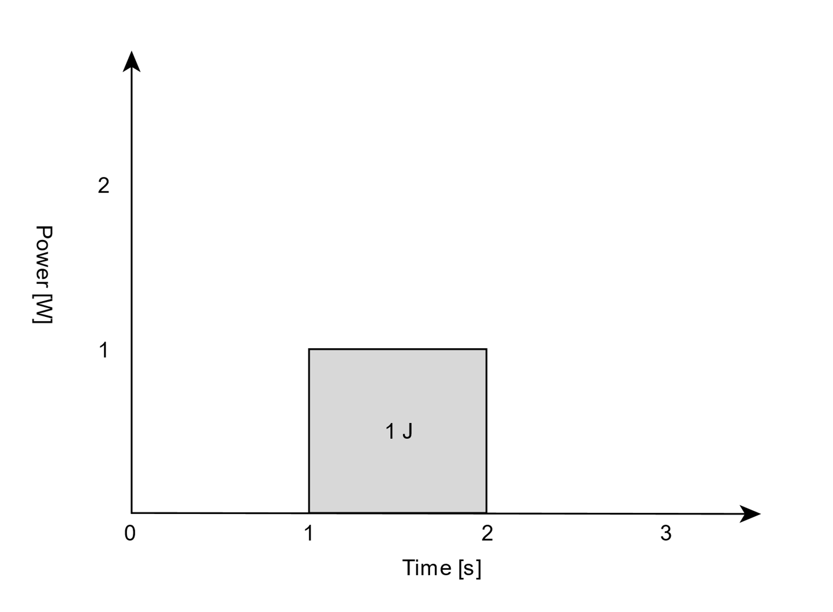
Power [W]
1 W * 1 s = 1 J
1 W * 1 h = 1 Wh = 3 600 J

Slide 9
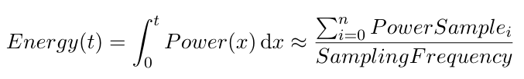
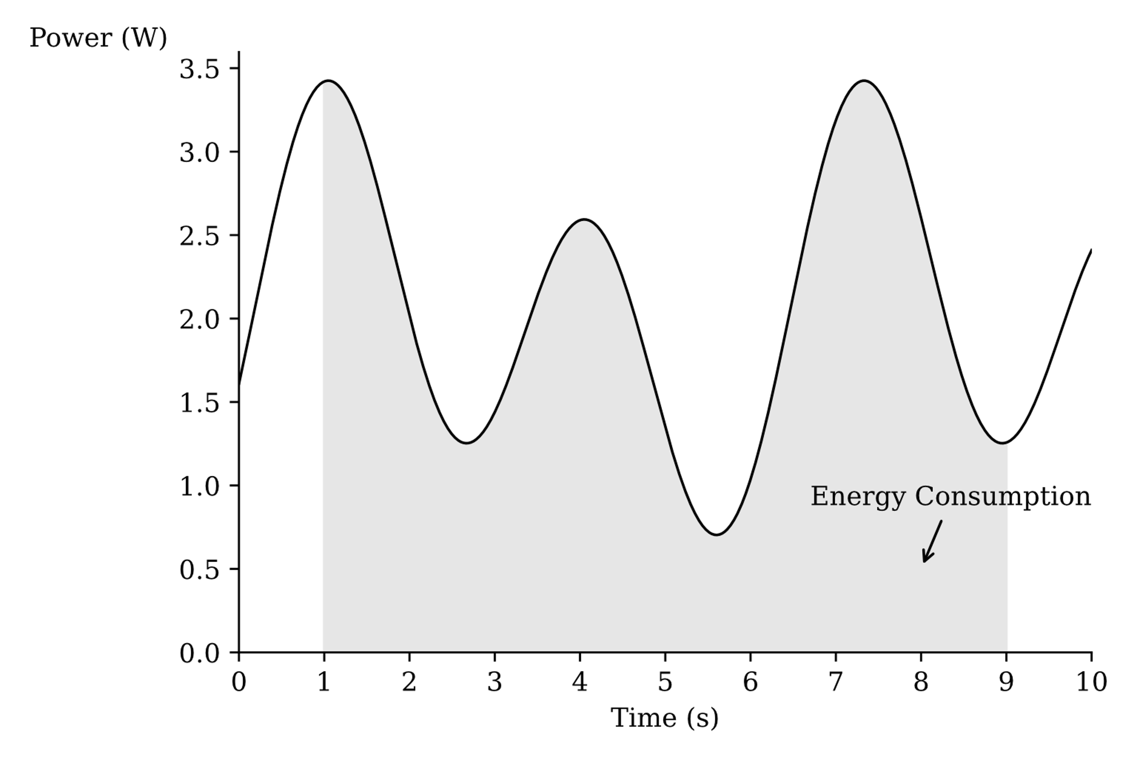
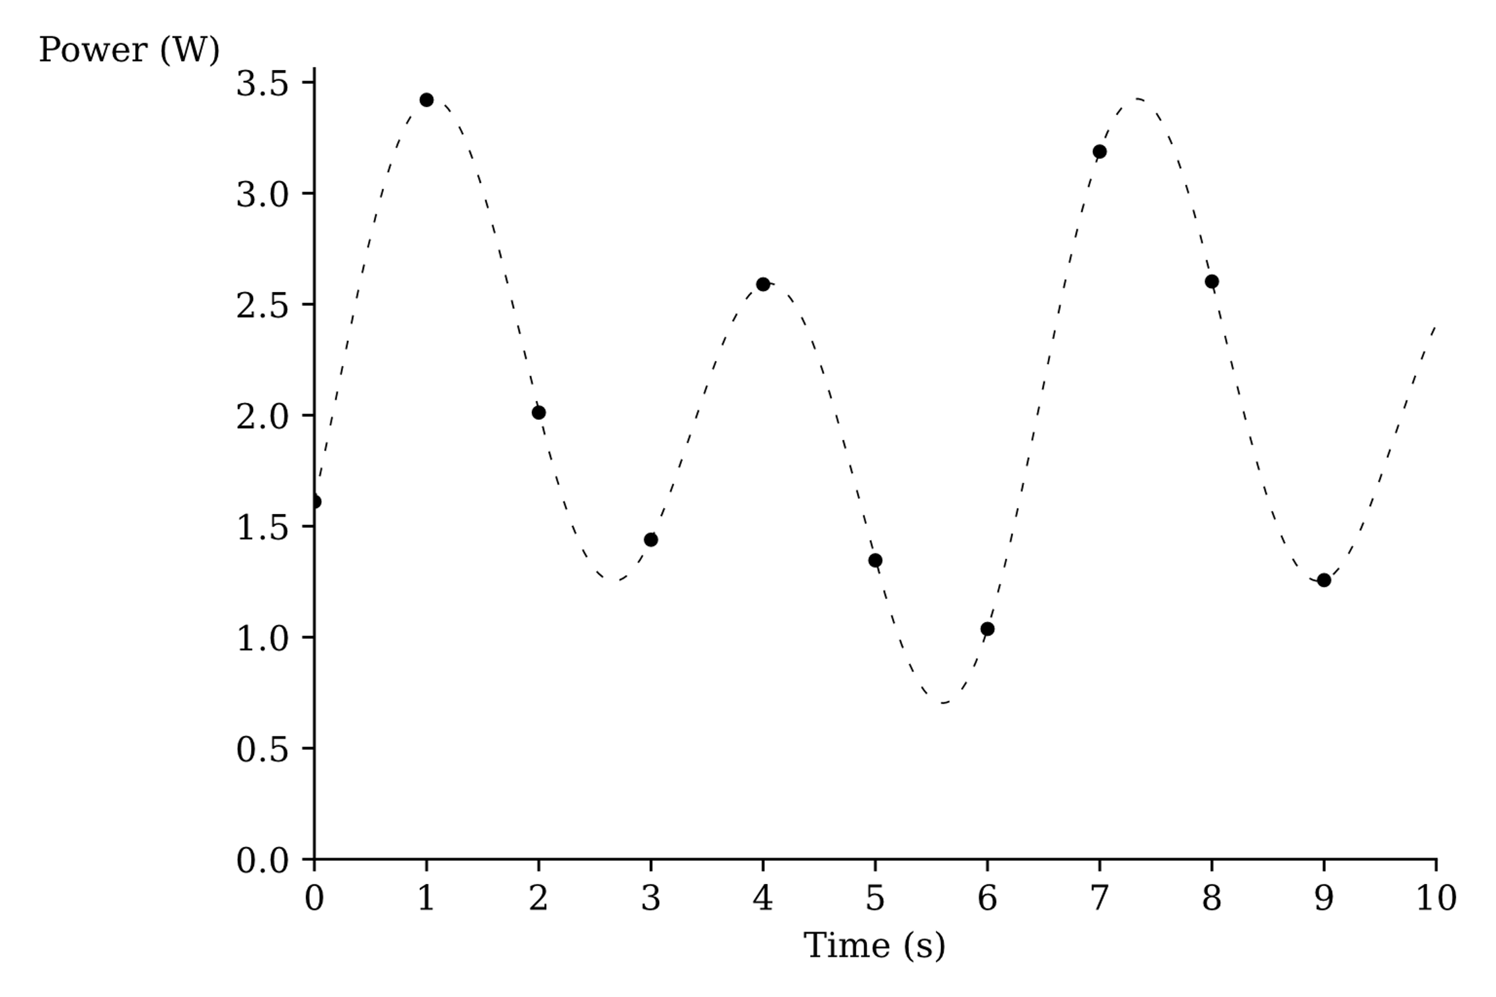
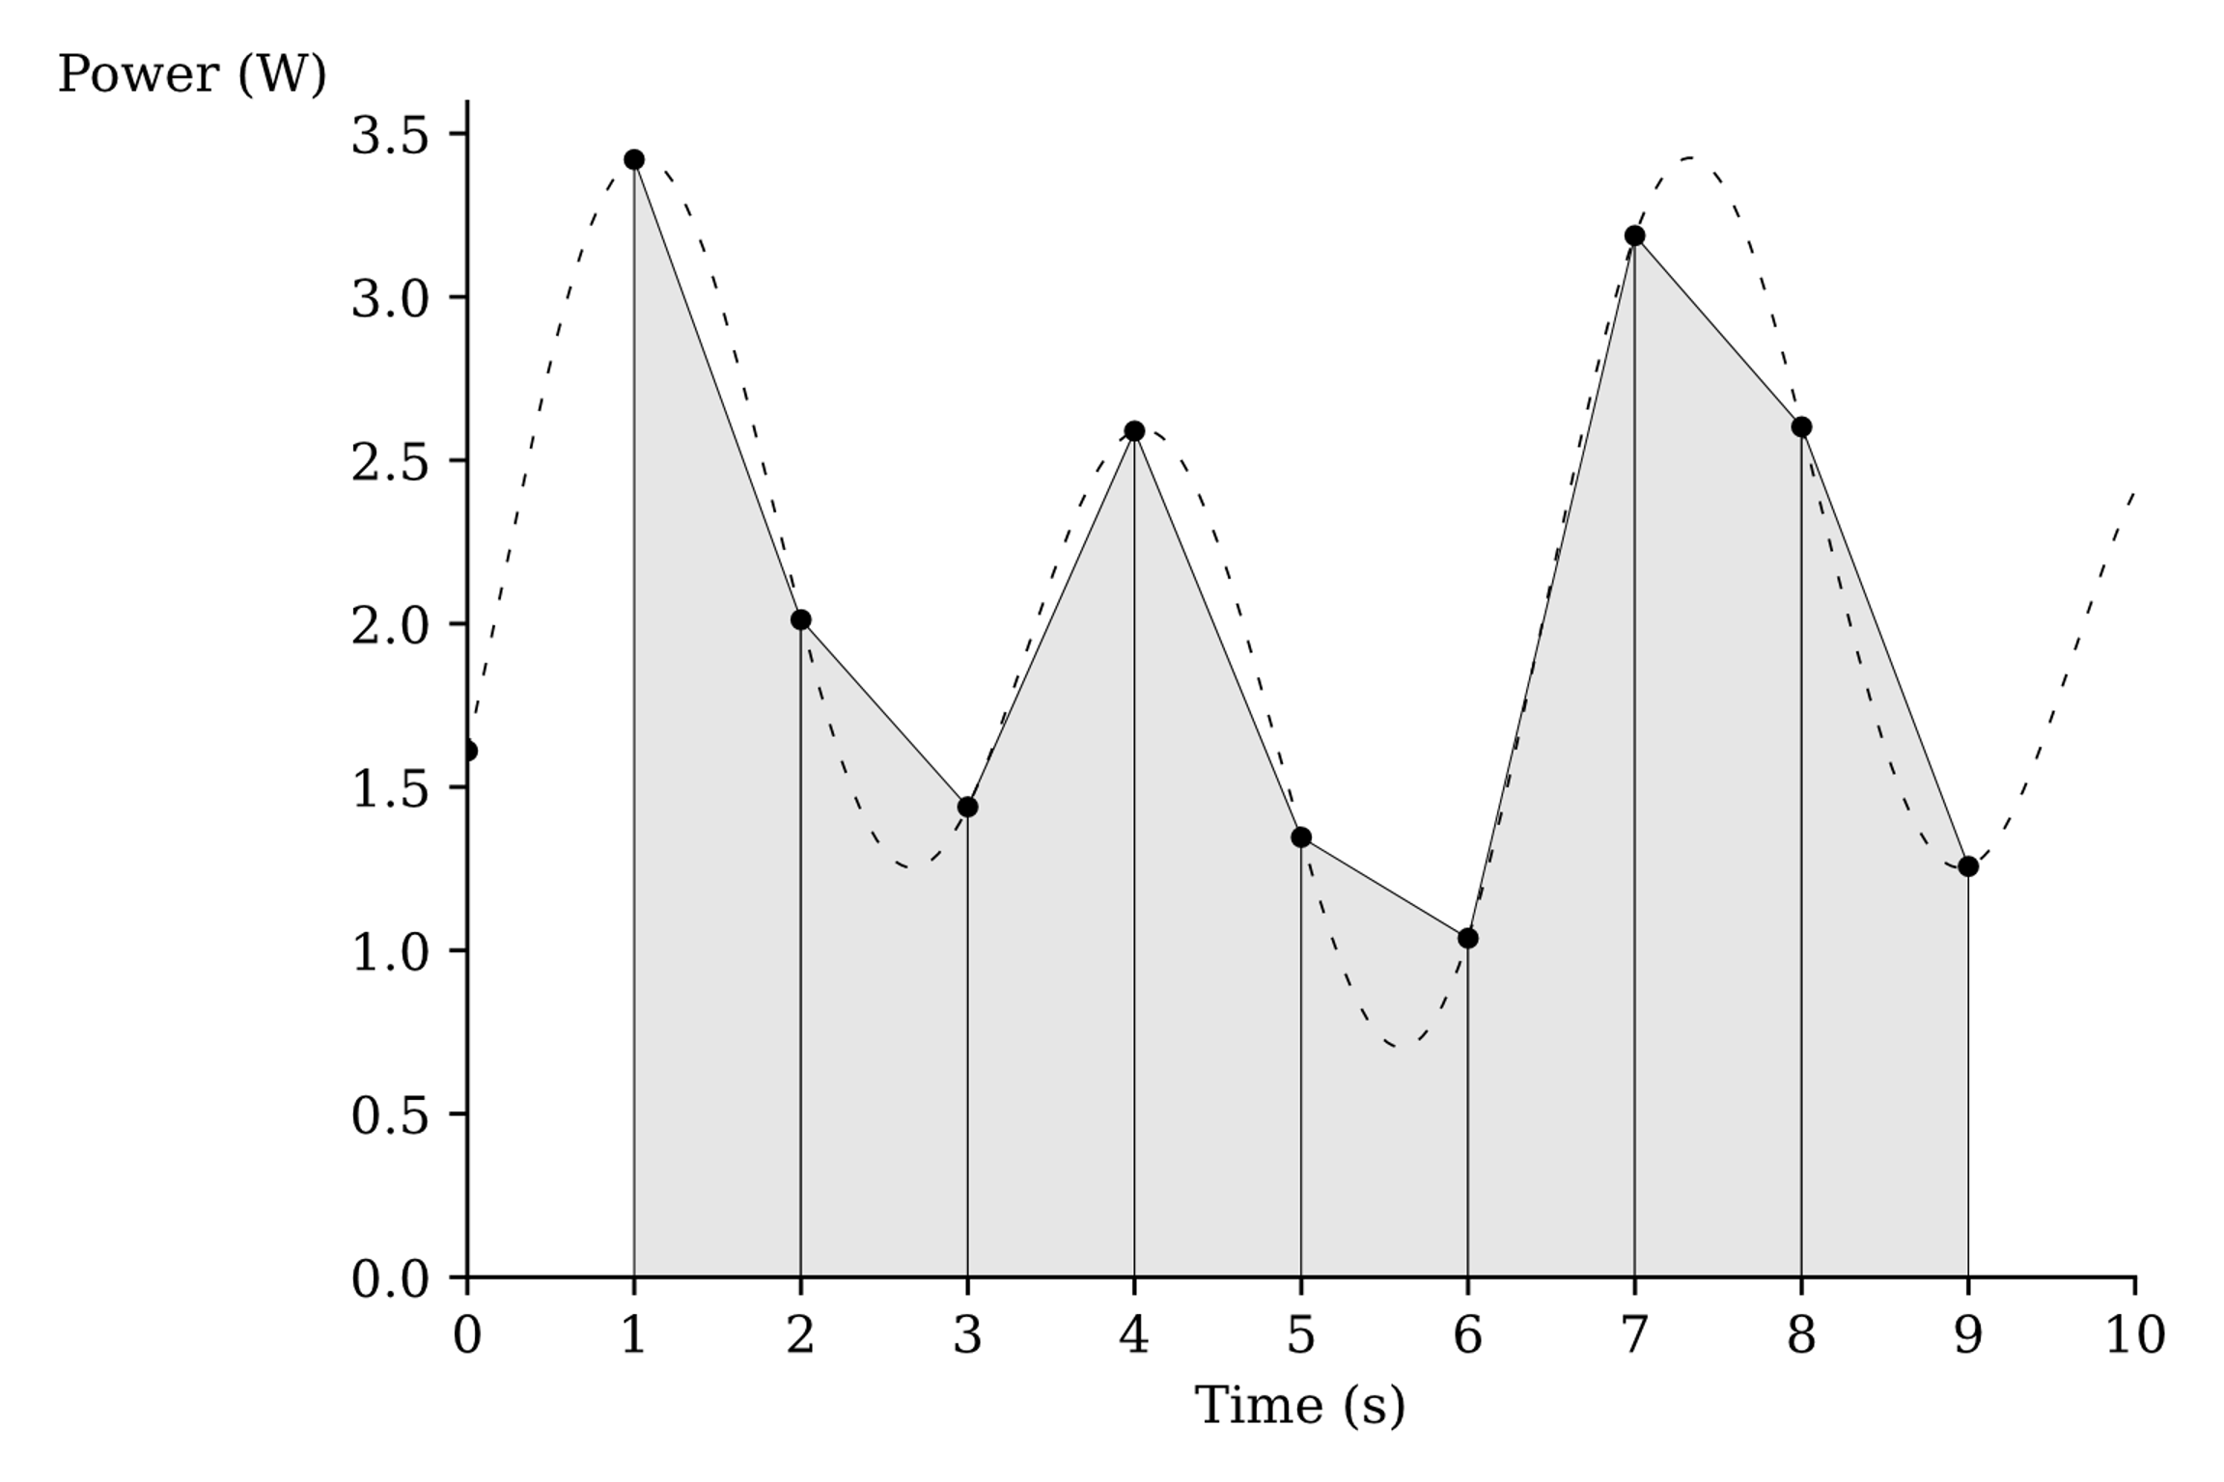
Img source, Luís Cruz (TU Delft)

Slide 10

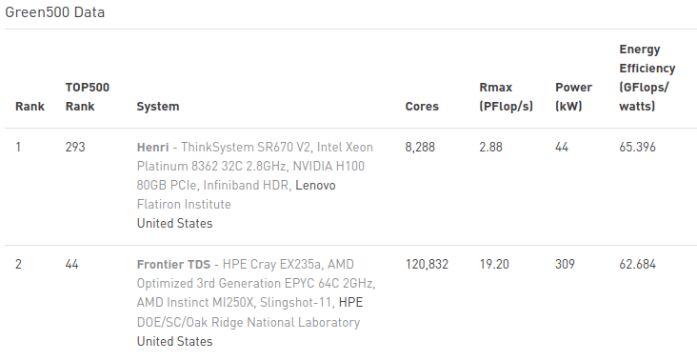
Energy efficiency
FLOPs/W

Slide 11
Energy efficiency
FLOPs/W
Rpeak/W

Slide 12
Energy efficiency
FLOPs/W
Rpeak/W
LUPs/W
(Lattice Boltzmann methods)

Slide 13

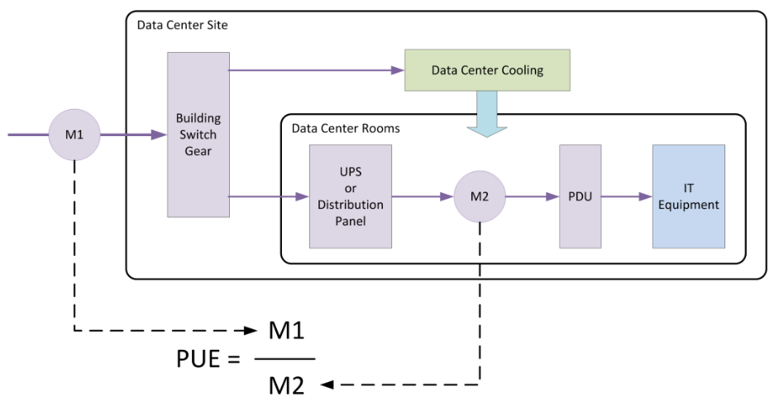
PUE
Power Usage Efficiency
Time window?
source, Better Buildings, U.S. Department of Energy
https://betterbuildingssolutioncenter.energy.gov/sites/default/files/Get_On_Board.pdf
Notes:
https://betterbuildingssolutioncenter.energy.gov/sites/default/files/Get_On_Board.pdf
Average industry PUE = 1.67
Most efficient DC PUE = 1.13

Slide 14
PUE
Power Usage Efficiency
Time window?
Trailing Twelve-Month (TTM) PUE
source, Better Buildings, U.S. Department of Energy
https://betterbuildingssolutioncenter.energy.gov/sites/default/files/Get_On_Board.pdf
Notes:
https://betterbuildingssolutioncenter.energy.gov/sites/default/files/Get_On_Board.pdf
Average industry PUE = 1.67
Most efficient DC PUE = 1.13

Slide 15
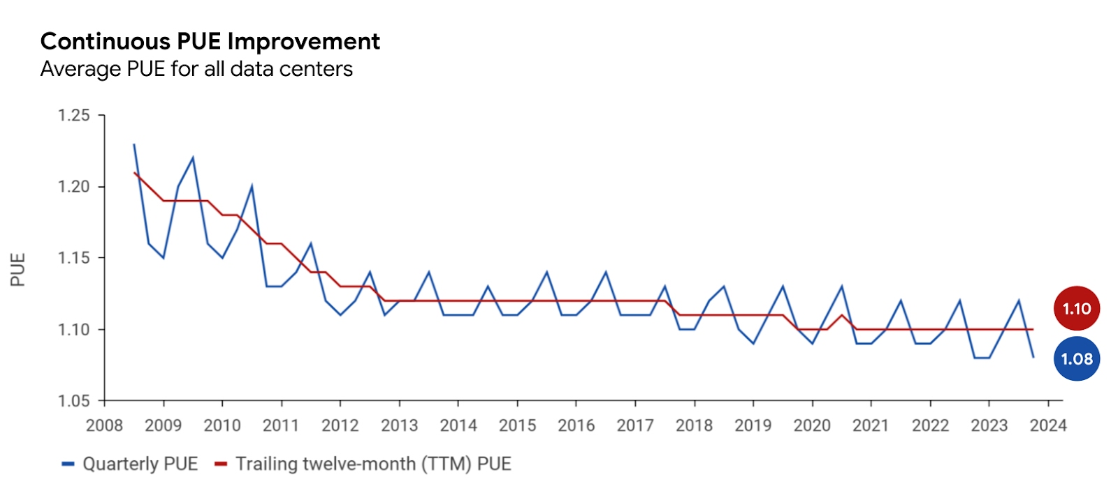
PUE
PUE data for all
large-scale Google
Data Centers
https://www.google.com/about/datacenters/efficiency/#measuring-efficiency
Notes:
https://betterbuildingssolutioncenter.energy.gov/sites/default/files/Get_On_Board.pdf

Slide 16
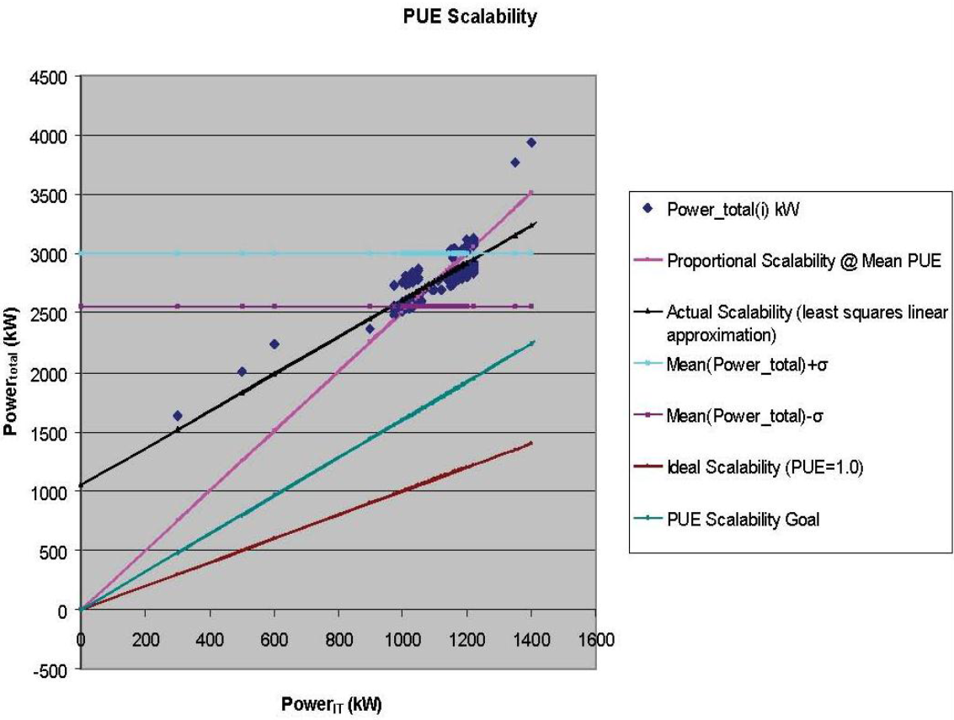
PUE scalability
Load
External conditions
Power total [kW]
Power IT [kW]
https://datacenters.lbl.gov/sites/default/files/WP49-PUE%20A%20Comprehensive%20Examination%20of%20the%20Metric_v6.pdf

Slide 17
DC efficiency is not just the energy
Energy
  CO₂ emissions – renewable energy sources (sustainablility)
  Green Energy Consumed (GEC)
Cooling efficiency
  Heat re-use
  Free cooling
Water

Slide 18
PUE family
ERE = Energy Reuse Effectiveness

Slide 19

PUE family
ERE = Energy Reuse Effectiveness
ITUE = IT Usage Effectiveness

Slide 20
PUE family
ERE = Energy Reuse Effectiveness
ITUE = IT Usage Effectiveness
CUE = Carbon Usage Effectiveness

Slide 21

PUE family
ERE = Energy Reuse Effectiveness
ITUE = IT Usage Effectiveness
CUE = Carbon Usage Effectiveness
WUE = Water Usage Effectiveness

Slide 22
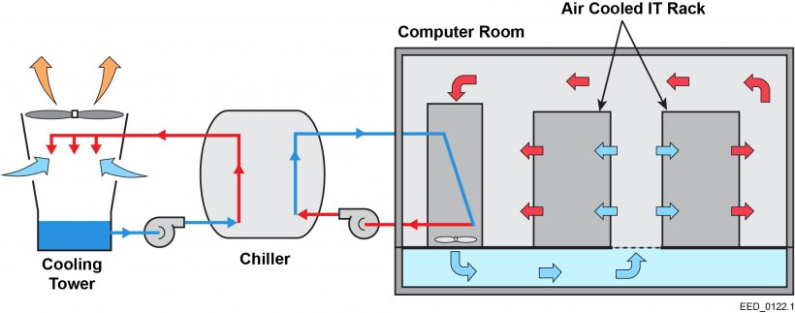
Water savings
Space temperature and humidity control
Air management
Maximizing Cycles of concetration
Thermal storage
Reverse osmosis
https://www.energy.gov/femp/cooling-water-efficiency-opportunities-federal-data-centers

Slide 23
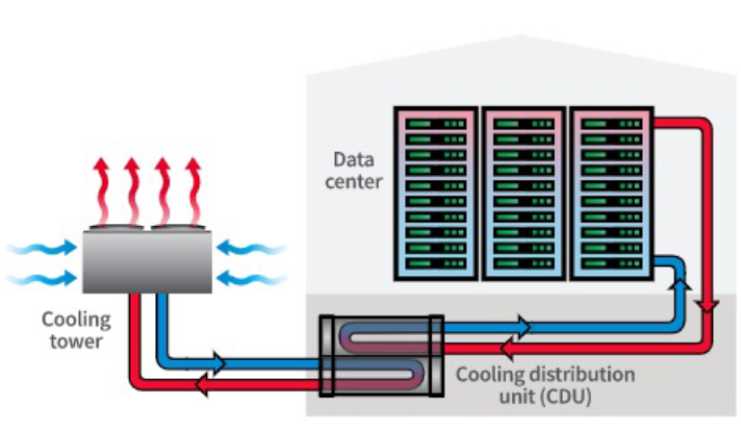
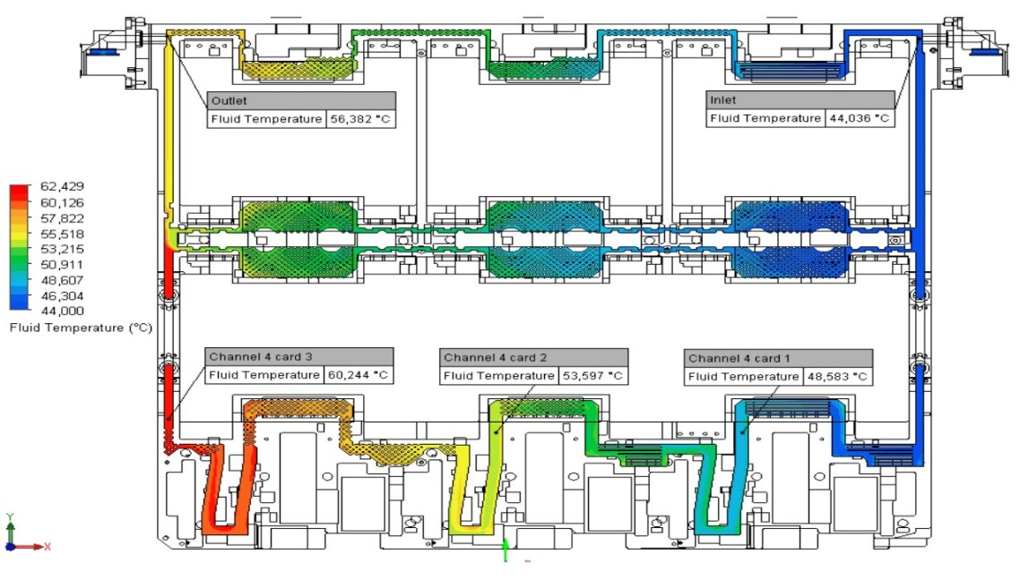
Warm water direct liquid cooling
Liquids require significantly less energy
Liquid cooling - Thermal stability, space efficiency
Warm water cooling
  Eliminates inefficient and expensive chillers
  Eliminates condensation concerns
  Better waste heat re-use options
  Save wasted fan energy and use it for computing
  Prevents thermal capping
Img source Atos, and Supermicro
Notes:
https://www.supermicro.com/white_paper/eGuide_Data_Center_Refresh.pdf

Slide 24
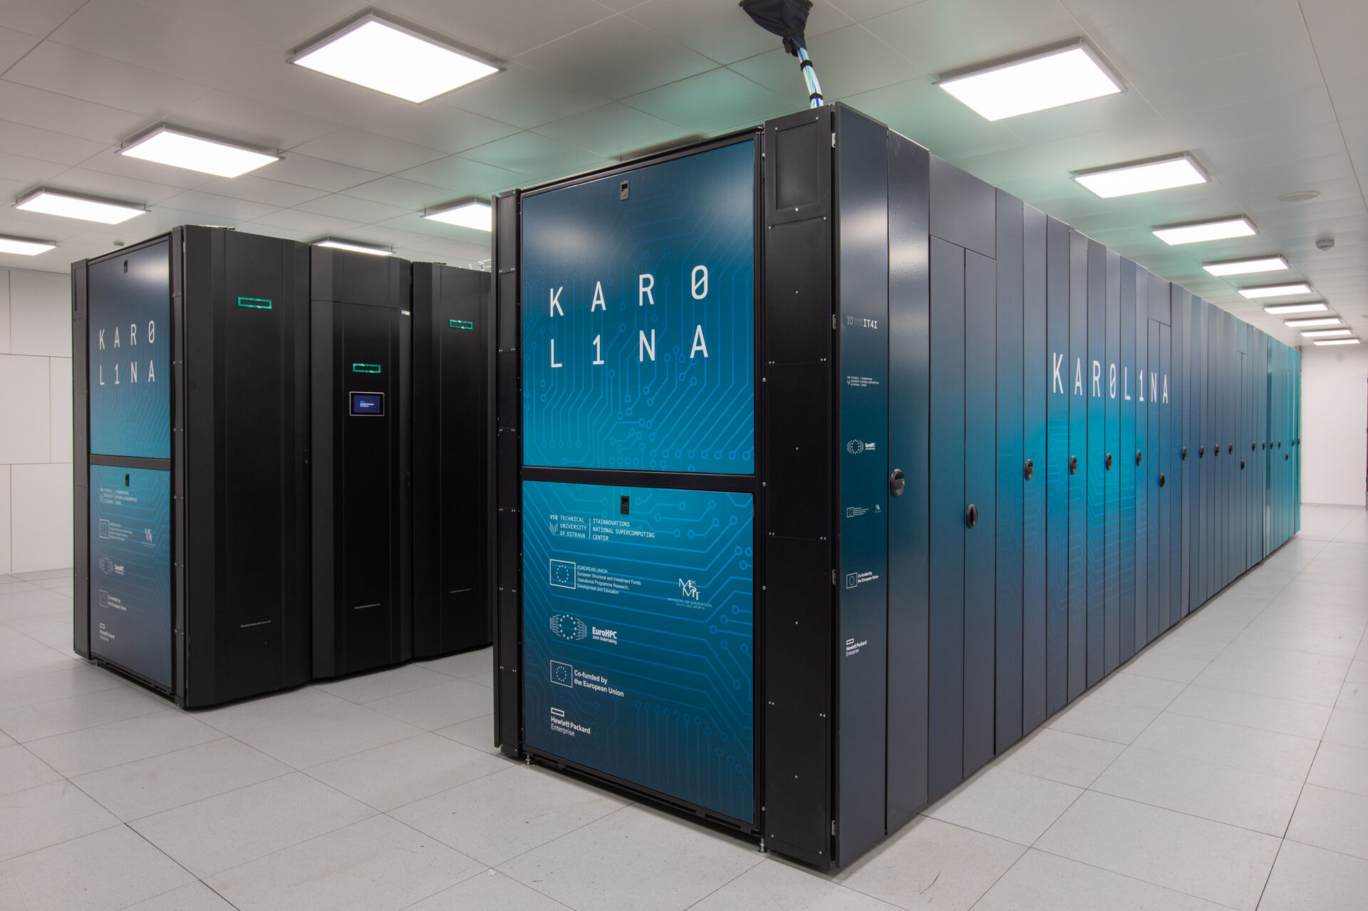
EuroHPC Karolina
From 1.2. 2023
~0,06 PUE increase
-
Notes:
https://betterbuildingssolutioncenter.energy.gov/sites/default/files/Get_On_Board.pdf
Average industry PUE = 1.67
Most efficient DC PUE = 1.13

Slide 25

PUE alternatives
CPE = compute power efficiency
DCeP = Data Center Energy Productivity

Slide 26
Jean-Olivier Gerphagnon
Eviden

Slide 27

Objectives
=
Reality
=
How does One Define An ‘Energy Efficient’ HPC System?
From Data to Action
Author and Date

Slide 28



Objectives
=
Reality
=
If (im)possible
How does One Define An ‘Energy Efficient’ HPC System?
From Data to Action
Author and Date

Slide 29

BUT
How does One Define An ‘Energy Efficient’ HPC System?
From Data to Action

Slide 30
BUT
How does One Define An ‘Energy Efficient’ HPC System?
From Data to Action
What to measure?
How to measure?
For which purpose?
Easy to compare?

Slide 31
BUT
How does One Define An ‘Energy Efficient’ HPC System?
From Data to Action
What to measure?
How to measure?
For which purpose?
However…
what is « efficiency »?
Easy to compare?

Slide 32

Gathering
Steps
How does One Define An ‘Energy Efficient’ HPC System?
From Data to Action
Data

Slide 33
Gathering
Steps
How does One Define An ‘Energy Efficient’ HPC System?
From Data to Action
Data
= Monitoring

Slide 34

Gathering
Modeling
Steps
How does One Define An ‘Energy Efficient’ HPC System?
From Data to Action
Data
Data

Slide 35

Gathering
Modeling
Understanding
Steps
How does One Define An ‘Energy Efficient’ HPC System?
From Data to Action
Data
Data
Data

Slide 36

Gathering
Modeling
Understanding
Using
Steps
How does One Define An ‘Energy Efficient’ HPC System?
From Data to Action
Data
Data
Data
Data

Slide 37

Gathering
Modeling
Understanding
Using
Improving
Steps
How does One Define An ‘Energy Efficient’ HPC System?
From Data to Action
Data
Data
Data
Data
Efficiency

Slide 38
Gathering
Modeling
Understanding
Using
Improving
Steps
How does One Define An ‘Energy Efficient’ HPC System?
From Data to Action
Data
Data
Data
Data
Efficiency
Data
Action

Slide 39
Gathering
Modeling
Understanding
Using
Improving
Steps
How does One Define An ‘Energy Efficient’ HPC System?
From Data to Action
Data
Data
Data
Data
Efficiency
Energy
Performance
Logs
Power
Metrics
Results
Hardware
Counters
Metrics
Events

Slide 40
Gathering
Modeling
Understanding
Using
Improving
Steps
How does One Define An ‘Energy Efficient’ HPC System?
From Data to Action
Data
Data
Data
Data
Efficiency
Time
Complexity
Challenges
Reproducibility
HW/SW
Dependencies

Slide 41
Gathering
Modeling
Understanding
Using
Improving
Steps
How does One Define An ‘Energy Efficient’ HPC System?
From Data to Action
Data
Data
Data
Data
Efficiency
Time
Medium
Low to Medium
High
High
?
Complexity
Low
Low
Medium
High
Very High
Challenges
Reproducibility
High
High
Medium
?
?
HW/SW
Dependencies
Medium
Low
?
High
High

Slide 42
Gathering
Modeling
Understanding
Using
Improving
Steps
How does One Define An ‘Energy Efficient’ HPC System?
From Data to Action
Data
Data
Data
Data
Efficiency
Time
Medium
Low to Medium
High
High
?
Complexity
Low
Low
Medium
High
Very High
Challenges
Reproducibility
High
High
Medium
?
?
HW/SW
Dependencies
Medium
Low
?
High
High

Slide 43
Where a provider may be involved?
How does One Define An ‘Energy Efficient’ HPC System?
From Data to Action

Slide 44





Where a provider may be involved?
Why
Design
=
Architecture
(or any other ☺)
Solution
Tools
Standards
Interfaces
How does One Define An ‘Energy Efficient’ HPC System?
From Data to Action

Slide 45

Why a provider may be involved?
Design
=
Architecture
(or any other ☺)
Solution
Tools
Standards
Interfaces
How does One Define An ‘Energy Efficient’ HPC System?
From Data to Action
Requirements have to be specified in tenders
Hardware
+
Software
+
Service
=
Solution
Author and Date

Slide 46
Why a provider may be involved?
(or any other ☺)
Hardware
+
Software
+
Service
Env. Footprint
How does One Define An ‘Energy Efficient’ HPC System?
From Data to Action
Energy Efficiency
Reliability
Monitor
Re-use
(inc. standards)

Slide 47
Why a provider may be involved?
(or any other ☺)
Hardware
+
Software
+
Service
Env. Footprint
Components type & origin
Transports & Packaging
Easy to replace
Reduced number of components
How does One Define An ‘Energy Efficient’ HPC System?
From Data to Action
Heat dissipation
Water usage
Energy Efficiency
Power convertor
Heat re-use
Efficient cooling
Power control
Resiliency
High MTBF
Reliability
Quality control
Sensors
(in/out band)
Frequency
Monitor
Quality
Interfaces
Re-use
Standard slots
Next-gen ready
(inc. standards)
Capacity enhancement
(cooling, power, etc.)

Slide 48
Why a provider may be involved?
(or any other ☺)
Hardware
+
Software
+
Service
Env. Footprint
Components type & origin
Environmental aware
DevOps
Transports & Packaging
Easy to replace
Efficient software
(code analysis, etc.)
Reduced number of components
Run less model
How does One Define An ‘Energy Efficient’ HPC System?
From Data to Action
Heat dissipation
Water usage
Run less model
Energy Efficiency
Power convertor
@Runtime live
optimization
Heat re-use
Efficient cooling
Power control
Monitor Data
Resiliency
High MTBF
Validation
Native HA
Reliability
Up-to-date
Quality control
Code Analysis
Live management
Sensors
(in/out band)
Frequency
Non-impacting data gathering
Monitor
Granularity
Infra-oriented
Historical
Quality
Interfaces
Job-oriented
Re-use
Standard slots
Next-gen ready
Open-source based
Rely on APIs
(inc. standards)
Capacity enhancement
(cooling, power, etc.)
Open-access model
EU projects

Slide 49
Why a provider may be involved?
(or any other ☺)
Hardware
+
Software
+
Service
Env. Footprint
Components type & origin
Environmental aware
DevOps
Expertise
Integration
Transports & Packaging
Easy to replace
Efficient software
(code analysis, etc.)
Reduced number of components
Run less model
How does One Define An ‘Energy Efficient’ HPC System?
From Data to Action
Heat dissipation
Water usage
Run less model
Energy Efficiency
Power convertor
@Runtime live
optimization
Heat re-use
Efficient cooling
Power control
Monitor Data
Resiliency
High MTBF
Validation
Native HA
Reliability
Up-to-date
Quality control
Code Analysis
Live management
Sensors
(in/out band)
Frequency
Non-impacting data gathering
Monitor
Granularity
Infra-oriented
Historical
Quality
Interfaces
Job-oriented
Re-use
Standard slots
Next-gen ready
Open-source based
Rely on APIs
(inc. standards)
Capacity enhancement
(cooling, power, etc.)
Open-access model
EU projects

Slide 50
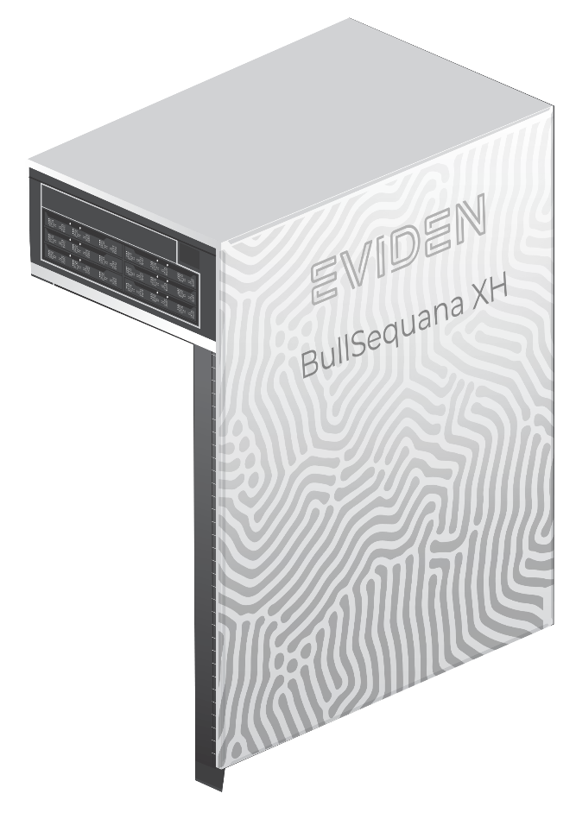
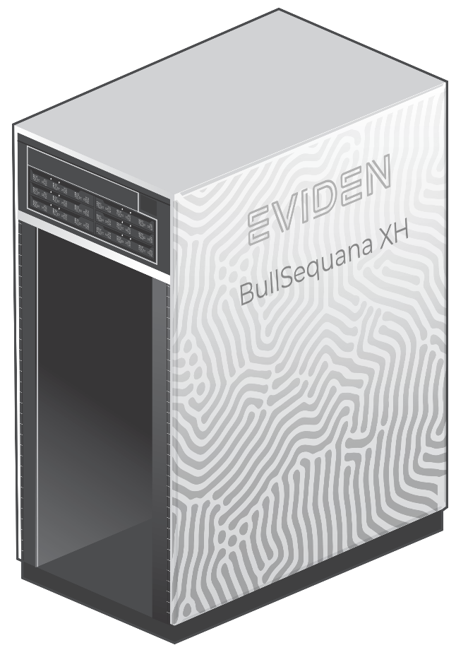



Why a provider may be involved?
(or any other ☺)
Hardware
+
Software
+
Service
=
Solution
Env. Footprint
Components type & origin
Environmental aware
DevOps
Transports & Packaging
Easy to replace
Efficient software
(code analysis, etc.)
Expertise
Integration
Reduced number of components
Run less model
How does One Define An ‘Energy Efficient’ HPC System?
From Data to Action
Heat dissipation
Water usage
Run less model
Energy Efficiency
Power convertor
@Runtime live
optimization
Heat re-use
Expertise
Integration
Efficient cooling
Power control
Monitor Data
Resiliency
High MTBF
Validation
Native HA
Reliability
Up-to-date
Expertise
Integration
Quality control
Code Analysis
Live management
Sensors
(in/out band)
Frequency
Non-impacting data gathering
Monitor
Granularity
Infra-oriented
Historical
Expertise
Integration
Quality
Interfaces
Job-oriented
Smart Energy
Management Suite
Re-use
Standard slots
Next-gen ready
Open-source based
Rely on APIs
(inc. standards)
Capacity enhancement
(cooling, power, etc.)
Expertise
Integration
Performance Studio
Open-access model
EU projects

Slide 51

Why we must all be involved?
Hardware
+
Software
+
Service
=
Solution
Get & structure data (even if you don’t know yet why)
Share & combine data (users, sites, communities, providers, etc.)
Define (steped) targets of improvement
Set (realistic) requirements in tenders (and discuss far in advance)
Env. Footprint
Components type & origin
Environmental aware
DevOps
Transports & Packaging
Easy to replace
Efficient software
(code analysis, etc.)
Expertise
Integration
Reduced number of components
Run less model
How does One Define An ‘Energy Efficient’ HPC System?
From Data to Action
Heat dissipation
Water usage
Run less model
Energy Efficiency
Power convertor
@Runtime live
optimization
Heat re-use
Expertise
Integration
Efficient cooling
Power control
Monitor Data
Resiliency
High MTBF
Validation
Native HA
Reliability
Up-to-date
Expertise
Integration
Quality control
Code Analysis
Live management
Sensors
(in/out band)
Frequency
Non-impacting data gathering
Monitor
Infra-oriented
Historical
Expertise
Integration
Quality
Interfaces
Job-oriented
Re-use
Standard slots
Next-gen ready
Open-source based
Rely on APIs
(inc. standards)
Capacity enhancement
(cooling, power, etc.)
Expertise
Integration
Open-access model
EU projects

Slide 52
Where a provider may be involved?
(or any other ☺)
Hardware
+
Software
+
Service
=
Solution
WHY USE?
Env. Footprint
Components type & origin
Environmental aware
DevOps
Transports & Packaging
Easy to replace
Efficient software
(code analysis, etc.)
Expertise
Integration
Provide standard tools & frameworks
to speed-up the path on
efficiency bottleneck detection
based on standardized & shared production data
Reduced number of components
Run less model
How does One Define An ‘Energy Efficient’ HPC System?
From Data to Action
Heat dissipation
Water usage
Run less model
Energy Efficiency
Power convertor
@Runtime live
optimization
Heat re-use
Expertise
Integration
Efficient cooling
Power control
Monitor Data
Resiliency
High MTBF
Validation
Native HA
Reliability
Up-to-date
Expertise
Integration
Quality control
Code Analysis
Live management
Sensors
(in/out band)
Frequency
Non-impacting data gathering
Monitor
Infra-oriented
Historical
Expertise
Integration
Quality
Interfaces
Job-oriented
Re-use
Standard slots
Next-gen ready
Open-source based
Rely on APIs
(inc. standards)
Capacity enhancement
(cooling, power, etc.)
Expertise
Integration
Open-access model
EU projects

Slide 53
Per Öster
CSC – IT-Center for Science

Slide 54
How Does One Define an "Energy Efficient" HPC System? From Data to Action
LUMI Data Center, Cooling and Heat Reuse
Per Öster, CSC – IT Center for Science

Slide 55

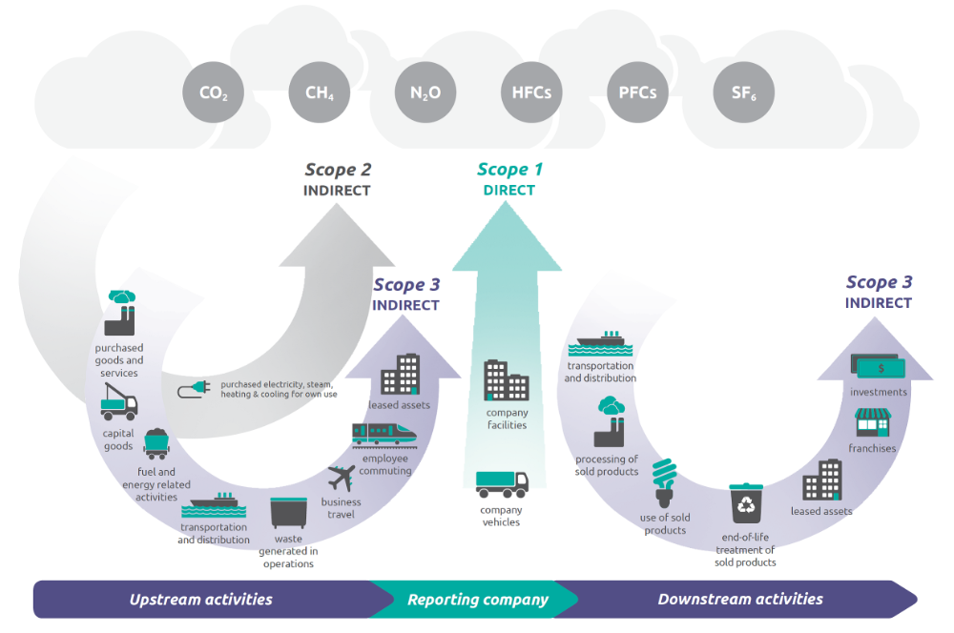


Slide 56
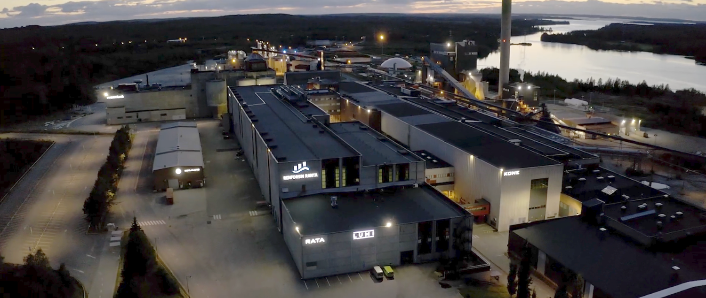
The green home of LUMI:
Renforsin Ranta Business Park, Kajaani, Finland

Slide 57
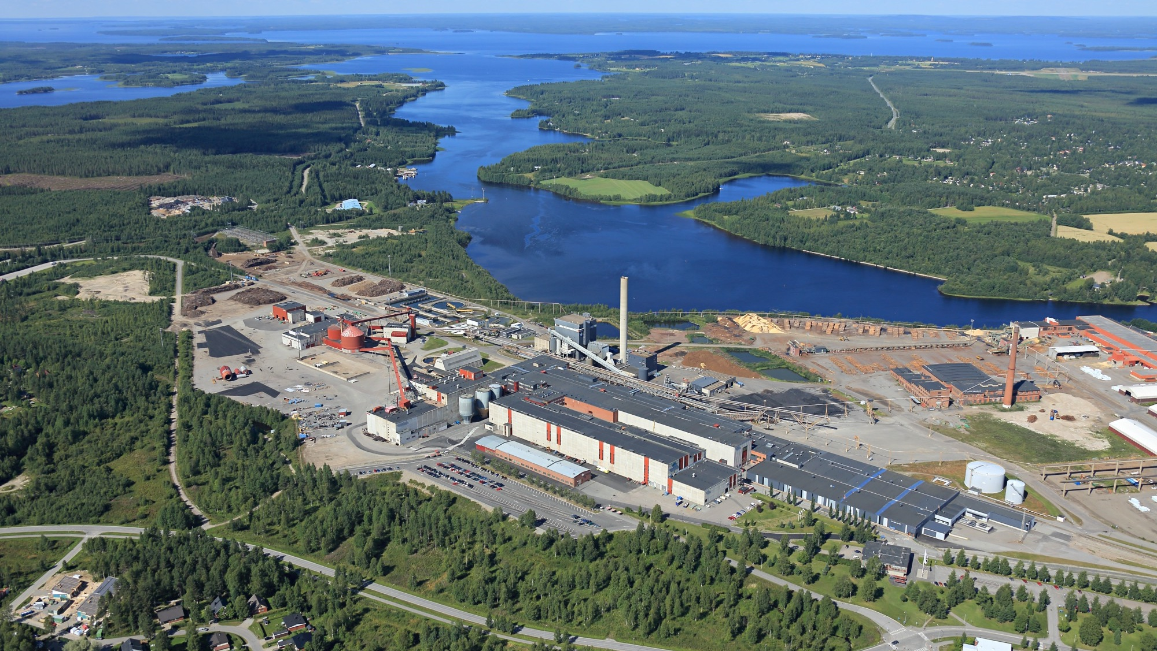







Home of LUMI
Renforsin Ranta Business Park, Kajaani Finland
National grid
substation (1000 MW)
Greenfield (200 ha)
Excess heat utilisation to district heat network
3 hydropower plants
In Kajaani river
3 x
230 MW existing
transformer capacity
LUMI Euro HPC
CSC’s national
supercomputers
Notes:
LUMI is located in an Old paper mill site that was shut down in 2008. The mill was transformed to a modern business park for data centers, and first CSC’s national datacenters were located to the are in 2012.
With LUMI we knew our options and also the benefits that the location could offer for the EuroHPC datacenter.
We had an option to a Greenfield project close to national grid substation with the 200 hectares of land (FLAG icon), but we selected a brownfield approach in an existing paper machine hall. Location is shown with snow icon in the middle.
This decision was justified with utilization of existing infrastructure, savings in expenses, time to market and the best ability to excess heat utilization.
District heating power plant is located where the temperature meter is.
And there is 3 hydro power plans in the distance of 2-3 km that feed the area.

Slide 58
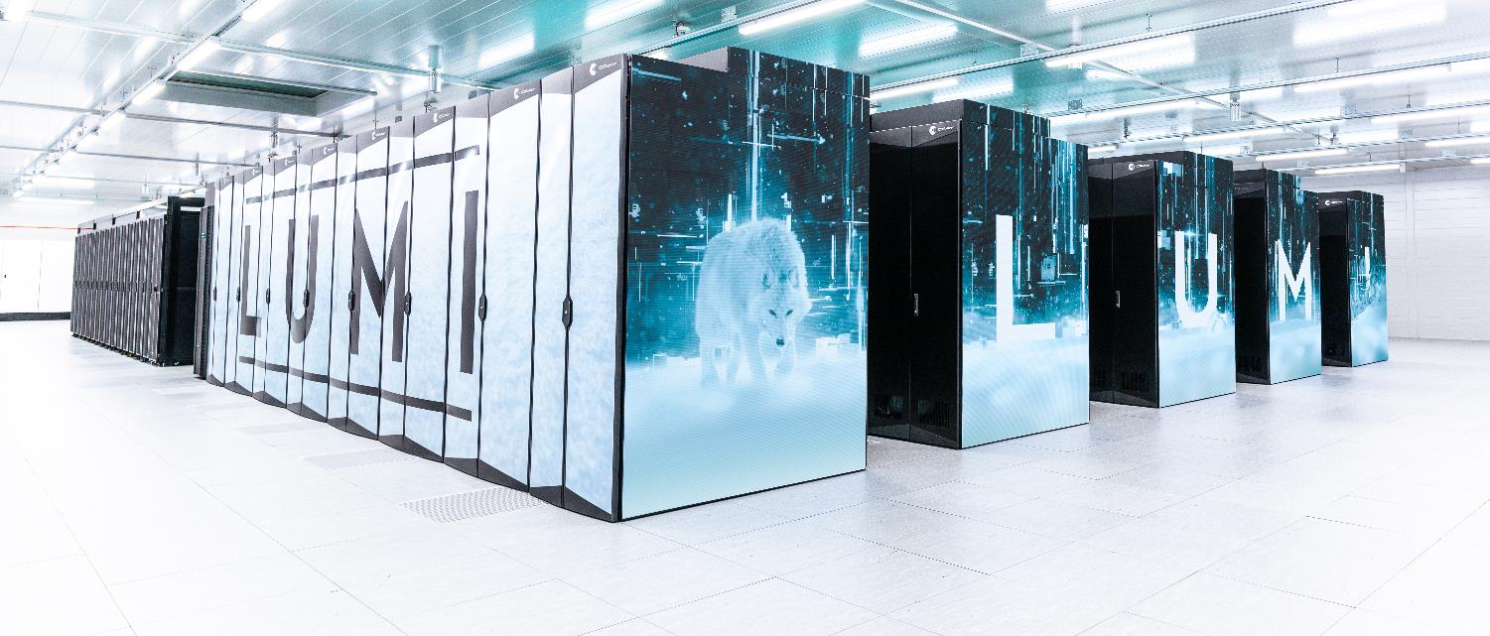

LUMI is an HPE Cray EX Supercomputer

Slide 59

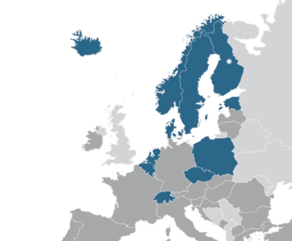
LUMI EuroHPC
Fastest Supercomputer in Europe
LUMI is a co-investment of eleven LUMI consortium countries (FI, BE, CH, CZ, DK, EE, IS, NL, NO, PL, SE) and the EU to build and operate a world-class supercomputer
The EuroHPC Joint Undertaking pools EU and national resources in high-performance computing
The total budget of LUMI in CSC’s data center in Kajaani, Finland, is over 202 M€ (50% EU and 50% the consortium countries)
The resources of LUMI are allocated proportionally to the investments. The share of the EuroHPC JU (50%) is allocated by a peer-review process and available for all European researchers
Notes:
Members: Nordics: Finland, Sweden, Norway, Denmark and Iceland
Estonia, Belgium, Czech Republic, Poland and Switzerland.

Slide 60
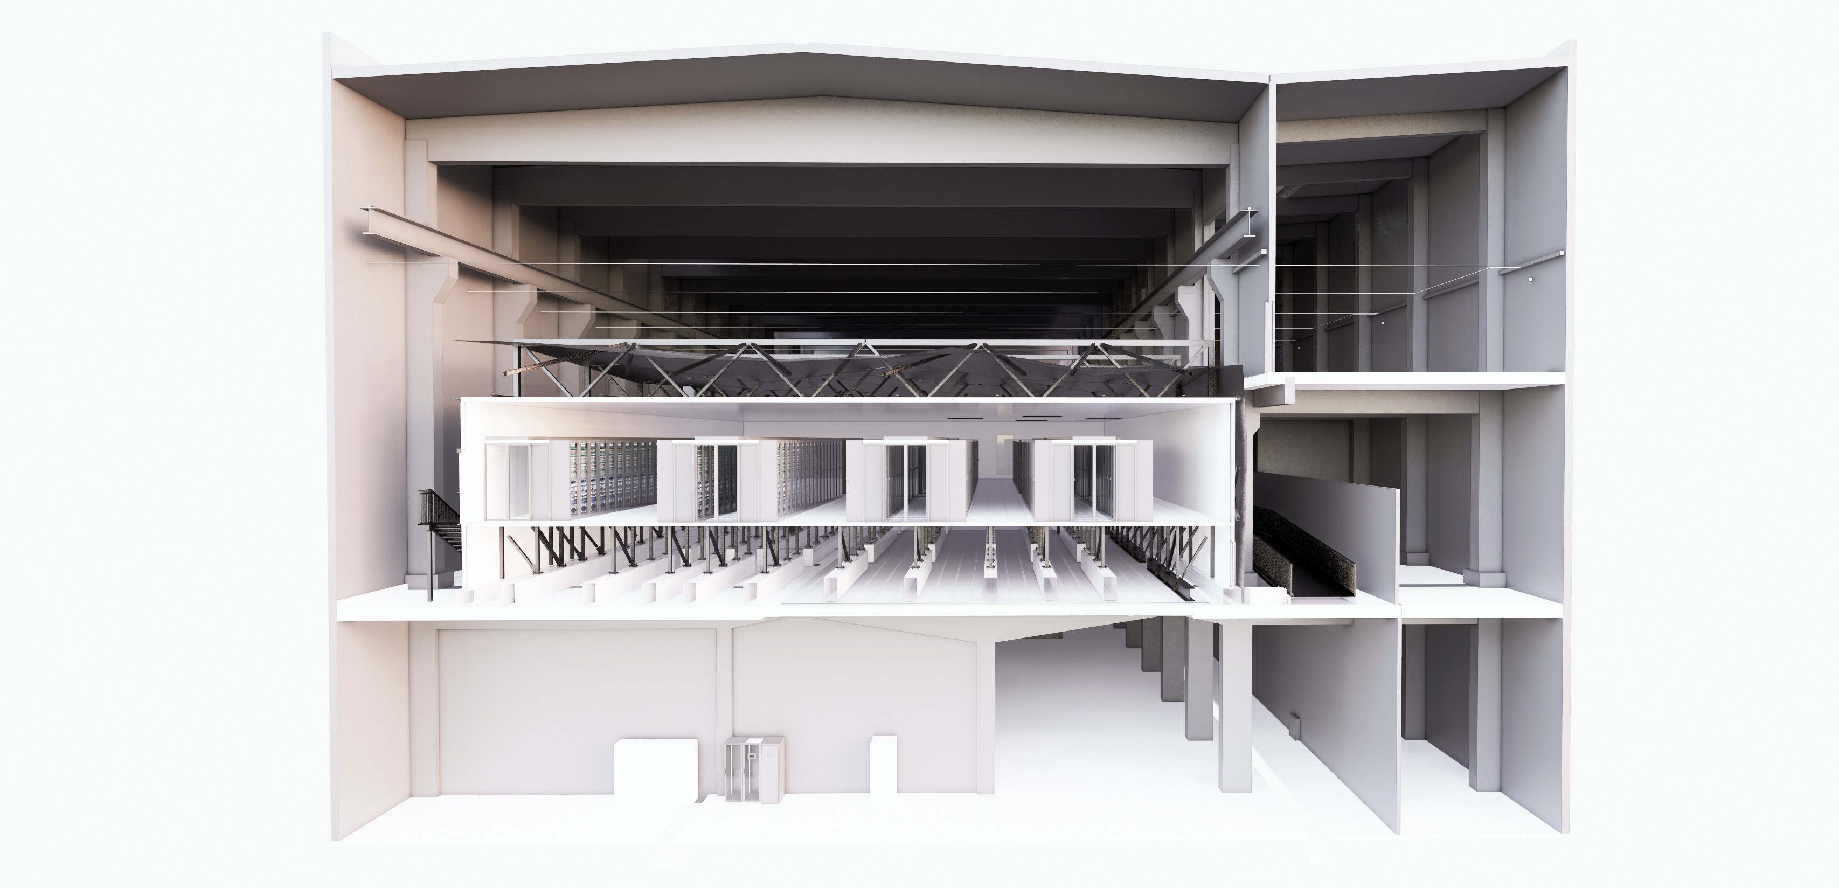

LUMI data center
White space
M&E installations
LUMI facility overview
5800m² in three floors
800m² whitespace for IT devices
Power capacity 15MW at full buildout
14 000m² free space for future expansions
Data center cooling
Mechanical cooling with 3 heat pumps with 7.2MW total cooling capacity and 9MW of total heating capacity
Free cooling, total capacity 10MW
Air cooling installed capacity 1MW with N+1 redundancy
17°C inlet to CRAH units in whitespace
Free cooling on chillers >15°C outside temperature
Showroom
Electrical main equipment
Cooling equipment

Slide 61
Some Basics of DC Business
Electricity consumption:
  Datacenter capacity (and size) is primarily measured by electricity consumption in kilowatts (kW) or megawatts (MW)
  Main cost in datacenter operations
  Power Usage Effectiveness (PUE):
    PUE measures the total energy use of the data center
    compared to the energy used by IT equipment.
  Energy Reuse Factor (ERF):
    The ERF of a data center reflects how much energy
    is exported for reuse outside of data center operations.
  Energy Reuse Effectiveness (ERE):
    The ERE is a metric for measuring the benefit of
    reuse energy from a data center
Total Facility Energy
PUE =
(Cooling+Power+Lightning+IT)
IT Equipment Energy
(IT)
Energy Reuse
ERF =
Total Facility Energy
Total Facility Energy – Energy Reuse
ERE =
IT Equipment Energy
(IT)
Notes:
ERF will range from 0.0 to 1.0. The value at 0.0 means no energy is exported from the data center for reuse, while a value of 1.0 means all of ...
LUMI: Estimated Energy Reuse Factor (ERF) with full load around 0.70
For example, if a facility has a PUE of 2, it indicates that the amount of power used to run the IT equipment is half of the power consumed by the entire data center facility. Therefore, a lower PUE value indicates a more efficient data center.
LUMI -> 10 MW / 9 MW -> 1,11

Slide 62
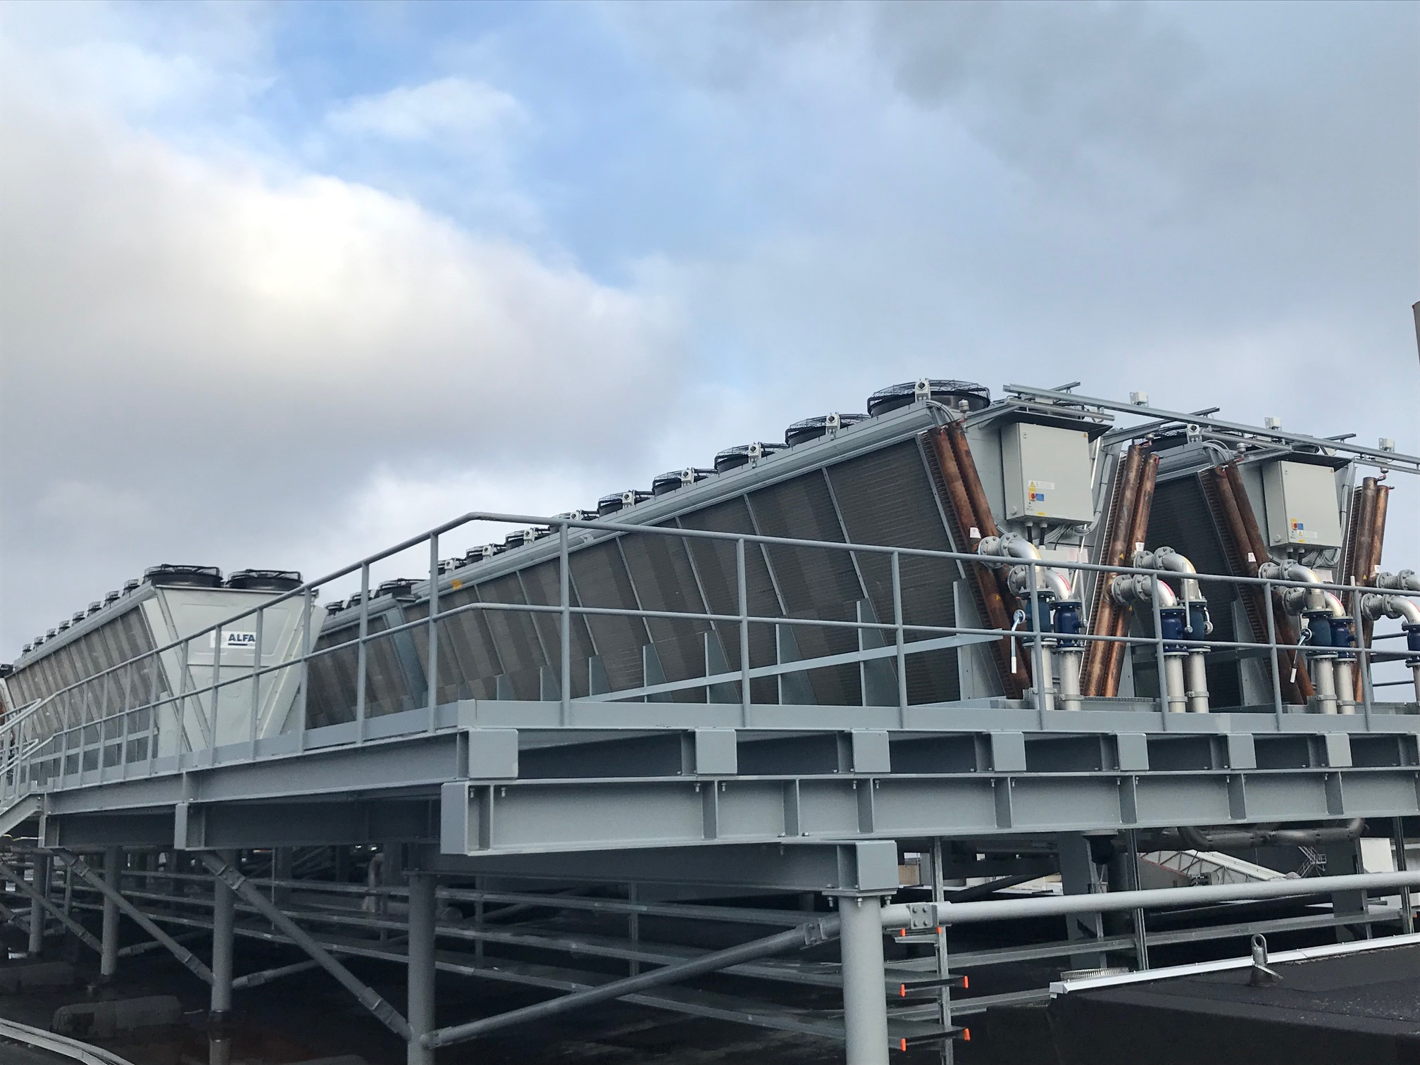
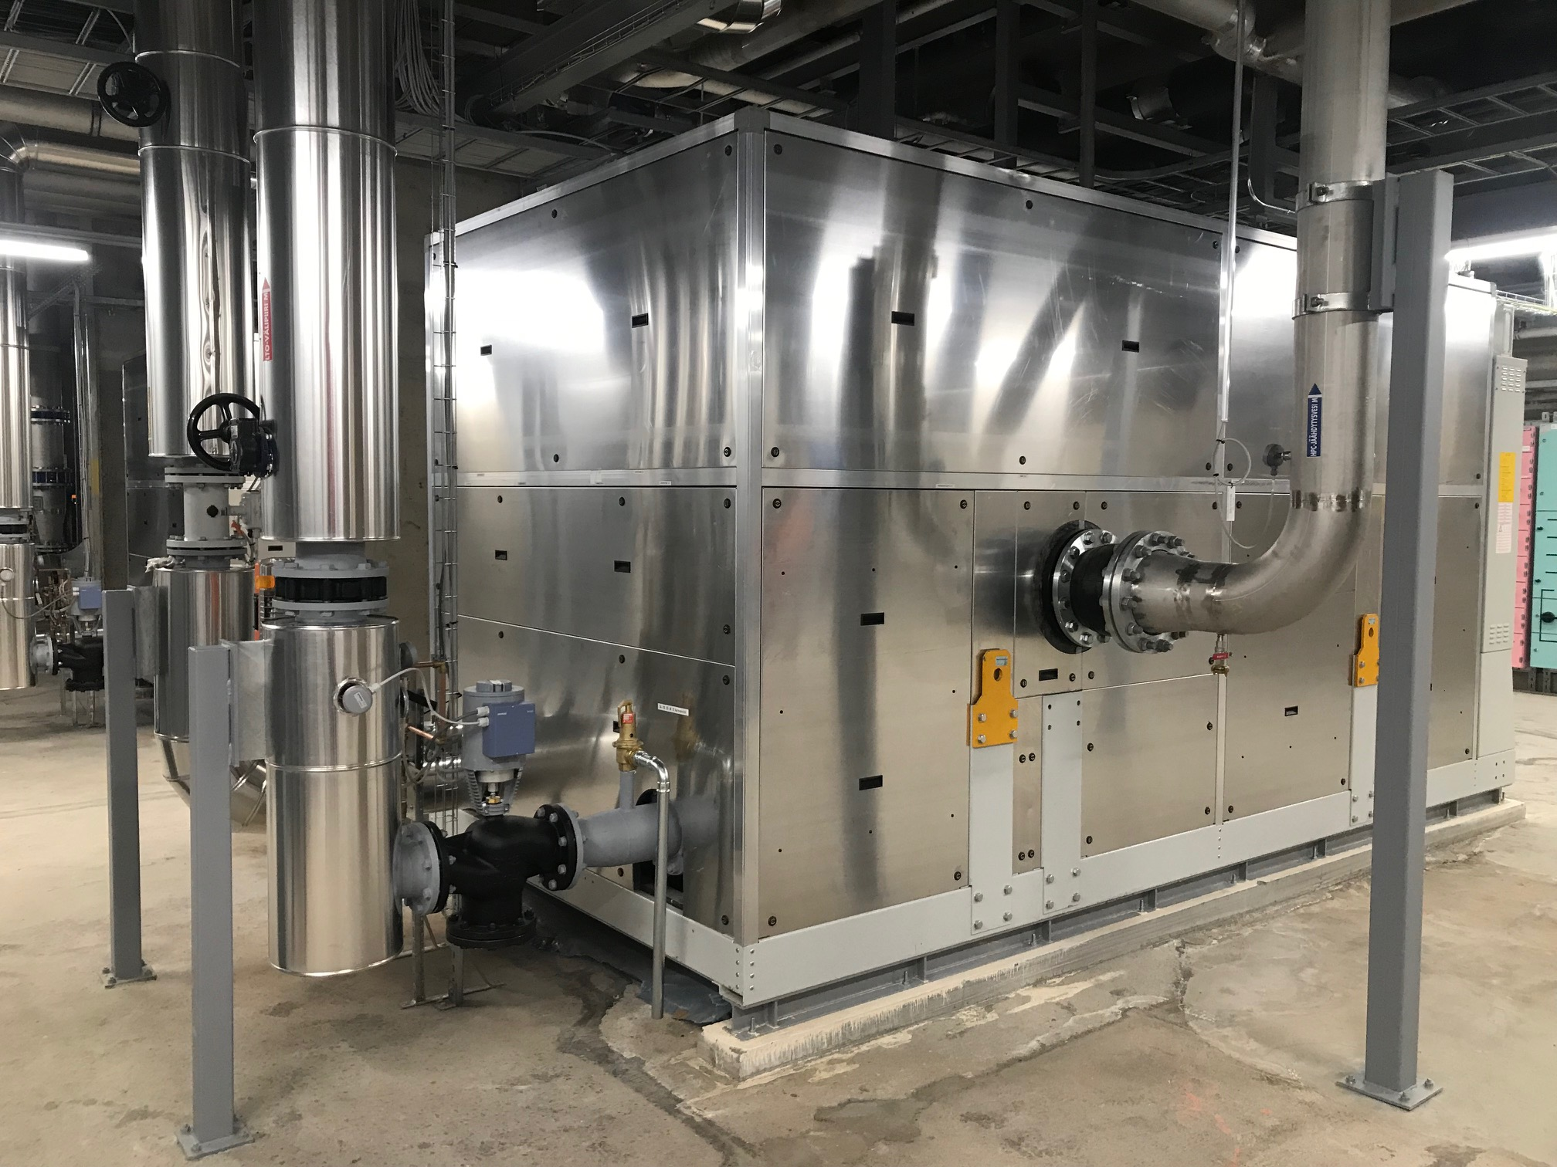
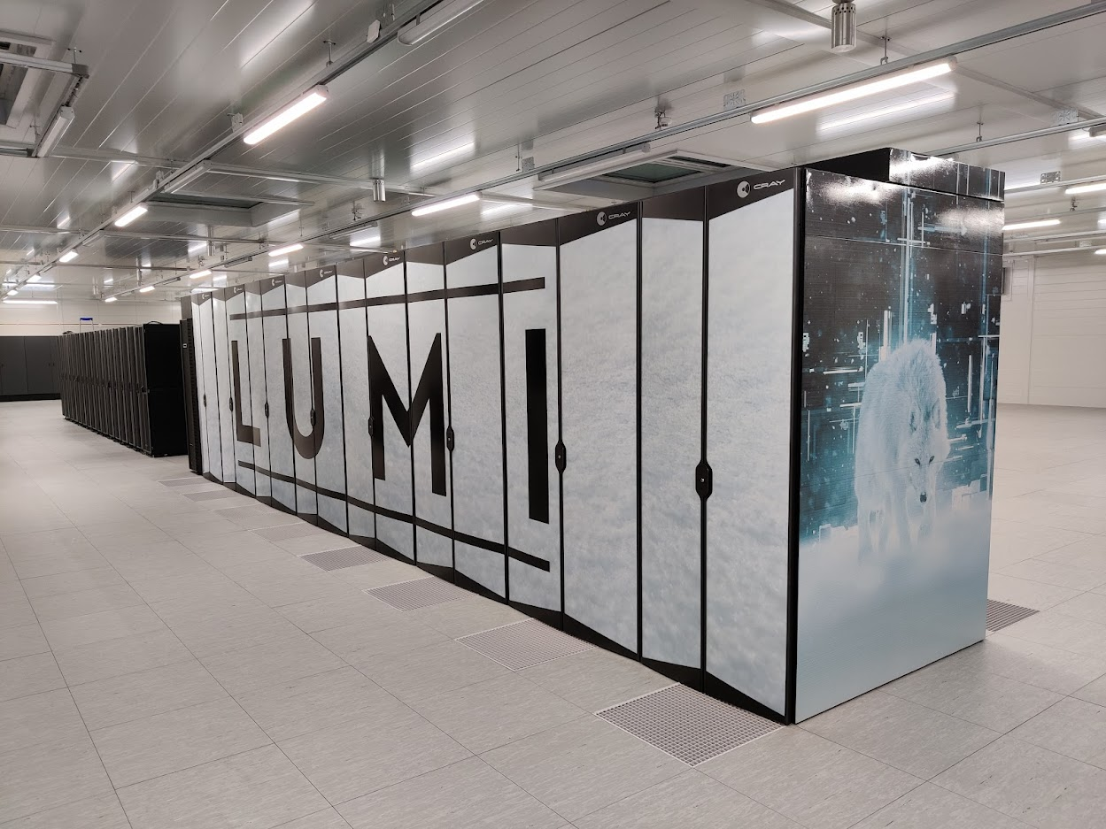
LUMI: Excess Heat Utilization Process Overview
Annual CO₂ savings around 6.000 tonnes
DRY AIR COOLING FOR BACK UP
~ 10 MW
DISTRICT HEATING NETWORKS ~ 10 MW
-Renforsin Ranta Business Park
-CITY of Kajaani
+43 °C
+58 °C
+80 °C
Service demarcation point for the excess heat utilization
+31 °C
HEAT EXCHANGERS
HEAT PUMPS
Heat pumps use renewable energy
+32 °C
+44 °C
+32 °C
+44 °C
In addition of Direct Liquid Cooling there is approximately 1 MW of capacity for the air-cooled servers (e.g. storage and management servers).
HPC load
Notes:
Heat exchanger = lämmönsiirrin , lämmönvaihdin
Every excess heat utilization case is unique and need careful design and planning!
Making use of created heat is always good, BUT when we want to have concrete impact to environment
it is crucial to find use-cases where delivered heat is actually reducing the use of fossil fuels or other source of CO2 emission
District heating is perfect example of this because, heat plants know their exact emission factor. And when you know heat input to the network you can multiple that with the emission factor and as off result you have concrete figure of reduced heat plant emissions. When you reduce your own energy consumption emission out of this figure you have the final result of your operations CO2 footprint.
We wanted to set the service demarcation (diimarkeijön) point after heat pumps → to secure that we have the control of the critical cooling operations.
Our primary cooling is the excess heat utilization and as a redundant backup we have air cooling chillers to cool our liquid cooled compute.
At the moment we have three heat pumps in place and ability to increase the number of pumps if our operations scale up.

Slide 63
Example of power usage and heat rejection delay
kW

Slide 64
LUMI data center sustainability and metrics
Waste heat is re-used for district heating ~9 months / year. Dependent on district heating network demand because power plant has minimum operating power.
Average temperature in Kajaani in 2022 was 3.6°C and highest measured temperature 2023 was 26.2°C. Free cooling available around a year.
The brownfield solution (re-use of exiting building) is estimated to have reduced the CO2 footprint of LUMI data center construction by over 80% compared to constructing an all-new building for LUMI. Approximately 1000 tons.
Notes:
While power plant reaching it’s minimum operational power. Heat re-use from LUMI needs to be limited. This usually only applies during daytime in start and in end of summer when day time temperatures increases and demand on district heating gets lower.
Summer time district heating power plant has annual maintenance break on main district heating production plant when LUMIs waste heat is again utilized.

Slide 65
Drivers to implement heat re-use in Finland
Changes in Finnish energy taxation for data centers on 2022
Energy taxation classes for data centers drives more energy efficient data centers with lower Opex.
  Energy taxation Class 1, 22,53 €/MWh
  Energy taxation Class 2, 6,3 €/MWh
Data centers whose IT-power exceeds 0,5MW and who are full filling energy efficiency requirements are eligible to apply energy taxation class 2.
ERE or PUE requirement that must be achieved
  ERE
    Data center with 0.5…5 MW IT-power calendar year average, ERE < 0.90
    Data center with 5…10 MW IT-power calendar year average, ERE < 1.00
    Data center over 10 MW IT-power calendar year average, ERE requirement does not apply
  PUE
    Data center calendar year average PUE < 1.25
    From 2026 calendar year average PUE < 1.20
Notes:
If data center cannot utilize waste heat f

Slide 66
LUMI data center statistics for 2023
Metric | LUMI (values from 2023)
Free cooling PUE | <1.05
PUE with heat re-use | 1.31
Heat re-use COP | 4
ERE | 0.52
ERF | 0.57 = 57%
Annual heat production | 26,7 GWh
Reduced CO2 emission | ~ 6.000 CO2 tonnes *
Source of electricity | 100% hydroelectric power
* LUMI reduced CO2 emisson based on district heating production plant average CO2 emission / year (2022: 161kg/MWh). No real-time data available

Slide 67
LUMI waste heat reuse lessons learnt
Heat pumps are difficult to operate on HPC load
  Applies mostly to GPU partition where load swings are large based on GPU utilization
  Buffer tank or another mechanism to CDU outlet side to align heat load variation to heat pumps
Partial waste heat utilization should be implemented if there is more than one partner that uses waste heat
GPU real operational power load is way lower than TDP values or during HPL (50..75% of HPL load)
Outlet temperature varies based on the IT load of the HPC system -> hard to maintain optimal circumstances for heat production

Slide 68
Acknowledgements
Esa Heiskanen, LUMI Operations Manager
Tero Tuonen, Director Sustainability and Risk Management

Slide 69
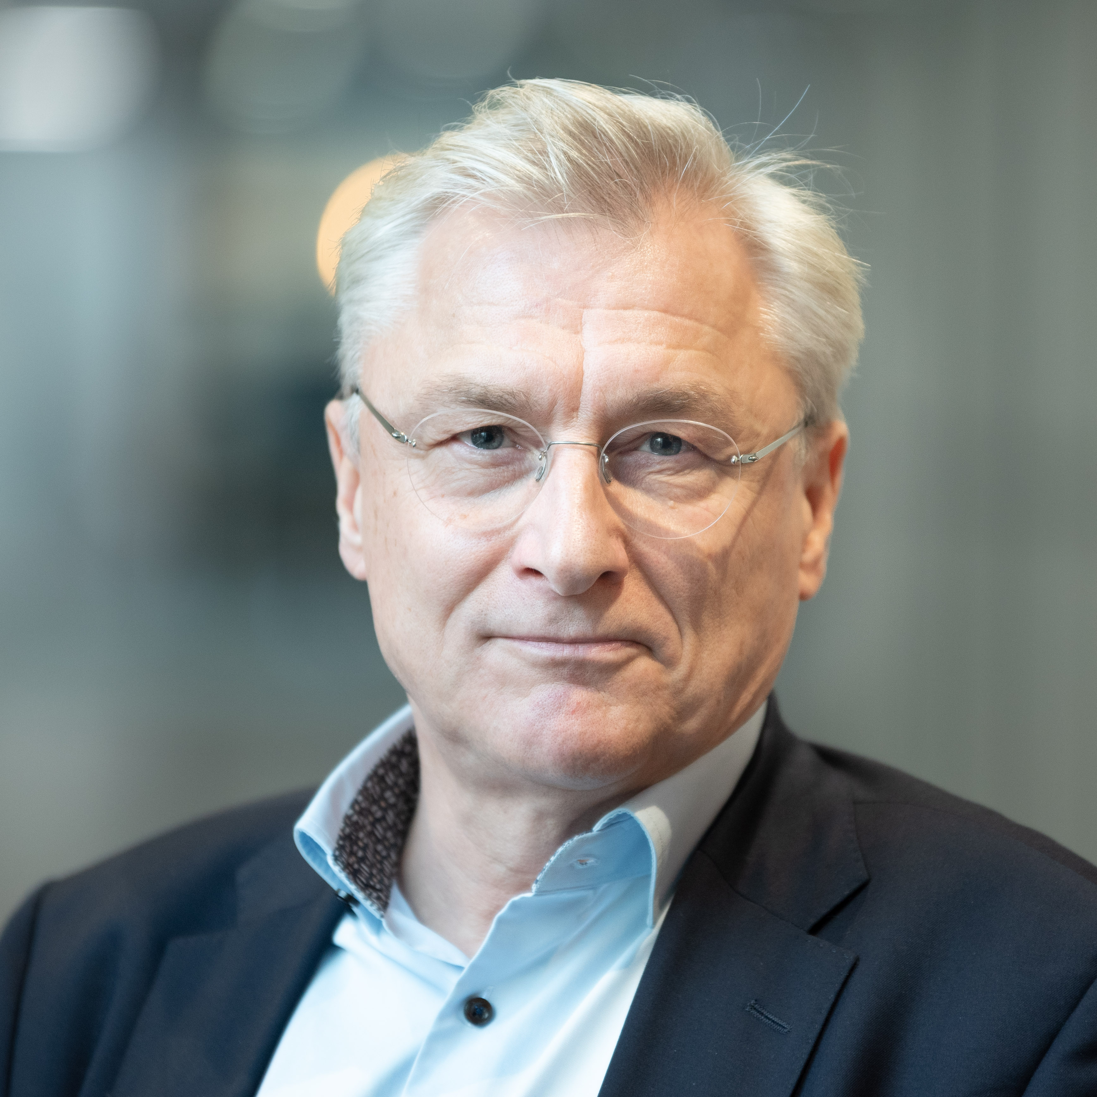
Per Öster
Director, Advanced Computing Facility
CSC – IT Center for Science Ltd.
per.oster@csc.fi
+358 50 381 9030

Slide 70
Additional slides

Slide 71
LUMI data center energy consumption and district heating
MWh
Notes:
Only DLC cooled partition measured. PuE not applicable

Slide 72
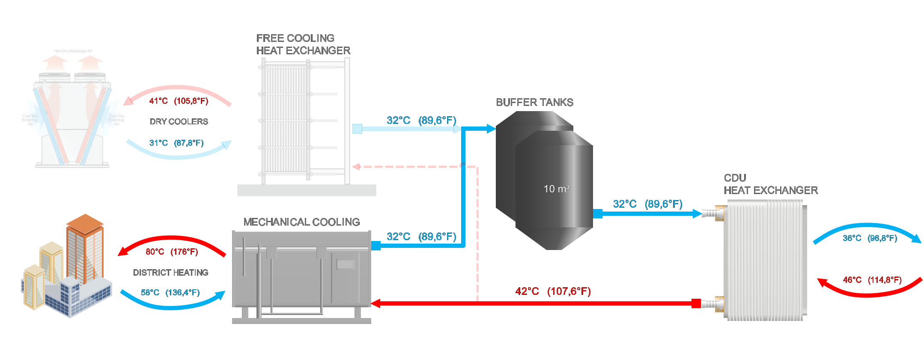
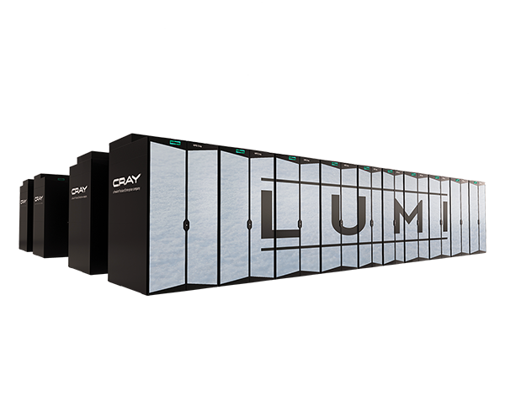
LUMI cooling and heat reuse
Three individually controlled cooling modules started in 2000kW steps based on LUMI IT power
Mechanical cooling and heat reuse for district heating with three heat pumps.
  2400kW cooling and 3000 kW of heating capacity/heat pump.
DCR 6x 1750kW
10 000kW
~8000 kW in HPL
Heat / Cooling
3000kW / 2400kW
~9000 kW in HPL
Notes:
Coolant Distribution Units (CDUs)

Slide 73
LUMI cooling and heat reuse
DCR 6x 1750kW
Three individually controlled cooling modules started in 2300kW steps based on LUMI IT power
Mechanical cooling and heat reuse for district heating with three heat pumps.
  2400kW cooling and 3000 kW of heating capacity/heat pump.
10 000kW
3000kW / 2400kW
~8000 kW in HPL
~9000 kW in HPL

Slide 74
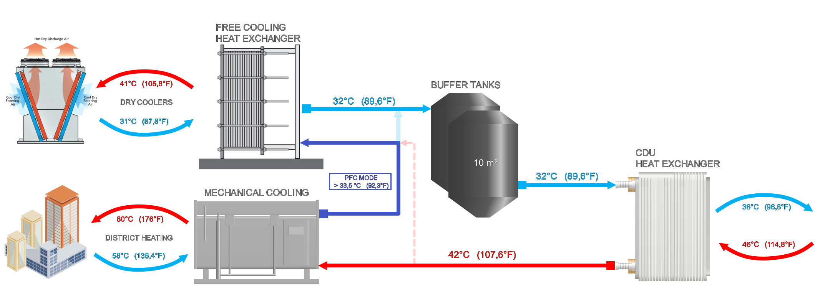
LUMI cooling and heat reuse
DCR 6x 1750kW
Three individually controlled cooling modules started in 2300kW steps based on LUMI IT power
Partial free cooling with heat pumps and free cooling heat exchangers + DCRs.
  Partial free cooling is used 15 minutes in CGM startup, if there is an alarm on heat pump or the heat pump outlet is >1.5 °C over setpoint
10 000kW
10 000kW
3000kW / 2400kW
~8000 kW in HPL
~9000 kW in HPL

Slide 75
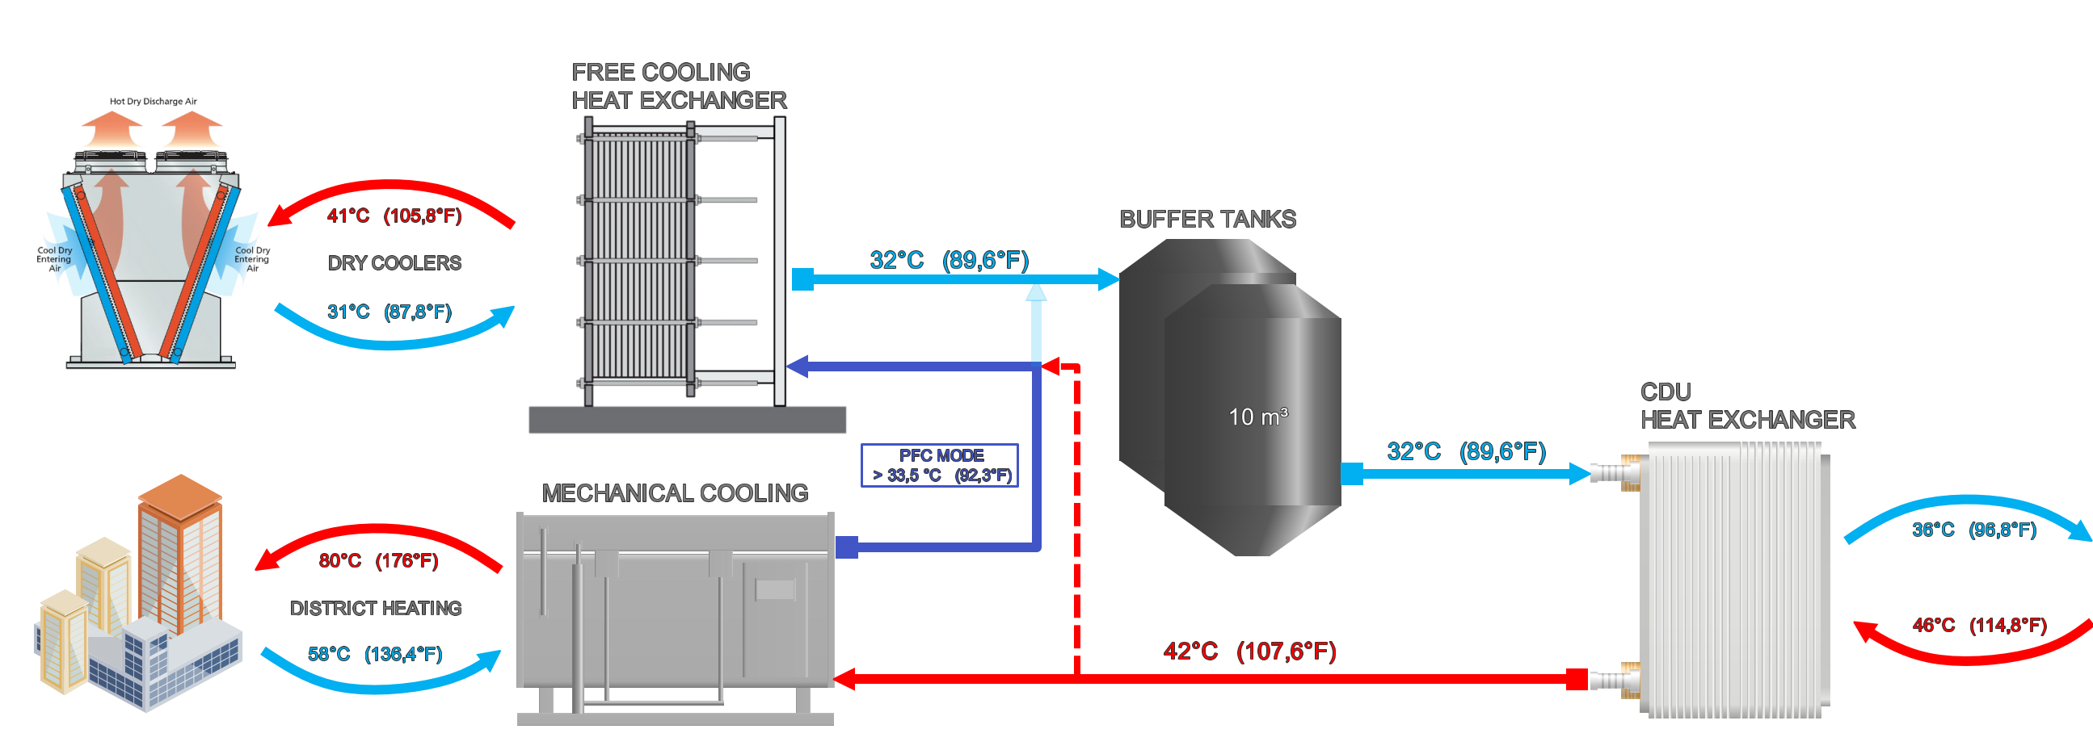
LUMI Cooling and heat re-use
DCR 6x 1750kW
Three individually controlled cooling modules started in 2300kW steps based on LUMI IT power
Partial free cooling with power limit
  Power limit is used if the district heating power plant indicates that there is not enough demand on the district heating network. Part of the heat load is bypassed to free cooling heat exchangers
800kW
10 000kW
800kW
10 000kW
2000kW / 1600kW
~8000 kW in HPL
~9000 kW in HPL

Slide 76
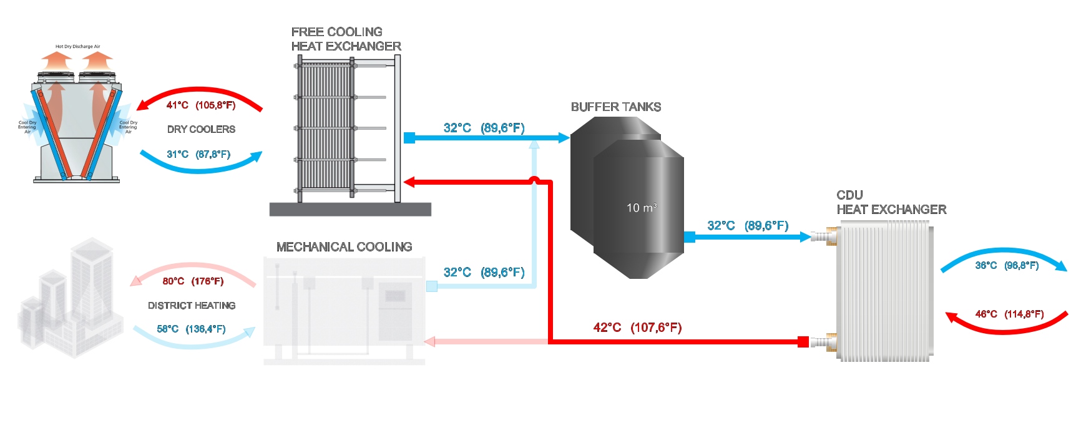
LUMI Cooling and heat reuse
DCR 6x 1750kW
Three individually controlled cooling modules started in 2300kW steps based on LUMI IT power
Free cooling with 3x 3300kW heat exchanger and total of 10 000kW DCR capacity
  All three free cooling module heat exchangers are connected to the same main pipeline on rooftop DCRs
  Free cooling is only operated when there is no demand on the district heating network or during a LUMI maintenance break
3000kW
10 000kW
~8000 kW in HPL
~9000 kW in HPL

Slide 77
Metrics
PUE (Power Usage Effectiveness) = Total Energy / IT Energy
ERE (Energy Reuse Effectiveness) = Total Energy – Energy reuse / IT Energy
ERF (Energy Reuse Factor) = Energy reuse / Total Energy
COP (Coefficient Of Performance) = Energy reuse / Heat production Energy
Electrical energy
Thermal energy / heat

Slide 78
Julita Corbalan
Barcelona Supercomputing Center (BSC)

Slide 79
How does one define ‘an Energy Efficient’ HPC System?
From data to action
ANNOTATION

Slide 80
Euro HPC monitoring strategies for energy efficiecy
Julita Corbalan (UPC/BSC/EAS)
EAR Project leader
Author and Date

Slide 81
DC power/energy in metrics
Data Centers focuses on performance (GFlops)
Energy efficiency (in Top500) is GFlops/watts
Not all the jobs performance can be measured in GFlops
    IO Jobs
    Not computational intensive Jobs (or not vectorial instructions used extensively)
    Others?

Slide 82
Energy efficiency
Green 500 (Top 500) uses HPL, but Jobs do not report GFlops (or other metrics)
To compare between DC we should compare with same workload
  That’s the idea of using HPL (is HPL enough for an energy efficiency classification ?)
Is the energy efficiency of the DC
  the energy efficiency of HPL?
  Is the average of the efficiency of several pre-selected applications
  is the average of 1 year of the DC workload execution?? (then not easy to compare, do we want to compare or just compute)

Slide 83
Energy efficiency
Efficiency is always a ratio : performance vs power/energy consumption
Performance is job performance
Power/Energy could be per job or per cluster
We need to collect job performance metrics automatically
We need to collect cluster power metrics (power/energy) automatically
And corelate them !!!!
  Job GFlops/Watts (classic)
  Workload GFlops/Watts
  Throughput/Watts (generic)
What are we doing?
How much we consume to do it?
DCeP= Data Center EnergyProductivity
usefulworkproduced/ totalData Center energyConsumedproducingthiswork
Is it the same idea??

Slide 84
EAR customers strategy: BSC/MN5, SuperMUC-NG, Snellius
At the job scope . Per job/Step/Node (also at runtime but maybe too much)
  Job time and energy accounting for all the jobs.
  Job performance metrics and detailed energy for all the jobs executed with EAR job manager (EAR library)
    Time and Gflops but also CPI, Memory Bandwith, IO activity, MPI hints, GPU info (GPU GFlops is difficult to compute!!!)
At the computational node scope: periodically (1-2 min), per node, even when idle
  Power, CPU frequency, Memory frequency, temperature. Stored for some period and after that removed (2-3 months)
Group of nodes/Cluster scope
  Only power consumption
No correlated with other system tools providing , for example, Storage information

Slide 85
Energy efficiency actions
No pro-active actions taken in general
  Users are not aware of their energy efficiency metrics! (even they are available and easy to collect)
  No energy efficiency analysis and evaluation (audits) and the job level
  No workload analysis at the DC scope
    Who is consuming energy and to do what!
The situation has started to change but (in my opinion) more motivated by some users/groups eco-responsability than from Data Center actions

Slide 86
Summary
If we agree on energy efficiency = Work done/energy consumed to do it
  We have to agree on what we consider as “work done”
  Energy consumed it’s easy to agree on “including everything”
  It must be easy to measure for DC owners
If we want to improve it (reduce the energy to do the same work) we must report to users and make them aware of these metrics

Slide 87
Bastian Koller
High Performance Computing Centre Stuttgart (HLRS)

Slide 88
Energy Efficient Data Center Design and Operation @ HLRS
Bastian Koller, HLRS
ANNOTATION

Slide 89
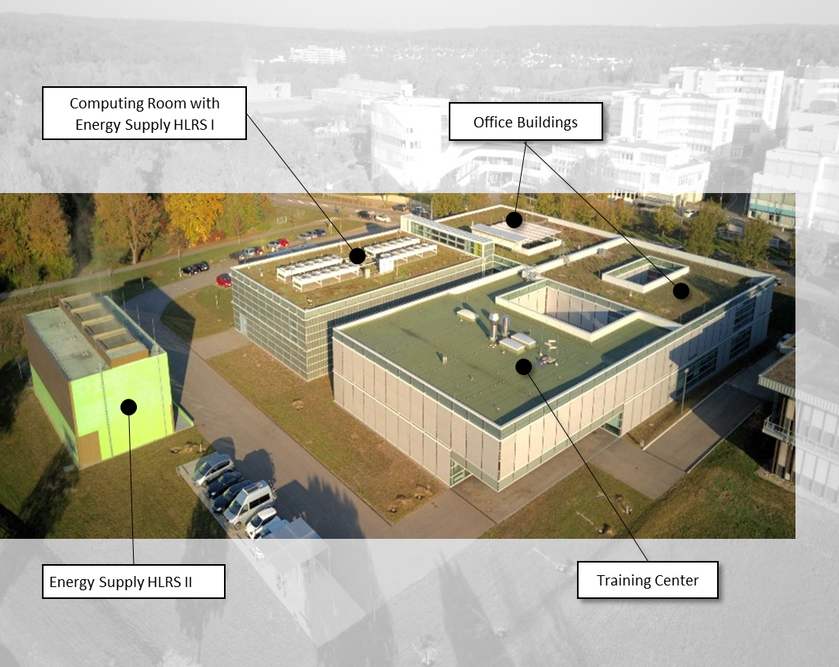
HLRS Infrastructure Today
Energy Supplies
  4.6 MW maximum IT-Load
  860 kW battery supplied UPS
Cooling Infrastructure
  ~1 MW recirculating air cooling
    14 °C inlet temp. / 22°C return temp.
    50% free cooling (dry coolers)
    50% district cooling
  ~4 MW water cooling
    25°C inlet temp. / 35°C return temp.
    85% free cooling (wet cooling towers)
    15% district cooling

Slide 90
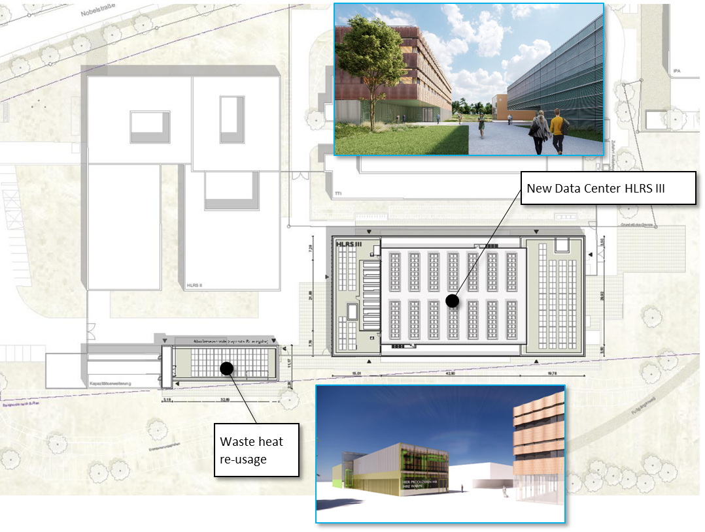
New Data Center HLRS III - Parameters
Energy Supplies
  8.0 MW maximum IT-Load
  0.6 MW battery supplied UPS
  7.4 MW Fly Wheel UPS
Cooling Infrastructure
  0.8 MW recirculating air cooling
    18 °C inlet temp. / 24°C return temp.
  7.2 MW water cooling
    min. 32°C inlet temp.
    min. 42°C return temp.
  No district cooling
  100% free cooling (adiabatic dry coolers)

Slide 91

New Data Center HLRS III – Energy Efficiency
Energy savings and sustainable
concepts are key features
Photovoltaic Façade & Roof
  ~ 850 m²
  100% self-consumption
  Energy output to be estimated
Wooden Construction
where possible
  Computing room ceiling
  Office Section

Slide 92
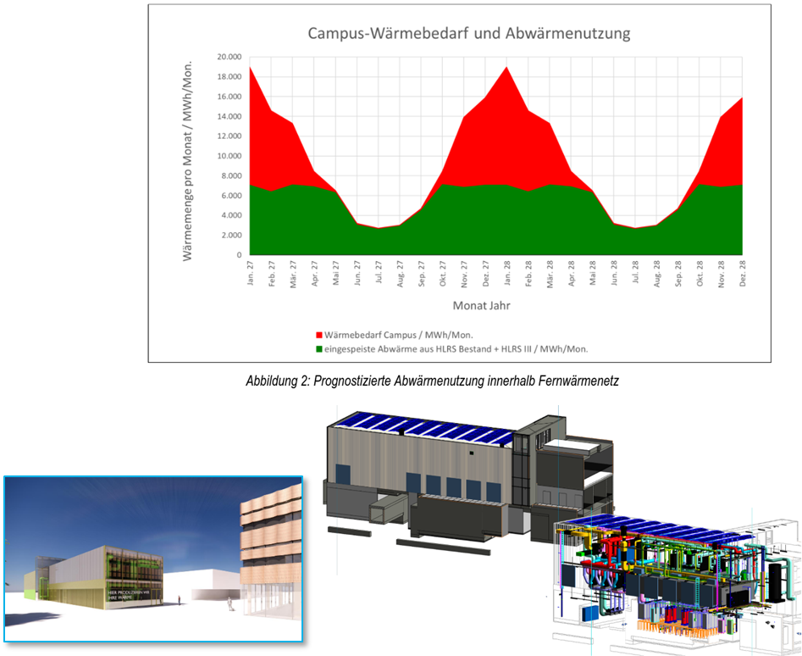
New Data Center HLRS III – Waste Heat Re-Usage
Waste heat re-usage is one key component for
the decarbonization of the Campus Vaihingen
University of Stuttgart
Innovative Cooling Concept
No external cold water loop
All heat is emitted with at least 42°C (target is 50°C)
6.2 MW average waste heat re-usage
Estimations for the Campus Vaihingen:
  20 % reduction of total energy consumption
  50% reduction of CO2 emissions

Slide 93
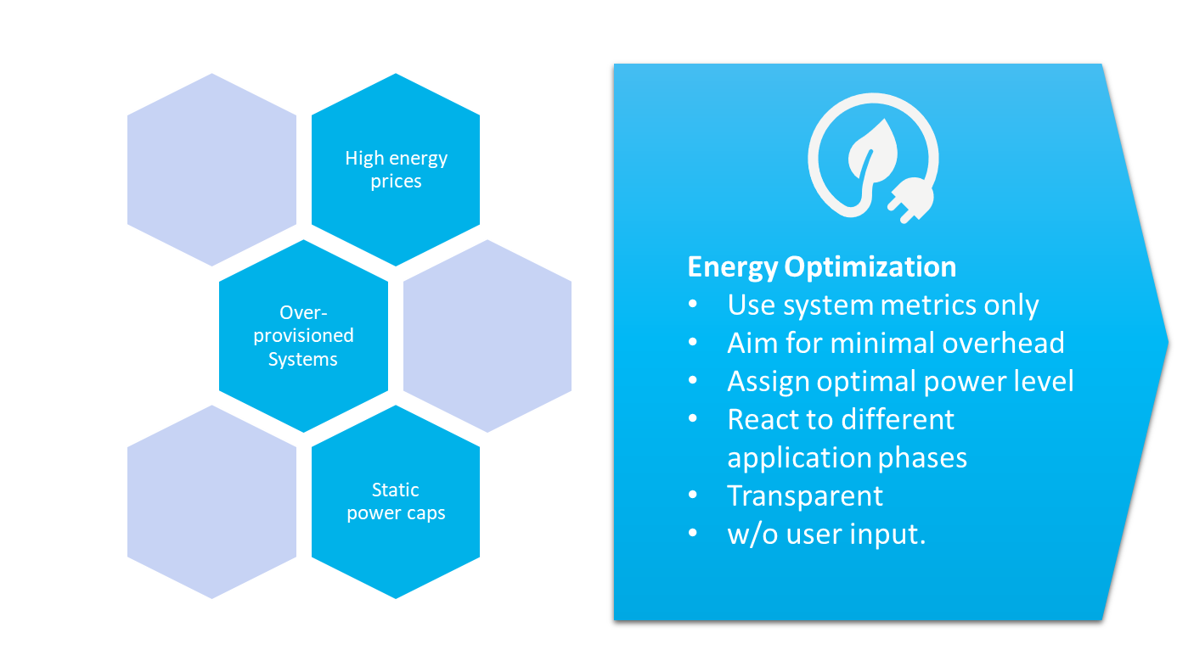
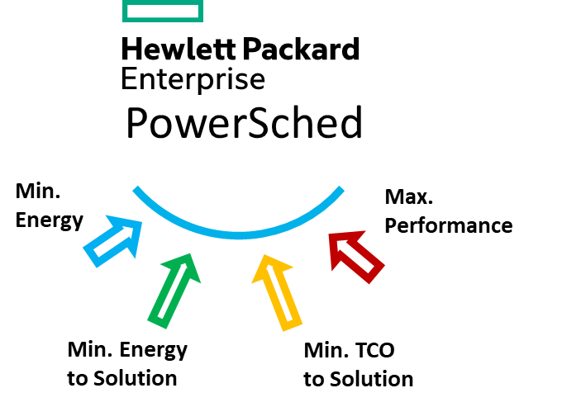
Energy Efficient Operation in Production
Dynamic Power Steering depending on
system load
external power or cooling constraints

Slide 94
Thank you!

Slide 95
Mentimeter
Next Round
  Join at menti.com | use code 3876 9437

Slide 96
Mentimeter
Final Round
  Join at menti.com | use code 3876 9437

Slide 97
Take-away Message
It is possible to improve!
Start monitoring now!!
But don’t leave it at that!!!
Analyse the data, share it, draw your conclusions and act on them
EuroHPC could really help here!
Get ready for this, you might have to do this soon
(Standardisation would be very helpful)

