Slide 1
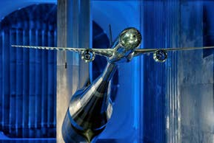
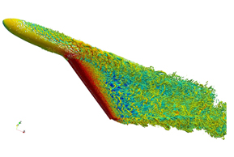
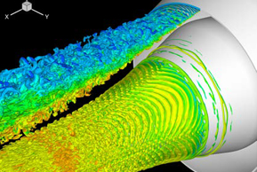
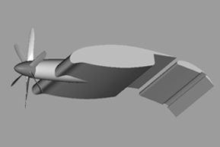
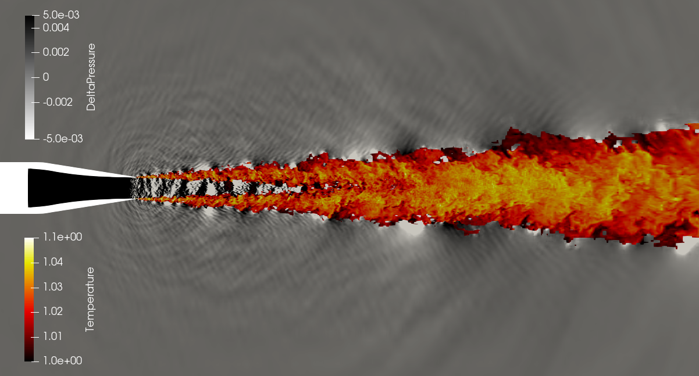
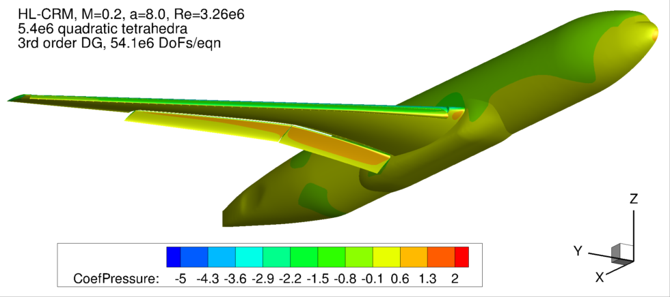
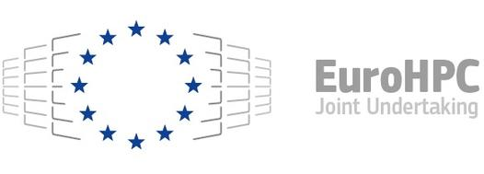
CODA: Next generation of industrial aerodynamic simulation code
NextSim is a 3-year project that aims to increase the capabilities of current Computational Fluid Dynamics tools for aeronautical design by re-engineering them for extreme-scale parallel computing platforms. It works specifically to develop CODA, a software used by project partner Airbus.
OBJECTIVES
TEST CASES
Increase the capabilities of current numerical simulation tools for aeronautical design by re-engineering them for extreme-scale parallel computing platforms.
Expand the use of HPC in the design loop of aeronautical products, which is essential to meet the performance and environmental targets proposed in the EU.
Improve CFD software efficiency, through better algorithms exploiting available hardware in a better way, to reduce computational cost, turnaround time and improve energy footprint.
Overcome the existing deficiencies and to achieve the goals set up by the Strategic Research and Innovation Agenda to reduce significantly certification costs by 2050 taking advantage of virtual design and simulation.
Long Range Aircrafts in Transonic Flight Conditions
Long Range Aircraft in Low Speed
Flight Conditions with deployed High Lift
Engine Jet
Generic Transport Aircraft
INITIAL RESULTS
Improved Noise Jet Predictions
In order to predict the noise generated by an engine jet, NextSim has used the CFD software CODA for highly accurate computer simulations resolved in space and time to simulate and predict the acoustic effects generated by the flow.
Improved solver performance for simulating flow around an aircraft under high-lift conditions
A third-order Discontinuous Galerkin simulation of the NASA Common Research Model configuration under high-lift conditions on a relatively coarse computational mesh shows aerodynamic lift and drag coefficients compare favorably with results in previous international workshops.
This project has received funding from the European High-Performance Computing Joint Undertaking Joint Undertaking (JU) under grant agreement No 956104. The JU receives support from the European Union’s Horizon 2020 research and innovation programme and Spain, France, Germany.

