Slide 1
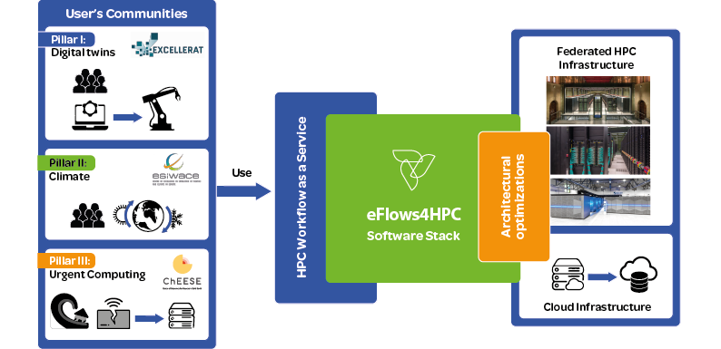
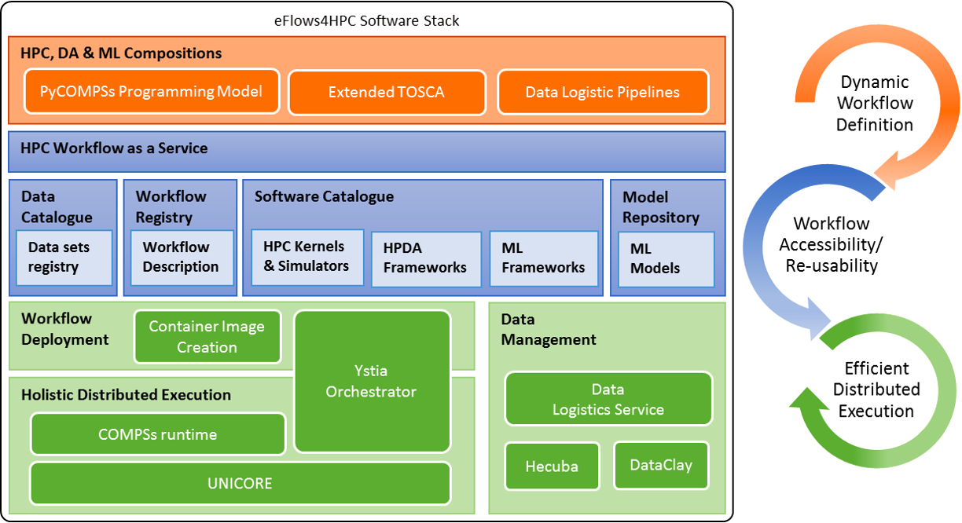
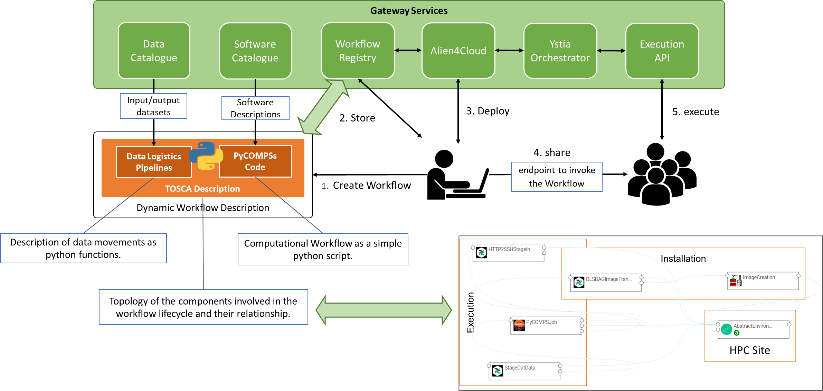
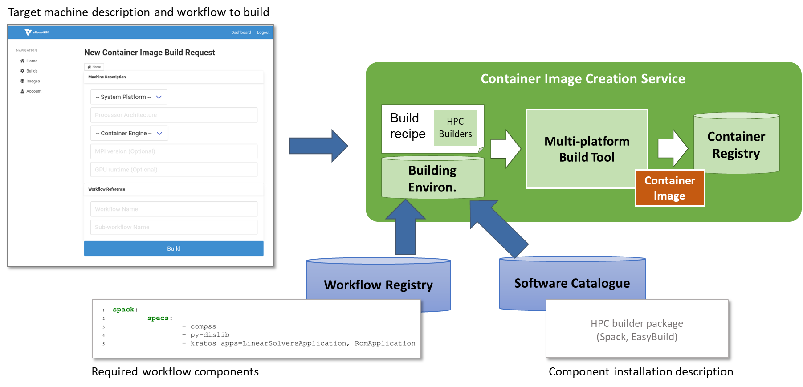

Creating a European workflow platform to enable the design of complex applications that integrate HPC processes, data analytics and artificial intelligence
Developing methodologies to widen the access to HPC to selected user communities
Demonstrating new workflow technologies through manufacturing, climate and urgent computing for natural hazards use cases
Overview
Software Stack
HPC Workflow as a Service (HPCWaaS)
Development phase
Different catalogues, repositories and registries will be source for workflow components
Developers create workflow description including:
  TOSCA description:
    Required software and services
    Deployment and configuration
  PyCOMPSs:
    Logic of the dynamic workflow
  Data logistics pipelines:
    Describe Data movements involved in the deployment and execution
Workflow description stored in Workflow Registry
Deployed on any HPC system using the HPCWaaS Developer Interface (Alien4Cloud)
Execution phase
Once deployed on the HPC, workflow execution can be triggered using a REST interface
Container Image Creation service (CIC)
HPC-ready containers
Simplify deployment keeping the performance
  Methodology to allow the creation containers for specific HPC system
  Specific containers for target architectures and HPC libraries (i.e., MPI, CUDA, ...)
Two usage model:
  Web Service with graphical and REST interface
  Standalone to easily integrate to CI/CD processes
Would you like to see a detailed tutorial?

