Slide 1
Boosting the Applications Ecosystem in the Future
Panel Session
EuroHPC Summit Week 2025

Slide 2
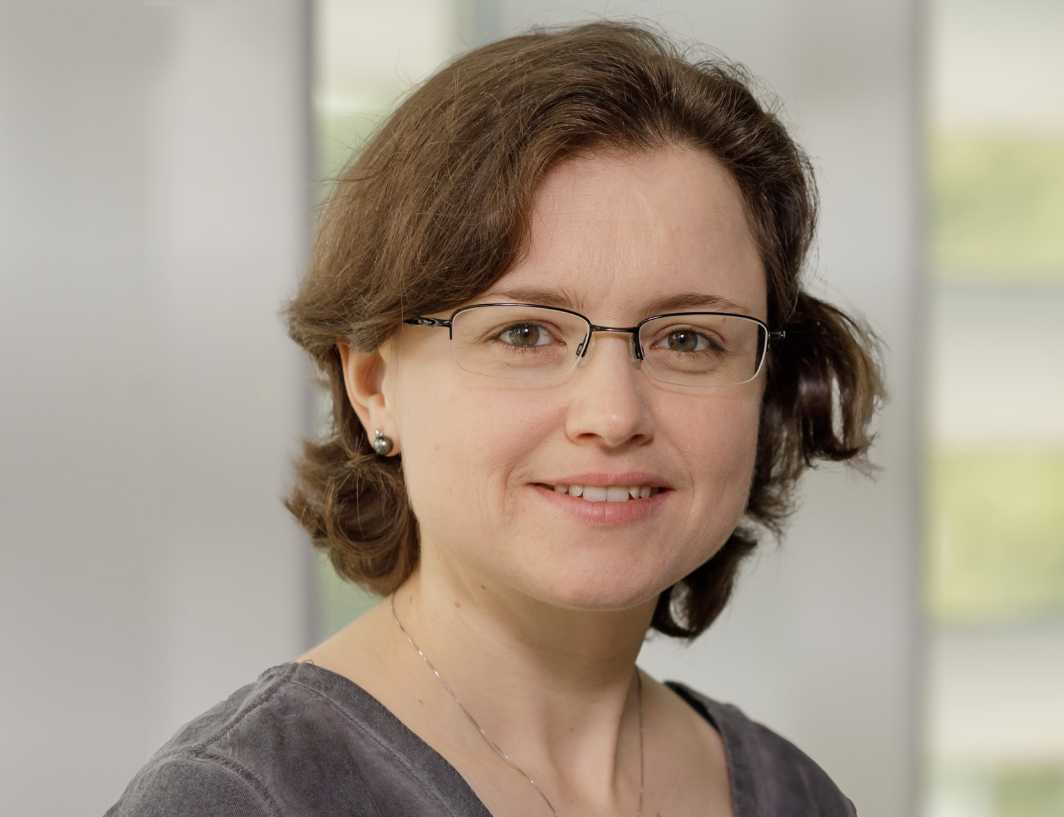
Estela Suarez
Area: HPC system architecture
My role here: Moderator
RIAG chair
Senior Principal Solution Architect at SiPEARL

Slide 3
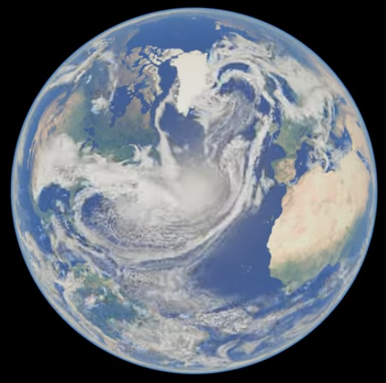
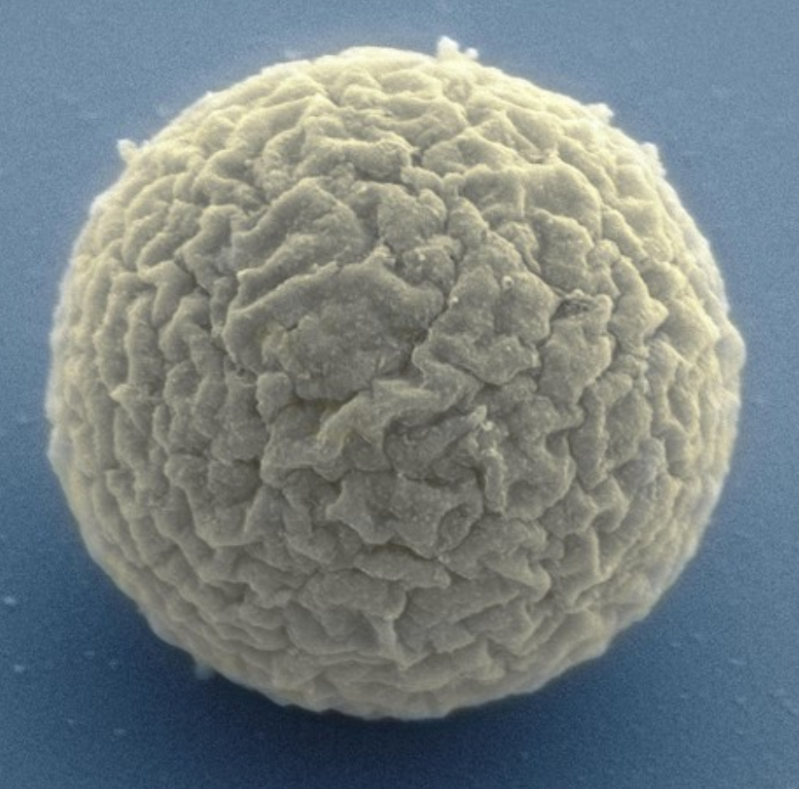
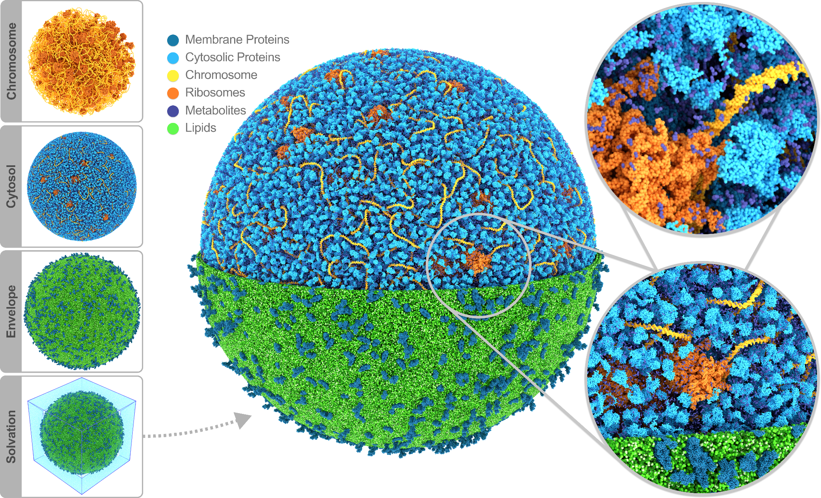
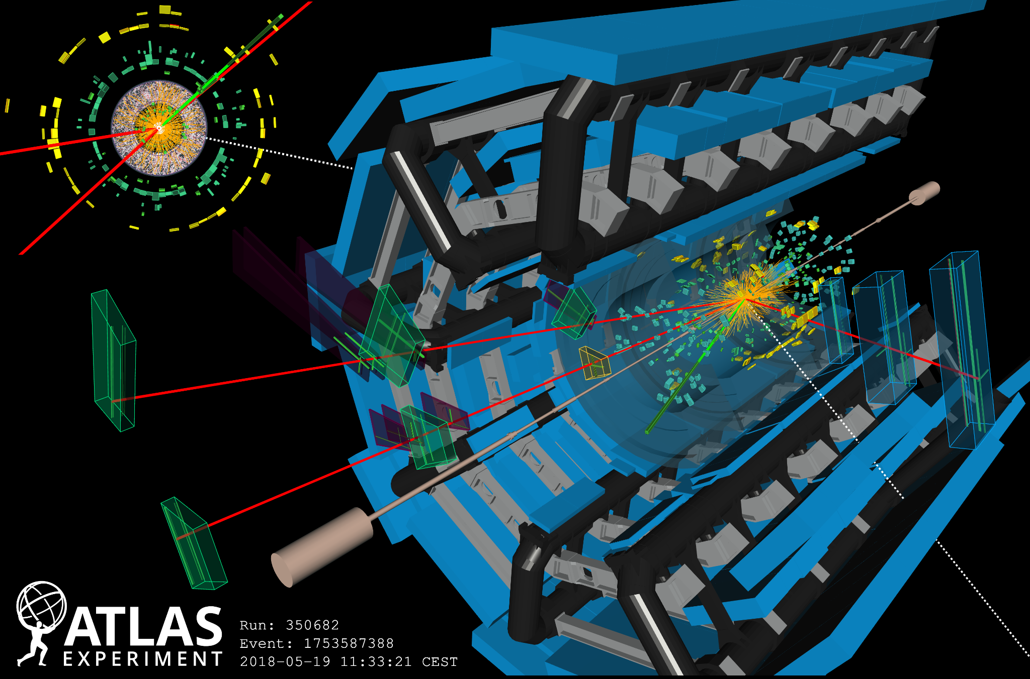
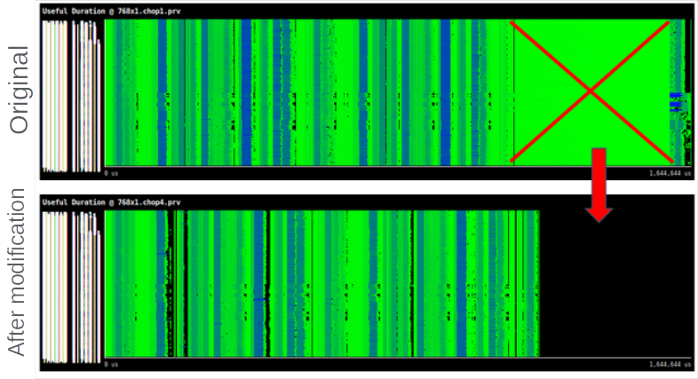
Applications Impact

Slide 4
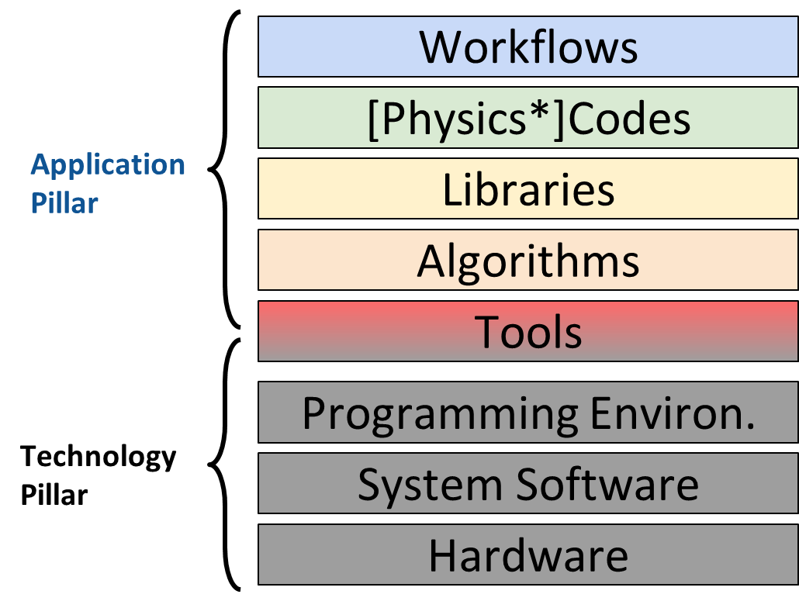
Context setting
(*) Physics, Chemistry, Biology, etc…
Simplified view HPC stack
We only discuss the application pillar today

Slide 5
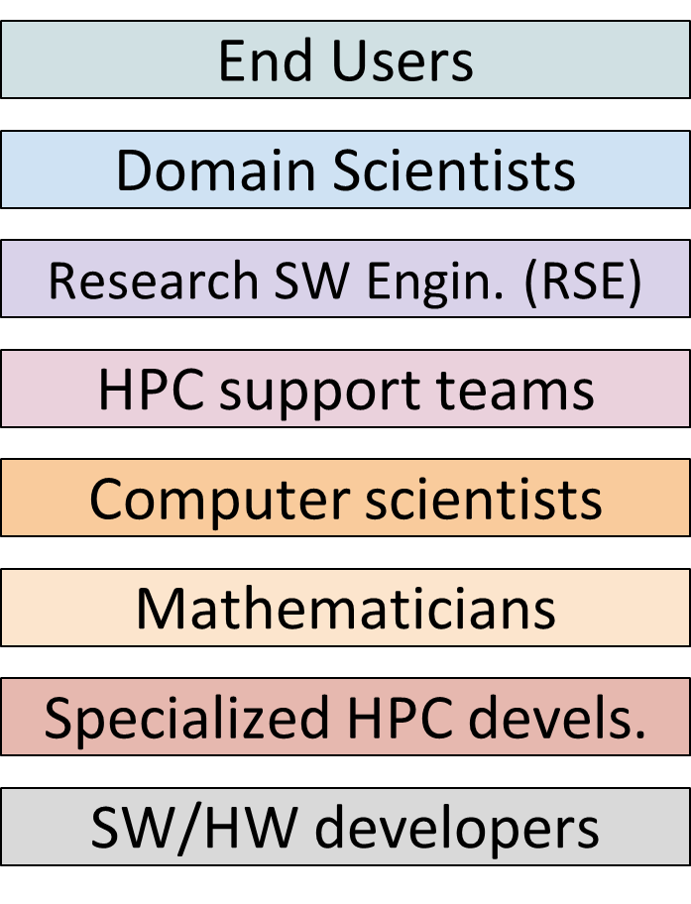
Players

Slide 6
Players & Tasks
CAUTION!! No 1-to-1 association btw. left and right, just approximation
Publish new scientific results
Training & community building
Use codes “as-it -is”, change just config.
Validate the outcome of simulations
Define new Physics* to be added to the codes
Implement Physics codes
Parallelize/scale code
Identify and solve performance bottlenecks
Install, port and optimize code to new HW devices
Port code to new language / programming models
Restructure code base
Version control, documentation
Design / implement new algorithms
Design / implement libraries
Support code developers in porting
Co-design (provide / apply)

Slide 7
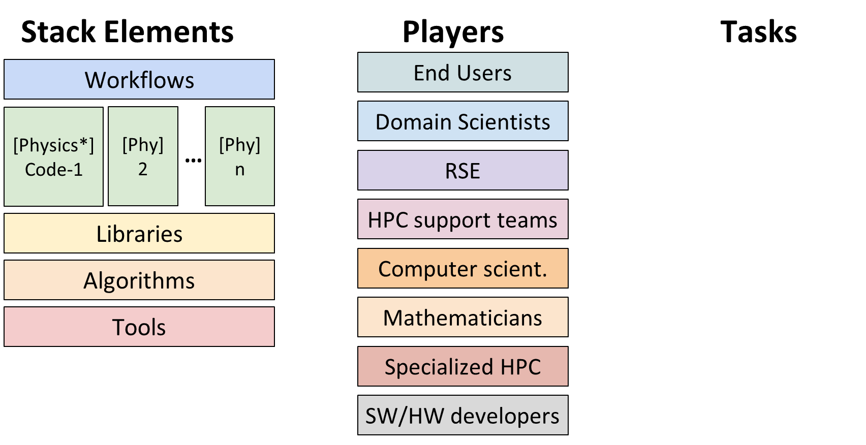
Global view
Publish new scientific results
Training & community building
Use codes “as-it -is”, change just config.
Validate the outcome of simulations
Define new Physics* to be added to the codes
Implement Physics codes
Parallelize/scale code
Identify and solve performance bottlenecks
Install, port and optimize code to new HW devices
Port code to new language / programming models
Restructure code base
Version control, documentation
Design / implement new algorithms
Design / implement libraries
Support code developers in porting
Co-design (provide / apply)
One domain / scientific question
(*) Physics, Chemistry, Biology, etc…
with “n” typically 3-6 codes

Slide 8
A CoE currently is asked to cover all
Publish new scientific results
Training & community building
Use codes “as-it -is”, change just config.
Validate the outcome of simulations
Define new Physics* to be added to the codes
Implement Physics codes
Parallelize/scale code
Identify and solve performance bottlenecks
Install, port and optimize code to new HW devices
Port code to new language / programming models
Restructure code base
Version control, documentation
Design / implement new algorithms
Design / implement libraries
Support code developers in porting
Co-design (provide / apply)
One domain / scientific question
(*) Physics, Chemistry, Biology, etc…
with “n” typically 3-6 codes

Slide 9
Other approaches have been discussed
1: Community CoEs
2: Lighthouse
3: Tools
4: Libraries & Methods
5: Algorithms
Stack Elements
Players
Tasks
End Users
Publish new scientific results
Training & community building
Use codes “as-it -is”, change just config.
Test, validate simulations and workflows
Define new Physics* to be added to the codes
Implement Physics codes
Parallelize/scale code
Identify and solve performance bottlenecks
Port and optimize code to new HW devices
Port code to new language / programming models
Restructure code base
Version control, documentation
Design / implement new algorithms
Design / implement libraries
Support code developers in porting
Co-design (provide / apply)
Workflows
[Phy] 2
[Phy] n
Domain Scientists
[Physics*] Code-1
[Phy] n
…
RSE
HPC support/devel.
Libraries
Algorithms
Mathematicians
Tools
Computer scient.
Different instruments for different purposes
SW/HW developers
Notes:
ES

Slide 10
What role should take European scientists and engineers globally?
What are the European goals in the area of applications?
How should communities be supported to reach them?
Which are the needed instruments?
Different Opinions in EuroHPC Governing Board
No final decision made yet → let us just brainstorm!

Slide 11
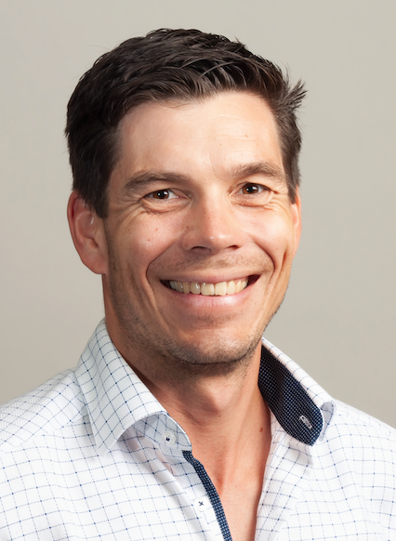
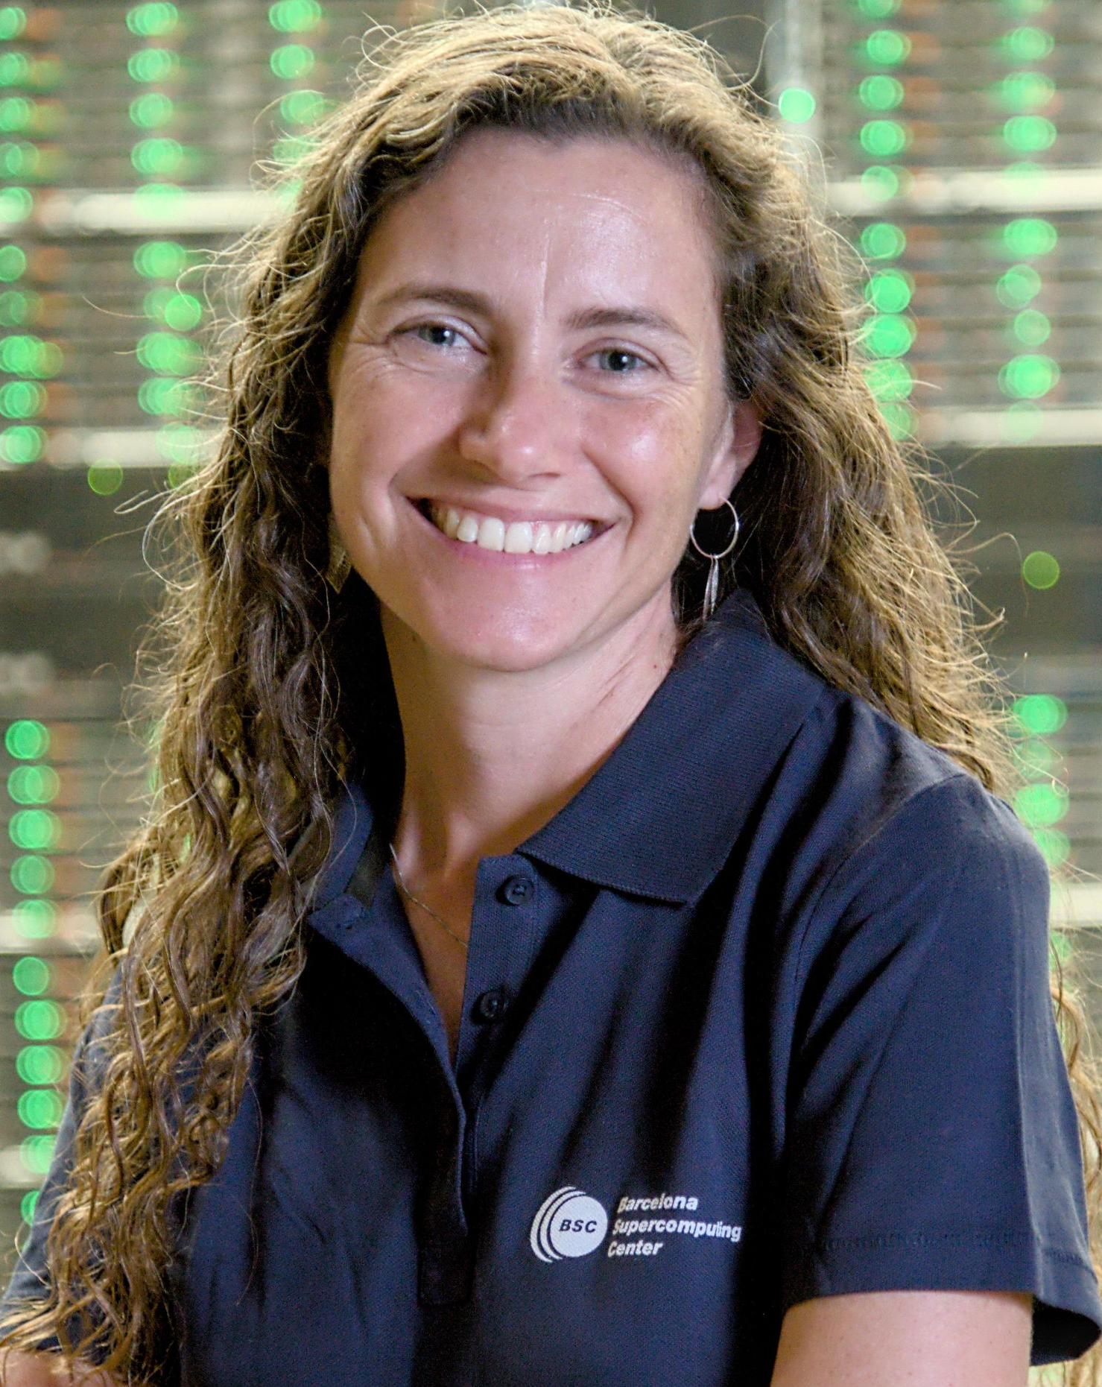
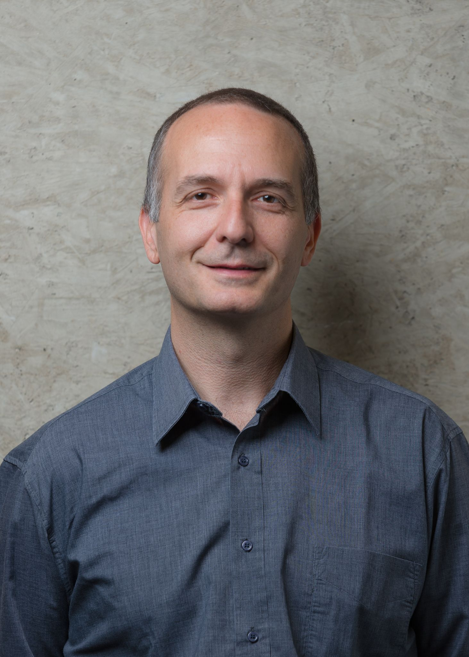
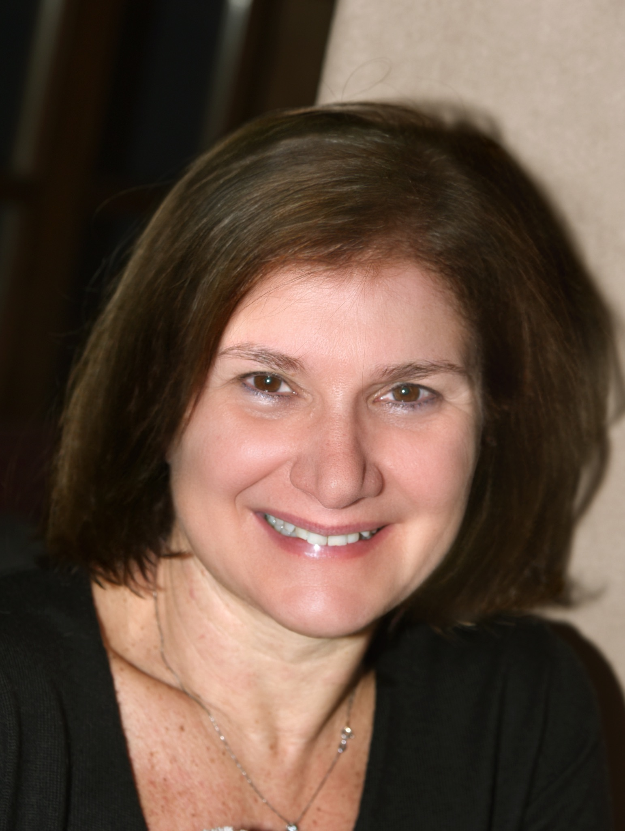
Our Panel
Hartwig Anzt
Marta Garcia
Edoardo Di Napoli
Mario Acosta
Maria Girone
Erik Lindahl
EuroHPC Summit Week 2025

Slide 12
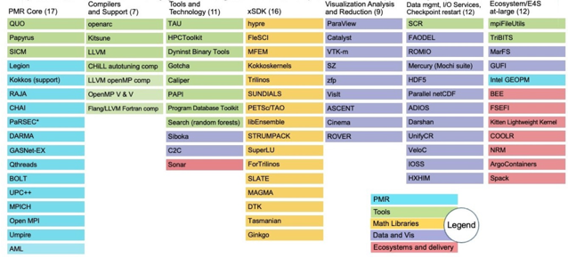
Hartwig Anzt
Area: Algorithm Development
Status Quo in Europe:
Algorithm development as part of CoEs tightly integrated with Apps, highly customized solutions
No top-down strategy developing a “product portfolio” with software tools with complementary functionality to be used off-the-shelf by domain scientists
No “building block” focus on tools, libraries …
Chair of Computational Mathematics TU Munich
Research Professor HPC University of Tennessee
CoE
v.s.

Slide 13
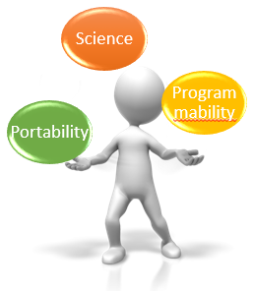
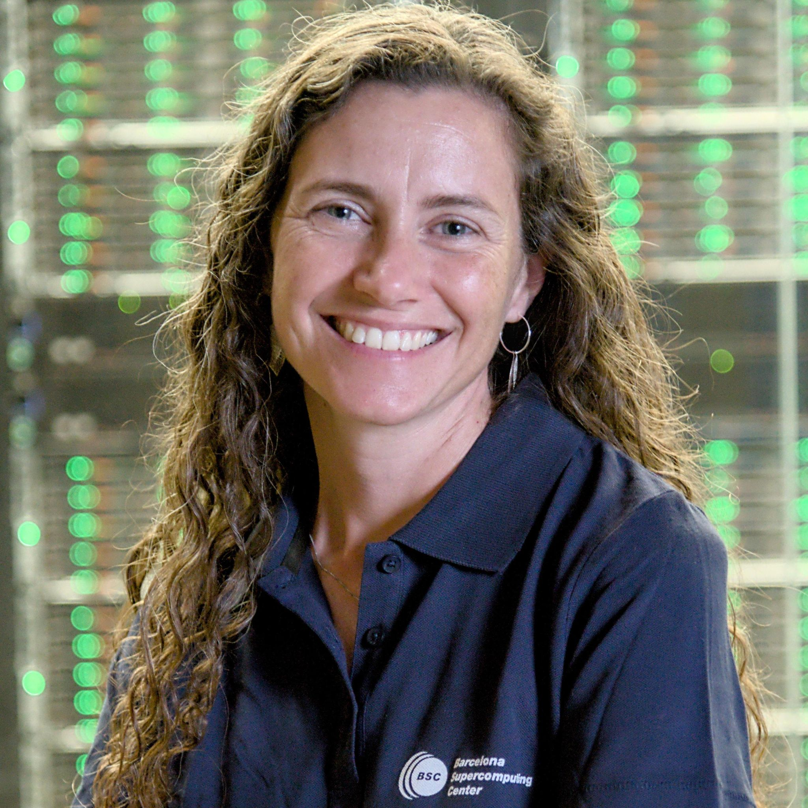
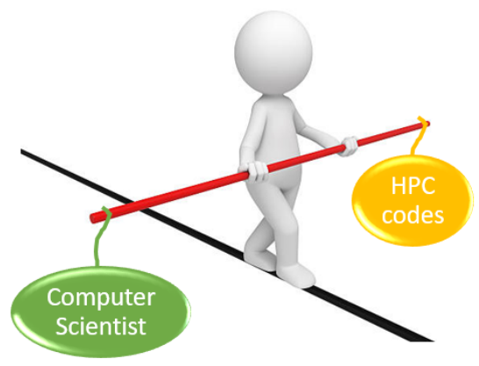
Marta García-Gasulla
Area: Performance analysis (POP CoE)
Transversal CoE
≥ 300 assessments
Target(s) in Exa and post-Exascale era:
HW and SW that HPC applications can efficiently exploit
Address needs of HPC production codes from the point of view of: Programming models, libraries and tools
Promote best practices among code developers to achieve efficient and portable code
Target scientific advances not “heroes runs”
Status Quo in Europe:
What works well: Resources dedicated to HPC software development (CoEs and other projects)
What is missing: Remove duplicated effort (dissemination, training…)
Leader of Best Practices for Performance and Programmability at Barcelona Supercomputing Centre

Slide 14
Edoardo Di Napoli
Area: Numerical linear algebra libraries, algorithm development and parallel programming in Materials Science (EoCoE-III and HANAMI)
Target(s) in Exa and post-Exascale era: Exascale computing is often a false target
Very few codes scales efficiently to a sustained Exaflop
Real target: bring as many applications to dozens or hundreds of sustained Petaflops
Status Quo in Europe:
What works well:
Established CoEs have created mature and productive networks of collaborations.
Several domains (Materials Science, Climate, Biomedicine, etc.) have been energized and coalesced in robust well-connected communities
What does not work well:
Activities within CoEs has been too diverse and dispersive. CoEs cannot do everything.
The way forward in Europe:
We need complementary types of CoE that are well-connected
We need transversal CoE for the development of tools useful to all CoEs (e.g. modern and scalable numerical libraries on distributed GPUs)
New scientific domains should be added to the existing CoEs
Head of Simulation and Data Lab Quantum Materials
Jülich Supercomputing Center

Slide 15
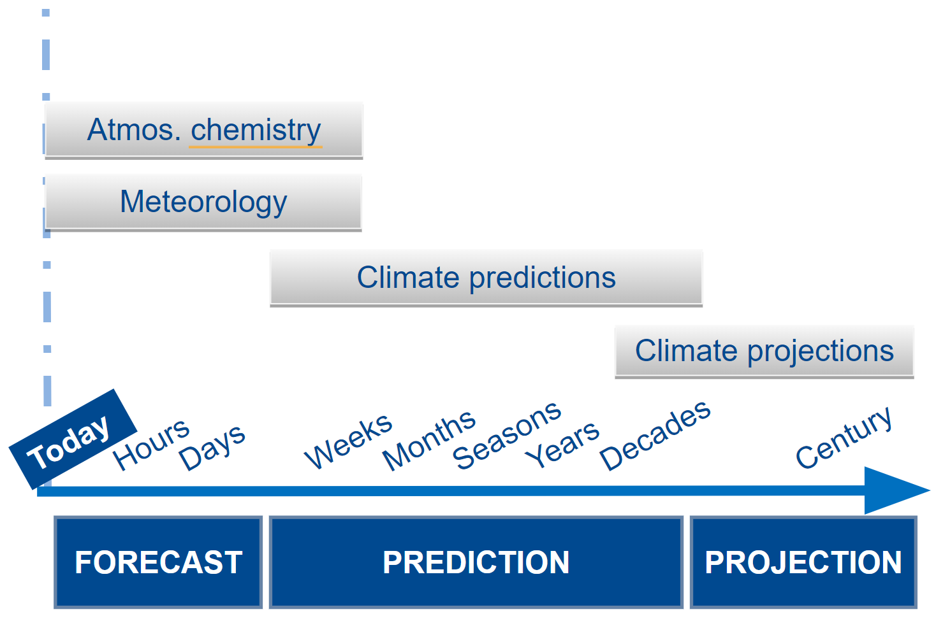
Mario Acosta
Area: Climate and Weather Forecast (ESIWACE CoE), HPC applied to Earth System Models
Target(s) in Exa and post-Exascale era:
Efficiently address the increasing complexity of Earth System Models with higher global resolutions and very long experiments for climate projections.
Leverage accelerators (e.g. GPUs) and new technologies (e.g. RISC-V) and the latest vector units and ML/AI units.
Overcome limitations (e.g. memory-bound nature of our models, large generated data volume)
Head of Computational Earth Sciences Group
Barcelona Supercomputing Center
Status Quo in Europe
What works well
Current frameworks such as the Center of Excellence or Destination Earth enable domain experts and HPC experts applied to the domain to work side by side.
The development of domain tools allows for an efficient HPC adaptation while considering the needs of the community and the operational urgency of the models.
What is missing
EuroHPC has and is developing a vast infrastructure that we aim to fully leverage with the right tools. Connecting HPC domain experts with infrastructure experts would be highly beneficial.
The development of new infrastructure and technologies could consider the specific needs of communities, such as the availability of data lakes

Slide 16
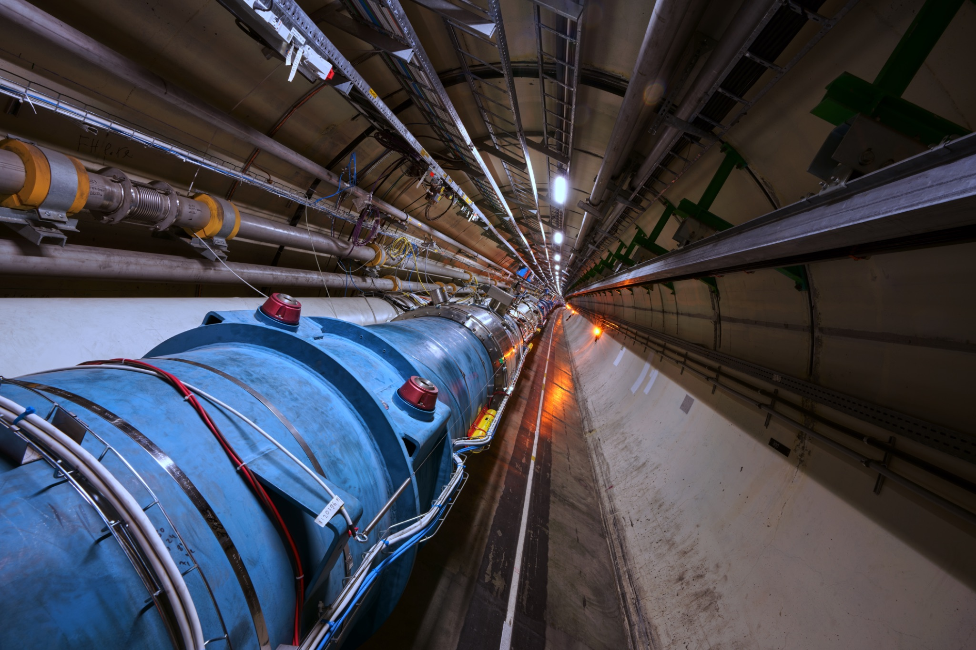
Maria Girone
Area: Applications in High Energy Physics (HEP)
HEP Simulations (e.g. Lattice QCD) are historically among the largest HPC use-cases.
HEP experiments have led the way in data-intensive computing, with unmatched software complexity, resource demands, and number of users;
Future experiments will generate exabytes of data annually, requiring efficient collection, distribution, processing, and analysis.
Target(s) in Exa and post-Exascale era:
Seamless integration of HEP’s distributed computing infrastructure with large-scale HPC resources is essential.
Co-develop interoperable interfaces and protocols to enable federated access to data and efficient job scheduling. Adopt a standards-based Authentication and Authorization Infrastructure to facilitate global collaboration.
Enhance compatibility and adopt unified programming models across software applications to expand platform usability and prevent vendor lock-in.
Status Quo in Europe:
What works well:
EuroHPC JU development/benchmarking resources provide a dynamic and cost-effective way to explore technologies
What HEP would like to have:
A CoE on HPC integration in HEP, to tackle domain-specific challenges ranging from workflow and data management, to resource provisioning, to code adaptation and software optimization, to interoperability with federated infrastructures.
Head of CERN OpenLab
Notes:
To exploit these vast amounts of data that are going to be produced, fully maximizing their physics potential, it is necessary to evaluate and adopt significant changes in processing techniques, technologies and resources. HPC sites offer by far the largest amount of computing resources available to scientific communities, and therefore it is imperative for HEP experiments to devote effort in integrating these facilities. The objective is not only to contain the costs of standard WLCG centers but also to significantly increase the total resources available to the field. This expansion directly benefits physics output, as greater resources enable, for instance, more Monte Carlo simulations, leading to more precise measurements. The HEP distributed computing infrastructure remains crucial to secure data repositories and supply a constant baseline compute contribution that best suits HEP needs.
Fully exploiting the immense data from future HEP experiments requires significant changes in processing techniques, technologies, and resources. HPC sites provide the largest computing capacity and the most cutting edge technologies.
Integrating HPC facilities for HEP computing is not straightforward. Numerous challenges need to be tackled ranging from workflow and data management, to resource provisioning and interoperability, to software.
x86-based HPC resources offer the lowest threshold for adoption in terms of both cost and effort.
Fully exploiting the immense data from future HEP experiments demands significant changes across workflow and data management, resource provisioning, interoperability, and software. High-Performance Computing (HPC) sites, especially CPU based, offer the largest computing capacity, are therefore pivotal to meeting these evolving requirements.
HEP codebases, traditionally optimized for x86_64 CPUs, require modernization to run efficiently on different architectures and/or on GPUs and other accelerators, as they are increasingly used at HPC sites. Portable parallelization strategies and updated programming models are essential to keep pace with evolving hardware. This process is not expected to cover all the relevant workflows, though, hence the availability of sizable CPU resources is expected to be a requirement also in the medium-long term.

Slide 17
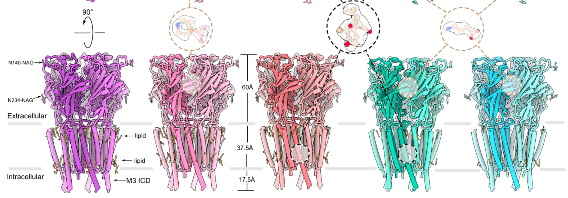
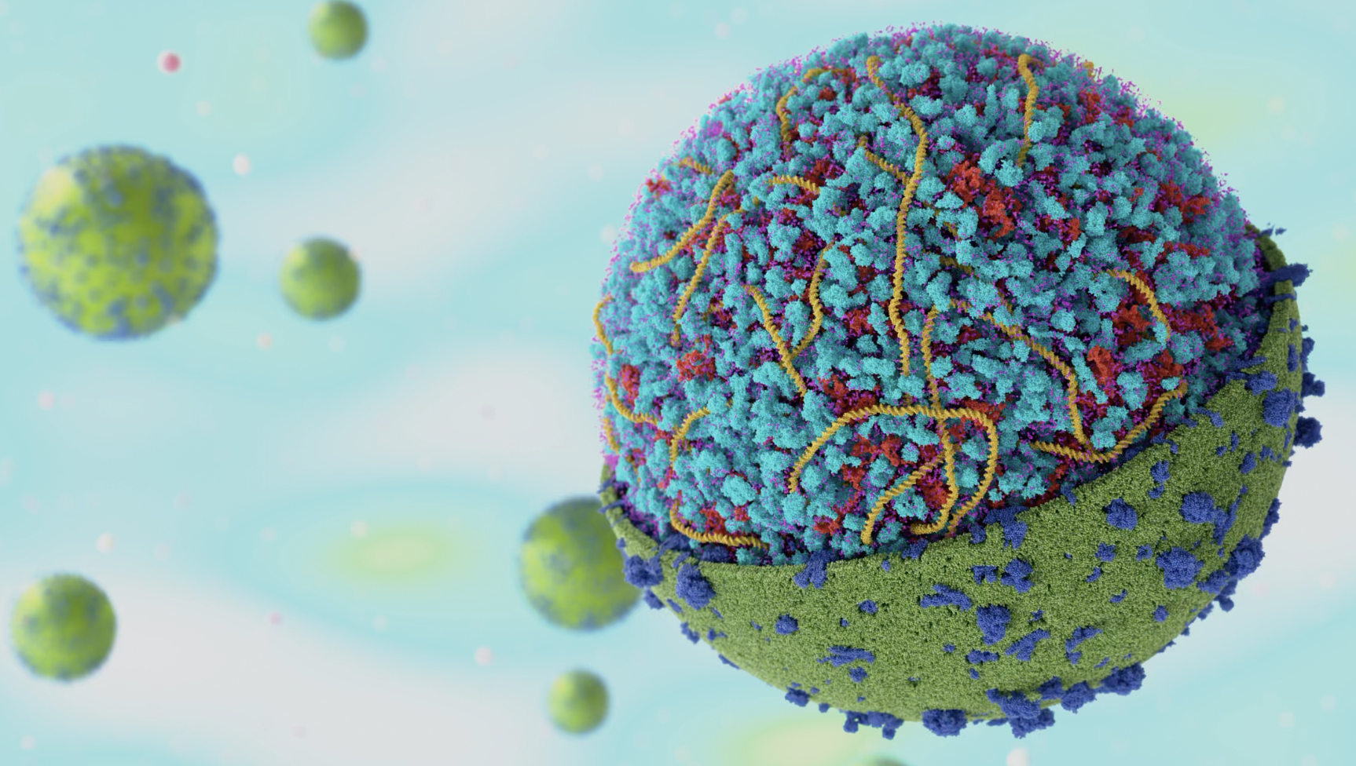
Erik Lindahl
Area: Applications (GROMACS, Cryo-EM) in chemistry/biology & data-driven life science
Target(s) in Exa and post-Exascale era:
Short-term: Make sure key applications can use Exascale machines well (perf & scaling)
Long-term: Reformulate scientific approaches into data-driven questions that we can Answer by exploiting 10s of 1000s of nodes with AI/ML-focused hardware using generative and agent-driven AI
Status Quo in Europe:
What works well
Europe is world-leading on applications, thanks to 15+ years of support by EC & EuroHPC
Investments in both method development and life science application impact work
We’ve been good at putting out fires (optimizing for current machines)
What is missing
Help/force broadly used applications to plan & prepare for architectures we’ll use in 2030
Find a good split between community-focused CoEs vs. strategic application investment
Major application investments should be based on a solid calculated expected return-on-investment - not mere hopes.
Europe must gain stronger profile throughout OSS stacks: Linux, compilers, libraries, data
Professor of Biophysics
Director NAISS National Academic Infrastructure for Super­computing in Sweden

Slide 18
Questions (1/2):
What is working well in Europe and EuroHPC program?
How to fill the gap the USA is creating by pulling out on the development of critical elements of the stack?
What does Europe expect from application fields? (more economical impact, more use of HPC,...)
What do you wish for Europe or you field?
How to fill the gap the USA is creating by pulling out on the development of critical elements of the stack?
In a scenario with limited resources:
Application diversity or application excellence?
Long-term support (for a few), or temporal support (for many)?
Which experts need to work together for successful application development?
How can one successfully transfer good work done in a community to others?
How to retain talent in scientific research in Europe?

Slide 19
Backup

Slide 20
RIAG consultation proposal
1: Community CoEs
Stack Elements
Players
Tasks
End Users
Publish new scientific results
Training & community building
Use codes “as-it -is”, change just config.
Test, validate simulations and workflows
Define new Physics* to be added to the codes
Implement Physics codes
Parallelize/scale code
Identify and solve performance bottlenecks
Port and optimize code to new HW devices
Port code to new language / programming models
Restructure code base
Version control, documentation
Design / implement new algorithms
Design / implement libraries
Support code developers in porting
Co-design (provide / apply)
Workflows
[Physics*] Code-1
[Phy] 2
[Phy] n
Domain Scientists
…
RSE
HPC support/devel.
Libraries
Algorithms
Mathematicians
Tools
Computer scient.
SW/HW developers
Different instruments for different purposes
Notes:
ES

Slide 21
RIAG consultation proposal
2: Lighthouse
Stack Elements
Tasks
End Users
Publish new scientific results
Training & community building
Use codes “as-it -is”, change just config.
Test, validate simulations and workflows
Define new Physics* to be added to the codes
Implement Physics codes
Parallelize/scale code
Identify and solve performance bottlenecks
Port and optimize code to new HW devices
Port code to new language / programming models
Restructure code base
Version control, documentation
Design / implement new algorithms
Design / implement libraries
Support code developers in porting
Co-design (provide / apply)
Workflows
[Physics*] Code-1
[Phy] 2
[Phy] n
Domain Scientists
…
RSE
HPC support/devel.
Libraries
Algorithms
Mathematicians
Tools
Computer scient.
SW/HW developers
Different instruments for different purposes
Notes:
ES

Slide 22
RIAG consultation proposal
2: Lighthouse
Stack Elements
Tasks
End Users
Publish new scientific results
Training & community building
Use codes “as-it -is”, change just config.
Test, validate simulations and workflows
Define new Physics* to be added to the codes
Implement Physics codes
Parallelize/scale code
Identify and solve performance bottlenecks
Port and optimize code to new HW devices
Port code to new language / programming models
Restructure code base
Version control, documentation
Design / implement new algorithms
Design / implement libraries
Support code developers in porting
Co-design (provide / apply)
Workflows
[Physics*] Code-1
[Phy] 2
[Phy] n
Domain Scientists
…
RSE
HPC support/devel.
Libraries
Algorithms
Mathematicians
Tools
Computer scient.
SW/HW developers
Different instruments for different purposes
Notes:
ES

Slide 23
3: Transversal CoEs
RIAG consultation proposal
Stack Elements
Players
Tasks
End Users
Publish new scientific results
Training & community building
Use codes “as-it -is”, change just config.
Test, validate simulations and workflows
Define new Physics* to be added to the codes
Implement Physics codes
Parallelize/scale code
Identify and solve performance bottlenecks
Port and optimize code to new HW devices
Port code to new language / programming models
Restructure code base
Version control, documentation
Design / implement new algorithms
Design / implement libraries
Support code developers in porting
Co-design (provide / apply)
Workflows
[Physics*] Code-1
[Phy] 2
[Phy] n
Domain Scientists
…
RSE
HPC support/devel.
Libraries
Algorithms
Mathematicians
Tools
Computer scient.
SW/HW developers
Different instruments for different purposes
Notes:
ES

Slide 24
RIAG consultation proposal
4: HPC methods and libraries
Stack Elements
Players
Tasks
End Users
Publish new scientific results
Training & community building
Use codes “as-it -is”, change just config.
Test, validate simulations and workflows
Define new Physics* to be added to the codes
Implement Physics codes
Parallelize/scale code
Identify and solve performance bottlenecks
Port and optimize code to new HW devices
Port code to new language / programming models
Restructure code base
Version control, documentation
Design / implement new algorithms
Design / implement libraries
Support code developers in porting
Co-design (provide / apply)
Workflows
[Physics*] Code-1
[Phy] 2
[Phy] n
Domain Scientists
…
RSE
HPC support/devel.
Libraries
Algorithms
Mathematicians
Tools
Computer scient.
SW/HW developers
Different instruments for different purposes
Notes:
ES

Slide 25
RIAG consultation proposal
5: Algorithms
Stack Elements
Players
Tasks
End Users
Publish new scientific results
Training & community building
Use codes “as-it -is”, change just config.
Test, validate simulations and workflows
Define new Physics* to be added to the codes
Implement Physics codes
Parallelize/scale code
Identify and solve performance bottlenecks
Port and optimize code to new HW devices
Port code to new language / programming models
Restructure code base
Version control, documentation
Design / implement new algorithms
Design / implement libraries
Support code developers in porting
Co-design (provide / apply)
Workflows
[Physics*] Code-1
[Phy] 2
[Phy] n
Domain Scientists
…
RSE
HPC support/devel.
Libraries
Algorithms
Mathematicians
Tools
Computer scient.
SW/HW developers
Different instruments for different purposes
Notes:
ES

Slide 26
RIAG consultation proposal
1: Community CoEs
2: Lighthouse
3: Tools
4: Methods & libraries
5: Algorithms
Stack Elements
Players
Tasks
End Users
Publish new scientific results
Training & community building
Use codes “as-it -is”, change just config.
Test, validate simulations and workflows
Define new Physics* to be added to the codes
Implement Physics codes
Parallelize/scale code
Identify and solve performance bottlenecks
Port and optimize code to new HW devices
Port code to new language / programming models
Restructure code base
Version control, documentation
Design / implement new algorithms
Design / implement libraries
Support code developers in porting
Co-design (provide / apply)
Workflows
[Phy] 2
[Phy] n
Domain Scientists
[Physics*] Code-1
[Phy] n
…
RSE
HPC support/devel.
Libraries
Algorithms
Mathematicians
Tools
Computer scient.
SW/HW developers
Different instruments for different purposes
Notes:
ES

