Slide 1

Where industrial AI and HPC meet: benefits, requirements, barriers
Ana García Robles
Secretary General BDVA
Antwerp, 19/3/2024

Slide 2
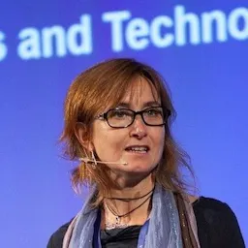







Where industrial AI and HPC meet: benefits, requirements, barriers
Tuesday 19/3/2024 at 11h30 CET
Ana García Robles, BDVA (Moderator)
Evangelia Markidou, EC
Daniel Opalka, EuroHPC JU
Jeanette Nilsson, RISE
Petri Millymäki
University of Helsinki
Thomas Hahn, Siemens
Roberta Turra, CINECA
Laszlo Friedmann , Fraunhofer IAIS

Slide 3
European AI
Innovation Package
Evangelia Markidou
Head of Sector - Artificial Intelligence Technology, Development and Impact
Directorate General CONNECT, European Commission

Slide 4

Relevance of Generative AI
Generative AI models (such as large language models) are a new wave of AI models adaptable to various domains and tasks.
These models have immense potential to revolutionise multiple sectors.
Despite their advantages, generative AI models, have capabilities and risks that are still being uncovered.
Mastery of this technology is of strategic importance for Europe to reduce dependency on non-European companies and ensure sovereignty.

Slide 5

Main elements:
AI startup and innovation Communication
Amended EuroHPC regulation
CitiVERSE EDIC
ALT EDIC
AI Office

Slide 6
The AI Package
AI Start-up and
Innovation Communication
AI Office
ALT-EDIC
CitiVERSE EDIC
EuroHPC Amendment:
AI Factories
GenAI4EU
Key Ingredients for AI
Data Access
Algorithms
Investment
Skills
Processors
€4 billion
Notes:
1 overview slide showing all the elements of the package in a graphic way
1 graphic slide on AI Factories
1 slide on GenAI4EU
4 billion somewhere

Slide 7
Strategic Framework
Upgrade EU supercomputers to AI capabilities and facilitate access
Increase availability of and facilitate access to high-quality data
Support algorithmic developments through R&I funds
and encouraging private investments in startups and SMEs
Promote joint projects and implementation of models in key application areas
Strengthen EU’s talent pool by focussing trainings on AI models
1
2
3
4
5
Notes:
To overcome the challenges and exploit its assets, it is vital to strengthen the EU’s tech landscape and ensure its global competitiveness.
First, in order to support the further development and scalability of AI models in the Union, access to world-class supercomputers that accelerate AI training, reducing training time from months to a matter of weeks, is crucial. The Union will further upgrade its supercomputers to AI capabilities and facilitate access to its network for startups and academics in need of training AI models.
Second, the Union will increase availability of and facilitate access to high-quality data, by accelerating the development and deployment of its Common European Data Spaces that are also benefitting from the opportunities offered by the EU data strategy and its legislative data instruments.
Third, the Union will support algorithmic developments, including by making available R&I supporting funds and by encouraging private investments in the form venture capital or equity to support startups in the field.
Fourth, the Union will strengthen EU’s talent pool, by focussing trainings on AI models, retaining and attracting new talent and supporting AI literacy in the workforce.
Fifth, the Union will promote joint projects and implementation of models in key application areas, including for the public administration that could act as lead user of such applications.
The following sections describe how the above strategic framework will be put in motion.
https://commission.europa.eu/strategy-and-policy/priorities-2019-2024/europe-fit-digital-age/european-data-strategy_en

Slide 8





AI Factories
Talent & Competences
Data centre
Data Spaces
Data Spaces
One Stop-Shop
The EU’s AI-oriented super-computers
Access & AI-HPC services
AI Ecosystem*
supercomputer-friendly programming facilities
*AI Ecosystem:
Testing and Experimentation Facilities, AI on Demand Platform, AI Networks of Excellence, AI-Data-Robotics PPP, etc.
8

Slide 9






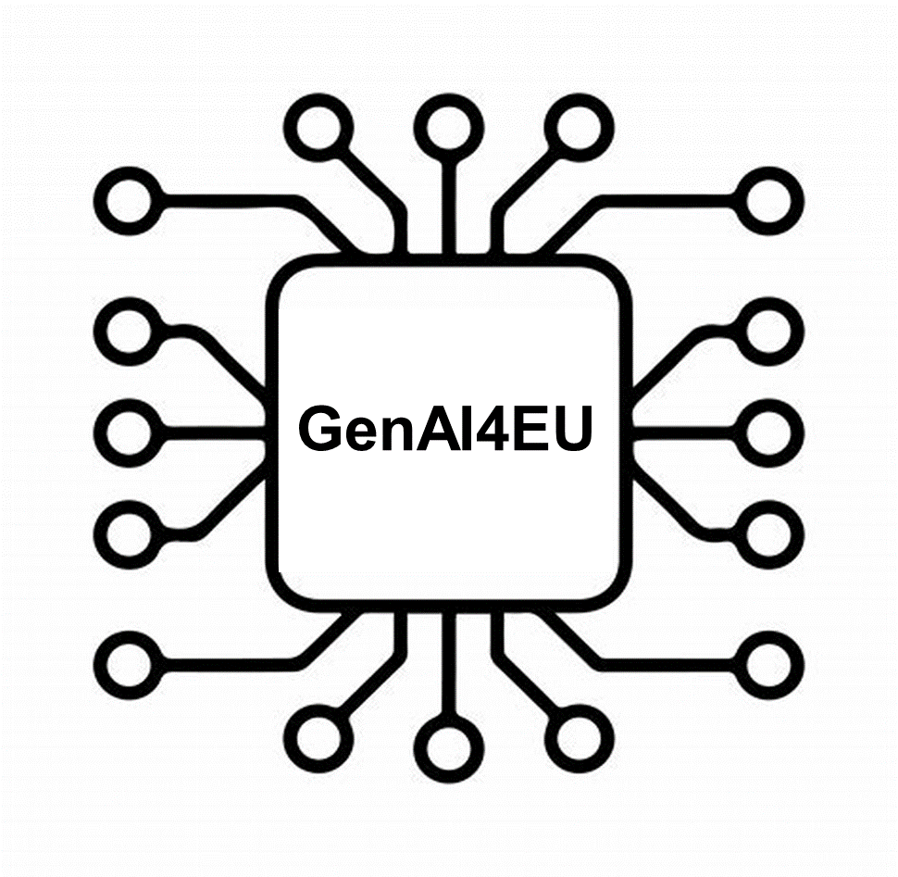







GenAI4EU Initiative
GenAI4EU initiative to stimulate the widespread uptake of generative AI across the Union’s strategic industrial ecosystems.
Startups and innovators can work closely with industrial users, attract investments in the Union and have access to the key ingredients of AI - data, computing, algorithms and talent.
Virtual worlds
and digital twins
Public sector
Examples:
Robotics
Sciences
Healthcare
Biotechnologies
and chemicals
AgriFood
Materials
and batteries
Aerospace
Manufacturing
and engineering
Cybersecurity
Climate change
and environmental
sustainability
Mobility
9

Slide 10




Example GenAI Applications | Healthcare
Medical Imaging and Diagnostics
Drug Discovery and Development
LLMs as healthcare assistants
Personalised Medicine
10
Notes:
Healthcare
Medical Imaging and Diagnostics
Generative AI can analyze medical images, such as X-rays, CT scans, or MRIs, to improve their quality, assist with the precise identification of abnormalities like tumors or lesions, and even create additional realistic images to expand datasets for training diagnostic AI models.
Drug Discovery and Development
Generative AI can accelerate drug discovery and development by designing new molecules with desired properties, predicting potential drug-target interactions, offering the potential to discover novel drug leads more quickly and efficiently.
LLMs as healthcare assistants
LLMs can serve as healthcare assistants by providing patients with reliable health information, answering questions, offering medication reminders, and even triaging symptoms. LLMs can offer a first line of support, schedule appointments, translate medical terminology into simpler language, and facilitate communication between patients and healthcare providers.
Personalised Medicine
Generative AI and LLMs hold significant promise for personalized medicine. Generative AI can analyze a patient's genetic data, medical history, and other health information to design tailored drug molecules or suggest specific treatment plans that are likely to be most effective for that individual.

Slide 11
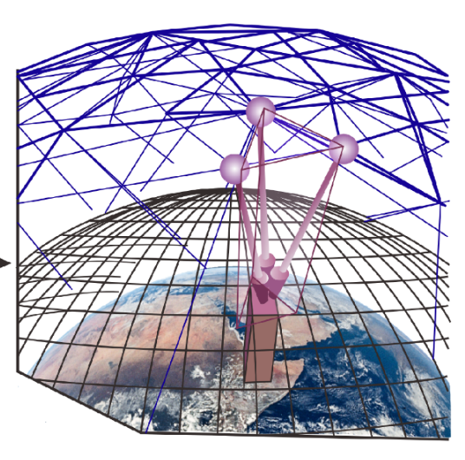


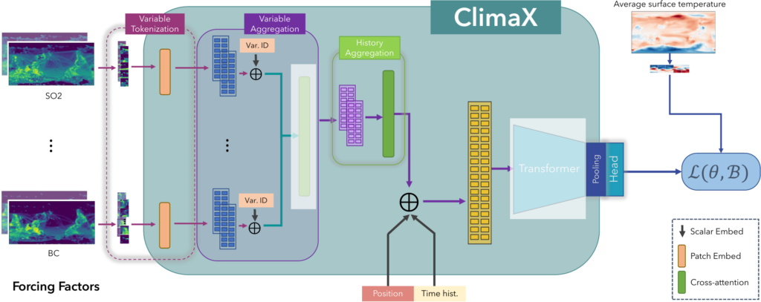
Example GenAI Applications |
Climate Change and Environmental Sustainability
Generative AI for weather forecasting
Enhanced data integration
Faster and more accurate weather forecasting
More efficient use of resources
Ability to detect extreme weather events
11
Notes:
Generative AI for weather forecasting
Faster and more accurate weather forecasting
Generative AI can revolutionize weather forecasting by learning complex weather patterns from vast historical data and then rapidly generating new predictions.
More efficient use of resources
Unlike traditional numerical weather models, which are computationally expensive, generative AI can produce high-resolution forecasts in minutes on standard computers. This translates to quicker insights into storms, precipitation, and temperature changes.
Ability to detect extreme weather events
Generative AI can be trained on diverse datasets, it can also predict localized weather events and identify subtle anomalies or combinations of factors that might indicate the formation of extreme events like hurricanes, tornadoes, or wildfires.

Slide 12




Example GenAI Applications | Cybersecurity
Enhanced Threat Detection and Prediction
Vulnerability Identification
Sophisticated Phishing and Social Engineering
LLMs as cybersecurity assistants
12
Notes:
Cybersecurity
Enhanced Threat Detection and Prediction
Generative AI can revolutionize threat detection and prediction by analyzing massive quantities of cybersecurity data to learn the intricate patterns of various cyberattacks
Vulnerability Identification
Generative AI can play a crucial role in vulnerability identification by analyzing sofware applications to uncover potential weaknesses. This allows for the discovery of vulnerabilities that traditional scanning methods might miss, enabling proactive patching and hardening of systems before they can be exploited by attackers.
Sophisticated Phishing and Social Engineering
Generative AI enhances the detection of sophisticated phishing and social engineering attacks by analyzing language patterns, email content, and user behavior. This allows for the detection of highly targeted and personalized attacks that often trick traditional security filters.
LLMs as cybersecurity assistants
LLMs can serve as powerful cybersecurity assistants by analyzing massive amounts of security data. They can process explain complex security concepts in plain language, answer questions from security analysts, and generate reports.

Slide 13
CitiVerse-EDIC |
Local Digital Twin
European Digital Infrastructure Consortium
Digital replica of a city to simulate
development & planning
Member States and cities-driven
Vehicle for ownership and operation
of common infrastructures
Enables provision of services
for citizens and cities
Opportunities for homegrown innovators
as providers of AI tools
Partnerships/consortia will involve around
60% of SMEs (including start-ups)
Marketplace for AI-based services/solutions
Leveraging from HPC to run AI-based services
Trustworthy AI-based tools for cities & citizens engagement (incl. AR/VR technologies)
European Ecosystem of AI-based solutions for cities
Notes:
Trustworthy AI-based tools for cities & citizens engagement (incl. AR/VR technologies) Marketplace for AI-based services/solutions Leveraging from HPC to run AI-based services European Ecosystem of AI-based solutions for cities

Slide 14
ALT-EDIC |
Alliance for Language Technologies
European Digital Infrastructure Consortium
Objectives
Actions Plan
Preserve linguistic and cultural
diversity in Europe
Technological leadership
and strategic autonomy
Respect European rules and values
Cooperation
Raising awareness
Linguistic diversity
Federate MS and EU
language data resources
Seed fund for new language models
Ease HPC access
Support SMEs take up
European
Ecosystem
Fine tuning existing language models

Slide 15
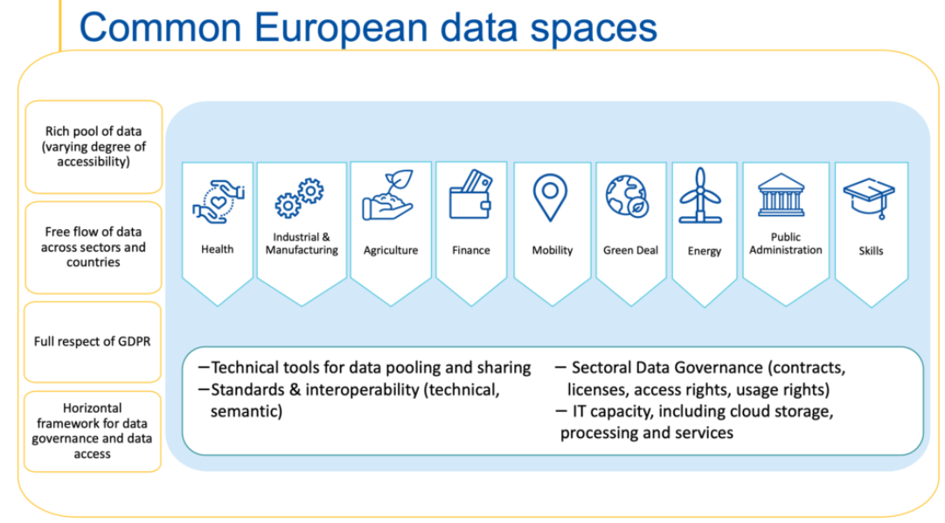
Key ingredient: Access to Data
Common European Data Spaces
European single market for data
Pooling European data in key sectors
Enabling a data-driven economy
Notes:
Data storage facilities and supercomputing services for AI
The second pillar concerns technology to support the AI-specific use of the AI-oriented supercomputers. Therefore, they will firstly have to be located in proximity to an established data centre or be connected via high-speed networks to an established data centre to benefit from large scale storage capacities that are required for the training of large-scale AI models. In addition, such data centres will be interconnected with the European Common Dataspaces in order to facilitate the training in the key sectorial domains covered by the dataspaces. .
Moreover, dedicated supercomputing support services in support of the AI start-up and research and innovation ecosystem should be part of the AI Factories. Examples of such services include: access to the AI oriented supercomputers for the AI-start-ups but also to the broader AI scientific and innovation community; dedicated supercomputer-friendly programming facilities and algorithmic support for the further development, testing, evaluation and validation of AI training models and systems; and support for the development of a variety of novel use cases and emerging applications based on AI in key areas such robotics and manufacturing, new materials (e.g., for batteries), connected and automated driving, personalised health and care, biotech, climate change and adaptation, etc. Moreover, EU-level federation of AI Factories, making their computing power available as-a-service throughout the Union, will be part of the support services.
Access conditions to the EuroHPC supercomputers will specify that such access is granted for the development of ethical and responsible AI models and systems, a commitment that may be provided for example by subscribing to the AI Pact

Slide 16

Key ingredient: Algorithms
Large AI Grand Challenge
ALT-EDIC funding for open-source EU model addressing all European languages
Testing and Experimentation facilities (TEFs)
Setup of AI regulatory sandboxes
Financial instruments to support European start-ups (EIC accelerator, investEU)
Notes:
Reaping the benefits of our Data strategy
Data, the lifeblood for training algorithms, is scarce for AI start-ups in the EU, creating a critical need for access to this resource. The EU is now on the cusp of realising a true single market for data by implementing its Common European Data Spaces boosted by the favourable legislative framework put in place as part of the Data Strategy. This framework includes: the Open Data Directive, which improves the availability of high-value datasets, including geospatial, environmental, statistical, and meteorological data; the Data Governance Act, which will stimulate data sharing by creating data intermediation services and encouraging the sharing of data for altruistic purposes; and the Data Act, which will facilitate the fair use of IoT-generated data, empowering AI start-ups to utilize this untapped resource. The Commission will give guidance on the concrete implementation of these legal instruments and will work on practical solution for data permission management. This framework will create an extensive and accessible pool of data resources, benefiting AI start-ups.
The Common European Data Spaces will provide a varied data ecosystem for AI start-ups, integrating data across sectors like health, mobility, agriculture, and manufacturing. The Commission will strengthen its financial support for Common European Data Spaces with new calls covering major sectorial application areas, including in the areas of mobility and energy, being launched in 2024 under the Digital Europe Programme.
As part of its efforts to support the Data Strategy, the Commission will also release and make widely available high-quality language data in all European languages available in the European institutions.
Algorithms for reinforcing EU’s supporting schemes - Investing in an innovative and vibrant AI start-up and scale-up ecosystem
A number of European AI start-ups has already started to develop and finetune algorithms for AI models, but more efforts are required for the EU to establish world-class algorithms. The Commission has already put in place initiatives to support these endeavors. Notably, in 2023 the Commission launched the Large AI Grand Challenge addressing AI startups to develop AI models. In the period 2024-2027, the Commission will provide additional support through Horizon Europe for advancing further AI capabilities.
To facilitate the emergence of AI models and systems in the EU, several Member States will join forces for federating resources in terms of data, access to computing and to algorithmic expertise, such as for finetuning algorithms, offering services to developers and in particular to startups. The Alliance for Language Technologies European Digital Infrastructure Consortium (ALT-EDIC) initiative will provide centralised access to language resources for the development of European ‘Large Language Models’, e.g. AI models designed to understand and generate human-like text. The Digital Europe Programme will also support a high-performing open-source European model addressing all European languages offering valuable tools in particular for small countries with limited language data and empowering users to engage with digital content in their native languages. As advances in technology have led to the development of models that can effectively handle multiple types of data simultaneously (text, audio, video, images, code, etc), ALT-EDIC will also open up possibilities for more holistic and comprehensive AI applications across various domains.
The Commission has also set up several initiatives to facilitate the testing of AI algorithms in real world conditions through Testing and Experimentation facilities that help SMEs, including startups, undertake the testing of their ground-breaking models. In addition, under the AI Act, Member States will put in place AI regulatory sandboxes providing a controlled environment for the development, testing and validation of innovative AI systems, under the supervision of competent authorities. Finally, in 2024, the Digital Europe Programme will also support the development of tools for testing and validation of AI models and systems.
The Commission is putting in place financial instruments to support efforts by start-ups: first, the Horizon Europe’s European Innovation Council will provide, through its accelerator scheme, dedicated investment possibilities in the forms of grants and equity to support startups and attract investors; second, InvestEU will provide a dedicated instrument for venture capital funds to support scaleups and SMEs.
European legislation on open data | Shaping Europe’s digital future (europa.eu)
https://digital-strategy.ec.europa.eu/en/policies/data-governance-act
https://digital-strategy.ec.europa.eu/en/policies/data-act
LARGE AI GRAND CHALLENGE – AI-BOOST (aiboost-project.eu)
Testing and Experimentation Facilities (TEFs)
The Networks of Excellence in AI bring together the best research teams in Europe from academia and industry to join forces in addressing the major challenges hampering the deployment of AI-based solutions. Networks of Excellence | AI-on-Demand (ai4europe.eu) - https://www.ai4europe.eu/Network-of-Excellence
With the adoption of the AI Act, one regulatory sandbox will be set up in all Member Sates. These sandboxes will provide a controlled environment for the development, testing and validation of innovative AI systems, under the supervision of competent authorities. In the sandboxes, companies will receive guidance on regulatory expectations and best practices to assist the future implementation of their systems.
EIC Accelerator - European Commission (europa.eu)

Slide 17


Key ingredients: Skills & Processors
Support training, up- and reskilling
activities through dedicated initiatives
Digital Europe
Networks of Excellence in AI
European Digital Innovation Hubs
European Research Council
Reduce reliance on specialised AI chips
designed and developed outside the Union
Follow-up Major European Processor Initiative in 2024 under the EuroHPC JU:
                First European post-exascale supercomputer
                Embedding of processors today for around 15% of all ERC projects
Notes:
Skills: leveraging on European capacities
For start-ups to grow and scale up their activities, access to talent is key. Appropriate skills are essential across all levels of the value chain, spanning from the initial development of general models to their fine-tuning for specific purposes. Additionally, skills are required for effectively working with these models in practical use cases.
In fact, Europe offers a breadth of talent, with nearly 200 000 engineers having experience in AI. However, it is only a few hundreds dedicated practitioners who are capable of developing AI, with remarkable gender disparity.
The Commission will support training, skilling and reskilling activities in this field, for example by supporting dedicated Masters and doctoral programs through Digital Europe and targeting female participation. In addition, it will involve education and training providers, as well as the Networks of Excellence and their doctoral programme. It will also work with the European Digital Innovation Hubs specialised in AI to engage SMEs and the public administrations and deliver training that corresponds to their needs, as the integration of AI models is expected to have a multi-fold impact on work, changing the skills requirements in all public and private sectors.
Finally, the European Research Council will play a significant role in attracting and retaining AI talent: by acting as a prestigious "quality label" for research labs and financing ambitious AI-related projects it will attract both EU and non-European research talents.
Enabling AI microprocessors chips
The training of AI models relies on specialised AI chips but these are mostly designed and developed outside the Union. This is why in 2019 the EU launched the European Processor Initiative, aiming to develop high-end processors, including for AI. A follow-up major initiative will be launched in 2024 under the EuroHPC JU, to address the design and development of a new generation of microprocessors and AI accelerators. The first objective is to use this technology to fully power the first European post-exascale supercomputer. The second objective is to support, through the Chips JU, the embedding of such processors in automated and connected vehicles and future advanced communication systems e.g. 6G.
In Europe, 16% of AI-skilled individuals are women.
The Networks of Excellence in AI bring together the best research teams in Europe from academia and industry to join forces in addressing the major challenges hampering the deployment of AI-based solutions. Networks of Excellence | AI-on-Demand (ai4europe.eu) - https://www.ai4europe.eu/Network-of-Excellence
AI accounts today for around 15% of all ERC projects

Slide 18

AI Office: Mission and tasks
Context:
  Clear need for EU-level governance
  system for AI (SotEU 2023)
  Political agreement on AI Act from
  8 December introduces role of AI Office
  Part of DG CNECT
  Responsibility to implement and enforce the AI Act,
  in particular rules on general-purpose AI models and systems
  Cooperate with all relevant EU bodies and Member States
  Collaboration with stakeholder community
  Cross-sectoral cooperation within the Commission
  Promote uptake of and innovation in AI with societal benefits
  Coordinate and promote international cooperation on AI

Slide 19
AI innovation ecosystem : from the Lab to the Market
GenAI
from the lab…
AI Ecosystem of Excellence
PPP - ADRA
Testing and Experimentation Facilities
(E)DIH
R&I projects
Networks of Excellence Centers
AI-on-Demand Platform
HPC
Data
DIGITAL EUROPE
HORIZON EUROPE
…to the market
skills

Slide 20



Putting EU in the map of Generative AI
Innovation: From the lab to the market
Opening 16/04/2024
Deadline 18/09/2024 (adoption tbc)
Opening 29/02/2024
Deadline 29/05/2024
Cut-off dates: 13/02/2024 and 4/09/2024
Horizon Europe
Advancing Large AI Models: Integration of New Data Modalities & Expansion of Capabilities
€43 million
Explainable and Robust AI
€12 million
Digital Europe
Alliance for Language Technologies
€24 million
Making available a high performing open-source European
foundation model for fine-tuning
€25 million
EIC Accelerator
Human Centric Generative AI made in Europe
€50 million
Development of foundation ‘frontier’ models

Slide 21


Key Actions of AI Innovation Package
Launch specific activities, through Horizon Europe and the Digital Europe Programme to:
Will provide innovative financial instruments through the EIC accelerator Programme and the InvestEU guarantee and encourage Member States and private investors to undertake similar investments for AI start-ups.
MS will establish the ALT-EDIC and the CITIVERSE EDICs with the support of the Commission.
      Support the setup of “AI Factories”, through the amendment of the EuroHPC Regulation;
      Accelerate the development and deployment of the Common European Data Spaces
      and make it available for the AI community;
      Support the development of large AI models and systems,
      Support “GenAI4EU” for developing novel use cases and emerging applications
      in several industrial and societal sectors;
      Support initiatives to strengthen EU’s generative AI talent pool.
Notes:
Key actions
The European Commission will support startups, drive breakthrough innovation and enhance the competitiveness of the European AI industrial ecosystem, positioning the EU as a globally competitive leader, notably through:
setting-up AI Factories and bring together the key resources needed for GPAI development;
establishing the ALT-EDIC and develop a common European infrastructure in Language Technologies to increase digital sovereignty, boost competitiveness and uphold Europe’s linguistic diversity and cultural richness;
creating AI sandboxes to provide controlled environment for the development, testing and validation of innovative trustworthy AI systems;
providing funding schemes through EIC accelerator Programme, InvestEU and Horizon Europe and Digital Europe Programme;
Support to key applications
This comprehensive set of actions will support GPAI development for a total of more than 3 billion euros until the end of this multiannual financial program (2027), adding to investment in standard AI activities already planned as part of different EU Programmes.

Slide 22
Where industrial AI and HPC meet: benefits, requirements, barriers
Tuesday 19/3/2024 at 11h30 CET
Ana García Robles, BDVA (Moderator)
Evangelia Markidou, EC
Daniel Opalka, EuroHPC JU
Jeanette Nilsson, RISE
Petri Millymäki
University of Helsinki
Thomas Hahn, Siemens
Roberta Turra, CINECA
Laszlo Friedmann , Fraunhofer IAIS

Slide 23
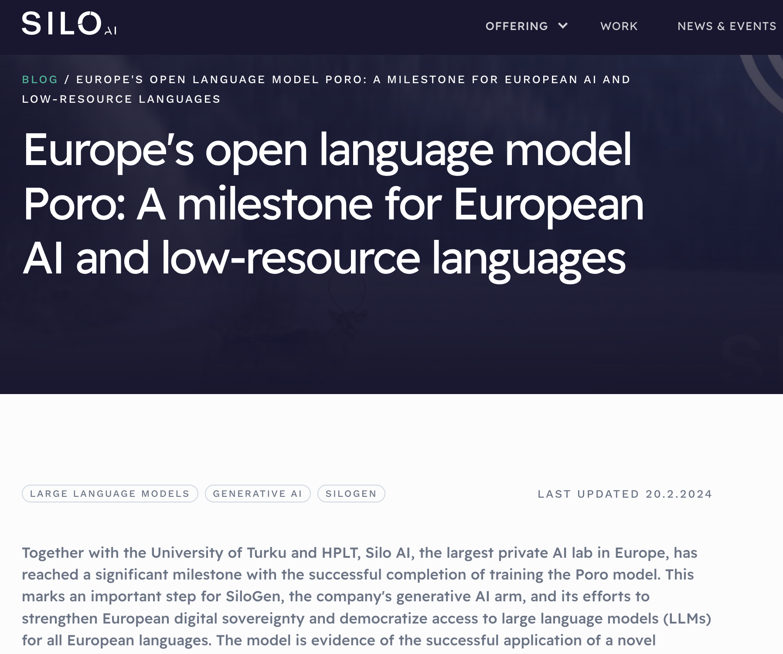


Slide 24

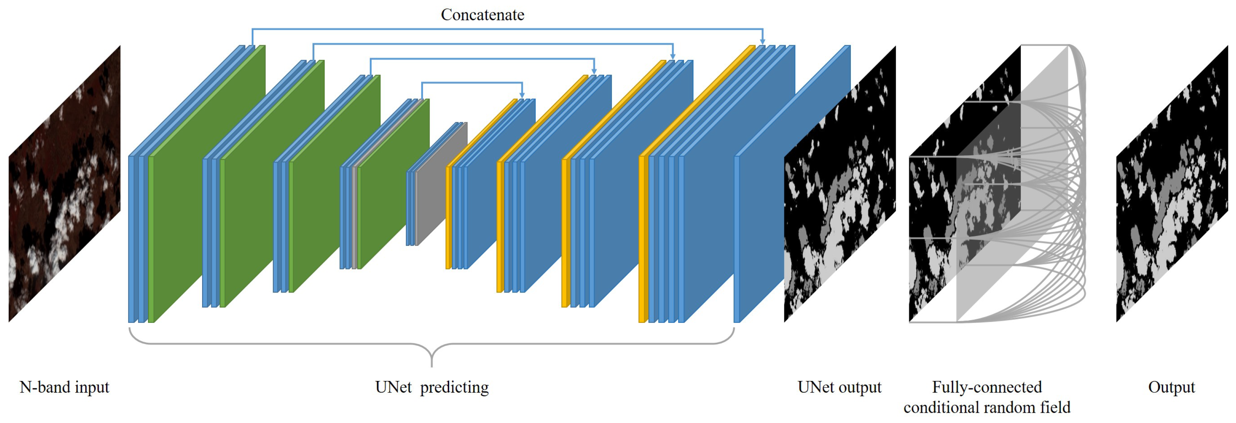
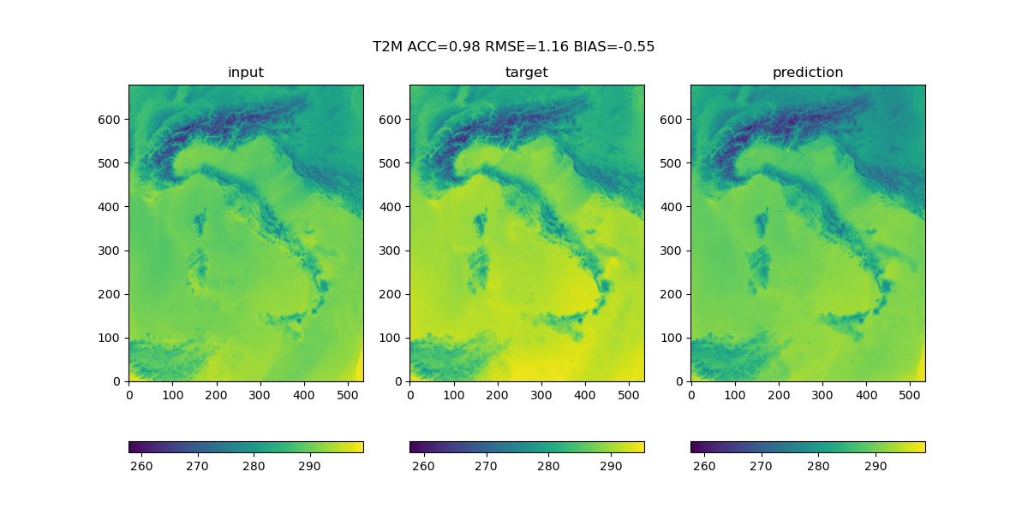



Machine Learning Weather Prediction (MLWP): The AI General Circulation Model
A ML-weather prediction model for Italy, with a horizontal resolution of 2.2km (hourly)
To be employed for an accurate prediction of renewable energies on both the production and demand side
The advantage is a (very) fast runtime and significant savings in computational resources
Surface Temperture [K] – 11 October 2020, 17UTC
Data: historical data on atmospheric behavior in the last 40 years reconstructed by means of reanalysis products (ERA5 downscaled) – volume 3TB
Moldel: UNet with 29 million parameters
Cineca role:
parallelization of training data on 10 nodes (1 GPU for each year, monthly batches) - 20 epochs in 7 hours,
testing alternative approaches such as Transformer and Generative Diffusion models with Spatio Temporal Learning tools
validation on observational data and standard numerical model predictions

Slide 25

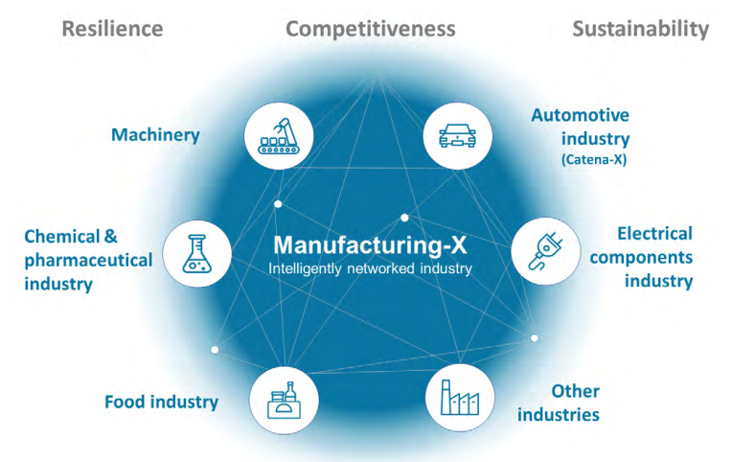
Where Industrial AI and HPC Meet: Benefits, Requirements, Barriers
Manufacturing-X: Make Data Work
      Goal
      Manufacturing-X is an initiative to digitalize the entire manufacturing and supply chains in industry.
      The goal is to enable digital innovations for greater resilience, sustainability and competitiveness.
      Approach
      Companies jointly work together on use cases and share services to enable data exchange across companies and products of different vendors. It builds on common standards.
      Data is used to create value and impact.
      Customer value
      Creates customer value for concrete use cases
      Opportunities for SMEs to gain access to technology and infrastructure as basis to provide their digital offerings​

Slide 26
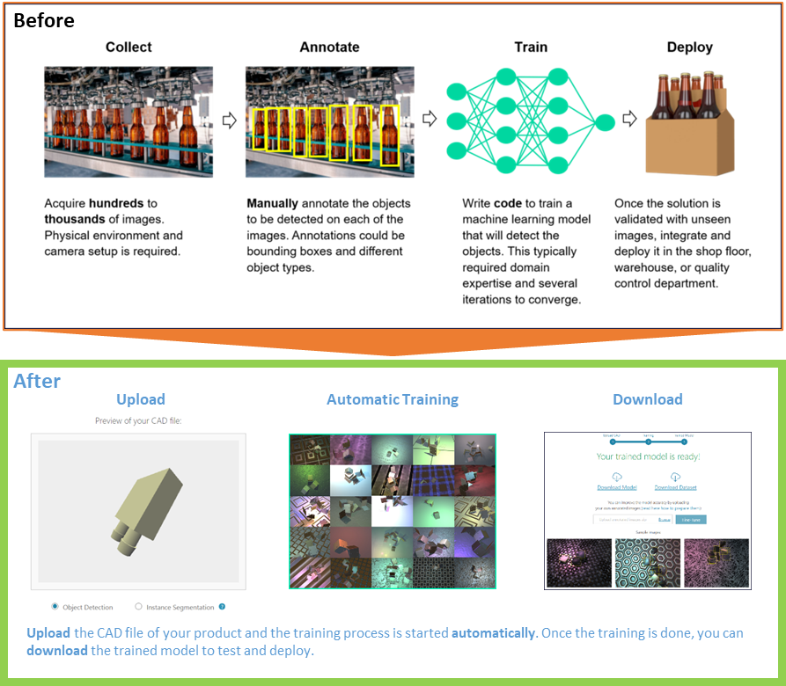
Where Industrial AI and HPC Meet: Benefits, Requirements, Barriers
Manufacturing-X: Make Data Work
„AI is on the spot“:
(Generative) AI is revolutionizing the digital economy
Automation of know-how activities
New usage paradigms
Translating between (formal) languages
Challenges:
Easy access to knowledge and HPC infrastructure
Training of own AI models
AI across company and vertical boundaries
Security and trust
Scalabilty

Slide 27












HPC ACCESS | SUPPORT | TRAINING
Meetings on a weekly basis with new potential EuroHPC users
What is available?
Which system is best for me and my group? How do we apply?
What are the requirements?
How can we get started?
Is it really free?
One-stop shop – if ENCCS can’t help you, we hopefully know someone who can

Slide 28
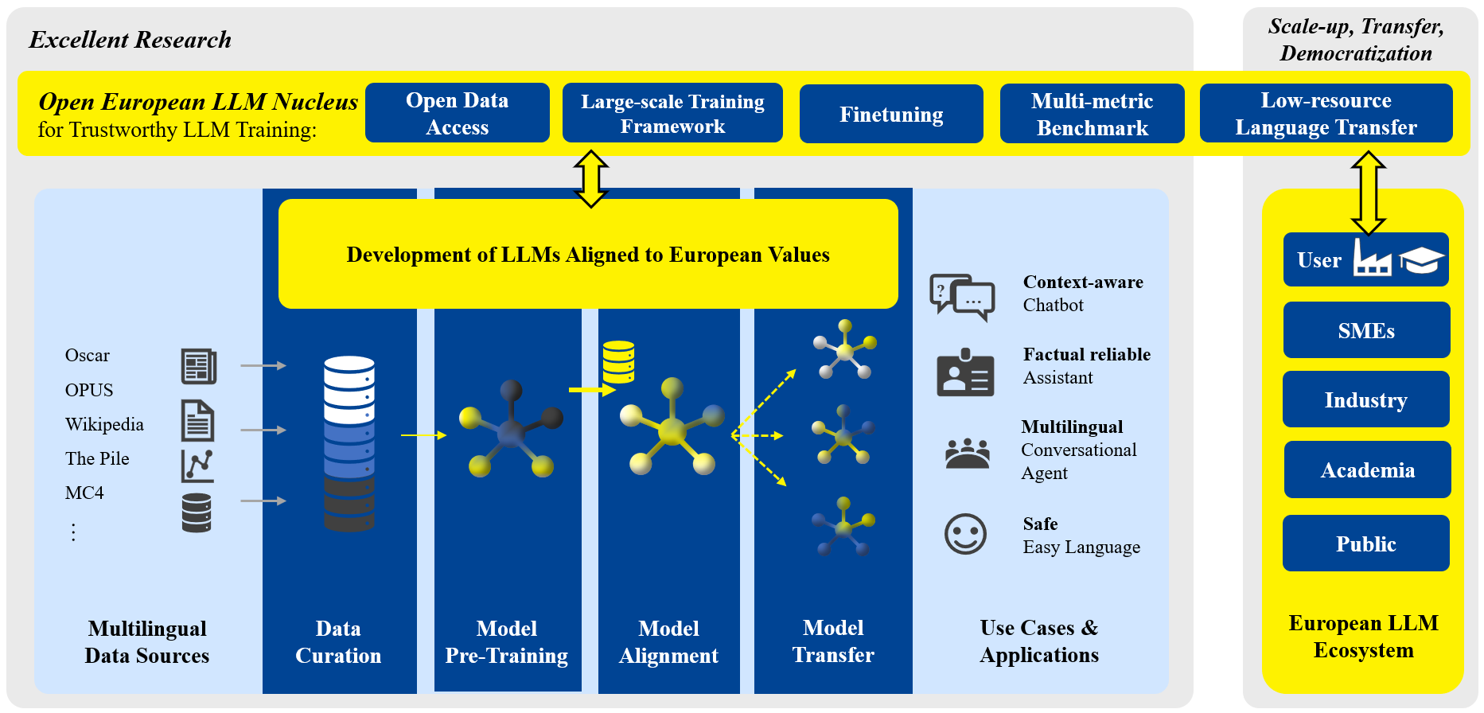
TRUSTLLM – DEMOCRATIZING TRUSTWORTHY AND EFFICIENT
LARGE LANGUAGE MODEL TECHNOLOGY FOR EUROPE
trustllm.eu

Slide 29
Where industrial AI and HPC meet: benefits, requirements, barriers
Tuesday 19/3/2024 at 11h30 CET
Ana García Robles, BDVA (Moderator)
Evangelia Markidou, EC
Daniel Opalka, EuroHPC JU
Jeanette Nilsson, RISE
Petri Millymäki
University of Helsinki
Thomas Hahn, Siemens
Roberta Turra, CINECA
Laszlo Friedmann , Fraunhofer IAIS

