Slide 1
PLENARY: Challenges in HPC after Exascale
Estela Suárez - (Jülich Supercomputing Centre)
Erik Lindahl - (KTH Royal Institute of Technology)
Jean-Yves Berthou - (INRIA Saclay)
Fabrizio Del Maffeo - (Axelera AI)
Sergi Girona - (Barcelona Supercomputing Centre)
Leonardo Flores Añover (EC) - Moderator

Slide 2
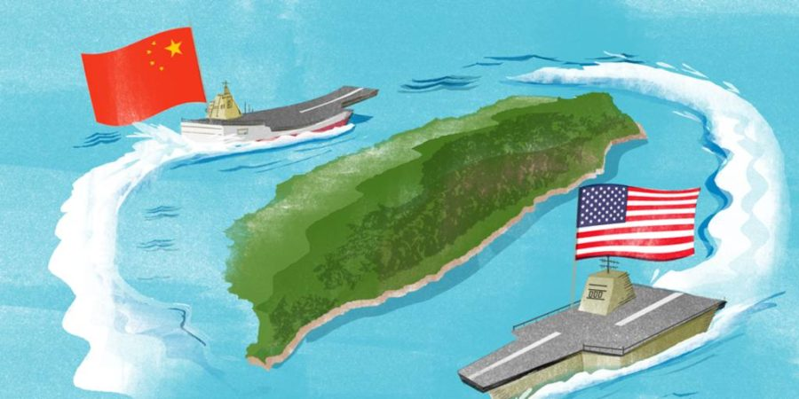
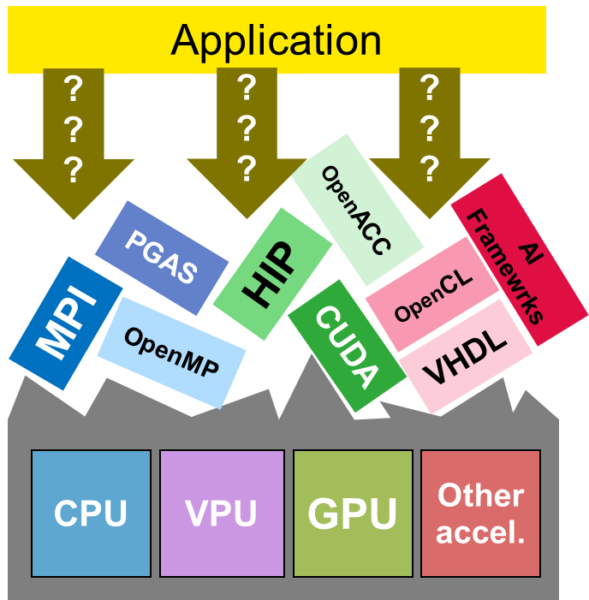





Challenges in HPC after Exascale
CPU
GPU
VPU
GPU
HBM
HBM
I/O
HBM
https://woodsidepawprint.com/feature/2022/01/12/taiwan-vs-china-whats-at-stake/
HBM
Interposer
Package
Technology dependency
Even more HW heterogeneity
Lack of performance portability
Logos owned by respective companies
Graphic owned by Disney/Imgbin
https://globalenergymonitor.org/projects/global-coal-plant-tracker/
Estela Suarez
18.03.2024, Antwerpen
HPC
Justify use of energy and natural resources
HPC vs. Hyperscalars

Slide 3

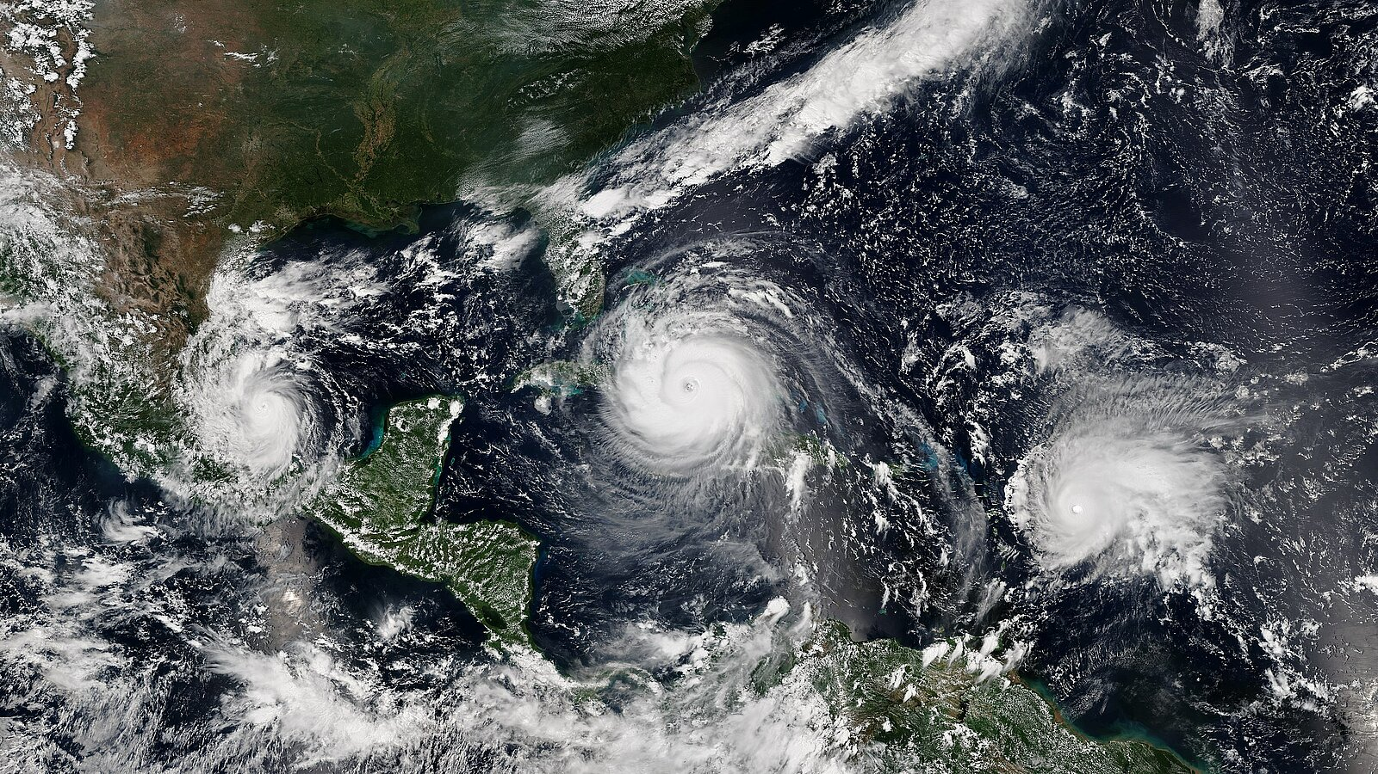

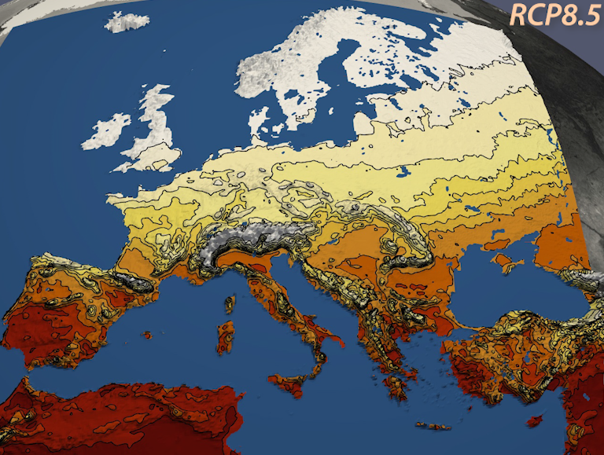
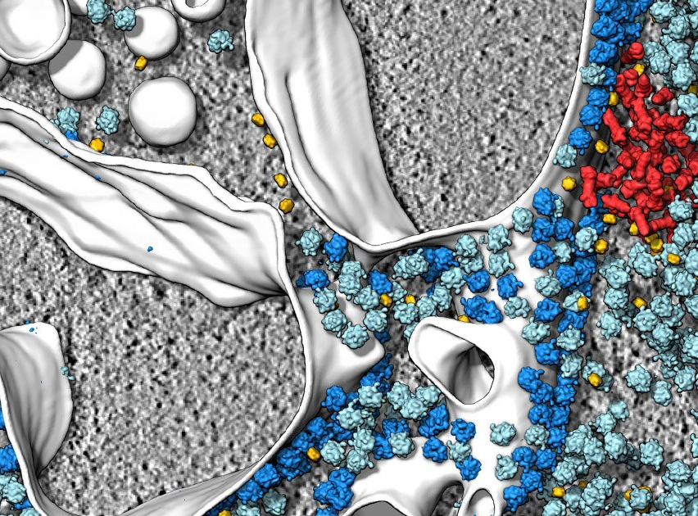
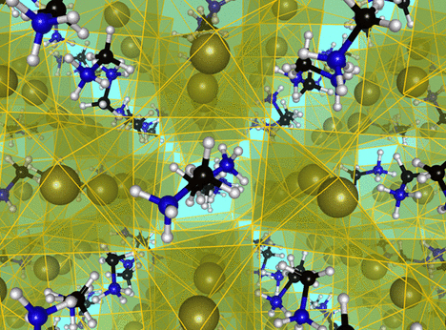
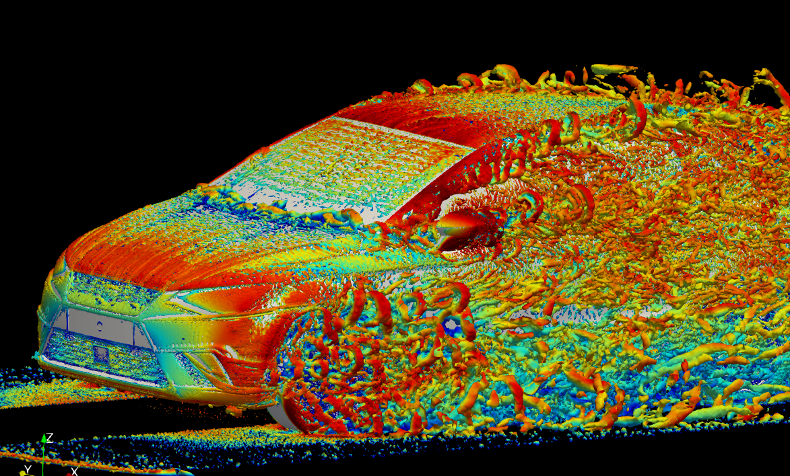


Challenges in HPC Erik Lindahl, KTH Royal Institute of Technology
Life science:
Pharmaceutical design & whole-cell modeling
Climate modeling & weather prediction
Impact: Data & Software is the key frontier
Material science:
H₂ production, solar cells
Engineering, CFD,
Data analytics
We need Manhattan-scale projects focused on solving societal problems

Slide 4
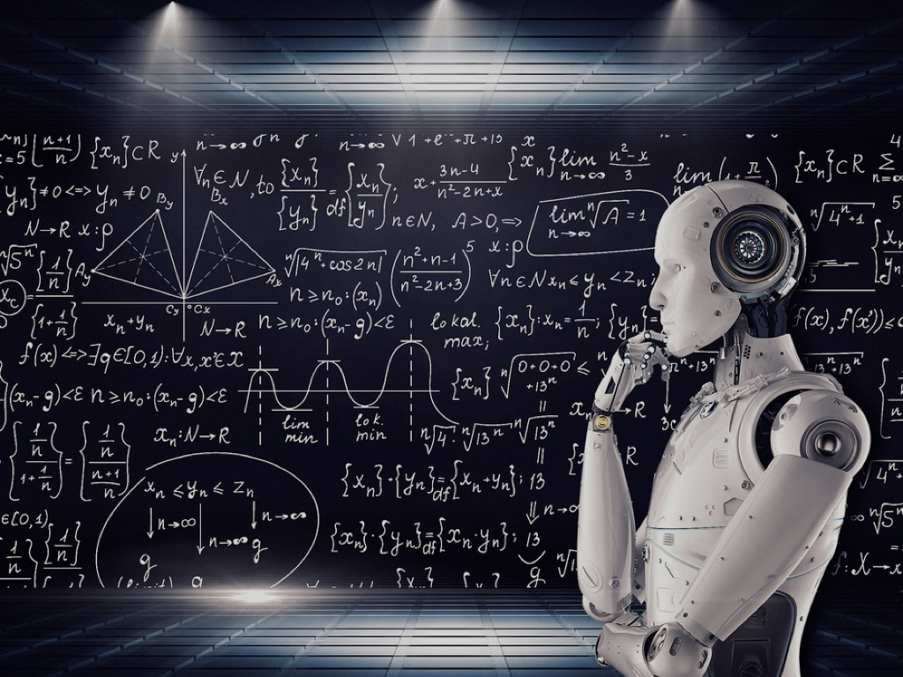


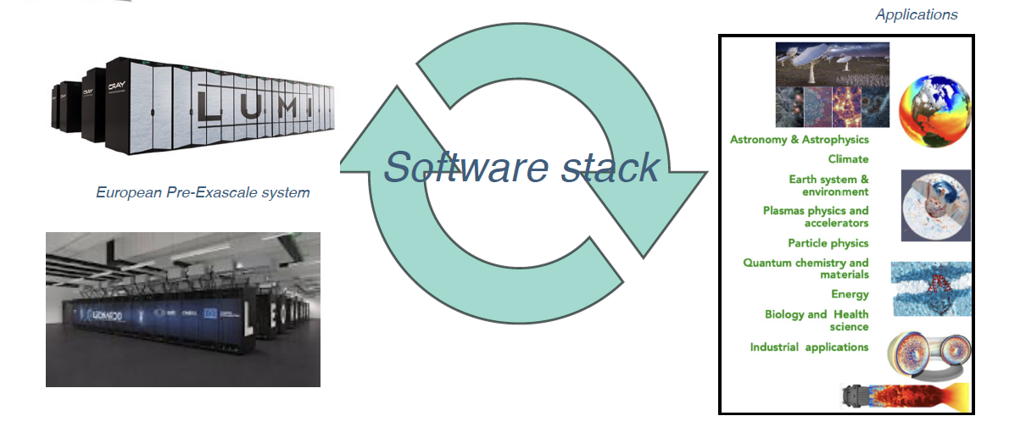
Some post-exascale challenges
From edge to HPC systems
The digital continuum
AI4Science – Science4AI
International collaboration is key - The International Post-Exascale project (InPEx)
Software, the new frontier
Software/application co-design
Need for a proper European agenda – InPEx-EU
Notes:
.

Slide 5
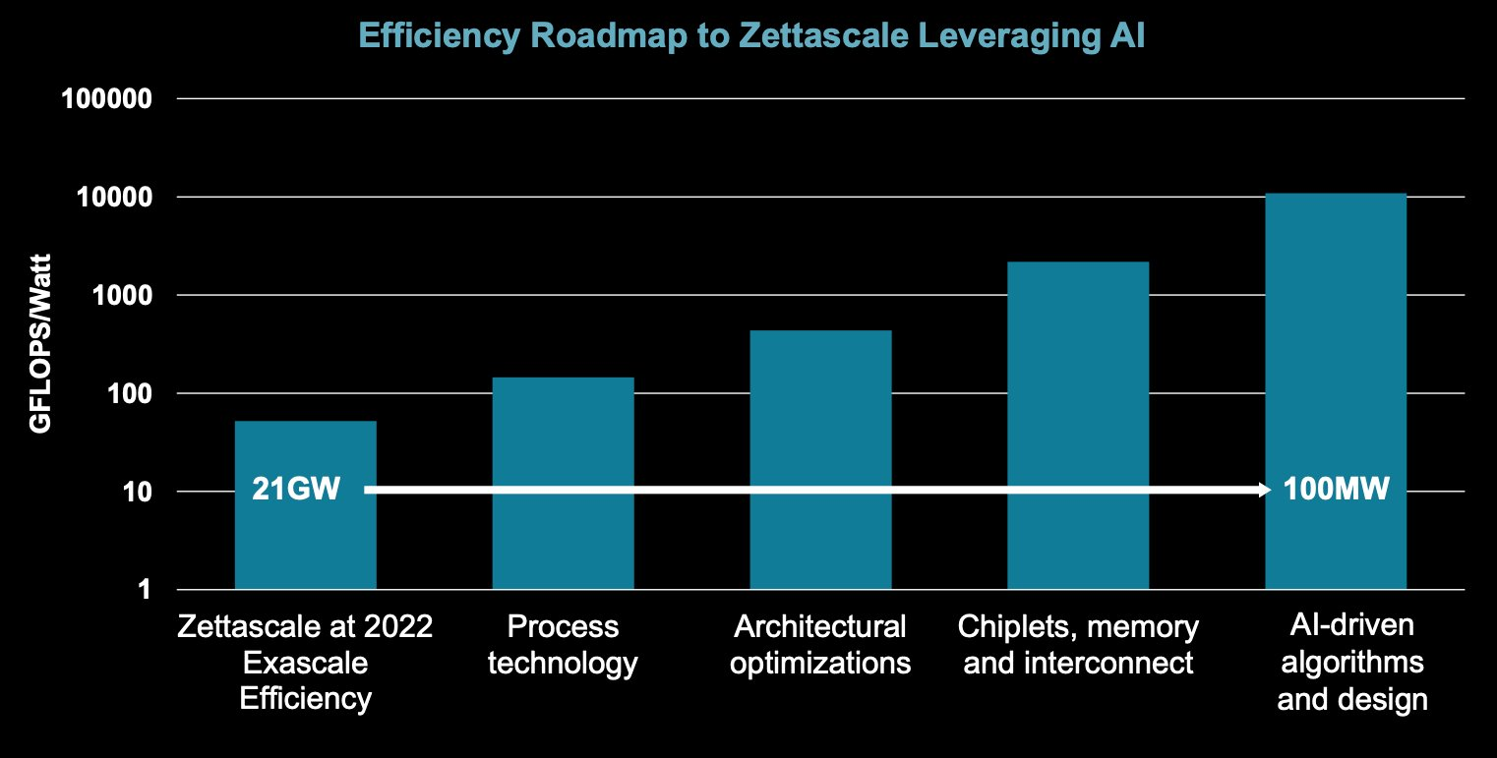
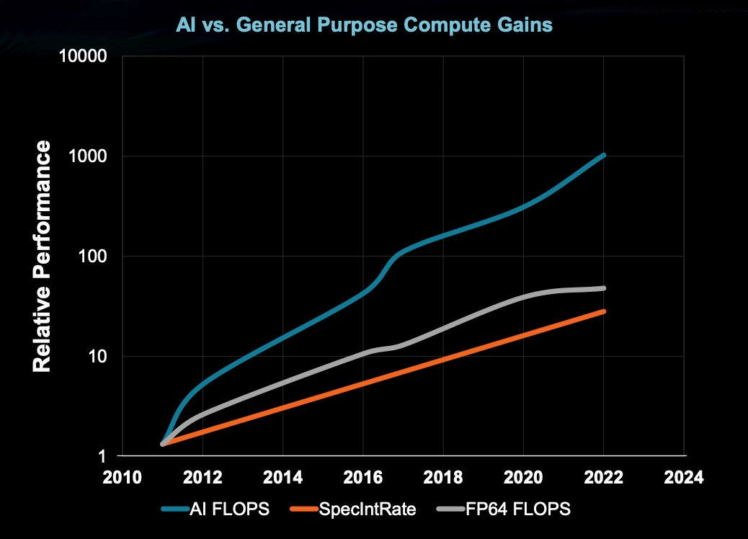

CHALLENGES TO BE ADDRESSED FOR THE NEXT
GENERATION/POST-EXASCALE OF HPC
Fabrizio Del Maffeo, CEO & Co-Founder Axelera AI
SCALING COMPUTING POWER
Classical computing doesn’t allow to scale easily to Zettascale, we need an hybrid approach with classical computing and AI
2) WORKING AT LOWER COMPUTING PRECISION
Lower precision computing (FP32/16/8) and machine learning to solve classical AI workload
Lisa Su, Plenary Session, ISSCC 2023, Feb
3) EU SOVEREIGNTY IN COMPUTING (HPC / AI)
It requires a very ambitious plan and a strong sense of urgency

Slide 6
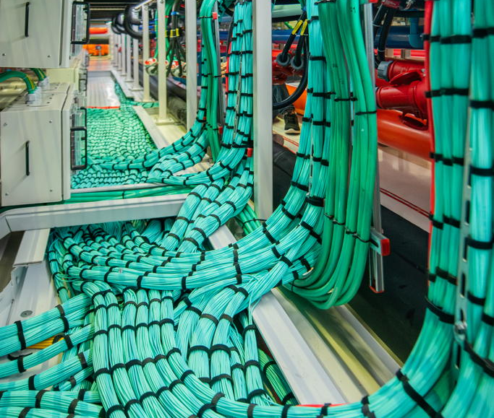
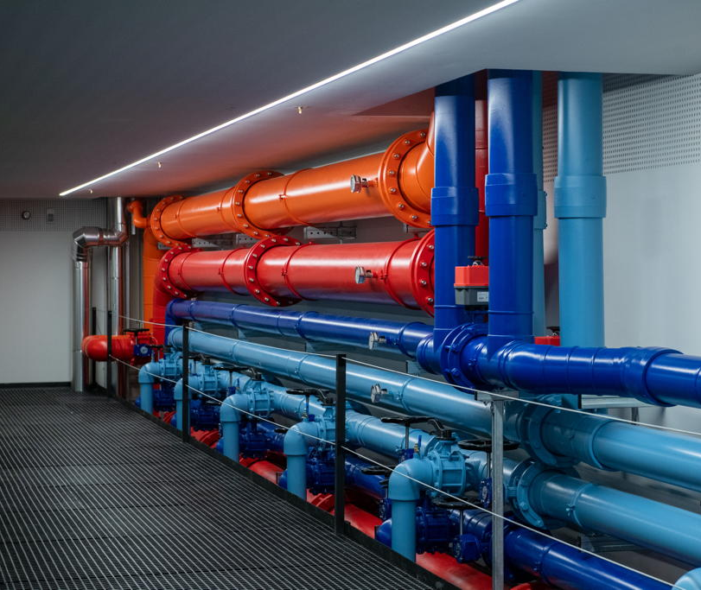
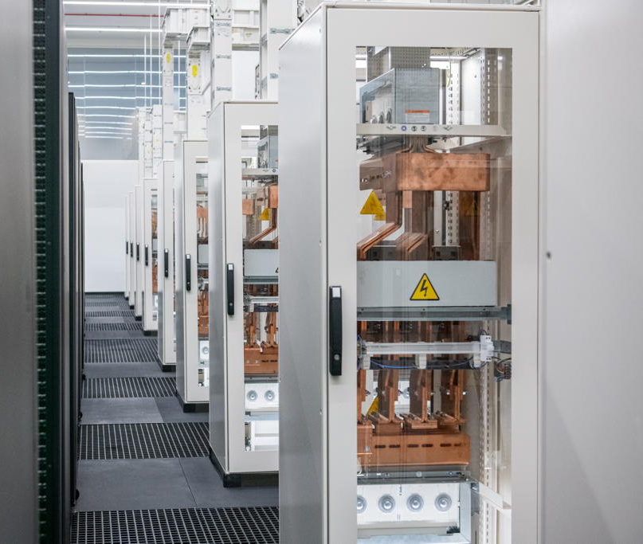
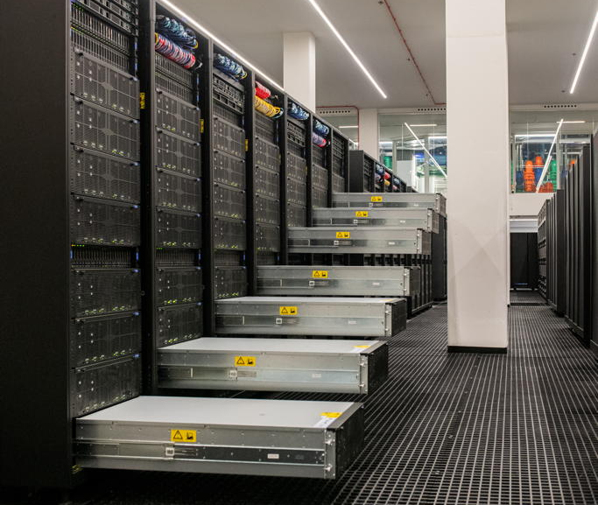

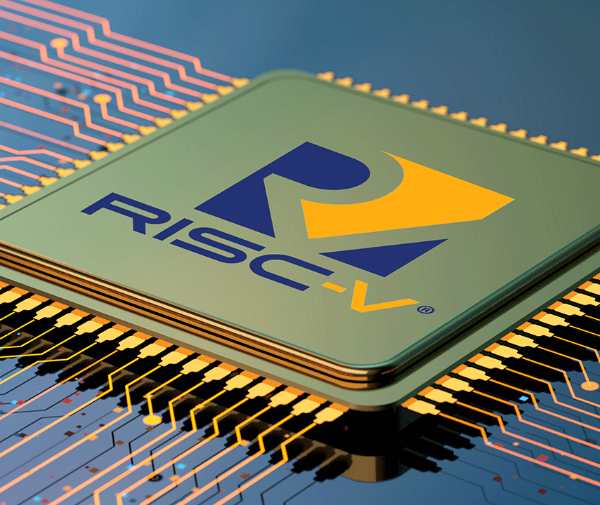
Challenges in HPC after exascale (some of them)
Sergi Girona
Barcelona Supercomputing Center
March 18, 2023

