Slide 1
Breaking the Dogmas: Redefining the System Software Stack for Next-Gen HPC Applications and Architectures
Prof. Jesús Carretero
Universidad Carlos III de Madrid
Focus area:
Dynamic Resource Management and Input/Output
ANNOTATION

Slide 2
HPC dogmas to break
Supercomputers are complex
Users aware of complexity and heterogeneity
Apps tailored to a HPC platform for performance
First HW then SW. First computation, then I/O
Codesign from the beginning
Adapt I/O and system software to new apps
Rigid allocation of resources
Dynamic adaptation of resources in runtime very challenging
App scheduler rigidly rules the system, users just issue jobs
(Expert) users request resources following their experience
Notes:
-List of Key Dogmas -Motivation to Break These Dogmas: What has changed? (New hardware trends, application diversity, AI/ML workloads, etc.) -Why are these beliefs holding back innovation in next-gen HPC?

Slide 3
Challenges and opportunities for DRM
Challenges
Opportunities
Simplifying the system view for resource control with user-friendly programming and deployment tools
Integrating variable capacity resources (Accelerators, energy, …)
Providing dynamic resource management (DRM) in apps and systems software stack.
User-friendly, cloud-like usage models
Intuitive solutions for programming and deployment
Defining the SW stack at EU level
Building variable capacity computing tools using DRM (heterogeneity, energy, …)
Co-design of applications to include DRM (CPU, ad-hoc I/O, accelerators,…)
System managed app resources & reconfiguration in runtime
Using AI to create controllers based on historic and real-time info of apps and system
Notes:
Short, only scene setter (no need to be detailed, we elaborate in the discussion) -Challenges in Breaking the Dogma -Opportunities & Future Directions

Slide 4
Challenges and opportunities for I/O
Challenges
Satisfying traditional HPC and new apps I/O workloads | Integrating multi-tier I/O stack efficiently for seamless data flow independent of technology | Reduce I/O overhead in time and space
Opportunities
Advance towards storage continuum with a multi-layer vision of the (federated) HPC system
Variable-precision data
Building new FS & I/O libraries
Virtualization and Data Processing Units for deployment of new apps
Understanding I/O patterns for new apps
Smart data placement:
AHFS, burst-buffers, active I/O servers, …
Unify storage technology with efficient and transparent data transfer protocols
I/O scheduling at system/continuum levels
Notes:
Short, only scene setter (no need to be detailed, we elaborate in the discussion) -Challenges in Breaking the Dogma -Opportunities & Future Directions

Slide 5
Breaking the Dogmas: Redefining the System Software Stack for Next-Gen HPC Applications and Architectures
Manolis Marazakis (FORTH – Greece)
Focus area: Resource Management
ANNOTATION

Slide 6
HPC dogmas to break
Exclusive resource allocation, rigid batch scheduling
Can we have cloud-like multi-tenant resource sharing ?
Flat resource model
Can we go beyond "single-level" nodes ? (1D world vs. Space-Time)
Perimeter-based security
How do we come to trust codes and datasets ?
Operator-controlled SW stack
Convergence of HPC, HPDA, ML / workflows focused on time-to-value?
Notes:
-List of Key Dogmas -Motivation to Break These Dogmas: What has changed? (New hardware trends, application diversity, AI/ML workloads, etc.) -Why are these beliefs holding back innovation in next-gen HPC?

Slide 7
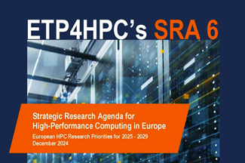
Challenges and opportunities
Challenges:
Software ecosystem fragmentation
Hardware-Software co-design complexity
Economic models and funding structure
Opportunities:
Convergence computing, Computing Continuum view
Domain-specific architectures and abstractions
Trust and provenance frameworks and processes
ETP4HPC SRA6 & Whitepapers:
https://etp4hpc.eu/strategic-research-agenda
Notes:
Short, only scene setter (no need to be detailed, we elaborate in the discussion) -Challenges in Breaking the Dogma -Opportunities & Future Directions

Slide 10
Breaking the Dogmas: Redefining the System Software Stack for Next-Gen HPC Applications and Architectures
Pierre Seroul, Eviden Bringing back the user at the center of Energy challenges
ANNOTATION

Slide 11
Three HPC Dogmas to Break
Energy control becomes one of the greatest challenges for HPC
AI massive adoption
Energy Price / TCO
Regulation around Environmental Footprint
Hardware improvements have reached a mature stage
DLC: Direct Liquid Cooling
Accelerators: GPU, APU, …
While there are existing software improvements, they are challenging to use and lack guarantees
Power Capping, C-State, Node switch, ...
Energy-aware scheduling
DVFS
Notes:
-List of Key Dogmas -Motivation to Break These Dogmas: What has changed? (New hardware trends, application diversity, AI/ML workloads, etc.) -Why are these beliefs holding back innovation in next-gen HPC?
Hardware are mature except from the Quantum Computing
HPC is like a Formula 1, It is powerful but not everyone can optimally use it
Jean Zay spend 2 to 4 millions euros a year for electricity

Slide 12
Challenges and Opportunities
Bringing back the user at the center of Energy challenges
Challenges
Hybrid system and power mechanism that are hardware-dependent
There is no such thing as optimal usage. It depends on:
Local objectives: User, application criticality, time/energy to solution, time of the day…
Global objectives: HPC Carbon footprint, TCO, throughput…
Opportunities
Build a trusted automation layer to simplify without losing specificities
Build different scenarios, show, advice and, incent but let the user choose
Metric collection and Frugal AI can help! (SEANERGYS)
Think out of the box: HPC are energy-intensive, so they can be useful for curtailment
Notes:
Short, only scene setter (no need to be detailed, we elaborate in the discussion) -Challenges in Breaking the Dogma -Opportunities & Future Directions
Game theory

Slide 13
Breaking the Dogmas: Redefining the System Software Stack for Next-Gen HPC Applications and Architectures
Venkatesh Kannan, Irish Centre for High-End Computing (ICHEC)
HPC Platforms + Data Management Services
ANNOTATION

Slide 14
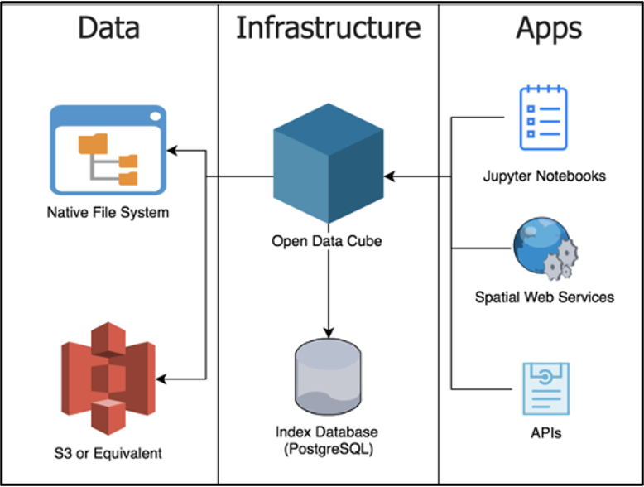
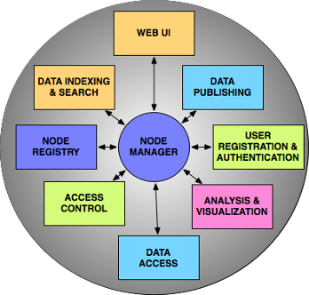
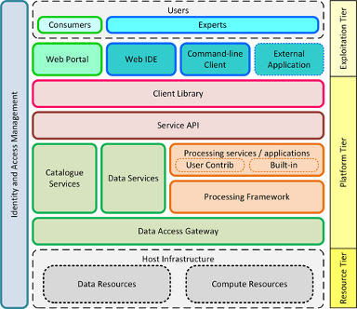
HPC dogmas to break
HPC infrastructure use-cases are compute-centric
High-performance data storage is to serve compute workflows
HPC (system) software stack is to deliver performance
Time-to-solution, energy efficiency, resource utilisation
Notes:
-List of Key Dogmas -Motivation to Break These Dogmas: What has changed? (New hardware trends, application diversity, AI/ML workloads, etc.) -Why are these beliefs holding back innovation in next-gen HPC?

Slide 15
Challenges and opportunities
Current HPC infrastructure are not data engines
Co-existing software infrastructure DevOps & Administration
Going beyond data storage, large file transfer, sync+share
Non-traditional-HPC functionalities (e.g., catalogue services, metadata services, OGC WMS/WCS, etc.)
DRM & scheduling for compute & data service workflows
Catering to time-bound vs. persistent workloads & workflows
Interleave data service "jobs" (e.g., bulk processing) with user-centric compute service jobs
HPC workflows, resources & performance in a federation
Compute = centralised and/or federated; Data = (mostly) federated
[Open] HPC Infrastructures <=> Data Spaces
Notes:
Short, only scene setter (no need to be detailed, we elaborate in the discussion) -Challenges in Breaking the Dogma -Opportunities & Future Directions

