Slide 1



EuroHPC Access Opportunities & User Needs
EuroHPC SUMMIT 2025 KRAKÓW, POLAND
Connecting HPC, Quantum & AI Communities.

Slide 2





THE EUROHPC SUPERCOMPUTING ECOSYSTEM
Operational
LUMI (FI)
Arrhenius (SE)
In preparation
PETASCALE
Operational
Currently being deployed
Operational
PRE-EXASCALE
JUPITER (DE)
Karolina (CZ)
In preparation
MeluXina (LU)
Operational
MID-RANGE
Vega (SI)
Operational
Alice Recoque (FR)
Discoverer (BG)
Operational
Leonardo (IT)
EXASCALE
Operational
Deucalion (PT)
MareNostrum 5 (ES)
In preparation
Operational
Daedalus (GR)

Slide 3

AVAILABLE ACCESS MODES
PREPARATORY ACTIVITIES
PRODUCTION ACTIVITIES
BENCHMARK ACCESS
Designed for code scalability tests
Access duration: 3 months
DEVELOPMENT ACCESS
Designed for code development and optimization
Access duration: 12/6 months
EXTREME SCALE ACCESS
Designed for high-impact, high-gain research applications requesting extremely large allocations
Access duration: 12 months
REGULAR ACCESS
Designed for research applications requesting large allocations
Access duration: 12 months
AI & DATA-INTENSIVE APPLICATIONS ACCESS
Designed for performing AI-related activities
Access duration: 12/6 months

Slide 4
ELIGIBILITY
WHO IS ELIGIBLE?
Open to all fields of research
Industrial enterprises and SMEs
Academic and research institutions (public and private)
Public sector organizations
Principal Investigators and Team Members whose organization is:
established or located in a Member State or in a third country associated to Horizon 2020 for accessing the supercomputers acquired by the EuroHPC Joint Undertaking established by Regulation (EU) 2018/1488.
established or located in a Member State or in a third country associated to the Digital Europe Programme or to Horizon Europe for accessing the supercomputers acquired by the EuroHPC Joint Undertaking after 2020.
Principal Investigator that have an employment contract in the organisation at the time of proposal submission and valid for at least 3 months after the end of the allocation period.
INDUSTRY ACCESS TRACK 20%
PUBLIC ADMINISTRATION ACCESS TRACK 5%
SCIENTIFIC ACCESS TRACK 75%

Slide 5

ACCESS CALLS CUT-OFFS IN 2025
January 2025
March 2025
April 2025
June 2025
September 2024
October 2025
December 2025
February 2025
August 2024
2024
2026
Benchmark and Development monthly cut-offs (12 per year)
Regular Access
28 March 2025
AI & Data-Intensive Applications Access
11 April 2025
Extreme Scale Access
18 April 2025

Slide 6









IMPLEMENTED PEER-REVIEW PROCESS
EXTREME SCALE ACCESS
REGULAR ACCESS
AI & DATA-INTENSIVE APPLICATIONS ACCESS
BENCHMARK & DEVELOPMENT ACCESS
Admin check
Technical Assessment
Scientific Evaluation
Response Phase
Rapporteur Reporting
ARC meeting
RAP meeting
GB results approval
1
2
4
7
6
3
8
5

Slide 7



EVALUATION CRITERIA
Proposal concept and objectives
Expected outcomes significance
Scientific and technical maturity
Methodology and feasibility
Resources request justification
Relevance for EU research
Objectives originality and novelty
Innovative nature of the proposed work
Potential impact on societal, economic and/or technological dimensions
Project plan feasibility
Requested resources and proposed objectives alignment
Gantt chart tasks distribution
Competencies of the team members
EXCELLENCE
INNOVATION & IMPACT
QUALITY & EFFICIENCY
WHAT?
WHY?
HOW?

Slide 8
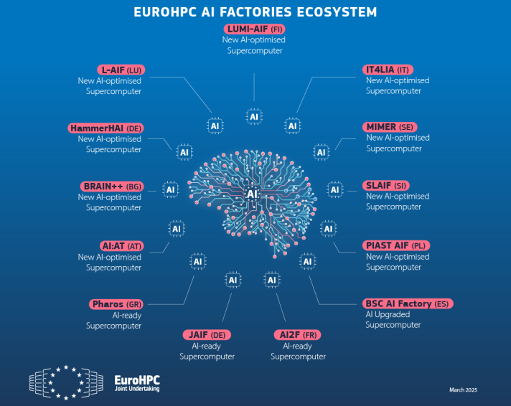
THE AI FACTORIES
EuroHPC JU selected 13 EU sites that will host the first AI Factories – which will drive Europe’s leadership in AI

Slide 9

AI FACTORIES ACCESS FOR INDUSTRIAL INNOVATION
PLAYGROUND ACCESS
Small allocations
Evalutions on rolling basis
Access within 2 days after the proposal submission
Duration: 1-3 months
FAST LANE ACCESS
Allocations up to 50,000 GPU hours
Evalutions on rolling basis
Access within 4 days after the proposal submission
Duration: 1-3 months
LARGE SCALE ACCESS
Allocations larger than 50,000 GPU hours
2 cut-off dates/month
Access within 10 days after the cut-off date
Duration: 3-12 months
Implementation targeted for 1 April 2025

Slide 10





AI FACTORIES ACCESS PEER-REVIEW PROCESS
LARGE SCALE ACCESS
FAST LANE ACCESS
PLAYGROUND ACCESS
AI FACTORIES
Eligibility check
Technical Assessment
Panel Evaluation
ED results approval

Slide 11







SUPPORT AND SERVICES
Notes:
FFplus (Fortissimo Plus) promotes innovation and competitiveness in industry, especially for SMEs. It will do so by providing financial support, facilitating access to EuroHPC resources, and offering expert guidance in technical, business development and outreach activities. 1 May 2024 - 30 Apr 2028
The EPICURE project aims at ameliorating the offering of user support by establishing and operating a distributed but coordinated European HPC application support service and encourage the best possible uptake of the systems by European researchers. provide their services aiming primarily at Level 2 and 3 application support encompassing in particular application porting, optimisation and execution of key applications to a selected number of projects which have been allocated time by peer-review process managed by the EuroHPC JU. 1 Feb 2024 - 31 Jan 2028
HPC SPECTRA aims at improving the EuroHPC JU’s training strategy by developing an innovative EuroHPC Training Platform and co-organising the 2024 and 2025 HPC Summer School (IHPCSS). 1 Jan 2024 - 31 Dec 2025
CASTIEL 2 promotes interaction and exchange of expertise and competence across the NCC network.
EuroCC 2 aims to establish and run a network of more than 30 NCCs across the EuroHPC Participating States. 1 Jan 2023 - 31 Dec 2026
EUMaster4HPC is composed of European universities, research/supercomputing centres and industrial partners with the mission of defining a joint curriculum in HPC across Europe .
12 Centre of Excellence
New project: Support Centre for HPC-powered Artificial Intelligence (AI) Applications

Slide 12
GUIDELINES & ADVICE
PROPOSAL DOCUMENTATION & WEBSITE UPDATES
Use most recent templates and read latest documentation; keep track of the JU website updates
BENCHMARKS
Perform tests and provide scaling data
GANTT CHART & RESOURCES USAGE
Provide feasible timelines with milestones and resources usage plan highlighting the peaks
RESPONSE PHASE
Even though it is not mandatory, provide replies to reviews
DEADLINES
Respect cut-off dates and deadlines within the process
FEEDBACK
Take the ARC feedback into consideration
FINAL REPORTS
Submit the Final Report on time - 3 months after end allocation date
COMMUNICATION
Communicate any concerns with the HPC centers and the JU

Slide 13


Slide 14





Dziękuję!
For more information, feel free to visit our website and social media:
/eurohpc-ju.europa.eu
/EuroHPC_JU
/eurohpc-ju
/eurohpc-ju
EuroHPC SUMMIT 2025 KRAKÓW, POLAND
Connecting HPC, Quantum & AI Communities.

Slide 15
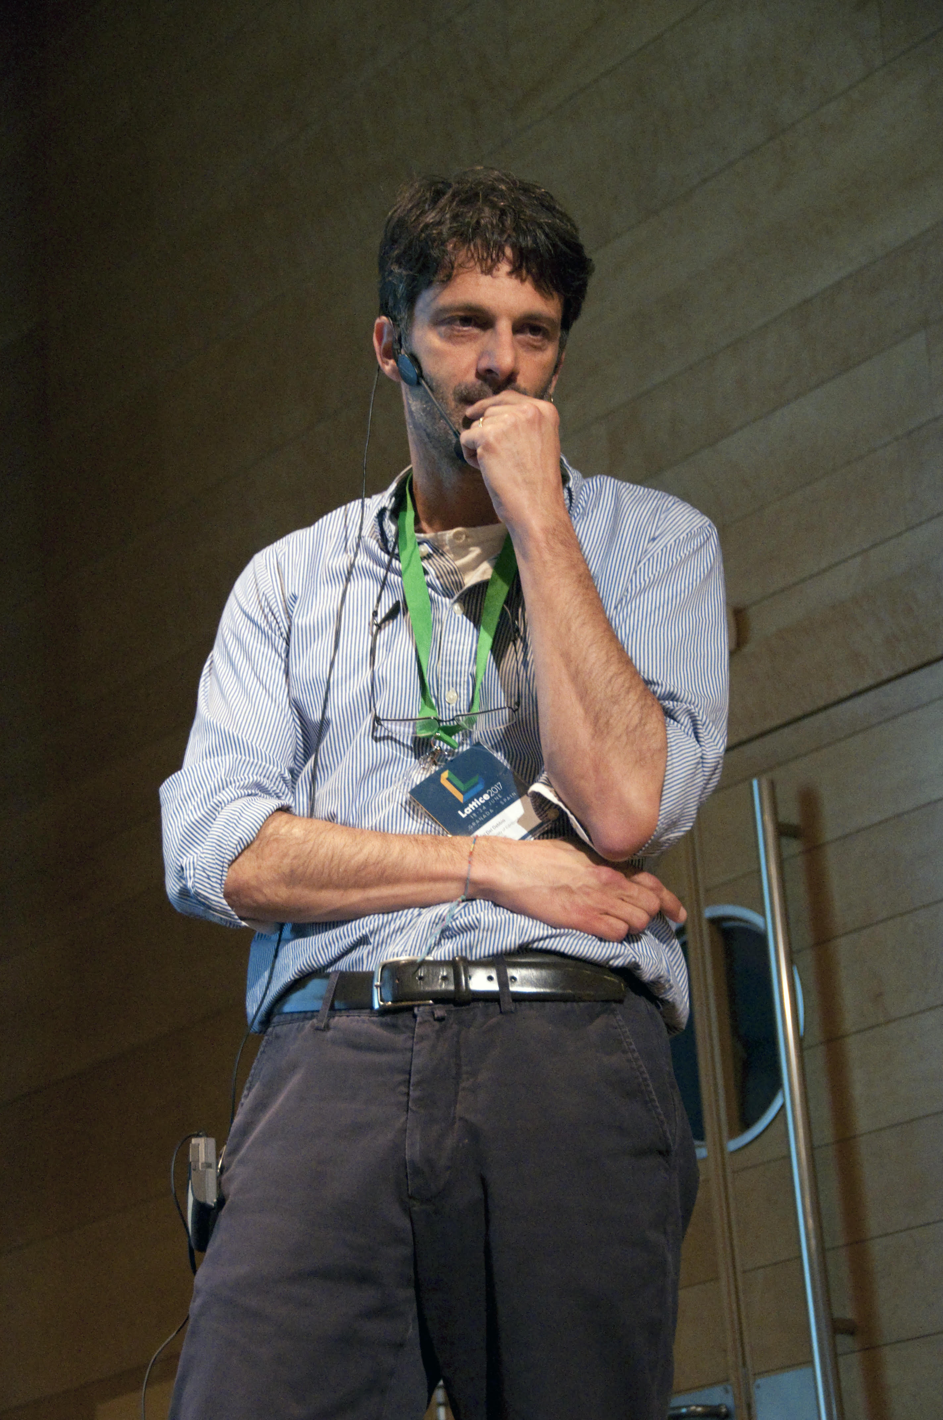

NEXT SPEAKERS
LUIGI DEL DEBBIO
ACCESS RESOURCE COMMITTEE (ARC) CHAIR
Professor of High-Energy Theoretical Physics
Edinburgh University
NUNO GUERREIRO
USER FORUM COORDINATION GROUP MEMBER
Senior research scientist Unbabel Portugal

Slide 16

Reflections from the ARC
Luigi Del Debbio
The University of Edinburgh

Slide 17

Computing: an on-going revolution
My personal visions of the field, shaped by my own work
  Research in high-energy theoretical physics
  Chair of Resource Allocation in EURO-HPC
  Scientific Advisory Committee of CSCS (Switzerland)
  Chair of DiRAC Board (UK)
  SIAB for UK Exascale project
I hope I can provide a broad overview
Do ask questions!

Slide 18
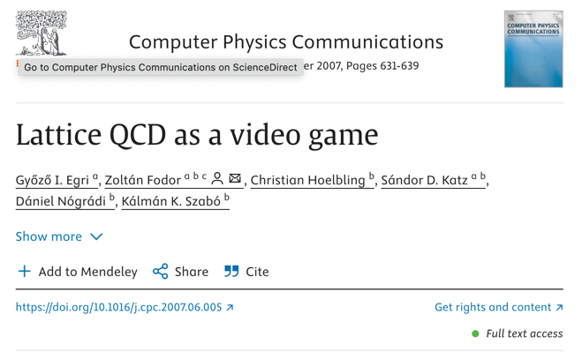
early GPU adopters… (2007)
scientific projects often push the boundaries

Slide 19
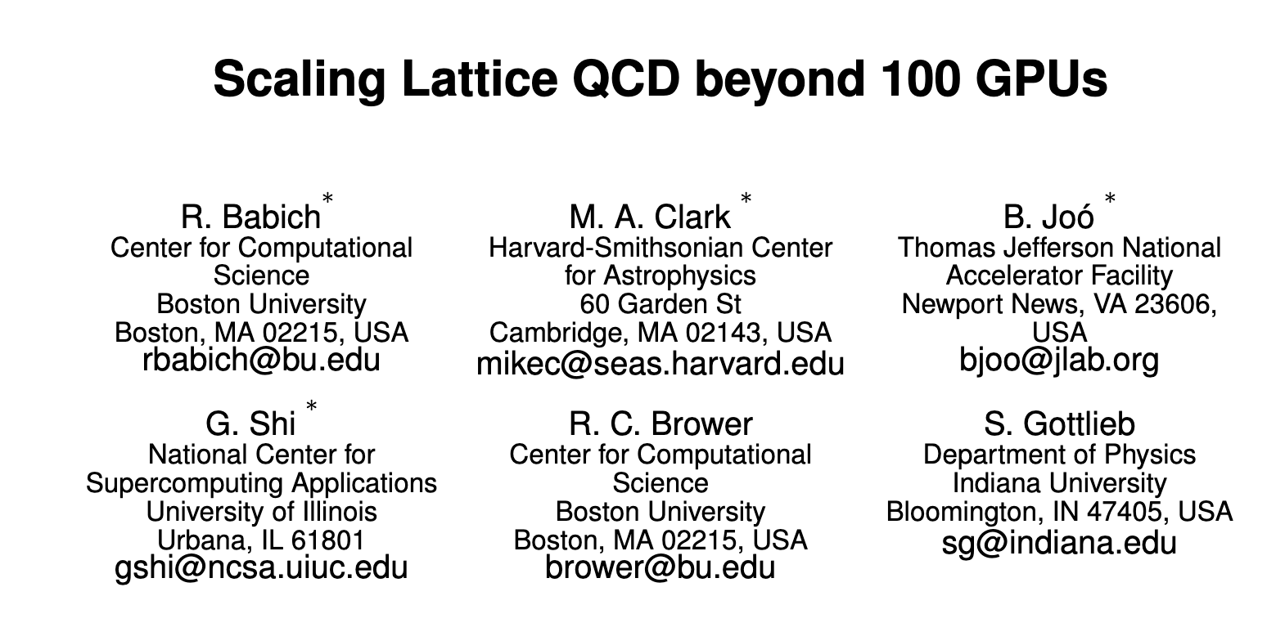
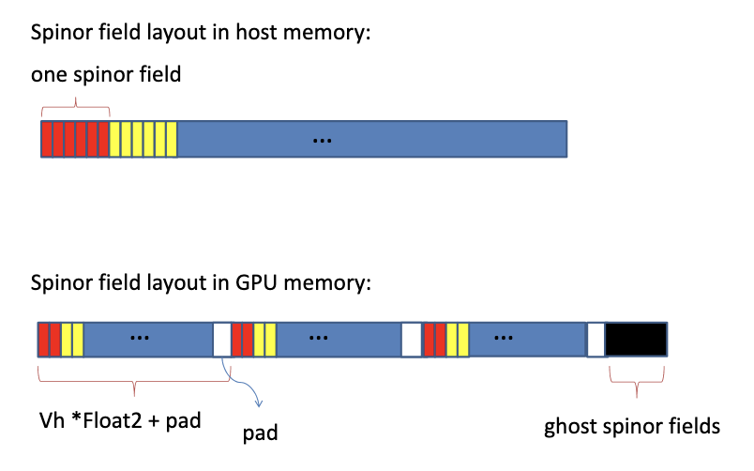
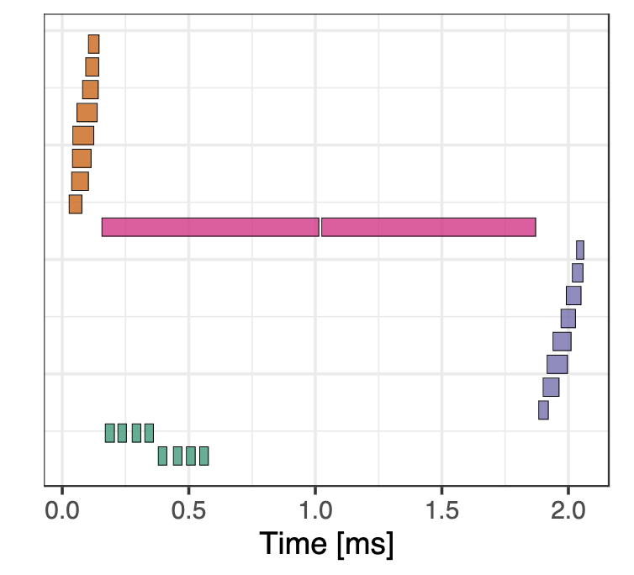
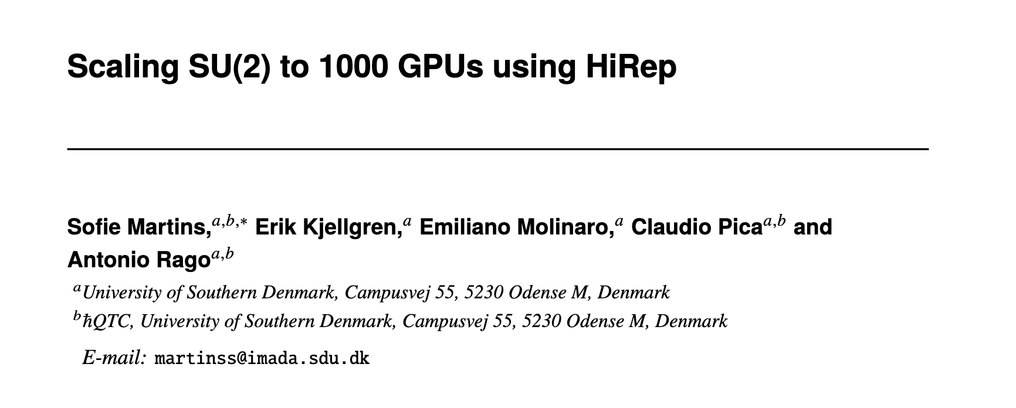
2011
2024

Slide 20
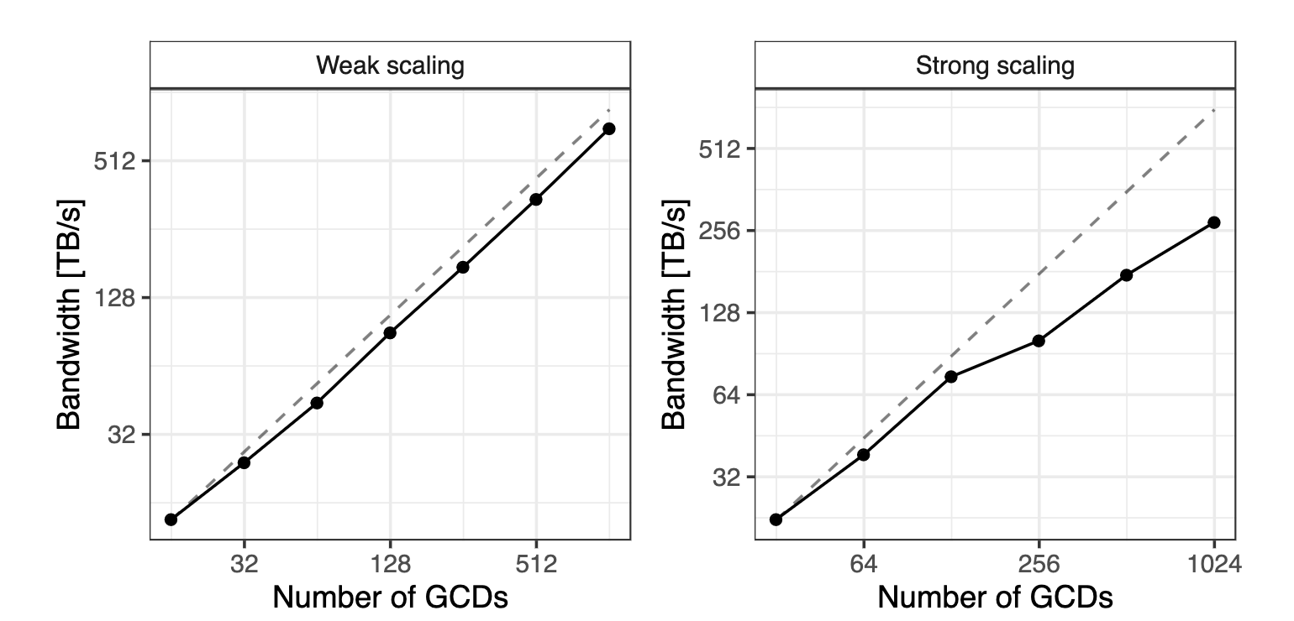
weak and strong scaling (not easy on current architectures!)
non optimized codes waste energy and money!
[Martins et al 2024]

Slide 21
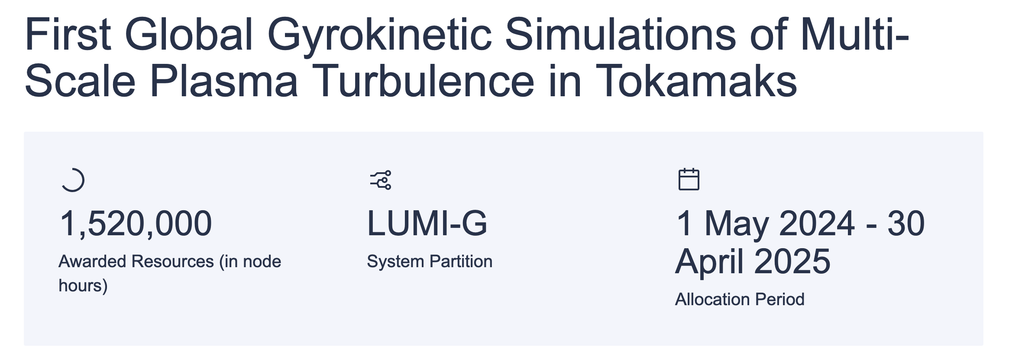

Nuclear Fusion
GENE codebase
international collaboration
GPU-enabled
Potentially huge societal impact

Slide 22

Weather simulations
EERIE project: https://eerie-project.eu/

Slide 23
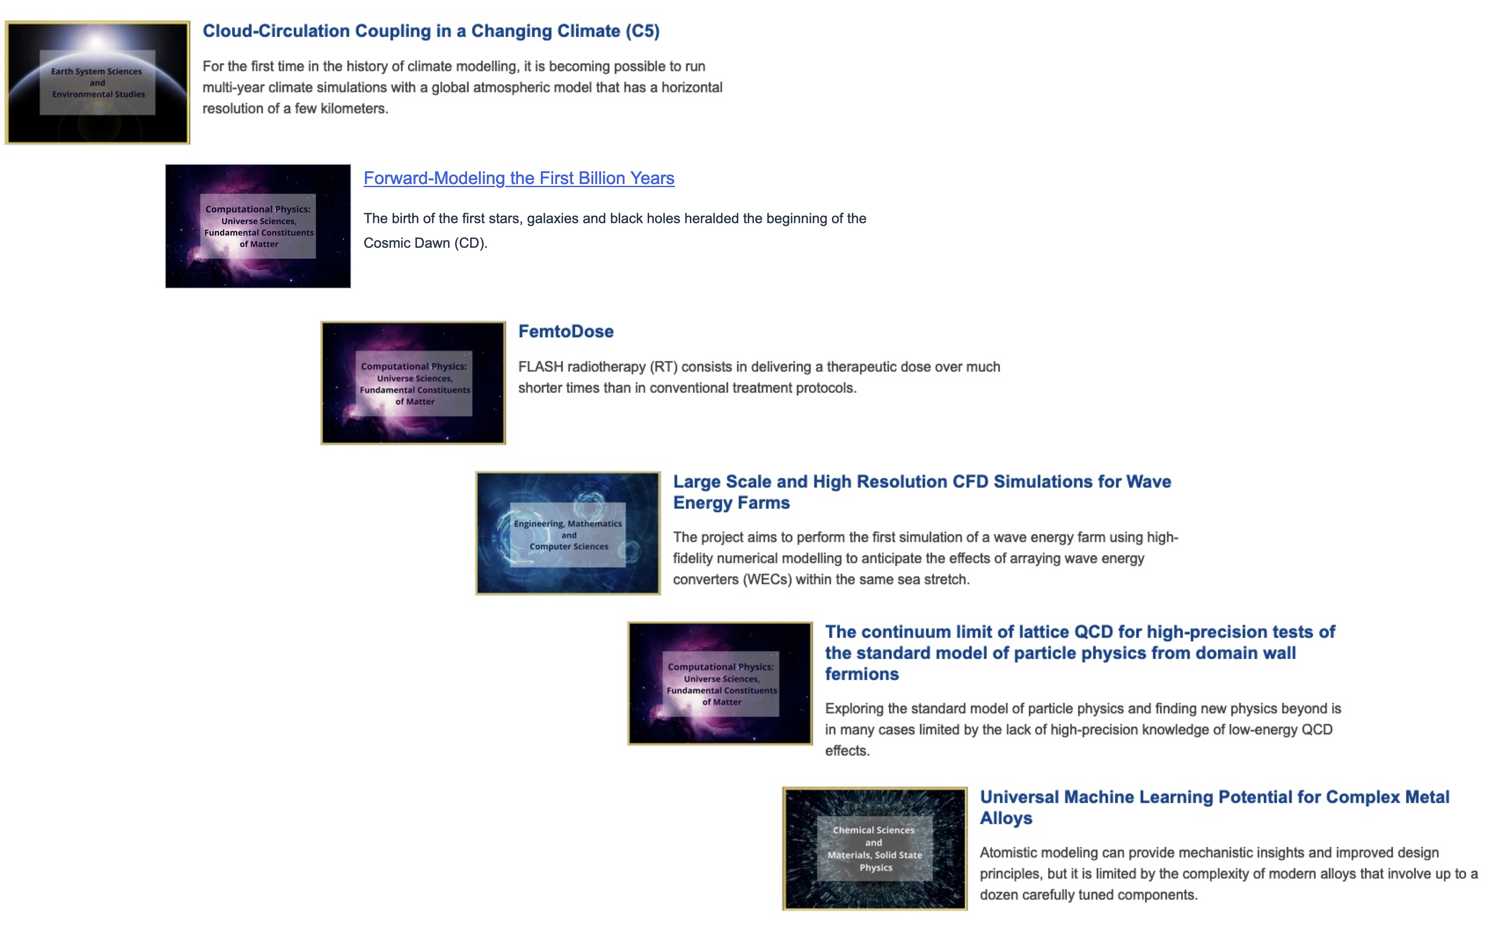
More EuroHPC projects
Just a few examples…

Slide 25
resource allocation
A single panel across all domains – one-year focused applications
Raises the bar for all domains
Quality of applications has improved – frequency of calls
Very expensive in terms of human resources (thank you !)

Slide 26
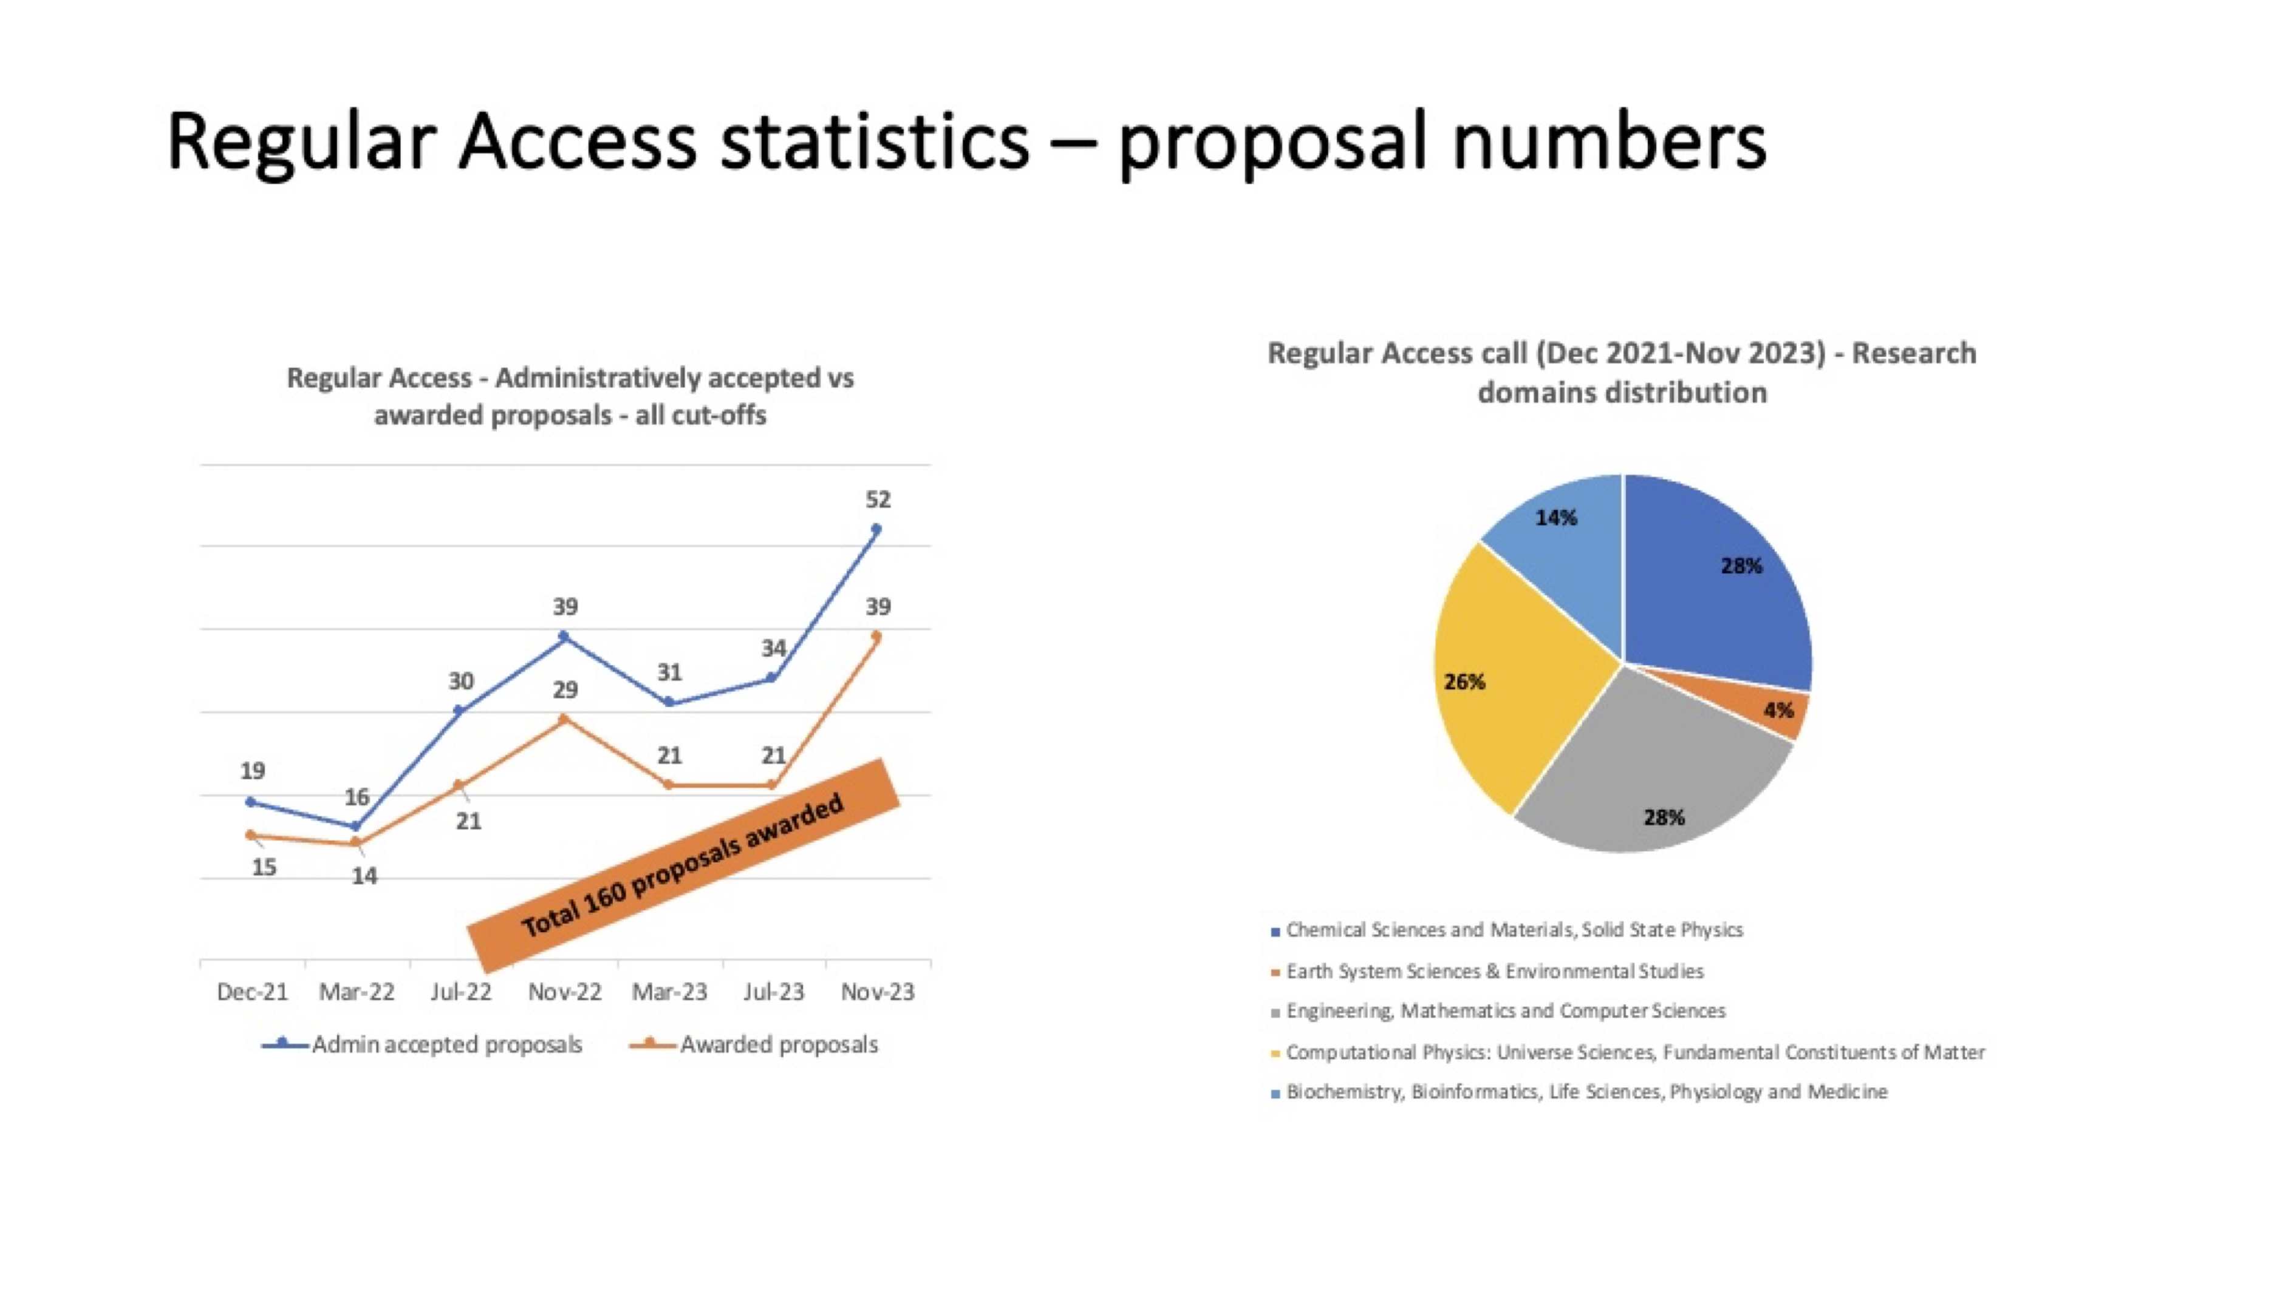

Slide 27
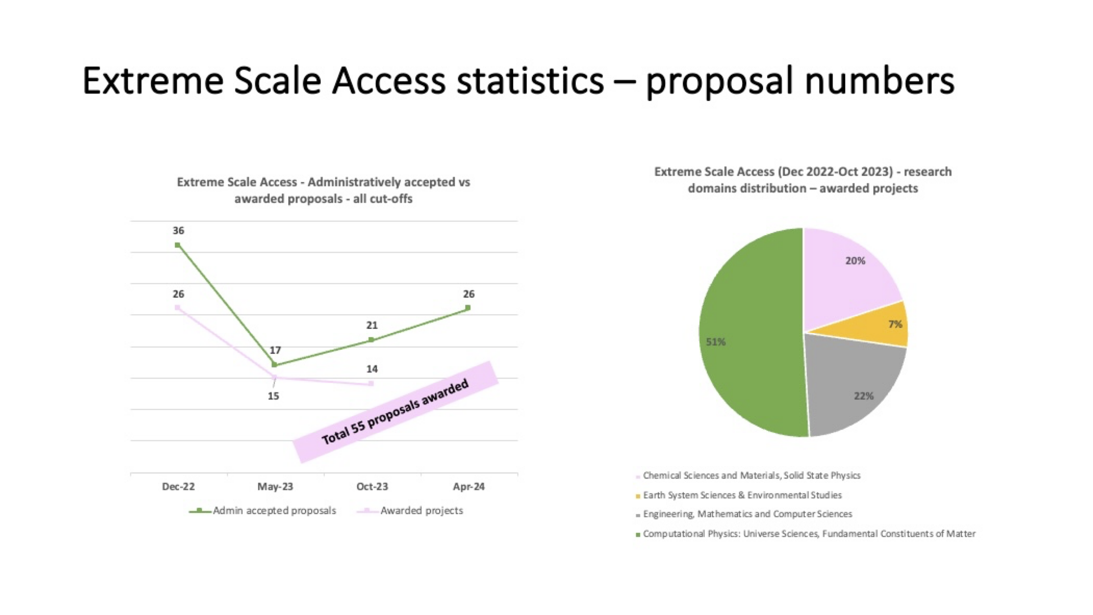
Oct 24
fantastic resource for European research & leadership

Slide 28
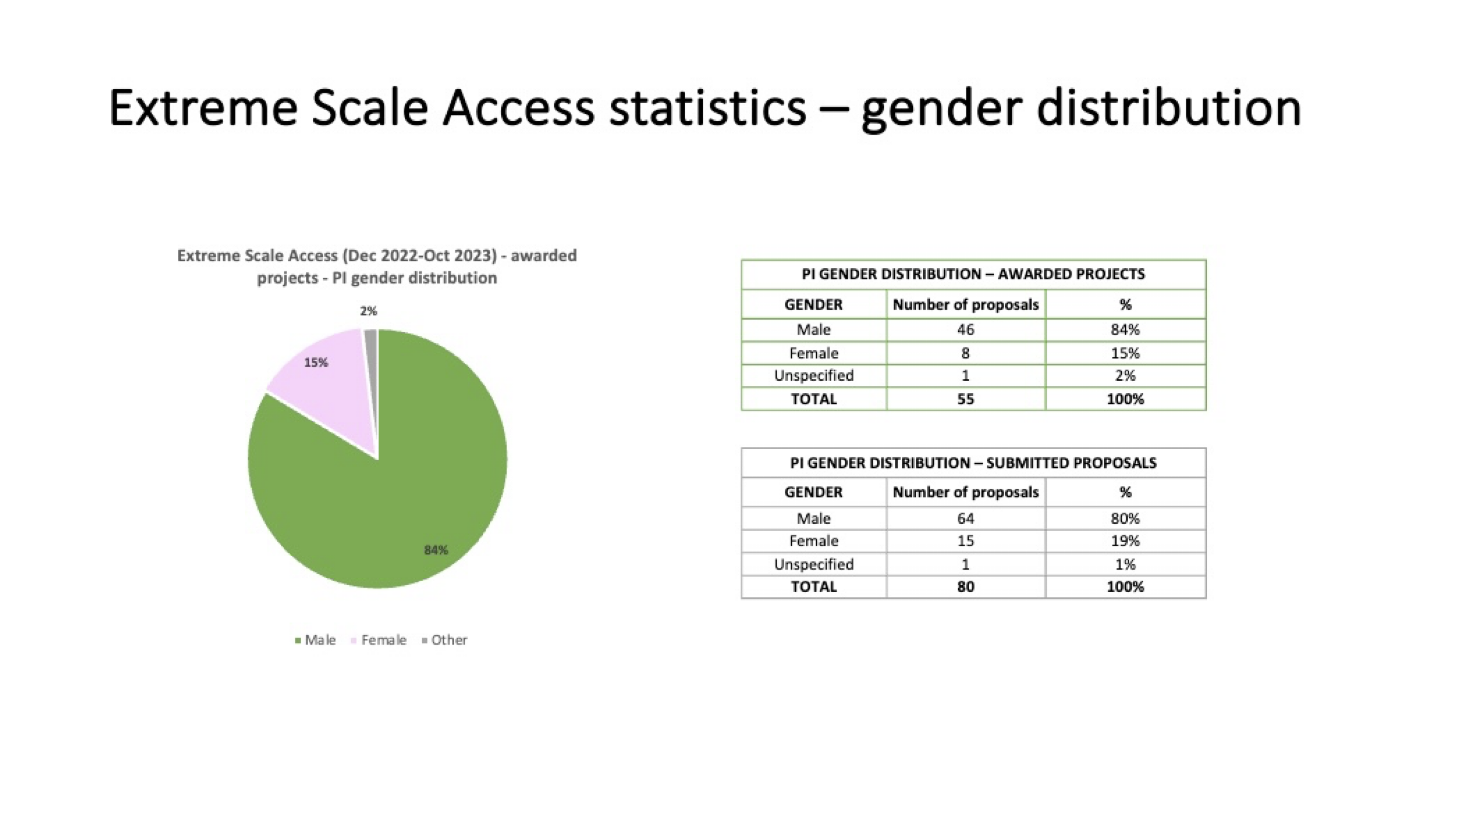

Slide 29
anectodes: peer review is hard! (but the best)
a good proposal needs to have
… solid motivations
… ambitious goals
… performant software
… requests that are justified by milestones
all of this needs to be in the application!
... needs to be clearly stated for external reviewers
… and for a majority of panel members

Slide 30
more anecdotes
economics is the management of insufficient resources
  what could you do with half of the requested time?
I would love to allocate all proposed projects

Slide 31
more anecdotes
economics is the management of insufficient resources
  what could you do with half of the requested time?
I would love to allocate all proposed projects
… actually, NO, I would only allocate the good ones!
there are two calls per year, this allows rejected projects to improve and resubmit quickly
this is a great resource, projects do improve

Slide 32
a financial curiosity
try buying computer time?
cloud providers charge for 250k node-hr…

Slide 33
a financial curiosity
try buying computer time?
cloud providers charge for 250k node-hr… M€
EuroHPC is a fantastic research infrastructure
it is our duty to make the best use of it
help the ARC: keep submitting strong proposals
make sure fundamental research remains a core priority!
invest in creating a proper interface with industry

Slide 34
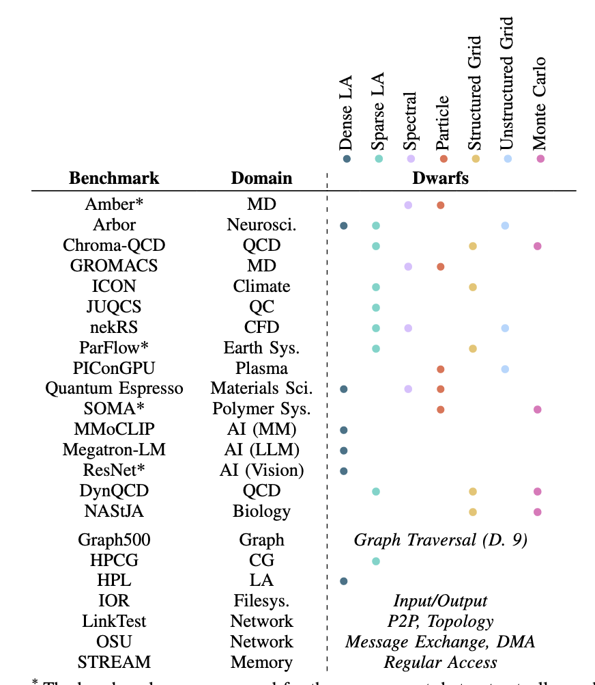
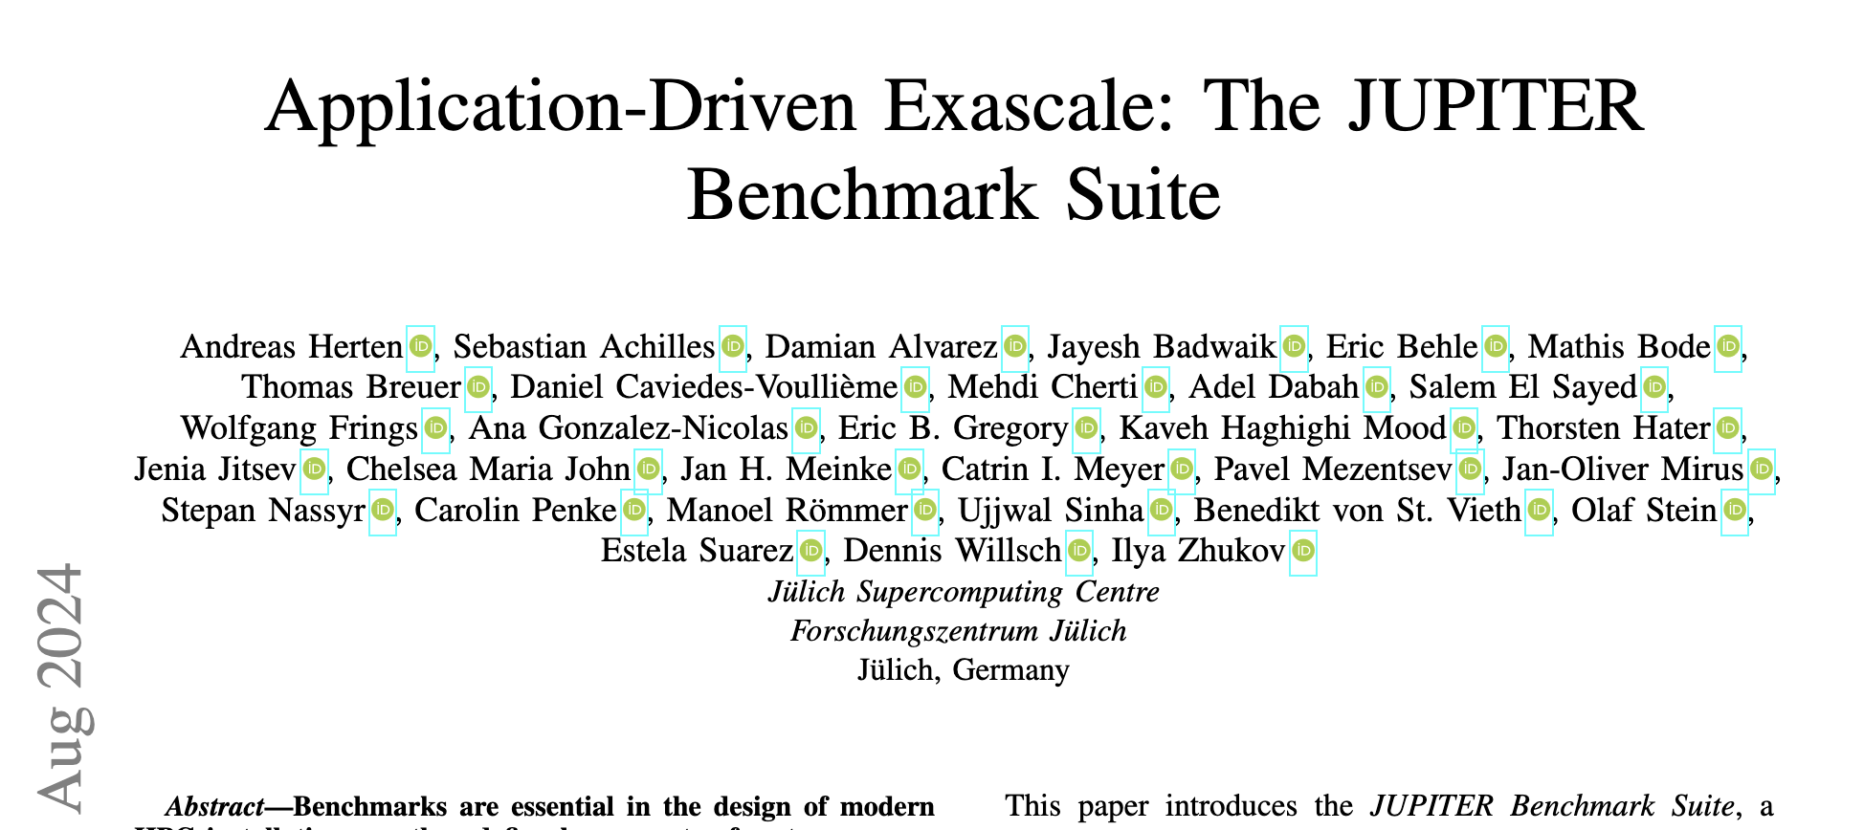
procuring new systems

Slide 35
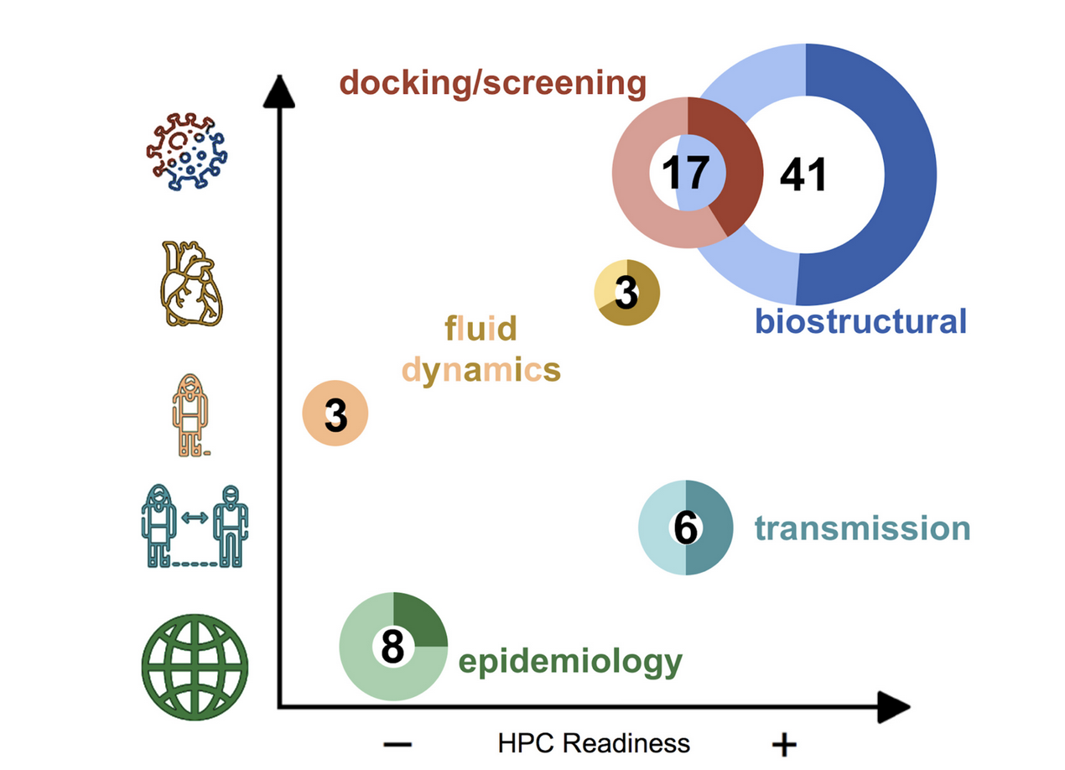
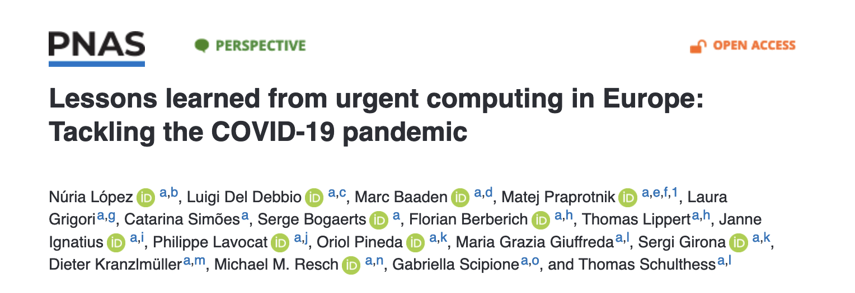
Covid-19 and a PNAS paper
emphasizes the need for a thriving ecosystem

Slide 36
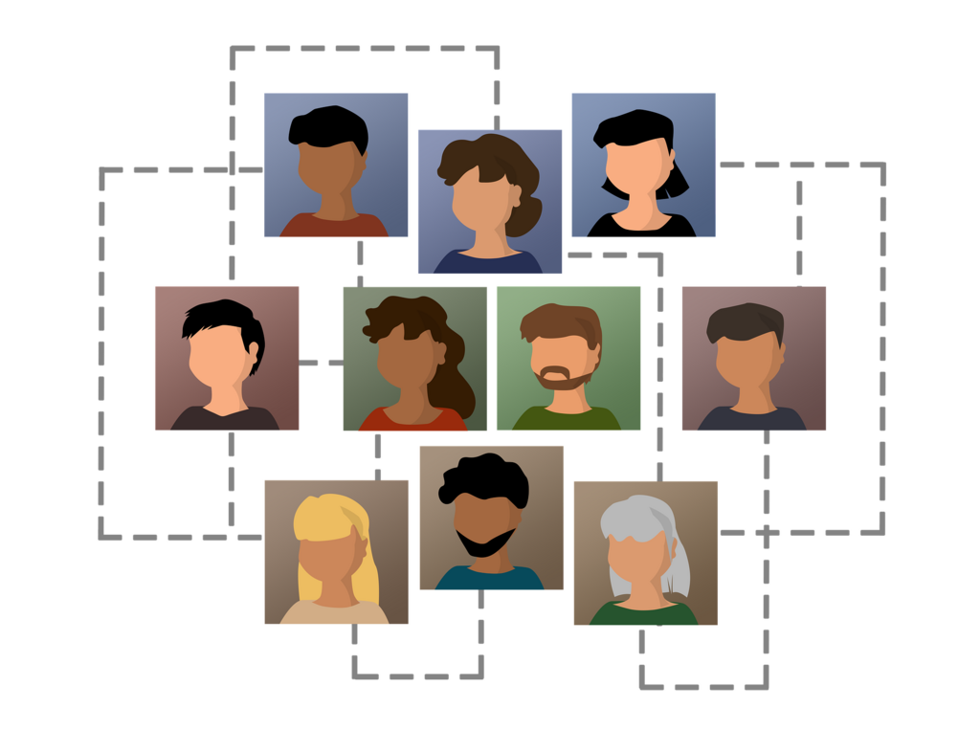
People!
Develop efficient algorithms on new architectures
Requires (in my experience) a lot of domain-specific knowledge – who? where?
Porting on multiple hardware and benchmarking, data (!)
Engage in co-design with industry
Career path for these people!
Work together with universities

Slide 37






thank you!

Slide 38

User Forum Coordination Group

Slide 39
Introducing the EuroHPC User Forum
From the Multi-Annual Strategic Programme:
Purpose: Promote knowledge exchange, professional development, and collaboration within European HPC and Quantum communities
Core Values: Open, inclusive, independent, transparent, responsive
Membership: Users from academic, industrial, and public sectors
Activities:
Share EuroHPC updates
Discuss European HPC developments
Collect user requirements
Address infrastructure challenges

Slide 40


Q?
A
Users

Slide 41
Users
Q?
Q?
A
A
Users

Slide 42
User dialogue
A
Q?
Q?
A
A
Q?

Slide 43

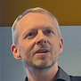

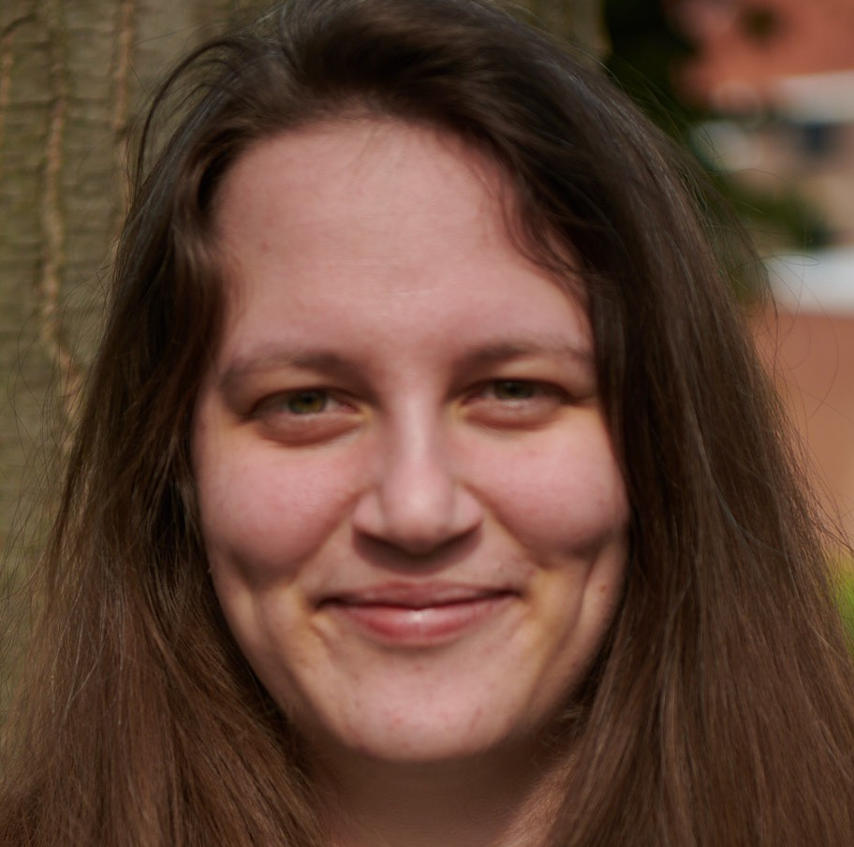
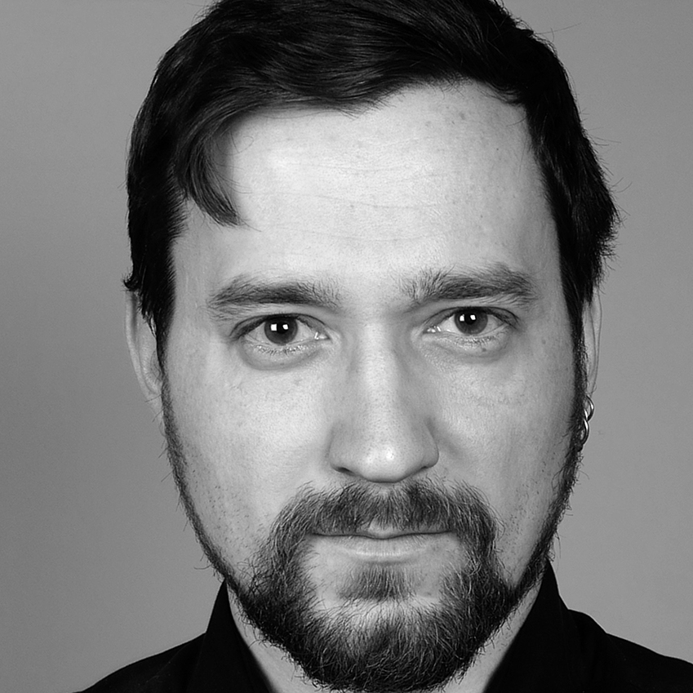

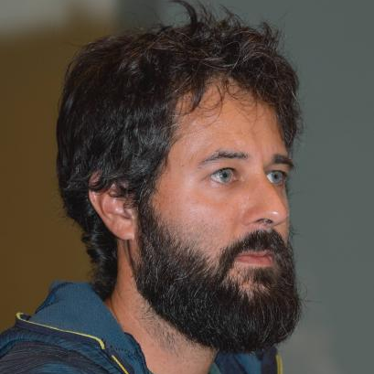



Who is involved in the Coordination Group
Chris Richardson (chair) Cambridge UK, Physics/Engineering finite element software development
Thomas Geenen (ECMWF, Destination Earth) - Climate and Weather Prediction and Earth System Digital Twin communities
Maria Girone (vice chair) High Energy Physics, CERN, Switzerland, IT HPC Strategy Coordinator
Lara Peeters (VSC - HPC in Flanders, Belgium) - Digital Humanities
Andrius Popovas (University of Oslo, Norway) HPC users for computational astrophysics
Sinéad Ryan – Lattice Quantum Chromodynamics
TCD Dublin, Ireland
Xavier Besseron (University of Luxembourg) Research Scientist in Computer Science and Engineering
Zoe Cournia - Biomolecular simulations and drug discovery
University of Athens, Greece
Ivan Carnimeo (CNR-IOM): Materials science/Chemistry/Physics developer of Quantum ESPRESSO, MAX (MAterials design at the eXascale) CoE, ICSC (Italian National Center for HPC)
Nuno M. Guerreiro – AI & ML; Large Language Model Development; Técnico Lisboa & Unbabel, Portugal
Jean-Yves Verhaeghe - Computer science: France
Sergio Posada Perez - Nanoscienes: Belgium
Peter Taborsky - AI LLM: Denmark
Matthias Meinke - Engineering: Germany

Slide 44



How to take part today!
https://join.slack.com/t/eurohpcuserforum/shared_invite/zt-2r4ok2azn-mek1mzsAnH9z94okYbJr6A
Informal “chat” application
Help to start conversations
Not a “high security” platform
Is the next step

Slide 45
User Group Survey
As the EuroHPC User Forum Coordination Group, we are conducting a short survey to better know our community.
The survey takes only a few minutes to complete and covers topics such as where you are from and what is your experience with EuroHPC systems.
https://ec.europa.eu/eusurvey/runner/EuroHPC_ufcg1
Your input is highly valuable, and we appreciate your time and contribution

Slide 46
Reporting back to EuroHPC JU
Issues EuroHPC JU want to hear about...
How to encourage users to use resources efficiently
- penalties for users who do not?
AI usage needs
HPC Applications ecosystem needs:
application software stack
User environment (tools etc.)
Compatibility across systems

Slide 47
We need you!
Please sign up to “slack” – or contact us by email
The “user forum” will only work if you take part!
Email: CEDeX-UFCG@eurohpc-ju.europa.eu

