Slide 1
Finding more Balance in HPC, Quantum and AI

Slide 2
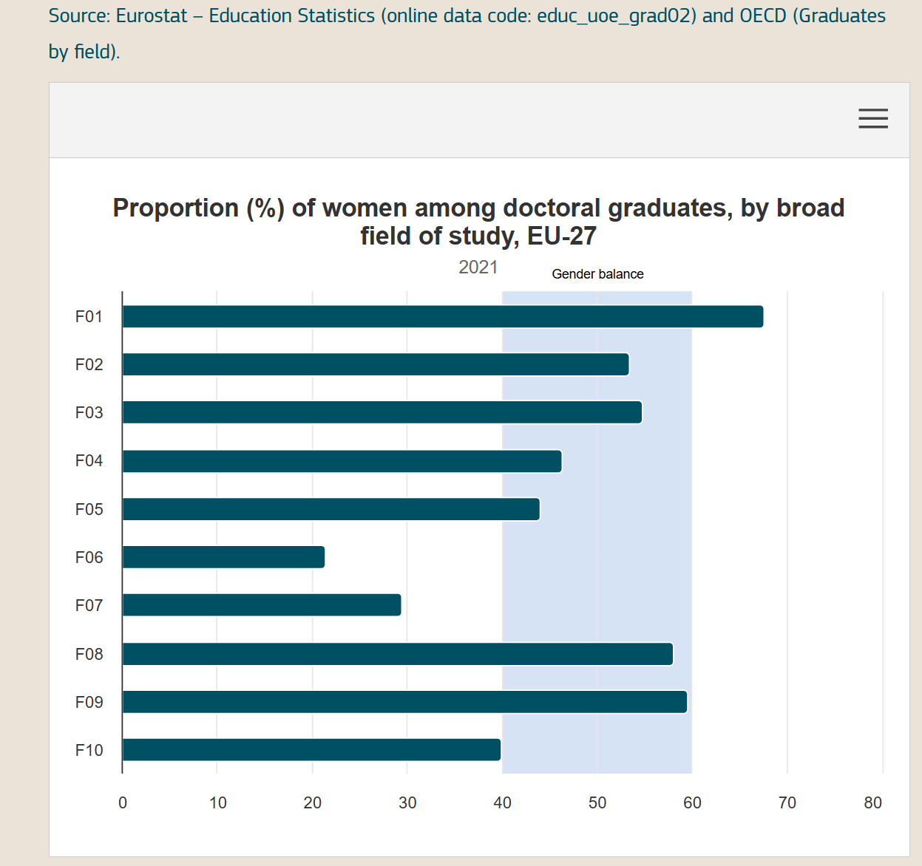
F05 : natural sciences, maths 43 %
F06 : ICT 21 %
F07: Engineering, manufacturing and construction 27%

Slide 3
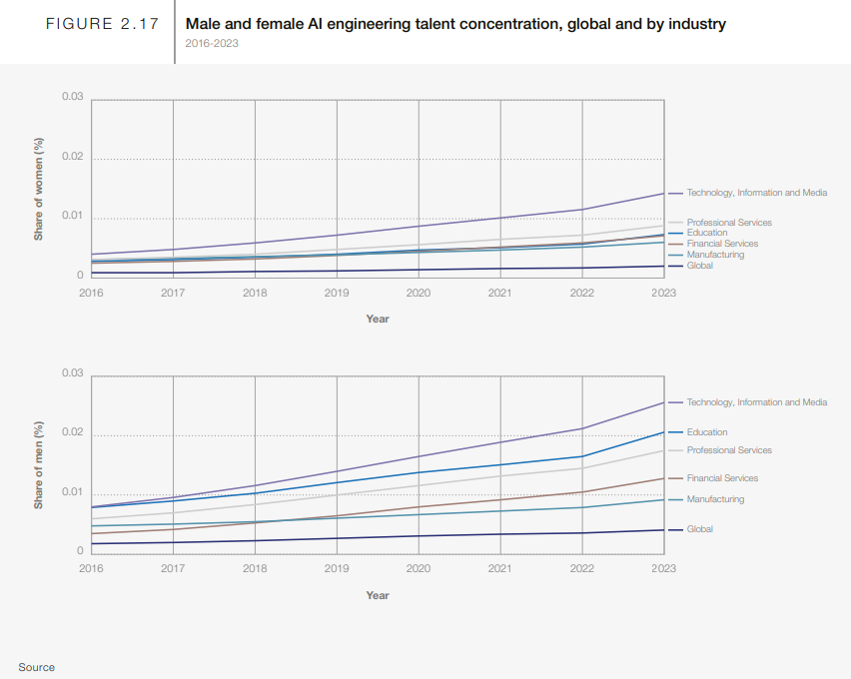
Female
Engineering/
Computer Science/AI- CAREERS
Male
Male and female AI Engineering Talent Concentration, global and by industry
World Economic Forum – Gender Gap Report 2024

Slide 4
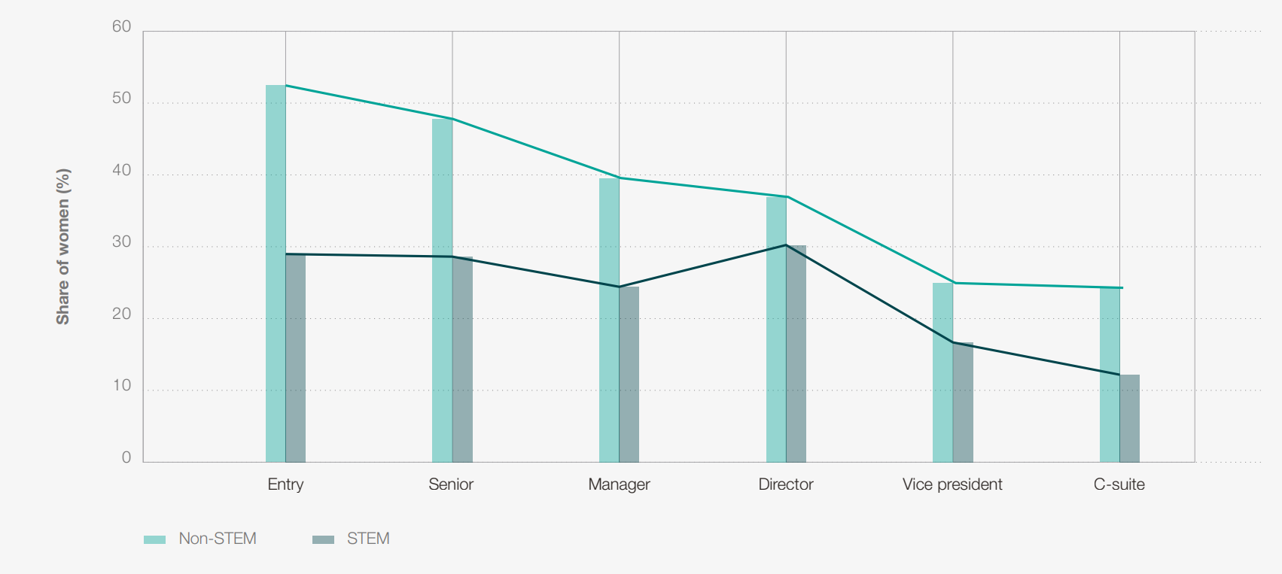
Women in STEM topics -retention
49.3% of global overall workforce are women ~ only 29.2% women in STEM

Slide 5
Gender Balance at EuroHPC:
In terms of the gender balance, 72.5 % of staff are female and 27.5 % male.
With regard to middle management, the gender balance is 75% male and 25% female.

Slide 6
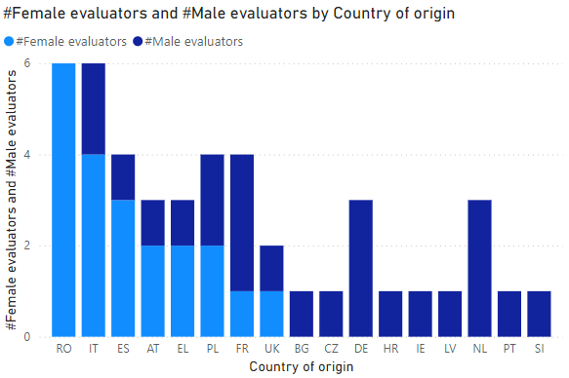
EuroHPC – Gender Performance
Evaluation Processes R&I
In 2024, a total of 37 experts from 17 different European countries contributed to the evaluation of proposals.
In 2024 there was a greater number of male evaluators (60%) than female (40%).
Notes:
A few thoughts:
Gender disparities exist
HPC Community needs to do more to attract men and women to HPC
Education is key, AI will help too

Slide 7
Gender balance in HPC:
Still not great, but getting better.
On average, women in STEM subjects represent about 22% of the IT/Computer science workforce globally (WEF 2024 data)
At this conference, about 25% are women
EuroHPC mission to grow the ecosystem in HPC, Quantum and AI
NCC mission to focus on this topic
What else can we all do to inspire and motivate everybody to think abut this issue?

