Slide 1
The Future of Benchmarks in HPC, AI, Quantum
Starter Slides by Andreas Herten
Dr. Andreas Herten, Jülich Supercomputing Centre, Forschungszentrum Jülich

Slide 2
What is Benchmarking?
Supercomputer
Node, Network
Memory Subsystem
Processor, Accelerator
Computing Unit
Objective
Different metrics
Mostly: Time to solution or rate of execution
Isolated (synthetic) or integrated
Result: Figure of merit
Verified
Comparable with itself
Comparable with other benchmarks
Execution prescribed
Input fixed
Modifications described
Automated?
Reproducible/repeatable
Assessing a device‘s performance through comparable, well-formed reference executions.
Somewhat synthesized
Available data for comparison
Understandable
Ideally: Explainable
Log files available
Various types: Synthetic benchmarks, micro-benchmarks, mini-apps, hardened apps, full-scale apps
Multiple measurements (statistics)

Slide 3
Most Popular Benchmark in HPC
HPL
Historic data, well-formed, easily comparable, close(ish) to th. peak
Limited real-world applicability, semi-synthetic
HPCG
Easily comparable, different focus vs HPL
Limited real-world applicability, semi-ynthetic
STREAM
Easy to run, clear results
Synthetic test (only memory bw)
GEMM
No standardized benchmark implementation, focus on compute, easy understand
Synthetic test, (too) much optimization potential?
OSU Micro-Benchmarks
Well-crafted suite, easy execution, many tests
Synthetic, not focused on high-level optimizations
Application-benchmarks useful, but harder
PRACE UEABS repository.prace-ri.eu/git/UEABS/ueabs
JUPITER Benchmark Suite github.com/FZJ-JSC/jubench

Slide 4
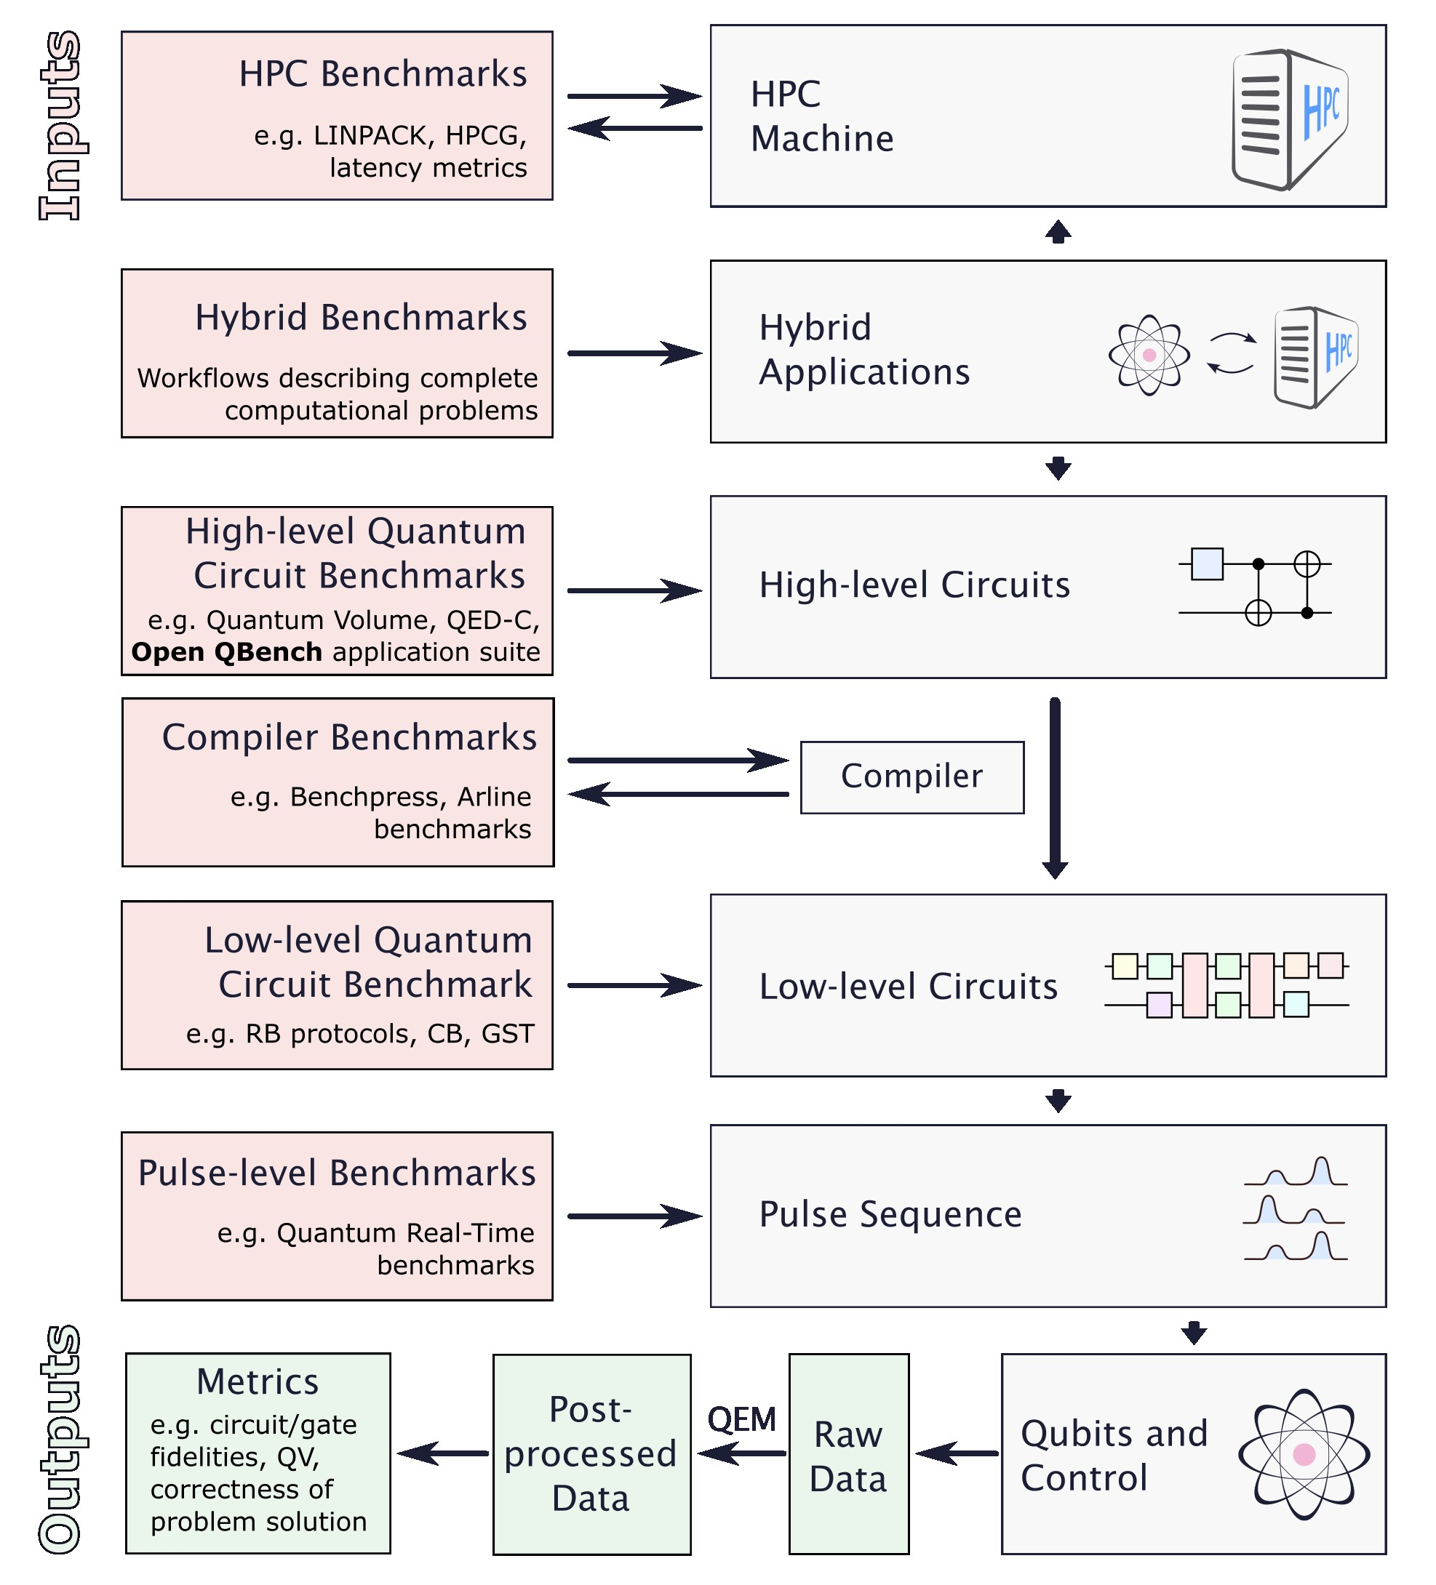
What is a Benchmark?
A metric of performance
A specific task or workload for evaluation and comparisons
Should be standardized and reproducible

Slide 5
Quantum Benchmarks
Category | Examples | Pros | Cons
Computational Problem Benchmarks | Random Circuit Sampling, Integer Factoring, Combinatorial Optimization | Applicable to any computing system (incl. HPC) | Difficult to identify good benchmarks
High-level Benchmarks | Quantum Volume, QED-C, Open QBench$^{1}$ | Holistic, measures performance on representative circuits | Usually not scalable, involves compilation
Low-level (Component) Benchmarks | Randomized Benchmarking | Scalable, does not have to involve compilation | Describes components only
$^{1}$https://quantum.psnc.pl/openqbench/

Slide 6
What is a Benchmark?
A measurement procedure to evaluate characteristics or performance
A reference, widely agreed and recognized
To serve as a common basis to compare different options with objectivity and transparency
And benchmarks for quantum computers?
QC is an emerging technology, with a large variety of implementations:
HW platforms (superconducting circuits, semiconductor spins, neutral atoms, trapped ions, photons, NC centers…)
and QC modalities (gate-based, analog such as qu. simulators and annealers…)
QC is promising for many applications, with increasing market and competition
Benchmarks of interest for technology providers, end-users (HPC centers, industries…), policy makers, investors…
⇒ To compare the performance of quantum computers
Different QC solutions (e.g., QC#1 vs. QC#2) [short term]
QC vs. other solutions (HPC, AI…) [longer term]
⇒ To evaluate the progress of quantum computers towards utility
F. Schopfer

Slide 7
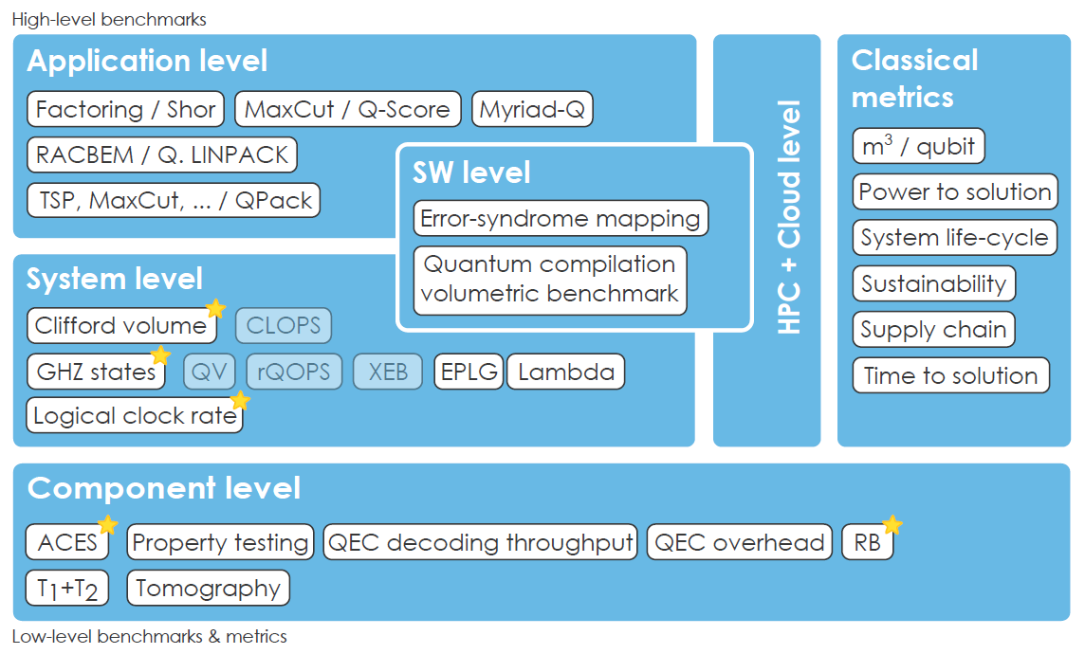
Quantum computing benchmarks
Mesasure the overall full-stack performance
More HW-agnostic, appropriate to compare different technologies
NISQ & FTQC-ready, more scalable
Measure the progress towards utility
Problem solving and/or
Algorithm execution
Circuit execution
Physical properties of qubits and/or gates
“Systematic benchmarking of quantum computers: status and recommendations” J. Lorenz et al. https://arxiv.org/abs/2503.04905
F. Schopfer

Slide 8
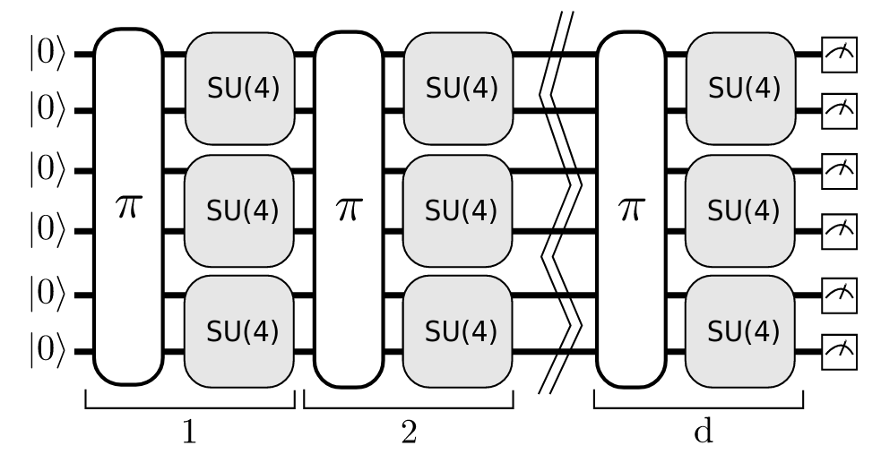
Quantum computing benchmarks
Mesasure the overall full-stack performance
More HW-agnostic, appropriate to compare different technologies
NISQ & FTQC-ready, more scalable
Measure the progress towards utility
Q-score / MaxCut
Largest graph size for which a quantum processor excels random approach of the MaxCut problem.
…
QED-C Bench.
Algo. execution, with volumetric result evaluation: Solution fidelity as a function of circuit width and depth
Quantum Volume
Largest representative square circuit a quantum device can on average successfully execute.
“Systematic benchmarking of quantum computers: status and recommendations” J. Lorenz et al. https://arxiv.org/abs/2503.04905
F. Schopfer

Slide 9
An example of application-oriented QC benchmarks set
BACQ is an application-oriented benchmark set for multicriteria evaluation of QC performance
[Set of reference Problems to be solved + Multiple Metrics + Aggregation tool for notation]
MYRIAD-Q
MCDA method including interacting metrics, user preferences…
Simulation of Quantum Physics
Optimization
Linear Systems Solving
Prime Factorization
Energetic metrics
All HW platforms
All QC modalities (analog to gate-based)
NISQ to FTQC
Q-score
Towards open-access
+ Standardization for globally harmonized and recognized benchmarks [CEN-CLC JTC22, IEC/ISO JTC3]
“Benchmarking Quantum Coprocessors in an Application-Centric, Hardware-Agnostic, and Scalable Way” S. Martiel et al.
https://doi.org/10.1109/TQE.2021.3090207
“BACQ - Application-oriented Benchmarks for Quantum Computing” F. Barbaresco et al.
https://arxiv.org/abs/2403.12205
F. Schopfer

Slide 10
What is a Benchmark?
A metric of performance
A specific task or workload for evaluation and comparisons
Should be standardized and reproducible

Slide 11
Quantum Benchmarks
Category | Examples | Pros | Cons
Computational Problem Benchmarks | Random Circuit Sampling, Integer Factoring, Combinatorial Optimization | Applicable to any computing system (incl. HPC) | Difficult to identify good benchmarks
High-level Benchmarks | Quantum Volume, QED-C, Open QBench$^{1}$ | Holistic, measures performance on representative circuits | Usually not scalable, involves compilation
Low-level (Component) Benchmarks | Randomized Benchmarking | Scalable, does not have to involve compilation | Describes components only
$^{1}$https://quantum.psnc.pl/openqbench/

Slide 12
The Future of Benchmarks
in HPC, AI, and Quantum
Starter Slides by Alexandra Kourfali
Dr. Alexandra Kourfali, EuroHPC JU

Slide 13
What is Benchmarking
For EuroHPC a benchmark is:
A metric - of performance, energy consumption, precision
Should be standardised
Should be used to objectively compare infrastructure
Challenges and needs for a new benchmarking suite
Existing benchmarks (e.g., LINPACK) focus on FLOPs and synthetic workloads: Realistic workloads?
Lack of emphasis on modern AI workloads: mixed-precision AI?
Energy efficiency / sustainability : New metrics?

Slide 14
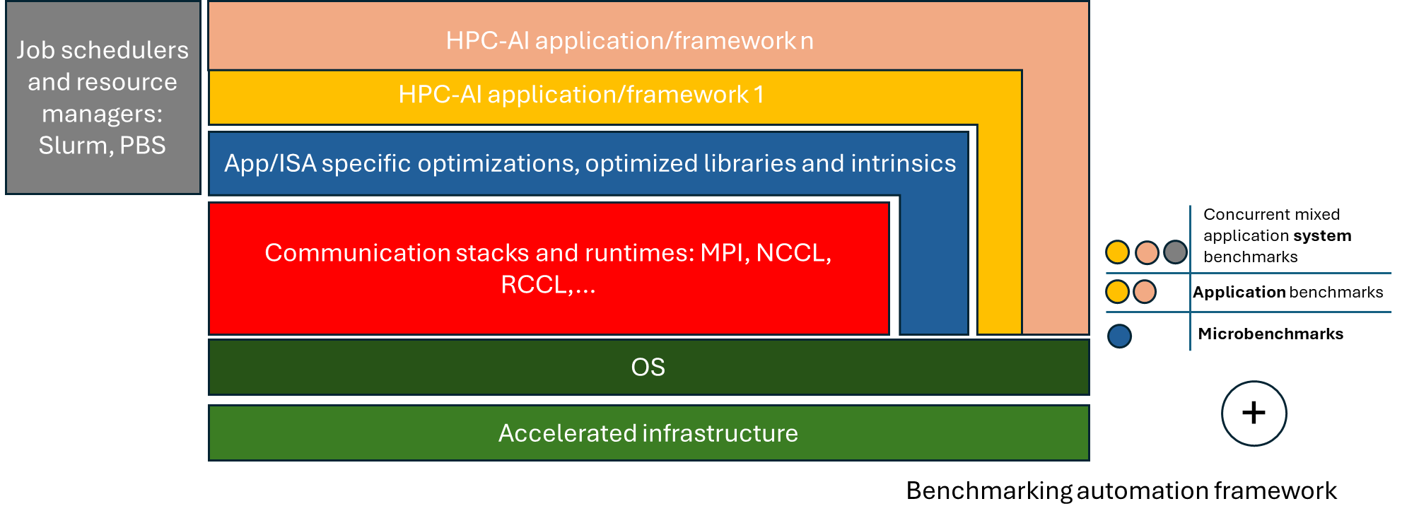
Towards a new benchmarking suite
Open European HPC-AI and HPC-QC frameworks
towards a converged and standardized benchmarking process
well-maintained, unified, extensible, continuously updated bench suite
new benchmarks with common standards, versioning, control
exascale and post-exascale HPC, incl. set of apps, AI models and hybrid HPC-QC workflows

Slide 15
Definition of Benchmarking
Benchmarks are designed to:
mimic a particular type of workload on a component or system of supercomputer to compare platforms,
identify performance bottlenecks,
evaluate potential solutions,
and help users in their decision of buying or using machines most appropriate for their application requirements.
Walter Lioen, SURF

Slide 16
Popular Benchmarks
Types
Application Benchmarks (CORAL-2, JUPITER, PRACE UEABS)
Dwarfs (7 dwarfs, Phillip Colella 2004)
Roofline modeling
Synthetic Benchmarks (STREAM, IMB, OSU, …)
TOP500 HPL / (HPCG)
Objectives
Time to Solution
Energy to Solution
TCO (€) to Solution
Walter Lioen, SURF

