Slide 1
Chips Joint Undertaking
Jari Kinaret
March 20, 2024

Slide 2
What is Chips Joint Undertaking?
Public-private partnership (PPP)
Partnerships between public authorities and industry intend to bring project results closer to the market and improve the link between research and societal growth. The PPPs are based on long term contracts that can take many different legal forms, from contractual partnerships to specific legal entities.
Joint undertaking (JU)
A Joint Undertaking is an institutionalized PPP with its own legal identity, with its own governance, budget etc.. In most cases, like for the Chips JU, the JUs are established by an EU regulation called the Single Basic Act which defines what the JU has to do and how it must do it. Most of the rules governing the JUs are very similar to those of the European Commission.
Chips JU
Chips JU was established in September, 2023, in an amendment to the Single Basic Act to implement the first pillar of the Chips Act and to continue the activities of its predecessors in the field of electronic components and systems (ECS). The Chips JU is a tri-partite partnership between the EC, the participating states and European industries; most of our actions are funded jointly and equally by these actors.

Slide 3
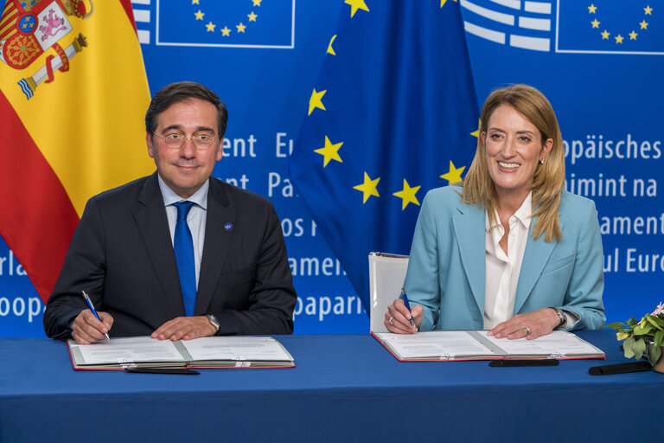
Chips Act: Entry into force, 21 September 2023
Signatures 13 September, Publication 18 September 2023
Chips Act:
https://eur-lex.europa.eu/eli/reg/2023/1781/oj
Single Basic Act amendment:
https://eur-lex.europa.eu/eli/reg/2023/1782/oj
Roberta Metsola (European Parliament President)
José Manuel Albares Bueno (Council Presidency)

Slide 4
The 3 pillars of the Chips Act
European Semiconductor Board (Governance)
Pillar 1
Chips for Europe Initiative
Initiative on infrastructure building in synergy with the EU’s research programmes
Support to start-ups and SMEs
Pillar 2
Security of Supply
First-of-a-kind semiconductor production facilities
Pillar 3
Monitoring and Crisis Response
Monitoring and alerting
Crisis coordination mechanism with MS
Strong Commission powers in times of crisis

Slide 5
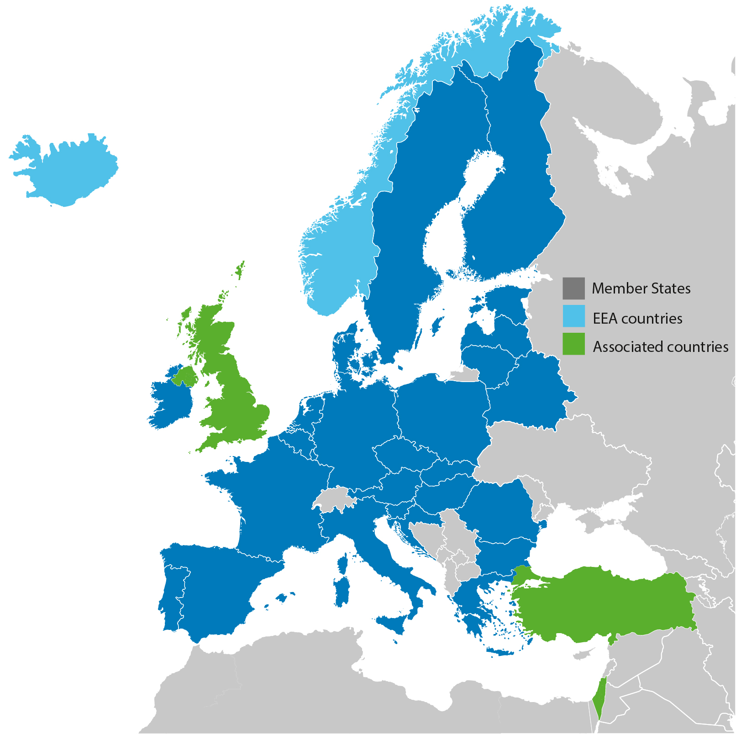
Chips JU and its predecessor
Key Digital Technologies JU (KDT JU)
Non-initiative
KDT General Objectives
  Reinforce EU strategic autonomy in electronic components and systems
  Establish EU scientific excellence and innovation leadership
  Ensure that components and systems technologies address Europe’s societal and environmental challenges
From KDT to Chips JU
  Pilot lines
  Design platform
  Competence centers
  Quantum chips technology
  Digital Europe Programme in addition to Horizon Europe
  Disclaimed: we know that the WP2023-2027 will need to be updated/amended in the spring and some details on the following pages may change
  Link to work programme 2023-2027:
  https://www.chips-ju.europa.eu/Library-1 (may be updated!)
Initiative
Notes:
General objectives:
reinforce the Union’s strategic autonomy in electronic components and systems to support future needs of vertical industries and the economy at large. The overall target is to contribute towards doubling the value of the design and production of electronic components and systems in Europe by 2030, in line with the weight of the Union in products and services;
establish Union scientific excellence and innovation leadership in emerging components and systems technologies, including in activities related to lower TRLs; and promote the active involvement of SMEs, which shall represent at least one third of the total number of participants in indirect actions and at least 20 % of public funding should go to them;
ensure that components and systems technologies address Europe’s societal and environmental challenges. The target is to align with the Union policy on energy efficiency and contribute towards the reduction of energy consumption by 32,5 % in 2030.
31 Participating States: all 27 MS, Iceland, Norway, Israel, and Turkey

Slide 6
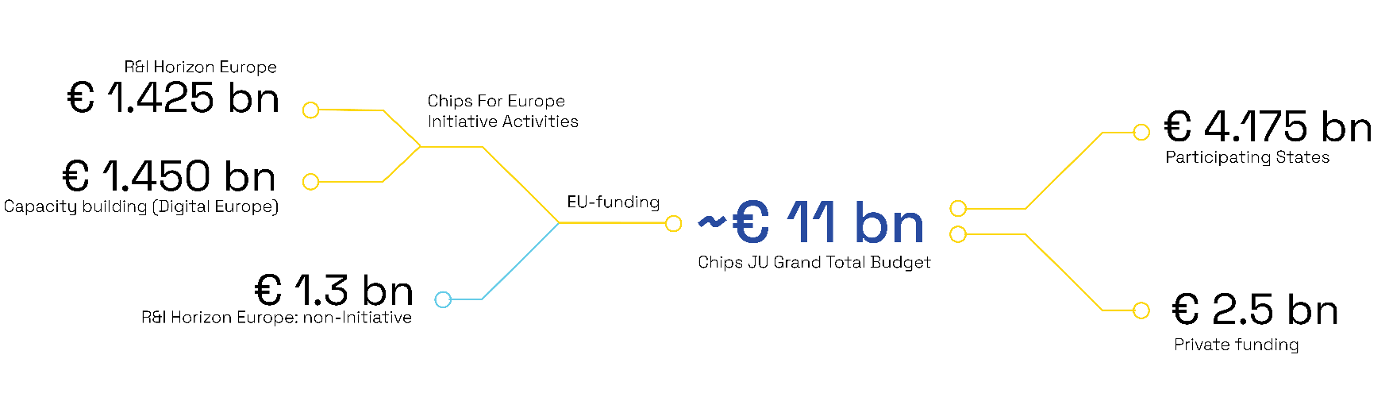
Chips JU
EU Contribution to Chips JU (excl | Chips for Europe Initiative | Non-Initiative | Total
R&I (Horizon Europe) | 1.425 | 1.300 | 2.725
Cap building (DEP) | 1.450 | n.a. | 1.450
Total | 2.875 | 1.300 | 4.175

Slide 7
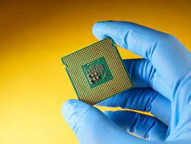
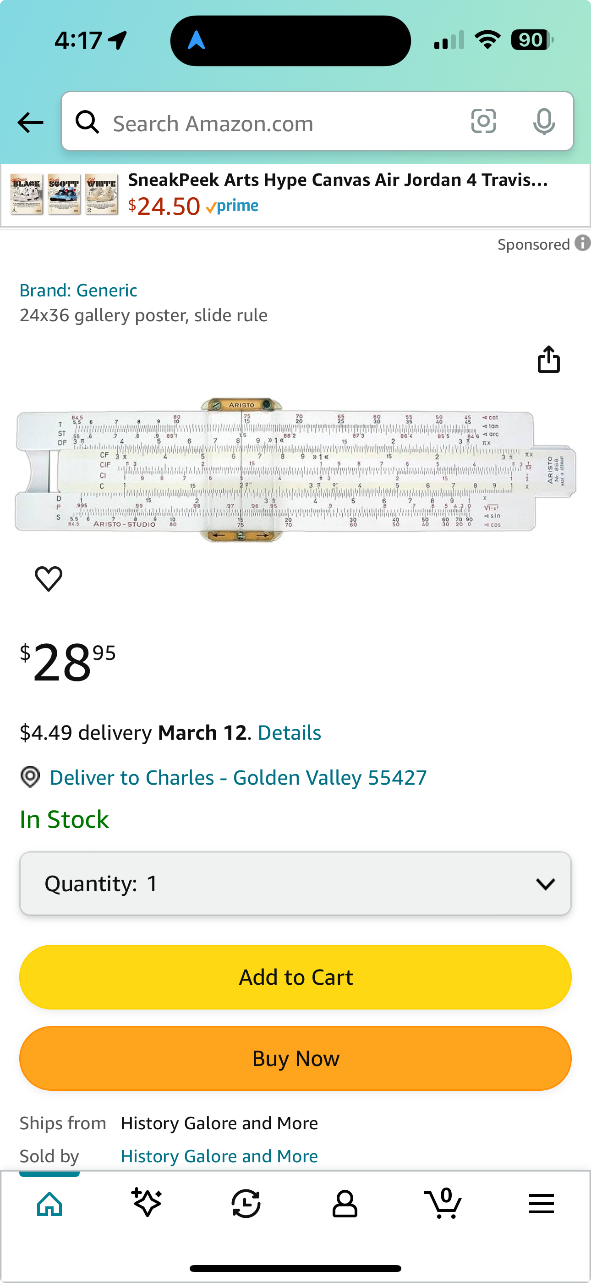
Chips and computing
Chips
No chips

Slide 8
Chips and computing: RISC-V
ECSEL heritage - The ECSEL portfolio covers a variety of RISC-V aspects at a project task level
  Scope: architecture extensions (e.g., accelerators, co-processors); (Low Power/High Performance) microarchitectures (e.g., implementations of the architectures);(Low Power) HW realizations (e.g., FD-SOI – By MEANS of?); SW support for RISC-V: System SW and tools for design, verification, testing, etc.
  ECSEL projects with RISC-V tasks - OCEAN 12 (2017-1-IA), CPS4EU (2018-1-IA), VALU3S (2019-2-RIA), FRACTAL (2019-2-SP2), Energy ECS (2020-1-IA), StorAIge (2020-1-IA), DAIS (2020-2-RIA) – most of these have also addressed AI.
KDT JU/Chips JU RISC-V strategy – focused and linked actions
  Recommendations and Roadmap for European Sovereignty in Open Source Hardware, Software, and RISC-V Technologies , 2022
  SRIA update on RISC-V, 2022
  Automotive RISC-V roadmap - The Road towards a High-Performance Automotive RISC-V Reference Platform , 2023, updated 2024
KDT JU/Chips JU RISC-V calls
Call 2021-1-IA-Focus-Topic-1-Development of open sources RISC-V building blocks
  Project TRISTAN, 47 Partners, Total cost: € 54,371,711.93; Max HE Funding €15,597,798.00; National Funding: €13,603,678.17
Call 2022-1-IA Topic 3: Focus topic on Design of Customisable and Domain Specific Open-source RISC-V Processors (IA)
  Project ISOLDE, 39 Partners, Total cost: € 39,410,109.71; Max HE Funding €11,582,733.37; National Funding: € 11.451.467,64
Now Open! Call 2024-1-IA Topic 2: Focus topic on High Performance RISC-V Automotive Processors supporting the vehicle of the future -
  Expected: Max 70 partners, Approx. cost: € 60-80M; Max HE Funding € 20M; Max National Funding: € 20M
Chips JU investment in RISC-V so far (2 projects contracted):
Total Cost: € 95M, HE Funding: € 27M, National Funding: € 25M, Private in-kind: € 43M

Slide 9
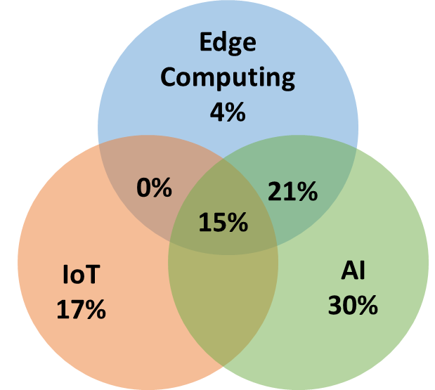

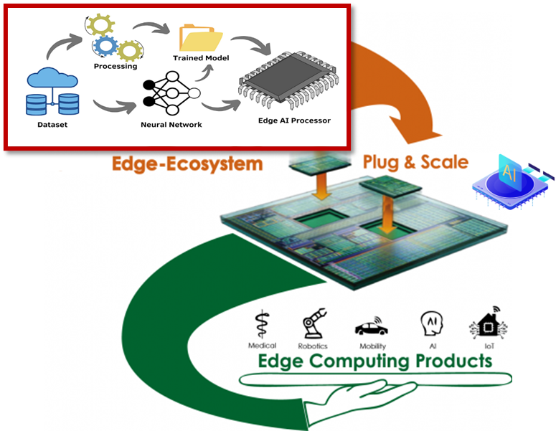

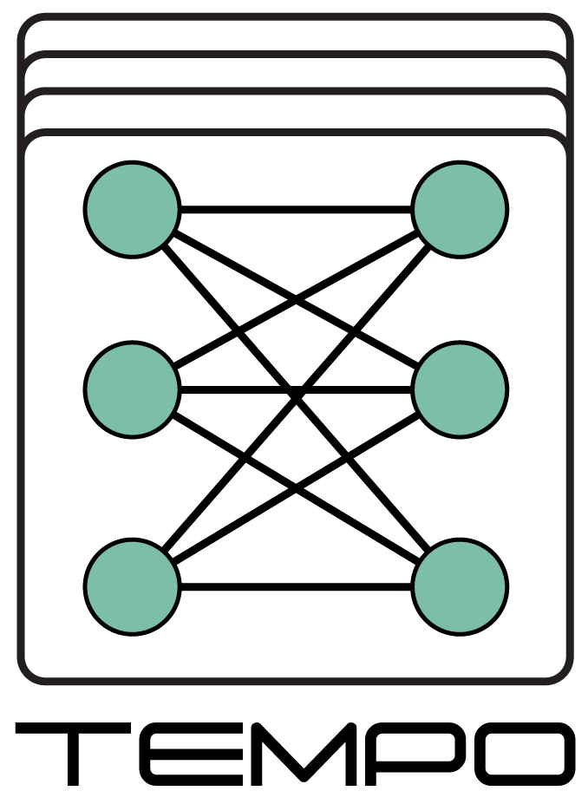







Chips and computing: AI
2014-2020. Three key technological areas: AI, IoT and Edge Computing
47 out of 92 of our projects (51%) produced results in these areas (2014-2020).
Results included: algorithms, HW components (e.g., devices, connectivity techs), architectures/platforms, cloud-to-edge techs, contributions to standards and open-source initiatives.
Mostly for industrial, mobility and energy applications.
2021-2027. Towards a Strong European Edge AI Ecosystem
Projects are expected to incrementally co-create a strong European edge AI ecosystem to strengthen established platforms/technologies & enable interconnections between them.
Projects 2014-2020
(IoT, AI, Edge Computing)
…..
Topic on Edge AI 2023
(Integration solutions)
Topic on Edge AI 2021
(Processing solutions)
*Contracts in preparation
CLEVER

Slide 10
Chips JU: First calls opened in Dec. 2023
Call | Topic | Max EU Contribution | Participating States’ contribution | Total
Chips-CPL-1 | Pilot line on advanced sub 2nm leading-edge system on chip technology | 700 MEUR | 700 MEUR | 1,400 MEUR
Chips-CPL-2 | Pilot line on advanced Fully Depleted Silicon On Insulator technologies targeting 7nm | 420 MEUR | 420 MEUR | 840 MEUR
Chips-CPL-3 | Pilot line on advanced Packaging and Heterogenous Integration | 370 MEUR | 370 MEUR | 740 MEUR
Chips-CPL-4 | Pilot line on advanced semiconductor devices based on Wide Bandgap materials | 180 MEUR | 180 MEUR | 360 MEUR
Calls closed on February 29, 2024. Complex call starting with a Call for Expression of Interest leading to a Hosting Agreement and a Joint Procurement Agreement, and calls for related HE and DEP grants.
Expected project start in late 2024.
Notes:
The setting up of a network of competence centres is one of the five objectives of the Chips for Europe Initiative.
As we can see in this graph, the role of competence centres will be crucial, serving as a bridge between the infrastructures and their users whenever this is not directly or easily available. Through the network of competence centres, SMEs and other users will have prioritised access to the design platform and the various pilot lines that will be set-up.

Slide 11
Chips JU: Upcoming calls (non-initiative)
Call | Topic | Max EU Contribution
Chips-2024-1-IA Topic 1 | Innovation Action on major challenges identified in the Strategic Research and Innovation Agenda (SRIA) | 103 MEUR
Chips-2024-1-IA Topic 2 | High performance RISC-V automotive processors | 20 MEUR
Chips-2024-1-IA Topic 3 | Software-defined vehicle | 20 MEUR
Chips-2024-2-RIA Topic 1 | Research and Innovation Action on major challenges identified in the SRIA | 52 MEUR
Chips-2024-2-RIA Topic 2 | Sustainable and greener manufacturing | 15 MEUR
Chips-2024-3-RIA | Joint call with Korea on heterogeneous integration and neuromorphic computing technologies | 6 MEUR
Calls opened on Feb 6, project outlines are due on May 14, and full project proposals on Sept 17,
except for the one-stage call with Korea where the deadline for a full proposal is May 14
Notes:
The setting up of a network of competence centres is one of the five objectives of the Chips for Europe Initiative.
As we can see in this graph, the role of competence centres will be crucial, serving as a bridge between the infrastructures and their users whenever this is not directly or easily available. Through the network of competence centres, SMEs and other users will have prioritised access to the design platform and the various pilot lines that will be set-up.

Slide 12
Chips JU: Upcoming calls (initiative)
Call | Topic | Max EU Contribution
Chips-2024-CDP-1 | Design platform. A cloud-based virtual platform that will enable users, particularly academia, start-ups and SMEs, to design and develop their chips. Details forthcoming. | 330 MEUR
Chips-2024-CPL-5 | Additional pilot line(s). Details forthcoming. | 180 MEUR
Chips-2024-CQC-1 | Quantum chips technology (preparatory action for a pilot line) | 30 MEUR
Chips-2024-CCC-1 | Competence centres. The centres are to provide access to technical expertise and experimentation in the area of semiconductors, helping companies, SMEs in particular, to approach and improve design capabilities and developing skills. Max 1 per EU MS or EEA country, funding up to 1 MEUR/yr from the EU for 4 years, to be matched nationally. Restricted call after national processes. | 116 MEUR
Chips-2024-CCC-2 | European Network of Chips Competence Centres (CSA) | 4 MEUR
Calls will open July 8 and close Sept 17.
Notes:
The setting up of a network of competence centres is one of the five objectives of the Chips for Europe Initiative.
As we can see in this graph, the role of competence centres will be crucial, serving as a bridge between the infrastructures and their users whenever this is not directly or easily available. Through the network of competence centres, SMEs and other users will have prioritised access to the design platform and the various pilot lines that will be set-up.

Slide 13
Summary of calls 2024
2023
2024
2025
Funding decision
23
Funding decision
24
5 Dec
Open PO
Evaluation
Close PO
Evaluation
Close FPP
2 Nov
Close PL
Open FPP
Evaluation
WP23
WP24
Call collaboration Korea
GAP
WP25
Project Monitoring
Calls PO
Calls FPP
GAP R&D (HE)
Nov
Dec
Jan
6 Feb
Mar
Apr
14 May
Jul
Aug
17 Sep
Oct
Nov
Dec
Jan
29 Feb
Jun
Hosting Agreement
PL
Calls PLs
JPA
GAPs PLs
Project Monitoring PLs
CC
NFA procedure for CC
Call R&D (DEP)
GAP R&D (DEP)
DP
Call (DEP)
JPA
GAP DP
Q
Calls Quantum
JPA
GAP Q
PL
Calls PL5
JPA
GAP PL5

Slide 14
Thank you!

