Slide 1
AI Factories and Cloud Integration: Unlocking Scalable and Flexible AI Workflows
Some notes for discussion
Kimmo.Koski@csc.fi
ANNOTATION

Slide 2
Need to note!
Computing resources are just one part of the Ecosystem
CPU, GPU, QPU, data, applications, competent people, …
And so is the Cloud
But where data is located and available matters a lot!
AI is not useful without high-quality data
European data needs to stay available and open for European research and innovation

Slide 3
European competitiveness
EuroHPC can be one big asset
Federating number of EuroHPC sites, cloud-like services on top of the HPC & AI
AIaaS can be implemented by EuroHPC, user interface and experience developement
HPC, AI and quantum integration
Federation Platform and other related projects/calls supporting
How to close the investment gap (in addition to invest more)?
Value of data acknowledged
Competence development

Slide 4
LUMI-AI system architecture: HPC + cloud converged
User access
partition
GPU partition
Multi-core partition
LUMI-IQ
Batch job
Interactive
Instance- based and API access
/home, /project
Flash-based /scratch
Application-optimized
LUMI-O
External (and LUMI) data spaces

Slide 5
LUMI-AI architecture vision (software-defined clusters)
User Interface
Command line interface
Open Ondemand
Notebooks
Dashboards
Command line or graphical interface
AI and HPC workflows
Computing environment
EasyBuild, Conda, containers, frameworks
Containers
LUMI CE
Customized CE
LUMI CE
Batch jobs
Jupyter Hub
MLFlow
Batch job scheduler
Container runtimes
Custom platforms
Platform
Batch job scheduler
Orchestrator
Batch job tenant
Interactive tenants
Special access tenants
Infrastructure
System management software
Maintained by end users and user communities
Maintained by CSC platform admin team
Maintained by CSC infrastructure admin team together with vendor’s team

Slide 14
AI factories and Cloud integration
March 2025
dr Maciej Krzyżanowski
CloudFerro CEO

Slide 15
Company overview
CloudFerro - a European/Polish medium size technological company
Cloud computing services, data and platforms for Space and other advanced markets
European sovereignity: Compliance with EU regulations and standards, fully European company with European competencies, IPRs, resources
Proactive R&D and product development
EUR 30mn
Investments last 2 years
+40%
Revenues CAGR 2022 - 2024
EUR 41+mn
Revenue 2024
90+ PB
EO data stored and published
>5 years
duration of service contracts
~250
employees
Own tech stack/Open Source
Own IaaS
PaaS built on own and open-software
Specialized EO tools and apps

Slide 16
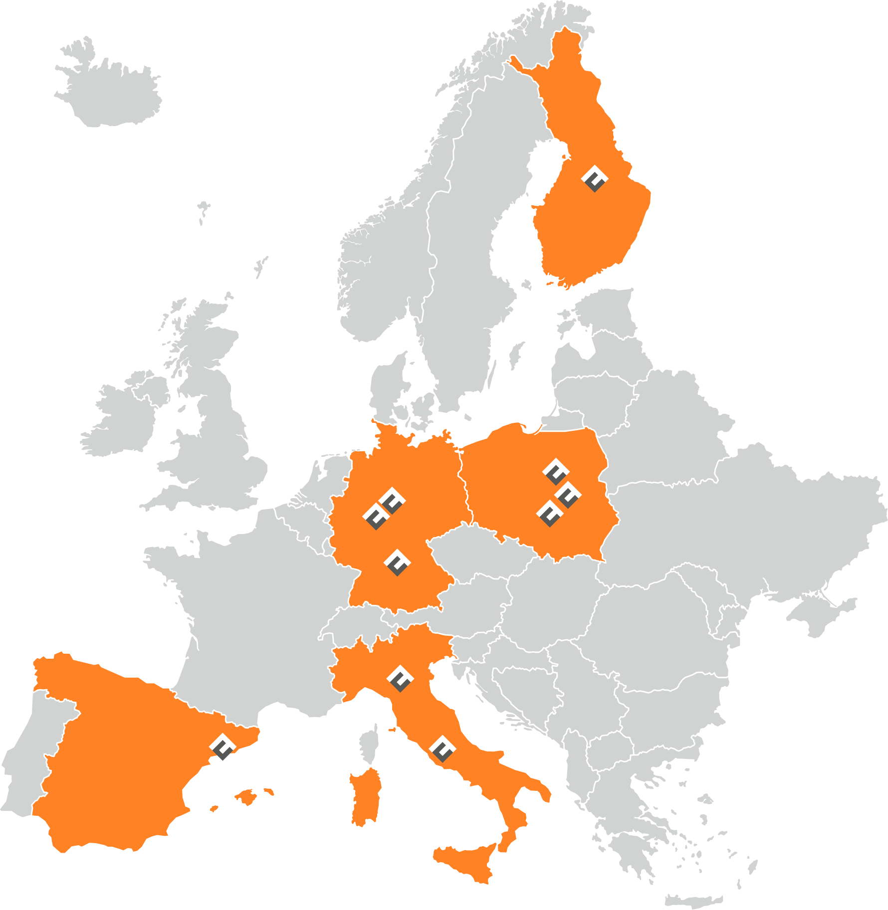
CloudFerro – highlights
European, technological company founded in 2015, leveraging over 20 years of experience of its team members in the IT industry
Provider and operator of public and private computing clouds and EO platforms around Europe
Specialized in storing, processing and publishing/delivering very large data sets, like multipetabyte repositories of Earth Observation satellite data
A solid and mature organisation of more than 250 specialists in Poland and Germany
Substantial computing resources with record 700+ PB of available storage
Technological autonomy via Open Source application and full control of technology stack

Slide 17
Selected customers and partners
Agencies & public bodies
Science & Education
Key customers
Business
PhilSA
+40 educational institutions
+30 CAP agencies
and many more

Slide 18
CloudFerro and HPC
Destination Earth Data Lake (EUMETSAT)
Cloud locations at main HPC centers in Europe
Big overall infrastructures: 60+ PB of storage, 23 500+ CPUs
Connectivity with HPC (100G+) and outside world
Provision of data (e.g. Copernicus)
Data and computing services
Governance (IAM and billing)
Other projects as well

Slide 19
Why Cloud at AI Factories/HPC
HPC/AI Factories
Heavy jobs – model training, numerical models, physical simulations
Handful of large computational tasks run by a handful of users
Relative high unit cost for simple resources (storage, „simple” computing)
Lack of effective IAM solutions and user separation
Cloud solutions – augmentation/extension of HPC power:
Governance of multitenancy, privacy, budgeting/billing, automated provisioning/self service – solution for thousands of users
Environments for application platforms and automation of tasks (e.g. repetitive tasks as data gathering and continual pre-processing)
Tooling for prototyping, staging and visualization; tooling for AI inference and application of models
Access to cheap big data storage (and maybe other IaaS resources)
Broad connectivity to the outside world with tooling for security and safety
Natural fit between HPC/AI Factories and Cloud Bridges/Extensions (natural place for European cloud industry)

Slide 20
Thank you!
dr Maciej Krzyżanowski
mkrzyzanowski@cloudferro.com

Slide 21
Building an Open Web Index and federated Web Data Infrastructure on European HPC Centers
Webis.de

Slide 22
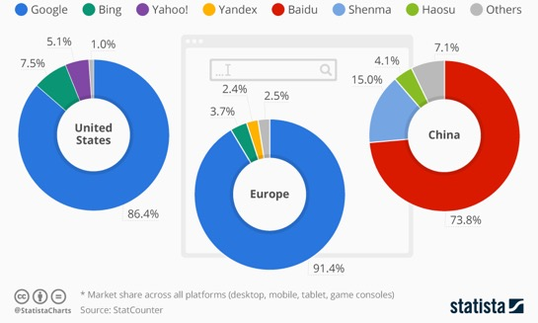
Todays Situation in Web Search: A Critical Infrastructure managed as Oligopoly
Likely to also happen in AI
Two properties of Web Search that don’t fit
A critical infrastructure for society, comparable to satellite navigation
A market oligopoly: i.e. “a market structure in which a market or industry is dominated by a small number of large sellers or producers.” (Wikipedia)
Effects
Missing Digital Sovereignty
Reduced User Experience (limited choice, locked-in ..)
Limited Innovation Potential
No large scale access to Web-data as driver for AI Innovation and beyond

Slide 23
OpenWebSearch.eu’s Proposition
Goal: Building an Open Index of the Web and a federated Open European Web Data Infrastructure as a basis for a Web Search, Analytics and AI in Europe to
empower Europe’s researchers, innovators and businesses to systematically tap into the Web as business and innovation resource at scale – Petabyte-Scale!
contribute to Europe’s tech- and digital sovereignty
support Web-data analytics and AI / RAG systems across Europe
build a federated infrastructure across existing European HPC centres
The piloting is currently funded by Horizon Europe (NGI) and is carried out by 14 core partners plus 9 additional third party projects and a large ecosystem
Webis.de

Slide 24
Our current Infrastructure setup
18 VMs 100 Million URLs/ day
100-200 TB per month (text only)
3-5 TB / Day / data center IO + memory bound
GPU bound when including AI-methods
10 – 20 TB index data / month
Cross Data Center Workflow Execution + Federated Data Storage
approx. factor 20 for commercial indices
Approx. factor 10-50 when including multimedia

Slide 25
AI Factories and Cloud Integration from the perspective of a data-centric, machine learning driven project
AI Sovereignty = Hardware + Software + Data + Standards
Data as First Class Citizen
Data preparation makes up 50%-60% of the work.
High-quality data can be a unique selling point (see AWS, HuggingFace).
Data requires equal continuous engineering as hardware and software
Training AI Models requires ready-to-use Data
Persistent Storage of strategic, high-quality data close to HPC Infrastructure
Re-usable across data centers and communities (e.g. HuggingFace, AWS)
Using AI Models (Inferencing) needs to be provided as a service
AI as service, particulary for inferencing (see OpenAI)
Sharing models /solution across communities (see Hugging Face)
Cross Data Center Standards, self-servics and joint Data / HPC Governane
Common standards and APIs
Unified interfaces and federated workflows (see AWS, Azure)
Joint Governance for Data and HPC (e.g. matrix organisation)

Slide 26
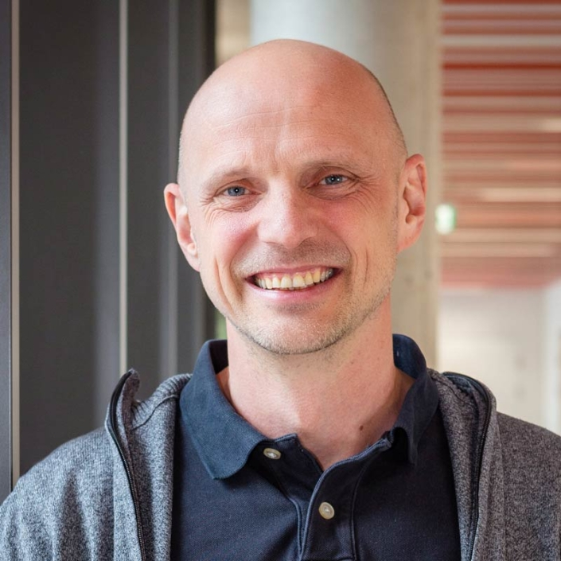
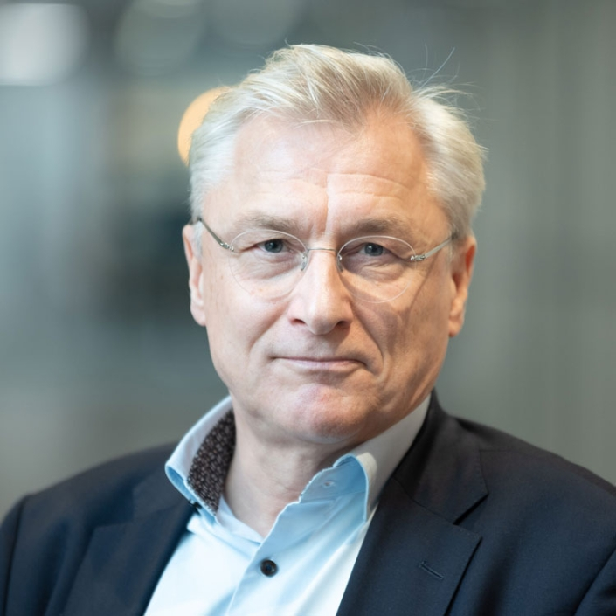
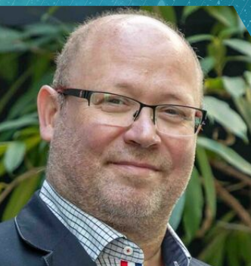
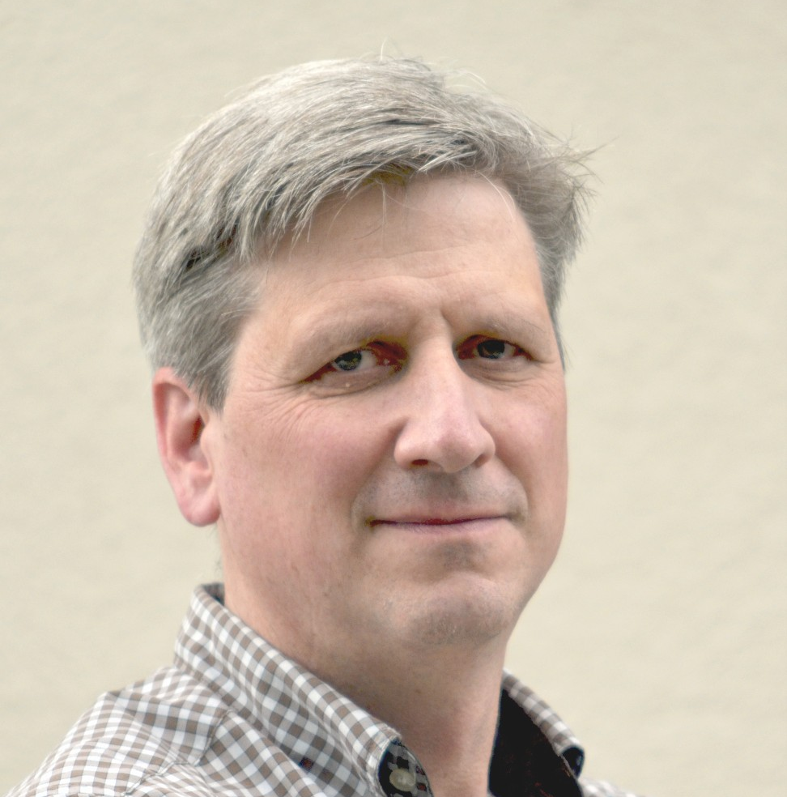
Europe needs to regain sovereignty in using and accessing the Web at scale!
We are here with a larger team for all three days - talk to us and
help implementing a federated European Web Data Infrastructure for Search, Analytics and AI in European HPC centers!
Michael Granitzer
University of Passau
Professor for Data Science
Germany
Per Öster
CSC – IT Center for Science
Director, Advanced Computing Facility
Finland
Vít Vondrák
IT4Innovations National Supercomputing Center
Managing Director
Czech Republic
Stefan Voigt
Open Search Foundation
Chairman
Germany
Contact: ows@openwebserach.eu

Slide 27
From Cloud to HPC and back again
Mateusz Tykierko
\

Slide 28
"Go back?" he thought. "No good at all! Go sideways? Impossible! Go forward? Only thing to do! On we go!"
J.R.R Tolkien „Hobbit”
Author and Date

Slide 29
Wroclaw Centre for Networking and Supercomputing - WCSS
WCSS - organizational unit of Wroclaw University of Science and Technology established in 1994
Lem supercomputer 100th on Top500
~ 2000 users
70+ staff
HPC services, Cloud services, data management services, …

Slide 30
Polish Cloud/Polska Chmura association
Polska Chmura is the only association of Polish cloud service providers on the domestic market, delivering cloud solutions for business and public administration.
We have joined forces to integrate the market, increase awareness of digital sovereignty guaranteed by Polish cloud solutions, and demonstrate their economic and business benefits, as well as potential.
Polska Chmura has been operating since 2016 as an Employers' Association.

Slide 31
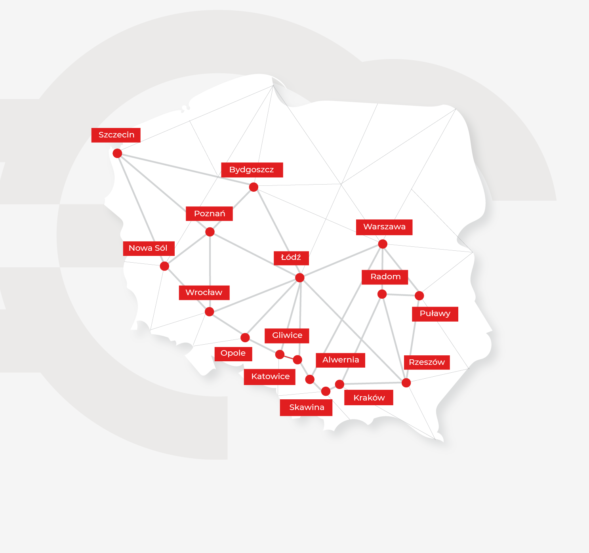
Polish Cloud/Polska Chmura association
11 data centers across the country
5,000 rack cabinets installed in 11 data centers
over 20 billion in total annual turnover
over 5,000 jobs
over 500 business clients for cloud services
over 40,000 square meters of total data center space

Slide 32
Opportunities
High-performance AI training
Scalable AI model cloud deployment
Hybrid workflows
Access to cutting-edge hardware (GPU, QPU, TPU, …)
National and European collaboration
Cost optimization
Automation & Resource Optimization
Services standardization

Slide 33
Challenges
Security & Compliance - Ensuring data protection, access control, and compliance with regulations.
Workflow adaptation - Adjusting workflows to work efficiently across both environments.
Vendor lock-in – Dependence on specific cloud providers and their proprietary solutions.
Unpredictable Cloud Costs - Difficulties in estimating long-term expenses
Data Sovereignty Concerns – Legal restrictions on where the data can be stored or processed
Limited trust in „academic” service providers and their bussines flexability
Overcome resistance to changing the working environment
Bridging the skills gap in HPC and cloud AI

Slide 34
Technical challenges
Open source fast storage solution for HPC & Cloud
Data and model versioning service
Data lineage/provenance solution
HPC queuing systems API optimized for workflows
High performance data mover
Container registry for HPC & Cloud

Slide 35
If we don’t get blown off, or drowned, or stuck in the tree, or lost, or eaten, we might arrive.
J.R.R Tolkien „Hobbit”

