Slide 1
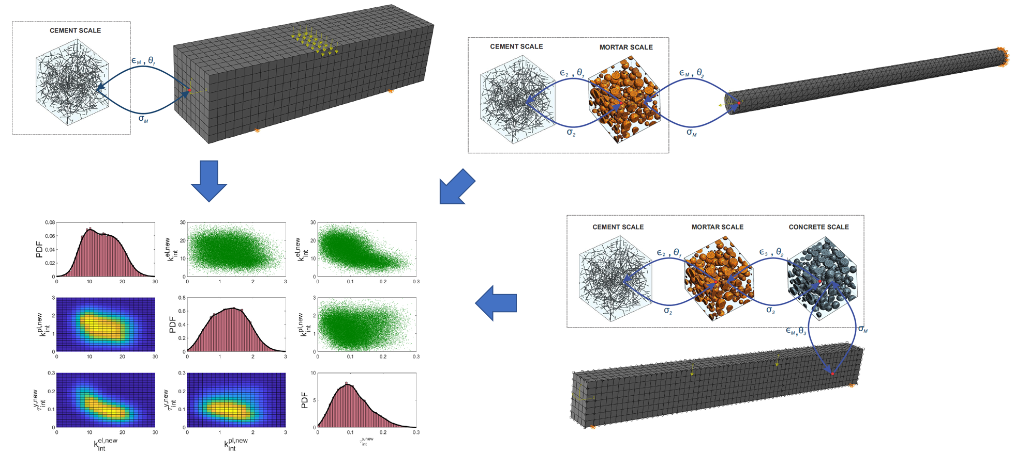
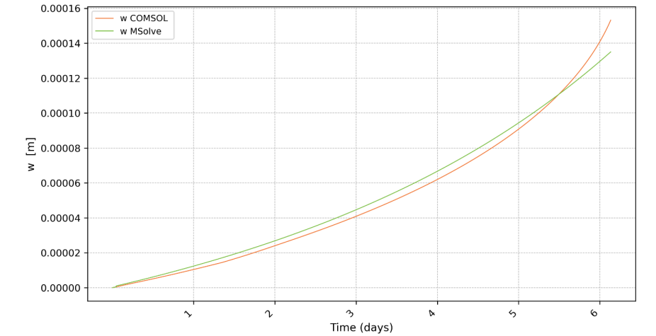
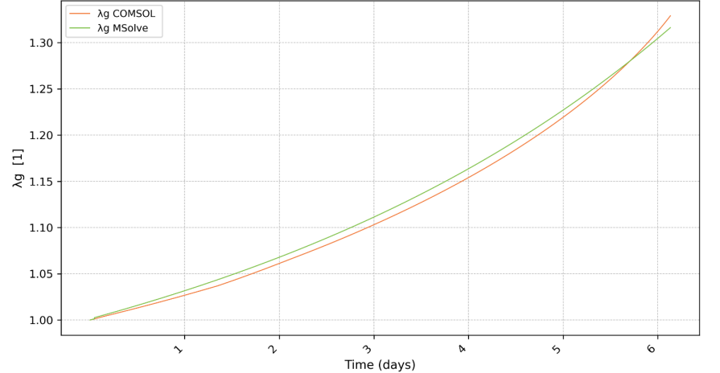
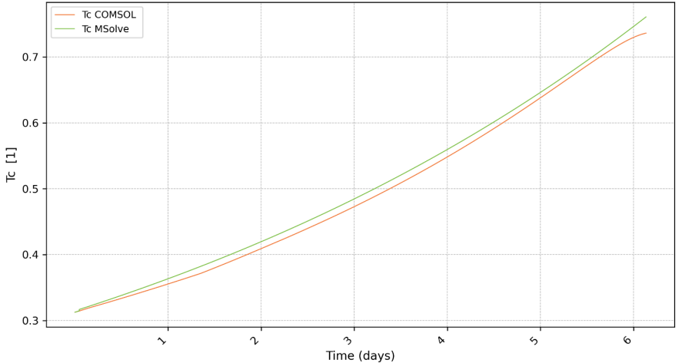
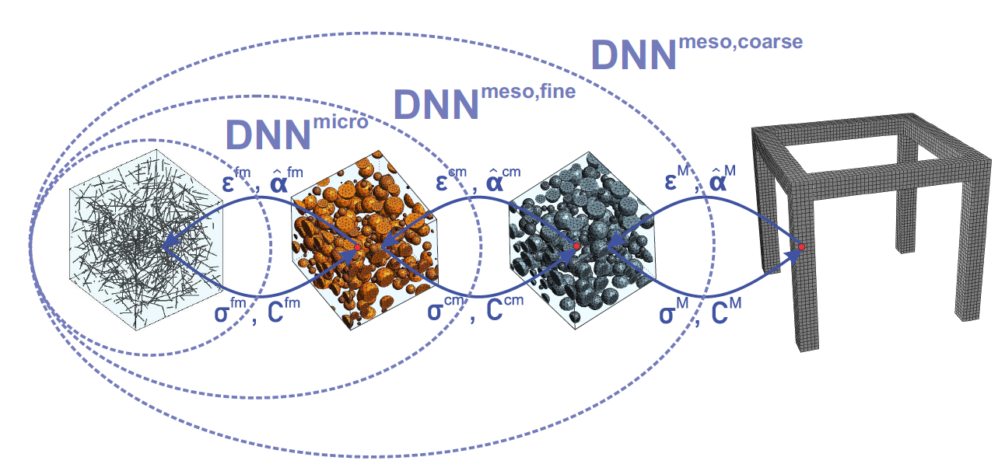
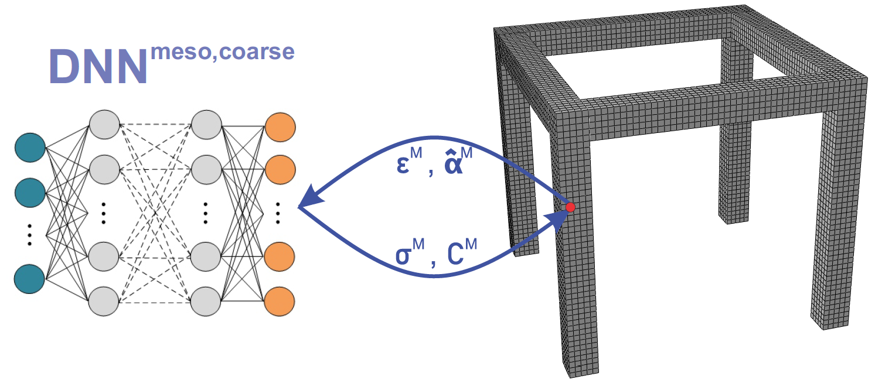
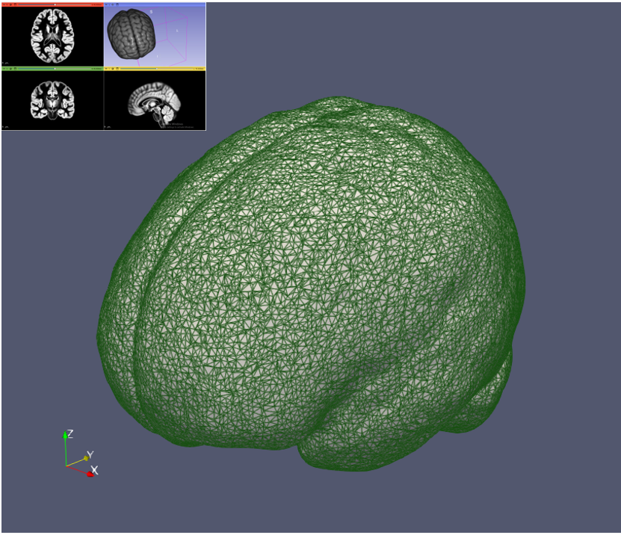
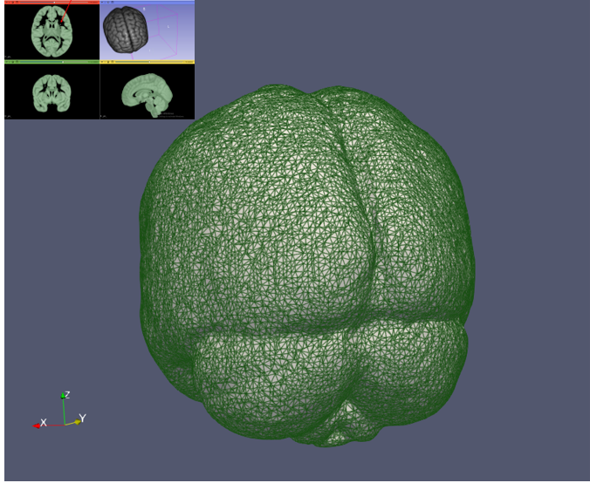
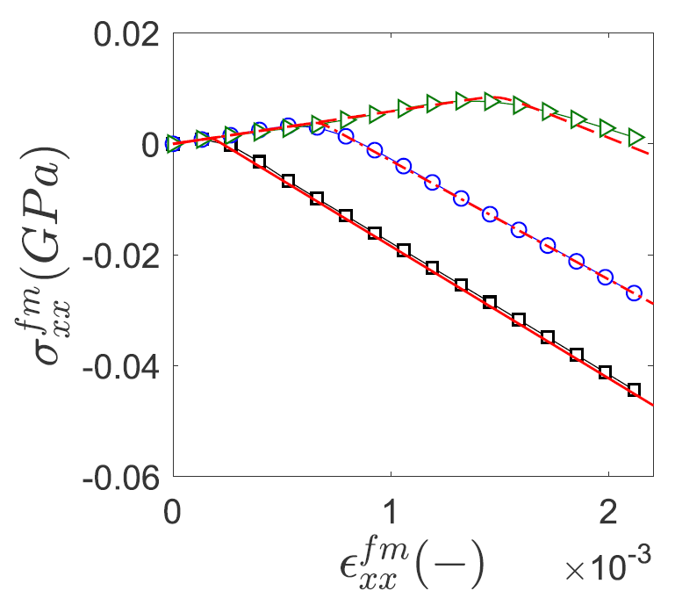
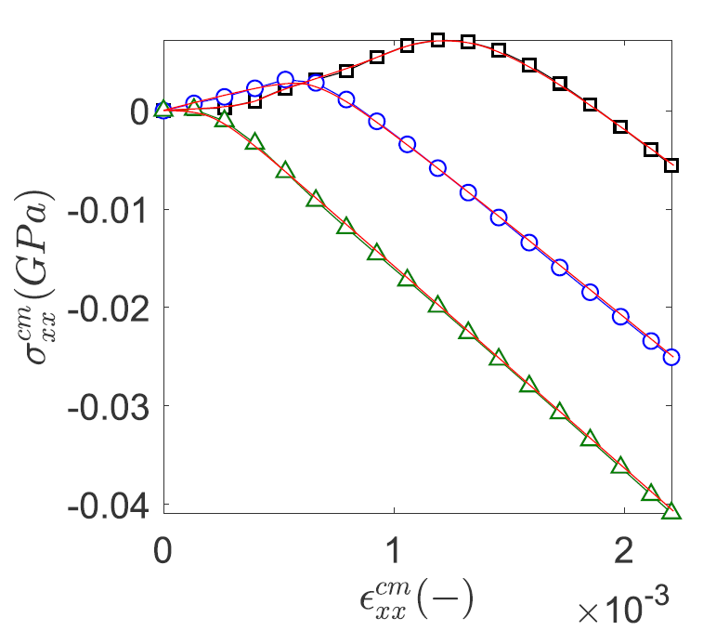
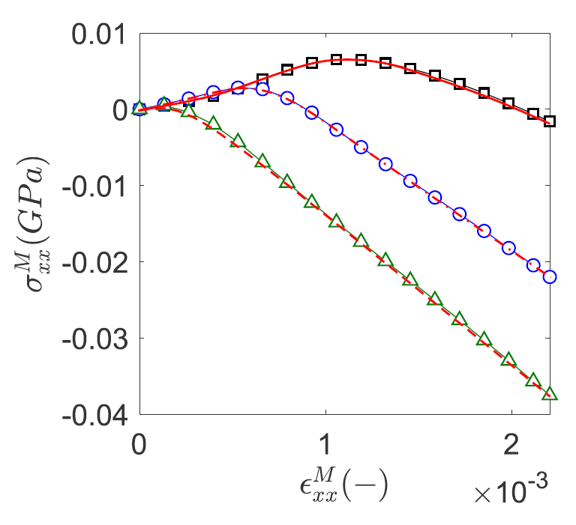
Data-driven computational mechanics at exascale
http://dcomex.eu
DCoMEX aims to develop novel numerical methods enhanced by artificial intelligence (AI) algorithms that are deployed with scalable and open source software to exascale computing architectures. A key innovation is the development of a novel scalable library of AI-enhanced algorithms for the solution of large scale sparse linear system of equations that lay at the core of computational mechanics. Our methods fuse physics-constrained machine learning with efficient block-iterative methods and incorporate experimental data at multiple levels of fidelity to quantify model uncertainties. Efficient deployment of these methods in exascale computing architectures will provide scientists and engineers with unprecedented capabilities for predictive simulations of mechanical systems in applications ranging from bioengineering to manufacturing.
DCoMEX-MAT (deliverable D7.2)
Hierarchical Bayesian Inference in multiscale material modeling
DCoMEX-BIO (deliverable D3.2)
Solid Displacement
Growth Stretch Ratio t
Cancer Cell population
Surrogate modeling via a hierarchy of neural networks
Finite element discretization of the brain with the tumor model
http://dcomex.eu
This project has received funding from the European High Performance Computing Joint Undertaking
under Grant Agreement number 956201

