Slide 1
EFP:
EuroHPC Federation Platform
EuroHPC Summit 20.3.2025
Dr. Pekka Lehtovuori

Slide 2
Setting the scene for the EuroHPC Federation Platform (EFP)
Contributes to EuroHPC Joint Undertaking’s vision to establish a world‐leading federated and secure HPC and quantum service infrastructure ecosystem in the Union
Integrates supercomputing, AI systems, quantum computing and data resources across Europe, enhancing user access to advanced technologies.
Enabler for the new AI objective of the EuroHPC JU - to drive the development of AI factories or open ecosystems for AI formed around the EuroHPC centers.
Serves increasing number of new user-groups, especially industry, which are not as familiar with classical supercomputing/computing in general or are used to a different set of tools or paradigms.

Slide 3
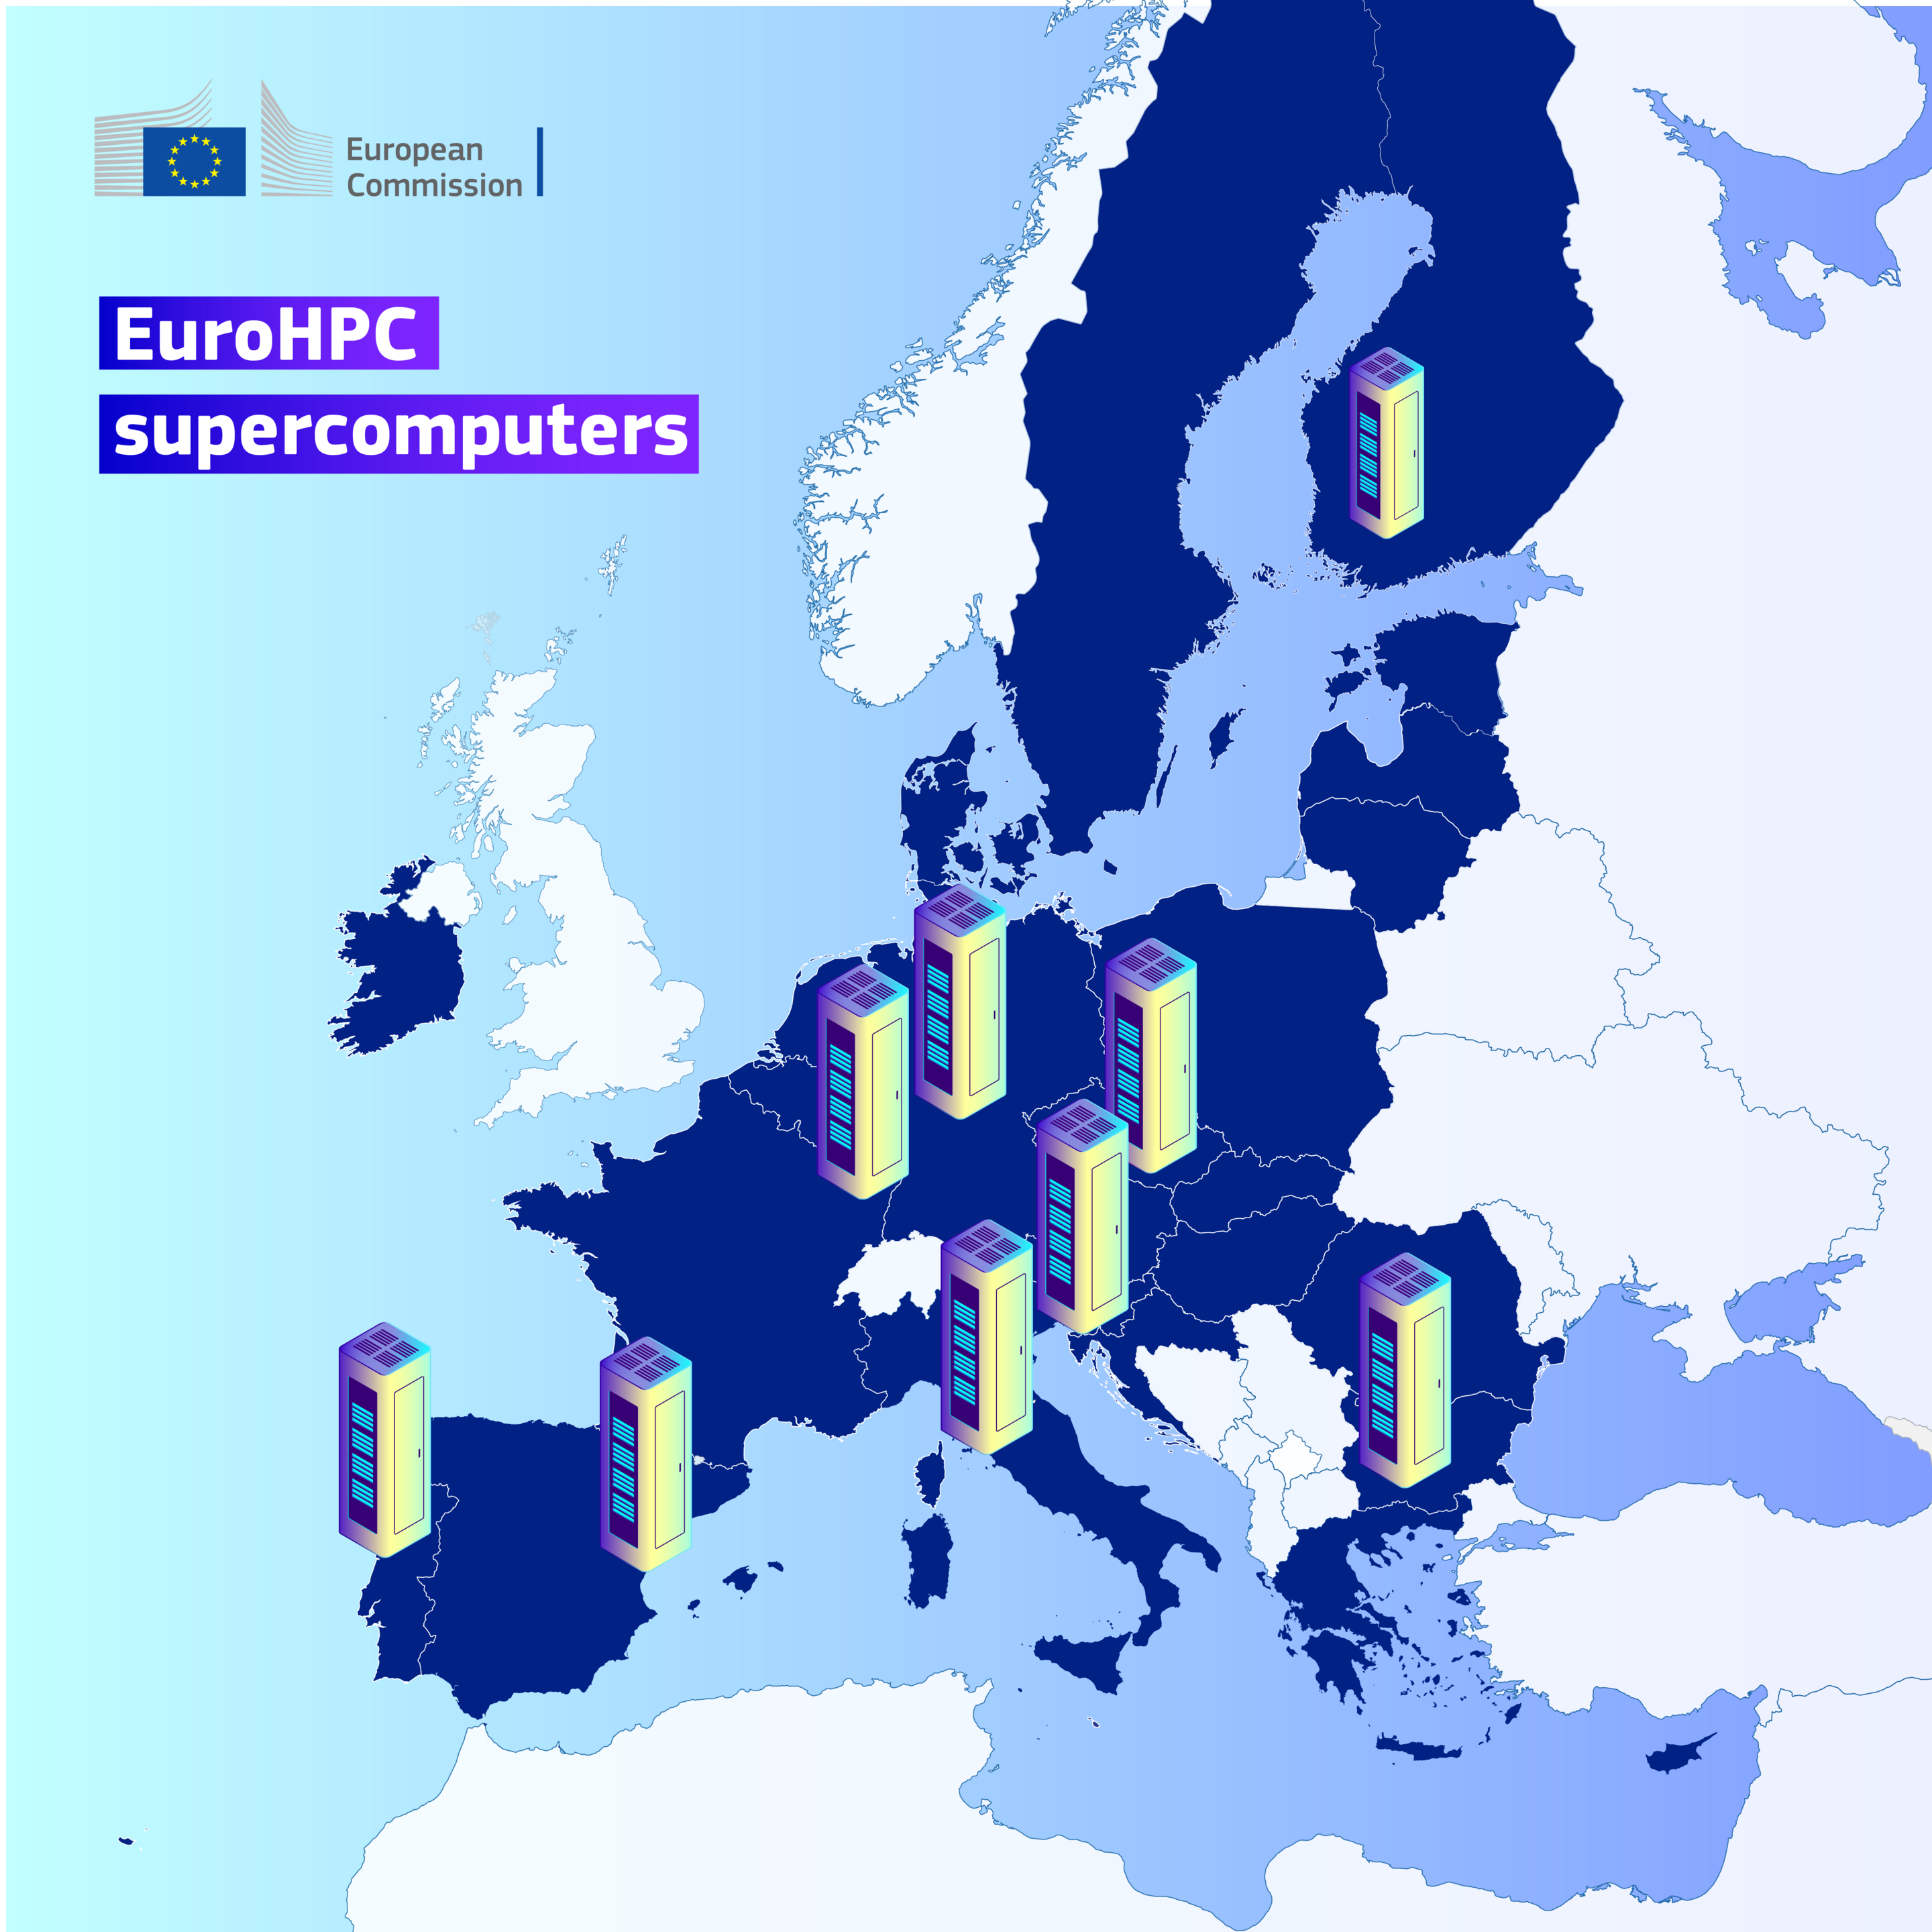
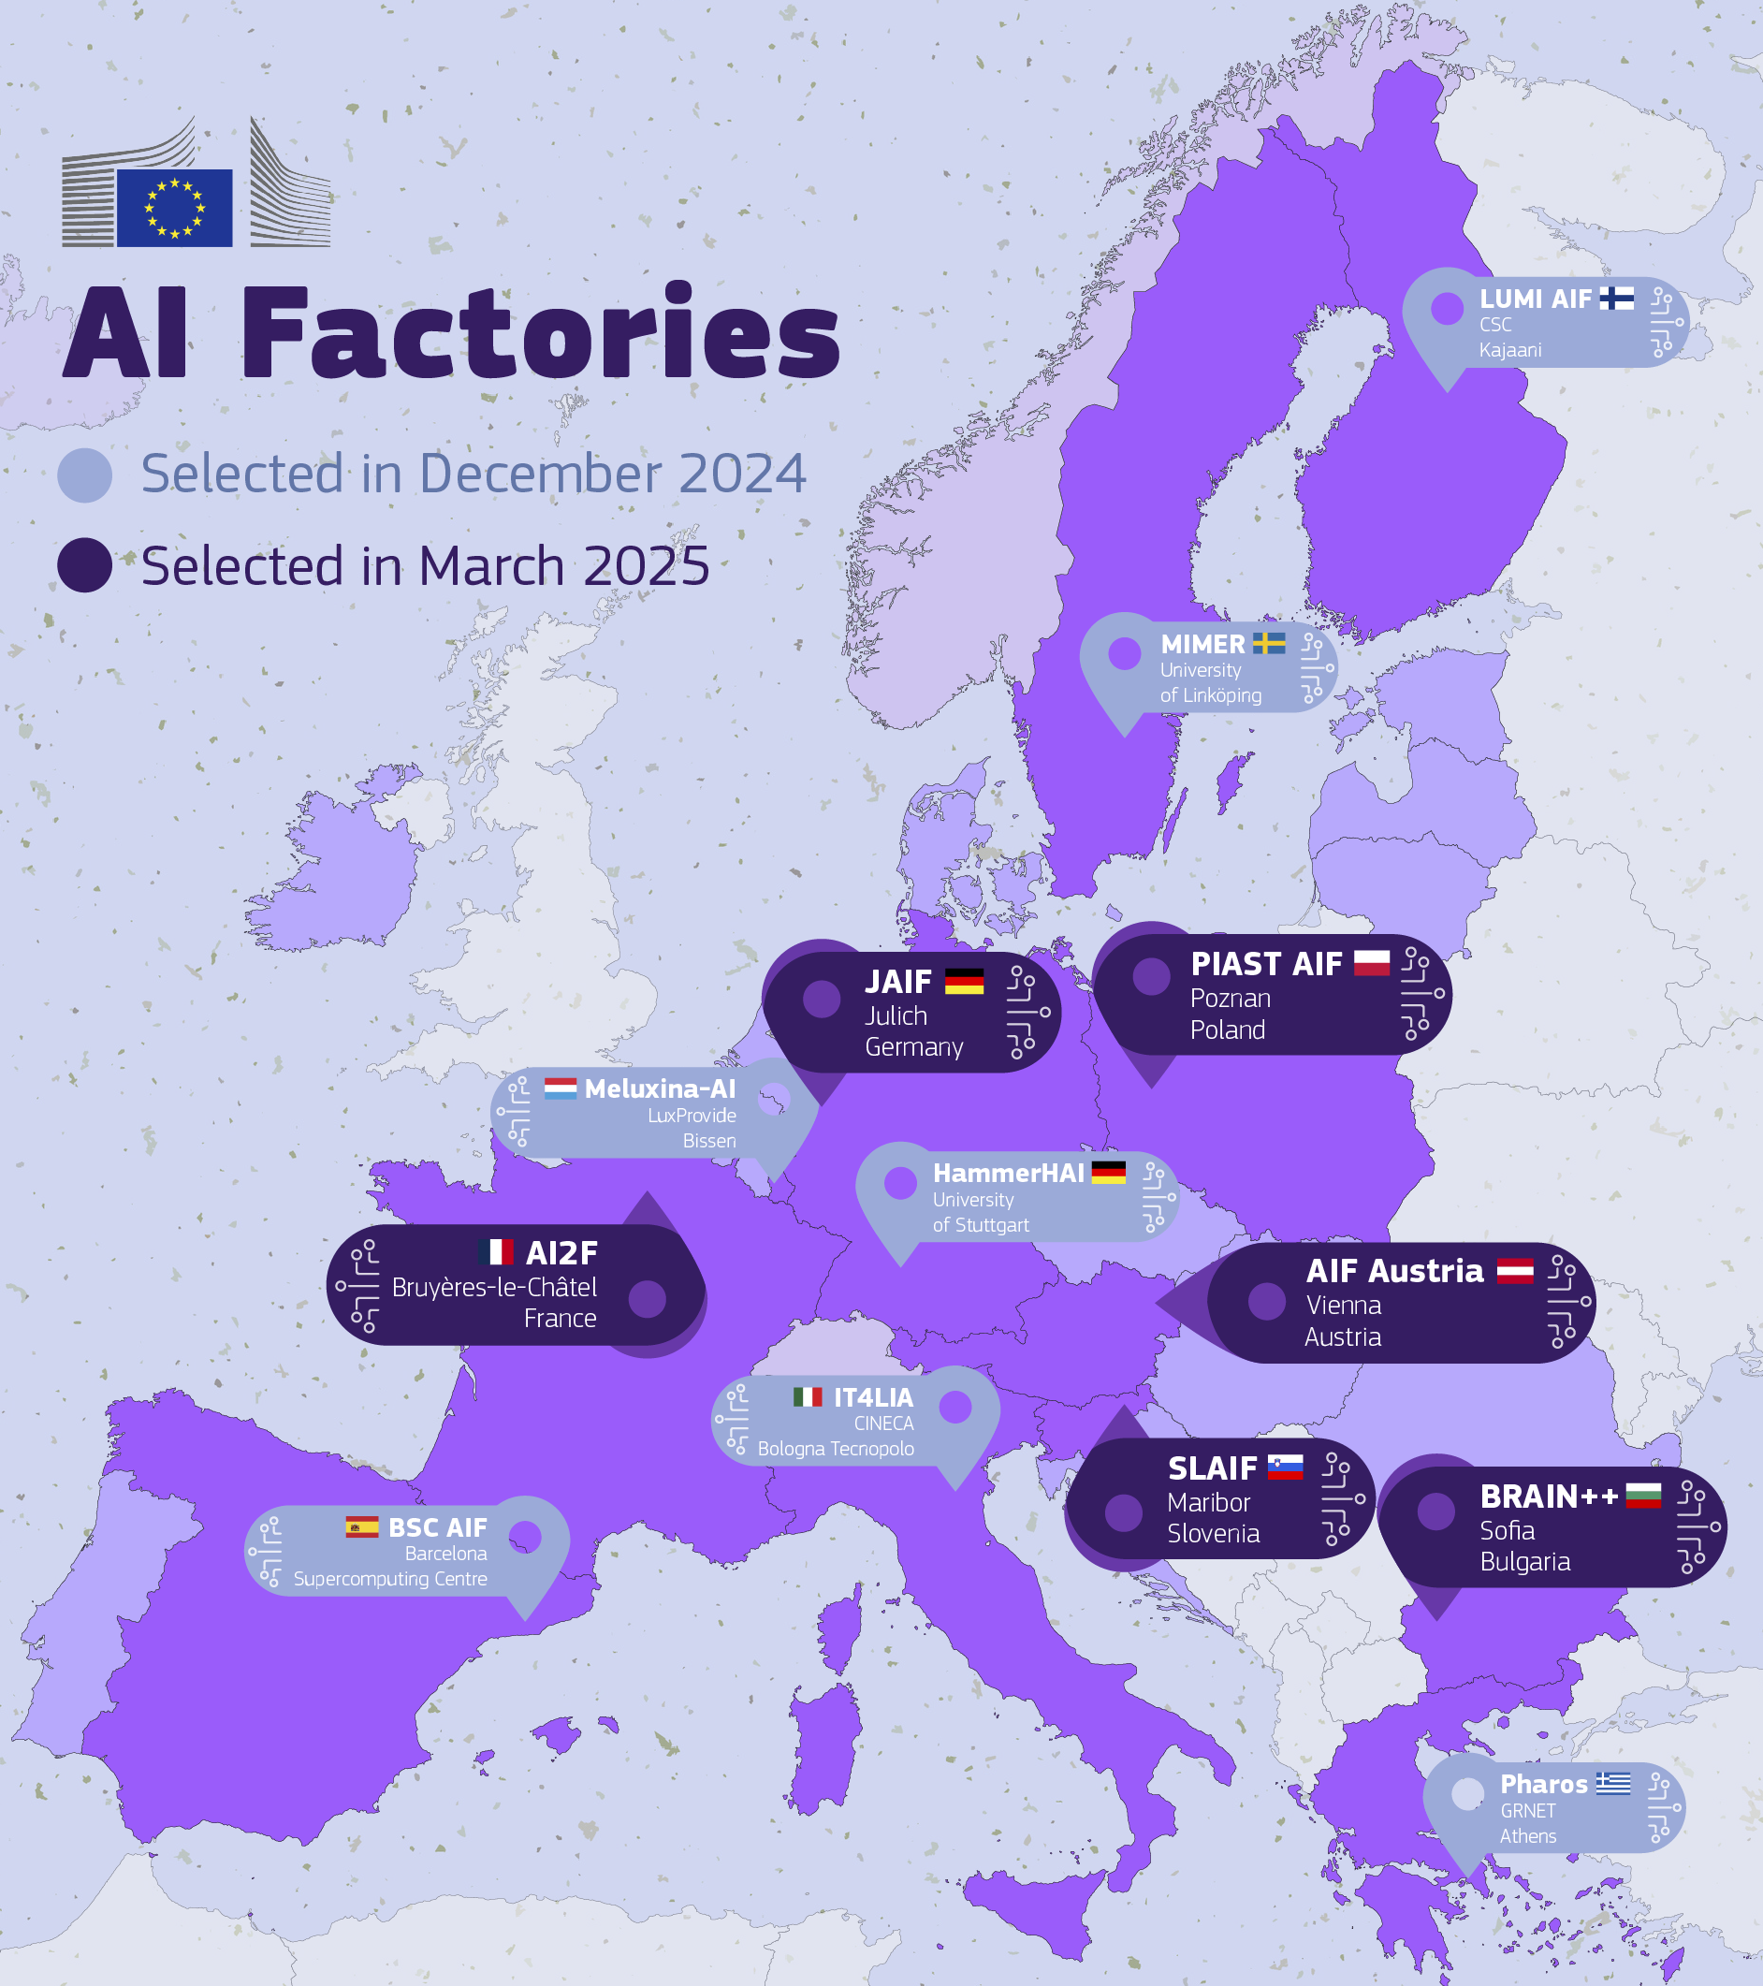
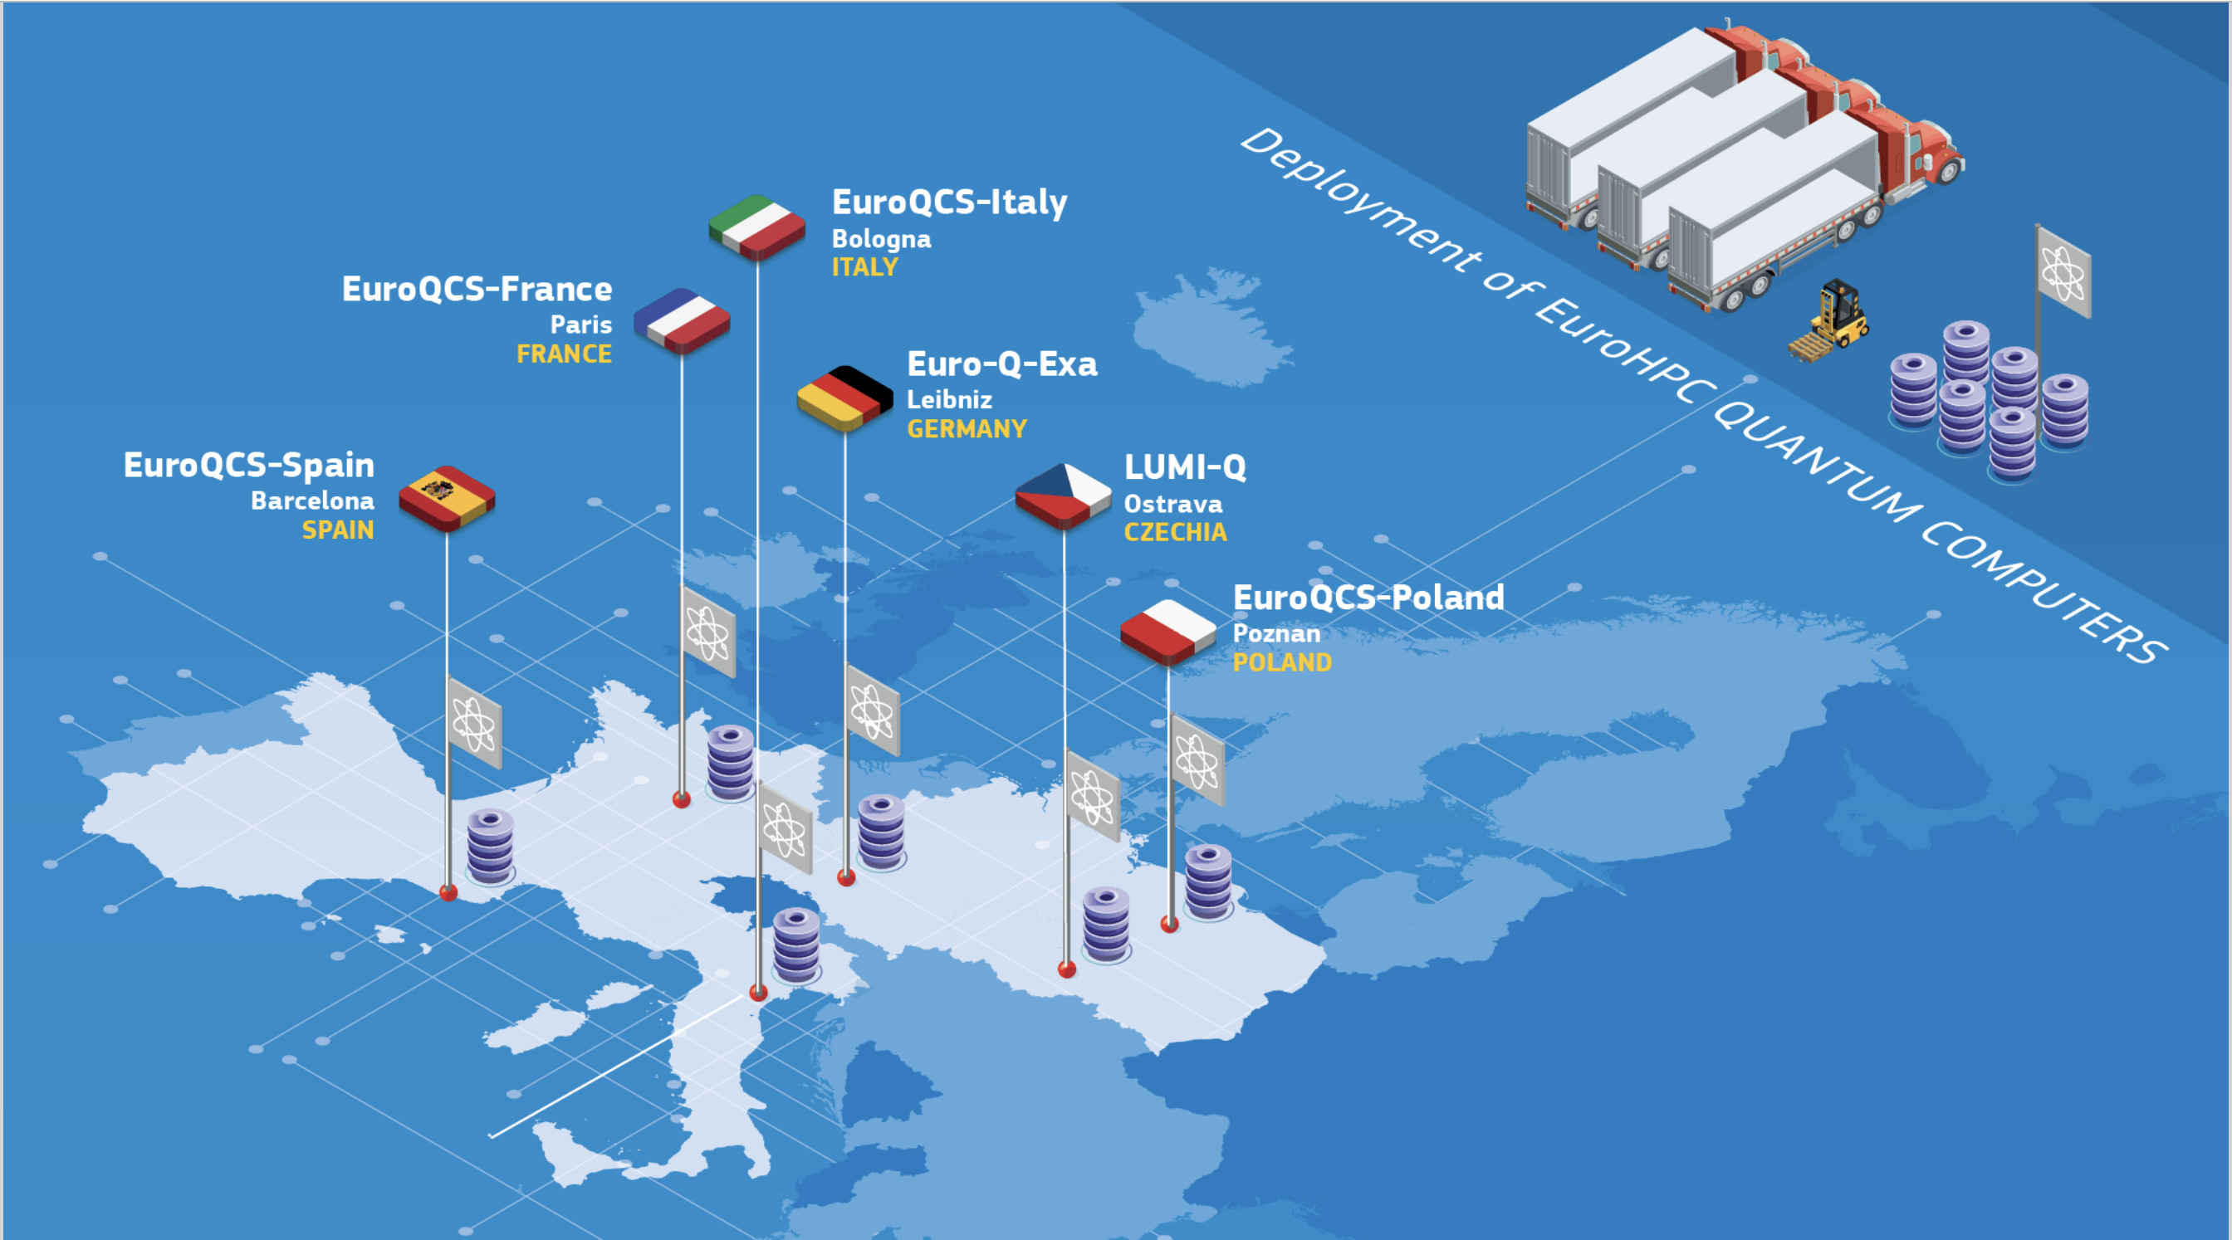
EFP Targets
Reaching Academia, Industry & SMEs, public sector through the federation of the EuroHPC JU:
Current supercomputers
AI Factories
Quantum Computers
Alice Recoque, Arrhenius, DAEDALUS, Deucalion, Discoverer, JUPITER, Karolina, Leonardo, LUMI, MareNostrum 5, MeluXina, Vega.
BSC AIF, HammerHAI, IT4LIA, LUMI AIF, Meluxina-AI, MIMER, Pharos
AI2F, AIF Austria, BRAIN++, JAIF, PIAST AIF, SLAIF
…
Euro-Q-Exa, EuroQCS-France, EuroQCS-Italy, EuroQCS-Spain, EuroQCS-Poland, LUMI-Q,

Slide 4
EFP Targets
Connections to other federation efforts such as EOSC, SIMPL, FENIX and support to flagship initiatives like Destination Earth

Slide 5
The federation platform
"The EuroHPC Federation platform provides a one-stop-shop for accessing and utilizing EuroHPC systems and services to their fullest potential"
The platform will provide:
Unified solution for users to manage their access and resources across all EuroHPC systems.
Unified software offering across the systems to reduces the cost and complexity of migrating workloads or utilizing multiple systems in complex workflows
Advanced graphical interface for:
Creation and management of workflows
Interactive computing using powerful domain specific tools
Novice users
Features for power users accustomed with direct access to systems and APIs
Smart scheduling capabilities to optimize compute usage and increase the level of abstractions for the provided compute capacity

Slide 6
EuroHPC Federation platform design principles
Modular Architecture
components that can be independently developed, upgraded, and combined.
API-First
EFP is designed for easy integration with thematic, regional and national systems using APIs
User-Centric
Focus on user experience and usability
Empowering different domains, like AI and Industry
Data Privacy and Security
Robust security and data privacy measures are prioritized
Scalability and Performance
Scale efficiently as user and stakeholder demands increase and become more diverse
Open to Innovation
open and accessible IT platform, reduces the risk for vendor lock-in, and enhances interoperability with other systems
Industry Standards
Development, Operations and Interoperability

Slide 7
Technical implementation

Slide 8
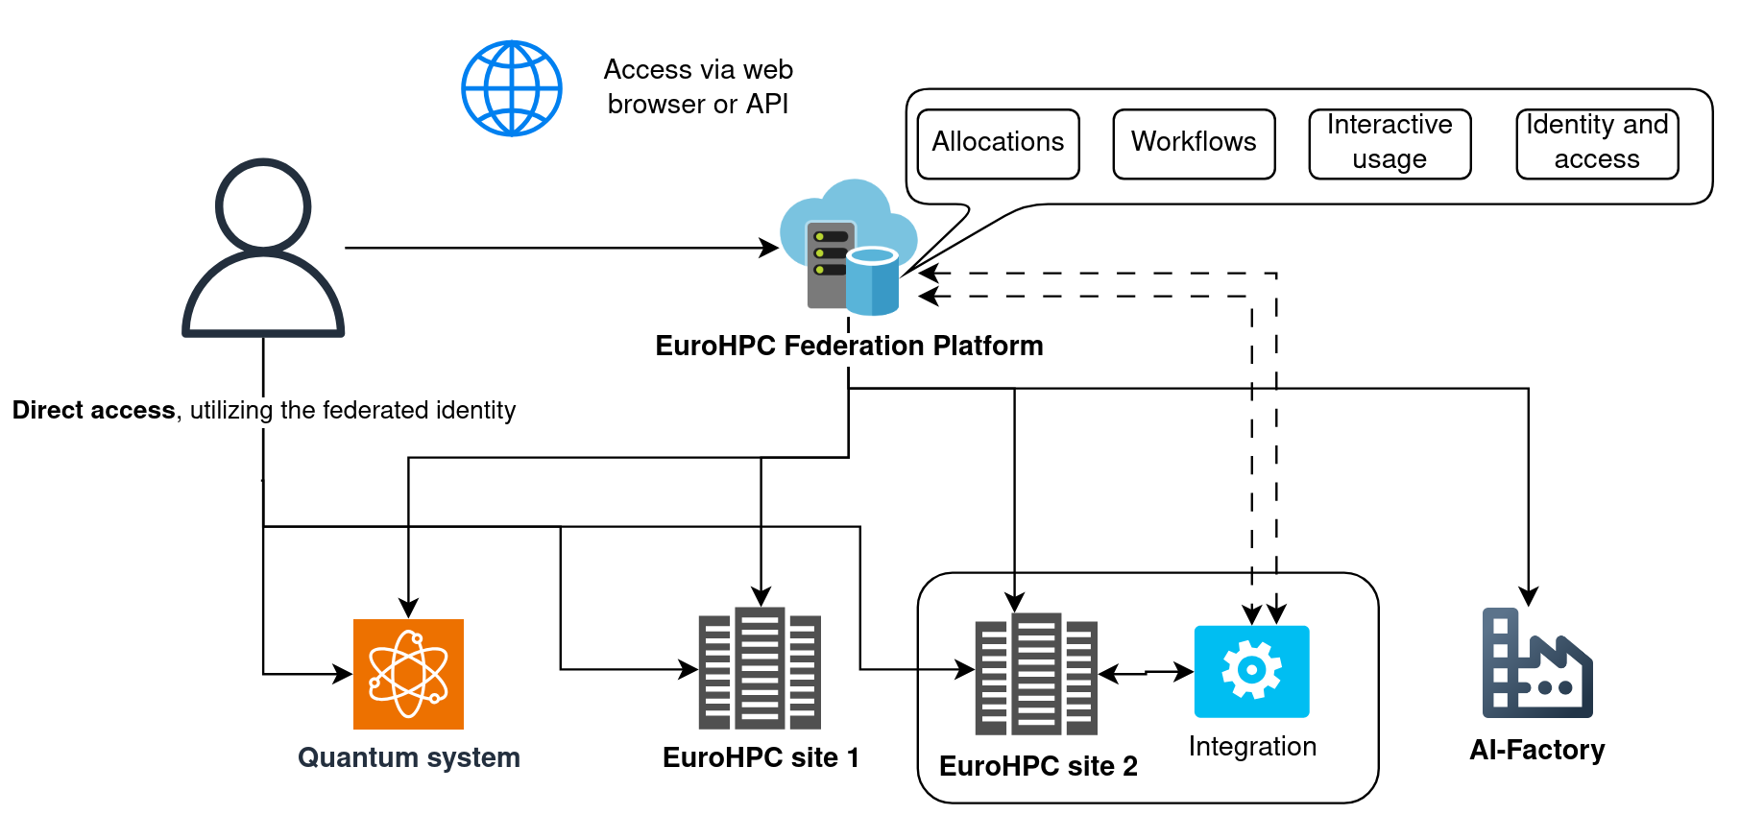
EFP Architecture

Slide 9
EuroHPC Federation platform design principles
Main features:
Federated identity and Single-Sign-On (SSO). Users utilize the same login and identity (e.g. granted via their home institution or national identity provider) to authenticate to all services and systems. Process for onboarding Industry. EFP AAI
Resource allocation, management and monitoring across systems. Users can view and manage their allocations and project members across all systems. EFP ALLOCATIONS
Interactive web-based usage with e.g., remote desktop, command line, AI training monitoring and Jupiter notebooks. Ability to launch batch jobs and browse files on the supercomputers. EFP INTERACTIVE
Federated software catalogue providing a pre-installed pseudo-uniform software stack on all systems. Advanced discoverability features for available software. EFP SOFTWARE LISTING
Advanced workflows and data transfer. Workflow execution and data transfers across systems. smart scheduling capabilities. High level graphical interfaces for creating and managing workflows. EFP WORKFLOWS
Direct access utilizing SSH certificates. Short lived certificates which are obtained via a login flow with Multi Factor Authentication MFA for increased security. EFP AAI

Slide 10
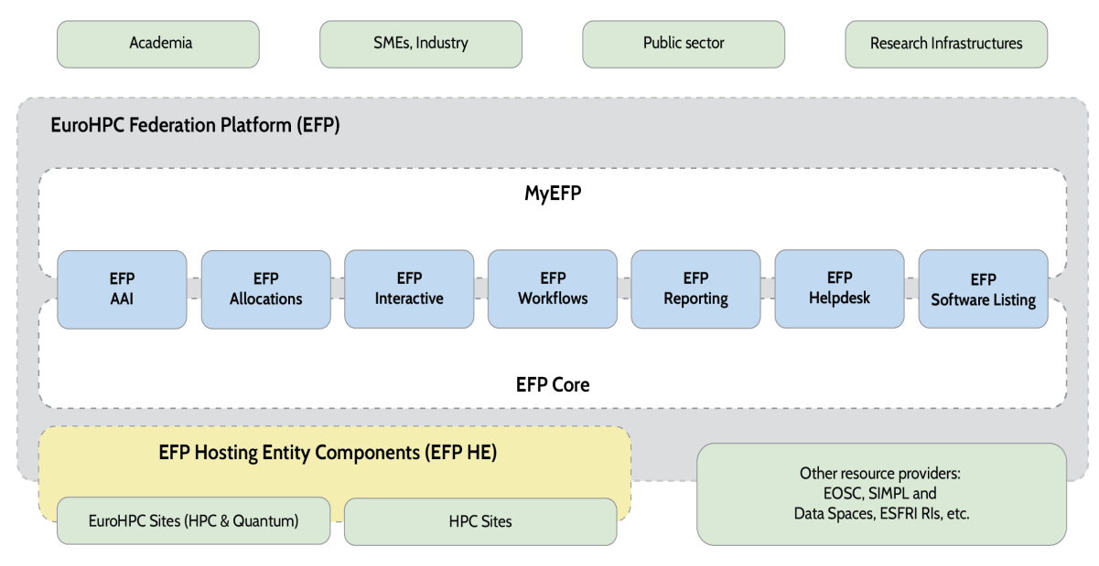
EFP Architecture

Slide 11
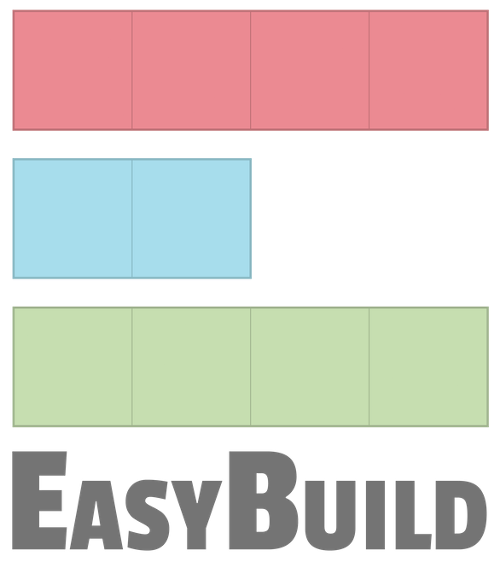
EuroHPC Federation platform design principles
The major components of the platform are all based on open-source technologies which are already in production use on several systems and have active communities.
Leveraging previous investments into European solutions
The hosting entity components, i.e. the "glue" between the federation platform and the EuroHPC systems, are developed using a co-design methodology to account for the special features for each system but also create generic integration blueprints for integrating future systems

Slide 12
Timeline
Started January 2025
1st phase (2025-2026) The development of a Minimum Viable (Federation) Platform (MVP) covering six key areas including federated AAI, resource allocations, and complex workflow manager including smart scheduler.
1st release: Q1/2026 with integration to currently online EuroHPC systems
2nd phase (2027 – 2029) - Focus on the development of further enhancements and integration of new systems

Slide 13
EFP: Phase 1 (2025-2026)
1.1.2025
Start of the project
2025 Q3
Technical Roadmap and documentation: 1st release
2026 Q1
1st release with 9 Hes/AI factories integrated
2026 Q4 2nd release integration with the remaining EFP components and the remaining HEs, AI factories and quantum systems and
Initial integration of Fenix, SIMPL and EOSC
2026 Q3
Integration with the peer review platform

Slide 14
EFP: Phase 2 (2027-2029)
2027 Q4
3rd release
Further integration of Fenix, SIMPL and EOSC and initial integration of other data lakes/repositories etc
2028 Q4
4th release
Complete integration of Fenix, SIMPL and EOSC and integration of other data lakes/repositories etc
2029 Q3
5th release
2029 Q4
Final EFP Technical Roadmap, including governance and service portfolio

Slide 15
The consortium delivering the platform:

Slide 16
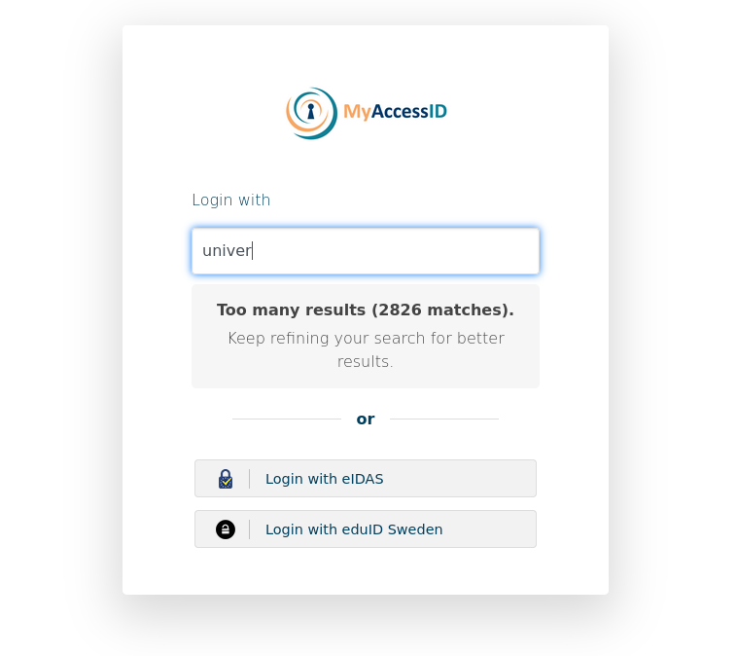
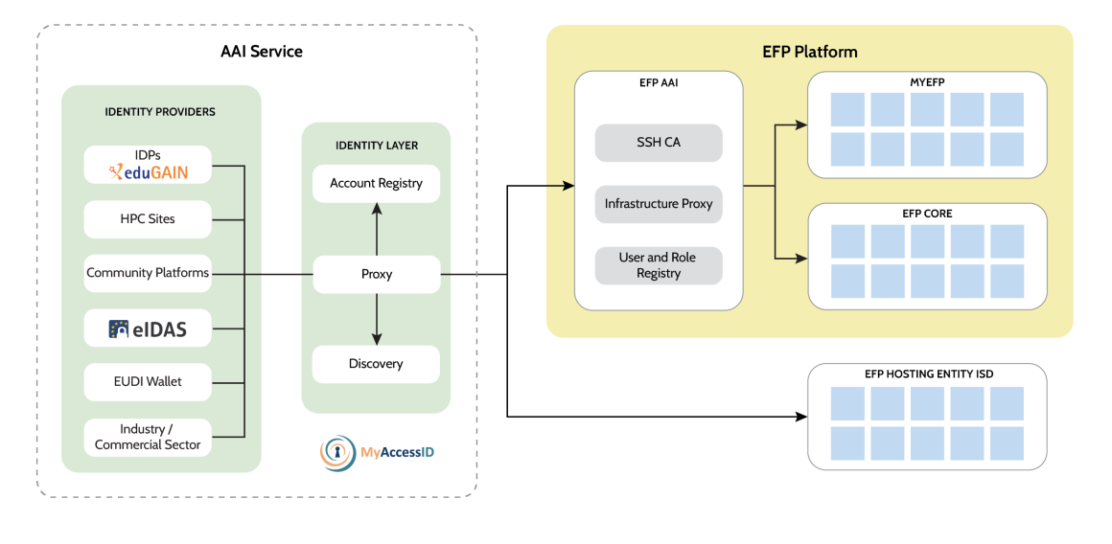
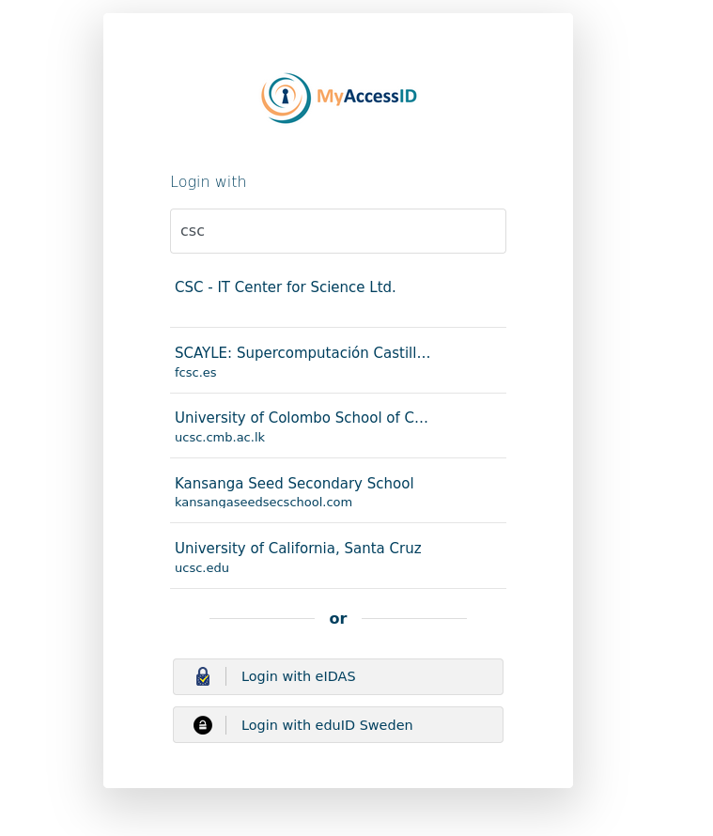
EFP AAI:
EFP Utilizes MyAccessID for identity federation, but does not provide it
Simplified -> an AAI Proxy + Discovery service + Account registry
MyAccessID can be integrated as an OpenID Connect Provider or SAML Identity Provider
Identity federation can also be utilized directly without going through the platform
SSH CA for direct access to the systems

Slide 17
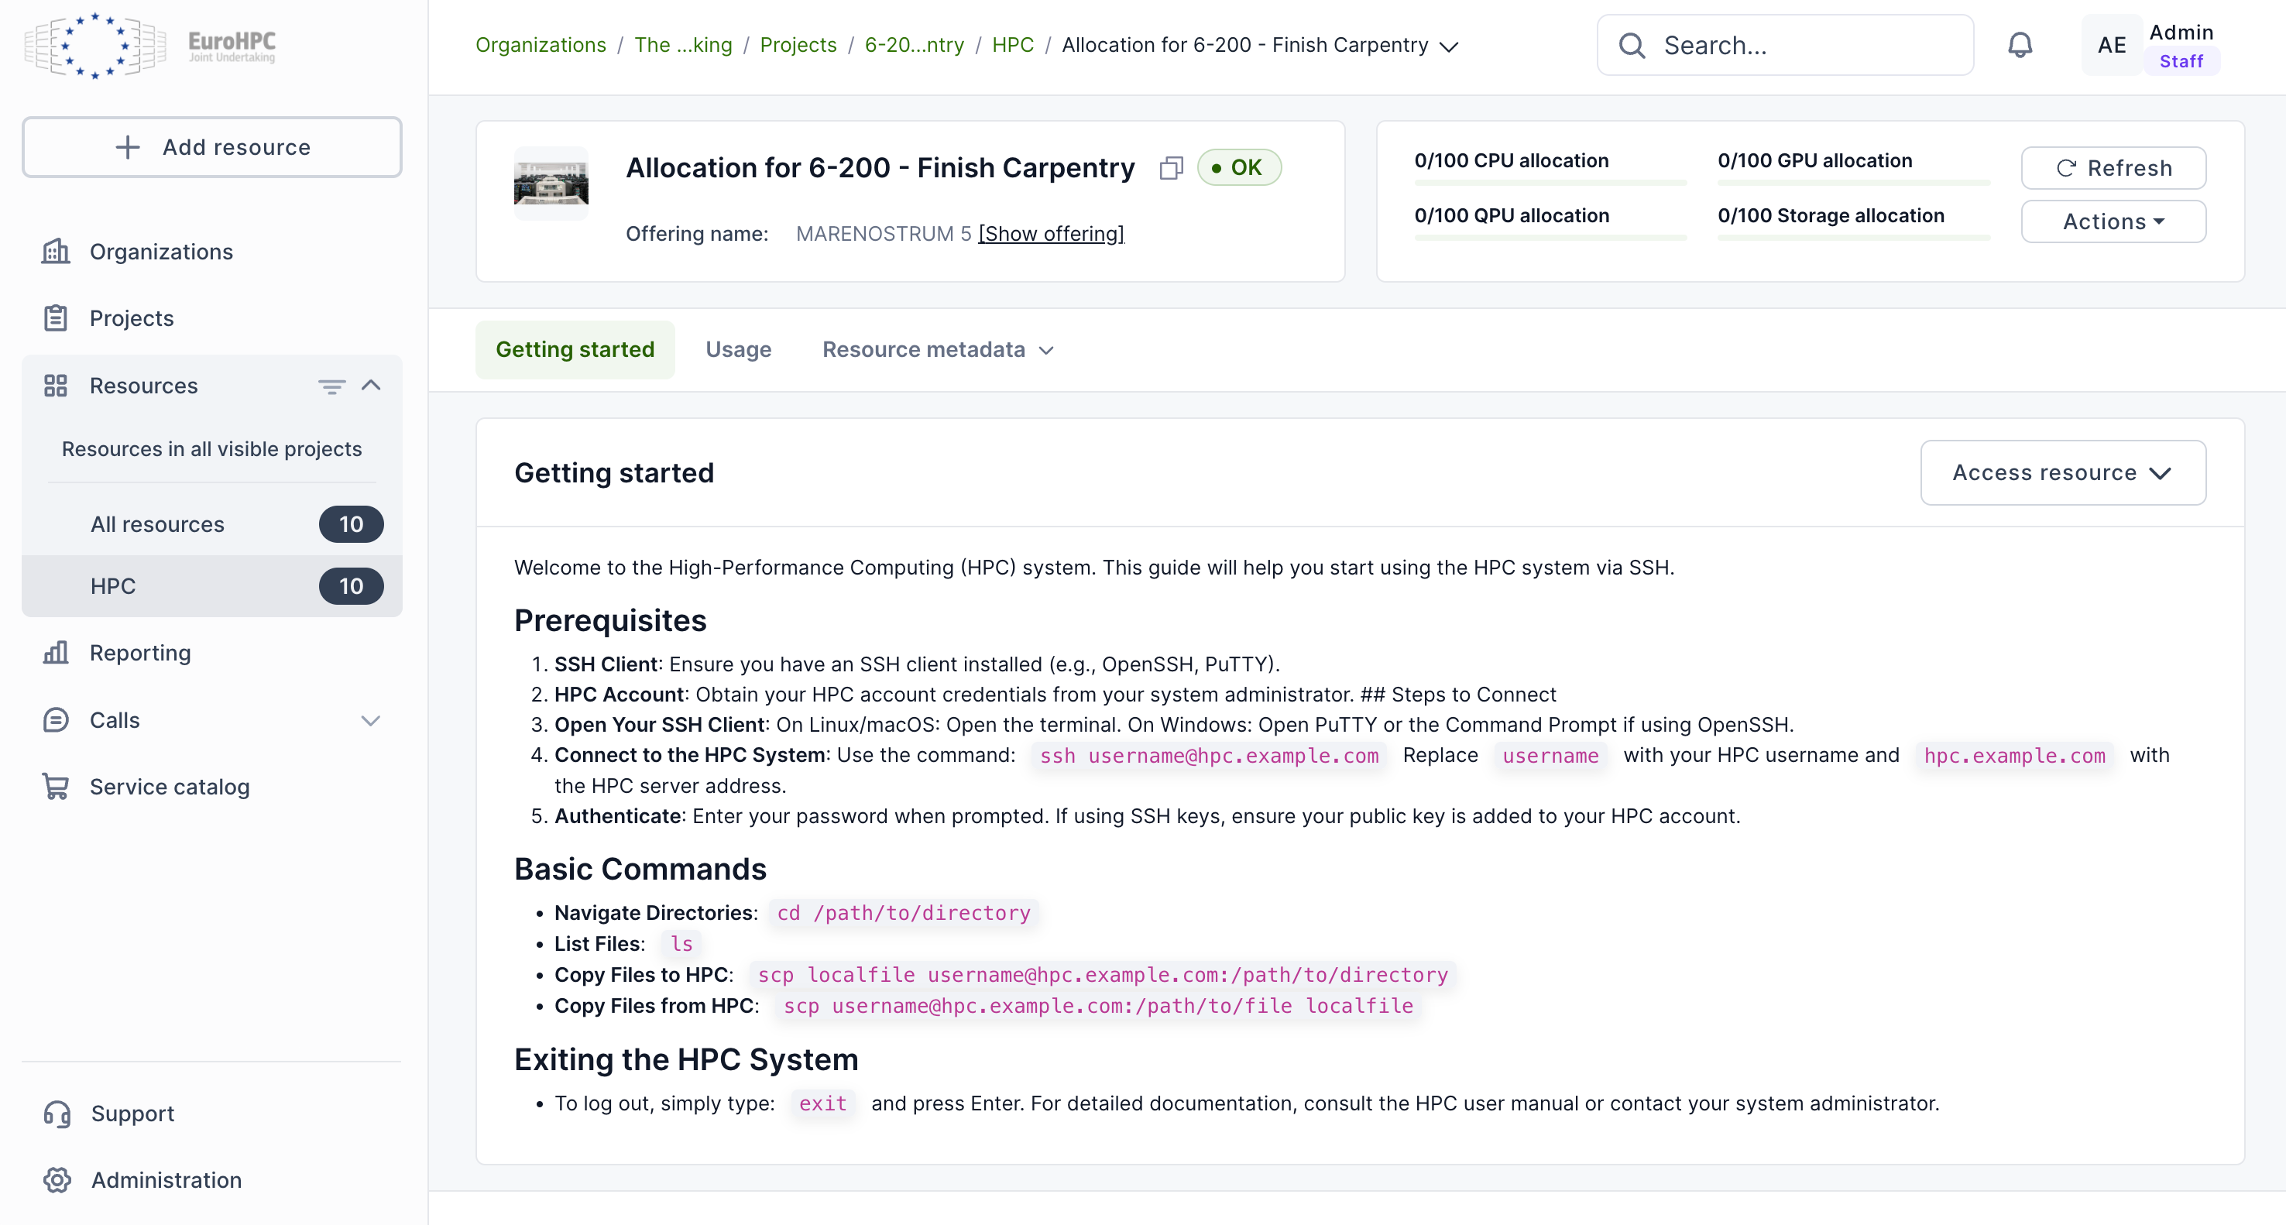
EFP Allocation:
Provides a unified allocation and project membership management capability
Users and resource management portal provides project-centric dashboards.
EFP Allocations allows project members to see and manage their allocations, request new ones either directly or via published calls for access.
Resource allocations for EuroHPC systems will be done via a separate EuroHPC Peer-Review Platform.

Slide 18
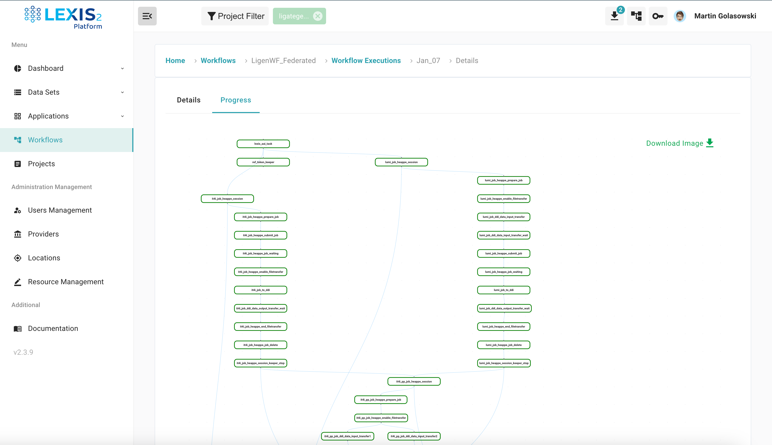
EFP Workflows:
Easy access to visually managed workflows and distributed data management across the federated resources.
Also allows API usage from various languages like Python or R.
Smart scheduling policies across federated resources in workflow executions based on metrics from HPC sites.
Multi system workflows
Data staging from external sources
Multiple backends e.g HPC batch scheduler and kubernetes
HEAppE Middleware: REST API for restricted access to HPC infrastructure

Slide 19
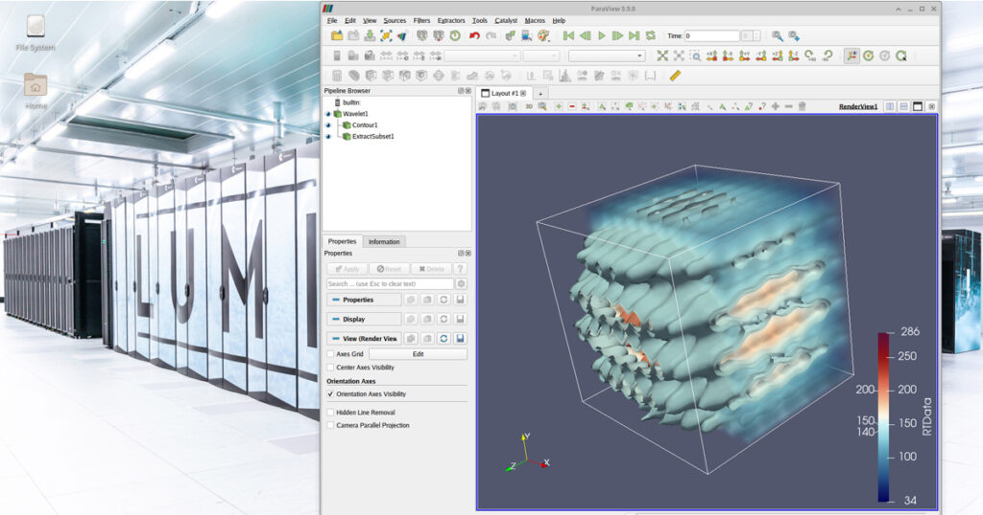
EFP Interactive:
Easy to use web interface for new and industrial users to be in interactive mode with HPC
Applications like Jupyter notebooks, remote desktops and shell
Fine-grained job level management and file management across the federated resources.

Slide 20
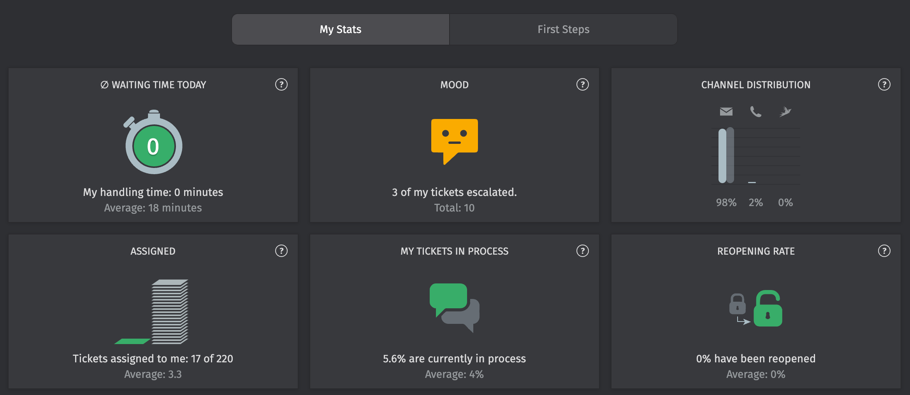
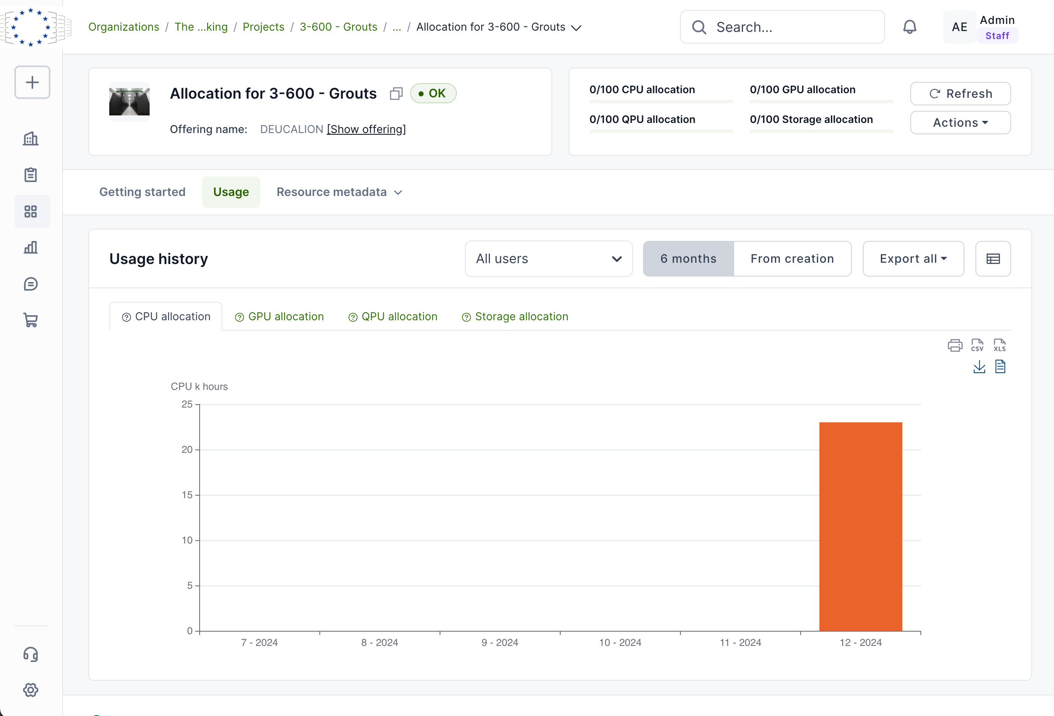
EFP Helpdesk:
It's a helpdesk/ticketing system
Centralized reporting solution
Resource consumption monitoring across different centers
EFP Reporting:

Slide 21
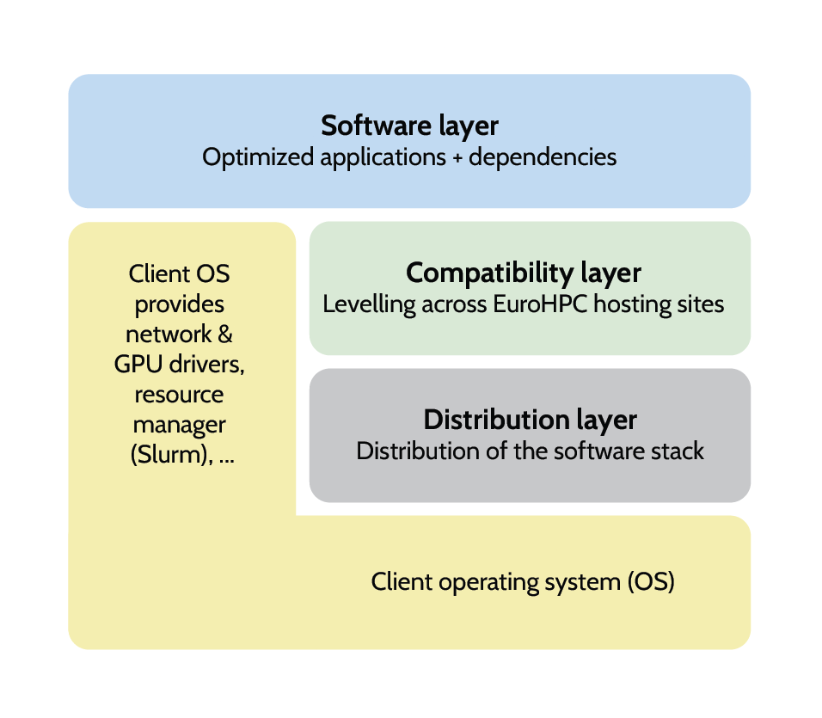
EFP Software catalogue:
The EuroFP Federated Software Catalogue component will manage the heterogeneity of the different system architectures
So ideally, basic users would not need to care about the underlying GPU or CPU architecture.
Available also for other systems, enabling the journey from laptop to tier 0 system.
The Federated Software Catalogue is based on the European Environment for Scientific Software Installations (EESSI)
Precompiled architecture optimized binary distributions of common scientific software
EFP Software Listing provides list of the available software

Slide 22
Thank you!

Slide 23
Hyper-Connectivity for HPC Resources
Study and the Open Tender
Dr. Christos DATSIKAS
Programme Manager, EuroHPC JU

Slide 24
Purpose of the Study
Objective: To define a hyperconnectivity service for a secure, federated European HPC and data infrastructure, with a final target of achieving terabit-per-second (Tbps) connectivity
Scope: Requirements analysis, network architecture, and service design
Key Findings and Gaps
Identified bottlenecks in data access and network performance
Different levels of security practices across HPC sites
Wide satisfaction with current networks (GEANT, NRENs), but a need for upgrades to meet future demands
Technical Specifications in a nutshell
EuroHPC JU will not build or operate the network; rather pay for a service
- Serve a wide range of Points of Interest (PoIs) across Europe
- Network-as-a-Service model.
Performance requirements: 99.99% availability, <0.1% packet loss
Integration with cloud providers and support for “jumbo” frames
Author and Date

Slide 25
From Study to Action: Where We Stand
The study was concluded in October 2024 and its Summary Report has been published by the EU Public Office
Based on the study findings and consultations, the bundle of documents for the hyperconnectivity open tender was prepared and the tender was launched on the F&T Portal on 16 December 2024
Proposal submission deadline: 14 March
Maximum contract duration: 48 Month
Currently in the evaluation phase of submitted proposals.
Author and Date

Slide 26
Thank you
for your attention!

Slide 27
Black Mamba Project
Jean-Gabriel BARTHELEMY - j-g.barthelemy@linguacustodia.com

Slide 28
Lingua Custodia is a company founded in 2011 based in Paris and Luxembourg. It masters the entire value chain of generative AI to offer secure, specialised, sovereign and frugal artificial intelligence solutions which deliver a true ROI for its regulated customers. Lingua Custodia provides three core values:
Specialized : We believe in specialized models that outperform big ones on specific tasks
Sovereign : We use exclusively european cloud providers and possess all technical verticals
Frugal : We focus on efficiency in all aspects: capital, inference and training
SAMPLE CLIENTS
LE LAB – RESEARCH AND DEVELOPMENT
Lauréat France 2030
Founding Member
2024 Winner Large AI Grand Challenge
Provides webinars and training programmes focused on the latest AI research and innovation
Certified member
Collaborates with clients’ innovation teams to publish joint research papers (Recent research paper with BNP Paribas on AI published in December 2024)
4 R&D papers
published
annually
+10.000
Finance professional users
11
Languages
+50
Clients
Creation of a foundation LLM specialised in finance as part of a joint project with French financial media L’AGEFI
Jean-Gabriel BARTHELEMY - j-g.barthelemy@linguacustodia.com

Slide 29
AI MODELS DEVELOPMENTS
We develop, test and put in production AI models that can enrich our own application suite or to directly address our clients’ specific requirements
LC AI Models / Recently released
LC AI Models / Work in progress
Fin-Pythia-1.4B model achieves 84% on financial sentiment analysis (FPB benchmark) while gpt-4 is at 78%
Dragon LLM – Foundation Large Language Model under Mamba architecture currently developed on EuroHPC with the support of the European Commission / frugal AI objective
Fin LC Translate 6.9 B model achieves higher scores than llama7b, mistral7b, Tower7B models in both general and finance translation domains
Financial LLM – Model developped jointly with the French financial media AGEFI with the support of the French State to answer specific use cases of financial institutions
ClassiFin - a classifier to identify financial related web pages
In Context Translation QA Model – Model developed in house to improve quality assessment of translation-related tasks
Datasets and benchmarks to evaluate models
Enlarged Translation LLM – Model developed to perform a multitude of translation-related tasks better than any other existing model
huggingface.co/LinguaCustodia
Jean-Gabriel BARTHELEMY - j-g.barthelemy@linguacustodia.com

Slide 30
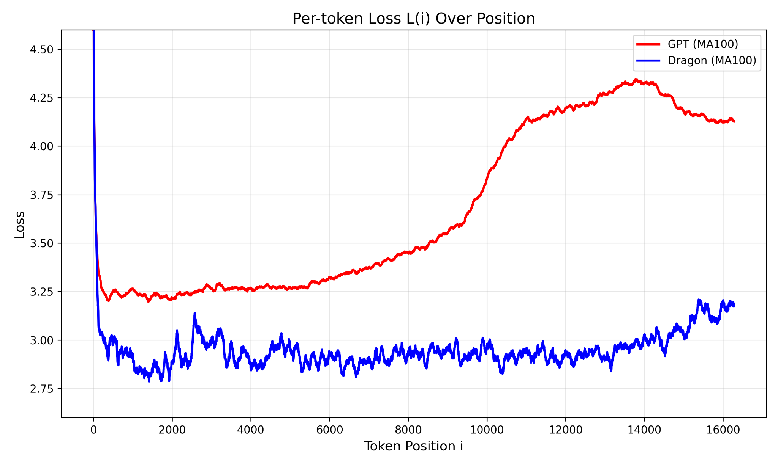
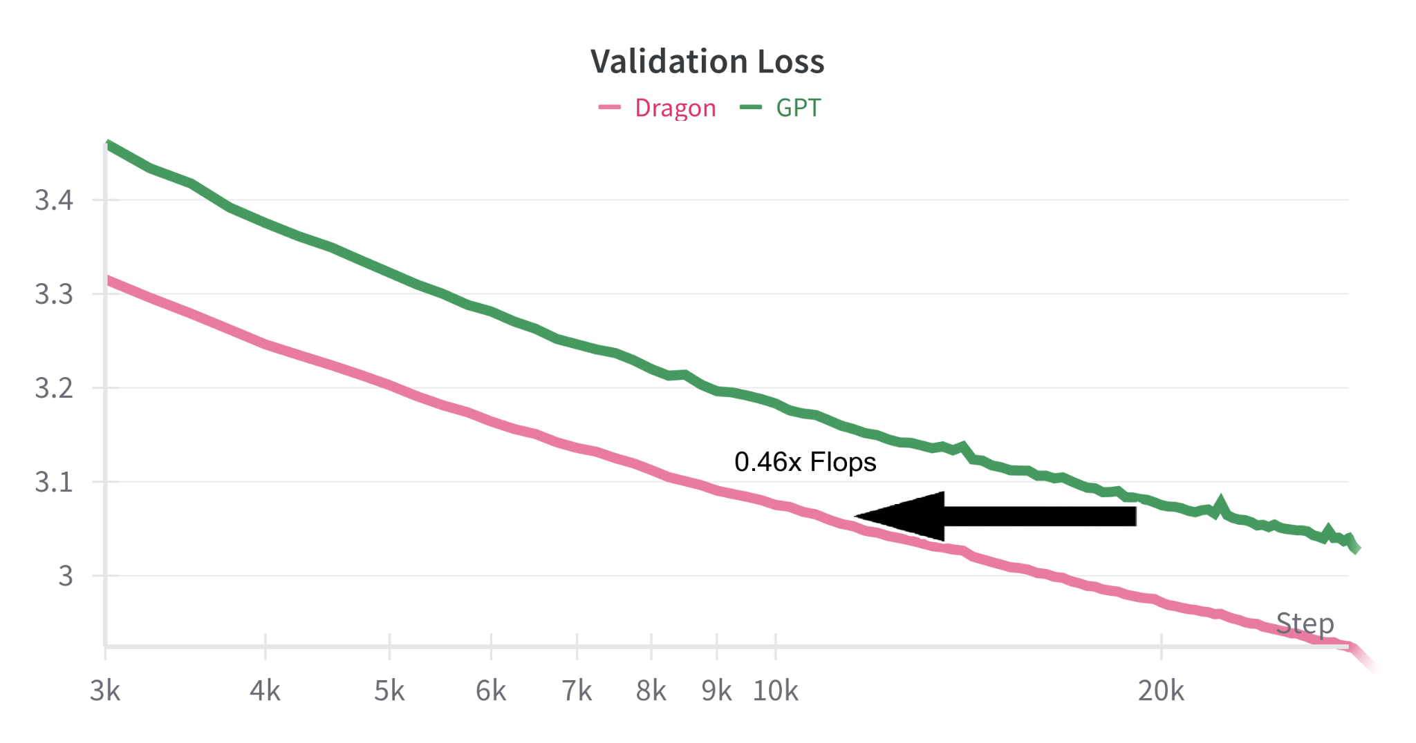
Black Mamba Project - Dragon LLM
Train an efficient and multilingual LLM
Objectives
Foundation Models
Hybrid architecture (2.5 faster inference, 75% KV Cache Reduction) leveraging state of the art Mamba architecture (GDN)
Performant architecture on long-context beyond training sequence length
Training on +10T tokens composed of 35 Languages mostly europeans
State of the art training techniques, 53% reduction in Flops to reach equivalent Llama architecture
3 sizes : 3B, 7B, 34B - open-source
Compute budget: 2 Millions hours on Leonardo HPC (Italy)
Jean-Gabriel BARTHELEMY - j-g.barthelemy@linguacustodia.com

Slide 31
The European Open Science Cloud (EOSC)
Bob Jones (EOSC Association & CERN)
ANNOTATION

Slide 32
EOSC in a nutshell
EOSC is the European web of FAIR data and related services for research
Research data that is easy to Find, Access, Interoperate and Reuse (FAIR)
Trusted and sustainable research outputs are available within and across scientific disciplines
What
Unlock the full potential of research data to accelerate discoveries and innovation
Why
Ensure that Open Science practices and skills are rewarded and taught, becoming the ‘new normal’
Enable the definition of standards, and the development of tools and services, to allow researchers to find, access, reuse and combine results
Establish a sustainable and federated infrastructure enabling open sharing of scientific results
How
EOSC Federation

Slide 33
Goals of the build-up phase of the EOSC Federation
By Q4 2025 the EOSC Federation will …
consist of several enrolled EOSC Nodes
have established a first operational governance and organisational structure, including clear description of the roles and responsibilities of its constituent bodies
have detailed the application process to become an EOSC Node, including assessment of organisational, legal and technical requirements
have established a first edition of Federation-wide policies, such as Rules of Participation, Access and Acceptable Use policies, cybersecurity, privacy and data protection
have established a first edition of the EOSC Interoperability Framework
have demonstrated cross-Node utilisation of some of the federating capabilities such as monitoring, accounting or helpdesk

Slide 34
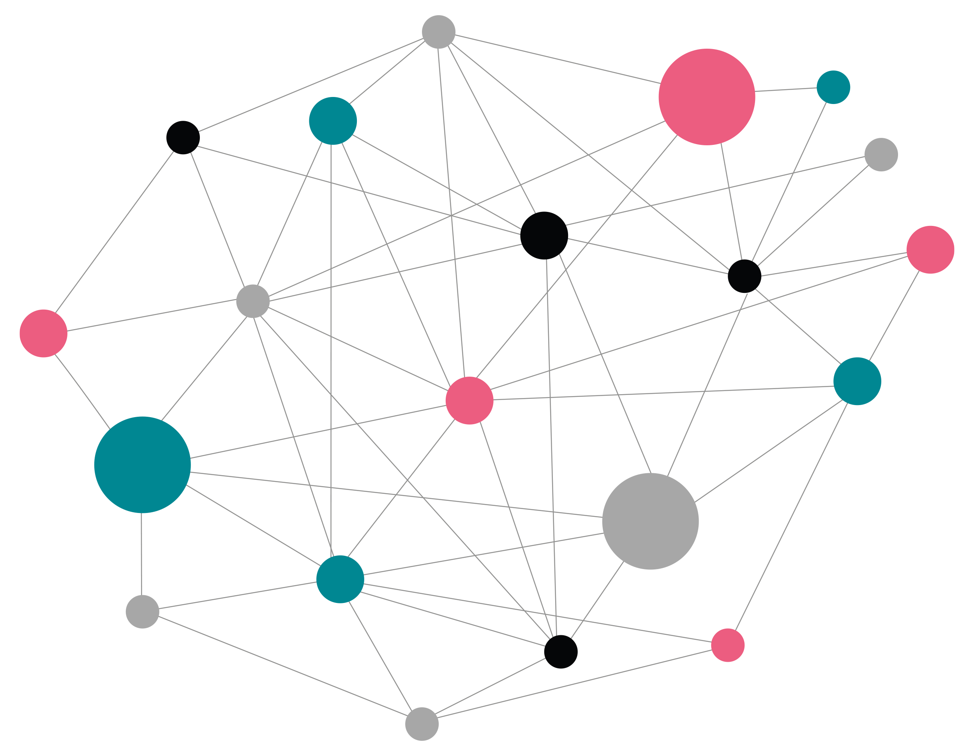
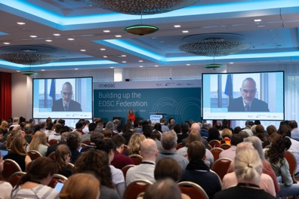
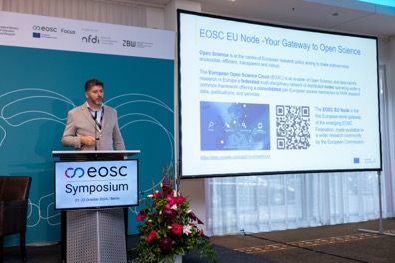
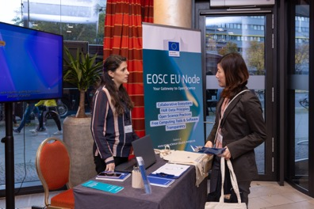
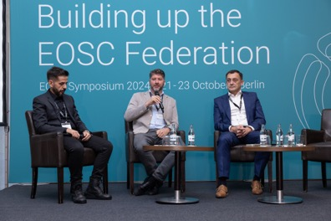
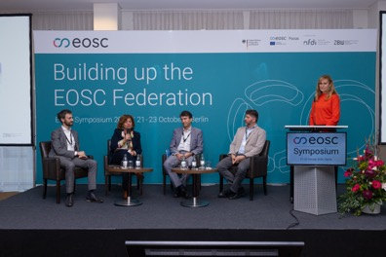
EOSC EU Node officially launched on 22 October 2024
As the first building block in the EOSC Federation, the EOSC EU Node makes a clear contribution to the adoption of Open Science principles across Europe.
Services offered by EOSC EU Node
Bulk Data Transfer: Move data effortlessly to data-intensive execution environments
Large File Transfer: Streamline large file transfers online with added security and integrity
Virtual Machines: Design and conduct experiments with flexibility while ensuring reproducibility
Cloud Container Platform: Deploy cloud-native containerised applications that can easily scale
Interactive Notebooks: Create and share documents with real-time code execution
File Sync & Share: Enable automatic file syncing and secure sharing across locations and teams

Slide 35
13 First Wave Nodes
https://eosc.eu/building-the-eosc-federation/

Slide 36
Integrated and federated HPC and quantum computing infrastructure
Kristel Michielsen
Jülich Supercomputing Centre

Slide 37
EU HPC – QCS Integration Strategy
Establish a pan-European federated hybrid high performance computer (HPC) – quantum computer and simulator (QCS) infrastructure, EuroHPC-QCS, with uniform, easy and affordable access for European scientific and industrial users.
Make various different QCS resources publicly available with training, support and services.

Slide 38
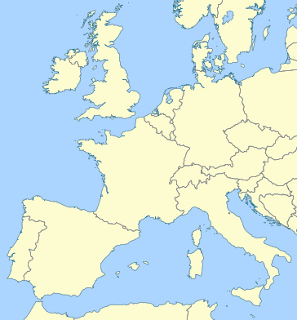
EuroHPC-QCS: EU Federated Hybrid HPC – QCS Infrastructure
EuroHPC-QCS
…
JUNIQ
JSC, Jülich, D
EuroQCS-Poland
PSNC, Poznań, PL
SURF
Amsterdam, NL
HPCQS
JSC, Jülich, D
HPCQS
GENCI/CEA, Paris, F
Meluxina-Q
LuxProvide, LU
2023
EuroQCS-France GENCI/CEA, Paris, F
Euro-Q-Exa
LRZ, München, D
LUMI-Q
IT4I, Ostrava, CZ
2022
EuroQCS-Spain
BSC-CNS Barcelona, ES
EuroQCS-Italy CINECA, Bologna, I
2021
2019

Slide 39
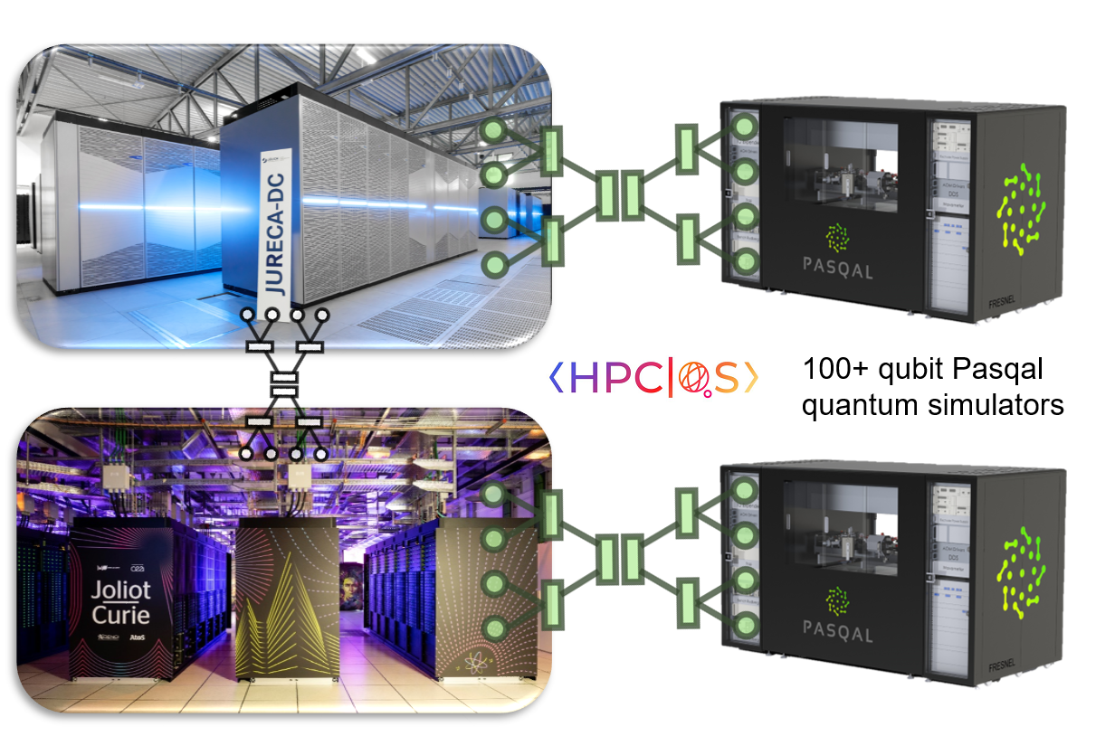
EUROHPC JU: HPC-QCS integration
HPCQS project
EuroQHPC-Integration project
QaptivaTM by Eviden
Programming environment
Access to quantum computing backends like the quantum simulator
Modular Supercomputing Architecture
For lowest latency integration of the quantum simulator
Developed in the series of EU-funded DEEP Projects
Based on ParTec’s ParaStation Modulo® middleware suite

Slide 40
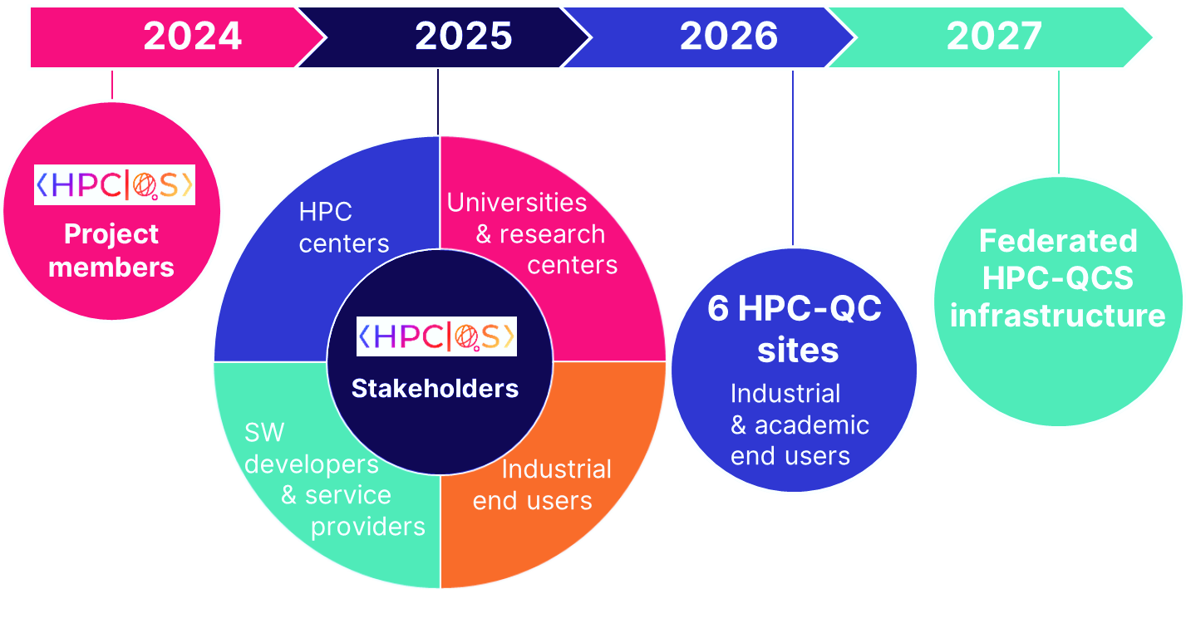
EuroHPC-QCS: Timeline

