Slide 1
Enabling SME and AI Communites to grow and scale Up with HPC
Jeanette Nilsson, AI Ecosystem expert RISE Member of RIAG
ANNOTATION

Slide 2
Structure of the session
Introduction of the theme
Presentation of the first panel on the user perspective
Presentation of the second panel with enablers and initatives
Summary and next steps

Slide 3
Panel user perspective
Kirill Blazhko, Founder and CEO of Tunell
Endri Deliu, AI Fellow EuroNCC Austria
Barbara Krasovec, System mananger VEGA, JSI
Mateusz Tykierko, Deputy Director , WCNS
Johan Kristiansson, Senior Researcher RISE

Slide 4
Enablers and Initatives
Lilt Axner, Programme Manager Infrastructure, Euro HPC JU
Natalie Lewandowski, Head of Business and and project management, HLRS
Ana Garcia Robles, Secretary General, BDVA
Jaume Cot, EU project team leader , Zabala Innovation
Diana Almeida, Enviroment & Acoustics researcher , Blue Oasis

Slide 5
Lilits slides
Please, exhange this for Lilit 2 slides,

Slide 6
Author and Date

Slide 7
Author and Date

Slide 8
Industry-driven
research and innovation Data and AI community with 250 members all over Europe.
And growing!!
Digital Transformation and Digital Decade
Data Strategy
AI Strategy
European Ecosystem
BDV cPPP
AI, Data and Robotics Partnership
EuroHPC JU
Data Spaces
Business Alliance (DSBA)
Other collaborations
Standard. Bodies…
430 M€ public and 2,26 B€ private investment

Slide 9
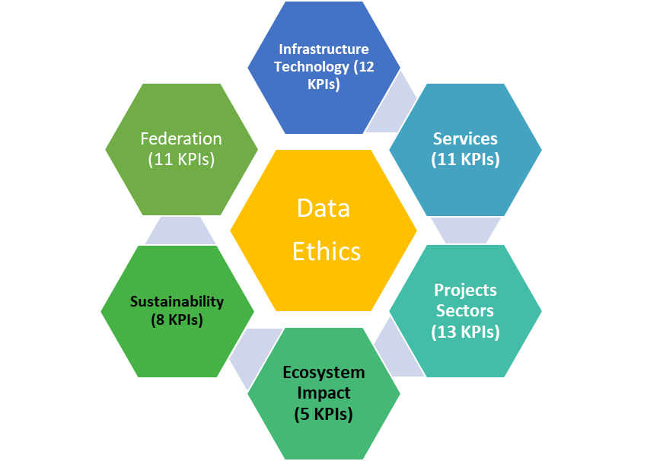
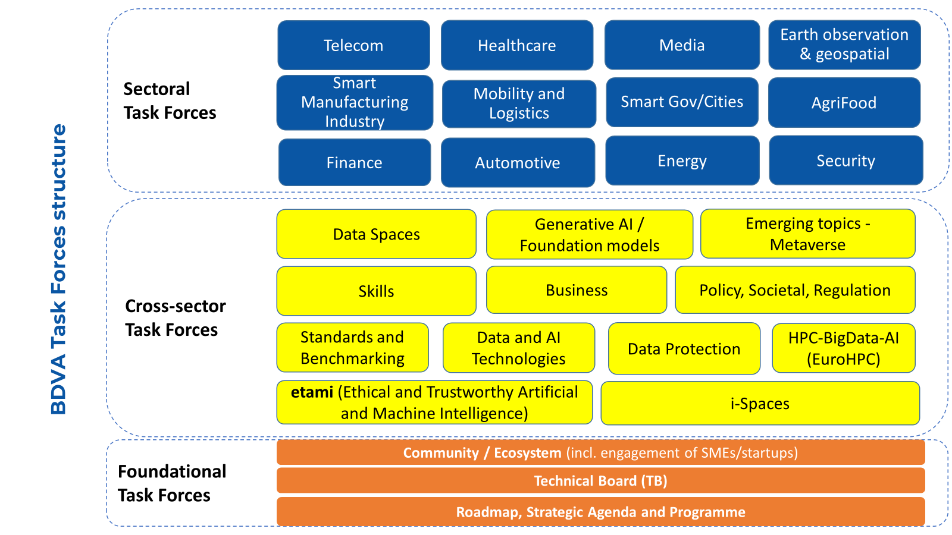
BDVA labelled i-Spaces
Data Spaces
AI Networks
Testing and Experimentation Facilities (TEF)
HPC
eDIH (in BD and AI)

Slide 10
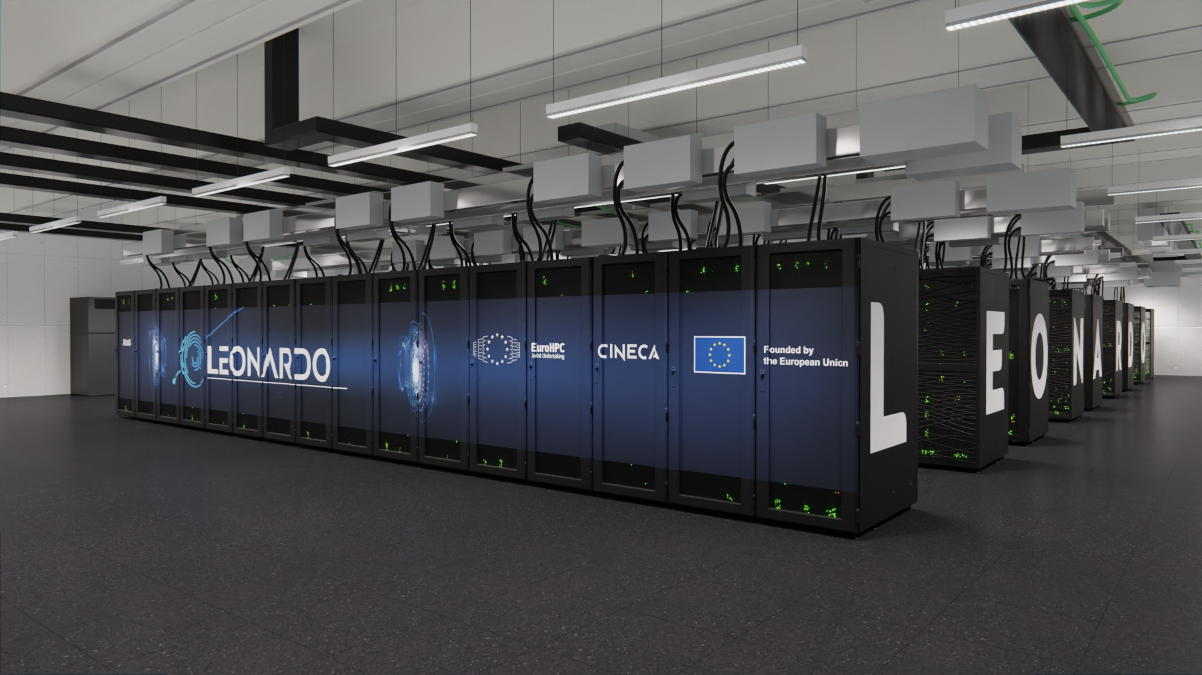
Large AI Grand Challenge
Reward Innovative startups and SMEs
Development of innovative Large Language Models
4 winners
1M€
8 million GPU hours

Slide 11
Open Challenge Prize Program
Benchmark for the EU AI community
Opportunities
New AI Grand Challenges
To define the next AI open innovation competitions/challenges, provide datasets, share problems, exchanges knowledge and experiences, etc.
Academia and industry
Solving real-world problems, winning rewards, gaining visibility among industry leaders, showcasing skills, accessing networking opportunities, etc.
Business
Breakthrough solutions, uptake of developed algorithms/solutions, meeting the needs of user industry, economic growth, talent development, etc.
Invest and collaborate
Access to innovation, outstanding talent and the best research teams, recruitment opportunities, exposure and brand visibility, networking

Slide 12
Diana slides
Please, exhange this for Dianas slides

Slide 13
Panel, Enablers and Initatives
Lilt Axner, Programme Manager Infrastructure, Euro HPC JU
Natalie Lewandowski, Head of Business and and project management, HLRS
Ana Garcia Robles, Secretary General, BDVA
Jaume Cot, EU project team leader , Zabala Innovation
Diana Almeida, Enviroment & Acoustics researcher , Blue Oasis

Slide 14
Enabling SME and AI Communites to grow and scale Up with HPC
Thank you
ANNOTATION

