Slide 1
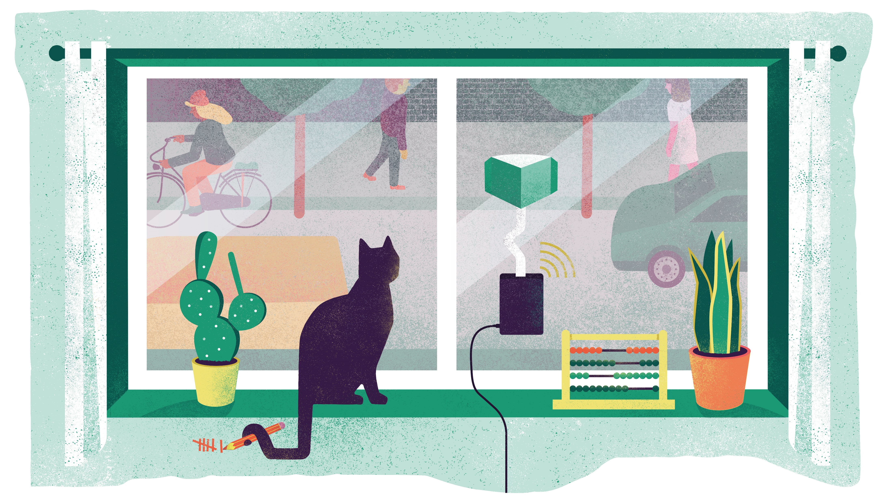
We Count
Using our senses to better understand and improve cities

Slide 2
Notes:
Who has ever heard of climate change?

Slide 3
Notes:
WEEK 1

Slide 4
Notes:
WEEK 1

Slide 5
Notes:
WEEK 1

Slide 6
Notes:
WEEK 1

Slide 7
Notes:
WEEK 1

Slide 8
Notes:
WEEK 1

Slide 9
Notes:
WEEK 1

Slide 10
Notes:
WEEK 1

Slide 11
Did you know…transport represents almost 25% of Europe's greenhouse gas emissions and is often the main cause of air pollution in cities.
Notes:
Did you know…transport represents almost a quarter (25%) of Europe's greenhouse gas emissions and is often the main cause of air pollution in cities.
Source: https://ec.europa.eu/clima/policies/transport_en

Slide 12
Notes:
When we look closer at the data we see that some types of transport are bigger contributors than others.
Shout out what type of transport is contributing the most to greenhouse gas emission (A = road transport)
What percentage of this 73% do you think comes from cars?
Key:
Planes
Road transport
Ships/maritime
Trains
Source: https://www.eea.europa.eu/data-and-maps/daviz/share-of-transport-ghg-emissions-2#tab-googlechartid_chart_13

Slide 13
Notes:
44% of this number comes from car. Did that surprise any of you?
Heavy vehicles, i.e. lorries and buses
https://www.eea.europa.eu/data-and-maps/daviz/share-of-transport-ghg-emissions-2#tab-googlechartid_chart_13

Slide 14
Why is road transport today so bad?
Contributes to:
climate change (CO₂ )
Notes:
Why is road transport so bad? Well we now know it contributes to climate change
Presenters supplementary information:
NOx comprises a mixture of nitric oxide (NO) and nitrogen dioxide (NO2). NO2 is a toxic gas that causes 79,000 premature deaths in Europe per year. In the air, NO is also converted to NO2 in a process that forms ozone (O3). NOx emissions also form secondary particles in the air and contribute to acidification and eutrophication, causing serious damage to ecosystems. Road transport accounts for a third of NOx emissions and is the dominant source in urban, heavily-trafficked areas.
The European Environment Agency estimates that road transport contributes to excessive concentrations about 70% for nitrogen dioxide (NO2) and about 30% for particulate matter (PM). It is estimated that around 7% of the EU urban population is exposed to NO2 levels above the EU/WHO limit value and that more than three-quarters of the urban population is exposed to PM2.5 levels exceeding the WHO guideline value.
https://www.transportenvironment.org/what-we-do/air-quality-and-transport/road-vehicles-and-air-quality
https://www.theguardian.com/environment/2020/jul/14/car-tyres-are-major-source-of-ocean-microplastics-study#:~:text=More%20than%20200%2C000%20tonnes%20of,every%20year%2C%20according%20to%20research.&text=It%20estimated%20that%20550%2C000%20tonnes,ending%20up%20in%20the%20ocean.

Slide 15
Why is road transport today so bad?
Contributes to:
climate change (CO₂ )
Air pollution (NOx, small particles and dust)
Notes:
and air pollution….

Slide 16
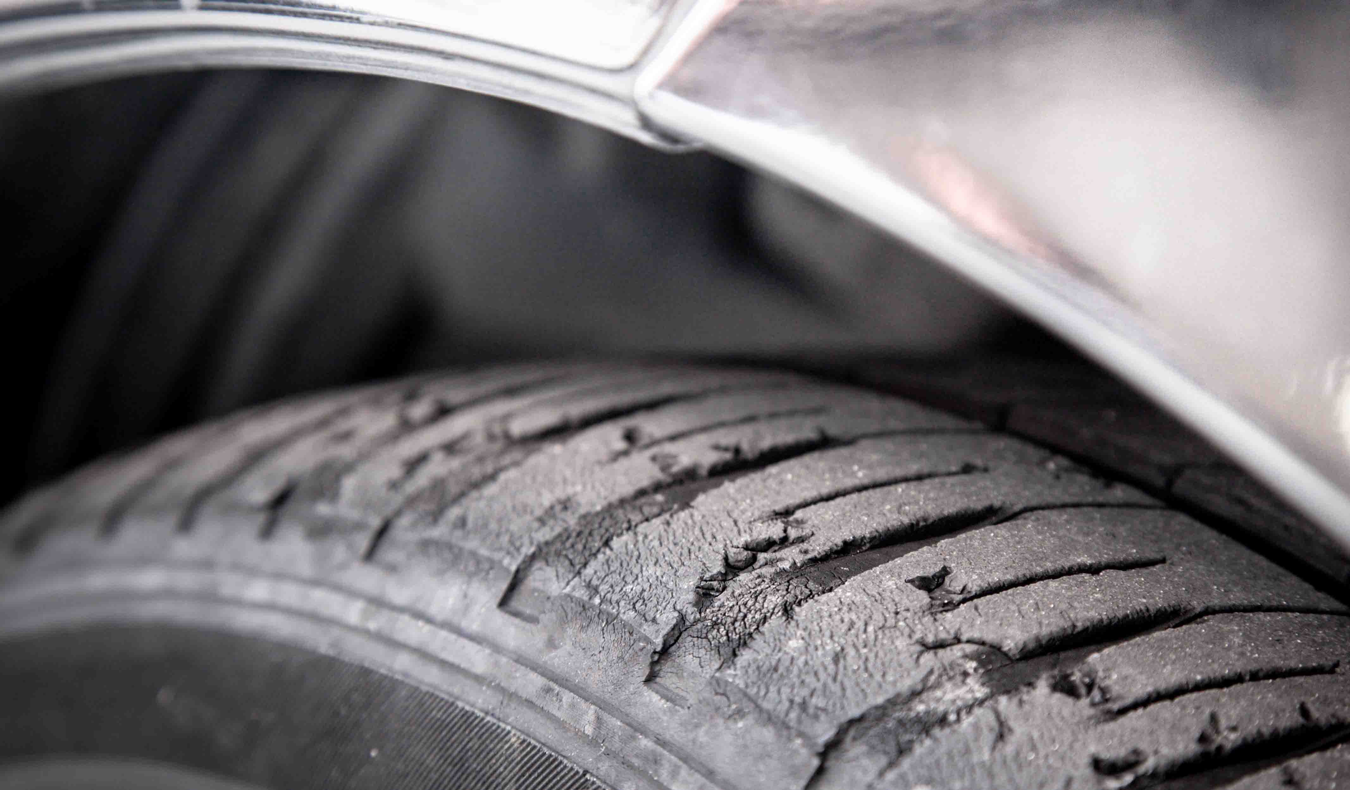
Why is road transport today so bad?
Contributes to:
climate change (CO₂ )
Air pollution
Plastic pollution
Notes:
But did you know that road transport also contributes to plastic pollution? More than 200,000 tonnes of tiny plastic particles are blown from roads into the oceans every year. Most of this plastic comes from car types and the wearing away of brake pads. An average tyre loses 4kg of plastic during its lifetime (that’s the equivalent of four bags of sugar)… you will not lose 4kg from your clothes.
Also, it takes a lot of energy and resources to build cars and other transport. Think of all the material we need – plastic, metal, electronics, glass. And most of these are non-renewable

Slide 17
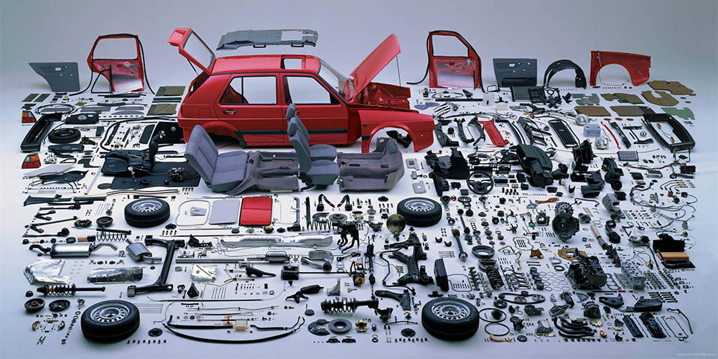
Why is road transport today so bad?
Contributes to:
climate change (CO₂ )
Air pollution
Plastic pollution
Resource depletion
Notes:
Also, it takes a lot of energy and resources to build cars and other transport. Think of all the material we need – plastic, metal, electronics, glass. And most of these are non-renewable

Slide 18
Why is road transport today so bad?
Contributes to:
climate change (CO₂ )
Air pollution (NOx, small particles and dust)
Plastic pollution
Resource depletion
And it’s bad for our health
Notes:
Air pollution is also bad for our health, affecting our lungs, brains, heart and pregnant women. All of us can be impacted by air pollution, but old people, people with health conditions and young people are most at risk.

Slide 19
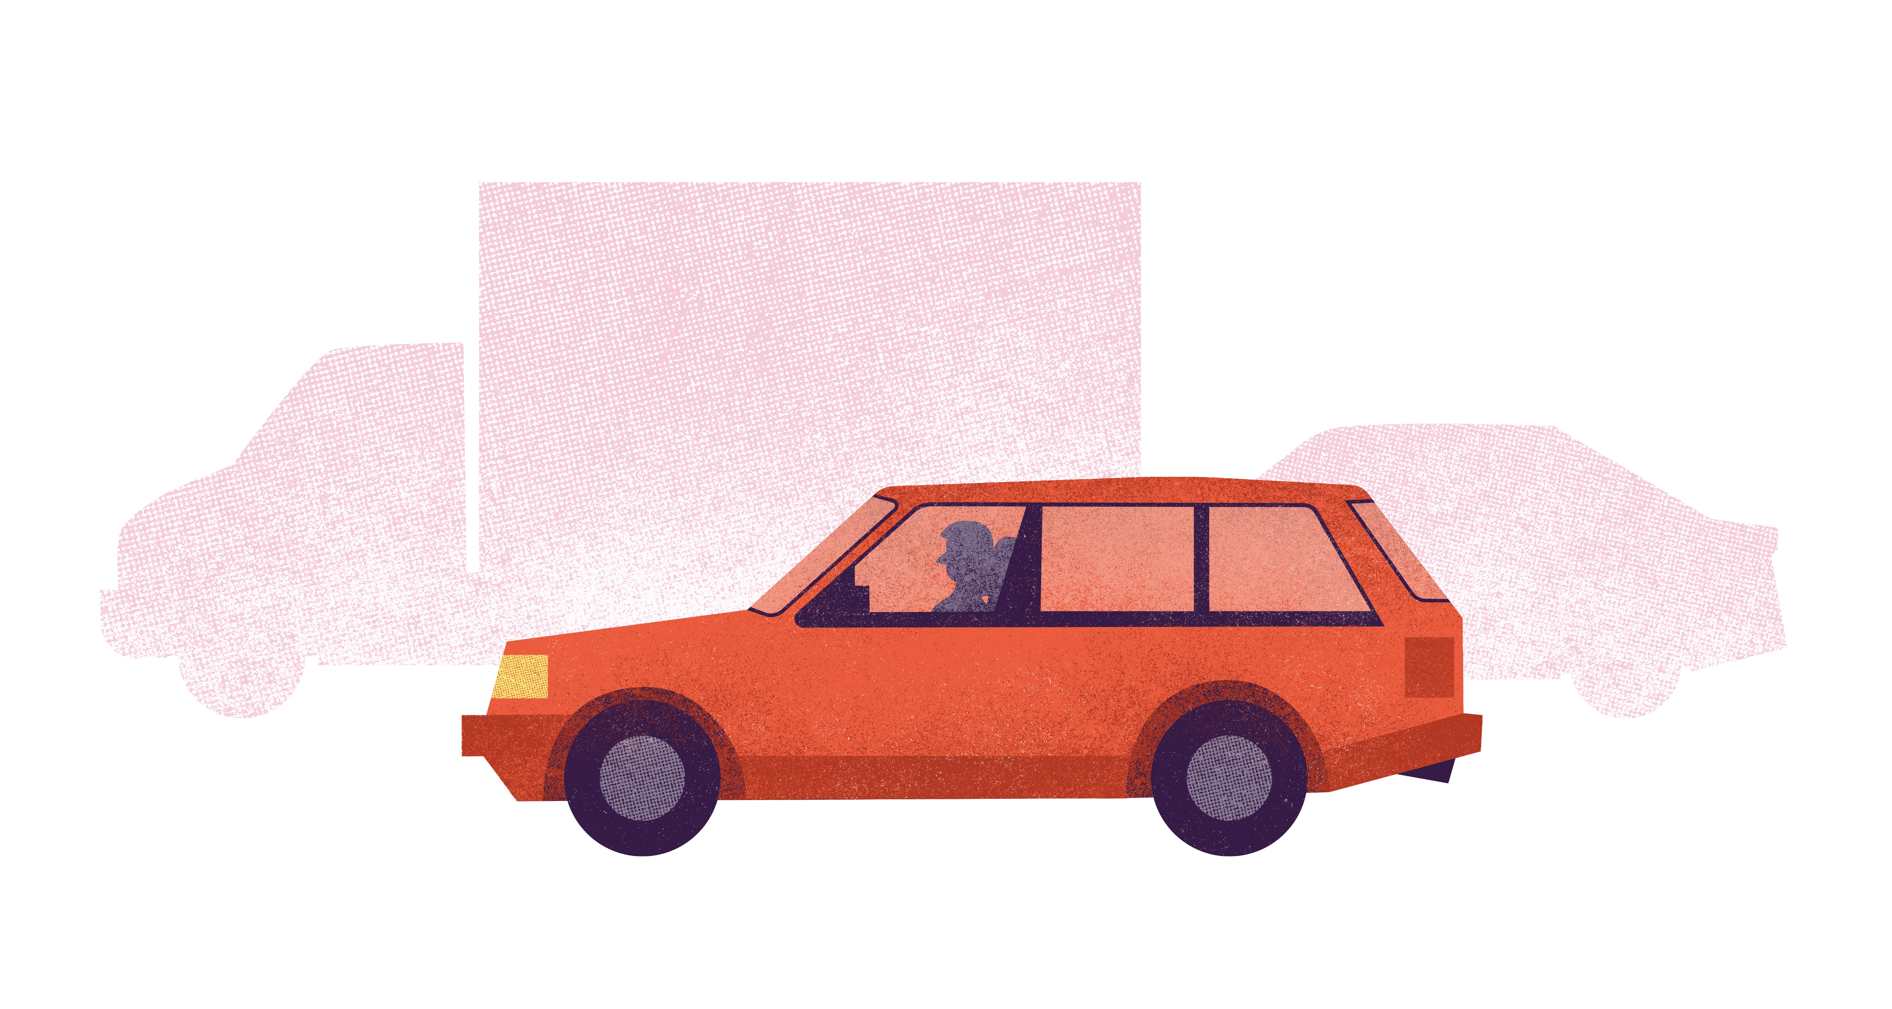
So how did we get here?
Notes:
So how did we get here? How did road transport become such a big contributor to these problems (air pollution, climate change, etc)

Slide 20
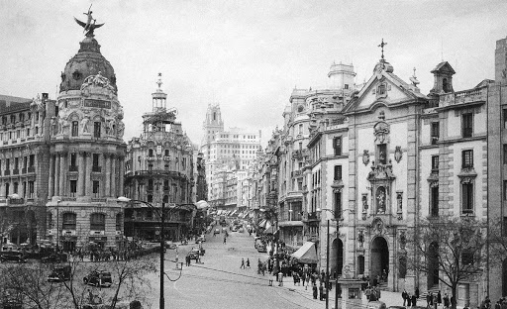
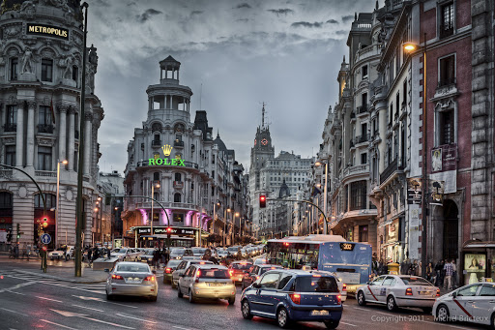
Cities taken over by cars
Madrid city centre, 1950s
Madrid city centre, today
Notes:
What do you notice in these two pictures? (e.g. more cars, fewer pedestrians)
Cities have changed to accommodate the rise in demand of cars. In cities across Europe we have seen a shift from mainly walking and taking public transport to cities dominated by private cars.

Slide 21
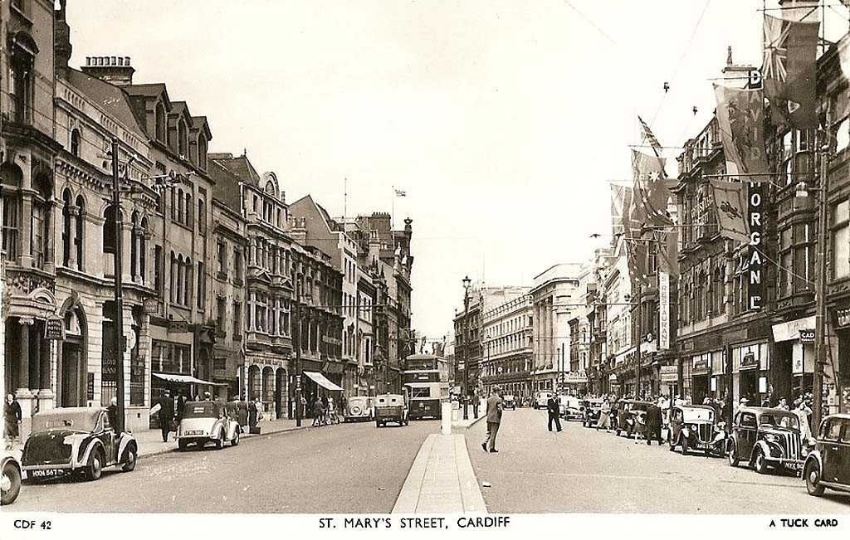
Cities re-designed for people
St Mary’s Street, Cardiff, 1950s
St Mary’s Street, Cardiff, today
Notes:
However we are starting to re-design cities to accommodate healthier, more active and more sustainable types of travel
What do you notice here? (e.g. fewer cars, more pedestrians)
Presenters note: Feel free to Google your city/street in the 1950s and today to see what has changed

Slide 22
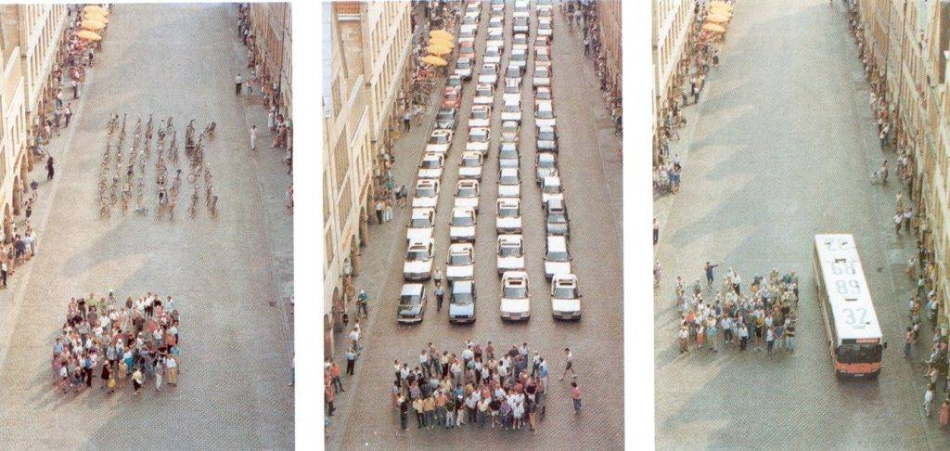
How much space can 60 people occupy?
Notes:
When we are able to design cities for people, we can also save space. What would you do if we had more space in our city? (would you plant trees, build a skate park, build a cinema…)
(Option to spend a few minutes asking for ideas)
Presenters note:
Showing the equivalent space occupied by 60 pedestrians, 60 cars and a bus with 60 people inside

Slide 23
Health
Social impact
Local economy
Time
Energy
Urban design
Accessibility
Smells
Noise
Notes:
We need to make active travel a priority in cities. As well as cleaner air and fewer carbon emissions, fewer vehicles in cities will reduce noise and smells and improve accessibility for the people that need to use public transport. It will reduce the time of journeys taken as we will spend less time in traffic, make more space for planting trees and building skate parks and improve our health and sense of wellbeing.
Presenters note:
Bicycle networks “reverse traffic pyramid” adapted from the Bicycle Innovation Lab

Slide 24
What do we need to convince leaders that things need to change?
Notes:
What do we need to convince leaders that things need to change? Leaders can be politicians, our head teacher or businesses – people who make the big decisions
(Hint: It’s what scientists gather) A…Evidence

Slide 25
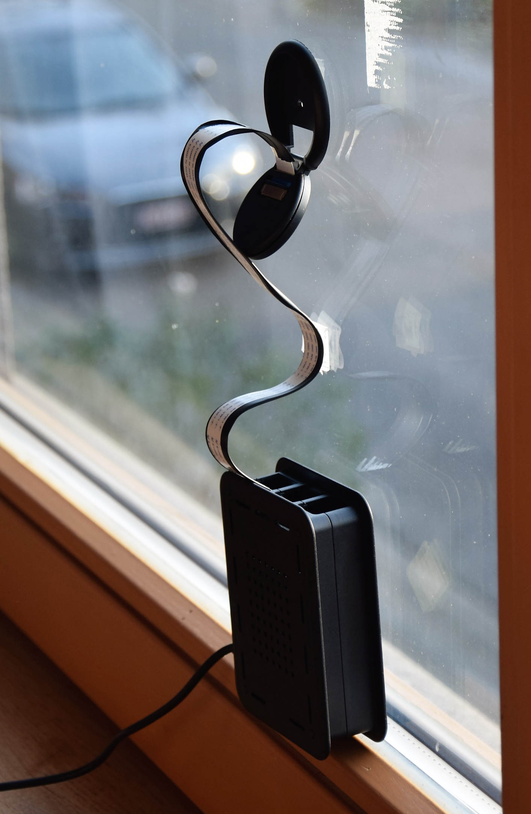
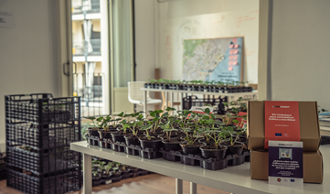
Sensing traffic issues with WeCount
Notes:
WeCount is one such example where residents in Europe are working together with scientists to gather evidence on transport and mobility issues. They are gathering evidence traffic numbers, the speed of cars and levels of air pollution using sensors. The image on the left shows WeCount’s traffic and speed sensor, which consists of a camera and a mini computer, (called a Raspberry Pi). The sensor is connected to the mains battery and sends data it collects to the Telraam website using WiFi. The image on the right shows strawberry plants, which collect air pollutants on their leaves that can then be analysed in a laboratory. In Spain, WeCount has distributed 1,000 of these plants.

Slide 26
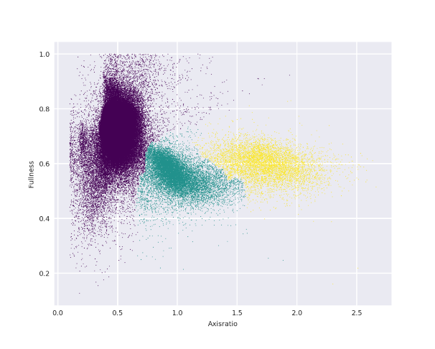
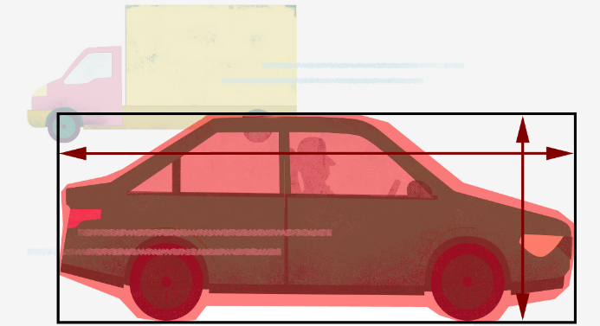
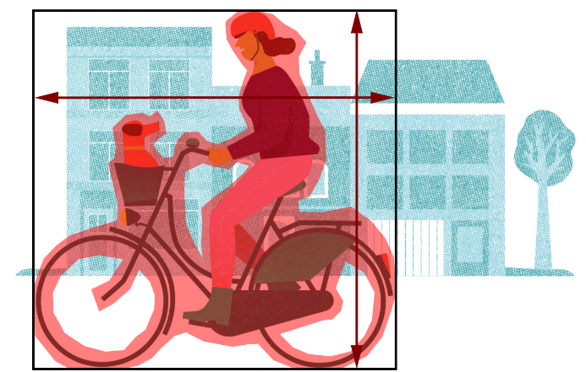
What is the function of the traffic sensor?
Notes:
The traffic sensor detects vehicles according to their size and produces graphs (like the one on the right) which translate the data into meaningful information

Slide 27
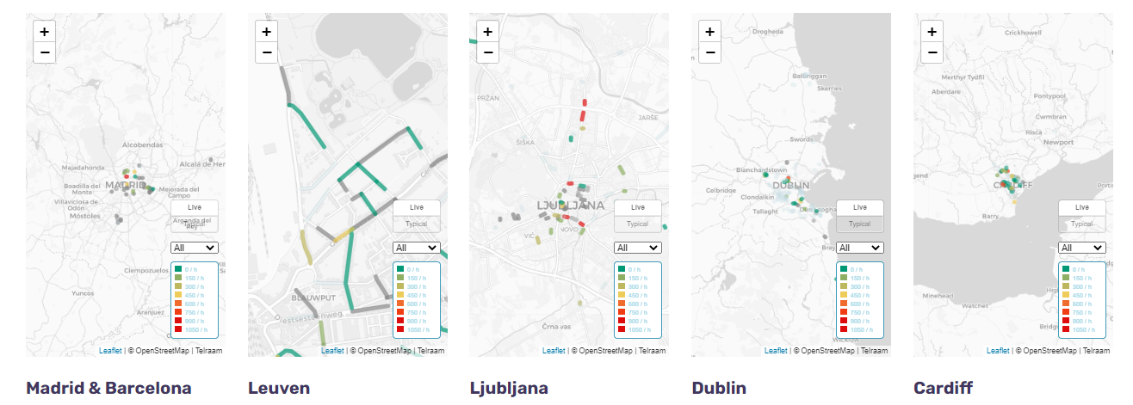
What can the data tell us?
https://telraam.net
Notes:
Each of the cities involved in the project have active sensors all across their cities, in the houses of residents

Slide 28
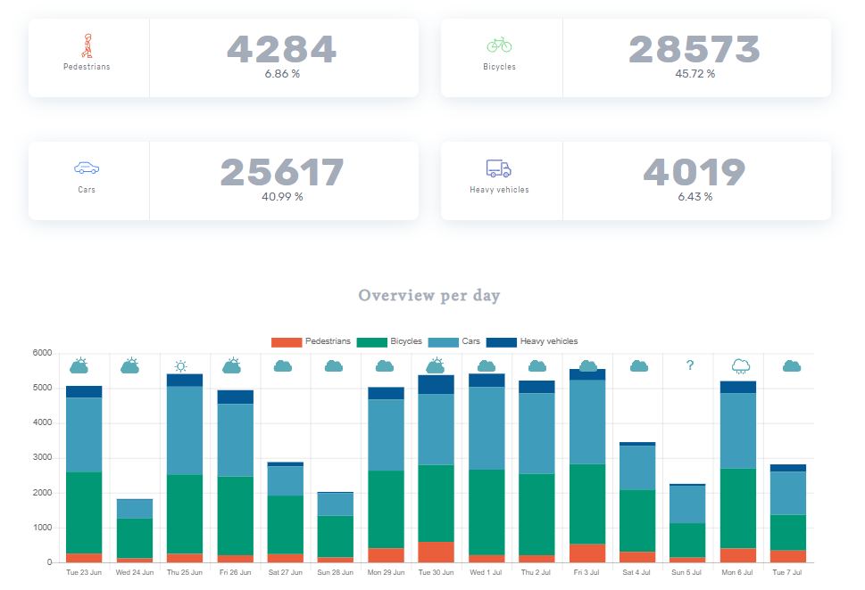
What can the data tell us?
Type of data
Daily summary of traffic numbers
Detailed summary since counting began so we can understand patterns
Car speeds
Notes:
And each sensor produces a daily report of the number of transport types, speeds and transport peaks during the day. This is an example of one street in Barcelona. You can also look at data over long time periods. So, for instance, you can see if COVID restrictions had an impact on traffic numbers
Head to: https://www.telraam.net/en
Zoom in to either Cardiff, Dublin, Leuven, Madrid, Barcelona or Ljubljana
Click on one of the active streets (look for one that has a lot of data) and click on the “more details” button to see the breakdown of data
Decide on one street to investigate and encourage pupils to describe what they see in the graphs
Ask pupils to draw graphs of their own for the street outside their school – what do they expect to see in one day? In one week? Over one year?
Head out as a class to count the traffic. Spend 15 minutes doing this and they work out the average for one hour. Ask pupils: do they expect to see the same results every hour? Every day? Every week? What would affect the yearly average?
Example taken from: https://www.telraam.net/en/location/9000000373

Slide 29
What would we like to know about transport and how we get to and from our school?

Slide 30
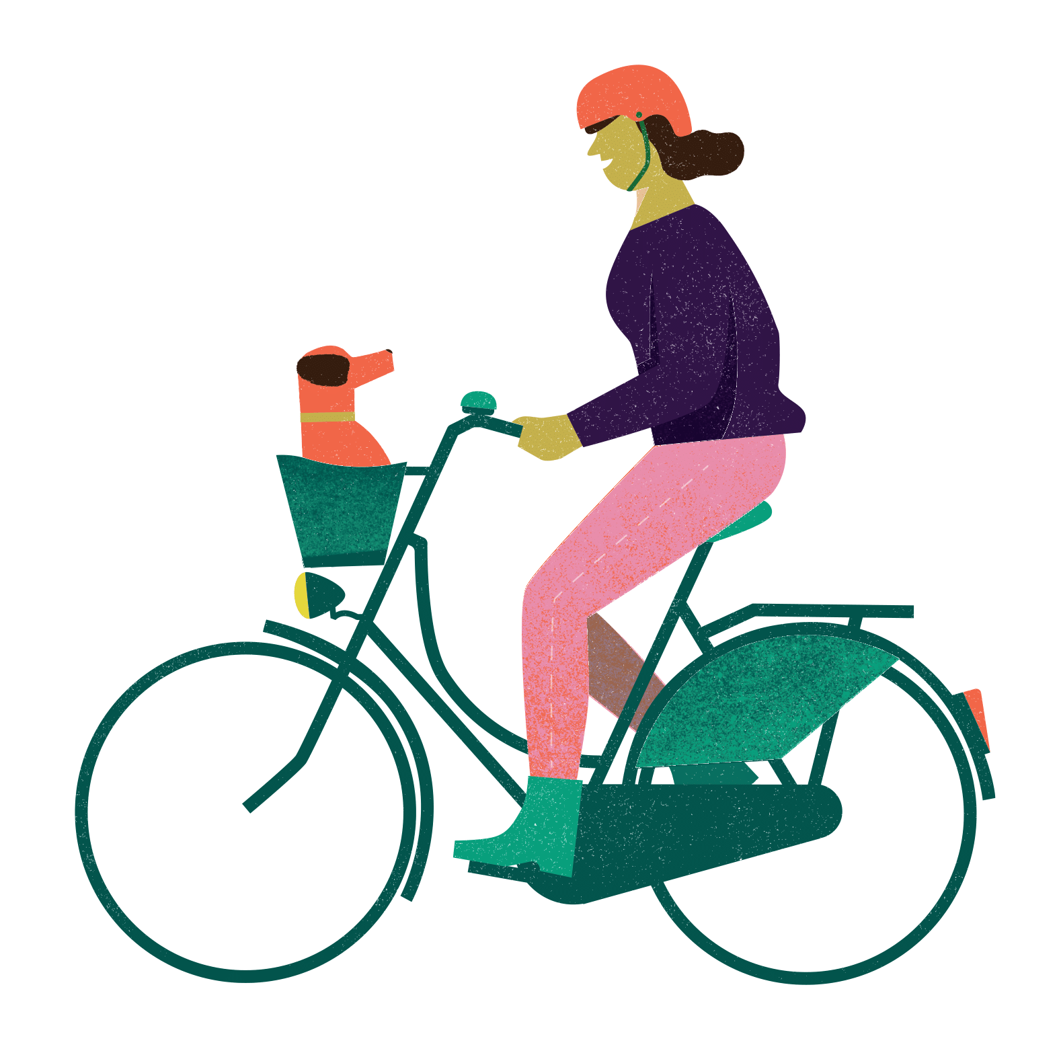
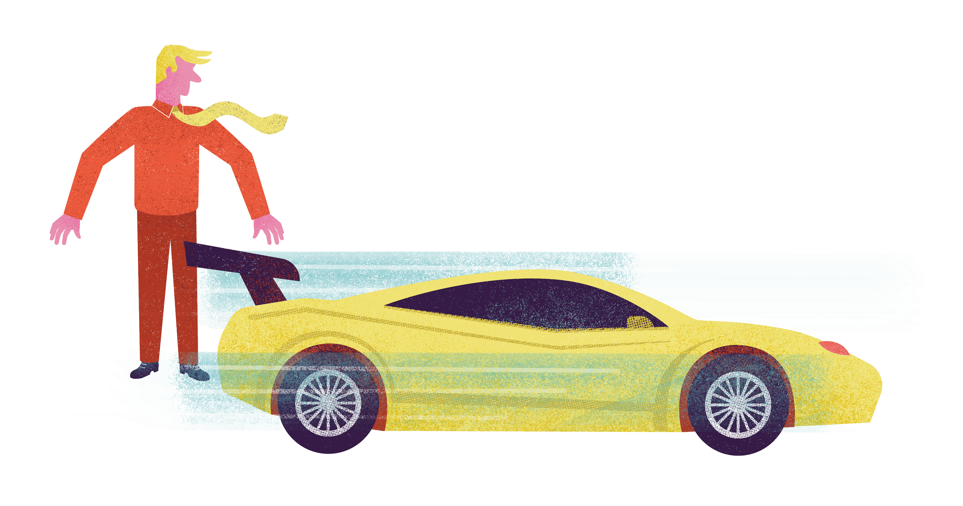
What do we want to find out?
Notes:
Do we want to know about speeding, or things that get in our way from walking? Or what about if there are enough cycle lanes, or if there is more we can do to get cars of the road?
Bring up some ‘hot topics’ relevant to your school, whether that is the lack of buses, not enough bicycle parking, etc

Slide 31
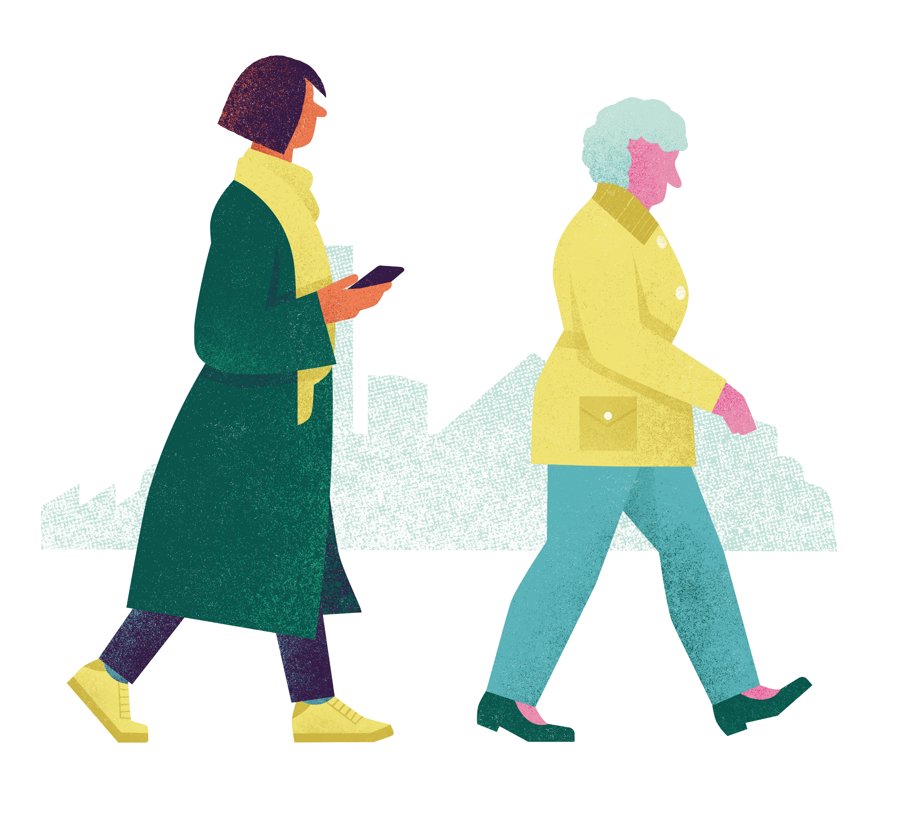
What do you love about…
Notes:
Walking and cycling
(e.g. makes me feel healthy…)

Slide 32
What would be cool to investigate about transport and mobility near us/around our school?
Notes:
What would be cool to investigate about transport and mobility near us/around our school? What changes would you like to see?
Presenters notes: Adjust the wording of this text as necessary. Spend a few minutes taking ideas from the pupils. Option to take these answers forward into next lesson. Activities accompany this PPT in case you want to take this further.

Slide 33
What have you learnt this morning/today?
Notes:
What have you learnt this morning/today? What would you like to do with this information?
Optional question if older, capable and relevant: Do you think technology is enough to change our cities for the better (our behaviours and policies)? How else can we influence change (e.g. surveys with people, protests, voting, becoming a politician)?
Presenters notes: Adjust the wording of this text as necessary?

