Slide 1
WeCount
KS4 activities

Slide 2
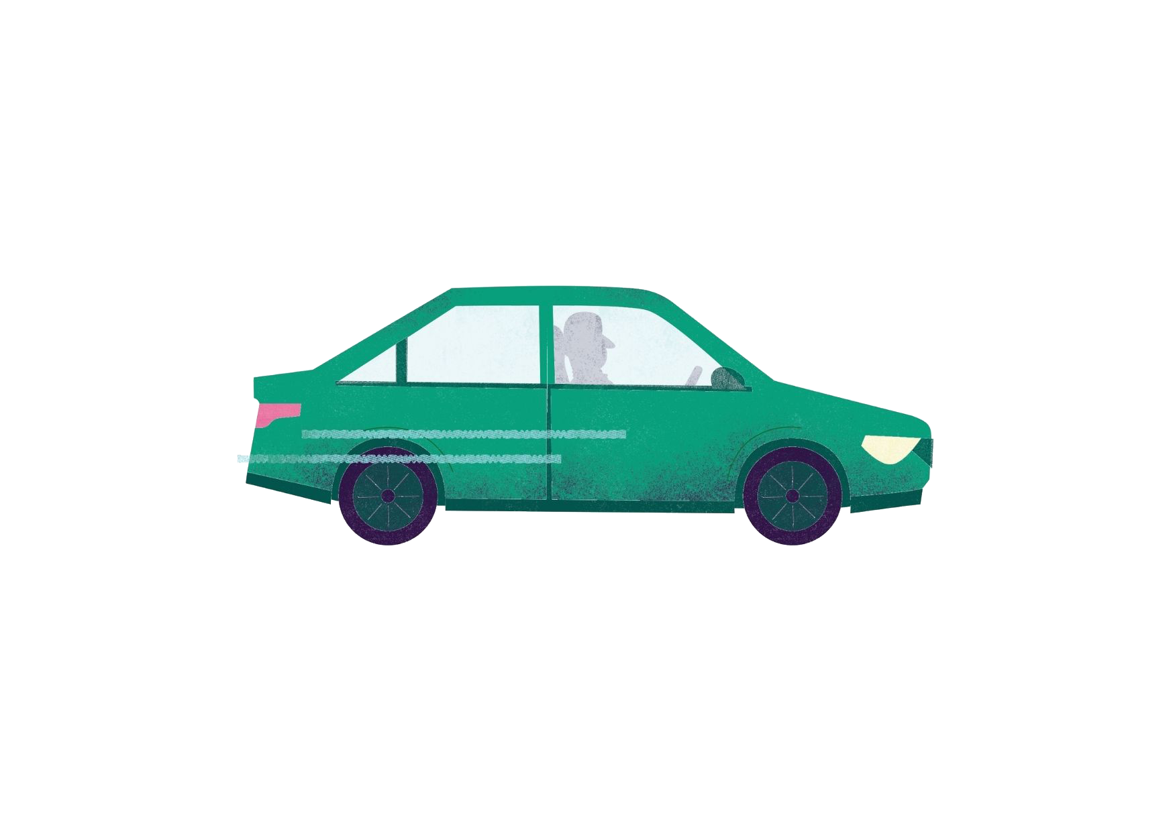
How Technology Shapes Us, and How We Shape Technology
Lesson one
Notes:
This relates to worksheet 1.
Option to write objectives (curriculum) on board:
To thematically study the development of technology in relation to cultural, economic and scientific change
To understand the impact of new and emerging technologies on industry, enterprise, sustainability, people, culture, society and environment, production techniques and systems
To critically evaluate these technologies to inform design decisions
To consider contemporary and potential future scenarios from different perspectives, such as ethics and the environment

Slide 3
Will electric vehicles solve our urban travelling challenges?
Notes:
As pupils enter ask Q
Add: Will they solve the traffic jams? The air pollution? Safety concerns?
Discuss the pros and cons of Evs and why the revolution is yet to happen (e.g. disjointed charging network; cost, etc)

Slide 4
Revolution
Notes:
"Does anyone know what a 'revolution' means?" Perhaps describe in terms of socio-political revolution to begin. "So, what then, is a technological revolution?". Today, we are going to look at how the electric vehicle started to revolutionise the car industry almost 100 years ago, and how different factors led to its decline and then re-birth.
A: a period in which one or more technologies is replaced by another, novel technology in a short amount of time. It is an era of accelerated technological progress characterized by new innovations whose rapid application and diffusion typically cause an abrupt change in society.

Slide 5
Video: the surprising history of EV’s
https://www.youtube.com/watch?v=zdqw1wCMz4I&ab_channel=OurChangingClimate
Notes:
Watch video (10 s to 11m 35) on the history of the electric vehicles. Ask pupils to take notes of key themes and dates
Ask: did anything surprise you about the video? Acknowledge that it was focussed on the US but that it has relevance in the UK as car manufacturing is a global industry
Note: it is advisable to watch this video in sections, allowing pupils to work through the timeline and then move on to the other questions on the worksheet.

Slide 6
Timeline of events
1900
Notes:
Now it is over to you to draw the timeline
Hand out worksheet. Depending on the abilities of the class, you may need to fill out the questions together or answer any questions they have in advance of setting them to task. Depending on time, option to leave the last questions to the end of the session/as homework.
Teachers notes: Option to show this before and after the video, and with or without bifurication. Can use a basic timeline, or if you would like to stretch pupil’s abilities, use this bifurcating timeline to show how the US/world moved away from Electric vehicles and now they are coming back to them.
For the task, encourage pupils to draw out the main themes and how they relate to cultural, economic and scientific change
Once complete, discuss answers as a class

Slide 7
What are the pros and cons of Evs?
Notes:
Engage pupils in a discussion around the pros and cons of EVs.
Ask: "Have your views changed after watching the video?" Use slide on 'net zero emissions' to explain what the UK mandate is for reducing emissions from transport. Discuss objectives for your city and whether students agree/what policies they would put forward for zero-carbon transport.
Revisit the question: Will electric vehicles solve our urban travelling challenges?

Slide 8
Net zero carbon emissions
The UK Government has already committed to ending the sale of new petrol and diesel cars by 2030 and is offering grants for people wanting to buy EV vehicles, to the value of £2,500 (link). However, there is still a long way to go before are out of our cars. What else do we need to change to shift away from the dominance of cars?
Notes:
Read slide, then the following:
EV’s will be part of our future.
All Governments need to be net-zero emissions by 2030 if we are to prevent climate breakdown.
Net zero = carbon neutrality. This can be done by balancing emissions of carbon dioxide with its removal (often through carbon offsetting/sequestration) or by eliminating emissions from society.
What else do we need to change to shift away from the dominance of cars?
(e.g. policy and infrastructural change to improve the cycling infrastructure and build amenities close by; change in the the cultural view of cars, or that they put us at less harm from air pollution. Air pollution is worse inside of cars as they circulate exhaust fumes of other cars)

Slide 9
Net zero emissions in our city
Notes:
Does anyone know what our climate action plan is for our city? Does anyone know the (transport) objectives?
Teachers note:
Before the session, pull together a few transport objectives for discussion. Option to add key facts from local Climate Action Plans relevant to transport to the slide.
E.g. in Bristol key objectives include:
Reducing vehicle miles by 40% by 2030 achieved through mode shift towards public transport, walking and cycling

Slide 10
Electric vehicles
Pros
Cons
No exhaust emissions
Often made with recyclable materials
Money-off incentives
Fuel and maintenance saving
Tax free
Expensive
Charing point network still patchy
Break pads and tyres contribute to particulate pollution
Batteries emit toxic fumes and materials to make them (lithium and cobalt) are often mined unethically
Notes:
Show this slide/populate from the previous discussion. Would you add anything else?

Slide 11
Lesson summary
Revolutions come and go – powerful actors and key moments shape these revolutions
The UK aims to be net neutral by 2050… scientists say this has to happen much sooner, by 2028
The EV could revolutionise the car industry… but is it enough to reduce emissions from transport?
Notes:
Write up summary with input from the pupils

Slide 12
What have you learnt today?
Notes:
End of activity one
Homework/extension
Either: Ask pupils to research another technology and how it has come to be so prolific. This time focus on a technology to make the world more sustainable (e.g. electric car, e-scooter, online shopping, the train, e-readers, etc). They should write about their views in how the technology benefits society and the environment but also how it may negatively impact people and planet. They can then suggest alternatives to this technology. Encourage them to draw a timeline and to include pictures. Or: ask pupils to answer the following; What would your future vision of cities be? What role would the car play? Encourage them to research other cities that are reducing car use so they can back up their ideas with proven examples.
Recap on objectives
To thematically study the development of technology in relation to cultural, economic and scientific change
To understand the impact of new and emerging technologies on industry, enterprise, sustainability, people, culture, society and environment, production techniques and systems
To critically evaluate these technologies to inform design decisions
To consider contemporary and potential future scenarios from different perspectives, such as ethics and the environment

Slide 13
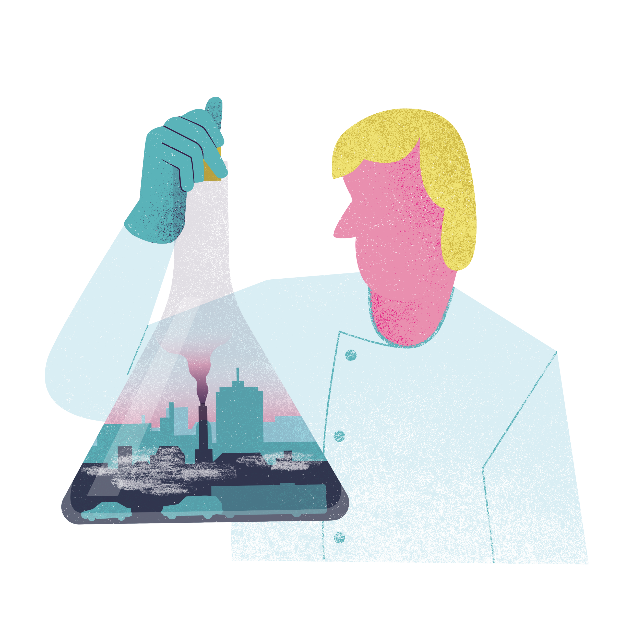
Observing Traffic, Working Scientifically
Lesson two
Notes:
This relates to worksheet two.
Option to write objectives (curriculum) on the board
To apply knowledge of a range of techniques, instruments, apparatus, and materials to select those appropriate to the experiment
To develop our use of scientific vocabulary and nomenclature
To use scientific theories and explanations to develop hypotheses
To plan experiments or devise procedures to make observations, test hypotheses, check data/explore phenomenon

Slide 14
What instruments do we use to monitor urban travel issues and patterns?
Notes:
As pupils enter, ask them to think about the following: "What instruments do we use to monitor urban travel issues and patterns?". Get them to jot down thoughts in notebook/on post-its. For online delivery, option to use a digital post-it tool. Ask pupils to call out answers. You will likely hear speed cameras and CCTV/helicopters. Also mention air pollution sensors, traffic counting sensors and manual traffic counting, surveys, and even using our nose (smelling chemicals in the air) and eyes (e.g. visual obstructions).
What are the units of measurement for these devices? Is there a value in using more than one sensor in a given area (e.g. speed and cctv; or air pollution and traffic volumes). Encourage pupils to think about the importance of combining datasets, as well as ethical considerations

Slide 15
Scientists use their ________ to observe the environment
Notes:
Scientists use their WHAT to observe the environment?
A: their senses
Scientists use their senses, manually and with the help of technology, to observe and study our environment. With travel-related issues it is no different.

Slide 16
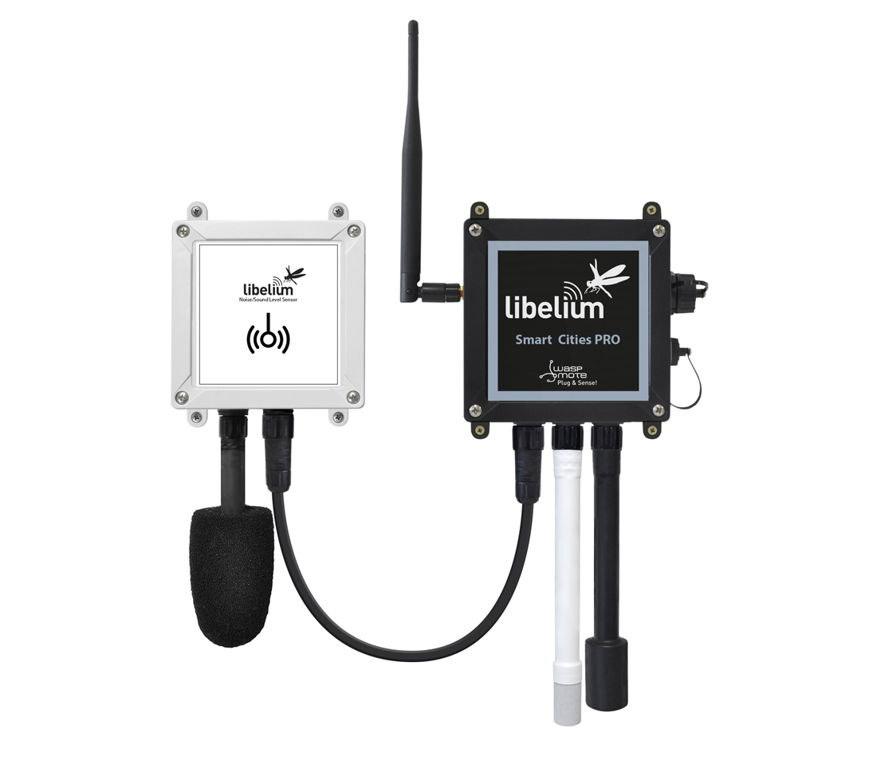
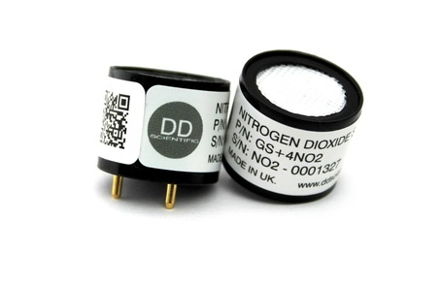
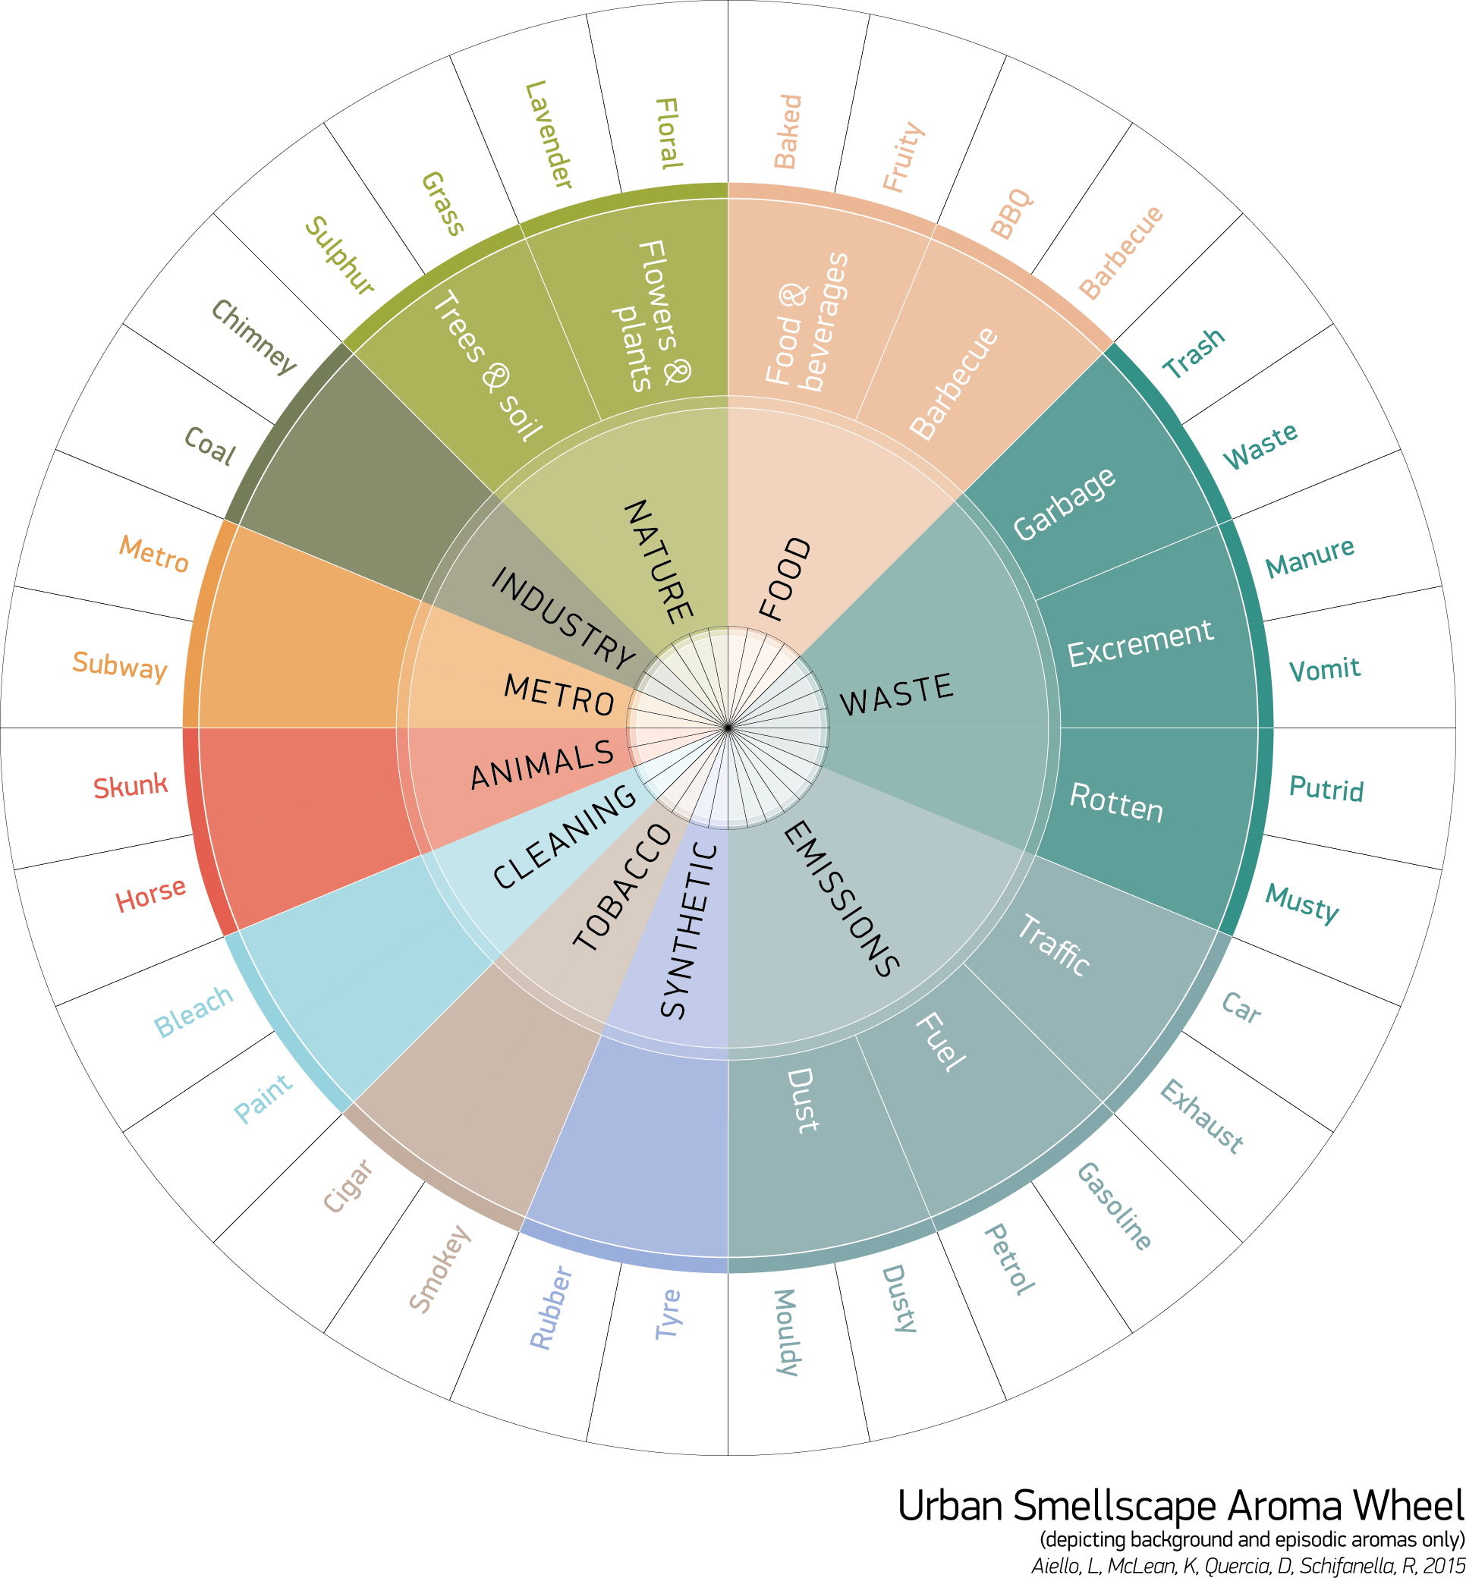
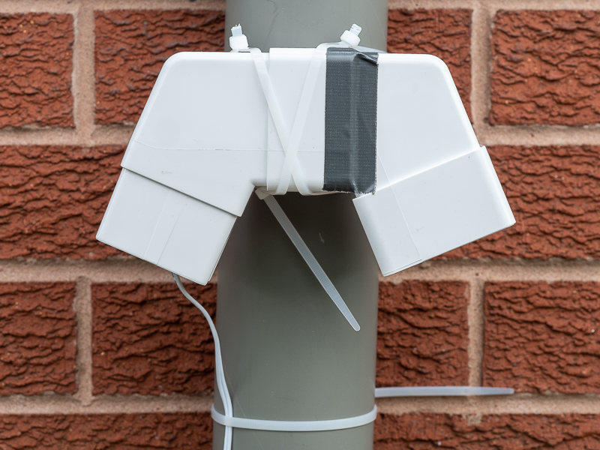
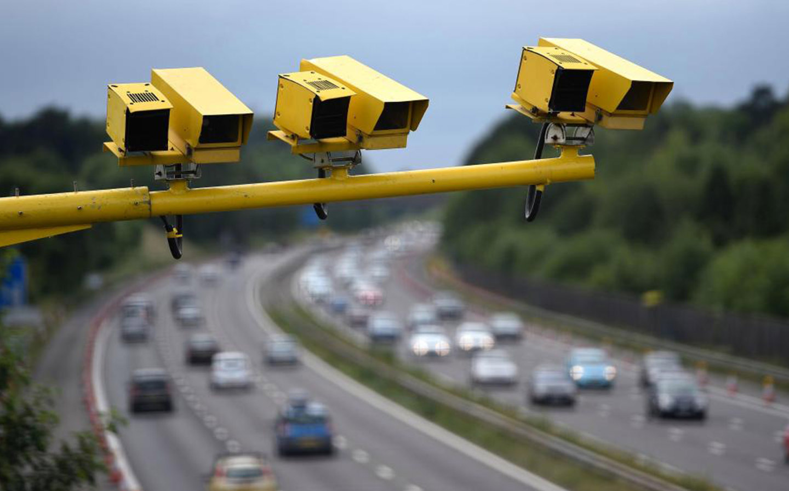
Sensing the environment
Notes:
We can use a variety of tools to sense the environment. Can you name any of these?
Clockwise, from top left: a noise sensor; an aroma wheel to log odours; an NO2 air pollution sensor; a DIY PM2.5 air pollution sensor (you can see the network of sensors through the link below); traffic cameras (speed and accidents)
Show some examples of sensors/use the slide. Could point to digital themometer guages or other sensors in the classroom/school. Option to show video: https://youtu.be/1WutQFBI9V8
Ask: "How do we ensure our process for data collection is robust and reliable?"
https://maps.sensor.community/#2/0.0/0.0
https://goodcitylife.org/smellymaps/project.php

Slide 17
Working scientifically
https://youtu.be/SMGRe824kak
Notes:
We need to follow a specific prodedure, known as the scientific method"
Watch video on the scientific method: https://youtu.be/SMGRe824kak
Hand out worksheet. Allow pupils 5 or so minutes to fill out the first page before talking through the points on the video, using the slides to guide conversation.

Slide 18
The scientific process
Science aims to develop a good explanation of natural events (phenomena) that are observed.
Scientists develop explanations using the scientific method. This follows a specific way of working:
propose a hypothesis, an initial theory or explanation for an observation
make a prediction based on the hypothesis, suggesting how changing one factor will affect the outcome
Plan an experiment - this should test the prediction and the hypothesis on which it is based

Slide 19
Experiment
Experimental group
Control group
Independent
Dependent
Qualitative
Quantitative

Slide 20
How can we apply the scientific method to the study of urban travel trends and patterns?
Notes:
"How can we use the scientific method to study urban travel trends and patterns? "What are the dependent variables we'd need to consider? What could you change to influence the dependent variables?"
Fill out page two of the worksheet. Depending on the abilities of the class, you may need to fill out the questions together or answer any questions they have in advance of setting them to task. Can use PowerPoint slide to help you.

Slide 21
Worksheet: our experiment
Aim: to understand if the introduction of speed bumps outside the school would impact the speed of cars
Hypothesis:
Experimental group:
Control group:
Dependent variable:
Independent variable:
Qualitative data:
Quantitative data:
Notes:
Fill out as a class/allow pupils to complete the worksheet
Example answers:
H: If a temporary speed bump is placed on the road outside of the school before and after school each day for a week then the speed of cars will reduce by 10%/5mph
Experimental group: week with the speed bump intervention
Control group: a week of testing one week before (and one week after) the intervention
Dependent variable: the speed of cars
Independent variable: the speed bump on the road
Qualitative data: surveys about people’s subjective feelings of safety
Quantitative data: speed measurements (mph) before, during and after intervention

Slide 22
Background information from reliable sources
Explore citizens traffic data on the WeCount project – https://www.telraam.net/en
Notes:
In the first video they mentioned obtaining information from reliable sources. Do we think the data from the Telraam is a reliable source of information?
Show pupils the Telraam website, zooming into the streets in Cardiff and opening data from one street and clicking “more data”. How do we know this data is reliable? (we assume the data is being collected accurately. The Telraam uses ‘machine learning’ to learn from its mistakes and get better over time. We will discuss machine learning another week. How could we improve data accuracy? We could improve accuracy with adding a validation step of manual counting, or compare data coming from different parts of the same road.)
If time, option to show pupils data from some of the following websites
Look at where people commute to and from – https://commute.datashine.org.uk/
Explore cycling data: https://bikedata.cyclestreets.net/#17/51.511737/-0.104551
Observe NO2 levels in your area: https://laqm.defra.gov.uk/diffusion-tubes/datacentre.php
Find out about road traffic statistics: https://roadtraffic.dft.gov.uk/#6/55.254/-6.053/basemap-regions-countpoints
Look at census data on a map (e.g car availability, health indicators, house size): https://datashine.org.uk/#table=QS502EW&col=QS502EW0010&ramp=YlOrRd&layers=BTTT&zoom=12&lon=-0.1500&lat=51.5200
Data Shine commute
DEFRA NO2 diffusion tubes – select your county and then look at the data tab. Can zoom in on particular streets. Check site before using as data is patchy (or use this observation as a topic of conversation)
Road traffic statistics – click on summary to see main facts (e.g. % change of cars, vans, lorries, cyclists). Can zoom into a particular city, or street and pull of graphs. Could discuss what the pupils see in the graphs and whether the findings surprise them. Do they think the data is accurate?
Data shine – can look at how people travel to work and how this differs across and between cities; if students are capable, can overlay data with health and inequality metrics.
Encourage pupils to take screen shots from the sites they use and write a short paragraph explaining what the data means

Slide 23
What are the pros and cons of digital counting versus manual counting?
Notes:
If time, discuss
Digital
Pros – saves time, can learn over time (machine learning)
Cons – data not always accurate, privacy issues (e.g. if personal data), can be expensive

Slide 24
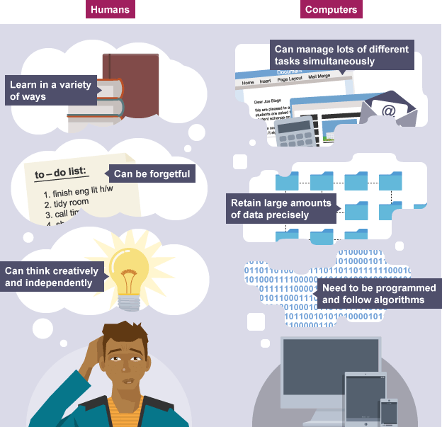
What are the pros and cons of digital counting versus manual counting?
Notes:
Digital
Pros – saves time, can learn over time (machine learning)
Cons – data not always accurate, privacy issues (e.g. if personal data), can be expensive

Slide 25
Lesson summary
We use our senses to observe the environment
We follow the scientific method to systematically capture and analyse these observations
1. Observation 2. Research 3. Hypothesis 4. Experiment 5. Conclusion 6. Share results
We create experiments to test hypotheses, and we make our data available for others to scrutinise (peer review), repeat and reproduce, thus constantly learning and improving our understanding of how the world works
Digital collection is accelerating our understanding

Slide 26
What have you learnt today?
Notes:
End of activity three
Homework/extension
Ask pupils to write their own experiment for the street where they live. What do they want to investigate? What is their hypothesis? What will they control? Etc. Ask them to use the same concepts explored today (on the second page of the worksheet)
Option to refer back to objectives on the board
To apply knowledge of a range of techniques, instruments, apparatus, and materials to select those appropriate to the experiment
To develop our use of scientific vocabulary and nomenclature
To use scientific theories and explanations to develop hypotheses
To plan experiments or devise procedures to make observations, test hypotheses, check data/explore phenomenon

Slide 27
Counting Traffic, Working Scientifically
Lesson three
Notes:
This relates to worksheet three.

Slide 28
How many cars pass outside of our [school street/nearby busy road] each hour?
Notes:
“How can we measure this? Which times of day will be busiest?” (If you already have a Telraam installed, check your data and ask: how can we verify this information?). Tease out the need to manually count to 'ground truth’.
If you haven't done the previous lesson, then recap/introduce the scientific method and follow the lesson plan till the main task. If you have, after a quick recap head straight to the main task.

Slide 29
The six steps of the scientific method
1. Observation 2. Research 3. Hypothesis 4. Experiment 5. Conclusion 6. Share results
Notes:
If you haven't done the previous lesson, then recap/introduce the scientific method and follow the lesson plan till the main task. If you have, after a quick recap head straight to the main task.

Slide 30
Designing our experiment
Notes:
What are our dependent and independent variables?
What is the control group and which is the experimental group?
Work through the first few questions in the worksheet together
Ask pupils to agree on a time they would like to count traffic. Why is this time of interest? (e.g. want to reduce cars during school drop off; expect people speed after school hours, making the road unsafe, etc).
"Write out your hypothesis for traffic on our [chosen] street at this time. What are the variables? What experiment can we run to see if we can affect these numbers? What do we need to control?" Ask pupils to continuing fillinf out the worksheet.
Send the pupils out to collect data from the road/as homework ask them to count traffic during their chosen hour (e.g. as pupils arrive at school).

Slide 31
What to consider before we begin
Notes:
Discuss health and safety implications. How will you evaluate your research? Ask pupils to fill out the questions on the worksheet.

Slide 32
Lesson summary
We follow the scientific method to systematically capture and analyse these observations
1. Observation 2. Research 3. Hypothesis 4. Experiment 5. Conclusion 6. Share results
We create experiments to test hypotheses, and we make our data available for others to scrutinise (peer review), repeat and reproduce, thus constantly learning and improving our understanding of how the world works
We must consider health and safety aspects of our research
It is important to evaluate for learning

Slide 33
What have you learnt today?
Notes:
End of activity
Homework/extension

Slide 34
Computer Science for Sustainability
Lesson four
Notes:
This relates to worksheet four.
Ask pupils to jot down all the elements of a computer that they have learnt about so far (e.g. CPU, memory, circuit chip, transistors, etc). If it is their first time exploring this subject, go straight to the next slide. Ask pupils to shout out answers.

Slide 35
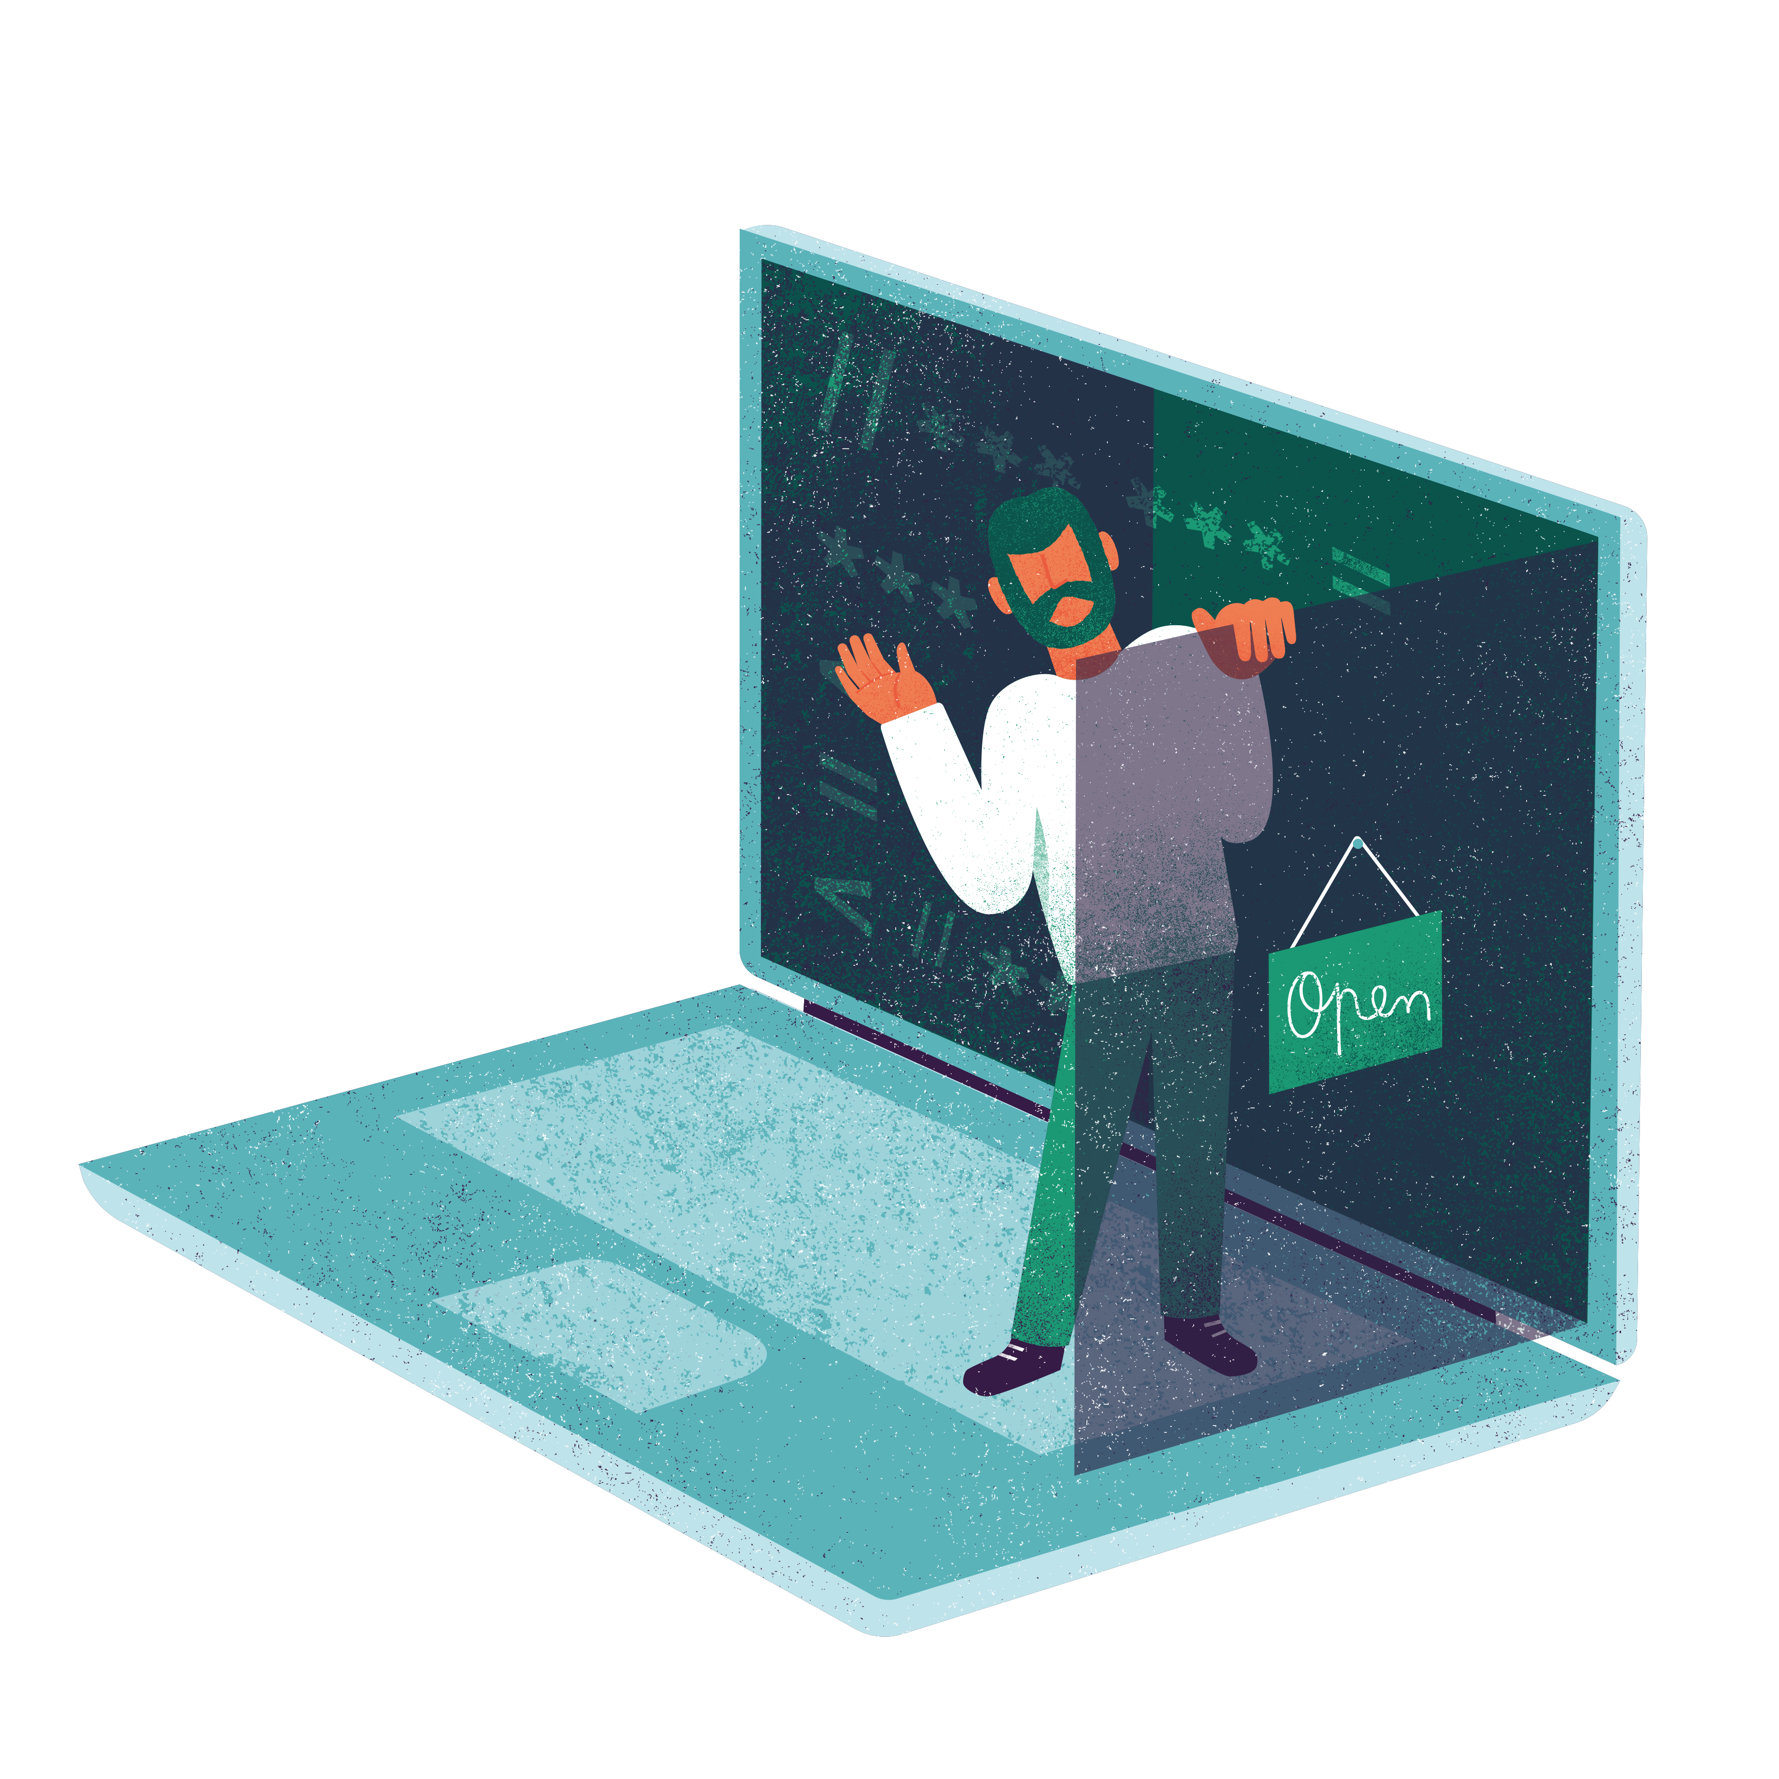
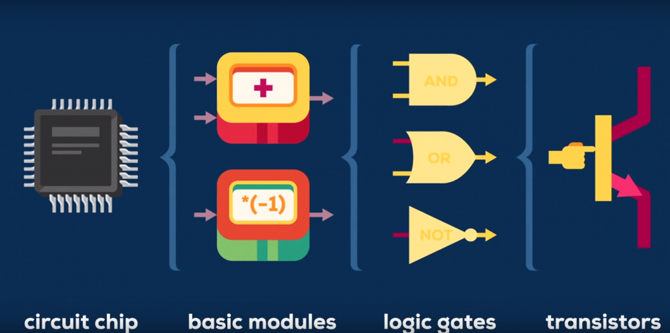
Notes:
Today we are going to learn about some of the main computer science concepts we need to know to code, and the steps we can take to design our code.
At the simplest level, computers are little more than a collection of transistors (switches) and circuits. They connect together to form logic gates, which tell the computer to perform simple actions. As you can see from the picture, most logic gates have two inputs and one output. At any given moment every terminal is either on (1) or off (0). 1s and 0s are Boolean binary numbers. In computer programming, data is divided up and organised according to type, eg numbers, characters and Boolean.
Each logic gate has a function. When combined with other gates in a circuit they can be used to perform basic mathematical functions like add, subtract and multiply.

Slide 36
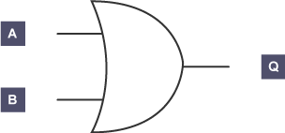
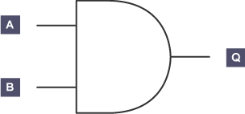
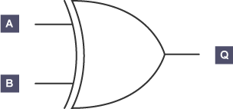
Logic gates
NOT
OR
AND
XOR
Notes:
There are four main logic gates – NOT, AND, OR and XOR (pronounced shore)

Slide 37
NOT truth table
NOT
Notes:
A NOT gate has just one input. The output of the circuit will be the opposite of the input. If 0 is input, then the output is 1. If 1 is input, then 0 is output.
The Boolean expression (formula) is written as Q = NOT A.
So if that is the case, what should the truth table look like?
Fill out the truth table together
Answer: A Q
1 0
0 1

Slide 38
AND truth table
AND
Notes:
An AND gate can be used on a gate with two inputs. AND tells us that both inputs have to be 1 in order for the output to be 1.
The Boolean expression for the AND logic gate is written as Q = A AND B.
Lets fill out the truth table together
Answer:
A B Q
0 0 0
0 1 0
1 0 0
1 1 1

Slide 39
OR truth table
OR
NOR
A NOR gate is a logic gate which gives a positive output (1) only when both inputs are negative (0).
Notes:
The OR gate has two inputs. One or both inputs must be 1 to output 1, otherwise it outputs 0.
The Boolean expression is written as Q = A OR B.
A B Q
0 0 0
0 1 1
1 0 1
1 1 1
NOR looks similar but functions differently. It is a bit like the opposite of AND, whereby instead of 2 positives (1s) equalling a positive (1), you need two negatives (0). We won’t use this gate very often but we will later today.

Slide 40
XOR truth table
XOR
Notes:
The exclusive XOR gate works the same as an OR gate, but will output 1 only if one or the other (not both) inputs are 1.
The XOR gate is indicated with the extra curved line to the left of the main shape.
The Boolean expression of XOR is written as Q = A XOR B.
Answers:
A B Q
0 0 0
0 1 1
1 0 1
1 1 0

Slide 41
Complex logic gates
Notes:
As mentioned, logic gates can be built up into chains of logical decisions (or mathematical equations like add and subtract). Can anyone remember what these three gates represent. Triangle with circle = NOT (Q = NOT A); Half moon = AND (Q = A AND B) and crescent moon = OR (Q = A OR B)
We are going to apply this logic to the Telraam traffic sensor

Slide 42
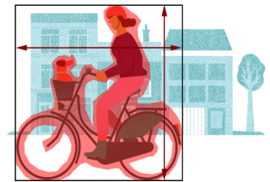
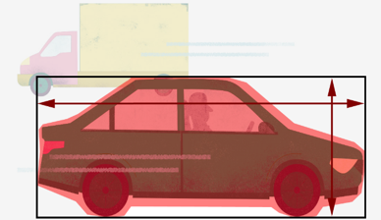
WeCount parameters
Axis ratio (width/height) Fullness
0001111
1011111
1100111
3.1m
80%
1.5m
Notes:
The computer scientists of WeCount have created an algorithm to compute transport types from a traffic camera in someone’s window. The input are pixels taken by the camera when a moving object passes. The instructions sent to the software in the Raspberry Pi computer are fullness + axis ratio (ratio between width and height). Once the information has been processed by the computer, these two parameters are compared automatically on a look-up table, and if both parameters fall within average ranges for one of the four transport types then they are assigned that category. The output, then, is transport type (heavy vehicle, car, pedestrian or cyclist).
So for example, if the computer works out that the axis ratio of the object is about 2 and the fullness is more than 80% then it will register the image as a car.
Axis ratio is worked out be dividing width/height. Fullness basically means how well the object fills its box. You can see that a car has less empty space than a cyclist, for instance. A computer cannot process an image in the same way as our eyes. Instead it can detect pixels. In the picture you see the computer has assigned 1s to the background/no object, and 0s to the object.
To work out fullness, the software program assigns 1s and 0s to each pixel of the image taken by the camera. 1s represent a moving object and 0s represent no object. The camera is already aware what the background looks like, so it ignores all of the static objects such as parked cars and houses. This method of assigning binary logic 1s and 0s is known as Boolean algebra. Boolean is one of the main data types in computer. The value of the data (1 or 0) is used to control the flow of the execution of programs. In other words, it allows the computer to make decisions. You can think of these values as on and off switches. 1 tells the computer to switch 'on' a logic gate and 0 tells the computer to switch it 'off'. These binary values can also be referred to as 'true' or 'false’. Typically computers run many logic gates at the same time, meaning there are multiple combinations of on/off occurring at the same time. For example, if two signals are present (e.g. fullness and black/white) there are four possible combinations: on/on, on/off, off/on and off/off. In a logic gate, each combination can be made to produce a different outcome.
Logic gate calculations are often represented as truth tables. These tables allow you to work through the logic for that block of code, assigning 1s and 0s.

Slide 43
Telraam logic gates
Notes:
All of these logic gates are used for determining whether one pixel (square) of the image captured (left-hand corner) is either a person, vehicle, bike or blank space. We need to work out which input value (a, b, c or d) is the blank space (1)
Do you remember what each gate means? What do you need to get a 1?
AND = both inputs have to be 1 (1, 1)
NOR = need two negatives (0) (0, 0)
OR = one or both inputs must be 1 (1, 0/0, 1/1, 1)
XOR = one or the other (not both) inputs are 1. (1, 0/0, 1)

Slide 44
The ½ ½ rule for creating truth tables
a b c d
0 0 1
0 0 0
0 1 1
0 1 0
1 0 1
1 0 0
1 1 1
1 1 0
Notes:
This is the beginning of a truth table. The columns, a, b, c and dare our input values.
Ask pupils to find the logic of these three columns (A= 4 0s, 4 1s, 2 0s, 2 1s, 1 0, 1 1 … they half each time). If this is the case, what is d? Fill out together
This is the rule we use when writing our logic tables
First figure out how many rows (in this case 8). Then half the 1s and 0s for the first variable, then half again for the second and so on.
If there were 12 rows, how many 1s and 0s would there be in each? (A =6)
We work out the number of rows by ‘powering’ the input values. So if we have 3 input values we’d write 2³ = 6. This is because each new input adds an exponential number of combinations (on/off switches). Like I mentioned, if one input is present there are two possible combinations – on/off. If there are two inputs are present there are four possible combinations: on/on, on/off, off/on and off/off. In a logic gate, each combination can be made to produce a different outcome.
If the camera is deciding between a pedestrian, bike, vehicle or blank space how many rows should the look up table be? (A= 16)

Slide 45
Telraam truth table
a | b | c | d | P | Q | R | X | Y | Z
Notes:
Work through the Telraam truth table as a class/fill out the first few columns and then leave the pupils to fill out the rest on the worksheet provided
a b c d P Q R X Y Z
0 0 0 0 0 1 1 1 1 0
0 0 0 1 1 0 1 1 1 0
0 0 1 0 0 0 0 0 1 0
0 0 1 1 0 0 0 1 1 0
0 1 0 0 0 0 0 0 0 1
0 1 0 1 0 0 0 1 0 0
0 1 1 0 0 0 0 0 1 0
0 1 1 1 0 0 0 1 1 0
1 0 0 0 0 1 1 1 1 0
1 0 0 1 0 1 1 1 1 0
1 0 1 0 0 0 0 0 1 0
1 0 1 1 0 0 0 1 1 0
1 1 0 0 1 0 1 1 1 0
1 1 0 1 1 0 1 1 1 0
1 1 1 0 1 0 1 1 0 0
1 1 1 1 1 0 1 1 0 0

Slide 46
Lesson summary
Logic gates tell the computer to perform simple actions (e.g. on/off)
Each logic gate has a function. When combined with other gates in a circuit they can be used to perform basic mathematical functions like add, subtract and multiply
There are four main logic gates – NOT, AND, OR and XOR
2^{x} = number of rows in truth table (x = number of inputs). ½ 1s and 0s, then ½ again
Notes:
At the simplest level, computers are little more than a collection of transistors (switches) and circuits. They connect together to form logic gates, which tell the computer to perform simple actions.
1s and 0s are Boolean binary numbers. In computer programming, data is divided up and organised according to type, eg numbers, characters and Boolean.
To output 1, AND = both inputs have to be 1 (1, 1), NOR = need two negatives (0, 0), OR = one or both inputs must be 1 (1, 0/0, 1/1, 1), XOR = one or the other (not both) inputs are 1 (1, 0/0, 1)

Slide 47
What have you learnt today?
Notes:
End of activity one
Homework/extension
Ask pupils to revise each of the four main logic gates and their function

Slide 48
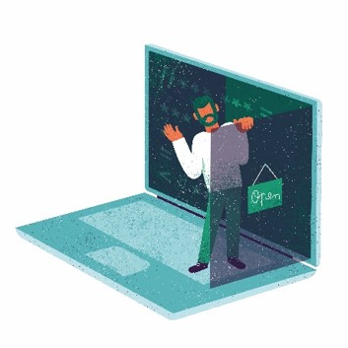
Data Diving and Storytelling
Lesson five
Notes:
This relates to worksheet five.
If using your own Telraam data, open your Telraam dashboard on the website https://telraam.net/en, selecting your sensor (street) and clicking ‘more data’
You will want to select the full counting time period in the date cells at the top of the page in order to answer the questions on the worksheet

Slide 49
Can you think of any examples of where data has been used to tell a story?
Notes:
Allow pupils a few minutes to jot down their answers to this question. Allow a few students to offer up examples. If they are struggling, prompt with examples from a recent newspaper story, or use Covid as an example, e.g. https://www.bbc.co.uk/news/world-56237778. Or this example on air pollution from the New York Times: https://www.nytimes.com/interactive/2019/12/02/climate/air-pollution-compare-ar-ul.html
Today we are going to see what data has been able to tell us about traffic in a local community. You could think of us as scientists, searching for the facts, and investigative journalists, looking to create the story. The data comes from a real-life traffic sensor that has been collected by a citizen on their residential street in a European city. The sensor has a view of the road and measures transport types (cars, pedestrians, cyclists and heavy vehicles) and car speeds all day, every day. The data has been collected each day for several months.
From listening to the description alone, what do you think we might see in the data?
Encourage pupils to think about trends they might see (e.g. weekend and rush hour peaks; lower traffic numbers during lockdown; perhaps more cars if the residential street is in the suburbs)

Slide 50
Open up the data file
Notes:
"Open up the excel file. What are the first things that jump out at you?" Encourage pupils to talk about average vehicles, look at interesting peaks in the day, and over time. "Lets answer the first three questions of the worksheet together". If more capable, allow pupils to answer all questions independently. If needed, recap on key terms, using the Powerpoint slides as a guide.
Note: teacher to select relevant questions before the class. Do not ask pupil to complete all answers as this will take too long. Leave some for homework.
Work through the answers on the worksheet, or collect for marking after the class. You have been provided with example answers. Award additional points for critical thinking.

Slide 51
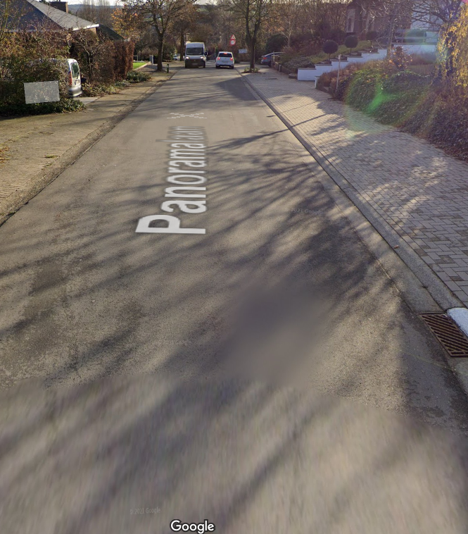
Task
Open the data file for case two
What immediately jumps out at you from the data? Are there any interesting peaks or gaps in the data?
Let’s answer the first three questions from the worksheet together
Notes:
"Open up the excel file. What are the first things that jump out at you?" Encourage pupils to talk about average vehicles, look at interesting peaks in the day, and over time. "Lets answer the first three questions of the worksheet together". If more capable, allow pupils to answer all questions independently. If needed, recap on key terms, using the Powerpoint slides as a guide.
Note: teacher to select relevant questions before the class. Do not ask pupil to complete all answers as this will take too long. Leave some for homework.
Work through the answers on the worksheet, or collect for marking after the class. You have been provided with example answers. Award additional points for critical thinking.
Ask: does anything unclear that needs explaining?

Slide 52
Percentage Change | Increase and Decrease
First: work out the difference (increase) between the two numbers you are comparing.
Increase = New Number - Original Number.
Then: divide the increase by the original number and multiply the answer by 100.
% increase = Increase ÷ Original Number × 100.
Notes:
Use if students need help answering worksheet. Delete if not needed.

Slide 53
Notes:
Use if students need help answering worksheet. Delete if not needed.

Slide 54
Statistics
Why is it important? To understand the distribution and significance of data; to test your hypothesis
Three fundamental concepts:
Mean
Median
Mode
Notes:
Use if students need help answering worksheet. Delete if not needed.

Slide 55
Statistics
Why is it important? To understand the distribution and significance of data; to test your hypothesis
Three fundamental concepts:
Mean: average value
Median: middle value
Mode: most frequent value
Notes:
Use if students need help answering worksheet. Delete if not needed.

Slide 56
Lesson summary
We can find stories in data
Largescale datasets give us a clearer, and more reliable story
Three basic statistical concepts:
Mean: average value
Median: middle value
Mode: most frequent value

Slide 57
What have you learnt today?
Notes:
End of activity
Homework/extension

Slide 58
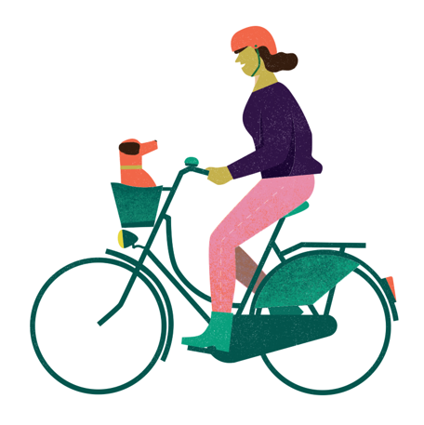
Sustainable Travel Where We Live
Lesson six
Notes:
This relates to lesson six. There are no worksheets for this session

Slide 59
Is transport in our city sustainable?
Notes:
Ask pupils to think about transport in the city. Write down answers to: is transport in this city sustainable? Can we safely get from A to B? Are our transport choices having a small or a big impact on the environment? Is it easy to make the green choice?

Slide 60
Three groups
Group 1:
History
Information source
Articles and reports from Google
Presentation
Timeline of key events
Group 2:
Differing views and current changes
Information source newspaper clippings /printed material
Presentation
Key arguments for and against developments/plans
Group 3:
Proposed actions
Information source
Local climate action plan
Presentation
Set of measurable objectives, organised into theme
Notes:
Today we are going to learn more about transport where we live, how it has changed over time and how it is and needs to change for a sustainable future. In front of you is a selection of papers and magazines, and a copy of our local climate action plan. Your task is to research 1) the history of travel in [our city/town]. 2) explore the current urban travel issues and the various views on these issues 3) find out what do we need to do to reduce our impact by looking at the transport section of the climate action plan and putting forward some ideas for change."
"You will be divided into one of three groups." Explain what each group will be investigating, with what sources, and how they will present findings (see slide)."Be prepared to present your findings later".
"But first: What makes a reliable data source?" Show slide of different data sources and encourage students to think through what makes sources of information reliable or not. Read out one of the possible answers on slide to get the ball rolling.

Slide 61
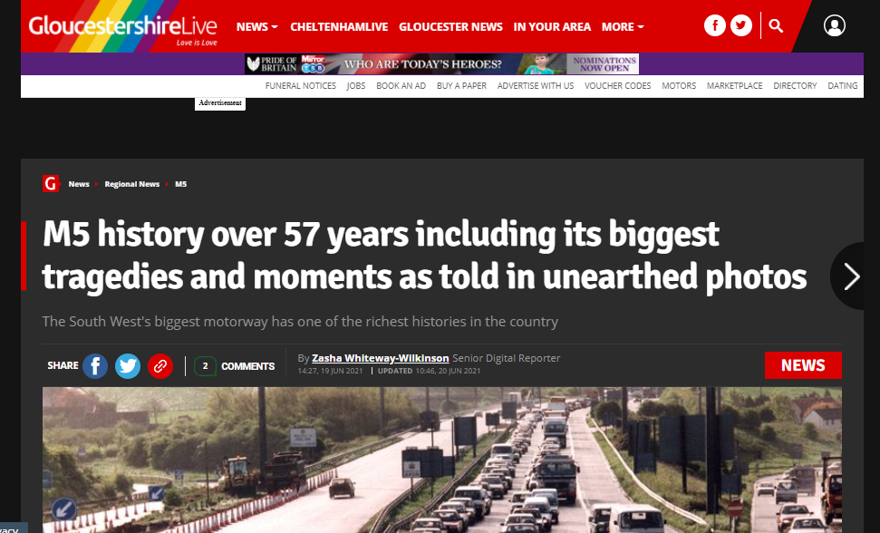
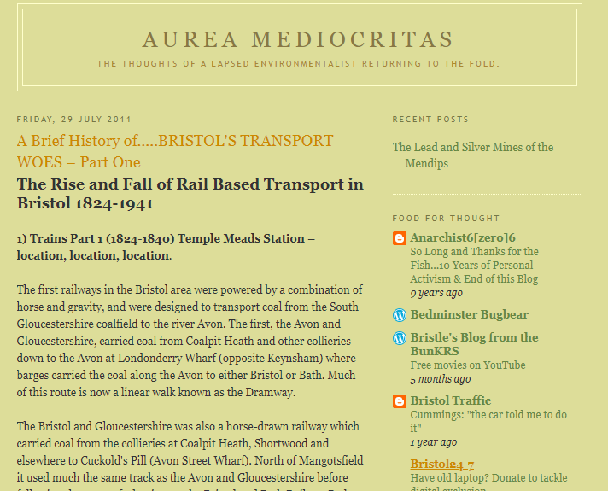
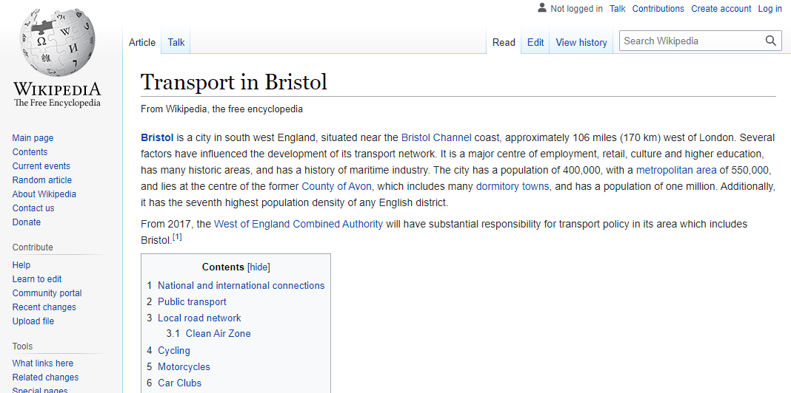
Researching transport and mobility over time
Notes:
What are reliable sources of information?
Examples above, clockwise from left: Government report, local newspaper with historic photos, Wikipedia, blog
Discuss what makes a reliable source of information. E.g. is referenced; based on fact (data) not gossip/opinion; peer reviewed
Option to use these sources if studying Bristol:
Early history: http://aureamediocritas-tonyd.blogspot.com/2011/07/brief-history-ofbristols-transport-woes.html
Last 60 years of the M5 motorway: https://www.gloucestershirelive.co.uk/news/regional-news/gallery/m5-history-over-57-years-5548411
https://en.wikipedia.org/wiki/Transport_in_Bristol
https://assets.publishing.service.gov.uk/government/uploads/system/uploads/attachment_data/file/761929/Historyoftransport.pdf (pages 3-5 only)
Split class into three groups and set to task on one of the three aspects of research. Roam the room, offering help where needed. Give pupils a 10 and 5 minute warning, so they have time to create a PowerPoint slide/ rehearse a 4 minute presentation. Encourage everyone from the group to speak.

Slide 62
Facts from our local Climate Action Plan
Notes:
Write a few facts from your local climate action plan (use as an example as to how you would like students to present data)

Slide 63
Presentations
Notes:
Allow each group about 4 minutes to explain the data sources they used, their method for looking up the information, and the evidence they have found. Ask the class: "what do you think about these findings?" "Do you think the sources of information are reliable?"

Slide 64
Lesson summary
We can gain information from different sources… some are more reliable than others
It is important to gather evidence from a variety of sources to understand context (history), viewpoints, and future plans, in order to influence change in our cities

Slide 65
What have you learnt today?
Notes:
End of activity
Homework/extension

Slide 66
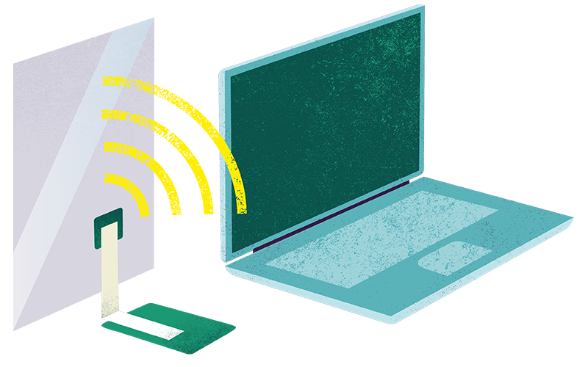
Can AI Solve the Climate Crisis?
Lesson six
Notes:
This relates to lesson six. There is no worksheet for this session.

Slide 67
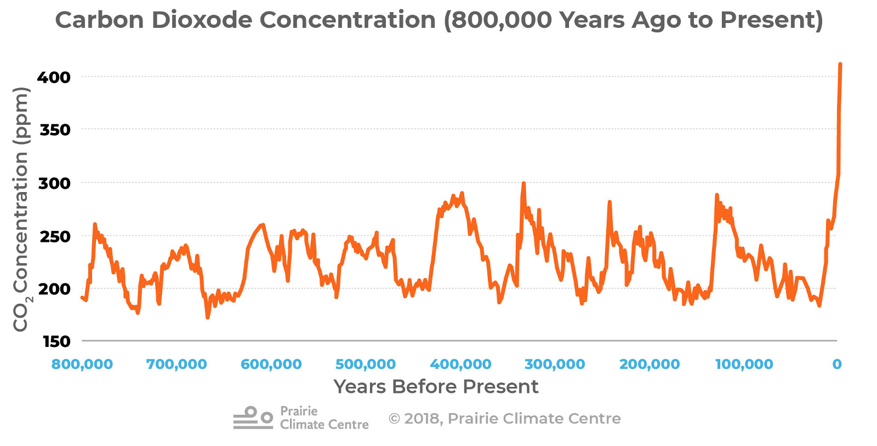
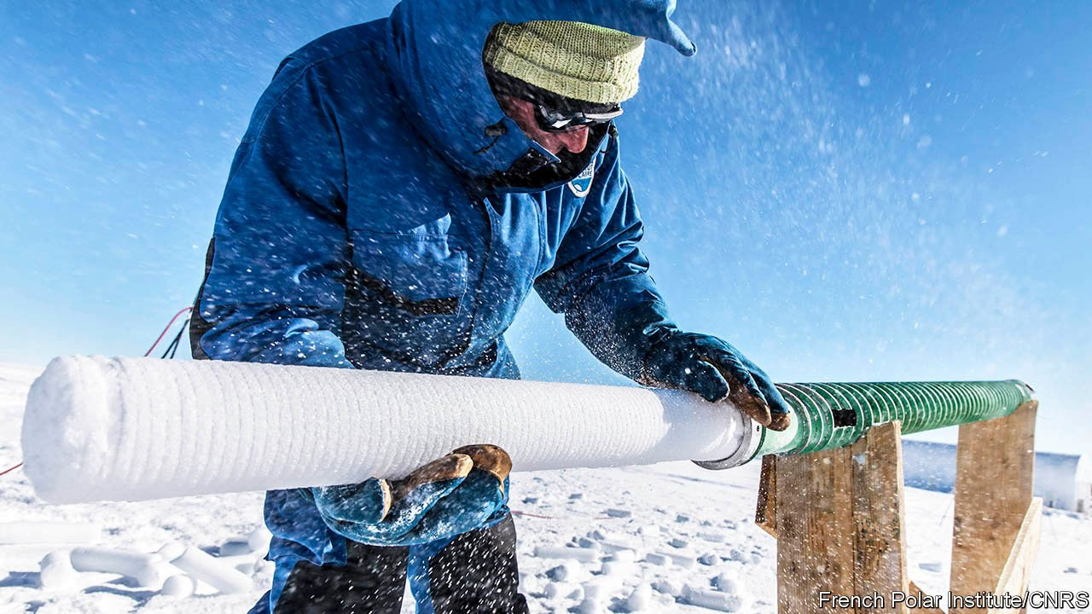
Notes:
Has anyone seen a graph like this before? This is often known as the ‘hockey stick’ graph, due to the big uptick at the end. This massive uptick show us an exponential increase in CO2 concentrations in the past century, since the start of the industrial revolution.
(explain industrial revolution if needed)
The carbon dioxide (CO2) record is from the EPICA (European Project for Ice Coring in Antarctica) Dome C ice core covering 0 to 800,000 years before present, 3233m above sea level. Ice cores are proxies for CO2 concentrations, like a time capsule containing memories of the past. Scientists drill down into the Antarctic sea ice to pull out ice cores. They then measure co2 concentrations (bubbles in the ice). You can think of it like fizzy water. The more fizz the more carbonation.

Slide 68
What causes CO2 to rise?
Notes:
Human activities (driving, flying, shopping, eating, wasting, consuming, the way we produce food, etc)
Natural variation

Slide 69
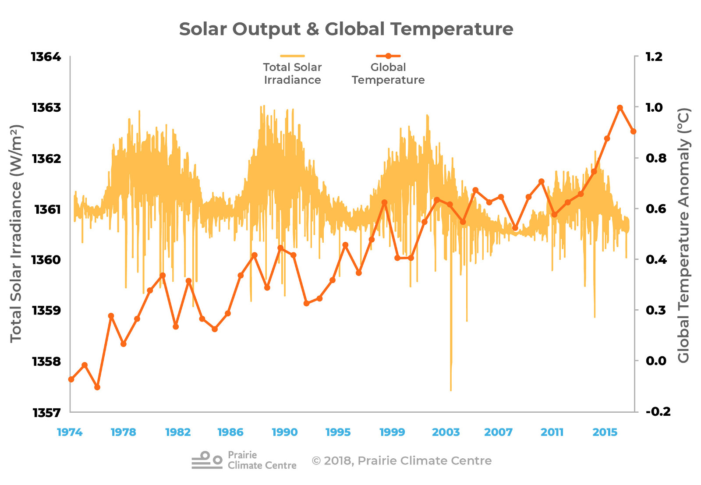
Notes:
Can anyone describe what this graph is telling us? What are the trends over time?
Historically solar output from the sun has influenced our climate, and in fact a period of low solar output is thought to have led to the ‘mini ice age’ over 200 years ago, which saw the Thames freeze over.
The graph shows the warming observed around the world compared to the 11-year solar cycle. This graph plots the Total Solar Irradiance (TSI; W/m2) and global land-ocean temperature anomalies (°C; relative to 1951-1980). The TSI satellite record extends back to 1974. There is no correlation between rising global temperatures and solar variation.
What does correlation mean? (A: the relationship between two variables)
We are at the low end of the most recent 11-year solar cycle, so the past decade of warming has taken place despite low output from the sun. e.g. it is likely not the result of natural variation. What other natural variation may affect warming? (A= volcanic activity and orbital change)
https://climateatlas.ca/why-climates-change

Slide 70
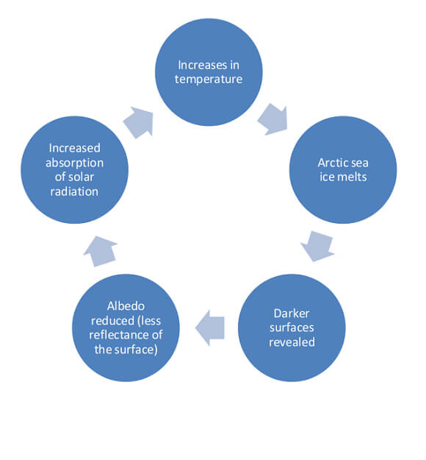
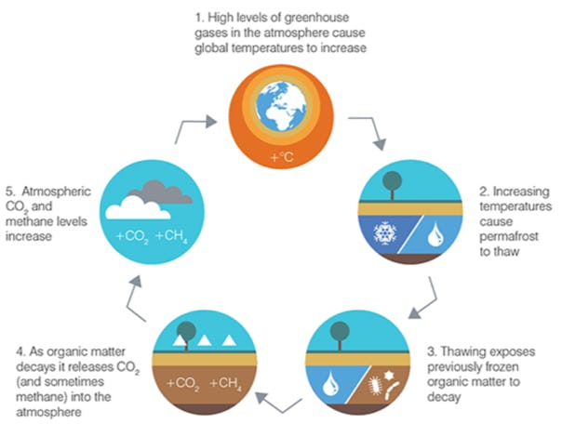
Notes:
Anyone know what these are? A: positive feedback loops
It is hard to predict how the climate will behave in the future due to the number of variables at play. There are many inputs, from different types of human activities, from deforestation to fishing to driving, and each of these activities has a knock on effect to everything else as everything is interconnected. If we make one small change to the planetary system it can have a knock on elsewhere in the system.
For instance, if we chop down trees, not only do we lose vital habitat for animals, but we increase CO2 locked up in the trees. We also release CO2 locked up in the soil. As the exposed soil dries its fertility declines, making it harder for plants to grow in the future. Fewer trees means less evapotranspiration and therefore less rainfall elsewhere. And so on.
There are various feedbacks occurring in nature in response to climate change, many of which we are currently unaware of. We do know some like how as heat increases, sea ice melts. This melting exposes dark waters, which absorb more heat that the ice itself, further increasing warming. This feedback is known as the albedo effect. Or as temperatures increase, permafrost melts, increasing CO2 and methane into the atmosphere.
Due to all of these variables and feedbacks there will always be some uncertainty in the simulations about the future climate.
https://www.thearcticinstitute.org/global-carbon-budget-permafrost-feedback-loops-arctic/

Slide 71
Impacts of climate change in the UK
Impacts around the world
sea levels could rise, covering low lying areas, in particular east England
Scottish ski resorts may have to close due to lack of snow
droughts and floods become more likely as extreme weather increases
increased demand for water in hotter summers puts pressure on water supplies
sea level rise will affect 80 million people
tropical storms will increase in magnitude (strength)
species in affected areas (eg Arctic) may become extinct
diseases such as malaria increase, an additional 280 million people may be affected

Slide 72
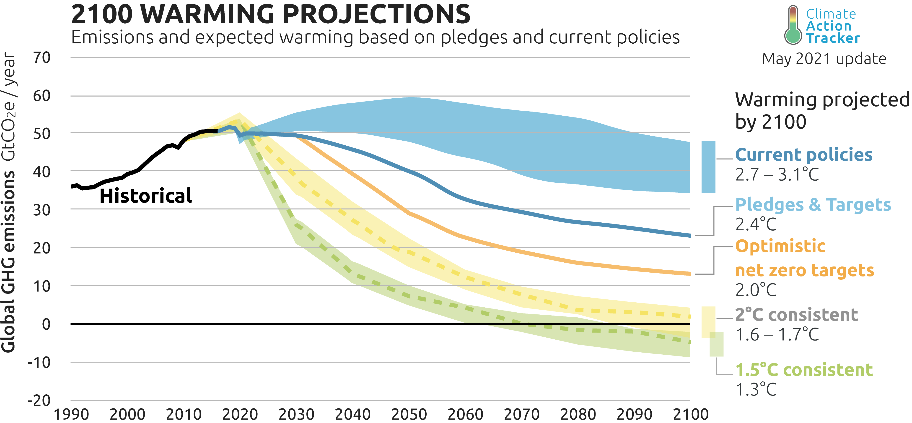
Notes:
Scientists have made projections into the future about CO2 emissions and global warming (which we have shown correlate). To keep temperatures below 2c and prevent runaway climate change, we have to act now and ensure all countries reach net zero carbon emissions by 2030.
So what role does AI play in all of this?

Slide 73
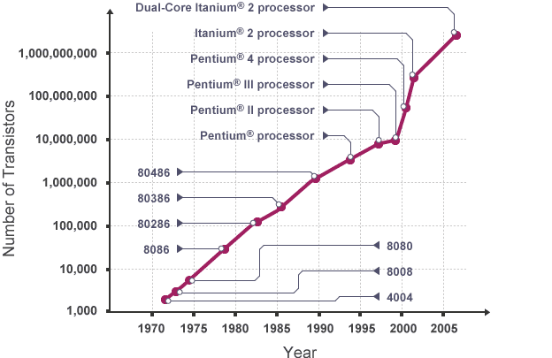
Moore’s law
Notes:
Since the 1970s, computer processing, along with CO2 emissions, has also increased exponentially
Moore's Law states that the number of transistors on integrated circuits doubles every two years or so. [If you did the previous activity: Think about the Telraam circuit we looked at. In a few years, as it learns more about its environment and becomes more sophisticated, it’s processing power could increase exponentially. Maybe it will be able to count transport types in the dark, or perhaps it could detect types of bikes, scooters, maybe even animals… ]
Computers have followed the trend of Moore's Law which means CPUs and memory are improving at exponential rates.
With such a speed of change, perhaps we can put computer to good use… Today we are going to discuss whether we think artificial intelligence can solve the climate crisis

Slide 74
AI for good
https://youtu.be/mJ6rjJiIHyo
Notes:
Play video.
How did the video make you feel? Allow space for pupils to bring up their concerns and hopes.
Sensors and machine learning can help mitigate against emissions and allow us to adapt to global warming so we can reduce our vulnerability. Like they said in the video, scientists are coming up with ways to bring together different models on the climate and combining it with data on how ecosystems work so we know how to intervene.

Slide 75
Smart sensors
Notes:
Can anyone think of a smart sensor? A device/programme that learns from the data that it recieves over time?
Allow time for a handful of answers. (Answers include: Alexa, OK google, Siri, Spotify, Netflix, Smart Meters). This idea, of technology learning over time is referred to as machine learning.
We can use smart devices in our home to regulate the temperature and control devices, making us more aware of our energy usage. These tools can learn about your habits over time and suggest ways to make your lifestyle greener. This process is called machine learning

Slide 76
AI and machine learning
https://youtu.be/ad79nYk2keg
Notes:
Let's watch this video to learn more…
Stop at quiz. What do you think is the answer to the quiz? Answers: A. Sophia has citizenship B. There are robots with muscular skeletal systems C. AI can recognise emotions by looking at face patterns. D. Not yet invented (end at 5minutes)
Ask: What are the three capabilities that make a technology artificially intelligent?
(A = the ability to adapt; reasoning; problem solving)
What do you think about having AI implants in the future? What are some of the ethical implications?
Option to play 2m 40 of this clip of Sophia: https://youtu.be/E8Ox6H64yu8

Slide 77
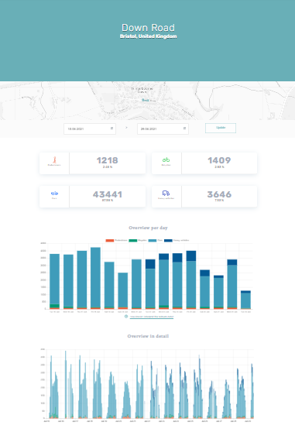
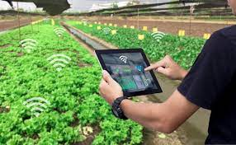
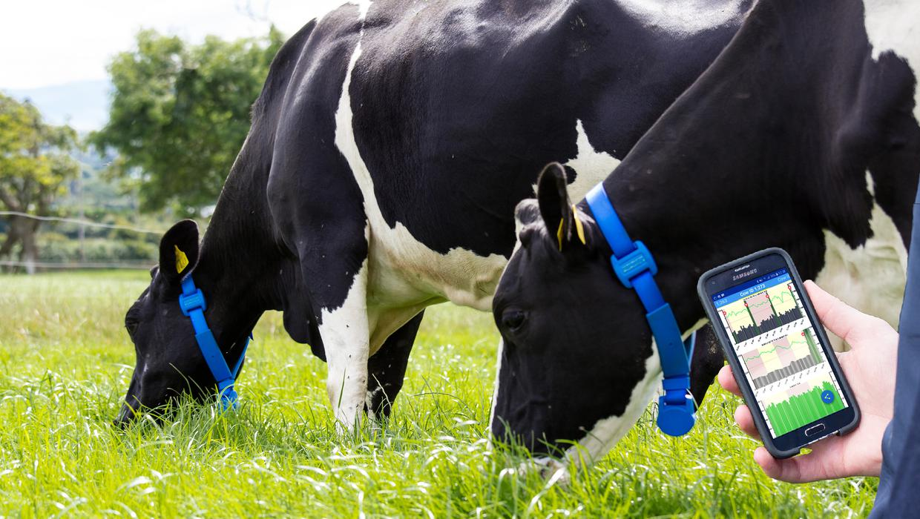
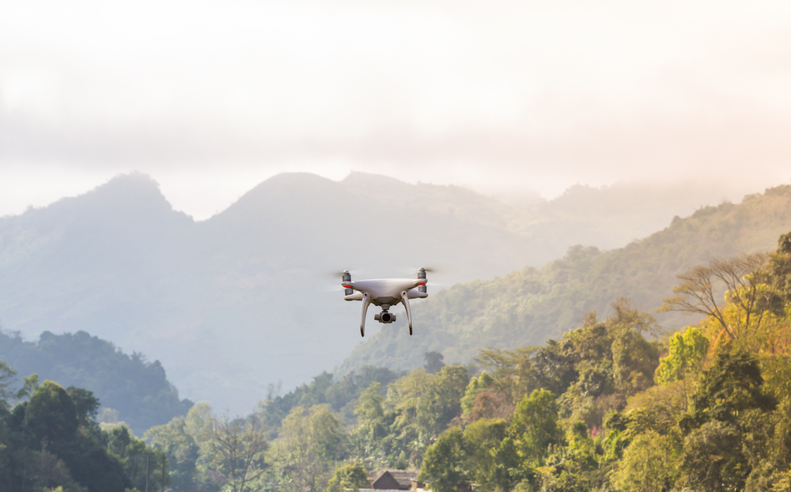
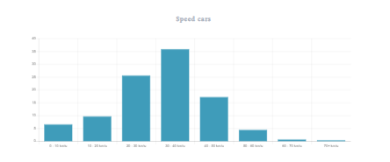
Smart monitoring
Notes:
Machine learning to improve the environment is called “smart monitoring”.
Smart monitoring devices and sensors can be attached to crops to monitor their growth constantly. Anomalies can be detected and resolved immediately. Parameters such as hydration, plant nutrition, and diseases can be monitored in real-time. The data can then be utilized to determine irrigation patterns and recommend the best watering cycles. A better variety of crops having high nutritional content can be farmed using AI, which can also lower our use of harmful pesticides.
Sensors can be used to study animal behavioural patterns, such as migration, mating, and feeding habits. The sensors enable the monitoring of these species non-invasively.
They can also help protect large forest areas. AI-enabled drones collect data to map the area and monitor changes. For instance, the images are compared overtime to detect species decline and poaching routes.
Machine learning can also improve the monitoring of traffic and air pollution in real-time. Tools can identify sources of air pollution quickly and accurately. For example, indoors they can detect when a gas leak in an industry occurs or when air purity levels fall below a certain level. Outdoors, they can pick up on gases emitted from vehicles overtime, or measure the changes in traffic volumes or speeds, like the WeCount. AI-enabled traffic lights, too, can contribute to reducing air pollution. They can use machine vision to adjust to the flow of traffic, minimizing the driving time.

Slide 78
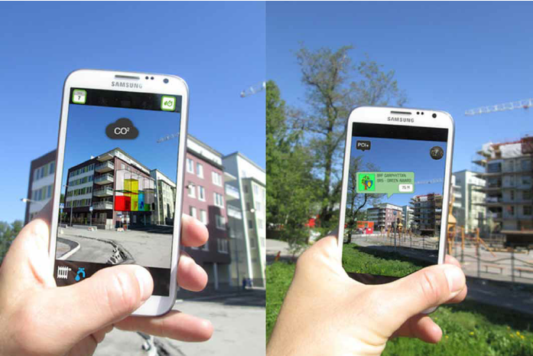
Artificial intelligence: AR
Notes:
Big companies like Google, Microsoft and Apple are always seeking to improve the intelligence of their products. They are all exploring how to make smartphones more intelligent through AI. For example, you may have heard of Google Glass that displays information onto a mini projector in front of your eye.
AI can be used for good, such as this app that ‘augments reality’ to show you the carbon footprint of buildings.

Slide 79
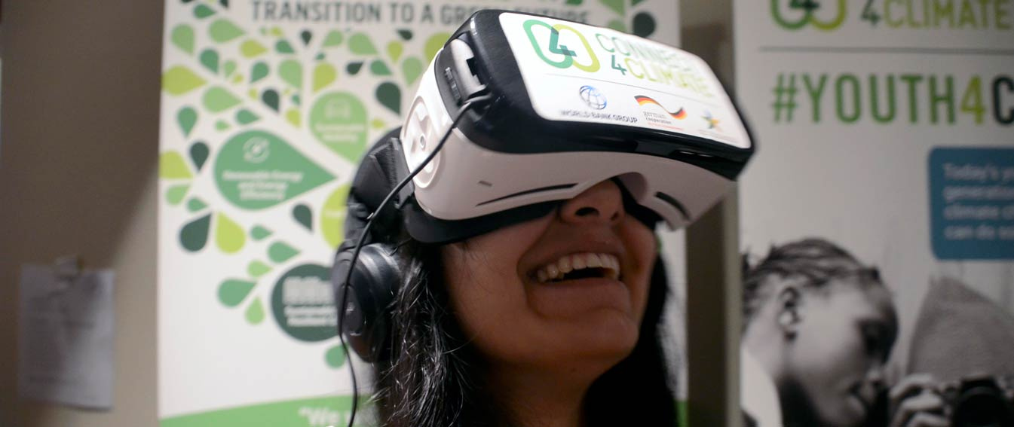
Artificial intelligence: VR
https://www.connect4climate.org/initiative/immersive-sustainable-development-virtual-reality-role-uniting4climate
https://www.unep.org/news-and-stories/story/experience-your-carbon-footprint-vr
Notes:
There is also virtual reality, which can put the viewer inside of an environment they may not be familiar with.
Play the first few minutes of the video in the first link. Use the arrows to show how the video is 360. This is what we would see if we were wearing a VR headset.
How did the video make you feel?
VR can build empathy and understanding towards other people and to nature.
Play the second video and again use the arrows to move around the world. Ask pupils how they feel while watching the clip.
This video could be given your data about your own carbon footprint and create a video tailored to your impact.

Slide 80
Play with kit
Notes:
Option for students to play with kit, AR app, watch VR videos, or similar, if technology available. Delete slide if not possible.

Slide 81
Do you think AI can solve climate crisis?
Is it enough? What else needs to change?
Notes:
Encourage pupils to debate the ethics, costs, sustainability and feasibility of various technologies. "What else needs to happen to reach net zero by 2030?" (Show slide 7 if students need an explanation on net zero). You could draw on geo-engineering, as well as large scale renewable energy projects and discuss how they could be seen as more ethical (e.g. do not use our data). Encourage pupils to disucss the need for policy and behaviour change.

Slide 82
Lesson summary
Hockey stick graph shows exponential increase in CO2 since the beginning of the industrial revolution (1900s-today)
Dramatic rise in temperatures, above background levels and not in correlation to solar output
Feedback loops exacerbate warming
Exponential increase in processing power
AI can help us learn about the environment and its feedback loops, advising us how to intervene, in a process known as machine learning. Examples include smart monitoring, and AR/VR can be useful educational tools
However, there are ethical implications. Do we want AI implants?
Technology is only a small part of the solution

Slide 83
What have you learnt today?
Notes:
End of activity
Homework/extension

Slide 84
Homework: Design an AI to solve the Climate Crisis
Notes:
Your homework [or do in class if time/no kit to play with], is to come up with an AI tool to solve the climate crisis. It could be a VR video, AR app, robot that learns…. Whatever you choose, I want you to follow this process.
Investigate the issues (ocean acidification, deforestation… a particular issue related to climate change)
Find out how it affects your target audience (stories you find online/ask them – could be young people, old people, people living in areas most vulnerable to climate change…)
Define the problem
Imagine how you might solve the problem
Sketch some ideas (think outside of the box), listing the features the tool will have
You won’t have time to test or improve, but I’d like you to write success criteria. How will you know that your tool has been successful, and served its purpose?

Slide 85
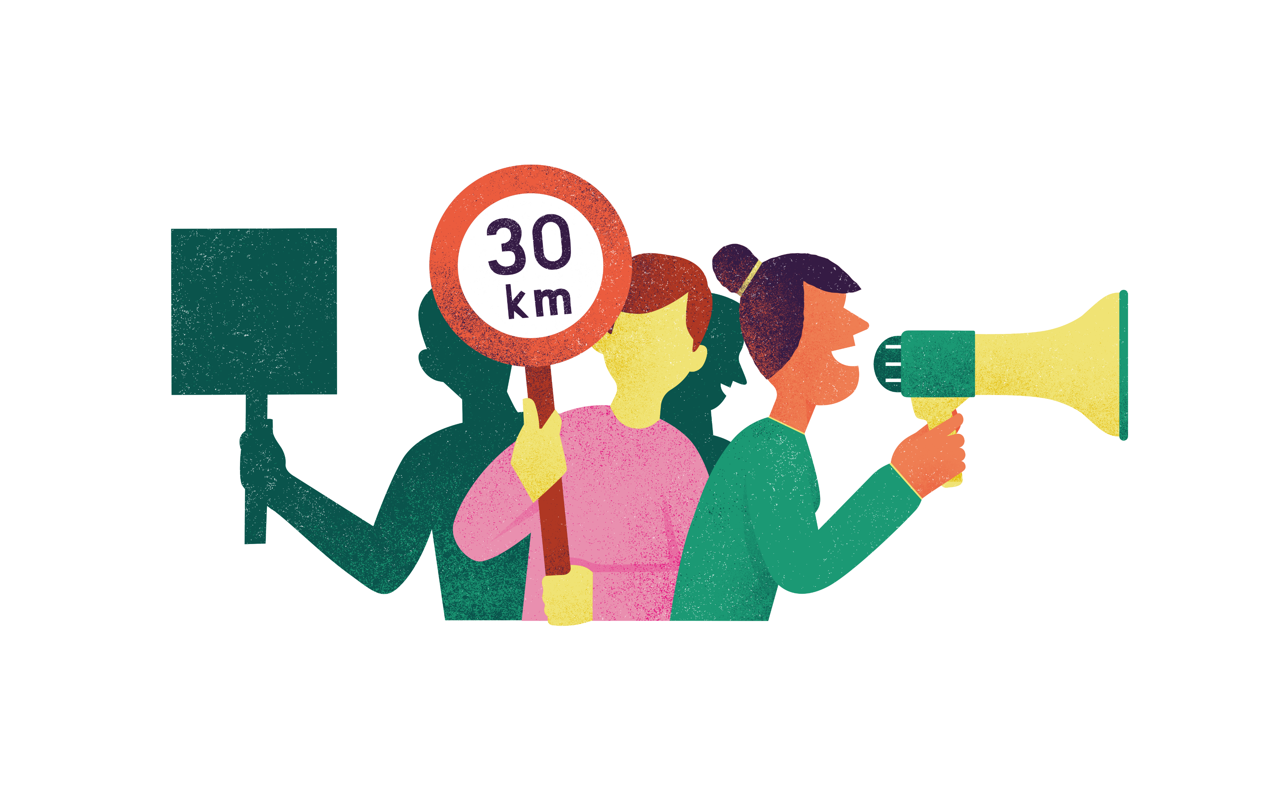
Active Citizen: diverse opinions
Lesson eight
Notes:
This relates to lesson eight. There are no worksheets

Slide 86
What does it mean to be an active citizen?
Notes:
5m
What does it mean to be an active citizen?
A: it means that you have done something to create change in your community.
Ask for examples pupils have seen/heard of. E.g. getting the council to introduce food waste in a block of flats; working with residents to get a cycling bay installed; joining a litter pick…
Can you think of an example where you have taken action in your community?

Slide 87
We need to be active on climate change.
Notes:
Do you agree with this statement? Who needs to be more active? What action can we take? (refer back to Assembly slides to explain how transport is a leading cause of climate change in cities).
Do you think people in other parts of the city/town would agree? (Think about poorer people, or wealthier people, as an example)

Slide 88
What action shall we take together?
Notes:
As a class agree on an action to take. Option for pupils to make an elevator pitch on their idea and for pupils to vote. If you are drawing this class out over several sessions, you could encourage pupils to record an explainer video with a call to action.
NOTE: if you have not used any of the previous lessons, or not covered much on climate chage, begin by playing this video before deciding upon actions: https://youtu.be/dcBXmj1nMTQ.

Slide 89
What is our research question? And what type of investigation do we need to carry out to answer it?
Notes:
What is the question we want to answer? Work with the group to craft quality questions that are clear and not biased in favour of a particular opinion.
(e.g. interviewing local people; obtaining data from pollution monitors/collecting our own data)
How would we go about obtaining reliable information? (ask a diversity of people/have multiple sensors and compare with existing data)
How do you know the data is accurate? (trust opinions/views; see if other people back up these opinions; see if other data backs up our observations)
Agree a strategy for gathering information, e.g. carrying out conversations in the community, questionnaires, holding a dialogue, focus groups, researching via the internet asking local organisations and institutions for information. If the group is collecting information on a sensitive issue, such as sexual and reproductive health, or gender-based violence, they need to think about how they can collect information in a way that respects confidentiality and keeps participants safe, but at the same time allows for open discussions. For instance, focus group discussions with single-sex groups led by someone of the same sex are likely to be more effective and less threatening than mixed-sex groups.
Discuss who you should talk to and the questions you want to ask. Talk to everyday people – for example, neighbours, kids, grandparents, librarians, shop clerks, taxi drivers and waiters. Read the local paper, and follow the local news. Consider asking journalists or the editor of the local newspaper about the kinds of views they hear on the issue. Talk to local leaders – for example, public officials, business people, religious leaders, activists, and teachers – but also be sure to talk to representatives of groups that may be under-represented in leadership positions in the community, such as women’s organisations, disability organisations and youth organisations. They might have different perspectives on the issue that also need to be considered. Use local libraries, visit local non-profit organisations and local councils.

Slide 90
Who might be for and against our proposed action? How do we win support?
Notes:
20m
Ask pupils to identify different people in their communities – teachers, farmers, politicians, school pupils etc – ask them to imagine what the issue looks like through the eyes of different stakeholders. What’s their agenda? What’s at stake for them?
Decide on what is at the heart of the issue and think about a provocative statement that will create a debate. For example, if the issue was about young people and air pollution, the statement could be: ‘We should pedestrianise streets around school gates, or ban cars from driving down them during certain times of day’.
Decide on two characters that could have differing opinions: one is ‘for’ the statement and one is ‘against’. Ask them to sit in the middle of the space. They have teams behind them who can freeze the action and offer advice once the debate has started. It’s important for facilitators to hold the space. In small groups, use the same question/case and think of other settings where this debate could take place. Try to find three or four contexts and create a short role-play that focuses on the issue. Who is being represented? How is this different? What other perspectives do we see? What does this tell us about the issue? Who’s invested in this issue and what aren’t they prepared to give up?

Slide 91
Reflection
Notes:
Reflect on the role playing activity. What did you learn about other people's views? Did anything surprise you? How might these differences of opinion be affecting current levels of climate action? How do we ensure that everyone has a voice, yet managing to increase climate action and policy change?

Slide 92
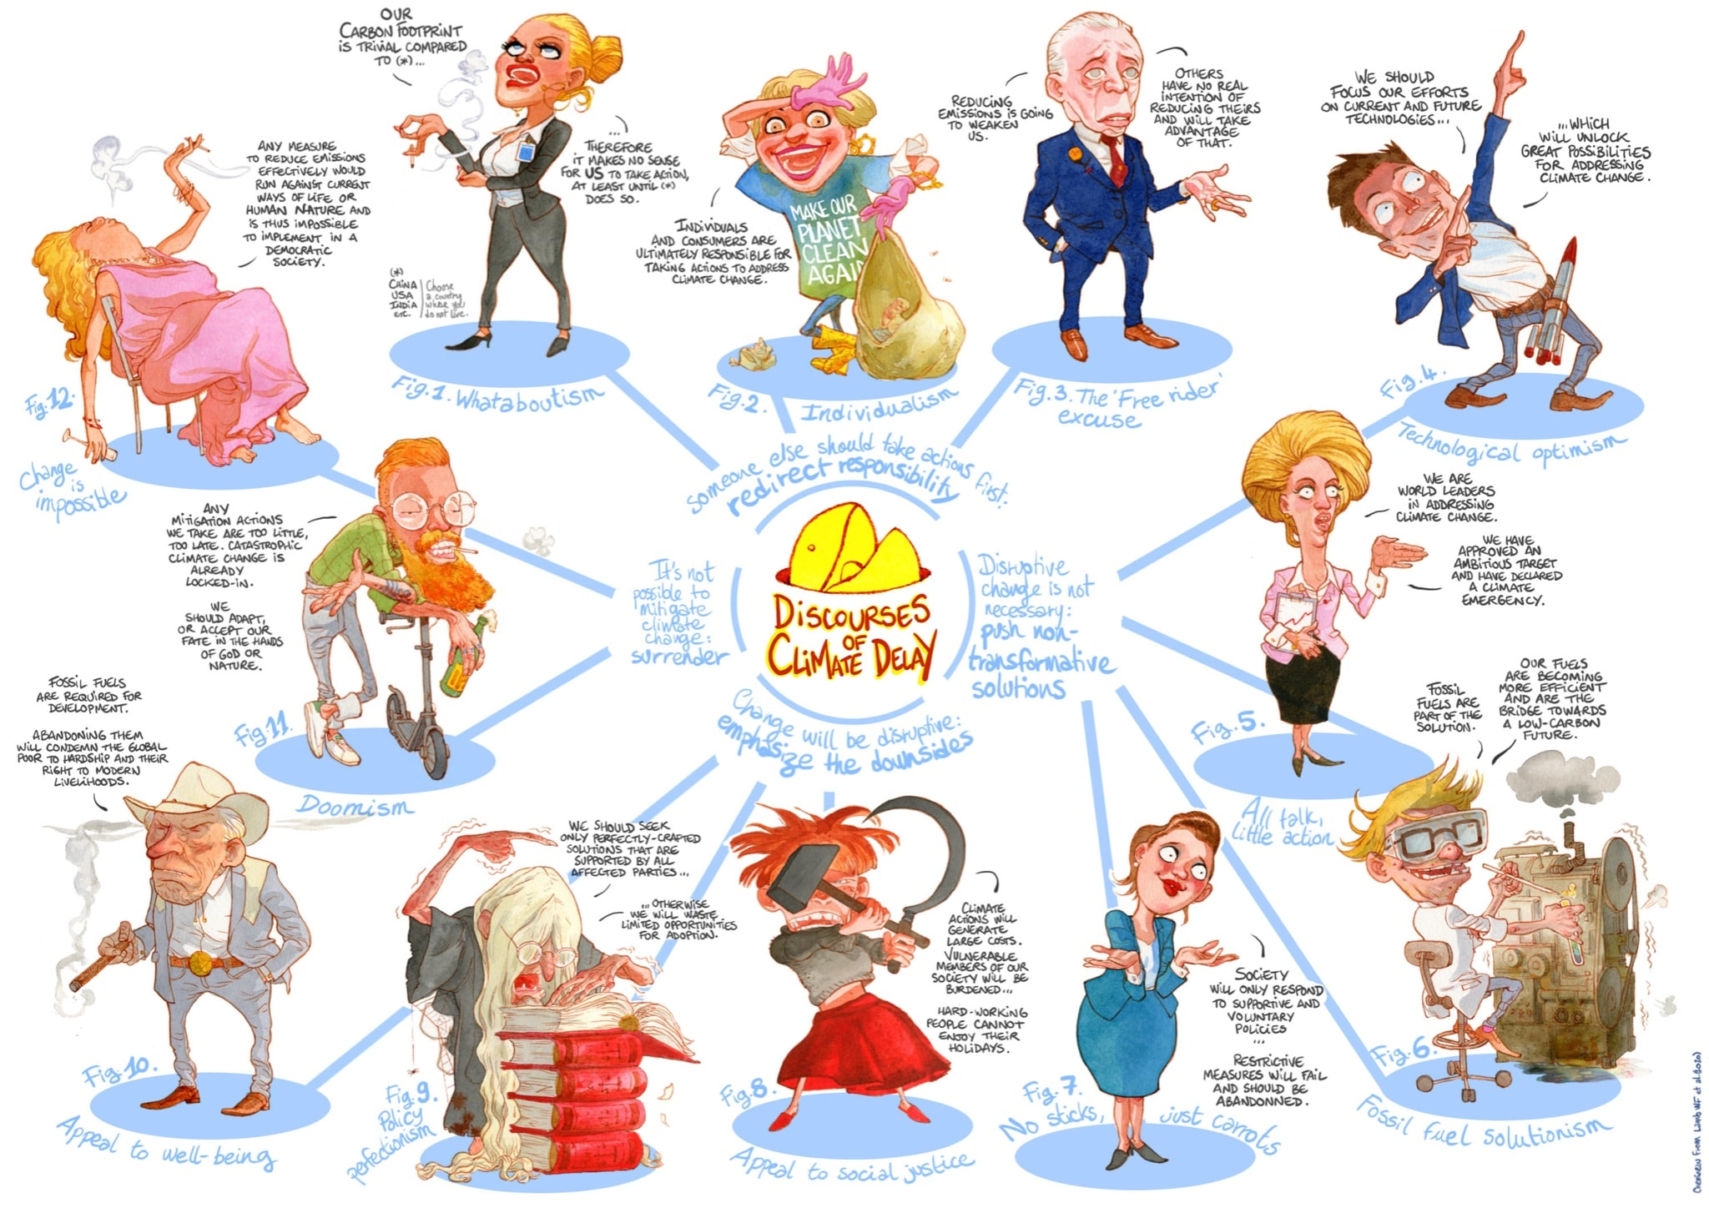
Notes:
Do you know anyone like this? Can you relate to these?

Slide 93
Lesson summary
Active Citizen: a person who actively takes responsibility and initiative in areas of public concern such as crime prevention and the local community.
People have varying and often strong issues on certain issues and it is worth bearing these in mind when developing our action projects so as to consider their concerns

Slide 94
Homework
Notes:
Homework:
Gather data from the community affected by the issue, asking them issues about the environment (i.e. what they love and what needs to improve)
map and identify community concerns through asking questions in the community.
Group similar concerns and perspectives to find main themes
Name the problem. Outcome: a statement that describes the common problem.

Slide 95
What have you learnt today?
Notes:
End of activity
Homework/extension

Slide 96
Active citizens
Part two
Notes:
This relates to worksheet three.

Slide 97
What did you find out?
Notes:
Ask pupils to share findings from their research into community needs and interests (or role play if homework not set).
Do you want to revise your proposal based on the input from the community?

Slide 98
Intervening in the system to:
Change behaviours and attitudes
Build new relationships, networks and collaborations (within community or between community and other organisations)
Instigate institutional changes
Change public policy
Change communities public life (e.g. culture of recycling)
Notes:
When we take action we are hoping to: change behaviours and attitudes, build new relationships, instigate institutional change, change public policy or public life. What changes do we want to see from our action? Given our limited time and resources, what shall we prioritise?
In a group decide on priority and intervention
Your action project doesn’t have to be big or costly projects, they’re often more effective when they’re small, strategic interventions (tweaks) which benefit the wider community.
The way in which you choose your social action and plan the activities is important – the process and approach is often an important part of the outcomes.
By ensuring the programme is ‘owned’ by a broad diverse group you can help to increase the impact and sustainability of the social action.
Choosing not just to focus on the problems but also recognising the opportunities and assets your community/ies has will open up more possibilities for powerful interventions.

Slide 99
How will we engage our audience to affect change?
Notes:
E.g. write persuasive letters, create a photo campaign, twitter/social media campaign, e-petition and YouTube video.
Share video as an example: https://vimeo.com/230151586
What type of organisation are Friends of the Earth? (a campaign organisation) (Option to show another example with Living Streets: https://www.livingstreets.org.uk/policy-and-resources/our-policy/air-pollution)
We need to have a call to action

Slide 100
Indicators of success
a person getting sunburnt
a clean river
improved road safety
reduced sexual harassment in public spaces
improved quality of cooking in a restaurant
improved education in schools
improved participation of young people in local decision making
Notes:
Ask pupils to raise hands and answer how they would measure success of interventions to improve these following situations
a person getting sunburnt (red or burnt skin). • a clean river (more fish and wildlife, the clarity of the water). • improved road safety (fewer accidents on the road). • reduced sexual harassment in public spaces (fewer reported incidents, better respect and understanding expressed toward each other). • improved quality of cooking in a restaurant (more customers and better feedback from customers on the quality of the food)... • a better relationship between husband and wife (fewer arguments, more expressions of love, free from violence). • improved education in schools (improved results by the students). • improved participation of young people in local decision making (higher number of young people participating in local community meetings, more young people on local government decision making committees)

Slide 101
How will we measure success of our action?
Notes:
Write this down on your worksheet, and begin to fill out action plan (worksheet)

Slide 102
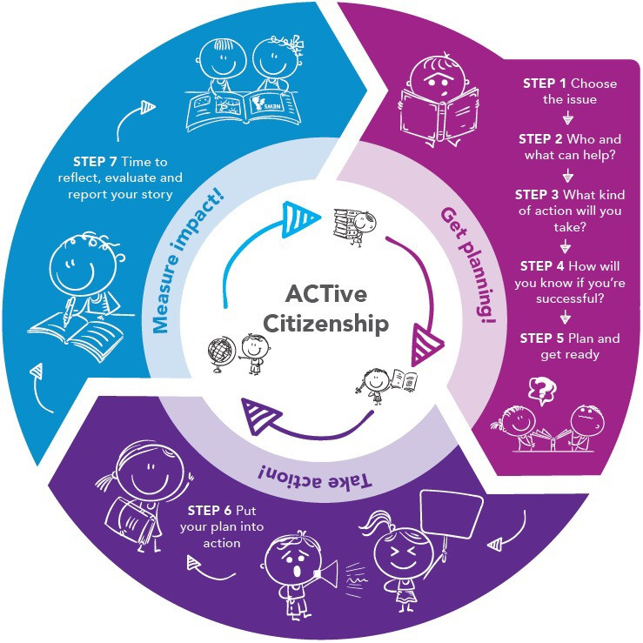
Plan your social action
Notes:
Plan your social action using the worksheet provided
I will be on hand to answer any questions you have

Slide 103
Present your proposal
Notes:
Present proposal and receive feedback

Slide 104
How could we improve our design?
Notes:
How could you improve your design based on the feedback?

Slide 105
Homework: option 1
Develop an awareness raising campaign about the problem of cars and how their solution could contribute to reducing the problem. Encourage them to write persuasively. What will win over your audience?
Notes:
develop an awareness raising campaign about the problem of cars and how their solution could contribute to reducing the problem. Encourage them to write persuasively. What will win over your audience? Each group can select from/or be assigned a medium through which to convey their message (video, Canva poster, podcast, news article). Explain how marking will work (i.e. points for originality, for team work, for evidence-based communications, for clarity of message, for persuasiveness). Option for pupils to score each idea the following week.

Slide 106
Homework: option 2
Examine ways UK citizens can bring about change to improve the situation of people who lack access to clean air. In your response, you should refer to the information provided and examples from your own knowledge.
Explain one feature of the action plan for your investigation
Discuss how you decided on the issue of your investigation
Analyse ways in which your research helped you carry out your investigation
Evaluate the extent to which your investigation was an example of citizenship
Notes:
Examine ways UK citizens can bring about change to improve the situation of people who lack access to clean air. In your response, you should refer to the information provided and examples from your own knowledge.
Explain one feature of the action plan for your investigation
Discuss how you decided on the issue of your investigation
Evaluate the extent to which your investigation was an example of citizenship
Your answer should refer to:
The range and type of research you did
How your initial research helped you to choose the issue to investigate
How research helped you to identify your investigation aims
How you made sure your research was reliable
How your research helped you to develop your investigation

Slide 107
Lesson summary
Action projects often work best when small and incremental
It is important to include certain stakeholders, and inform others
Actions are planned, implemented and then reflected upon to improve next time

Slide 108
What have you learnt today?
Notes:
End of activity
Homework/extension

