Slide 1
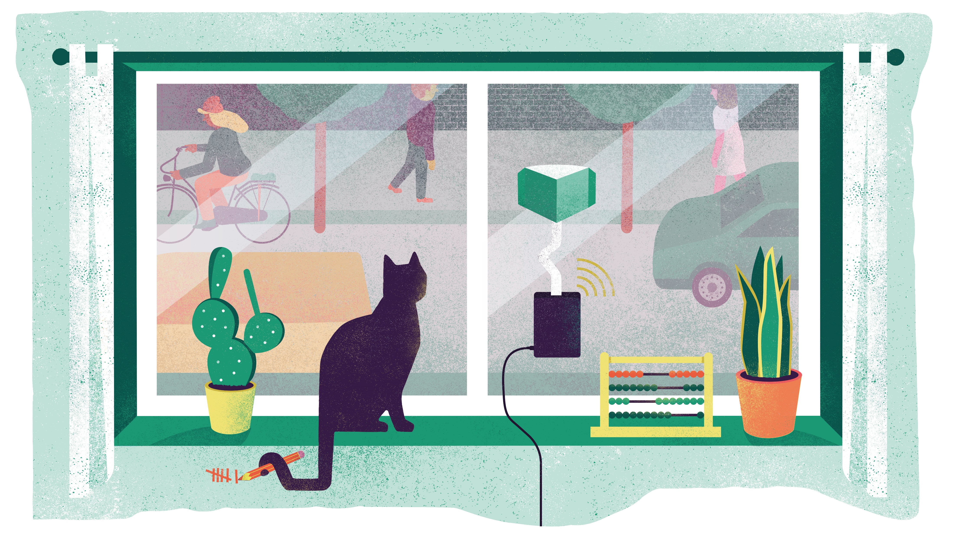
We Count
Using our senses to better understand and improve cities

Slide 2
Did you know…transport represents almost 25% of Europe's greenhouse gas emissions and is often the main cause of air pollution in cities.
Notes:
Did you know…transport represents almost a quarter (25%) of Europe's greenhouse gas emissions and is often the main cause of air pollution in cities.
The United Nation has found that: More than 80% of people living in urban areas which monitor air pollution are exposed to air quality levels that exceed WHO guideline limits, with low- and middle-income countries suffering from the highest exposures, both indoors and outdoors
As a result, across the world, air pollution is estimated to cause over 7m deaths annually largely as a result of increased mortality from stroke, heart disease, chronic obstructive pulmonary disease, lung cancer, bladder cancer and acute respiratory infections. More recently there has been compelling evidence to suggest that air pollution worsens the effects of Covid-19.
https://www.ncbi.nlm.nih.gov/books/NBK507623/#:~:text=Environmental%20inequality%20implies%20disadvantages%20in,may%20lead%20to%20impaired%20health.&text=This%20allows%20us%20to%20identify,of%20the%20air%20pollution%20scenarios.
Source: https://ec.europa.eu/clima/policies/transport_en

Slide 3
Notes:
When we look closer at the data we see that some types of transport are bigger contributors than others.
Shout out what type of transport is contributing the most to greenhouse gas emission (A = road transport)
What percentage of this 73% do you think comes from cars?
Key:
Planes
Road transport
Ships/maritime
Trains
Source: https://www.eea.europa.eu/data-and-maps/daviz/share-of-transport-ghg-emissions-2#tab-googlechartid_chart_13

Slide 4
Notes:
44% of this number comes from car. Did that surprise any of you?
Heavy vehicles, i.e. lorries and buses
https://www.eea.europa.eu/data-and-maps/daviz/share-of-transport-ghg-emissions-2#tab-googlechartid_chart_13

Slide 5
Why is road transport today so bad?
Contributes to:
climate change (CO₂ )
Notes:
Why is road transport so bad? Well we now know it contributes to climate change
Presenters supplementary information:
NOx comprises a mixture of nitric oxide (NO) and nitrogen dioxide (NO2). NO2 is a toxic gas that causes 79,000 premature deaths in Europe per year. In the air, NO is also converted to NO2 in a process that forms ozone (O3). NOx emissions also form secondary particles in the air and contribute to acidification and eutrophication, causing serious damage to ecosystems. Road transport accounts for a third of NOx emissions and is the dominant source in urban, heavily-trafficked areas.
The European Environment Agency estimates that road transport contributes to excessive concentrations about 70% for nitrogen dioxide (NO2) and about 30% for particulate matter (PM). It is estimated that around 7% of the EU urban population is exposed to NO2 levels above the EU/WHO limit value and that more than three-quarters of the urban population is exposed to PM2.5 levels exceeding the WHO guideline value.
https://www.transportenvironment.org/what-we-do/air-quality-and-transport/road-vehicles-and-air-quality
https://www.theguardian.com/environment/2020/jul/14/car-tyres-are-major-source-of-ocean-microplastics-study#:~:text=More%20than%20200%2C000%20tonnes%20of,every%20year%2C%20according%20to%20research.&text=It%20estimated%20that%20550%2C000%20tonnes,ending%20up%20in%20the%20ocean.

Slide 6
Why is road transport today so bad?
Contributes to:
climate change (CO₂ )
Air pollution (NOx, small particles and dust)
Notes:
and air pollution….

Slide 7
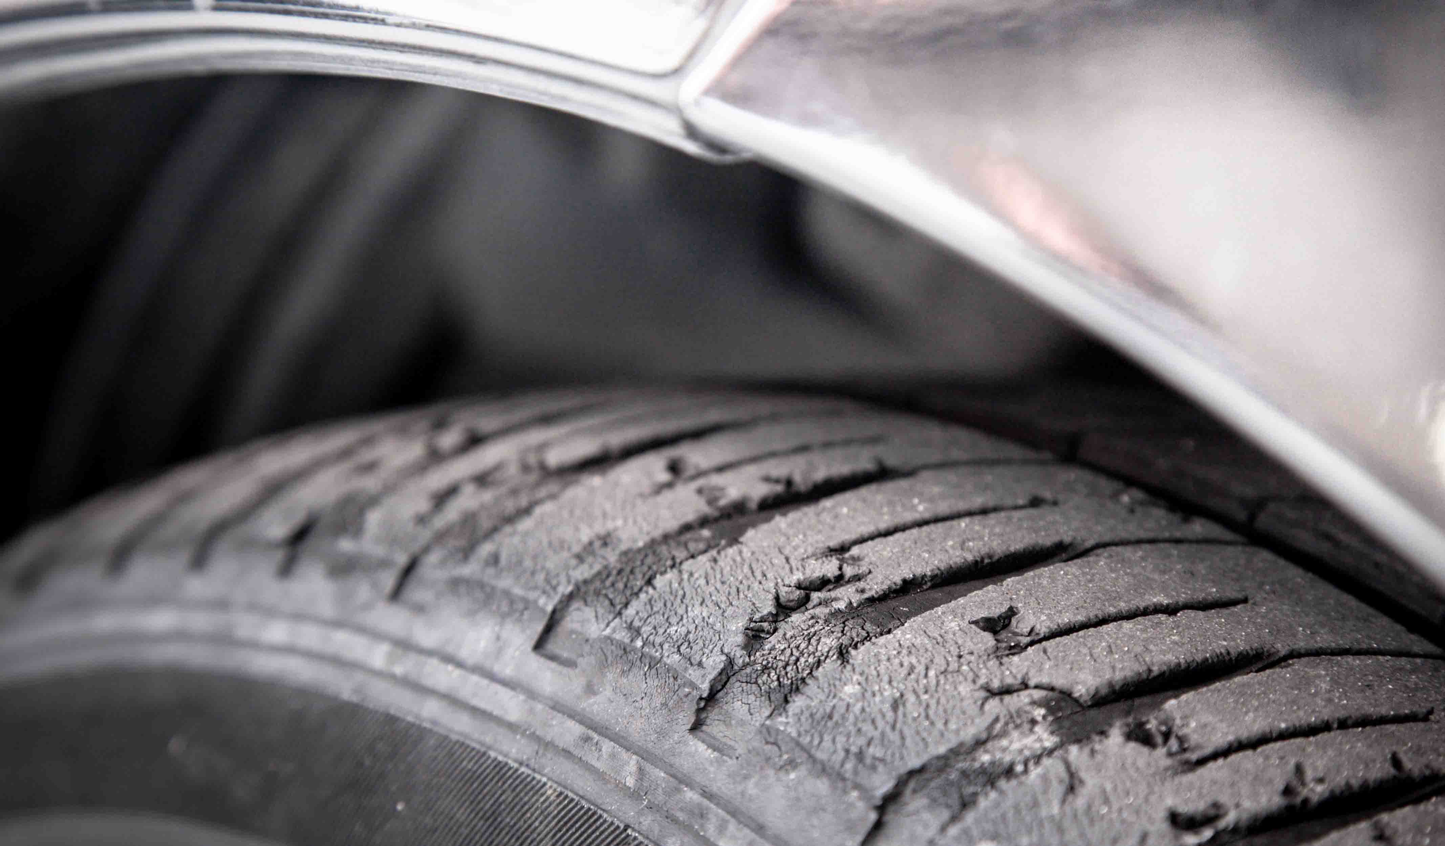
Why is road transport today so bad?
Contributes to:
climate change (CO₂ )
Air pollution
Plastic pollution
Notes:
But did you know that road transport also contributes to plastic pollution? More than 200,000 tonnes of tiny plastic particles are blown from roads into the oceans every year. Most of this plastic comes from car types and the wearing away of brake pads. An average tyre loses 4kg of plastic during its lifetime (that’s the equivalent of four bags of sugar)… you will not lose 4kg from your clothes.
Also, it takes a lot of energy and resources to build cars and other transport. Think of all the material we need – plastic, metal, electronics, glass. And most of these are non-renewable

Slide 8
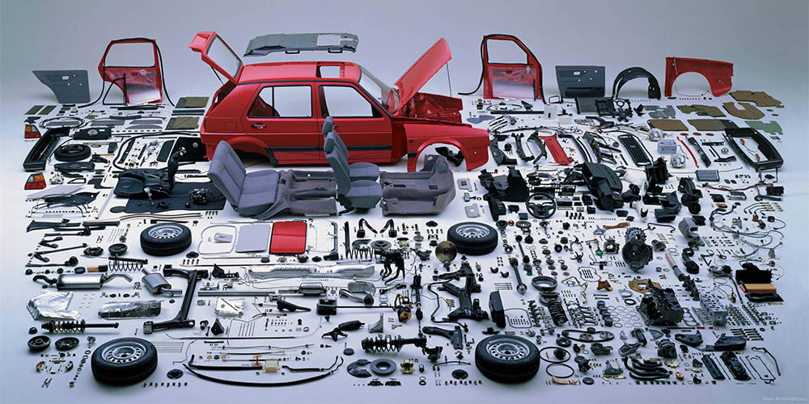
Why is road transport today so bad?
Contributes to:
climate change (CO₂ )
Air pollution
Plastic pollution
Resource depletion
Notes:
Also, it takes a lot of energy and resources to build cars and other transport. Think of all the material we need – plastic, metal, electronics, glass. And most of these are non-renewable

Slide 9
Why is road transport today so bad?
Contributes to:
climate change (CO₂ )
Air pollution (NOx, small particles and dust)
Plastic pollution
Resource depletion
And it’s bad for our health
Notes:
Air pollution is also bad for our health, affecting our lungs, brains, heart and pregnant women. All of us can be impacted by air pollution, but old people, people with health conditions and young people are most at risk.
Air pollution also has a profound impact on mental health. This is a relationship that can take a number of different forms such as the mental health impacts of physical illness linked to air pollution, a lack of access to green space and even a chemical link between depression and particulate pollution.

Slide 10
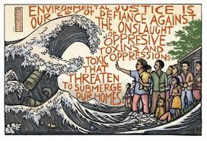
We need to be active on addressing environmental issues
Social, economic and environmental issues inextricably linked
People in the poorest parts of cities are often the most impacted by exposure to pollutants and a lack of green space. This is called environmental inequality.
Wards in Great Britain with higher proportions of non-white residence and higher deprivation are expected to be closer to roads and, therefore, have higher NO₂ levels.
Notes:
They have less coverage than social and economic issues (e.g. discrimination, job insecurity, and homelessness)… however they are inextricably linked
For instance, people in the poorest parts of cities are often the most impacted by exposure to pollutants and a lack of green space. This is called environmental inequality. One type of environmental inequality is, you guessed it, air pollution.
Wards in Great Britain with higher proportions of non-white residence and higher deprivation are expected to be closer to roads and, therefore, have higher NO₂ levels. Relative differences (i.e. ratios) in NO₂ between white and non-white populations were much larger than the differences between the most and least deprived populations in GB and Wales in 2011.
https://airqualitynews.com/2020/10/13/exploring-the-link-between-air-pollution-and-inequality/

Slide 11
Air pollution in the UK
The UK needs to be carbon neutral by 2028 at the latest to avoid global warming above 2 degrees C
UK cities are breaching legal limits on air pollution
Many of our activities, especially transport and energy generation, contribute to both local air pollution and global climate change, so tackling one issue will help tackle the other

Slide 12
Everyone deserves clean air
Do you agree? Do we need to prioritise environmental issues, specifically clean air?

Slide 13
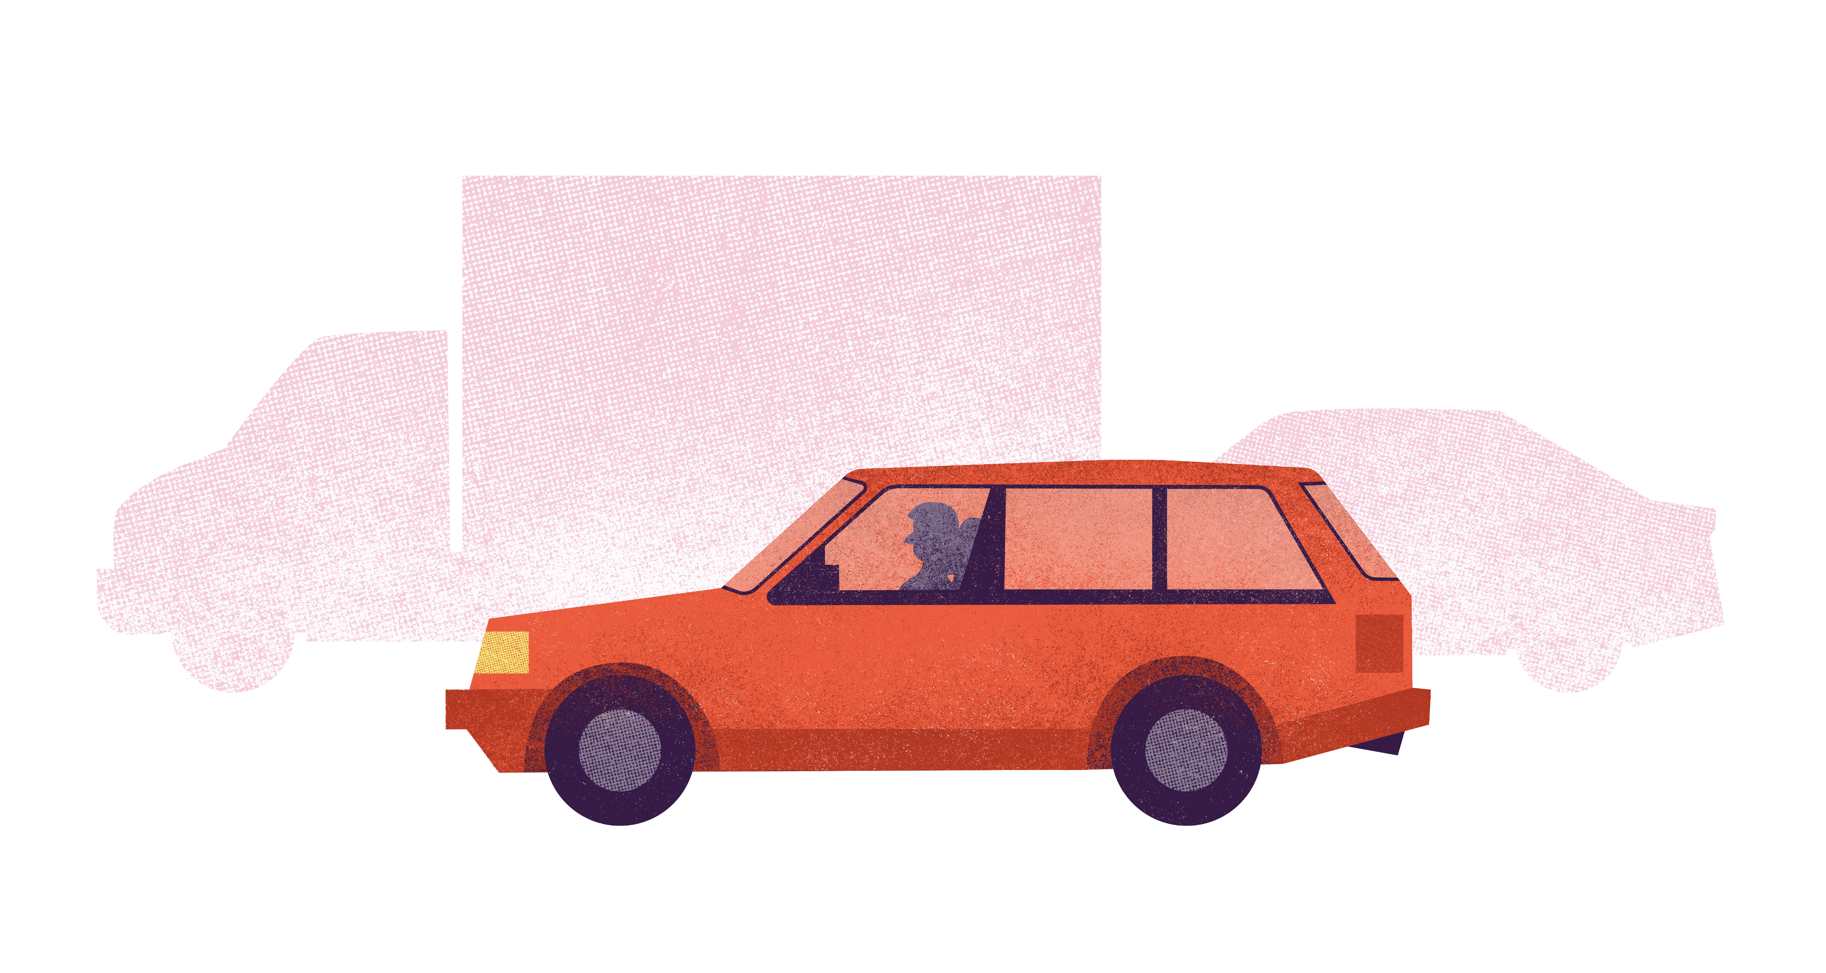
So how did we get here?
Notes:
So how did we get here? How did road transport become such a big contributor to these problems (air pollution, climate change, etc)

Slide 14
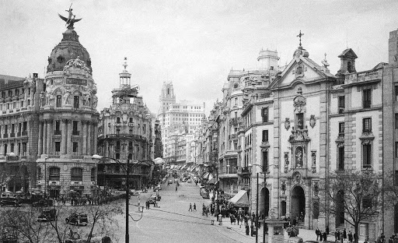
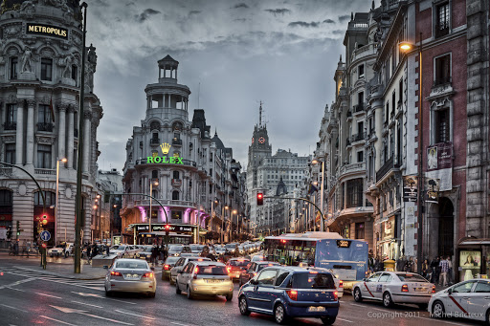
Cities taken over by cars
Madrid city centre, 1950s
Madrid city centre, today
Notes:
What do you notice in these two pictures? (e.g. more cars, fewer pedestrians)
Cities have changed to accommodate the rise in demand of cars. In cities across Europe we have seen a shift from mainly walking and taking public transport to cities dominated by private cars.

Slide 15
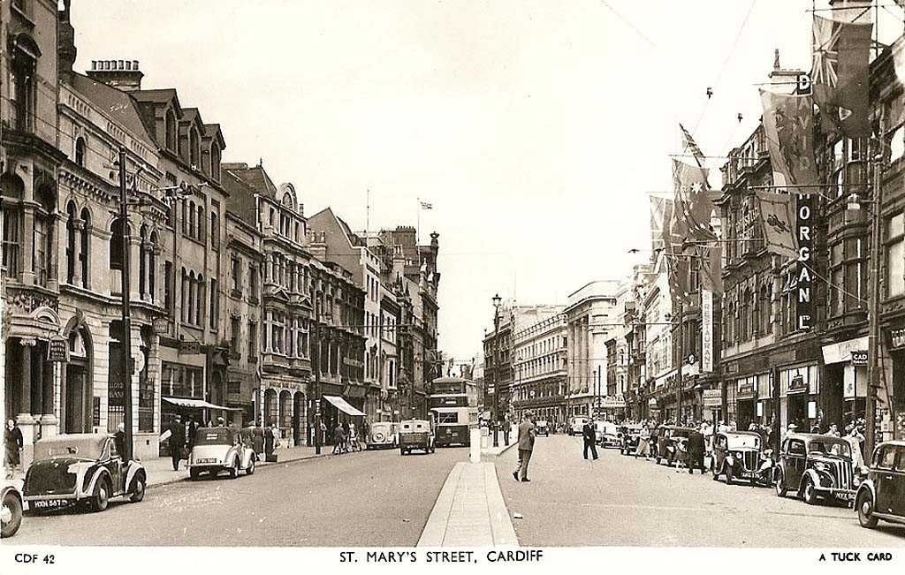
Cities re-designed for people
St Mary’s Street, Cardiff, 1950s
St Mary’s Street, Cardiff, today
Notes:
However we are starting to re-design cities to accommodate healthier, more active and more sustainable types of travel
What do you notice here? (e.g. fewer cars, more pedestrians)
Presenters note: Feel free to Google your city/street in the 1950s and today to see what has changed

Slide 16
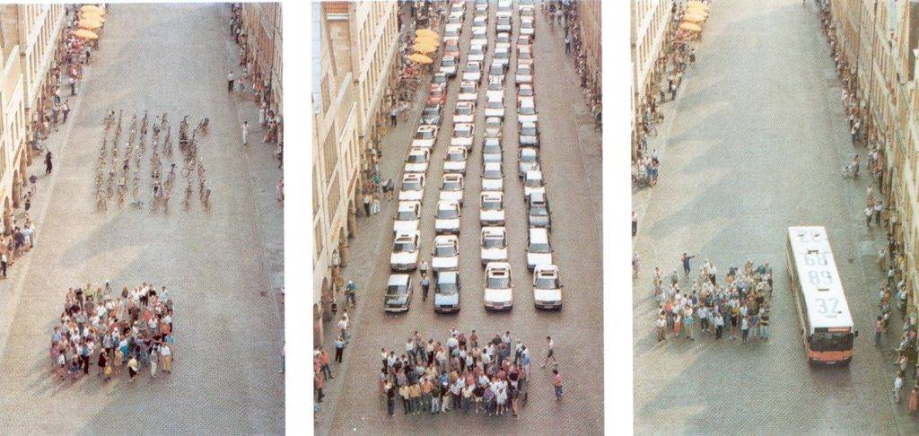
How much space can 60 people occupy?
Notes:
When we are able to design cities for people, we can also save space. What would you do if we had more space in our city? (would you plant trees, build a skate park, build a cinema…)
(Option to spend a few minutes asking for ideas)
Presenters note:
Showing the equivalent space occupied by 60 pedestrians, 60 cars and a bus with 60 people inside

Slide 17
Health
Social impact
Local economy
Time
Energy
Urban design
Accessibility
Smells
Noise
Notes:
We need to make active travel a priority in cities. As well as cleaner air and fewer carbon emissions, fewer vehicles in cities will reduce noise and smells and improve accessibility for the people that need to use public transport. It will reduce the time of journeys taken as we will spend less time in traffic, make more space for planting trees and building skate parks and improve our health and sense of wellbeing.
Presenters note:
Bicycle networks “reverse traffic pyramid” adapted from the Bicycle Innovation Lab

Slide 18
What do we need to convince leaders that things need to change?
Notes:
What do we need to convince leaders that things need to change? Leaders can be politicians, our head teacher or businesses – people who make the big decisions
(Hint: It’s what scientists gather) A…Evidence

Slide 19
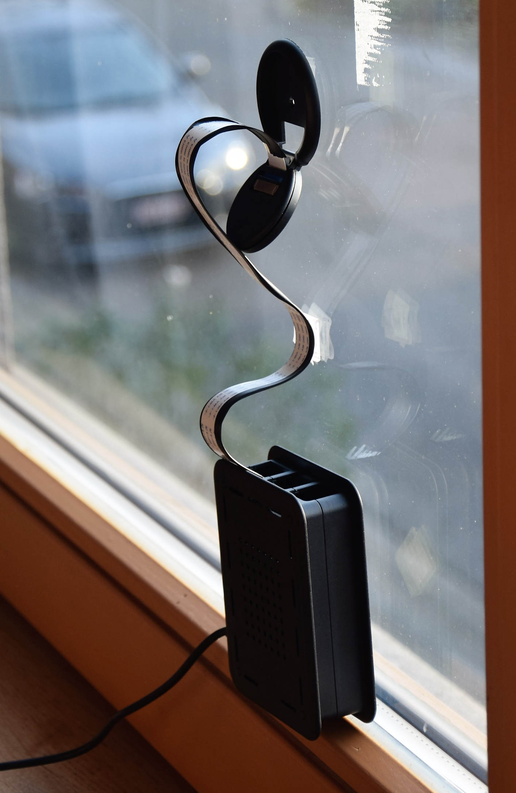
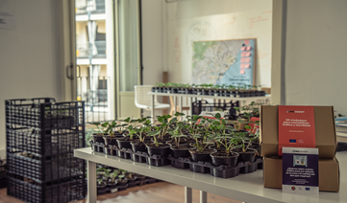
Sensing traffic issues with WeCount
Notes:
WeCount is one such example where residents in Europe are working together with scientists to gather evidence on transport and mobility issues. They are gathering evidence traffic numbers, the speed of cars and levels of air pollution using sensors. The image on the left shows WeCount’s traffic and speed sensor, which consists of a camera and a mini computer, (called a Raspberry Pi). The sensor is connected to the mains battery and sends data it collects to the Telraam website using WiFi. The image on the right shows strawberry plants, which collect air pollutants on their leaves that can then be analysed in a laboratory. In Spain, WeCount has distributed 1,000 of these plants.

Slide 20
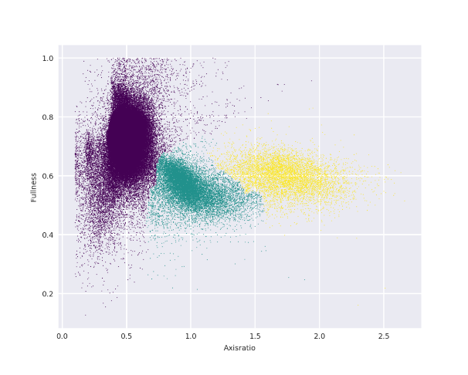
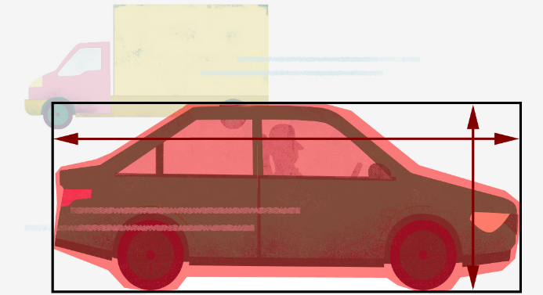
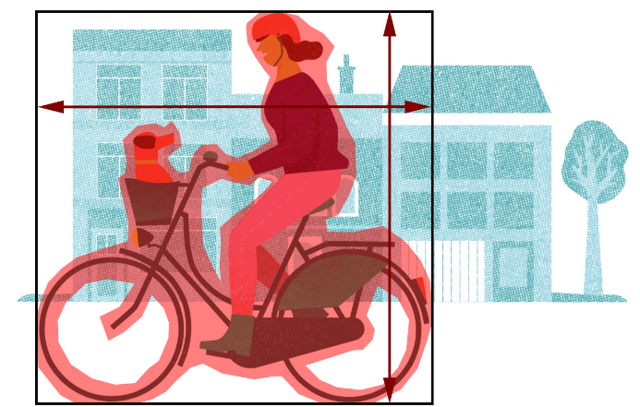
What is the function of the traffic sensor?
Notes:
The traffic sensor detects vehicles according to their size and produces graphs (like the one on the right) which translate the data into meaningful information

Slide 21
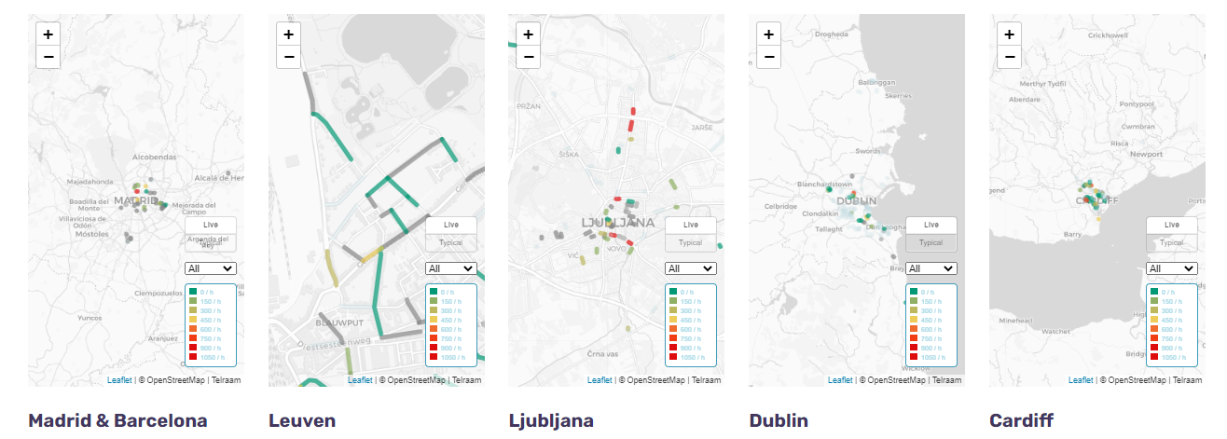
What can the data tell us?
https://telraam.net
Notes:
Each of the cities involved in the project have active sensors all across their cities, in the houses of residents

Slide 22
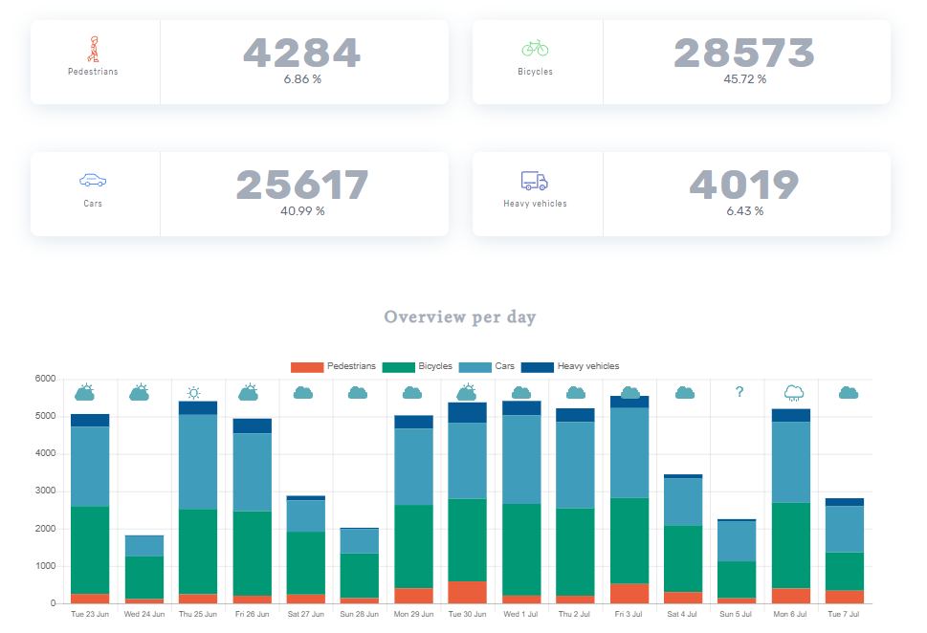
What can the data tell us?
Type of data
Daily summary of traffic numbers
Detailed summary since counting began so we can understand patterns
Car speeds
Notes:
And each sensor produces a daily report of the number of transport types, speeds and transport peaks during the day. This is an example of one street in Barcelona. You can also look at data over long time periods. So, for instance, you can see if COVID restrictions had an impact on traffic numbers
Head to: https://www.telraam.net/en
Zoom in to either Cardiff, Dublin, Leuven, Madrid, Barcelona or Ljubljana
Click on one of the active streets (look for one that has a lot of data) and click on the “more details” button to see the breakdown of data
Decide on one street to investigate and encourage pupils to describe what they see in the graphs
Ask pupils to draw graphs of their own for the street outside their school – what do they expect to see in one day? In one week? Over one year?
Head out as a class to count the traffic. Spend 15 minutes doing this and they work out the average for one hour. Ask pupils: do they expect to see the same results every hour? Every day? Every week? What would affect the yearly average?
Example taken from: https://www.telraam.net/en/location/9000000373

Slide 23
What would we like to know about traffic and how we get to and from our school?
Notes:
Do we want to know about speeding, or things that get in our way from walking? Or what about if there are enough cycle lanes, or if there is more we can do to get cars of the road?
Bring up some ‘hot topics’ relevant to your school, whether that is the lack of buses, not enough bicycle parking, etc

Slide 24
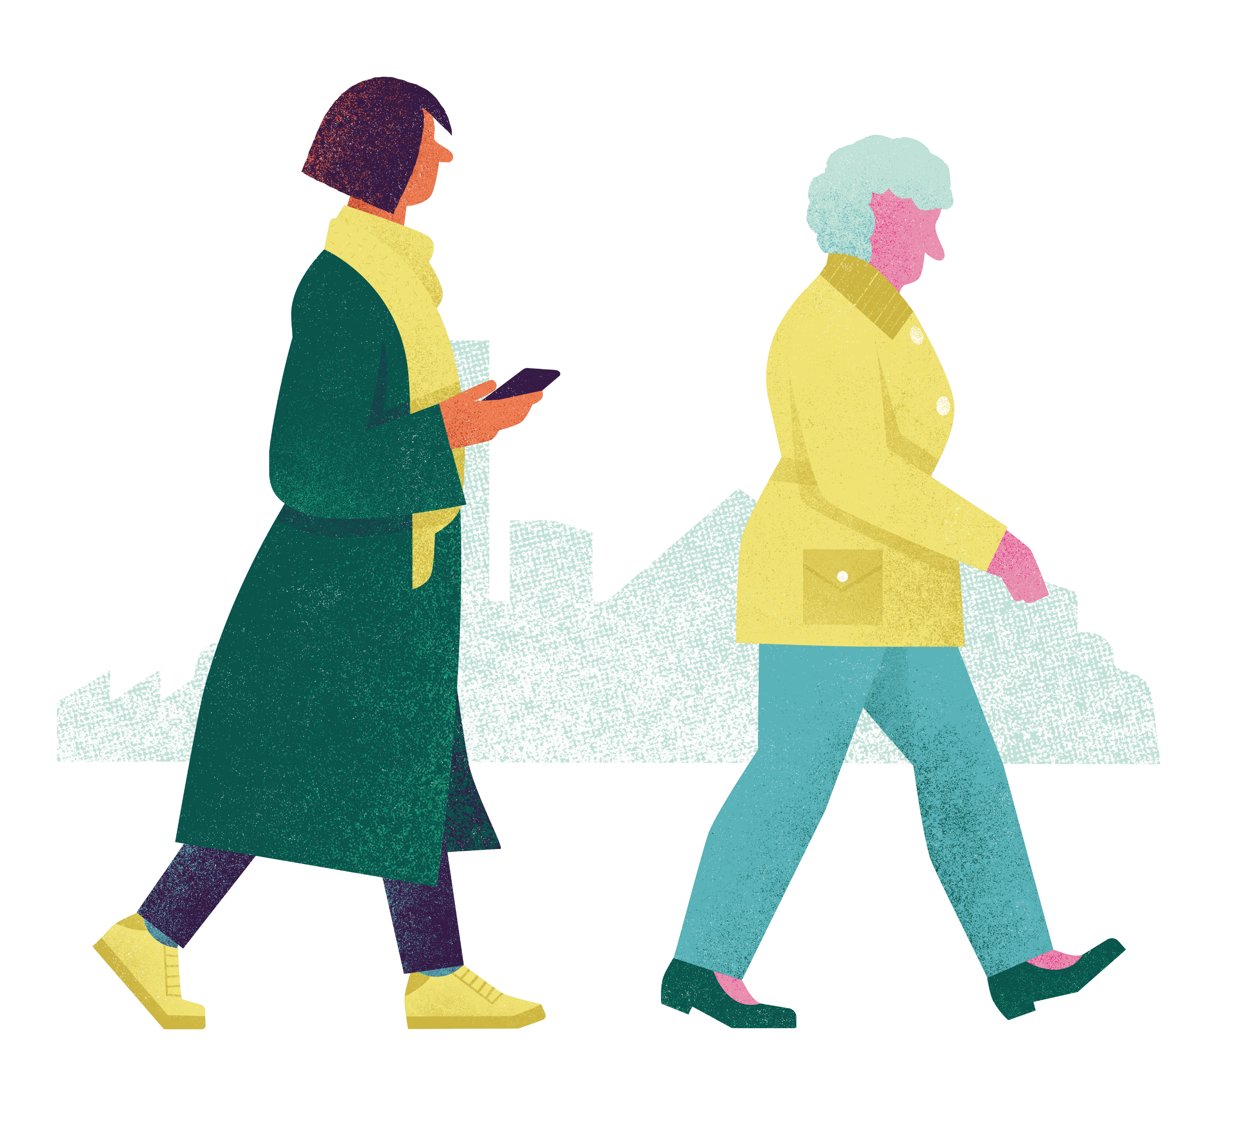
What would make it easier to…
Notes:
Walk and cycle
Is there anything you have already done to make your lifestyle more active, and greener?

Slide 25
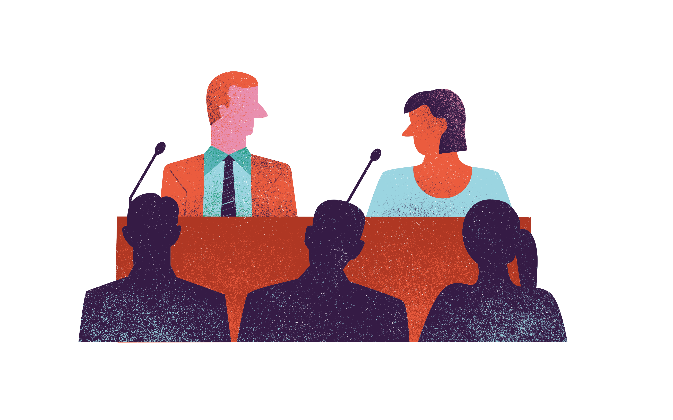
Who do we need to influence…
Notes:
Politicians, businesses, the mayor, our headmaster, parents, teachers….
How can we influence them (social media, writing letters, campaigning/protesting, presenting evidence)

Slide 26
What have you learnt this morning/today?
Notes:
What have you learnt this morning/today? What would you like to do with this information?/What do you want to do next?/What action will you take… and what can we take as a school
Optional question if older, capable and relevant: Do you think technology is enough to change our cities for the better (our behaviours and policies)? How else can we influence change (e.g. surveys with people, protests, voting, becoming a politician)?
Presenters notes: Adjust the wording of this text as necessary?

