Slide 1


WeCount primary activities
Slides to accompany worksheets. Best delivered after running the WeCount assembly
Notes:
Use the relevant slide to your worksheet

Slide 2
Definitions
Road traffic
Mobility
Vehicles, pedestrians, bikes or other types of transport moving along a route
The potential for movement and the ability to get from one place to another using one or more types of transport
Notes:
Optional slide (can be incorporated in at the start of any activity)

Slide 3
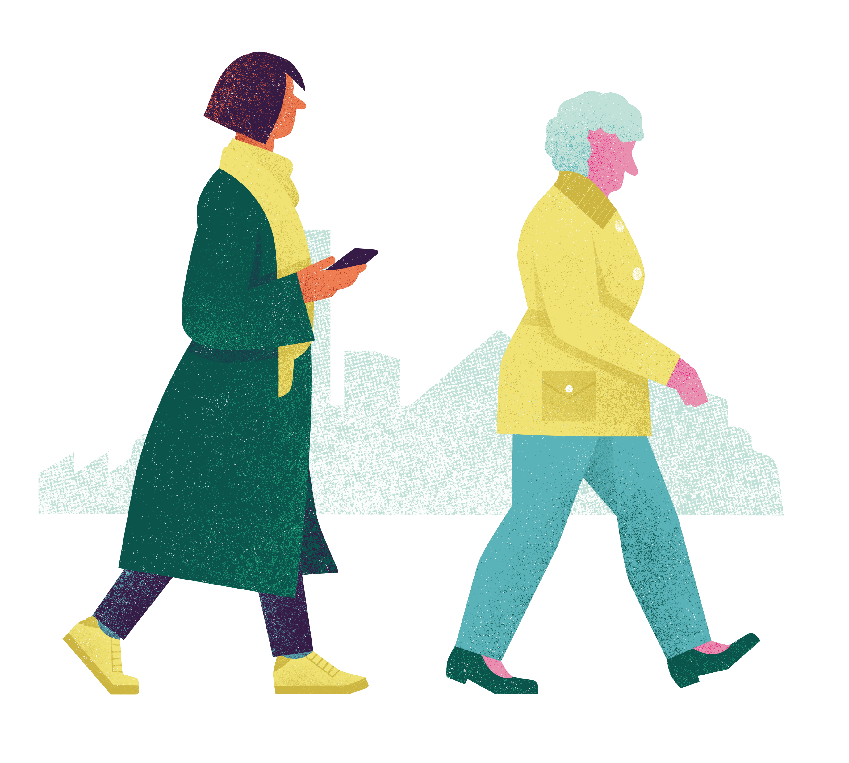
Mobility and Me
Activity one
Notes:
This relates to worksheet 1.

Slide 4
Mobility and Me
The ability to travel around a place using one or more types of transport
Activity one
Notes:
This relates to worksheet 1.

Slide 5
How does where you live make you feel?
Trace over a map of our local area
Label key landmarks
Draw your route to school
Add icons to represent how you feel about certain places/objects on the way (think about your senses)
Add a key
Notes:
These are prompt Qs for the worksheets
How does where you live make you feel? E.g. What makes you feel happy, what makes you feel nervous, what makes you feel angry?
We are going to do a mapping exercise of your route to school.
We want you to draw your route to school on your tracing, label the key landmarks and add a key to explain how different things along your journey affect how you feel.
Think about all of your senses (sights, sounds, smells, physical obstructions, tastes)

Slide 6



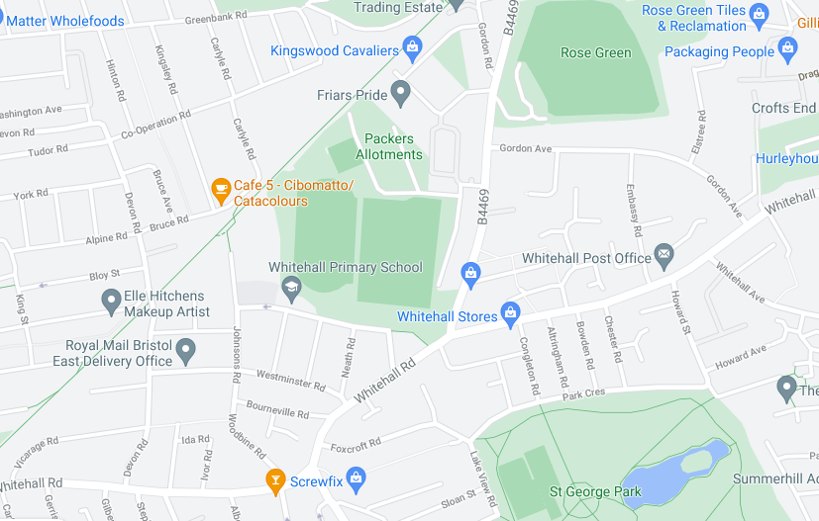






Example
Key
School – it makes me feel safe, but it is cold!
Roads – they allow me to get to school but are noisy
River – it allows me to relax
Fast cars – they are scary
Rubbish – it smells
Dog poo – it makes me sad
Trees – they make me feel calm
Ducks – I love to watch them at the lake
Access – I struggle to cross the road here (there isn’t a drop kerb)
Route to school
Notes:
Here is an example. You can see the route to school in one colour and the icons of how the person feels in another colour. You can see that this person thinks school makes them feel safe, but it is cold. They use the roads to get to school but they are noisy, etc.
Teachers note:
Option to look at local map together and discuss some common likes and dislikes. E.g. we like the ice cream parlour, the ice creams are tasty and make us feel happy; we don’t like the main road, it is busy and makes us feel scared
(If you are doing this in class, close your eyes for a moment and imagine your journey to school. What do you see? How does your journey make you feel? If homework, they can make a note as they walk to school)

Slide 7

Why do you take this route and this type of transport?
To collect friends on the way
To avoid busy routes
Because it is the fastest
Because it is the most scenic (pretty)
To feel safe
Because it is….
Notes:
After the exercise, ask: why do you take this route and this type of transport?
Think about our definitions on mobility. How do certain things affect your ability to get to school

Slide 8
What are the main problems with too many vehicles?
Noise pollution
Air pollution
Physical obstructions (e.g. parked cars, holes in the pavement)
Safety
Speed
Notes:
If time, optional slide
Look back at your map. Make a tally chart to count how many of each issue you have. For example, if you put the street is noisy, put one for noise pollution. If you put, I can smell petrol or car fumes, put a one for air pollution.
Teacher asks each student in turn to give them their score for each category, writing it on some flip chart paper. Announce the top issue(s)

Slide 9
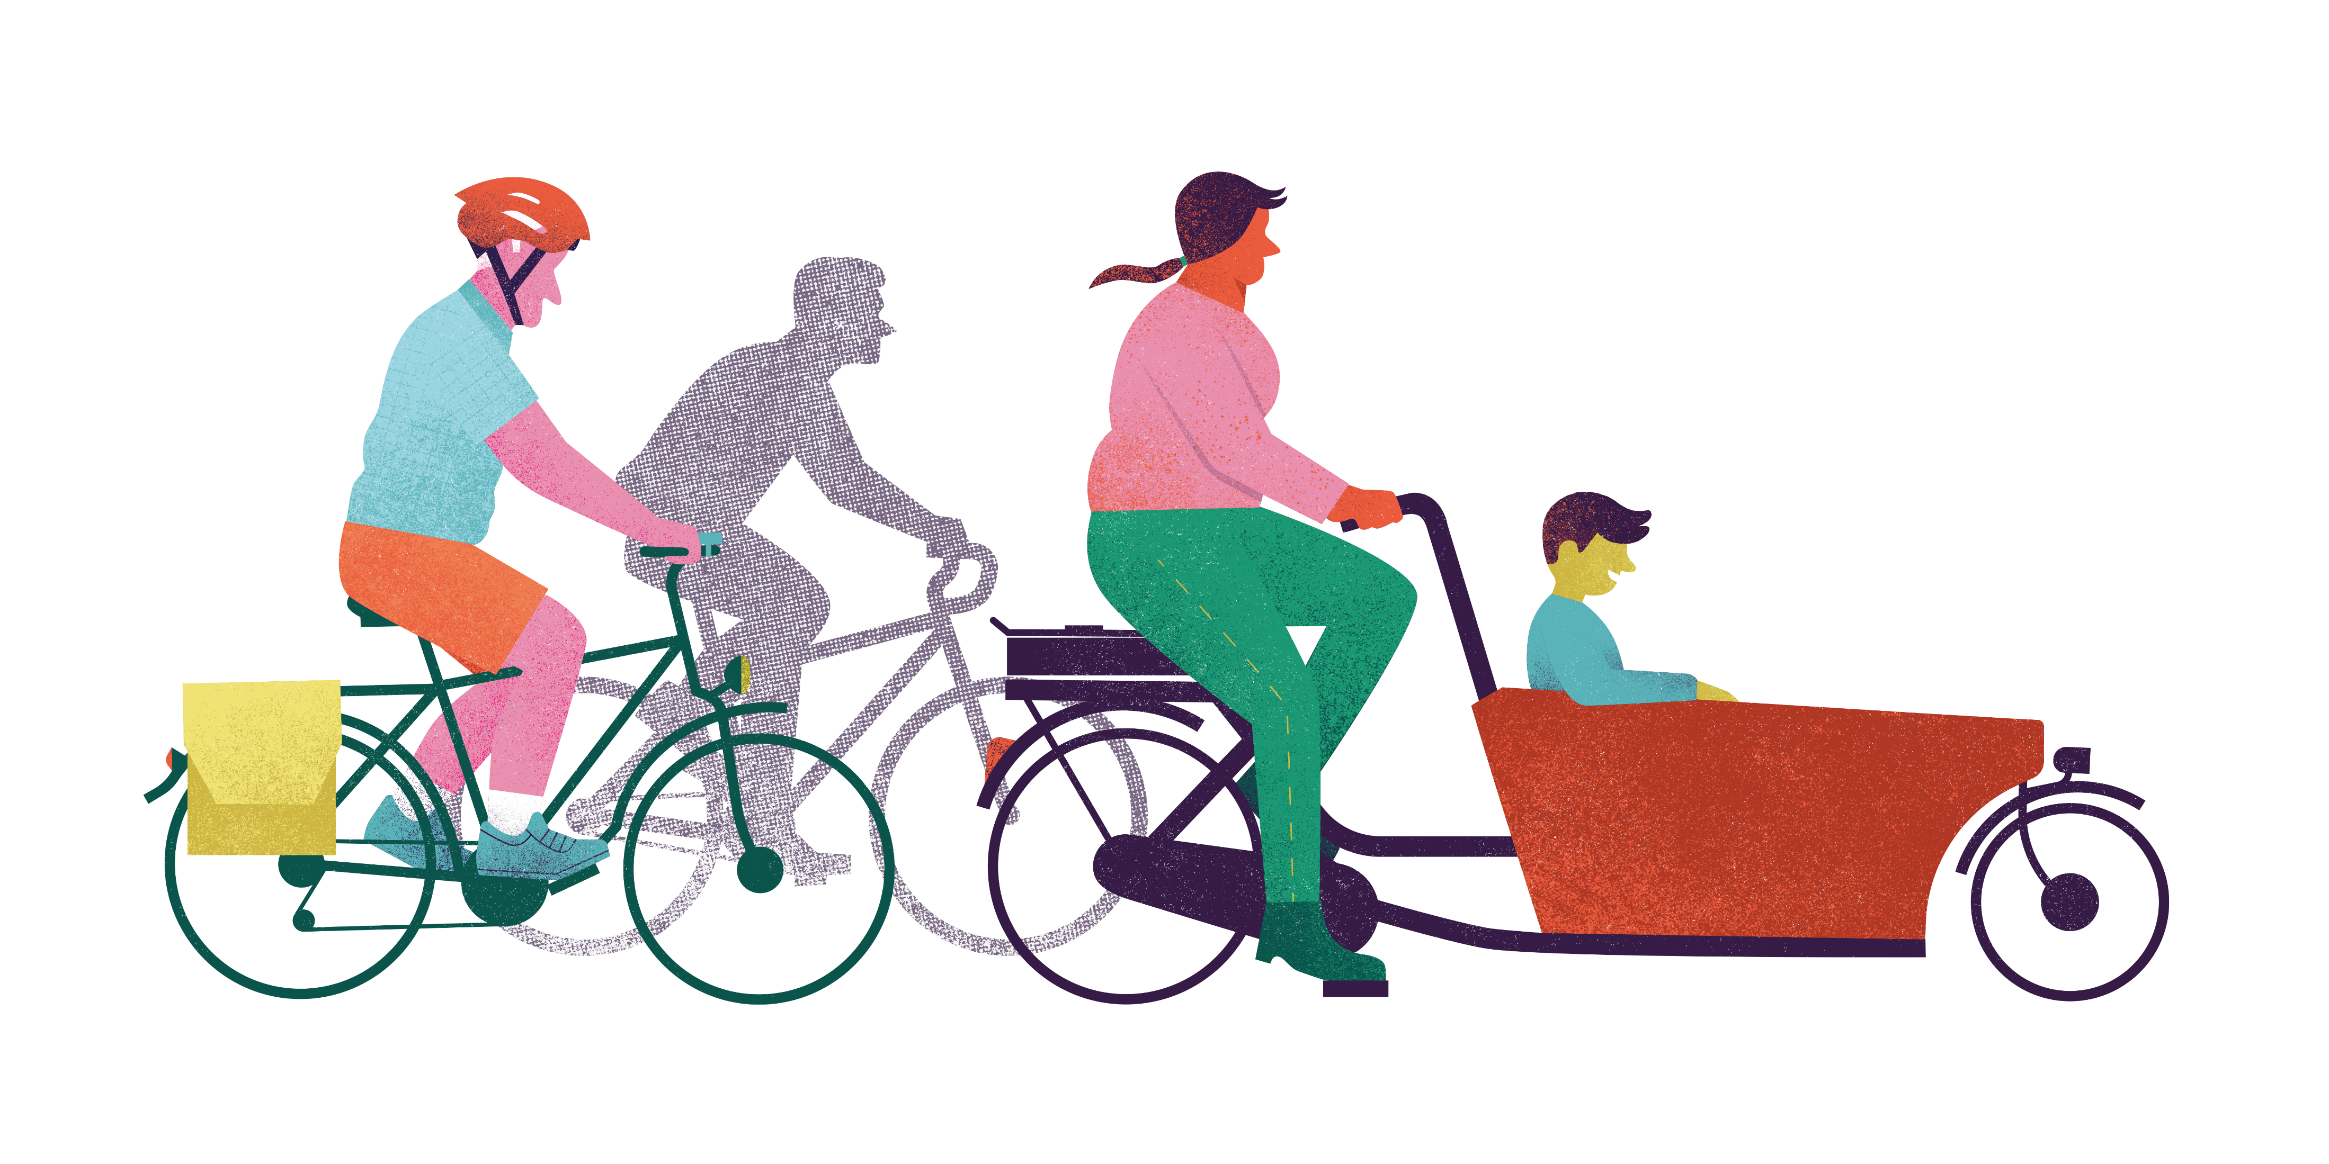
What do you love about walking and cycling?
Notes:
Engage pupils in discussion
How can we encourage more of this?

Slide 10

What have you learnt today?
Notes:
This is the end of activity 1.

Slide 11
How does your street move?
Activity two
Notes:
This relates to worksheet 2.

Slide 12
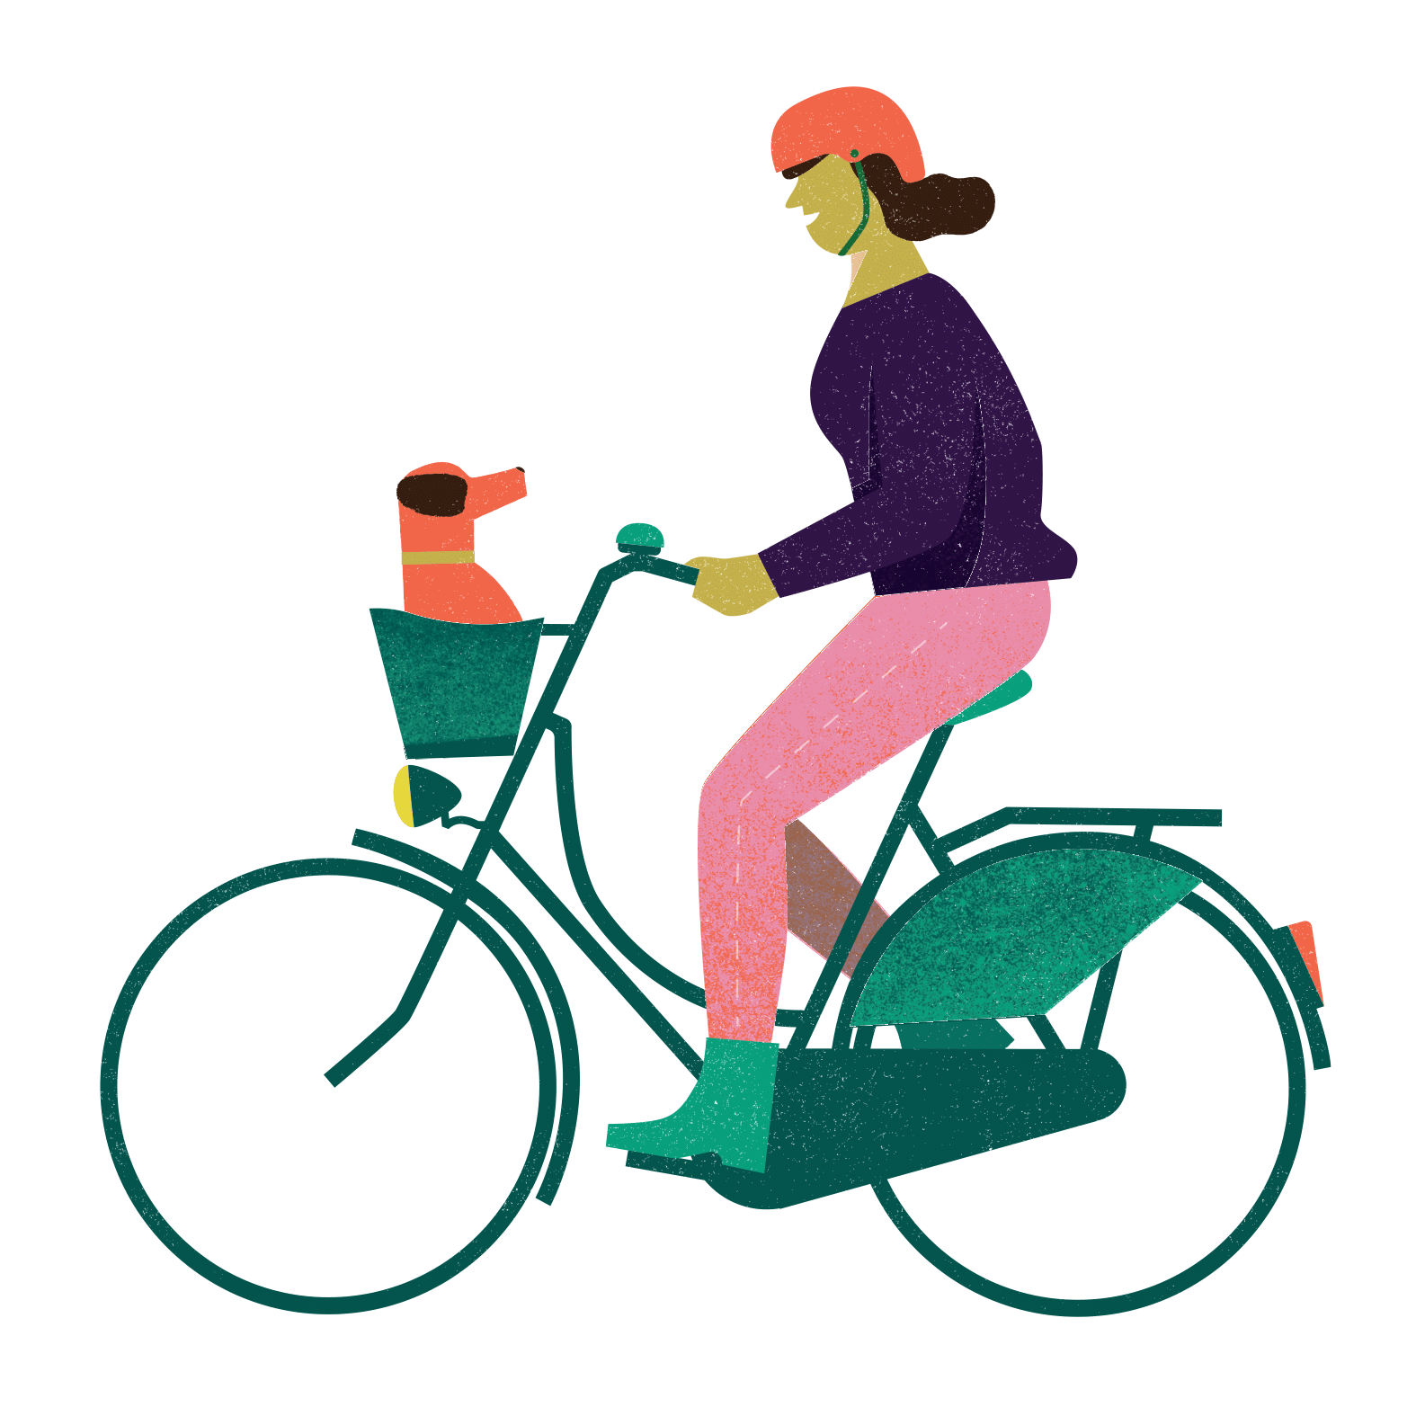
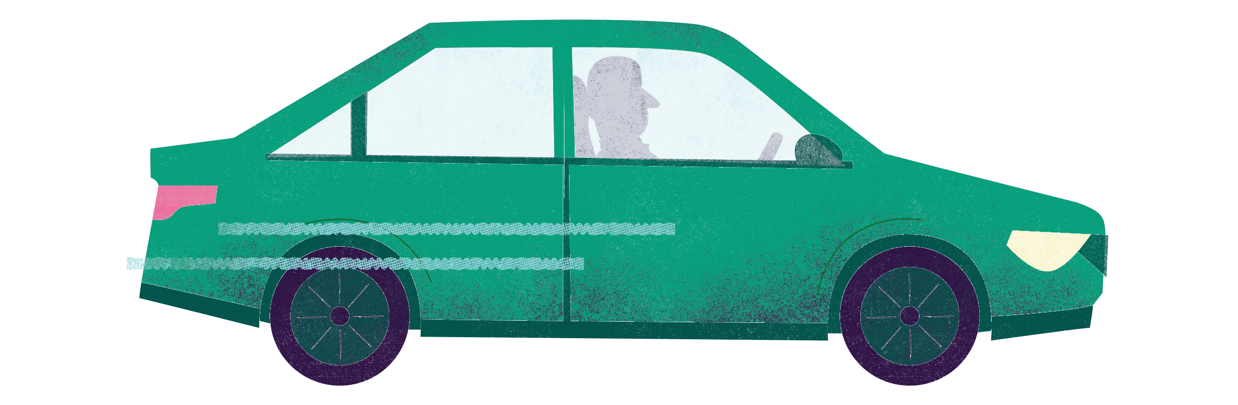
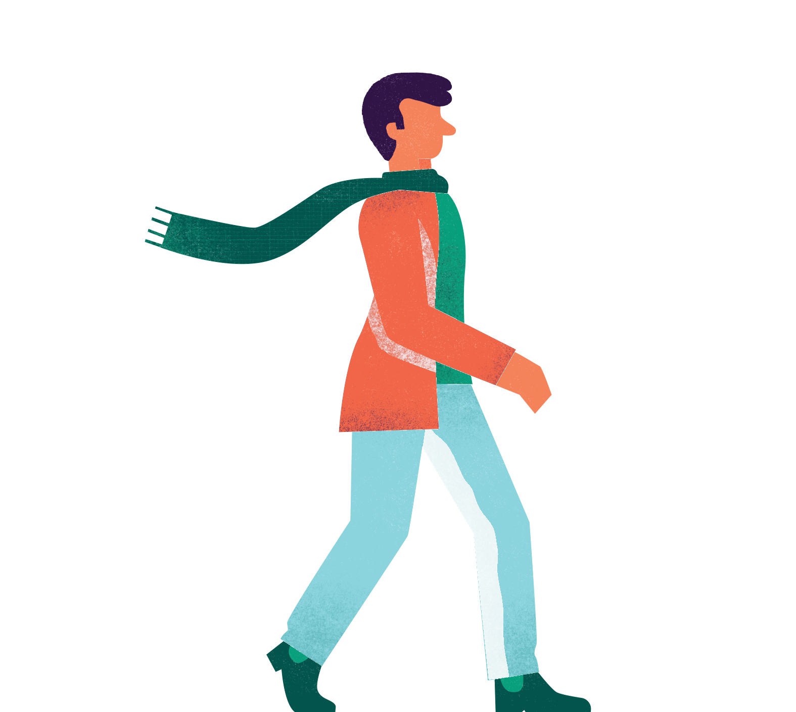
How do people move about the city today?
Notes:
Do we have a lot of cars? How about cyclists, buses, pedestrians…? How easy is it for you to get to school by bike or walking? What is affecting your ability to get to school by bike or walking?
Teacher to write main issues on flipchart/whiteboard

Slide 13
What else might affect how we travel on a given day?
Notes:
What else might affect traffic and mobility on a given day? Scientists call things that affect something else over time a ‘variable’
Pupils raise hand to answer. Answer to include:
Weather
Time of year (season)
Road works
Road closures
Speed cameras and speed bumps
Signs
Accidents
Tiredness

Slide 14
What would you like travelling around the city to look like in the future?
How would you get to and from school?
Where would you play with friends?
How would you feel?
How would you get your shopping?
How would you travel to your hobbies/sports?
Notes:
What would you like traffic and mobility to look like in the future? Spend a few minutes silently answering these questions (in your workbooks), and then we will share some answers.
Teacher to ask/pick pupils to give their answer.

Slide 15

HOW DOES YOUR STREET MOVE?
1. DRAW YOUR STREET AS IT IS TODAY
2. DRAW HOW YOU WOULD LIKE YOUR STREET TO BE
Notes:
Now I would like you to draw your vision. On the worksheet you will see two boxes. First, I would like you to draw your street as it is today. Second, I would like you to draw how you would like it to be in the future
Teachers note: you can ask pupils to draw the street outside of the school or outside of their house.
Again, ask/choose a selection pupils to present their ideas

Slide 16
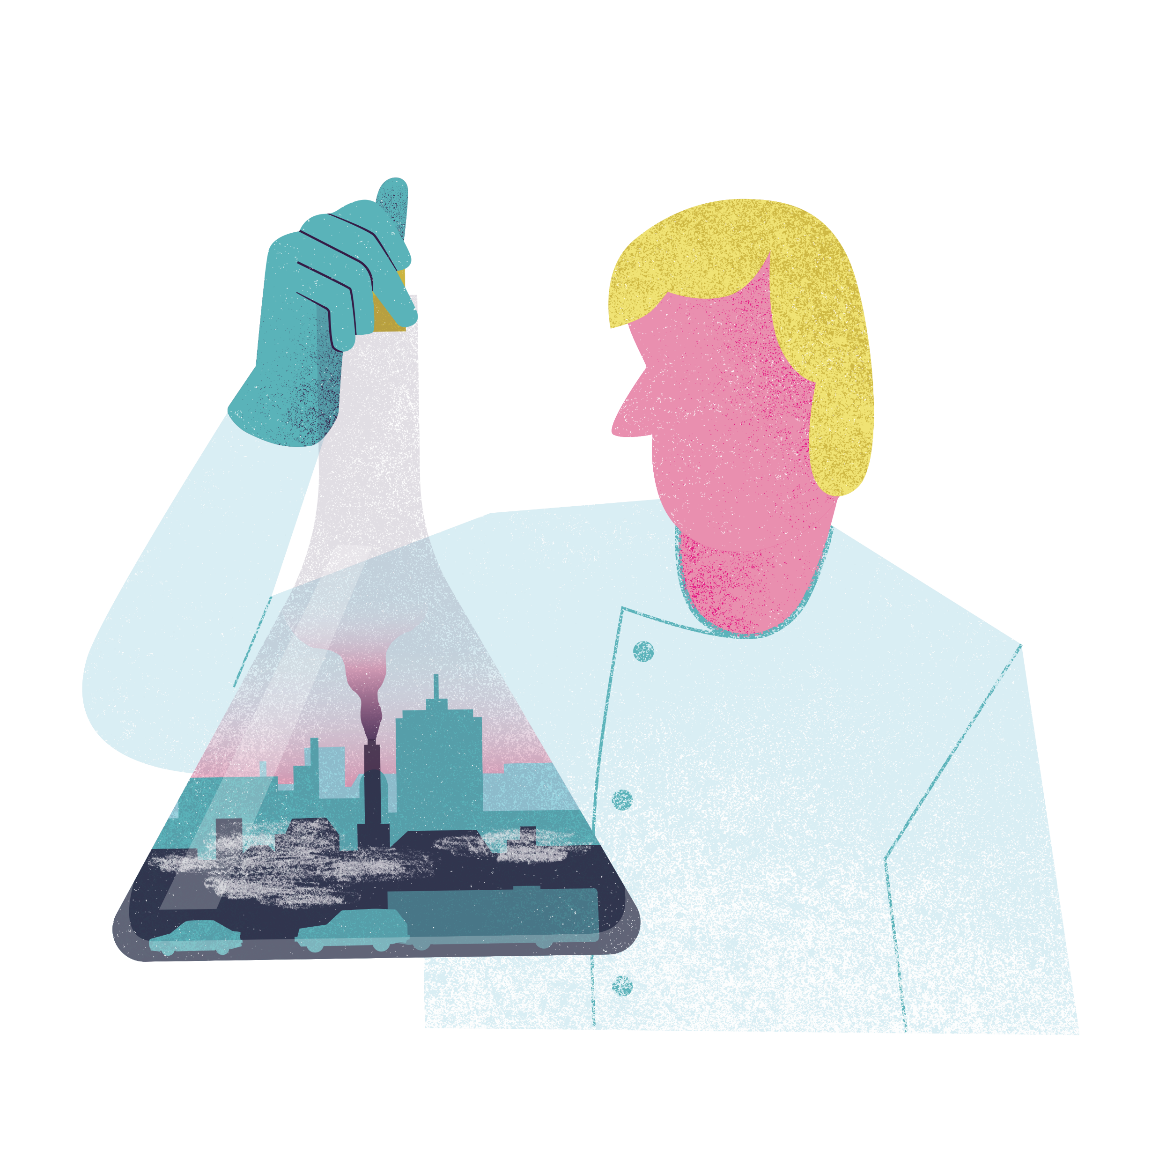
What needs to happen to make your vision a reality?
Notes:
What needs to happen to make your vision a reality? How do we get from today to your future vision? What support do you need (e.g. neighbours, the council, parents, businesses, money)? What resources do you need (materials, money, time)?

Slide 17
What have you learnt today?

Slide 18
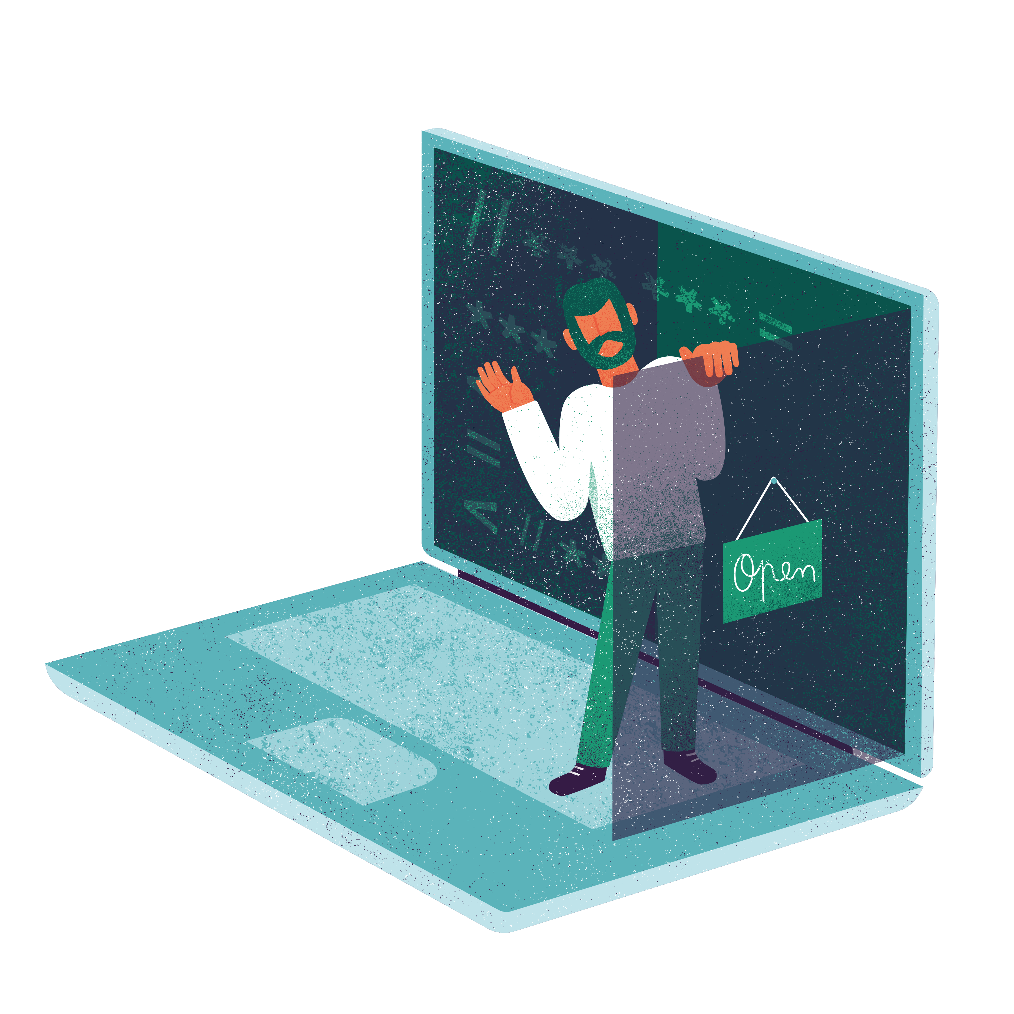
Data explorers
Activity three
Notes:
This relates to worksheet 3.

Slide 19
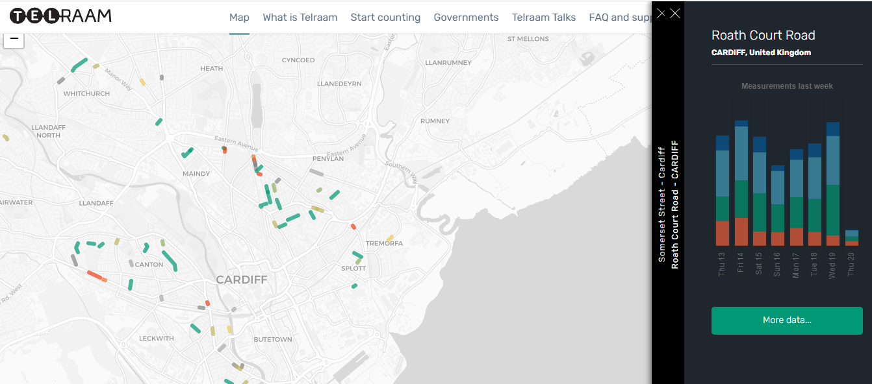
Notes:
This is a screenshot of the Telraam website, the website used in WeCount to show you all of the active traffic sensors.
You can click on an active street and click ‘more data’ to find out about daily speeds, the number of different types of transport and traffic peaks (like rush hour)
If you haven’t run the WeCount assembly, add slide 25 and 26 from File A.

Slide 20
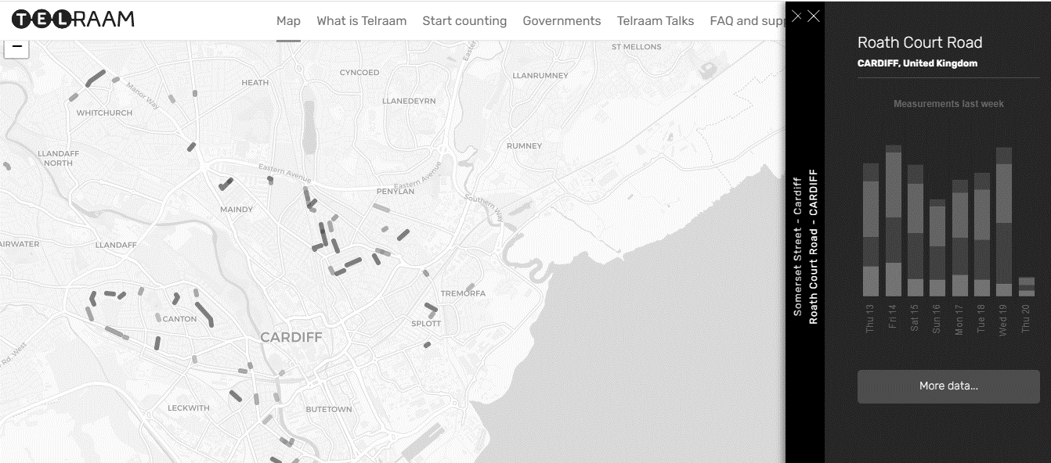
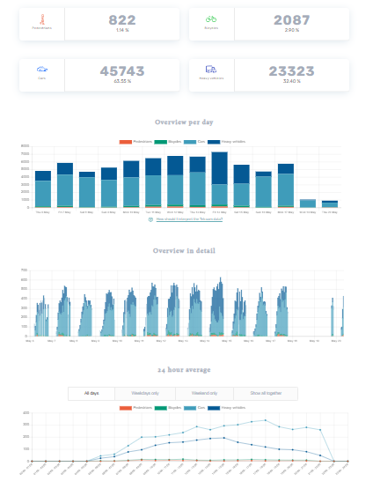
Notes:
This is an example showing you the number of vehicles, pedestrians and bike and when they pass by the sensor. Does anything surprise you about the traffic numbers for this street? (encourage pupils to say how surprising it is about the number of cars and vehicles)
Well luckily that data is from a period of several months, not just one day! Imagine how busy our school street would be like if 45,000 cars passed in one day!!

Slide 21
Data diving – our tasks today
Look at the data on the worksheet. What do you see?
Fill out the questions in your worksheet
Draw and label a graph to show the number of different transport types
Notes:
These are questions prompts from the worksheet
We are now going to dive into some data. Take out your worksheet and look at the data. What do you see?
I will soon ask you to fill out your worksheet and draw and label your graph. But first we are going to look at an example together…

Slide 22
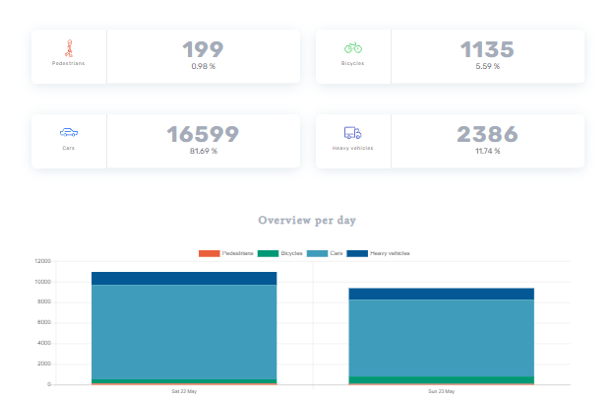
Example
Notes:
This is an example showing the last 24 hours on a street in Cardiff.
How many pedestrians were there? How many bicycles? How many cars? How many heavy vehicles?
Were there more cars on Saturday or Sunday?
You can view this dataset here:
https://www.telraam.net/en/location/9000001941/2021-05-22/2021-05-23

Slide 23
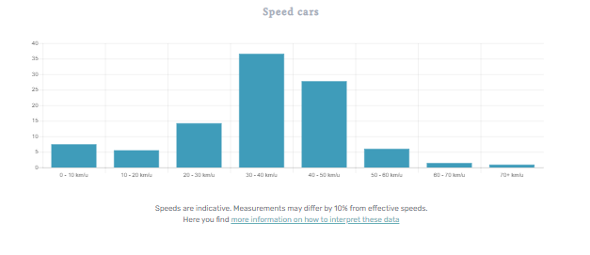
Example: speed
1 Kilometer/hour = 0.6 Mile/hour
So
10 kmh = 6 mph
20 kmh = 12 mph
30 kmh = 18 mph
40 kmh = 24 mph
50 kmh = 30 mph
60 kmh = ???
Notes:
For the same street, here is the speed data. The data is in kmh because WeCount is a European project and European cities use kmh instead of mph, like we do in the UK. But it is pretty easy to change kmh into mph as 1 kmh is roughly 0.6 mph, which means 10 kmh = 6 mph, 20 kmh = 12 mph, 30 kmh = 18 mph, 40 kmh = 24 mph, 50 kmh = 30 mph. If we know this, how many mph is the same as 60 kmh? A= 36mph
What is the most frequent speed on this street? 30-40 kmh. What is that in mph? 18-24 mph.
If this street has a 20 mph speed limit, are any of the cars speeding? A= yes

Slide 24
Now it is your turn…
Look at the three graphs on your worksheet (number of transport types, total traffic and car speeds)
Fill out the questions
Draw a graph (we will practice this together first)
Notes:
We are now going to dive into some data. Go to Telraam.net and zoom into one of the cities with coloured streets. (Teachers discretion to select the street prior to the class)
Select a coloured street and click ‘more data’
Set the time period to the last 24 hours. What do you see?

Slide 25
Drawing our graph
Transport counts in Smith Street over a 24 hour period
Number of each transport type
350
300
250
200
150
100
50
0
312
Legend
Cars
Heavy vehicles
Pedestrians
Cyclists
199
161
148
Cars
Heavy vehicles
Pedestrians
Cyclists
Notes:
What are the key elements of a graph? (encourage pupils to raise hands and answer)
The title
The legend (key)
X axis (horizontal line)
Y axis (vertical, divided into equal parts)
The data

Slide 26
Drawing our graph
Title
Transport counts in Smith Street over a 24 hour period
Y axis
Key
Number of each transport type
350
300
250
200
150
100
50
0
312
Legend
Cars
Heavy vehicles
Pedestrians
Cyclists
The data
199
161
148
X axis
Cars
Heavy vehicles
Pedestrians
Cyclists
Labels
Notes:
What are the key elements of a graph? (encourage pupils to raise hands and answer)
The title
The legend (key)
X axis (horizontal line)
Y axis (vertical, divided into equal parts)
The data

Slide 27
Discussion
Would anyone like to share their findings?
What did you find most interesting?
Would you be interested in finding out about traffic numbers and speed in your area/outside our school? Why?

Slide 28
What have you learnt today?

Slide 29
Gathering evidence
Activities on counting
Notes:
This section relates to worksheet 4a-e.

Slide 30
Counting traffic
Activity on counting
Notes:
This relates to worksheet four A

Slide 31
Our tasks today
Fill out the air pollution log.
Write down any other observations that you think might affect traffic numbers today.
Draw what you see, labelling the road and the main objects you observe related to traffic.
Stop counting after agreed upon time period and come back to class
Notes:
Choose a date and time period to record traffic with pupils outside, on the road by the school. With supervision, head to your location and begin counting. Get children to then work through these steps. They will need a clipboard and pens.
Discuss the importance of health and safety before commencing this task.
Teachers note: adapt these tasks accordingly, and do the same in the worksheet

Slide 32
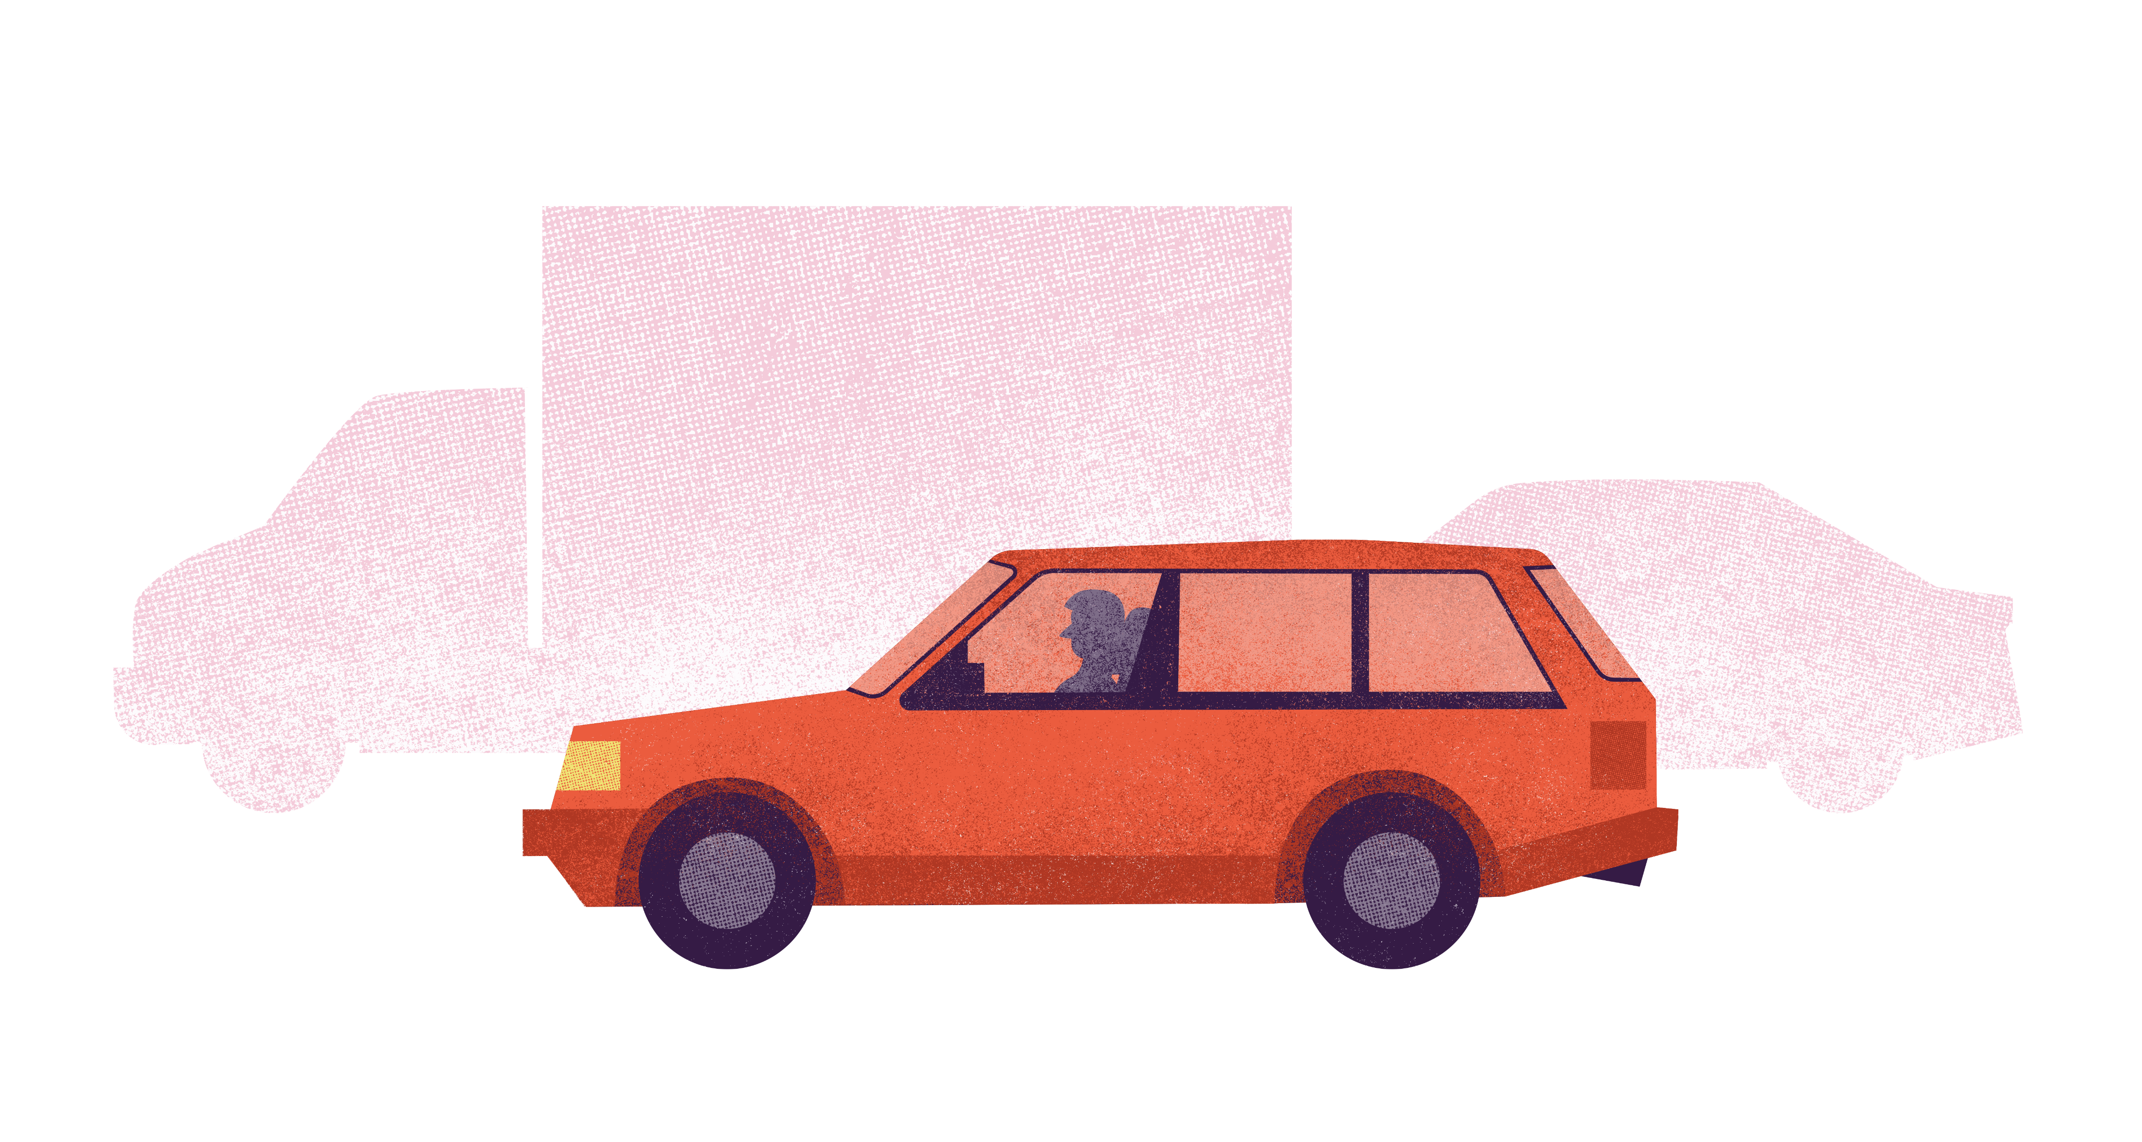
Transport type | Tally
Notes:
Ask pupils to name transport types and fill out the left-hand column of their table before heading outside
Can do as a class
On return to the class, add all of the numbers for each type to the table, according to each group and work out the average. Explain why it is useful and important to collect data by several people/with several sensors (i.e. to improve accuracy)

Slide 33
What did we observe?
How many of each transport type were there?
Did anyone count more or less?
What were some of the things you observed on and around the road and pavements that may have affected these numbers?
Do you think any cars might have been speeding?

Slide 34
What have you learnt today?
Notes:
End of activity

Slide 35
Measuring noise levels
Activity on counting
Notes:
This relates to worksheet four B
Teacher: hand out worksheets and sound level meter. If you do not have a sound level meter, you can either download an app, get children to make educated guesses, or simply skip this activity entirely

Slide 36
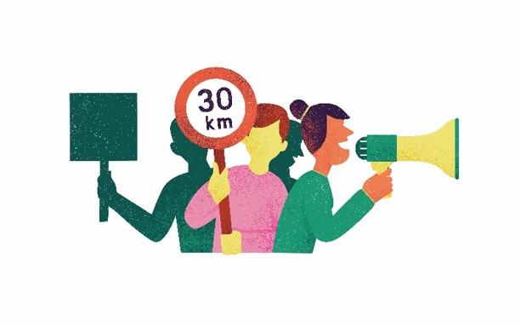
What is the difference between noise and sound?
Notes:
Ask the class this question.
Sound is what we hear. Noise is unwanted sound.
What kind of unwanted sounds can you think of? (e.g. drilling, road works, screaming, loud parties or festivals, traffic noise)

Slide 37
What is the unit measurement of noise?
Notes:
Ask the class this question.
Decibels
What do we use to measure noise levels? – A. a sound level meter.
Where might these be useful? – A. a construction site, a concert… to make sure we don’t hurt our ears/can prevent damage e.g. with ear protectors

Slide 38
Our tasks today
Fill out the Noise Pollution Log
Write down any other observations that you think might affect noise today.
Draw what you see, labelling the road and the main objects you observe related to noise.
Notes:
Decide on a date and time to record noise levels outside, on the road by your school. With supervision, head to your location and begin recording.
Ask pupils to answer the questions on their worksheet (above). They will need pens and a clipboard.
Discuss the importance of health and safety before commencing this task.

Slide 39
Discussion
What type of noises did you observe?
Were you surprised by any of the noise levels?
Do you think noise levels might be different at another time of day? Or another day of the week?
Do you think these noise levels are acceptable?
What could we do to reduce these noises?
Notes:
Teachers note: feel free to remove these questions and pop in this slide notes section. These are possible prompt questions. Adapt as you see fit.

Slide 40
What have you learnt today?
Notes:
This is the end of the activity

Slide 41
Measuring speed
Activity on counting
Notes:
This relates to worksheet 5 C
Teacher: hand out worksheets and speedometer. If you do not have access to one, you can either download an app, get children to make educated guesses, or simply skip this activity entirely

Slide 42
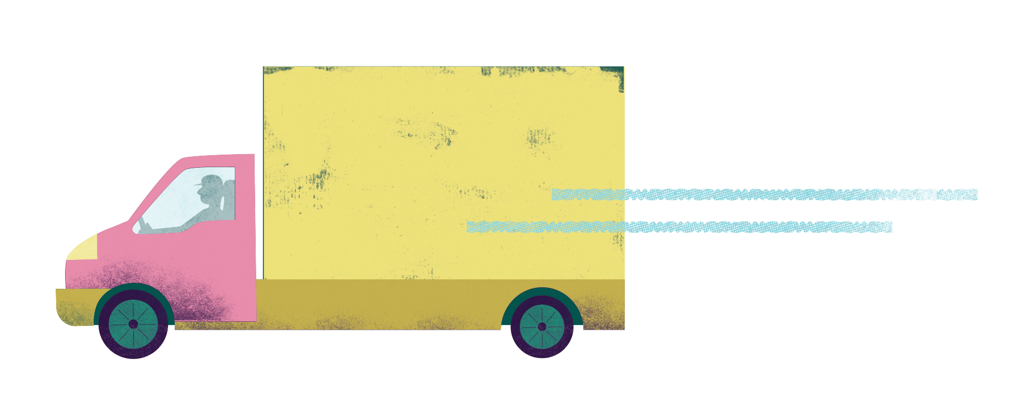
What is the unit measurement for vehicle speed?
Notes:
Ask the question
Mph (in UK)/kmh (in Europe)
How do we measure speed?
With a speedometer

Slide 43
Why is it important that vehicles do not speed?
Notes:
Why is measuring speed important?
A. To prevent accidents; to make our journeys safer, etc

Slide 44
Our tasks today
Fill out the Speed Log, recording the transport type on the left-hand column and the speed, in miles per hour (mph), on the right.
Write down any other observations that you think might affect speeding at this moment.
Draw what you see, labelling the road and the main objects you observe related to speed, like speed bumps or speed cameras.
Notes:
Decide on a date and time period to record speed levels outside, on the road by the school. With supervision, head to your location and begin recording.
Ask pupils to fill out their worksheet. They will needs pens and a clipboard.
Discuss the importance of health and safety before commencing this task.

Slide 45
Discussion
Were you surprised by what you observed?
What might affect transport speeds during this time period?
Do you think speeds might be different at a different time of day, or day of the week? Why?
What could we do to reduce speeding?

Slide 46
What have you learnt today?
Notes:
This is the end of the activity.

Slide 47
Counting obstructions
Activity on counting
Notes:
This relates to worksheet four D

Slide 48
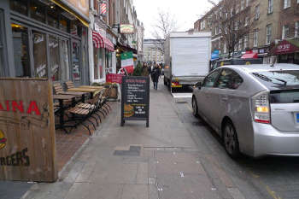
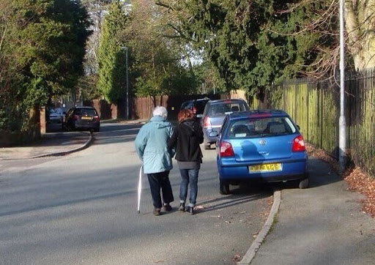
How would you feel as a pedestrian to walk on these streets?
Notes:
How would you feel as a pedestrian to walk on these streets?
What is getting in their way?
Signs, rubbish/construction material, parked cars.
What other types of obstructions have you experienced on your journey to school?

Slide 49
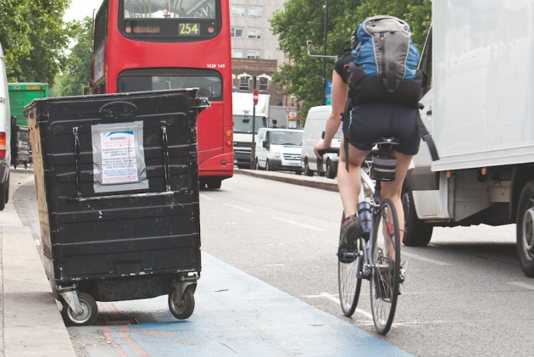
How would you feel as a cyclist?
Notes:
How would you feel as a cyclist?
What other obstructions have you seen for a cyclist? E.g. parked cars, end of cycle lane/no cycle lane

Slide 50

What gets in the way of cycling or walking to school?
Notes:
What else gets in the way of our active travel journey to school?
e.g. parked cars, no drop kerbs (for scooters or mobility scooters), no safe cycle lanes or footpaths, etc
Feel free to refer back to active travel ‘reverse pyramid’ from assembly slides

Slide 51
Our tasks
List the types of obstructions you see outside your school/on your journey to school that may prevent people from completing their journey.
Draw your route and the obstructions in the space provided.
Write down some suggestions for how to remove these obstructions.
Notes:
Teachers note: can set as homework, or encourage pupils to close eyes and think of their journey to school. Do they ever have to step off the pavement or get off their bike because of an obstruction. How does it make them feel?
Read instructions

Slide 52
Discussion
What are the common obstructions we see on our journeys to school?
What are some of the ideas you had on removing these obstacles?
Notes:
Write down the main obstructions on a flipchart or whiteboard

Slide 53
What have you learnt today?
Notes:
This is the end of the activity.

Slide 54
Counting smells
Counting activity
Notes:
This relates to worksheet four E

Slide 55
What smells nice and what does not?
Notes:
Ask questions
Answers include:
Flowers, oranges, cereal, chocolate, etc
Poo, wee, sewage works, rubbish, compost, etc

Slide 56

Smells are a sign of what’s in the air. Smells are chemicals. Some chemicals are good, like the smell of flowers or oranges, some are bad, like petrol or rotten food.

Slide 57
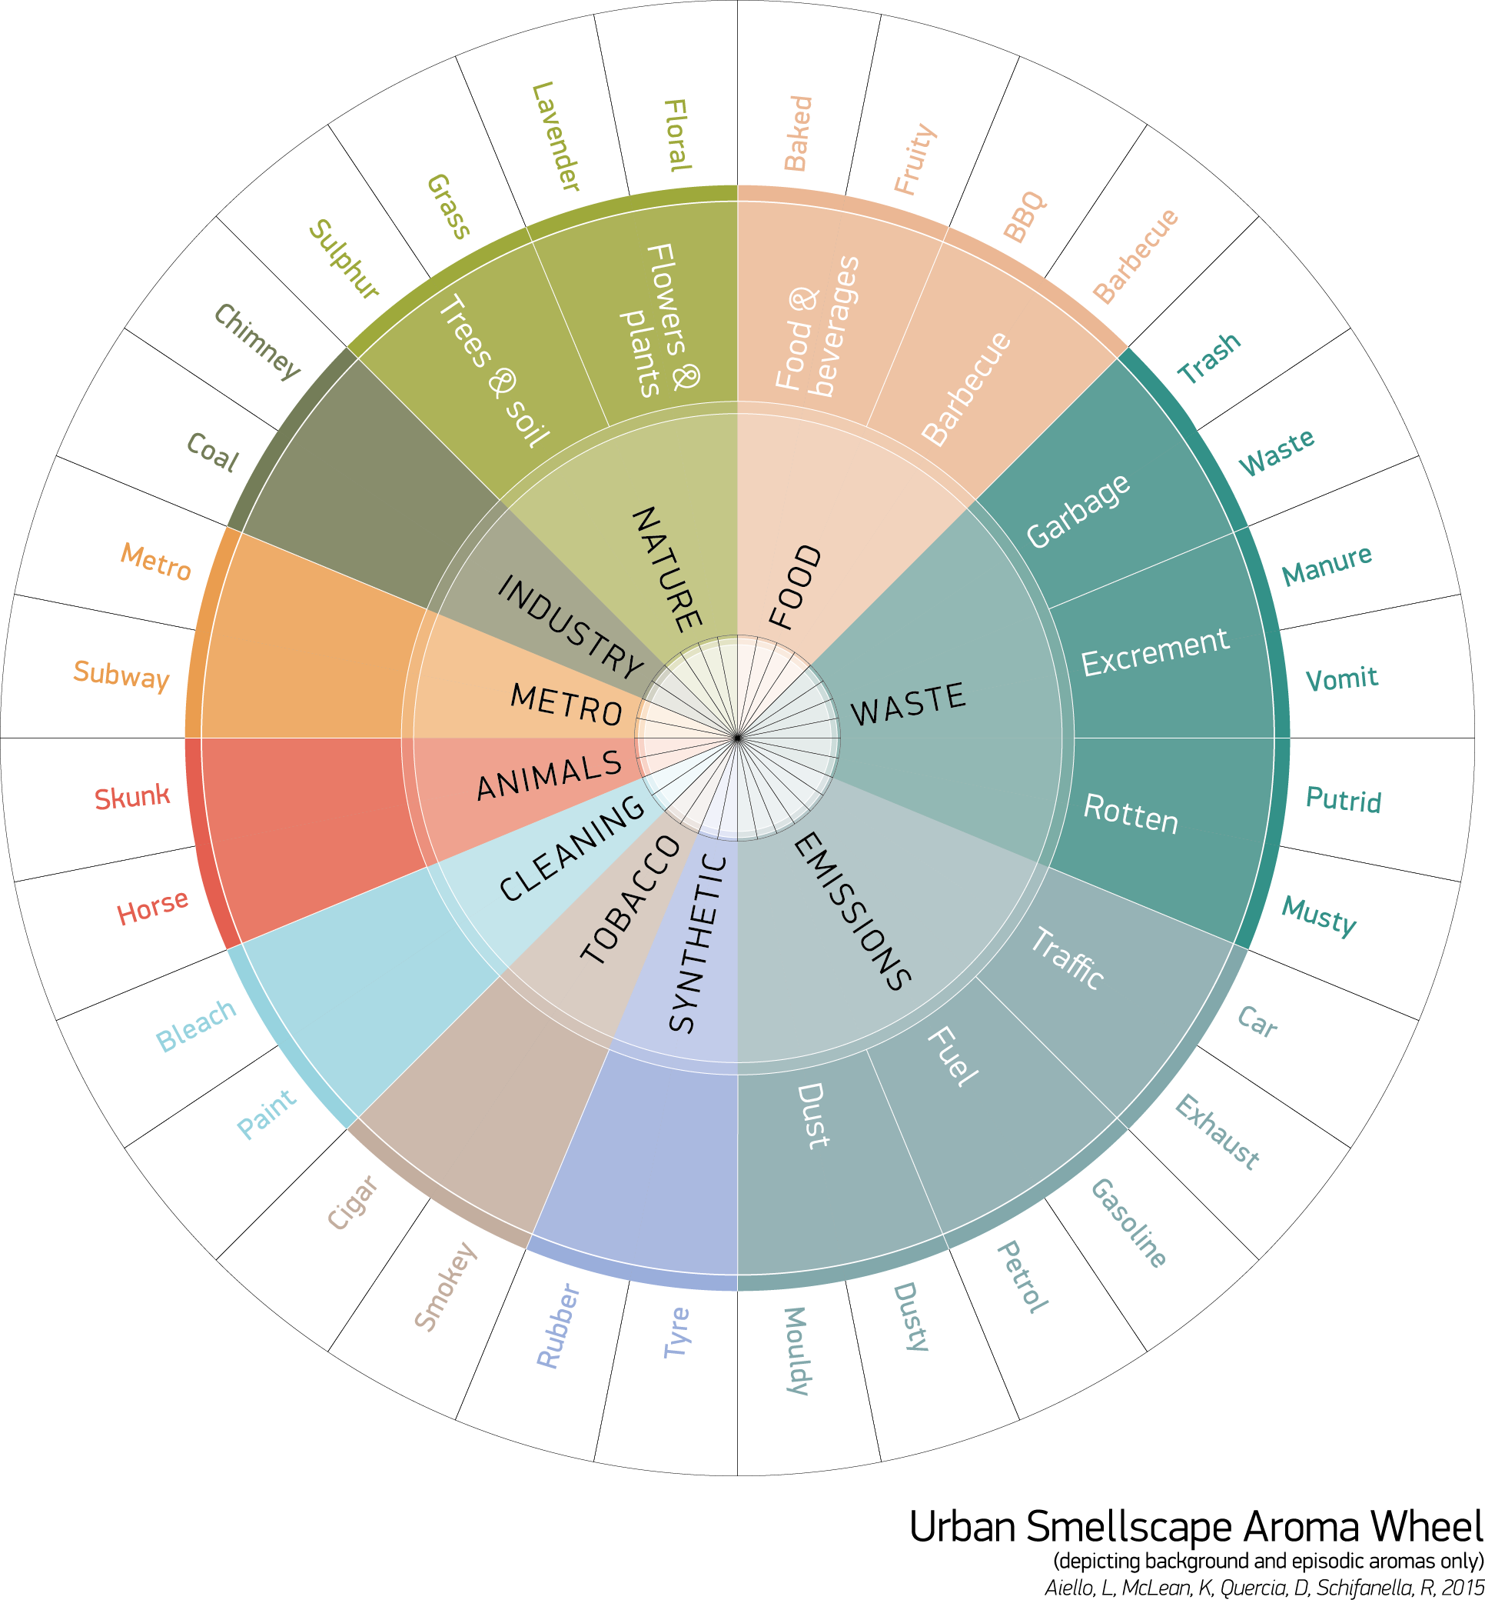
What do you smell on your way to school?
Notes:
Ask question
Hand out worksheet and show urban smellscape aroma wheel. This wheel is used by citizens in their cities to map the smells they encounter. It helps scientists to understand where in cities smells are the worst and where they are the best. This can help to then improve how cities are managed. For example, if there are often smells of rubbish outside takeaways then the council could impose charges if the takeaways do not do something about it.

Slide 58
What do you smell at different times of the day?
Morning:
On the way to school:
Lunchtime:
Afternoon:
The way home from school:
Tea time:
Bedtime:
Notes:
Option to ask pupils to think about particular smells throughout the day. OR they could keep a smell diary as homework
Can delete slide

Slide 59
Our tasks/homework today
Think of a walk you take frequently. How often do you stop to smell different parts of your journey?
Plan this walk/or agree on a common route to school or around your neighbourhood
Print the map of your area (e.g. from Google) and draw your route.
Take your walk, stopping along the way to document smells
Notes:
Read the instructions
Teachers note: print out maps in advance of the class to save time
If unable to take the walk, ask pupils to close their eyes and imagine their route instead

Slide 60
What have you learnt today?
Notes:
This is the end of activity 4e.

Slide 61
Computer programming with traffic sensors
Activities five
Notes:
This is the start of the computer programming activity

Slide 62

What is an algorithm?
Notes:
Ask the class the question, then play the video

Slide 63
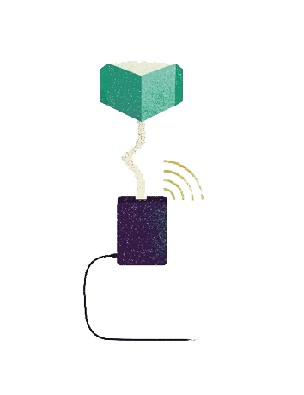
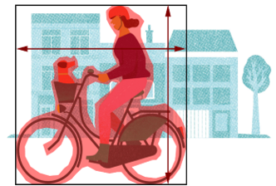
The Telraam traffic sensor
The Telraam traffic sensor consists of a Raspberry Pi computer and a camera. The camera takes a photo every time it detects a moving object.
The computer then uses an algorithm to work out the transport type of the object (car, person, bike or heavy vehicle).
Computers speak their own language, so we need to translate our instructions into code the computer programme will understand, like logic statements.
IF…
THEN…
ELSE…
Notes:
Like the video said, an algorithm is a sequence of clear instructions that tells the computer what to do, like a recipe tells us how to cook. To make pasta, we need to 1) boil pasta; 2) make sauce; 3) drain pasta; 4) combine pasta and sauce. If we missed out one of the steps, or ordered them incorrectly, we could end up with raw pasta, or soup.

Slide 64
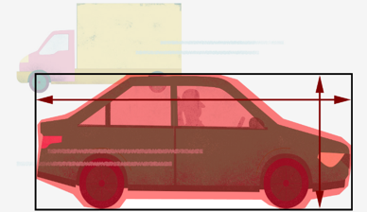
The Telraam traffic sensor VARIABLES
The sensor decides what transport type the object is according to it’s axis ratio and fullness
1.8m
50%
3.1m
80%
1.5m
1.5m
Width ÷ height = axis ratio
Percentage of box occupied by object = fullness
Notes:
The sensor measures both axis ratio and fullness to improve the accuracy of the program, improving the likelihood that the computer makes the right decision.
Ask pupils to complete the first page of worksheet

Slide 65
The Telraam traffic sensor ALGORITHM
Computers can normally only deal with true or false logic statements (yes or no answers). We plan these set of instructions with a flowchart to plan our program.
IF it is raining THEN pick up an umbrella ELSE get wet
Once programmed into the computer, this information is stored within the computer programs memory, meaning the computer can keep repeating these instructions every time the camera takes a photo, without having to ask us for input.
IF…
THEN…
ELSE…
Notes:
Read

Slide 66
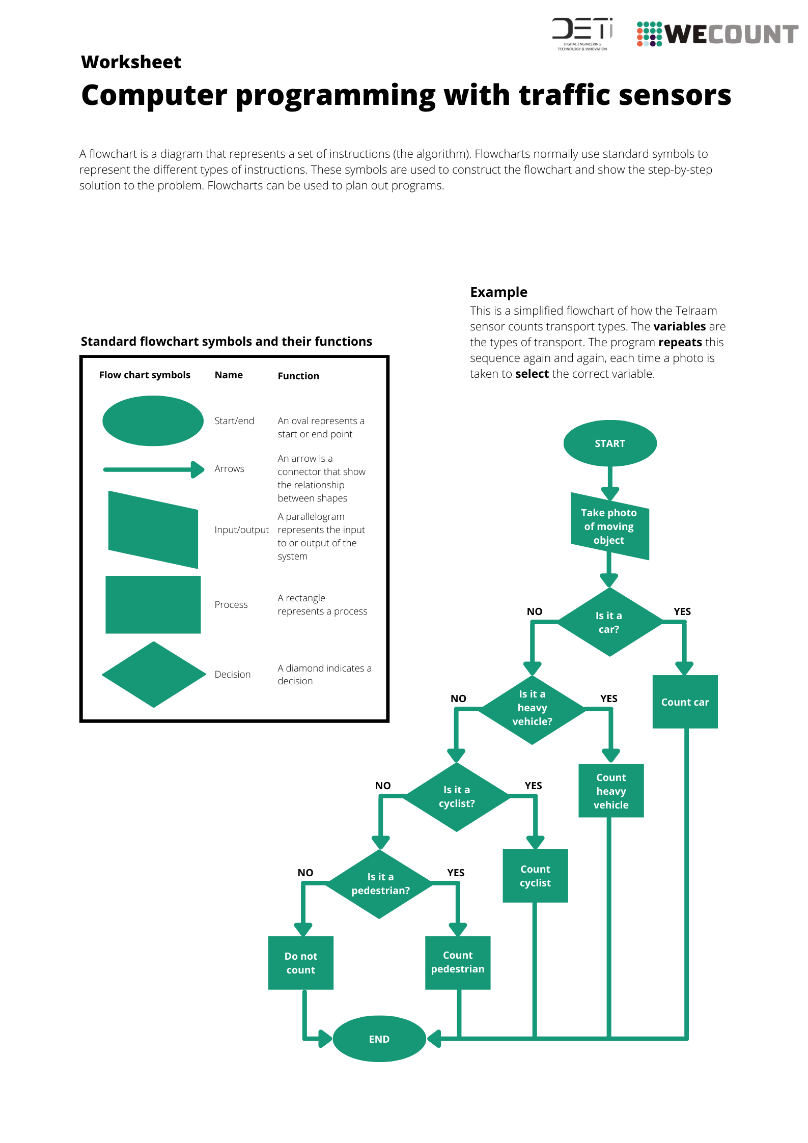
The Telraam traffic sensor FLOWCHART
Notes:
Flowcharts normally use standard symbols to represent the different types of instructions. These symbols are used to construct the flowchart and show the step-by-step solution to the problem.
Read through table and flowchart. Filter questions
Ask pupils to complete second page of worksheet

Slide 67
Vocabulary recap
Algorithm:
Logic statement:
Variables:
Flowchart:
Notes:
Ask pupils to define the above vocabulary

Slide 68
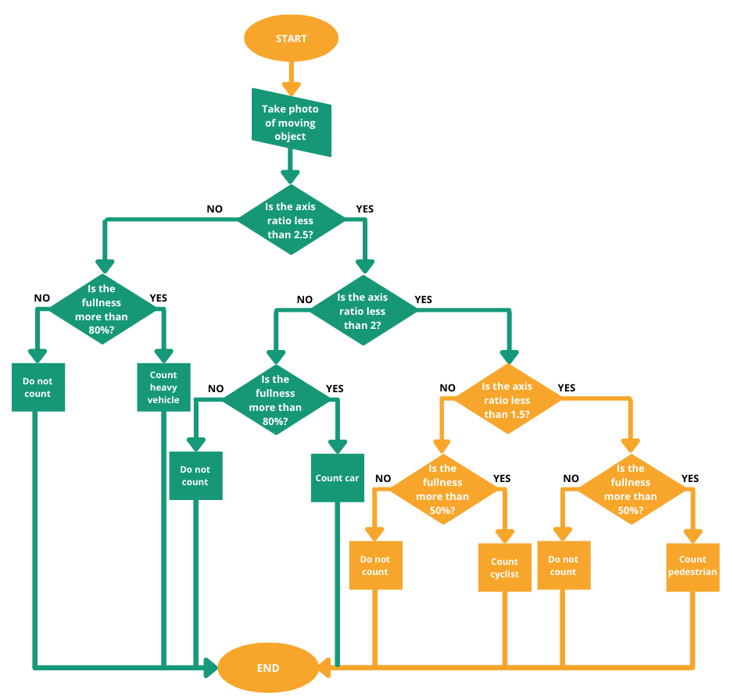
Notes:
This is what the full program will look like. The sections highlighted in orange should be what you used to create your flowchart.
Answers to the questions in the worksheet:
Axis ratio:
Truck = 2.9
Car = 2
Bike = 1.2
Pedestrian = 0.2
IF the car is more than 80% full
THEN car
ELSE no car
IF the heavy vehicle is more than 80% full
THEN heavy vehicle
ELSE no heavy vehicle
IF the pedestrian is more than 50% full
THEN pedestrian
ELSE no pedestrian
IF the cyclist is more than 50% full
THEN cyclist
ElSE no cylist

Slide 69
What have you learnt today?
Notes:
End of worksheet on computer programming

Slide 70
My journey matters to me
Comprehension activity
Notes:
This relates to worksheet six

Slide 71
Does your journey matter to you?
Do you find it easy to move about where you live?
How do you move about?
What don’t you like about moving around your area?
Notes:
Read the questions and filter answers

Slide 72
Different opinions
People often have different opinions on a particular topic
We are now going to hear from some of them in this exercise
Take it in turns to read a paragraph out loud in class, from the information on the worksheet

Slide 73
Comprehension task
Which person has three cars?
Who loves taking the bus?
What are the main reasons why the cyclists ride their bikes?
What are the main concerns of the residents?
If new bike parking were to be built, do you think everyone would be happy? Why?
Notes:
Ask pupils to fill out the answers to these questions on their worksheet
When ready, ask pupils to answer the questions aloud

Slide 74
Comprehension task
What are your concluding thoughts from this exercise?
Notes:
Ask question and facilitate discussion
Prompts…
What have you learnt about opinions on this street?
Do you think your street might be like this?
What might be some of the biggest transport challenges facing your street/city?
(Optional for more able students) How might we be able to reach consensus about traffic issues when there are differences of opinion?

Slide 75
Homework
Ask your parents and/or grandparents what their favourite form of transport is (including walking and cycling) and why.
Ask them about the biggest changes they have seen to the way people travel over the years.
Ask them what they would like to see change to allow more people to walk, cycle or use mobility scooters.
Write down your answers on the worksheet.
Be prepared to present your findings in class next time.
Notes:
Read aloud and answer any questions the pupils have. These questions are also written on the worksheet for this activity

Slide 76
What have you learnt today?
Notes:
This is the end of activity six

Slide 77
A postcard for our future
Persuasive writing exercise
Notes:
This relates to worksheet seven.
Having completed one of the previous exercises, children can now use their expertise to make a real difference? Ask: Have you read or written a persuasive letter before?
Together decide the best audience for a persuasive letter about improving transport and travelling around the city (the Mayor? Local MP? Head Teacher?).

Slide 78
What needs to change about how we travel in our area?
Notes:
Ask the question

Slide 79

Who needs to know?
Notes:
Who needs to know? What do we need to tell them to convince them that things need to change? E.g. cars contribute to air pollution and climate change and are bad for our health

Slide 80
https://www.bbc.co.uk/teach/class-clips-video/how-to-write-a-persuasive-text/zkcfbdm
Notes:
Watch the video
Ask: is the language appropriate for someone like, for example, the Mayor?
Create a toolkit together to highlight the key elements of a successful persuasive text. Explore the phrasing and decide on more appropriate language choices.
Consider exploring some written examples, such as the deforestation text from www.literacywagoll.com/persuasive.html
Annotate to draw out key structure and phrases the children would like to use.
Draft and then write the persuasive letter. Work in pairs to encourage peer review. Remind the children to refer regularly to the toolkit and to be prepared to redraft
sections a number of times. Consider a mini plenary where some children are invited to read a paragraph they are proud of, allowing others to learn from their ideas.
Condense the persuasive letter into the postcard on the worksheet

Slide 81
What have you learnt today?
Notes:
This is the end of activity seven

Slide 82
Clean Air Top Trumps
Activity eight
Notes:
This relates to worksheet eight.
We have a BIG problem to solve - designing a future with clean air and fewer carbon emissions. Air pollution is linked to 4.6 million deaths each year. Carbon emissions could change our way of life forever through global heating. Your mission is to think about and compare a range of different solutions, voting on priorities for change. Think quietly about: What is air pollution? Where do emissions come from? What causes air pollution and carbon emissions?
So, what can we do? Share a few ideas as a class: what could we build to help us travel? What could we change in our lives? What could we teach? Encourage class to consider to be as creative as possible. In pairs, jot down at least three travel ideas as either sketches or in note form.
Teachers note: depending on time, you could create the cards in advance and allow the pupils to simply have a play.

Slide 83
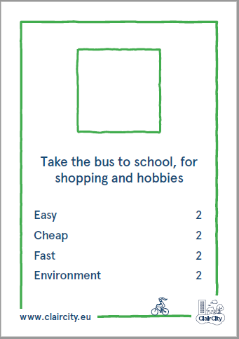

Difficulty
Cost
Speed
Eco-friendly
Notes:
Now to make use of these ideas. Does anyone know the game Top Trumps? What do we need for Top Trumps? (cards and scores). Make cards to play “Clean Air Top Trumps.
Initially score this card together. Get pairs to do the same. Do this three more times, emphasising the scale is a maximum of 10 (1 is low, 10 high).
Difficulty: how hard it is to do this – what skills do you need? What equipment?
Cost: how expensive is it?
Speed: how fast will journeys be?
Environmental: how much harm will this cause?
Hand out completed packs so together each pair has 10 cards to play with. Play the game! If you lose all your cards, and there is time, create another.

Slide 84
What solution won?
Vote on winning solution
What would you have to give up to choose this solution over driving?
What would you gain
Notes:
Which was a winner? - ask a member from each pair to answer
Ask pairs to vote on their favourite by sticking a dot against their preferred option on the flipchart. Option to give pupils three dots if there are lots to choose from
Hold a class discussion about the winning solution.
Discuss trade-offs - what would you have to give up? What would you gain? Is there a perfect solution for all?

Slide 85
What have you learnt today?
Notes:
This is the end of activity eight

Slide 86
I love to travel by…
Activity nine
Notes:
This relates to worksheet nine.

Slide 87
What is your favourite way to get around, other than the car? Walking, cycling, scooting, or something else? Think about the thing that makes you feel the happiest and healthiest.
Notes:
Ask question and facilitate discussion

Slide 88
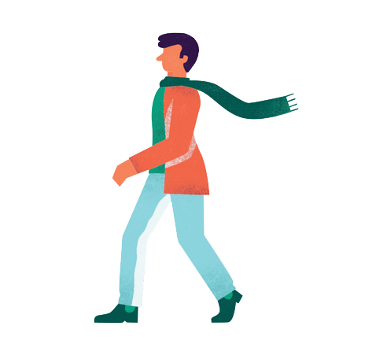
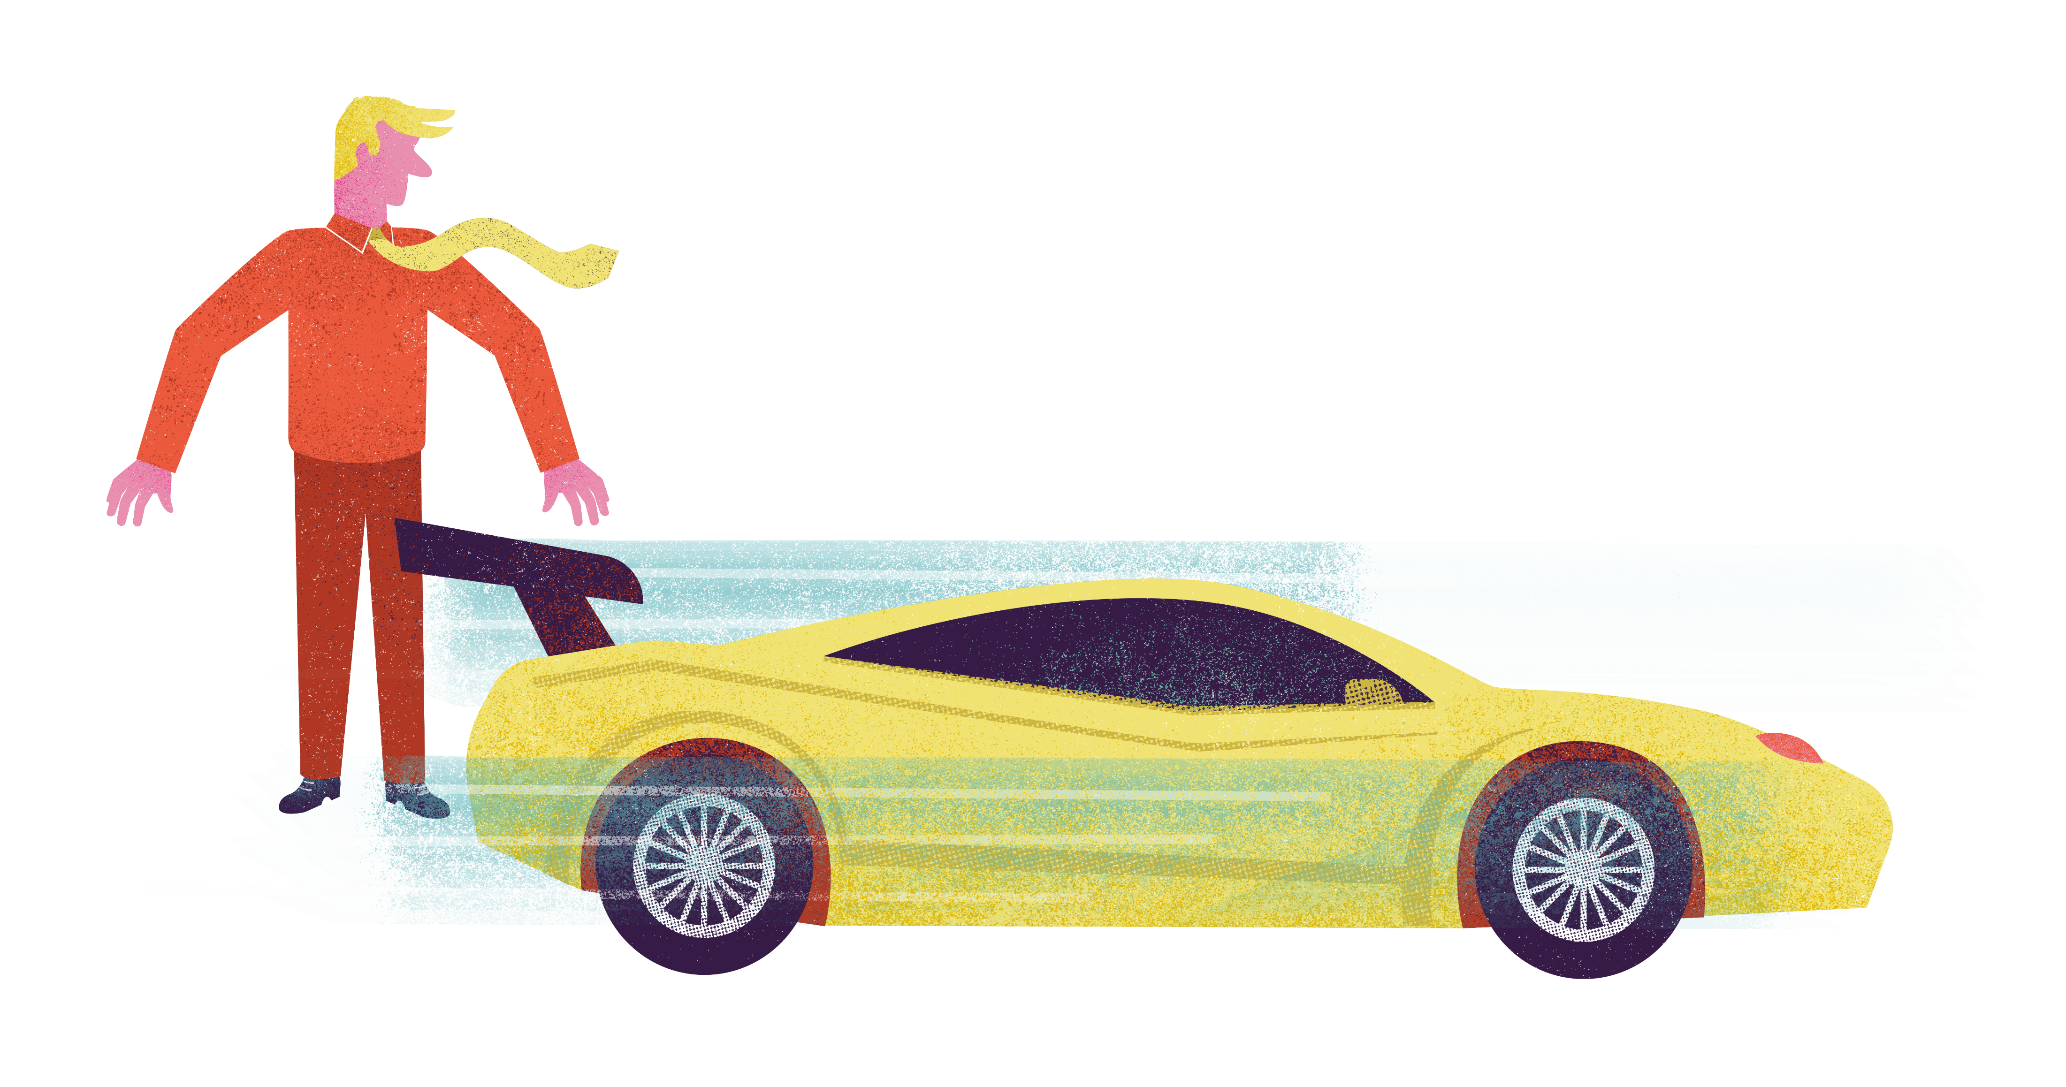
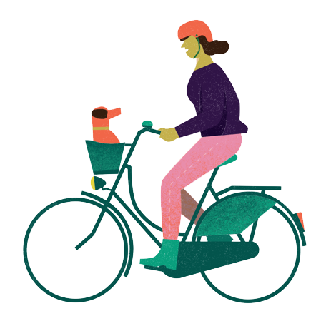
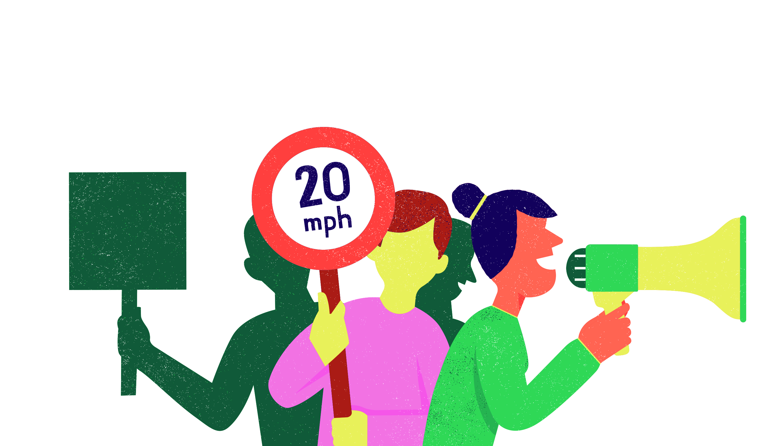
We all need to play our part in making our cities healthier, happier and cleaner places to live…

Slide 89
Task:
Write down all the things you love about your chosen form of travelling around the city. Come up with at least 10 reasons why.
Draw a picture of you travelling to school on the transport you love.

Slide 90
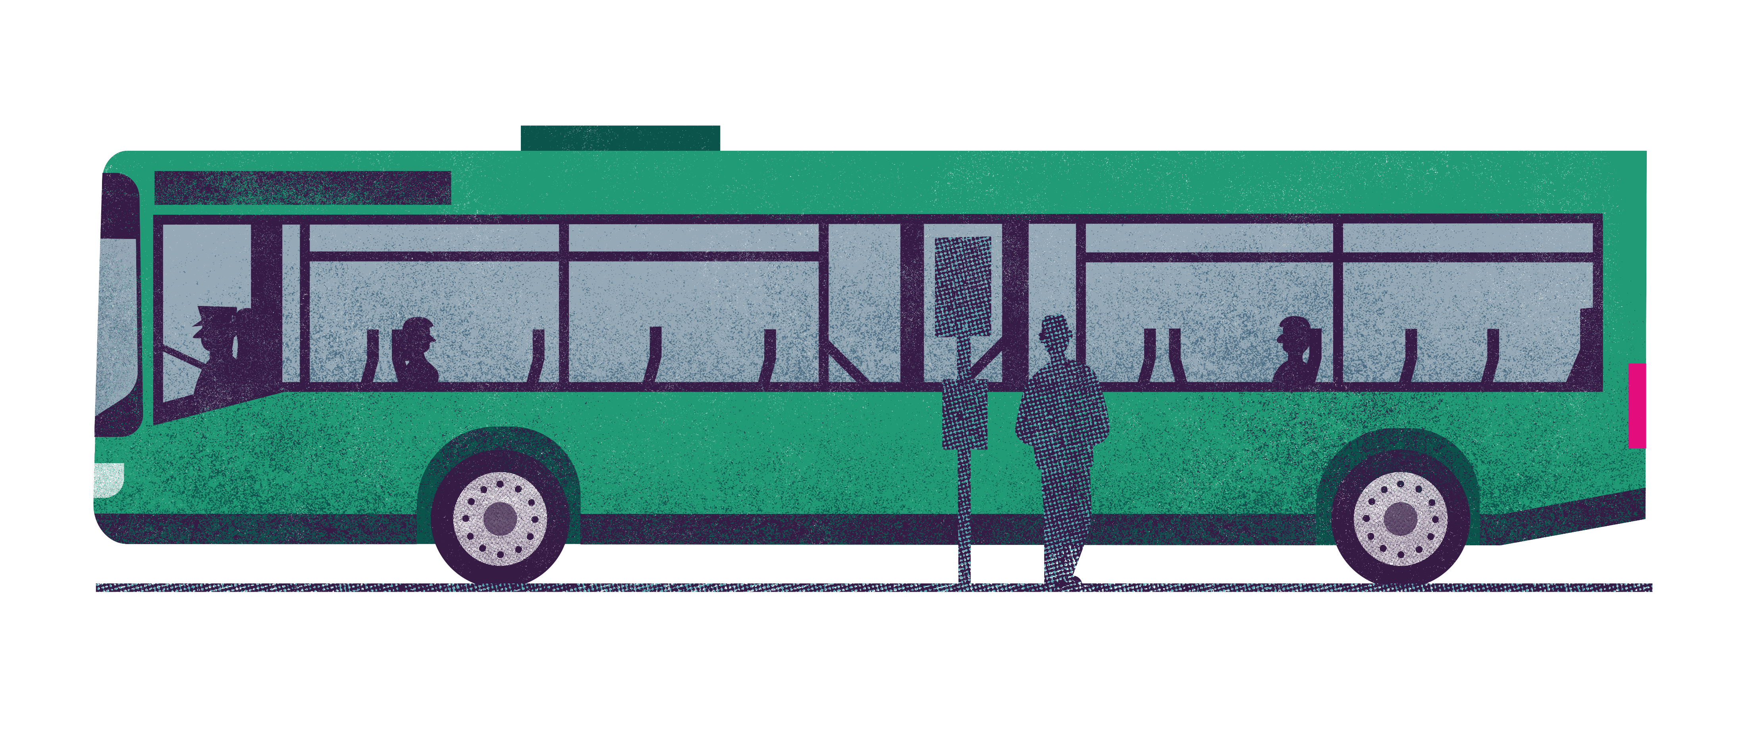

Discussion
Share how you like to travel around the city and why
What would make it easier for you to travel this way?

Slide 91
What have you learnt today?
Notes:
This is the end of activity nine

Slide 92
Design a future proof bike
Activity ten
Notes:
This relates to worksheet nine.

Slide 93
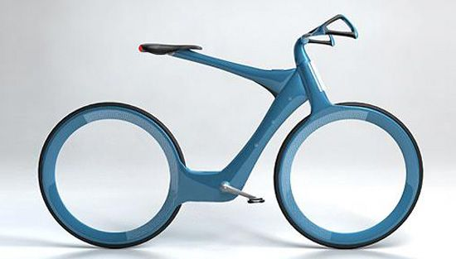
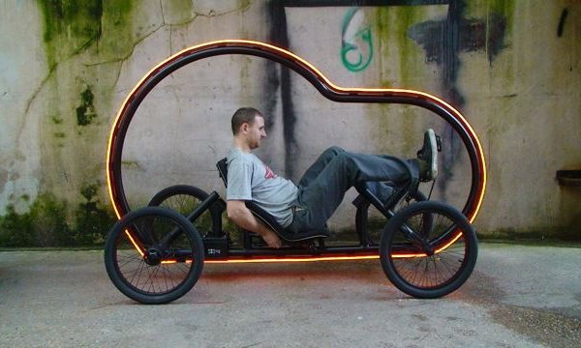
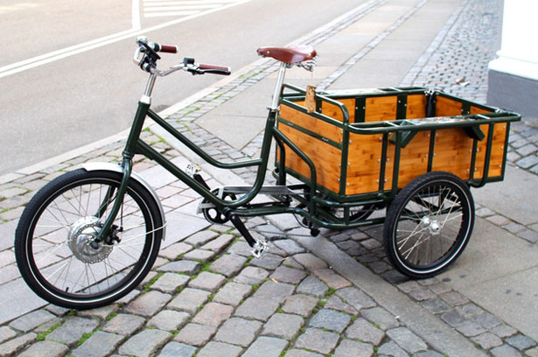
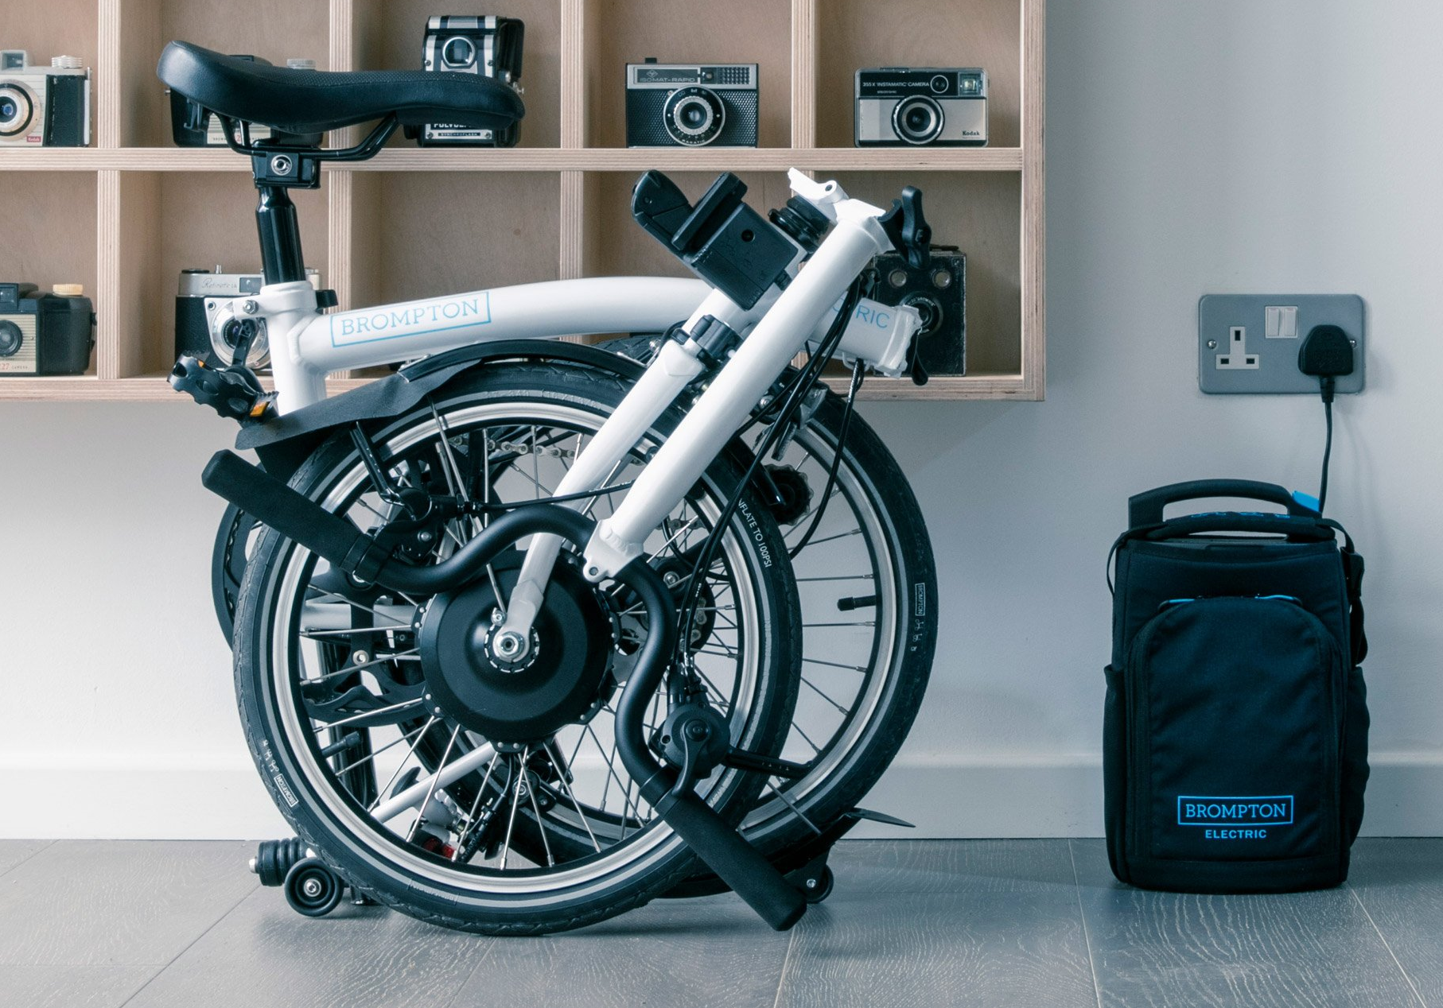
What will bikes look like in the future?
Notes:
Ask the question
What needs to change about bikes today to make them suitable for our future needs? (e.g. buying food, travelling long distance, staying dry in bad weather…)

Slide 94


Over to you…
Notes:
Now it is your turn to draw your bike of the future
Think about all of the design features it will need to get you around the city/to encourage people to get out of their cars
What materials will it need to be made from to be sustainable? Open up short discussion about sustainable materials (need to be long lasting, recyclable, not made from oil, etc)

Slide 95
Share your designs
Notes:
Ask some pupils to share their designs and the features they have added. What materials have you used?
Ask pupils to vote on the best features/write the best features on a flipchart

Slide 96
What have you learnt today?
Notes:
This is the end of activity ten

