Slide 1

Contractor
Health and Safety Induction
“Home Safe Everyday”

Slide 2

Contractor Induction
Contents
Welcome to Damar Industries
Arriving on Site
Sign in Requirements
Evacuation
Emergency Evacuation Route
Facilities
Personal Protective Equipment (PPE)
Area Restrictions
Hazards
Large quantities of flammable liquids
Static electricity
Chemicals
Hazardous Substances
Forklifts, Reach Trucks and other Mobile Plant
Exclusion Zones
Other Vehicles
Other Hazards
Permit to Work
Isolation/Lock Out Tag Out
Drugs and Alcohol
Reporting Events
Golden Rules
Failure to Follow Damar Rules
Induction
Contacts

Slide 3
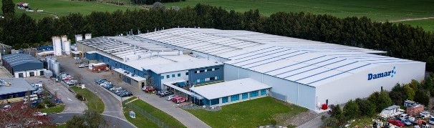
Contractor Induction
Welcome to Damar Industries
Damar Industries Limited operates a lower tier Major Hazard Facility (MHF) manufacturing site at Eastgate Business Park Rotorua.
Stored on the site can be up to;
97,800 litres of blended P45 & P72 LPG (Liquid Petroleum Gas)
370,000 litres of bulk flammable liquids
1.4 million litres water capacity of aerosols, and
2.2 million litres of flammable liquid finished goods
WH9 – 75,000L Oxidising Products
These substances are used to manufacture a variety of paints, aerosols, road marking paints, cleaning products and liquid fill products for storage and distribution throughout New Zealand and overseas export markets.
The volumes of substances in use and stored on the site, create Hazardous Atmosphere Zones and Controlled Zones in all production and storage areas.
Damar Industries Ltd is obliged to ensure that workers, contractors and visitors are informed of the hazards that could be encountered when entering the plant and the controls necessary to manage these risks under the:
Health and Safety at Work Act 2015 (HSWA),
Health and Safety at Work (Major Hazard Facilities) Regulations 2016, and
Health and Safety at Work (Hazardous Substances) Regulations 2017 legislation

Slide 4
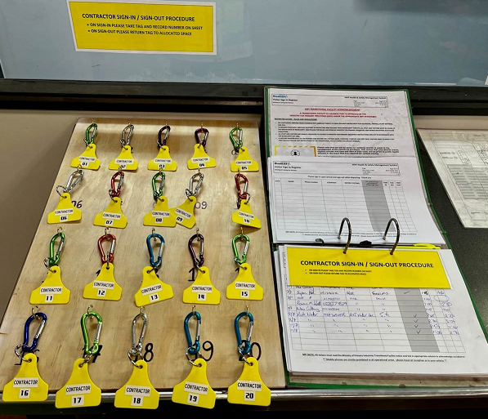

Contractor Induction
Arriving on Site
Damar Industries Ltd is a Ministry of Primary Industries (MPI) Transitional Facility, to comply with regulations for the above, this is a secure site with authorised access only.
On arrival;
  Contractors should park in the allocated visitor car parks outside reception.
  Report to reception and ask for your site contact.
  Visitors sign in the visitor register at Reception and take a tag. Ensure you have the correct PPE on.
  Contractors sign in at the Permit Station in the GMH Hall and take a Contractor tag. Ensure you have the correct PPE on.
  If you need to bring your vehicle on site - Once signed in, proceed to the entrance gate, push the intercom, and wait for a Damar operator to answer.
  The operator will ask for your name and company, then check the system to see that you have completed this induction and that it is current.
  If behind another vehicle at the gate, DO NOT pass through when the gate opens for them to enter – Wait until the gate has closed and you have spoken to the operator on the intercom.
  When travelling through the site, adhere to the speed limit of 5km - headlights must be on.
NOTE: ANIMALS ARE NOT PERMITTED ON SITE
This is a MPI requirement for transitional facilities

Slide 5
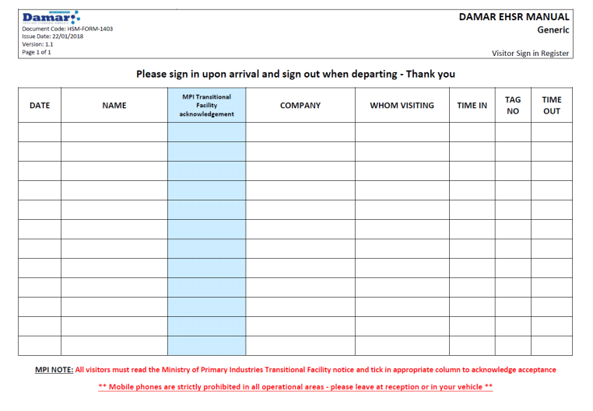
Contractor Induction
Sign in Requirements
Contractors must read the MPI Transitional Facility notice posted in the sign in registers and acknowledge acceptance by ticking the indicated (shaded) column of the Sign In Sheet
You must sign in and out every time, even if you’re temporarily leaving site as these registers form part of our fire roll for other persons on site in the event of an emergency
If entering a production area while on site, your site contact will also check:
  You are wearing or have the correct PPE, and
  That you are aware of the restrictions placed on sources of ignition and mobile phone use

Slide 6
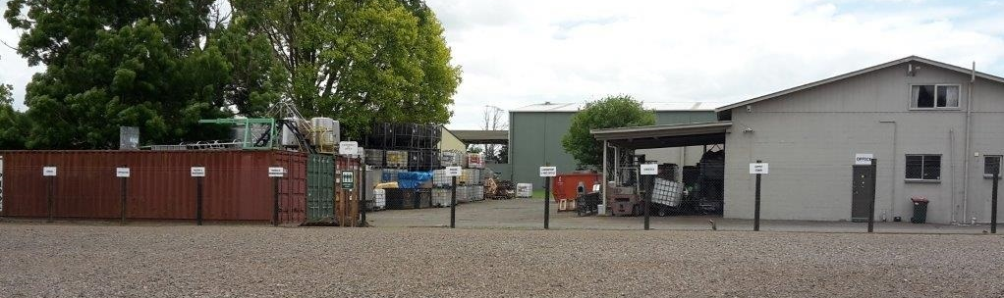
Contractor Induction
Evacuation Procedure
If alarm sounds (siren), move steadily to the nearest exit and gather at the Emergency Assembly Area (all security gates will automatically open)
The Emergency Assembly Area is located in the staff carpark across the road
Once at the Assembly Point:
Assemble in your work groups (Admin if signed at Reception or Contractor if signed in at Permit to Work Station in the GM Hall)
Report to your area warden and make sure your name gets checked off
Do not smoke or vape
Do not leave the Emergency Assembly Area
Do not stand on the driveway
Do not use your mobile phone unless directed to do so by the Head Warden
Do not re-enter the buildings until cleared to do so by the Head Warden or Facility Emergency Controller

Slide 7



Contractor Induction
Emergency Evacuation Route
Gas Hall/Houses
Solvent Tank Farm
Aerosol Hall
LPG Tank Farm
L I N K W A Y L I N K W A Y
NZ Fire Service
National Training
Centre
Warehouse 1
DAF
Factory
PARKING
Car parks
Linkway
Linkway
Warehouse 2
Transit Depot
Canopy Area
General Manufacturing Hall (GMH)
Warehouse 3
Liquid Fill
Te Huaki Cres
PARKING
ä
ä
Warehouse 4
Damar Industries Staff and Visitor Car Park
PARKING
Administration
Warehouse 5
MAIN
GATE
Emergency Assembly Area

Slide 8






Contractor Induction
Facilities
Toilets are located;
In the Main Building just inside the entrance door to the left, and
In the corridor between the GMH and Factory areas
Tea/Coffee making facilities;
The main lunch room is inside the entrance door to the right in the main building
Personal Protective Equipment (PPE)
Compulsory PPE required in production areas;
Other PPE when specified as a control on JSA/SWMS/Permit to Work e.g. Safety Harness
 | High Visibility Clothing Cotton Overalls/Vest or Anti-static vest |  | Protective Footwear
 | Eye Protection Safety glasses – Plain, Prescription or over-glasses |  | Hearing Protection Additional in Aerosol Hall only (and task specific)

Slide 9








Contractor Induction
Area Restrictions
Restricted in all production areas
 | No Ignition Sources |  | No Mobile Phones
 | No Smoking/Vaping |  | No Long Hair
 | No Eating or Drinking from unapproved drink bottles |  | No Hoods
Food Grade Restrictions – Do not enter if you have been unwell
 | Keep Hair Covered |  | Wash Hands Regularly Wear Gloves

Slide 10

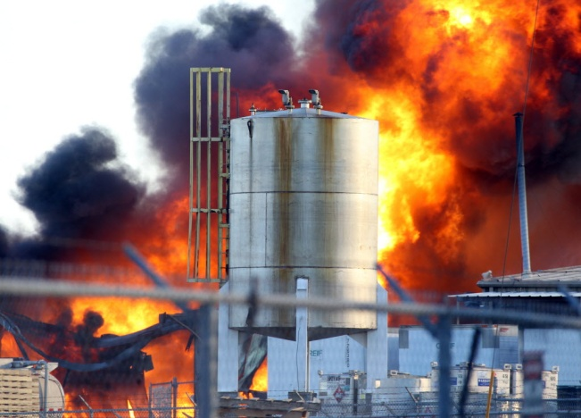
Contractor Induction
Hazards
A hazard is anything that can cause harm
There are many different hazards on site, today is an overview of some of the hazards that contribute to our critical risk profile and the controls we have in place to reduce that risk
All work may require a work permit to be issued to you and will identify specific hazards for the work activity you are to undertake
NOTE WHERE THE FIRE EXTINGUISHERS ARE IN YOUR WORK AREA
Large quantities of flammable liquids
Fire and explosion is the main risk associated with flammable liquids.
Controls include;
Restrictions on sources of ignition
No smoking/vaping
No cell phones or other electronic devices permitted in operations areas
Intrinsically safe plant and equipment

Slide 11

Contractor Induction
Static electricity
A static spark can start a fire
(and is our most likely cause of fire on site)
Controls Include;
Cotton or anti-static high visibility clothing only
Make sure earth straps are attached when operating equipment and BEFORE pouring or mixing any solvents
Notify the Engineering team if you get any static shocks in a production area
Chemicals
  Skin Sensitisation Hazards – Some of the chemicals used on site are known or suspected skin sensitisers and may cause allergic skin reactions upon contact. Repeated or prolonged exposure can lead to the development of sensitivity, resulting in adverse effects even at low levels of future exposure.
  Eye splash – Wear safety glasses at ALL times in ALL production areas. Where practical, contractors should wear prescription lenses as an alternative to contact lenses, where this is not practical; goggles will be worn over contact lenses.
  Skin contact – Wash off unknown chemicals immediately
  Inhalation & ingestion – Report any effects e.g. nausea, dizziness, or shortness of breath.
Controls include;
PPE (is necessary but it’s also the last line of defence), Fixed Vapour Detectors, VOC monitoring systems, extraction and ventilation systems

Slide 12
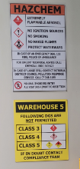
Contractor Induction
Hazardous Substances
Chemical classes held on site;
Class 2 Flammable Gas
Class 3 Flammable Liquid
Class 4 Flammable Solids
Class 5 Oxidisers
Class 6 Toxic
Class 8 Corrosives
Class 9 Ecotoxic
Chemical Classes not held on site;
Class 1 Explosives
Class 7 Radioactives
For further information on chemicals, see the:
Label
Chemwatch Safety Data Sheet (SDS)
Technical Staff (Laboratory/Quality Control)
Certified Handlers

Slide 13
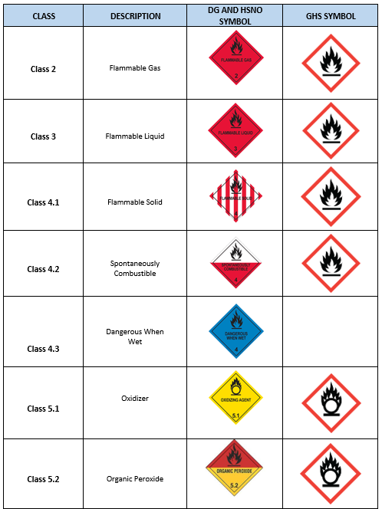
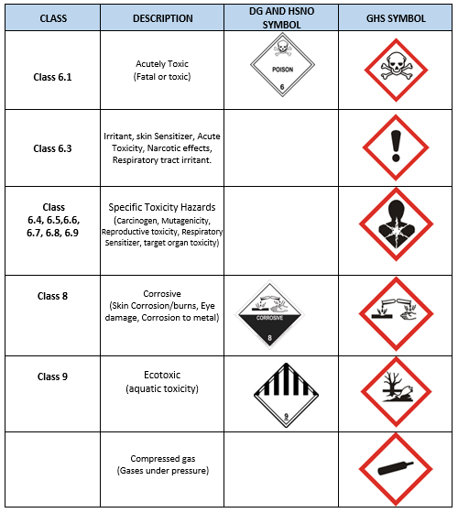
Contractor Induction
HSNO & GHS Pictograms

Slide 14



Contractor Induction
Forklifts, Reach Trucks and other Mobile Plant
There are many forklift/mobile plant movements on site
Only trained authorized Personnel are permitted to operate Forklifts
Controls include items listed below.
At all times;
Give way to forklifts and reach trucks – they have the right of way
Keep to marked walkways where available
Look and Listen for forklifts and reach trucks, especially when approaching corners
Use the convex mirrors located opposite doorways in the Linkway to check for approaching forklifts/reach trucks before crossing any open doorway
Whenever an operator is in the cab or in control of any mobile plant, you must communicate either vocally or by hand signals your intended direction of travel with that operator, and wait for confirmation from the operator before proceeding
 | Never ride on a Forklift as a passenger |  | Never walk under a raised load

Slide 15
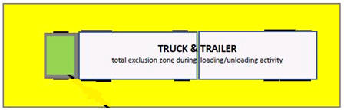

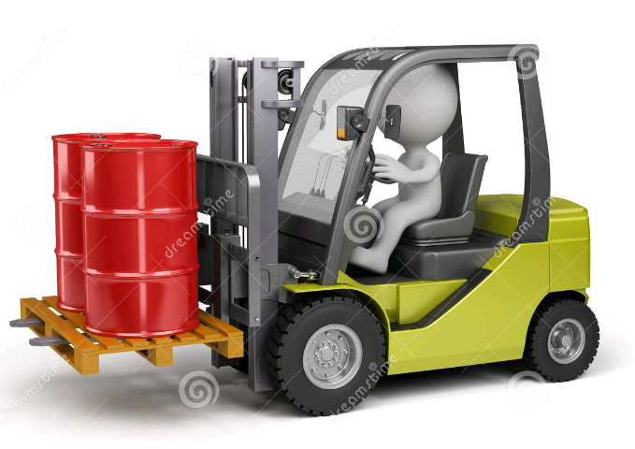
Contractor Induction
Exclusion Zones
Controls - Always observe Exclusion Zones when in place and remain at least 2m away when;
In the Transit Depot and Tanker Delivery areas on the roadway around site when loading and/or unloading is underway.
Overhead gantry cranes are in use in the Batching Factory
A forklift/reach truck has a load at height

Slide 16
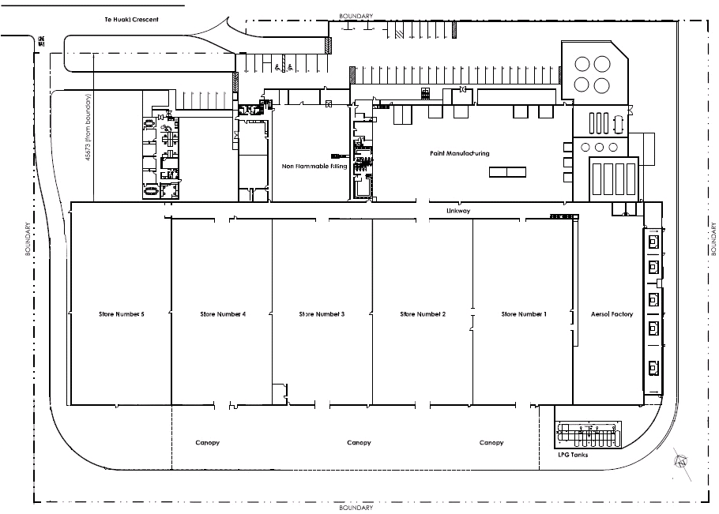

Contractor Induction
Other Vehicles
Controls - When driving on the one way roadway on site, expect and be prepared for:
Delivery trucks
Solvent and flammable gas tankers
Private and contractor vehicles
All drivers must observe the site speed limit of 5km per hour
AT ALL TIMES, REMEMBER THE RISKS ASSOCIATED WITH A VEHICLE ACCIDENT OR IMPACT INCIDENT ON SITE, THIS INCLUDES THE POTENTIAL FOR;
Personal injuries
Fire and explosion of flammable gases and liquids
Loss of containment and environmental damage
Bulk Solvent Tanker
No Stopping on ring road (red line) except when under the Canopy
LPG Tanker

Slide 17




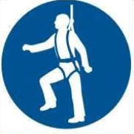

Contractor Induction
Other Hazards
Include but are not limited to;
 | Tools and Equipment Permission is required to use Damar equipment Tools must be in good condition Observe Permit to Work conditions when using tools in Hazardous/Controlled areas |  | Electrical Electrical equipment must be tested and tagged by electrician RCD’s required in all circumstances at power source Do not run cords across floors
 | Housekeeping Keep access ways clear for emergency exits and appliances at all times Clean up spills immediately |  | Manual Handling Use best practice lifting techniques Ask for assistance when required
 | Work at Height Work at Height must only be carried out once trained Harness/restraint required when working over 2 metres A work permit may be required |  | Excessive Noise Hearing protection is required at all times in the Aerosol Hall Hearing protection must be worn for any drilling, grinding or other work where noise levels exceed 85dB

Slide 18

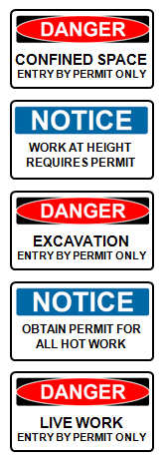
Contractor Induction
Permit to Work System
Work Permits
Work Permits ensure work activities are performed in a controlled and coordinated manner, identifying and controlling hazards associated with the work, to reduce the risk of accidents and incidents
Work Permits are required for all work unless otherwise agreed and must be issued before work starts
Work Permits are legal documents covering both contractors and Damar and are subject to audit
Permit to Work Certificates
Additional documentation and certificates are required for work that involves confined spaces, hot work, work at height, excavation, live work and intrusive work
Your site contact will work with you to arrange and fill out your Work Permit/certificates
A copy of Damar’s Permit to Work Procedures Manual (MHF-HSMS-6400) is available at the Permit to Work Station inside the GMH

Slide 19
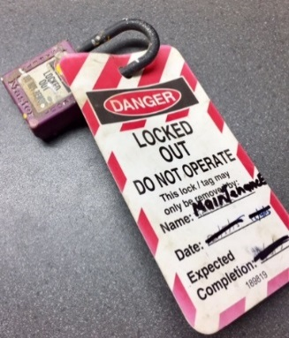
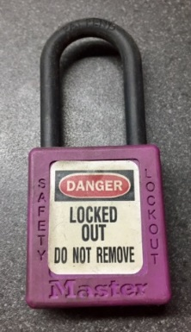
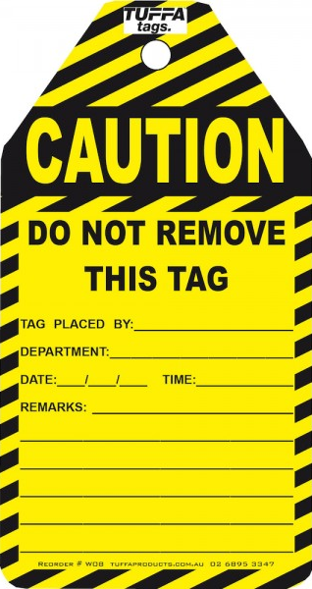
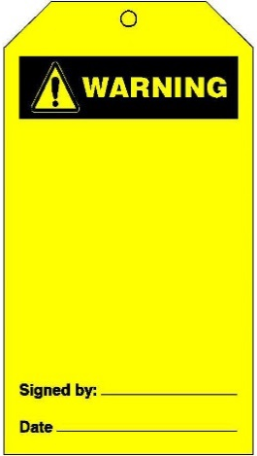
Contractor Induction
Isolation/Lock Out Tag Out
All Isolations must be undertaken in accordance with Damar Industries procedures as listed in Section 12 of the Permit to Work Procedures Manual (MHF-HSMS-6400)
Personal locks and lock out tags are issued at the Permit receivers or users discretion
Red and White Lock Out Tags are available at the Permit to Work Station.
✓
Other Tags
Damar does not permit the use of yellow ‘Warning’, ‘Caution’ or other tags on site
If you are identifying defects in operational plant, notification must be received both verbally and in writing, stating Asset Number and/or description.
DO NOT ATTACH TAGS AS IDENTIFYING MARKERS FOR FUTURE WORK
X

Slide 20


Contractor Induction
Drugs and Alcohol
Damar has a Zero Tolerance for Drugs or Alcohol in the workplace and enforce a strict Drug and Alcohol Policy
All contractors are subject to testing for drugs and alcohol for the following reasons:
  Post accident/incident – If you are involved in any significant accident or incident you will be tested immediately
  Reasonable Cause – We suspect drug and/or alcohol use
  Random Testing – Occurs on an unannounced basis
Reporting Events
All hazards, accidents, incidents and near misses must be documented and reported to your site contact – this includes plant or property damage
An Incident / Near miss Form (online) must be completed BEFORE leaving the site, your site contact will assist in its completion
Where requested, you may be required to assist in an investigation
The accident/incident scene must remain undisturbed unless the movement of vehicles, objects, etc. is necessary to administer first aid, save life, prevent further injury, allow access for emergency services or prevent serious property damage

Slide 21


Contractor Induction
Failure to Follow Damar Rules
Subject to investigation, a contractor may be removed from site, or may be stood down for a period.
Cancellation of the contractors site induction and/or refusal to allow the contractor back on site may be an additional consequence of not abiding by site rules
Any incidents of failing to adhere to Damar rules will be formally communicated to the Damar business partner the contractor represents
24. Induction
On completion of your Induction, your name will be placed on our Damar Inducted Contractor list, which will remain valid for a period of 12 months from the initial date of Induction.
You will be required to follow the sign in process when entering the Damar site.
All contractors are required to complete the Induction paperwork to gain access ono the Damar Rotorua site. Completion of the induction process does not guarantee access. We reserve the right to deny site access at our discretion, regardless of induction status.

Slide 22
Contractor Induction
Contacts
David Lewis
Engineering & Compliance Manager
Stacey Rimene
Health, Safety, Quality & Environmental (HSQE) Manager

