Slide 1
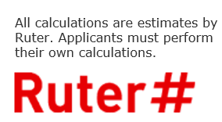

Dokumentasjon til operatører
Innspill dialogkonferanse - Ruter

Slide 2
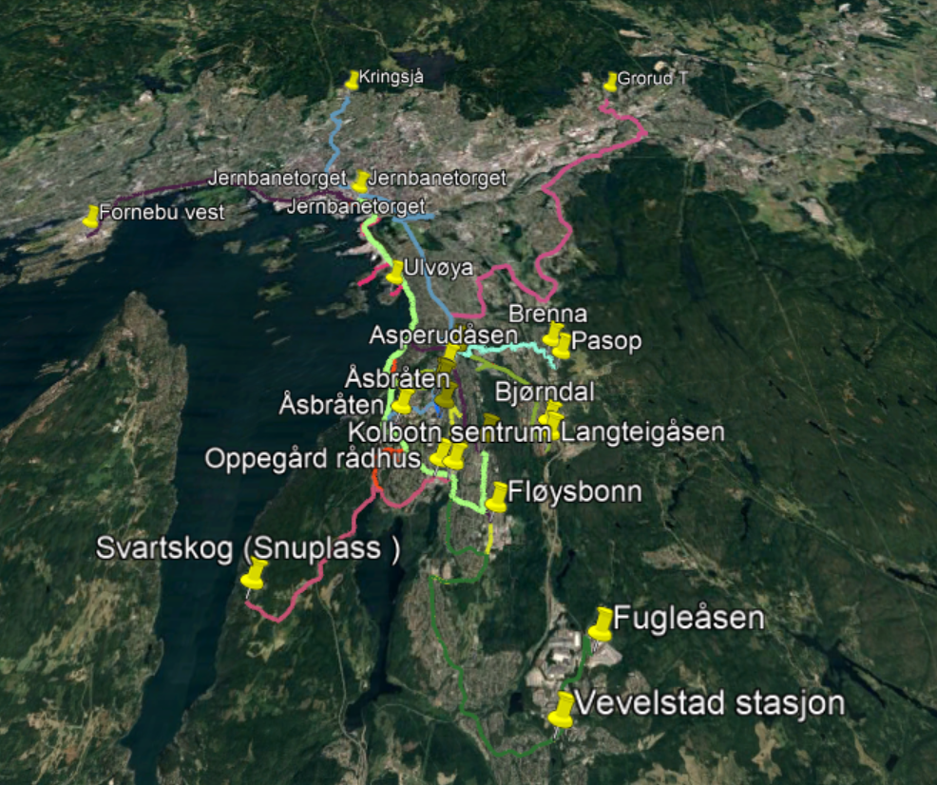
Oslo syd

Slide 3
All calculations are estimates by Ruter. Applicants must perform their own calculations.

Slide 4
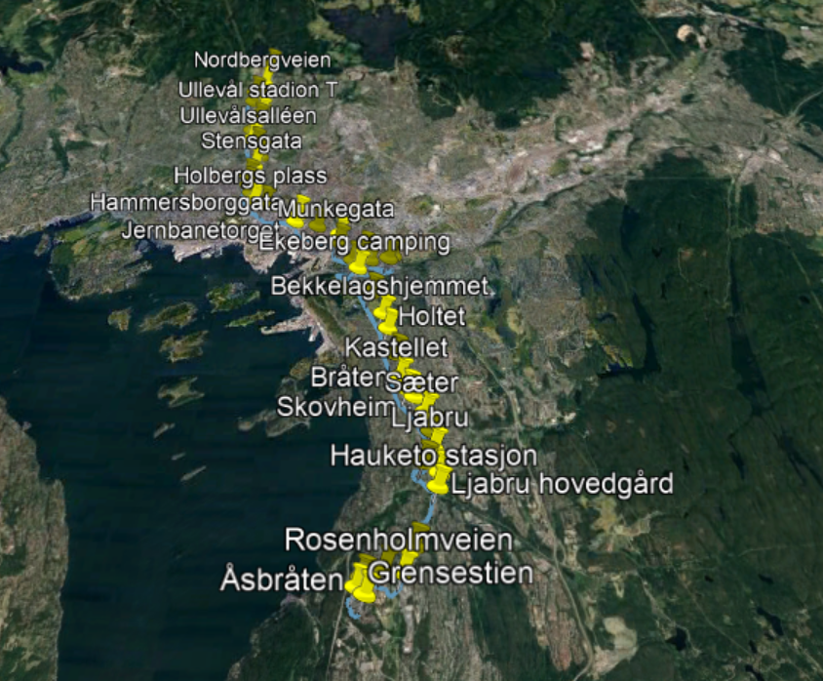
Line 18N

Slide 5
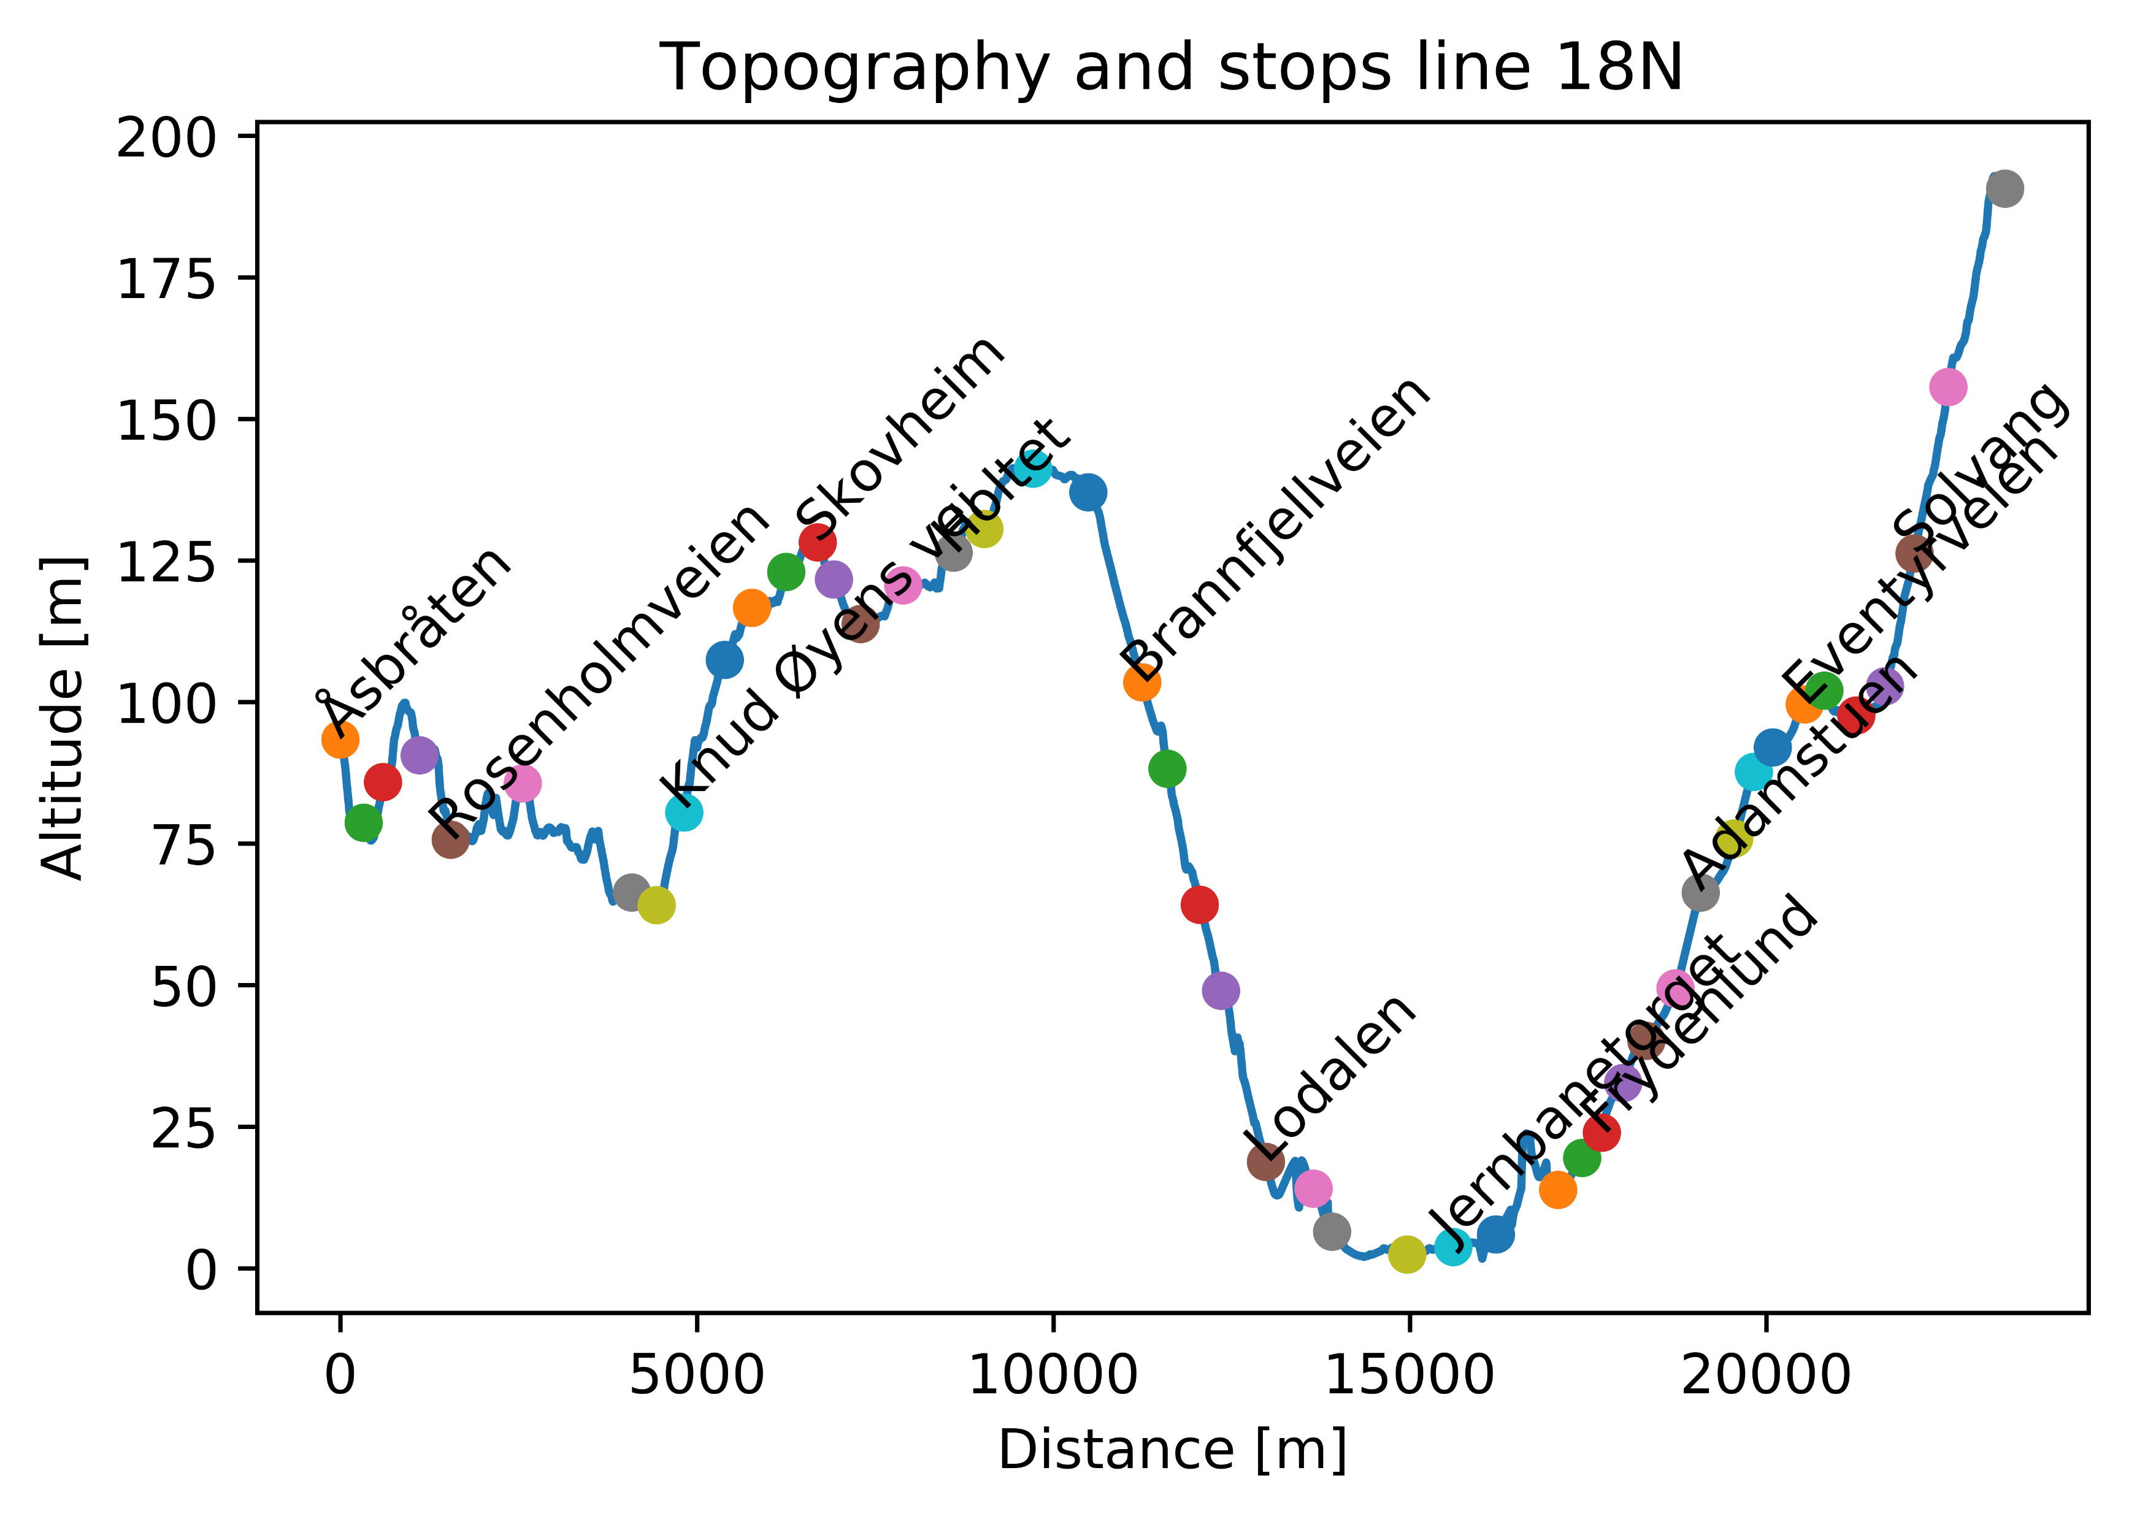

Slide 6
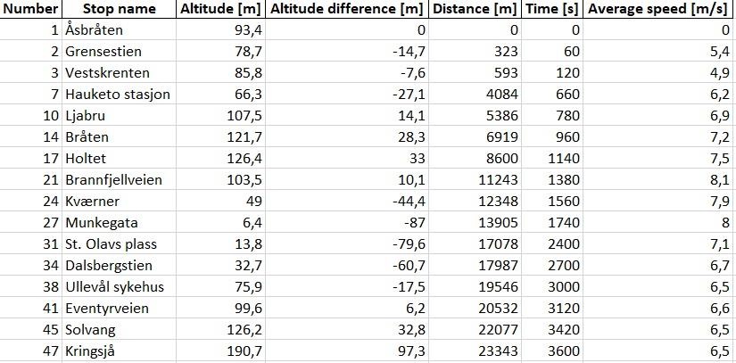
Line 18n – Subset of stops
Table shows subset of stops on line

Slide 7
Line 18n – Energy calculations
Line | Start | Stop | Energy [kWh] | Distance [m] | Energy per distance [kWh/km] | Altitude difference [m] | Time [min]
18N Tur/retur |  |  | 70,5 | 27704 | 1,53 |  | 120
18N Tur | Åsbråten | Kringsjå | 41 | 23343 | 1,8 | 96 | 60
18N Retur | Kringsjå | Åsbråten | 29,5 | 23343 | 1,26 | -96 | 60
Energy calculations are based on:
- Physics simulation of actual route
- 18 m bus, with total weight of 24,5 tons (including passengers)
- 50 % efficiency of regenerative braking

Slide 8
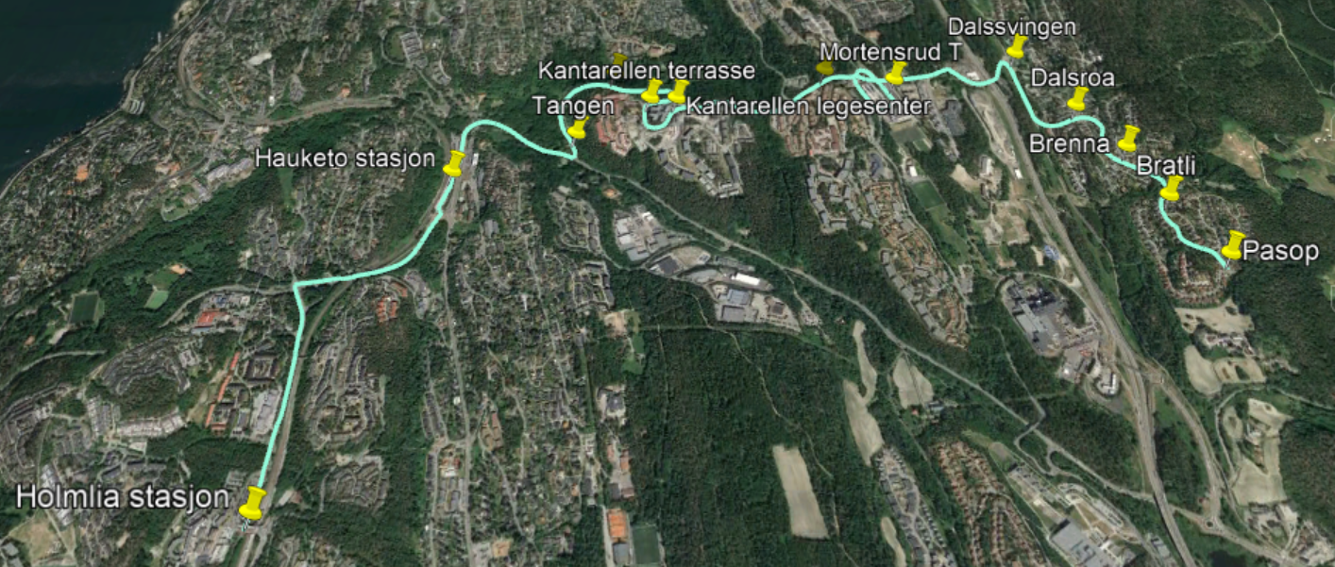
Line 73

Slide 9
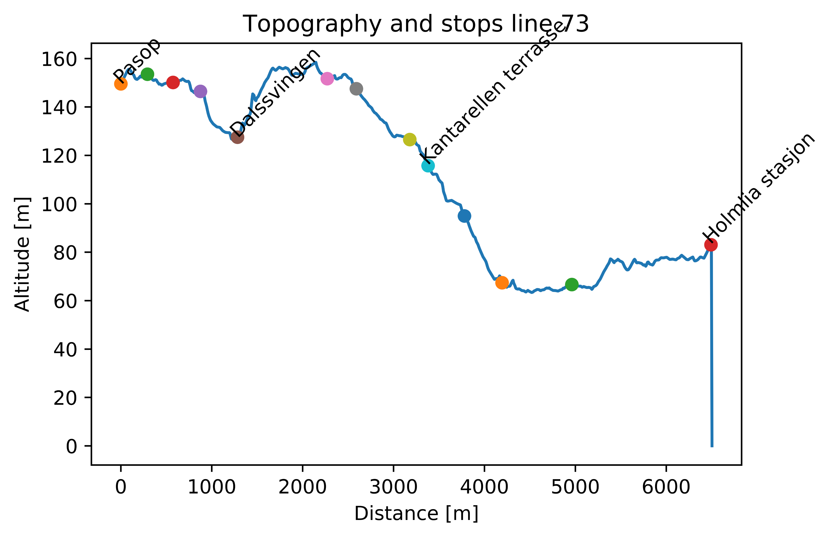

Slide 10
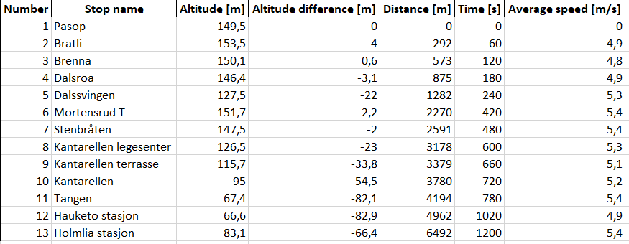
Line 73 – Subset of stops
Table shows subset of stops on line

Slide 11
Line 73 – Energy calculations
Line | Start | Stop | Energy [kWh] | Distance [m] | Energy per distance [kWh/km] | Altitude difference [m] | Time [min]
73 Tur/retur |  |  | 17,4 | 12984 | 1,34 |  | 40
73 Tur | Pasop | Holmlia stasjon | 7,2 | 6492 | 1,1 | -67 | 20
73 Retur | Holmlia stasjon | Pasop | 10,2 | 6492 | 1,57 | 67 | 20
Energy calculations are based on:
- Physics simulation of actual route
- 12 m bus, with total weight of 17,5 tons (including passengers)
- 50 % efficiency of regenerative braking

Slide 12
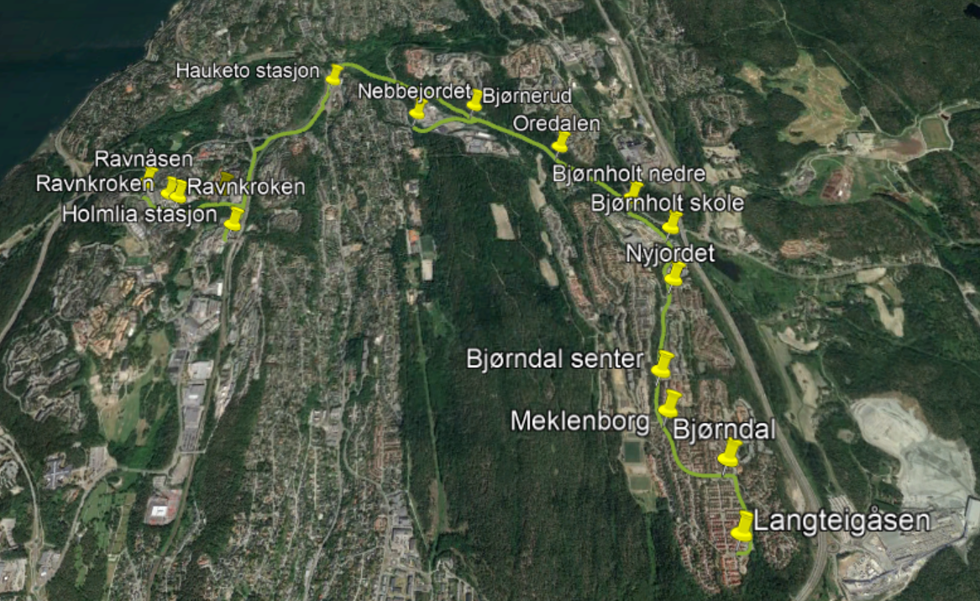
Line 77

Slide 13
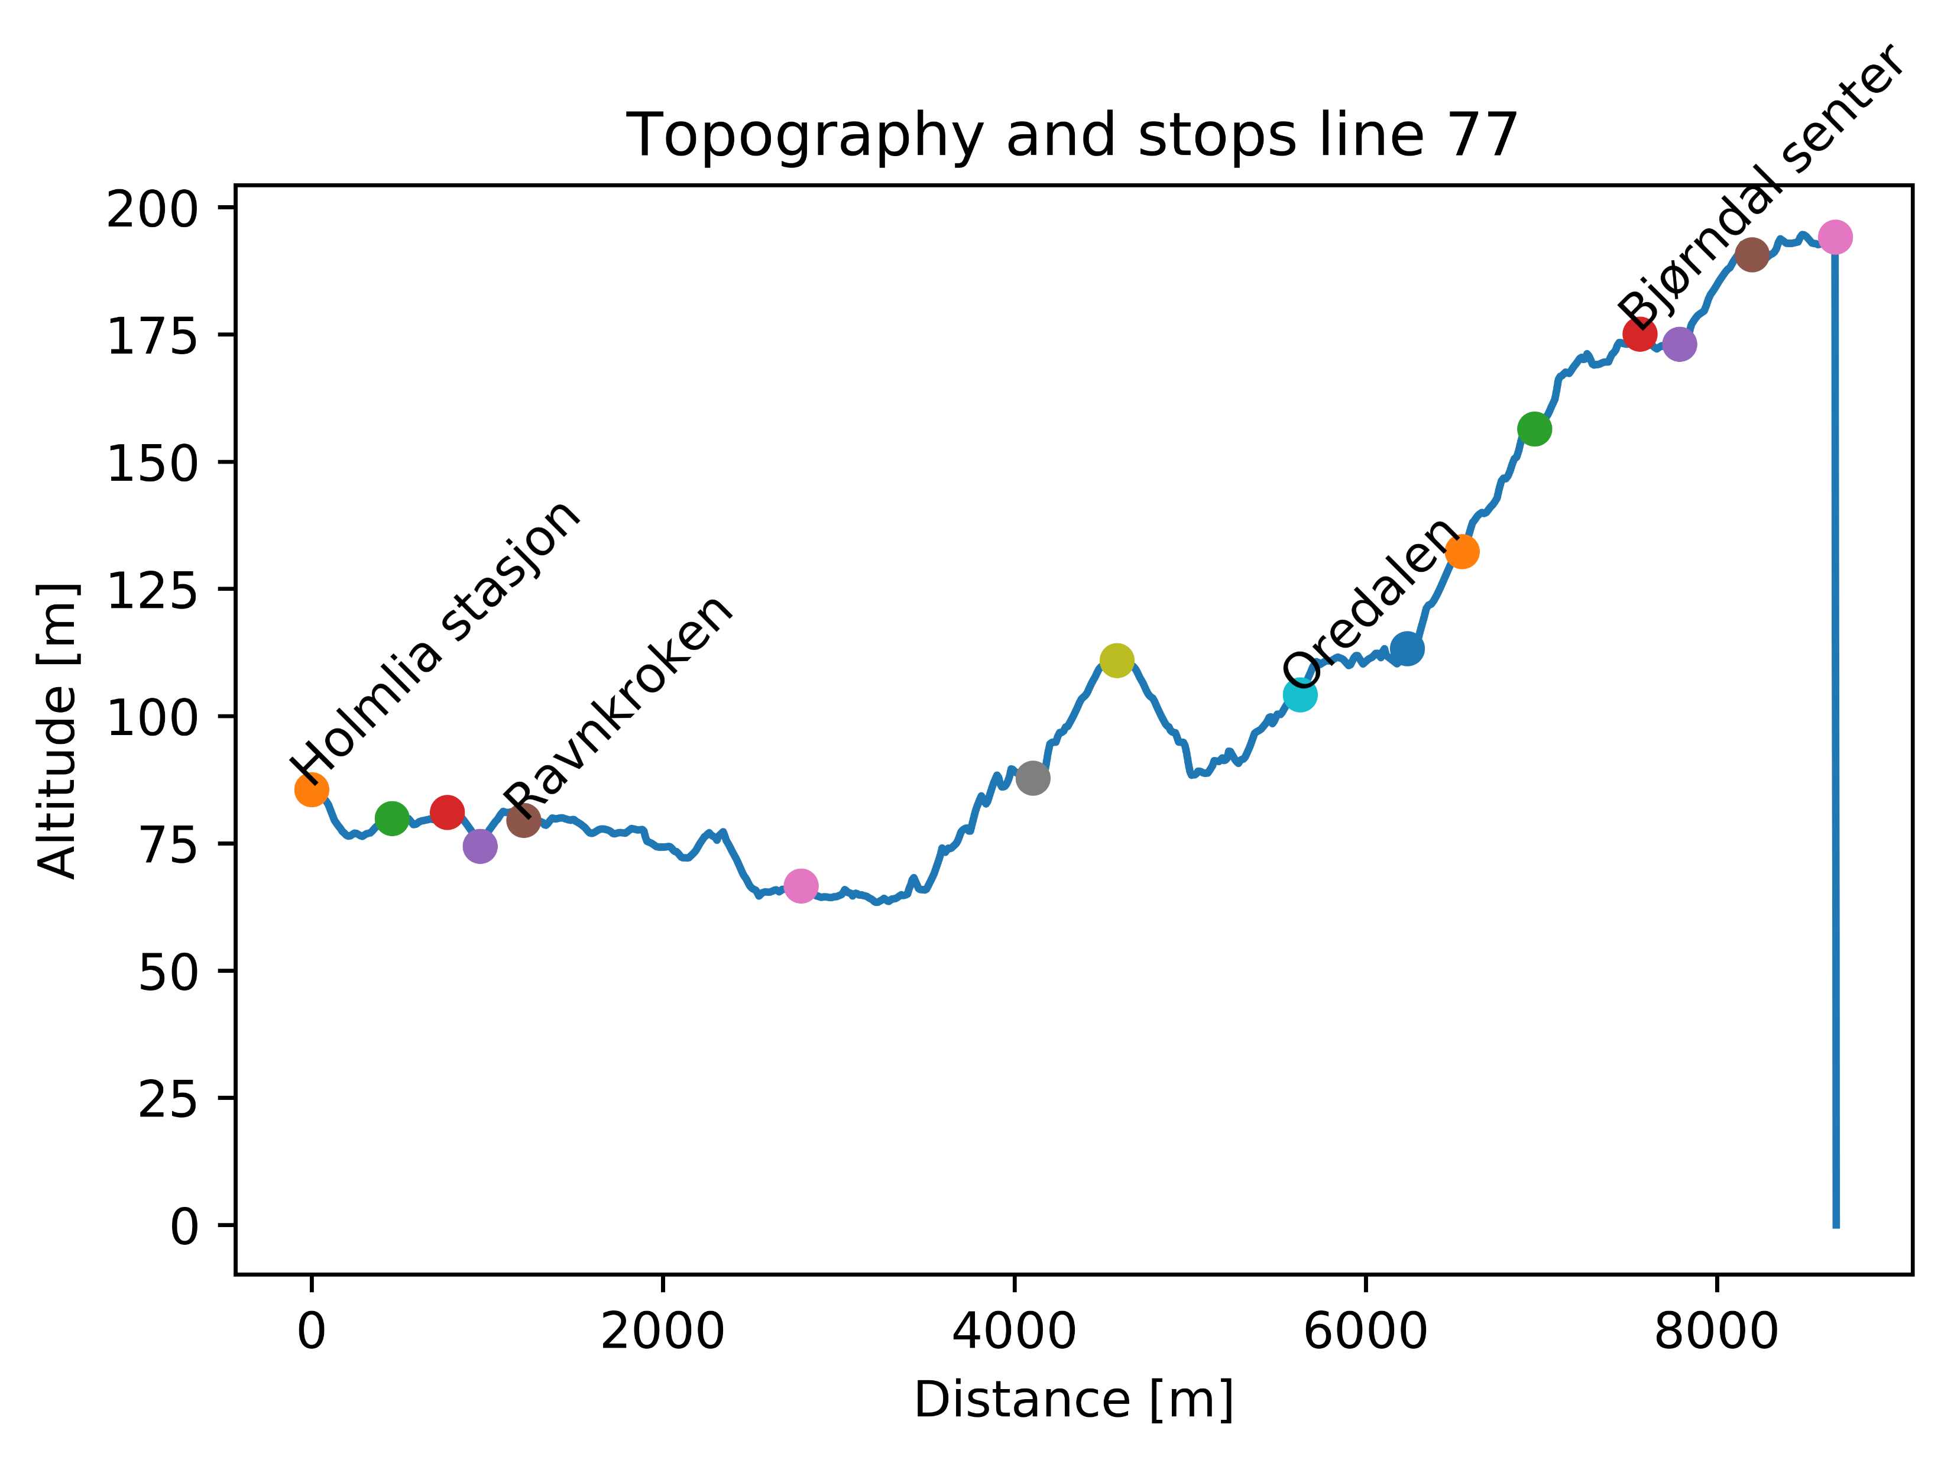

Slide 14
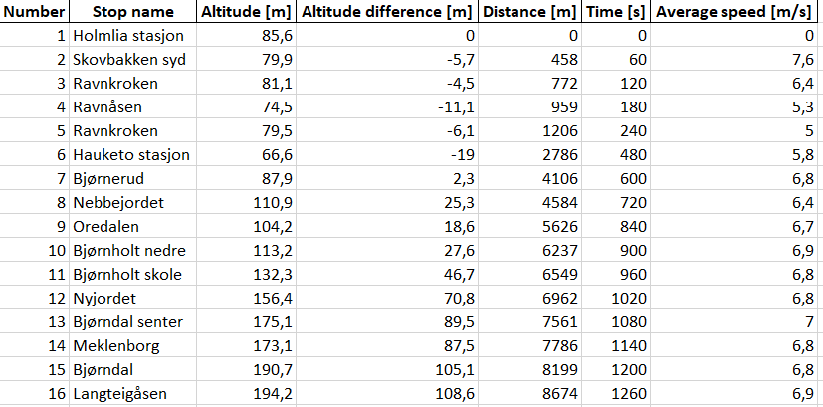
Line 77 – Subset of stops
Table shows subset of stops on line

Slide 15
Line 77 – Energy calculations
Line | Start | Stop | Energy [kWh] | Distance [m] | Energy per distance [kWh/km] | Altitude difference [m] | Time [min]
77 Tur/retur |  |  | 22,7 | 17348 | 1,3 |  | 42
77 Tur | Langteigåsen | Holmlia stasjon | 14,0 | 8674 | 1,0 | -109 | 21
77 Retur | Holmlia stasjon | Langteigåsen | 8,7 | 8674 | 1,6 | 109 | 21
Energy calculations are based on:
- Physics simulation of actual route
- 12 m bus, with total weight of 17,5 tons (including passengers)
- 50 % efficiency of regenerative braking

Slide 16
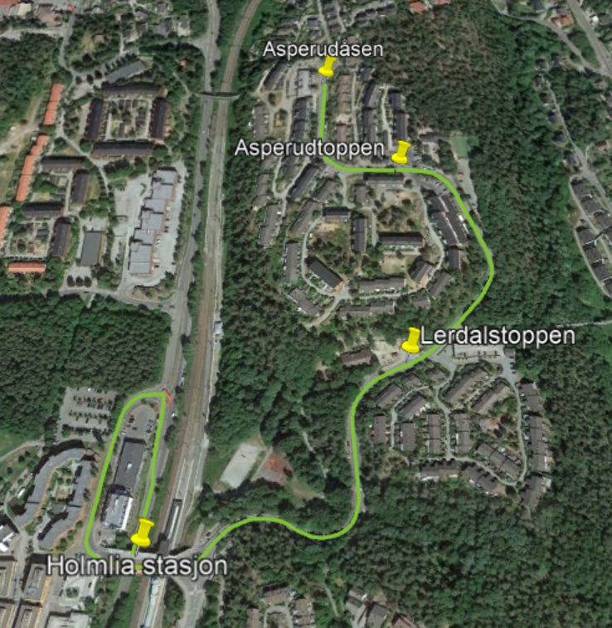
Line 77B

Slide 17
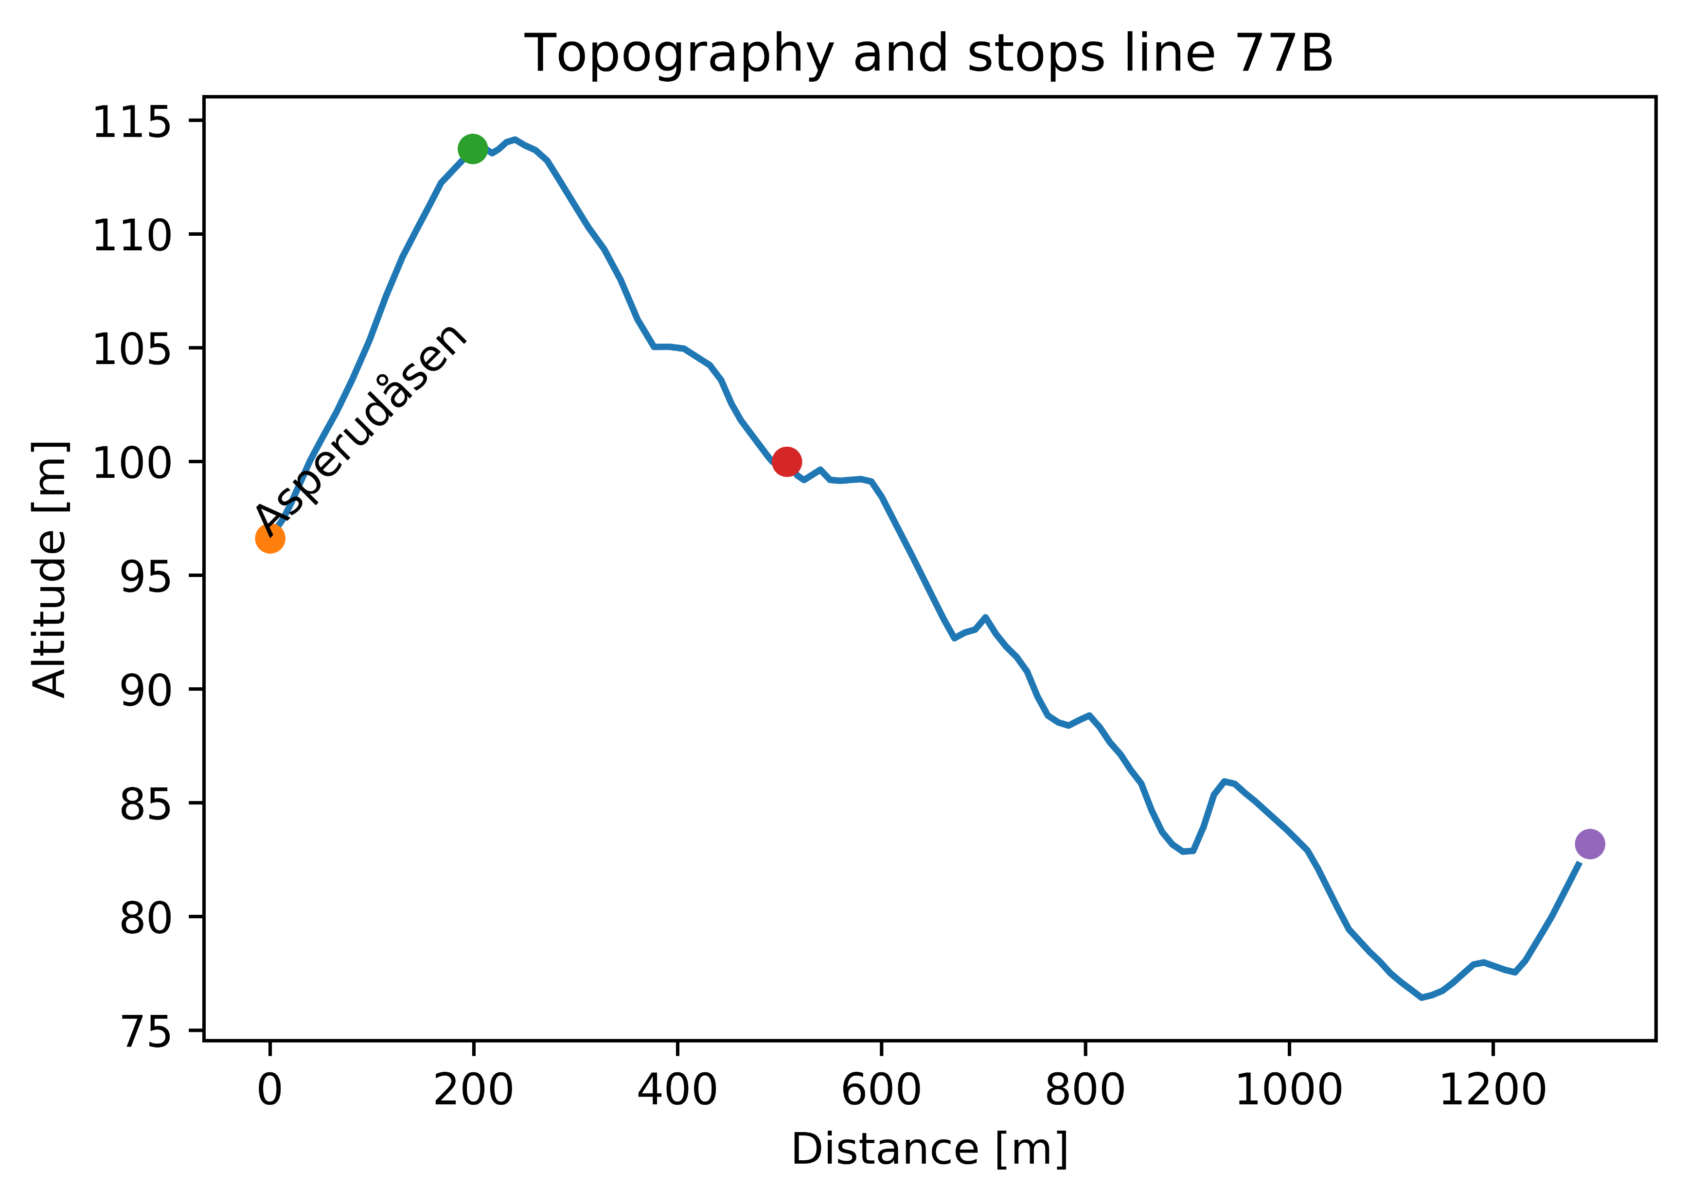

Slide 18
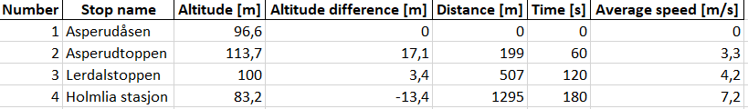
Line 77B – Subset of stops
Table shows subset of stops on line

Slide 19
Line 77B – Energy calculations
Line | Start | Stop | Energy [kWh] | Distance [m] | Energy per distance [kWh/km] | Altitude difference [m] | Time [min]
77B Tur/retur |  |  | 2,9 | 2590 | 1,14 |  | 6
77B Tur | Asperudåsen | Holmlia stasjon | 1,1 | 1295 | 0,9 | -13 | 3
77B Retur | Holmlia stasjon | Asperudåsen | 1,8 | 1295 | 1,37 | 13 | 3
Energy calculations are based on:
- Physics simulation of actual route
- 12 m bus, with total weight of 17,5 tons (including passengers)
- 50 % efficiency of regenerative braking

Slide 20
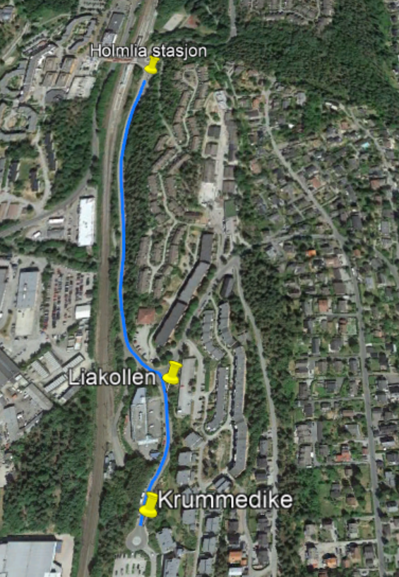
Line 77C

Slide 21
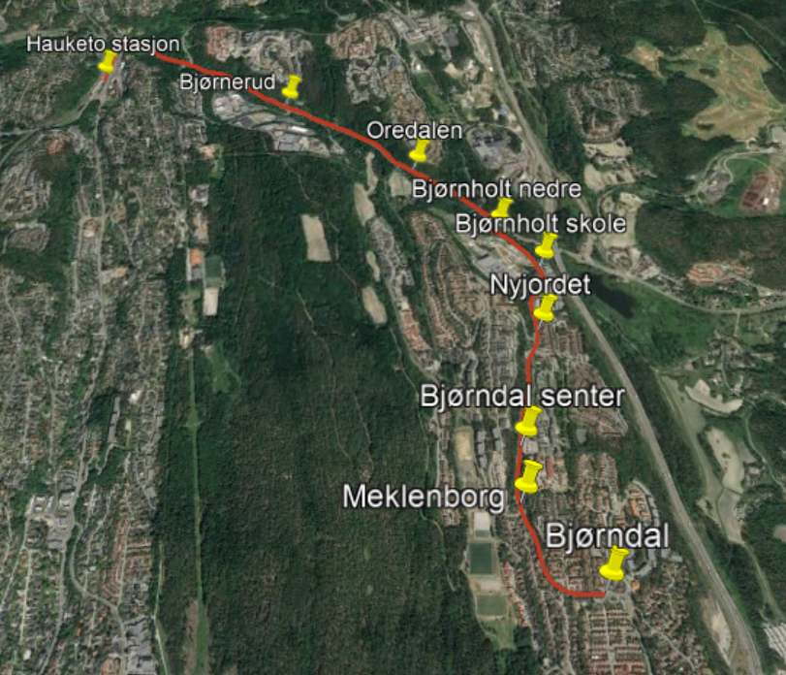
Line 77X

Slide 22
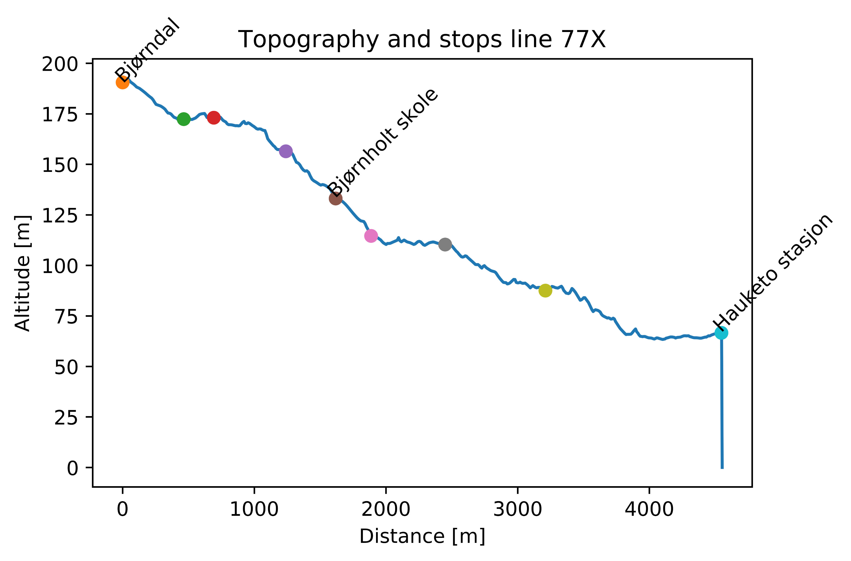

Slide 23
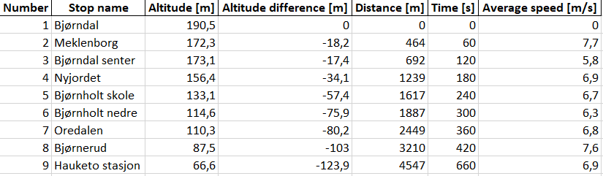
Line 77x – Subset of stops
Table shows subset of stops on line

Slide 24
Line 77X – Energy calculations
Line | Start | Stop | Energy [kWh] | Distance [m] | Energy per distance [kWh/km] | Altitude difference [m] | Time [min]
77X Tur/retur |  |  | 12,2 | 9094 | 1,3 |  | 22
77X Tur | Bjørndal | Hauketo stasjon | 3,3 | 4547 | 0,7 | -124 | 11
77X Retur | Hauketo stasjon | Bjørndal | 8,9 | 4547 | 1,9 | 124 | 11
Energy calculations are based on:
- Physics simulation of actual route
- 12 m bus, with total weight of 17,5 tons (including passengers)
- 50 % efficiency of regenerative braking

Slide 25
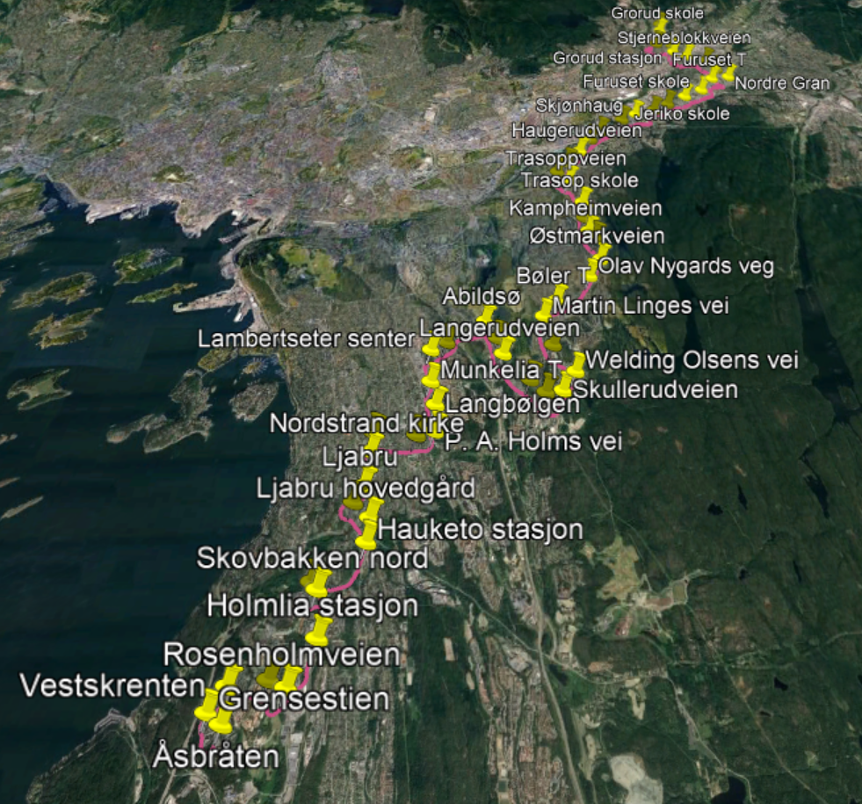
Line 79

Slide 26
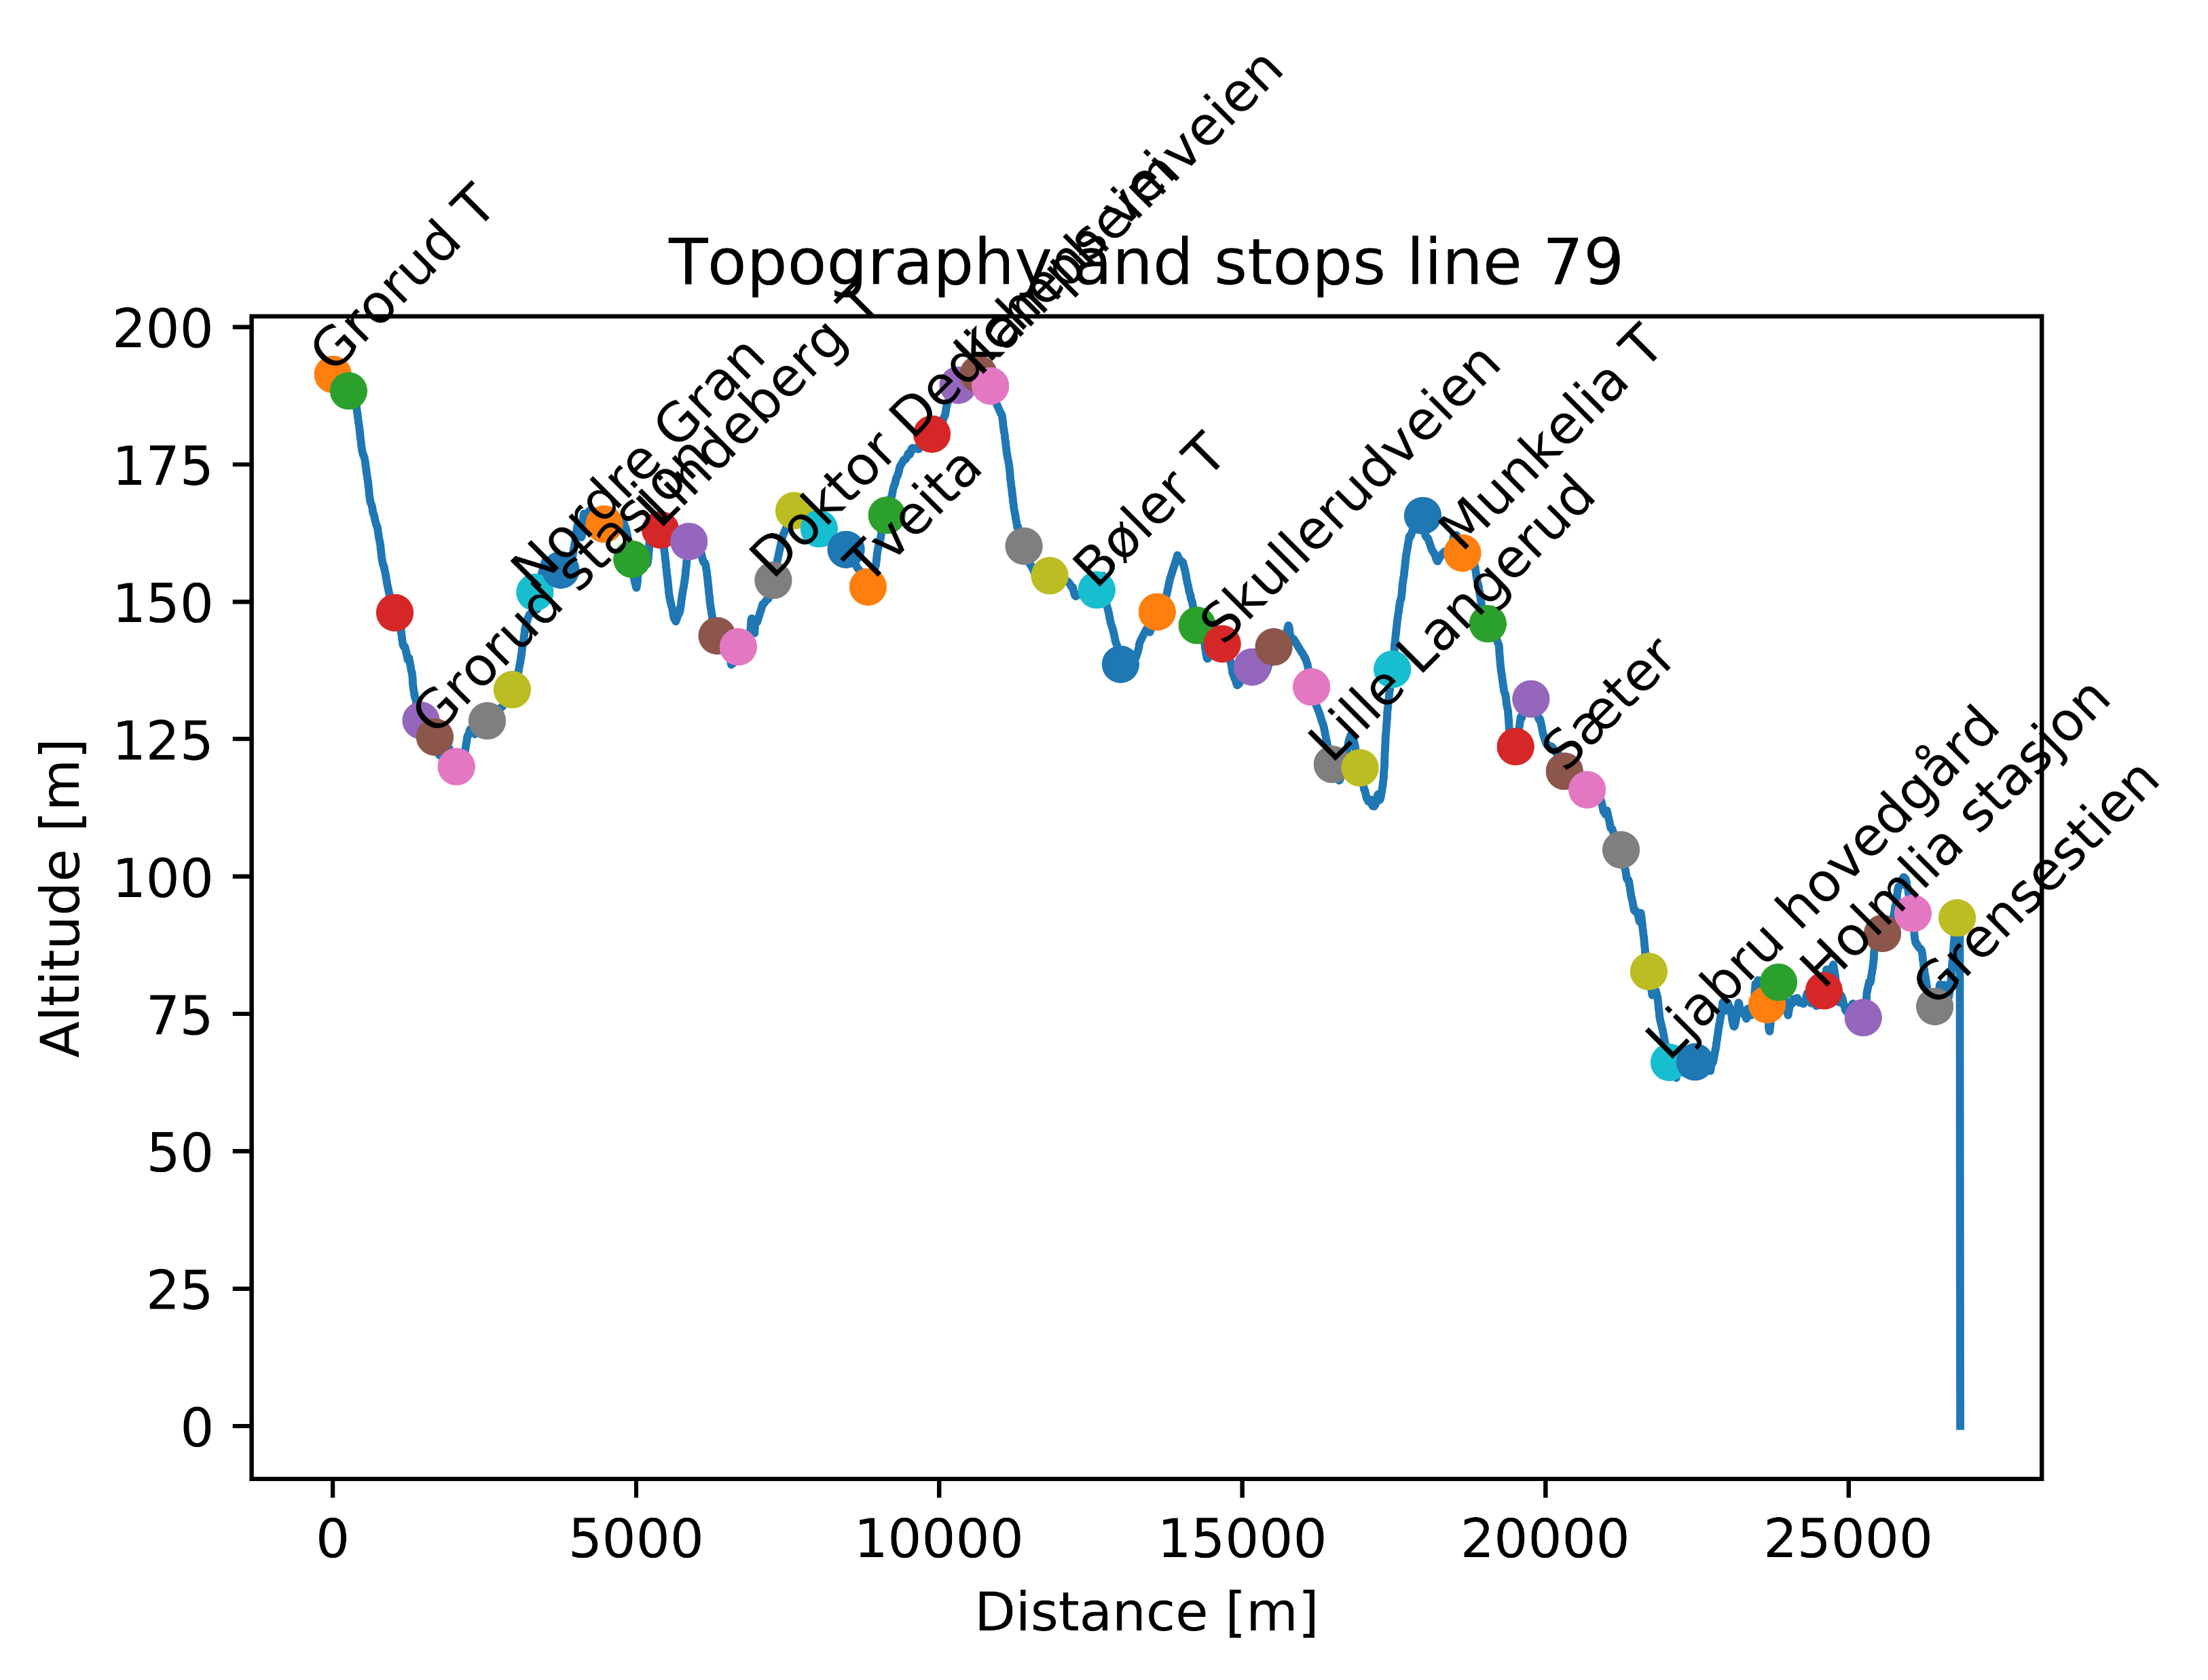

Slide 27
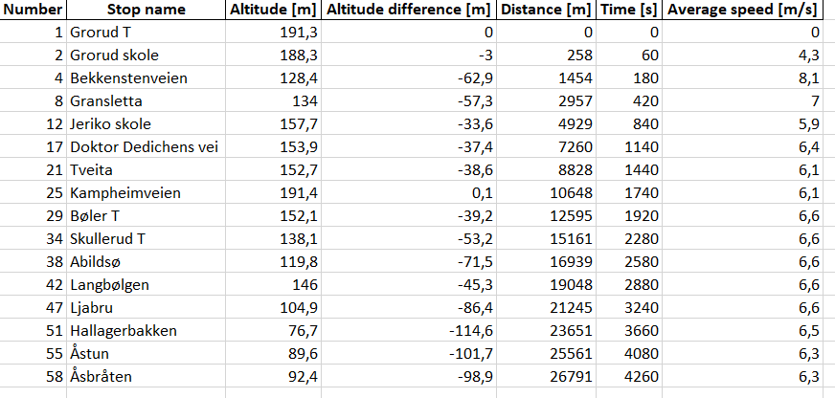
Line 79 – Subset of stops
Table shows subset of stops on line

Slide 28
Line 79 – Energy calculations
Line | Start | Stop | Energy [kWh] | Distance [m] | Energy per distance [kWh/km] | Altitude difference [m] | Time [min]
79 Tur/retur |  |  | 85,7 | 53582 | 1,6 |  | 142
79 Tur | Grorud T | Åsbråten | 40,1 | 26791 | 1,5 | -97 | 71
79 Retur | Åsbråten | Grorud T | 45,6 | 26791 | 1,7 | 97 | 71
Energy calculations are based on:
- Physics simulation of actual route
- 18 m bus, with total weight of 24,5 tons (including passengers)
- 50 % efficiency of regenerative braking

Slide 29
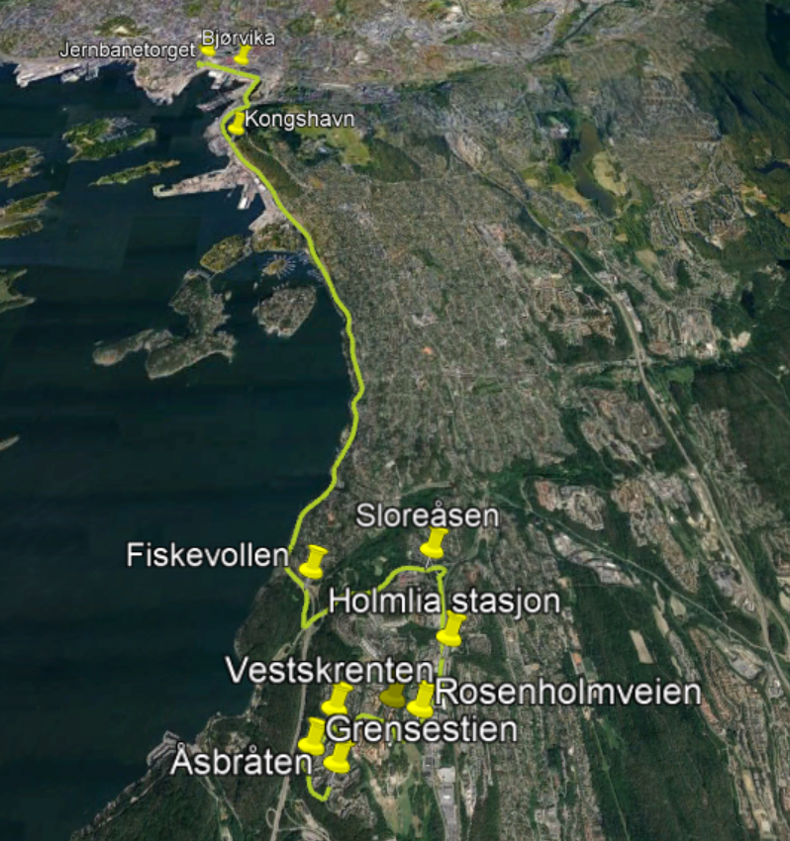
Line 80E

Slide 30
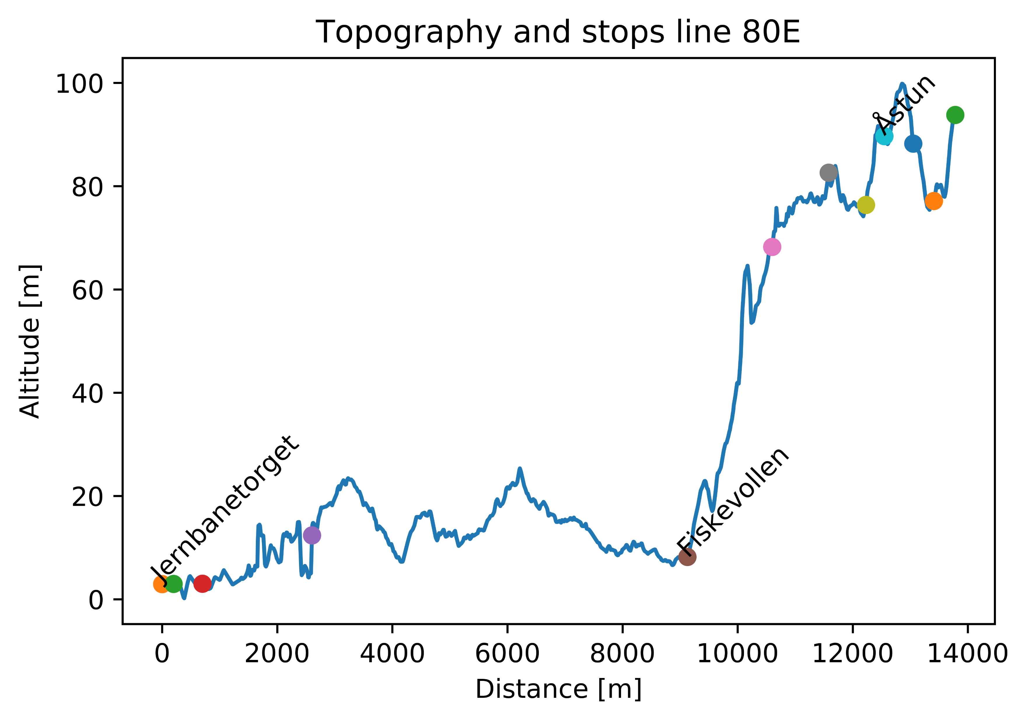

Slide 31
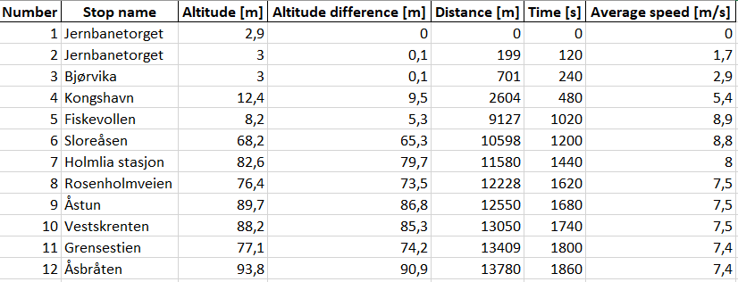
Line 80E – Subset of stops
Table shows subset of stops on line

Slide 32
Line 80e – Energy calculations
Line | Start | Stop | Energy [kWh] | Distance [m] | Energy per distance [kWh/km] | Altitude difference [m] | Time [min]
80E Tur/retur |  |  | 42,0 | 25760 | 1,6 |  | 62
80E Tur | Jernbanetorget | Åsbråten | 24,1 | 13780 | 1,8 | 92 | 31
80E Retur | Åsbråten | Jernbanetorget | 17,9 | 13780 | 1,3 | -92 | 31
Energy calculations are based on:
- Physics simulation of actual route
- 18 m bus, with total weight of 24,5 tons (including passengers)
- 50 % efficiency of regenerative braking

Slide 33
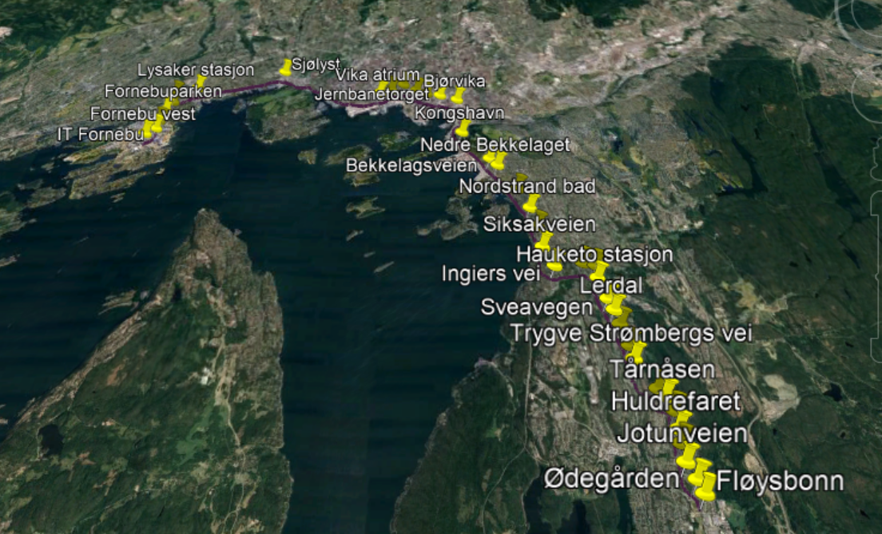
Line 81

Slide 34
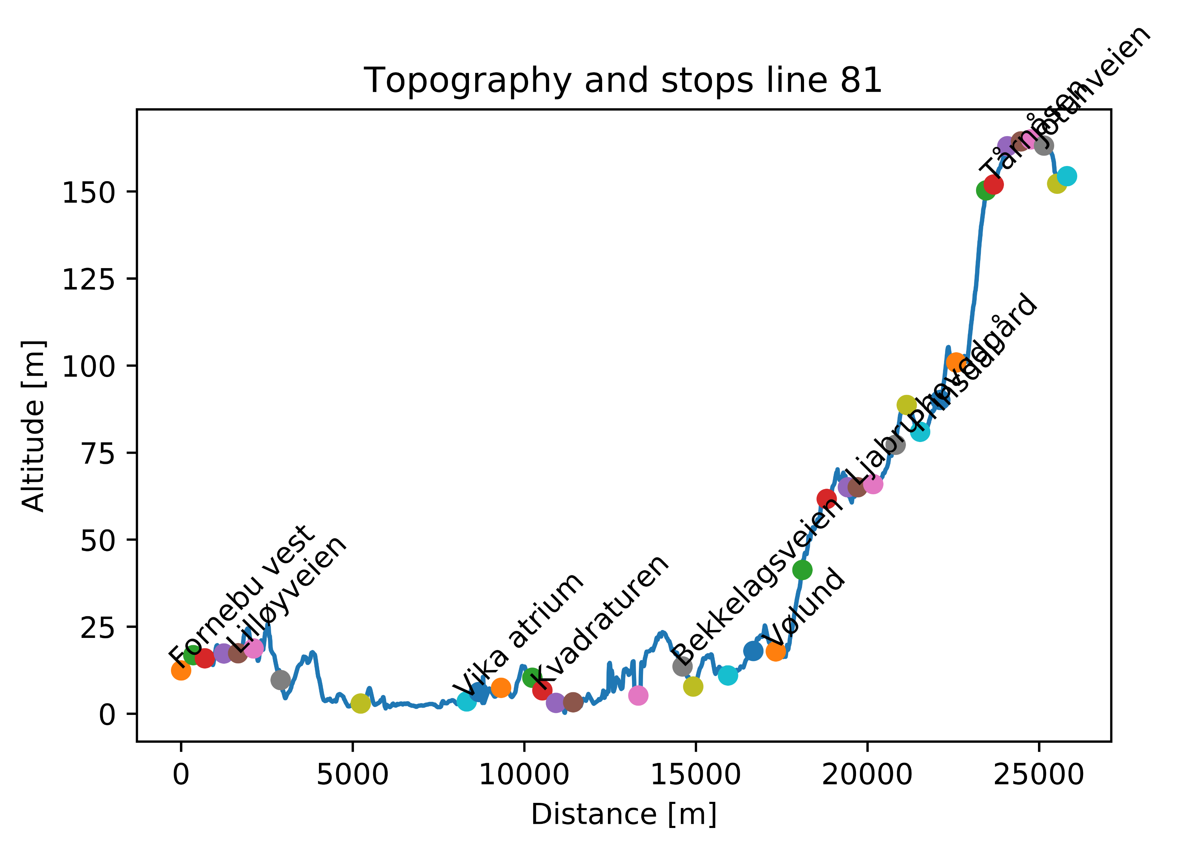

Slide 35
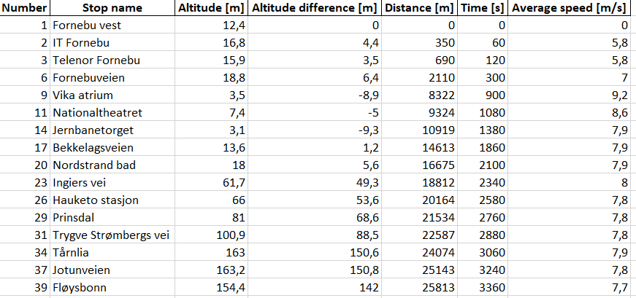
Line 81 – Subset of stops
Table shows subset of stops on line

Slide 36
Line 81 – Energy calculations
Line | Start | Stop | Energy [kWh] | Distance [m] | Energy per distance [kWh/km] | Altitude difference [m] | Time [min]
81 Tur/retur |  |  | 75,5 | 51626 | 1,5 |  | 112
81 Tur | Fornebu vest | Fløysbonn | 43,0 | 25813 | 1,7 | 142 | 56
81 Retur | Fløysbonn | Fornebu vest | 32,5 | 25813 | 1,3 | -142 | 56
Energy calculations are based on:
- Physics simulation of actual route
- 18 m bus, with total weight of 24,5 tons (including passengers)
- 50 % efficiency of regenerative braking

Slide 37
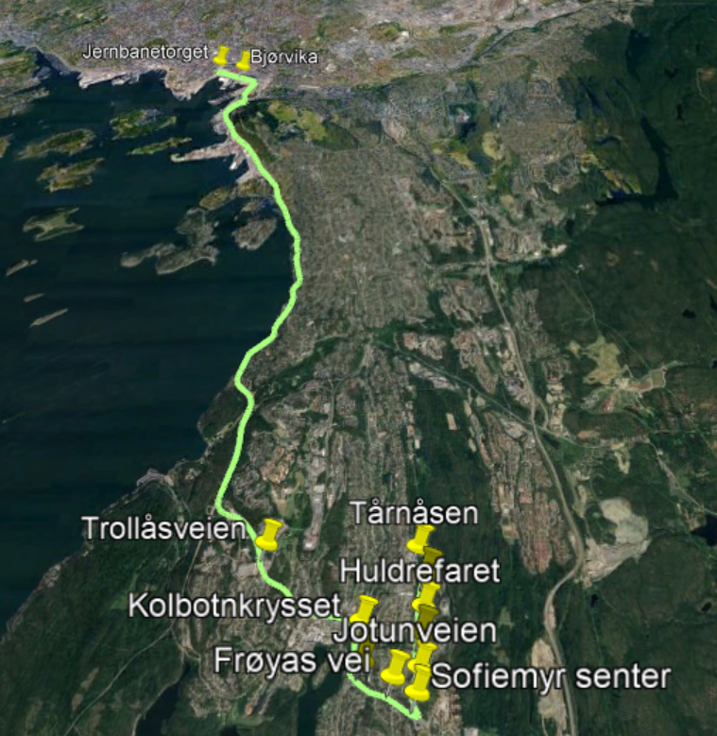
Line 82E

Slide 38
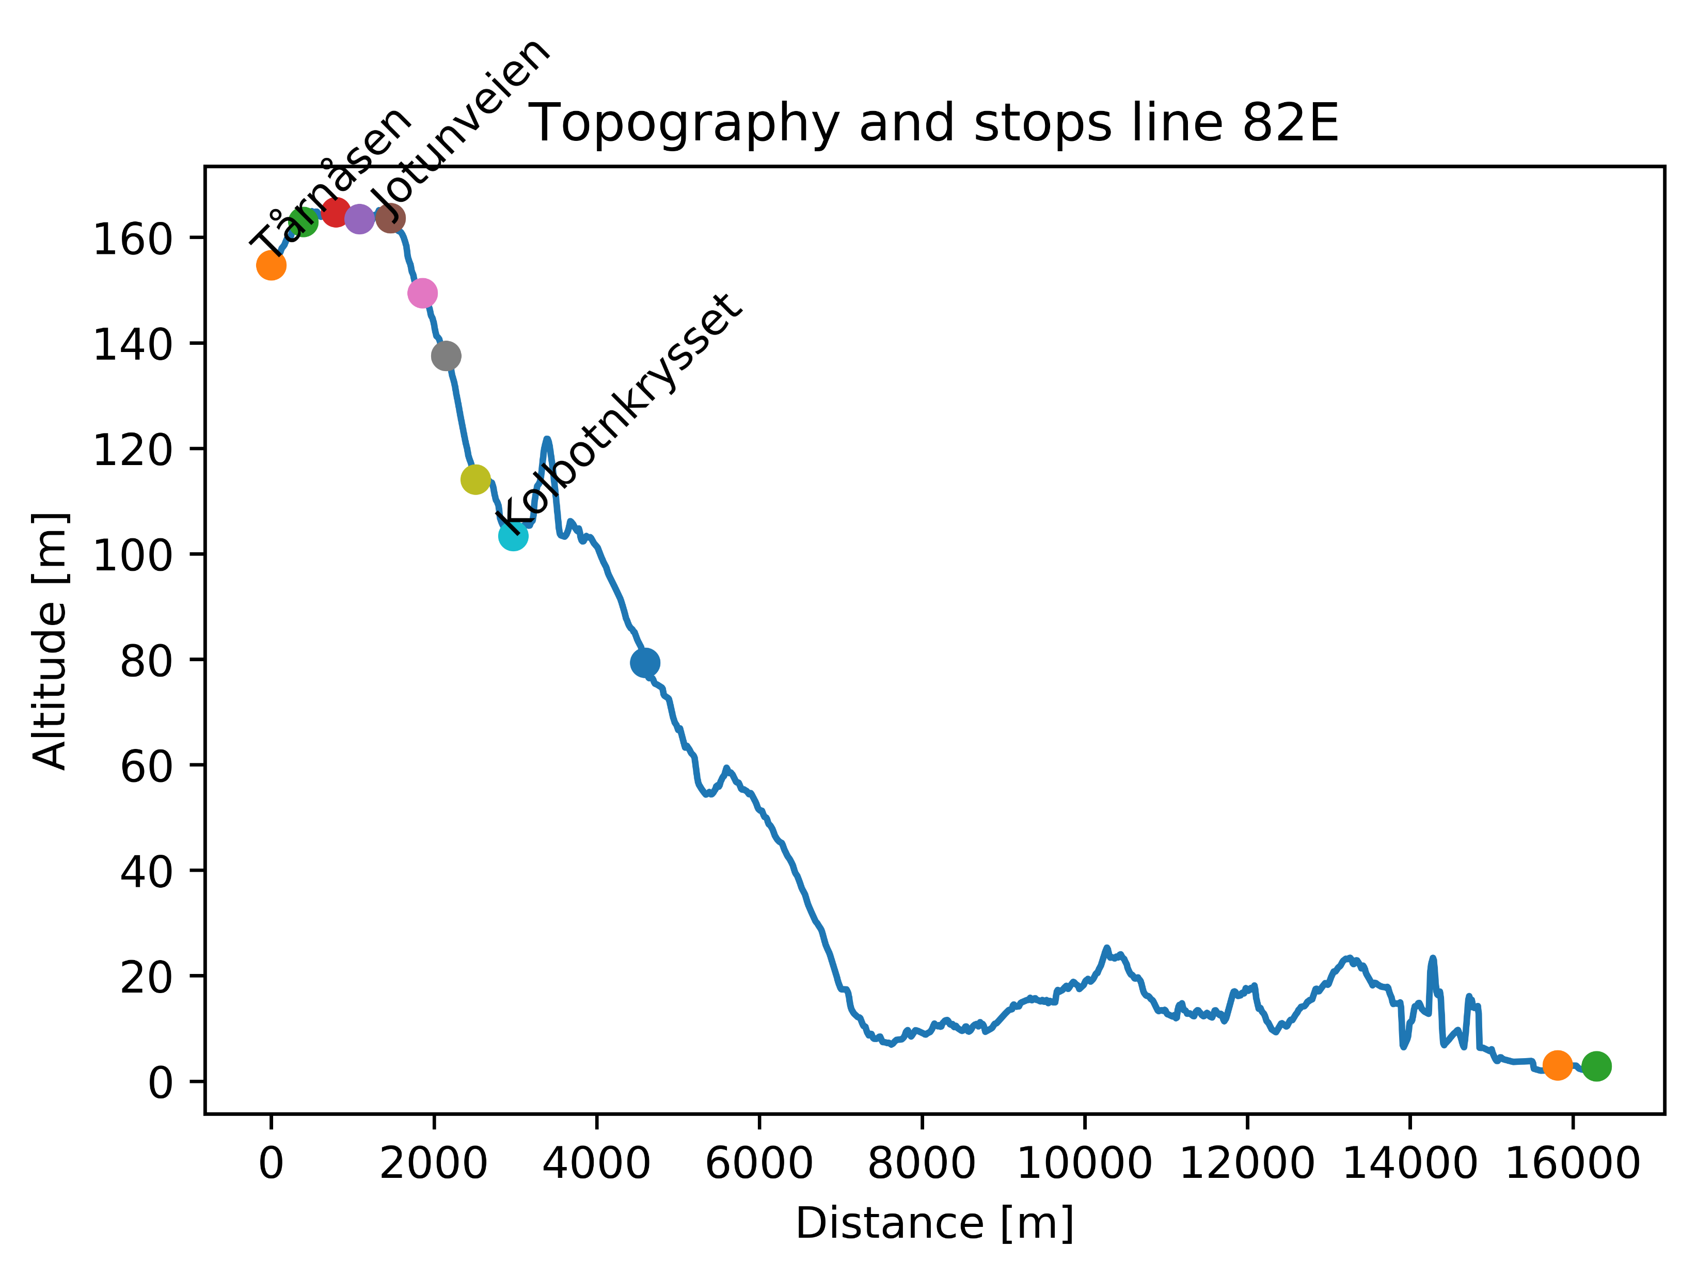

Slide 39
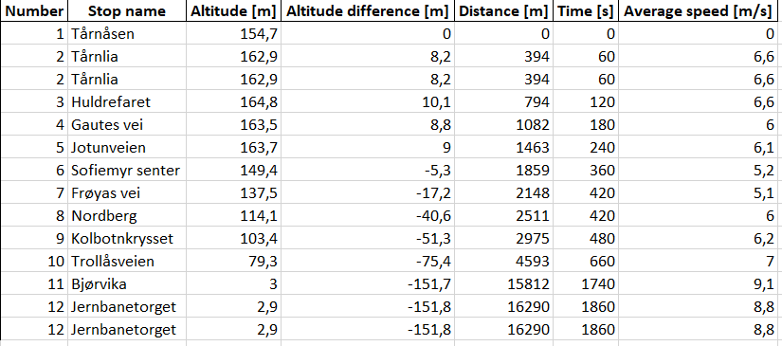
Line 82E – Subset of stops
Table shows subset of stops on line

Slide 40
Line 82e – Energy calculations
Line | Start | Stop | Energy [kWh] | Distance [m] | Energy per distance [kWh/km] | Altitude difference [m] | Time [min]
82E Tur/retur |  |  | 46,3 | 32580 | 1,4 |  | 62
82E Tur | Tårnåsen | Jernbanetorget | 19,7 | 16290 | 1,2 | -152 | 31
82E Retur | Jernbanetorget | Tårnåsen | 26,6 | 16290 | 1,6 | 152 | 31
Energy calculations are based on:
- Physics simulation of actual route
- 18 m bus, with total weight of 24,5 tons (including passengers)
- 50 % efficiency of regenerative braking

Slide 41
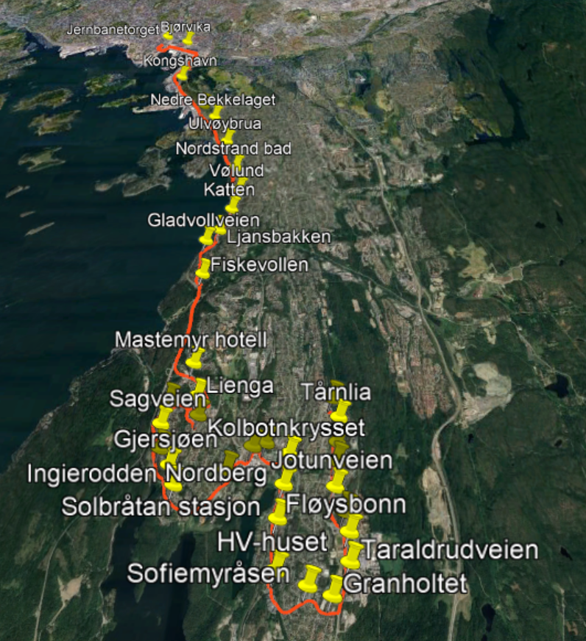
Line 83

Slide 42
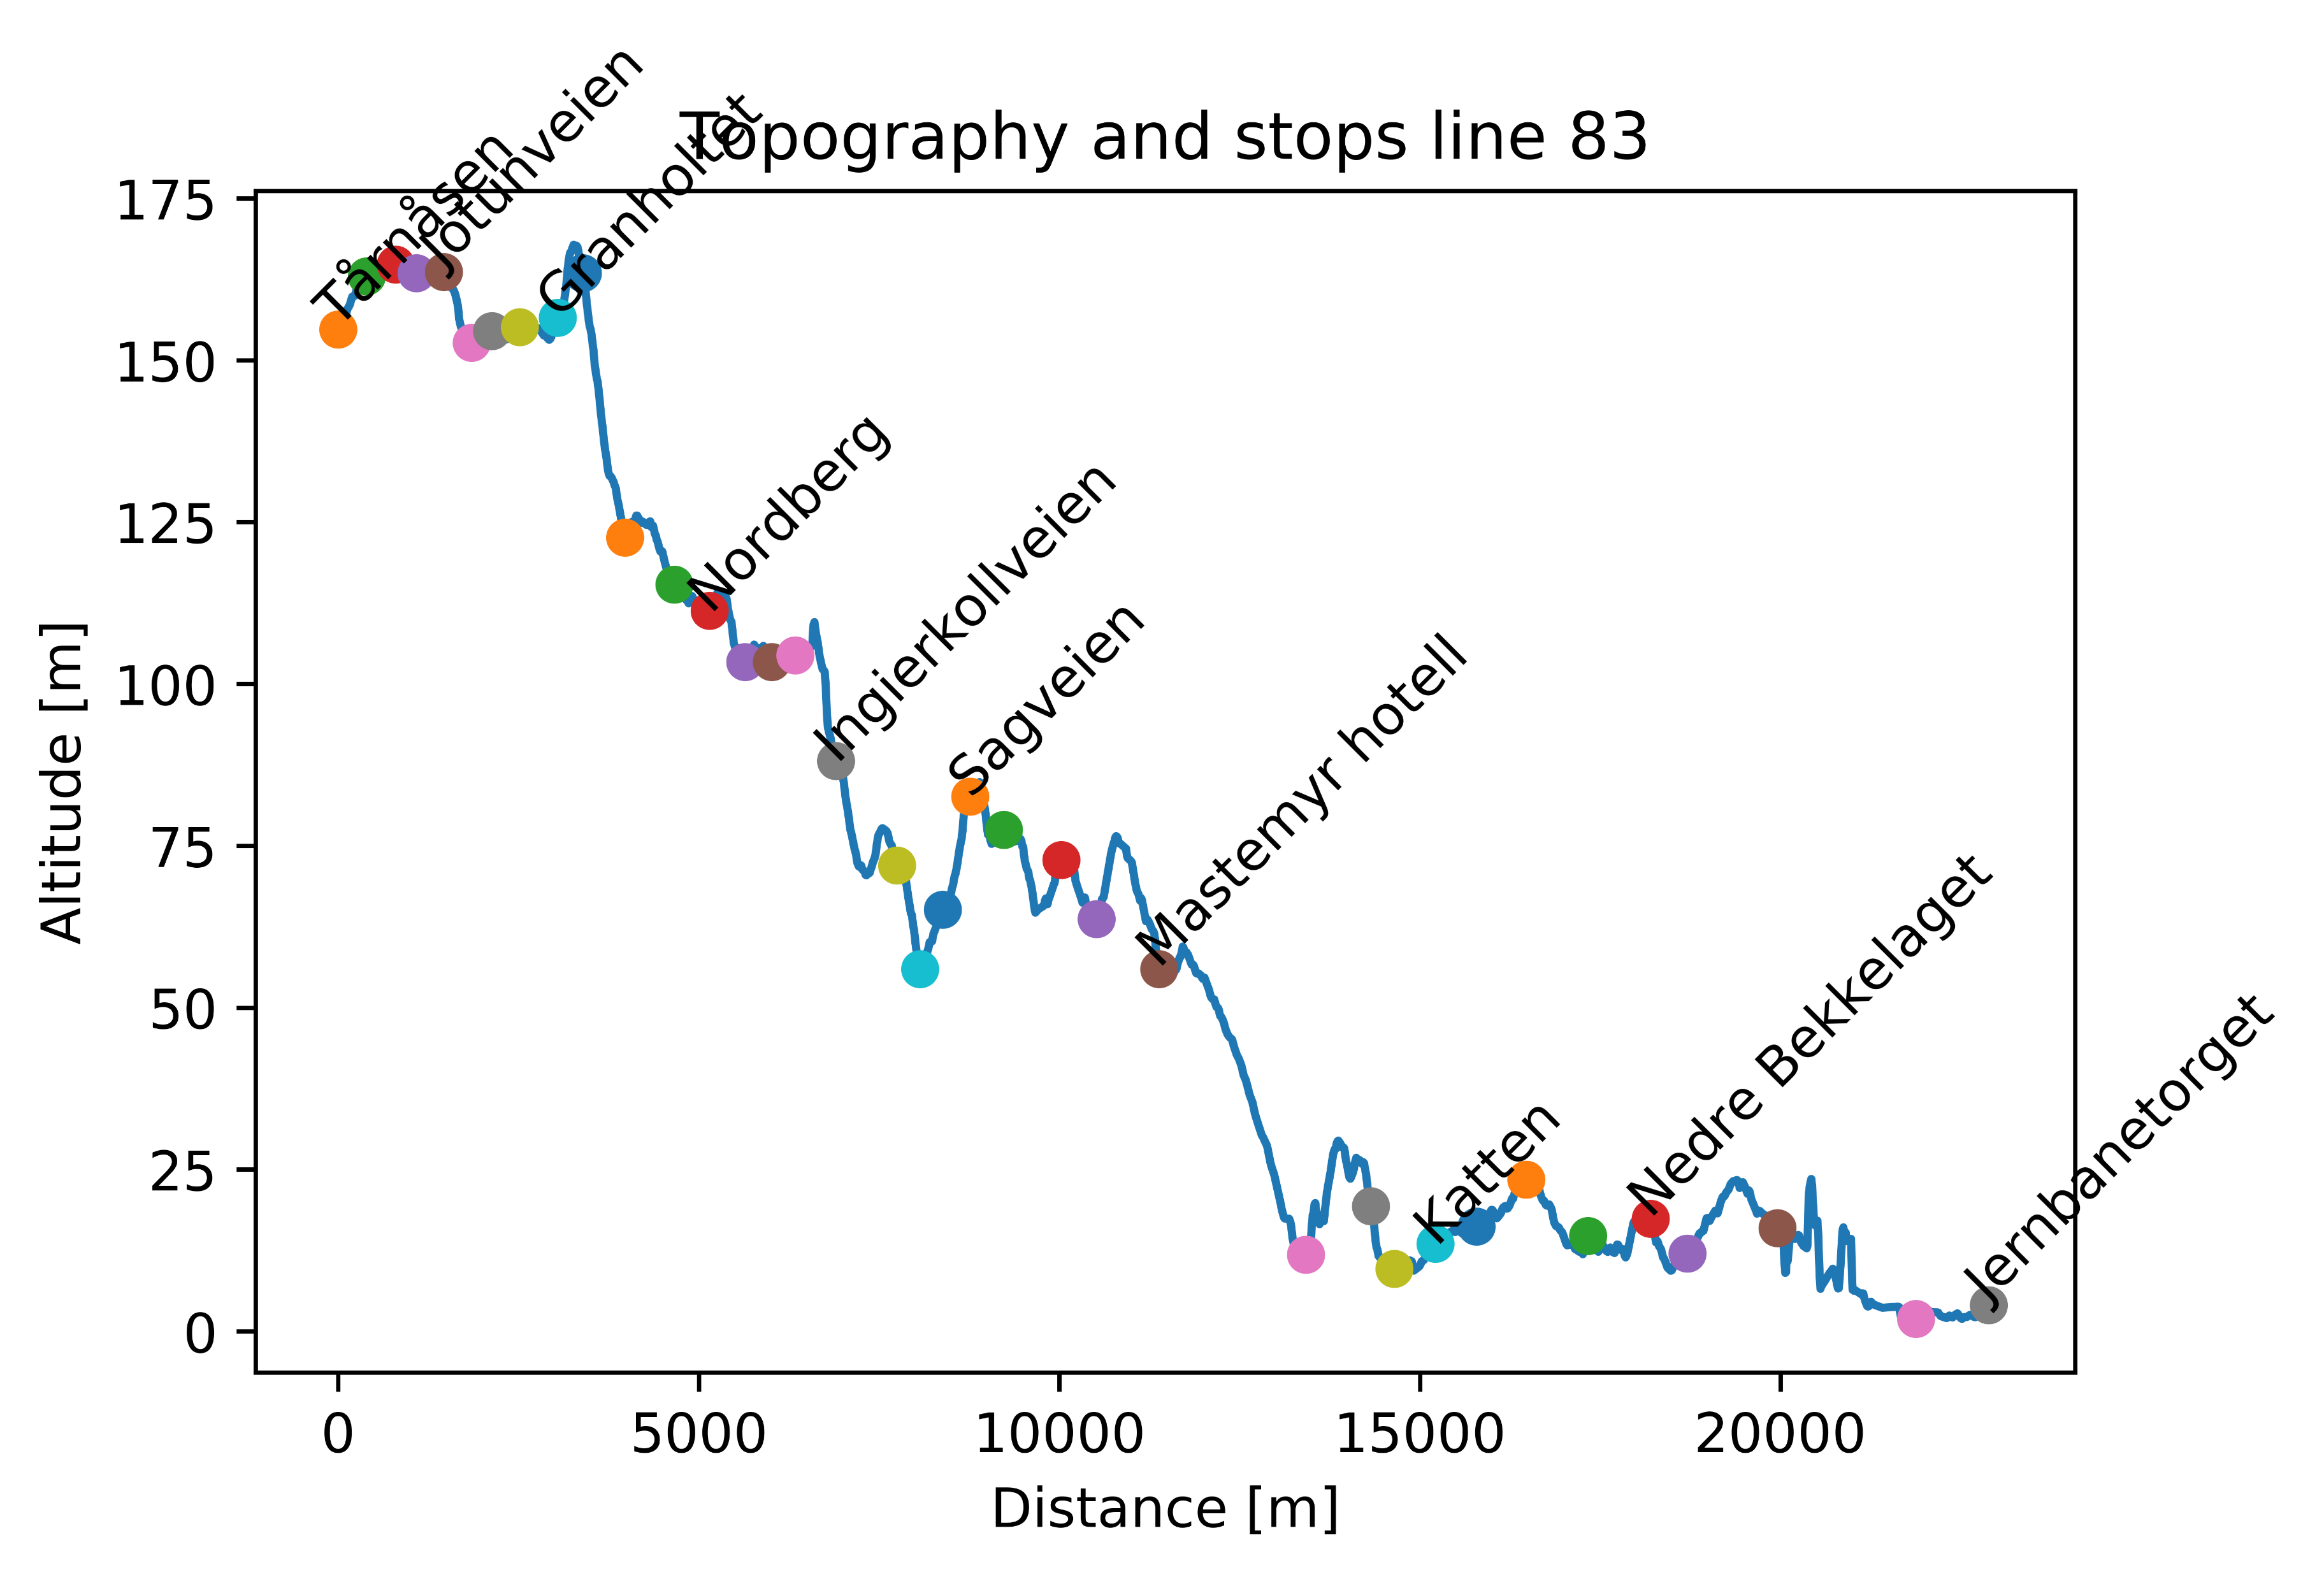

Slide 43
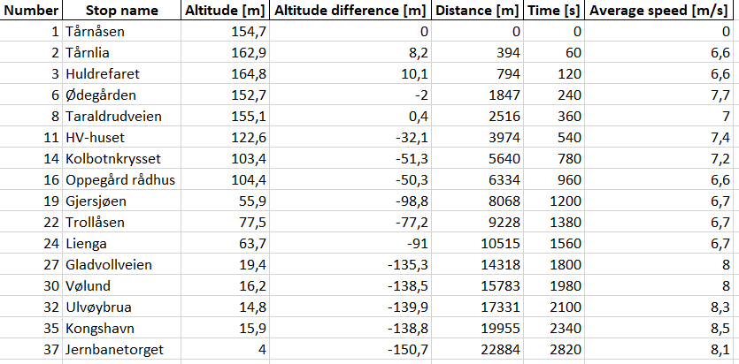
Line 83 – Subset of stops
Table shows subset of stops on line

Slide 44
Line 83 – Energy calculations
Line | Start | Stop | Energy [kWh] | Distance [m] | Energy per distance [kWh/km] | Altitude difference [m] | Time [min]
83 Tur/retur |  |  | 63,2 | 45768 | 1,4 |  | 94
83 Tur | Tårnåsen | Jernbanetorget | 29 | 22884 | 1,3 | -152 | 47
83 Retur | Jernbanetorget | Tårnåsen | 34,2 | 22884 | 1,5 | 152 | 47
Energy calculations are based on:
- Physics simulation of actual route
- 18 m bus, with total weight of 24,5 tons (including passengers)
- 50 % efficiency of regenerative braking

Slide 45
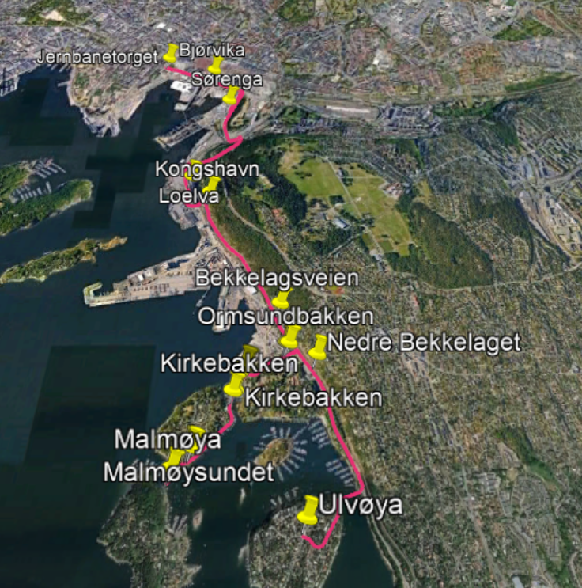
Line 85

Slide 46
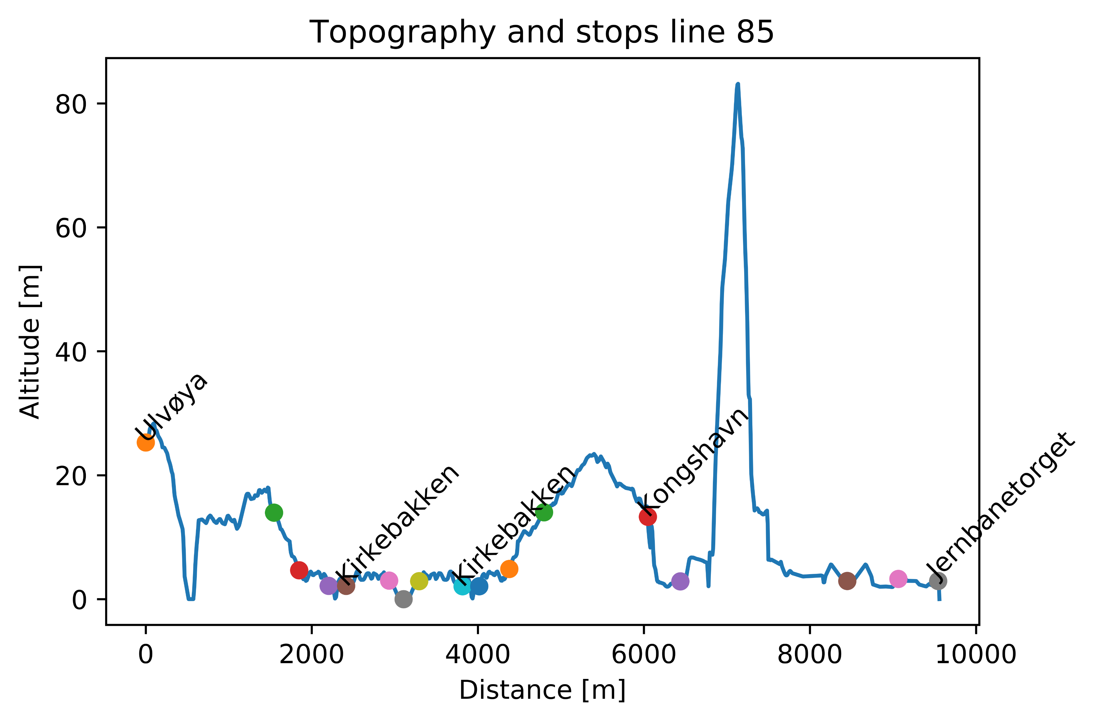

Slide 47
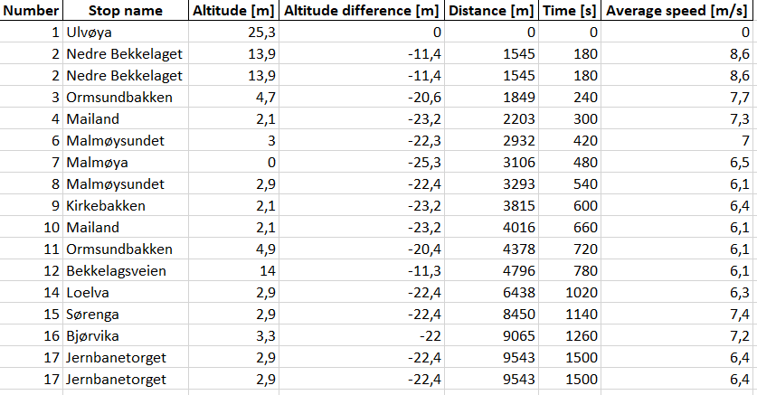
Line 85 – Subset of stops
Table shows subset of stops on line

Slide 48
Line 85 – Energy calculations
Line | Start | Stop | Energy [kWh] | Distance [m] | Energy per distance [kWh/km] | Altitude difference [m] | Time [min]
85 Tur/retur |  |  | 24,2 | 19086 | 1,3 |  | 50
85 Tur | Ulvøya | Jernbanetorget | 11,5 | 9543 | 1,2 | -22 | 25
85 Retur | Jernbanetorget | Ulvøya | 12,7 | 9543 | 1,3 | 22 | 25
Energy calculations are based on:
- Physics simulation of actual route
- 12 m bus, with total weight of 17,5 tons (including passengers)
- 50 % efficiency of regenerative braking

Slide 49
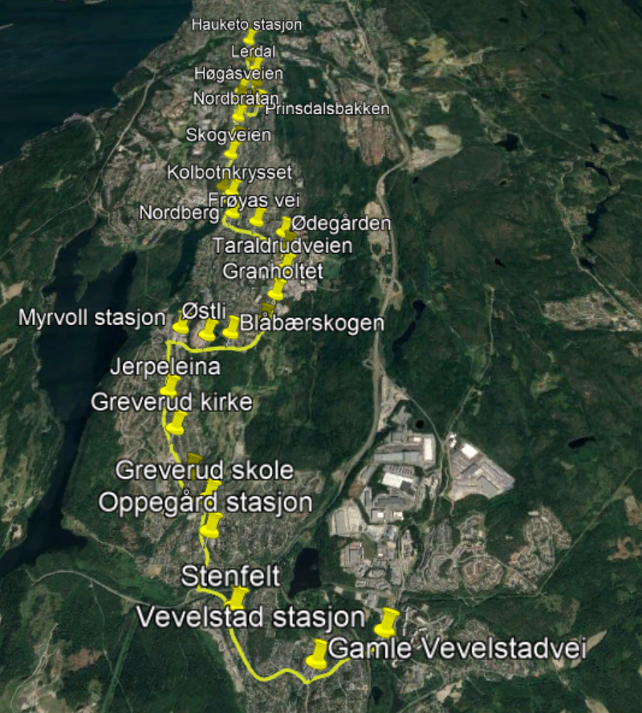
Line 87

Slide 50
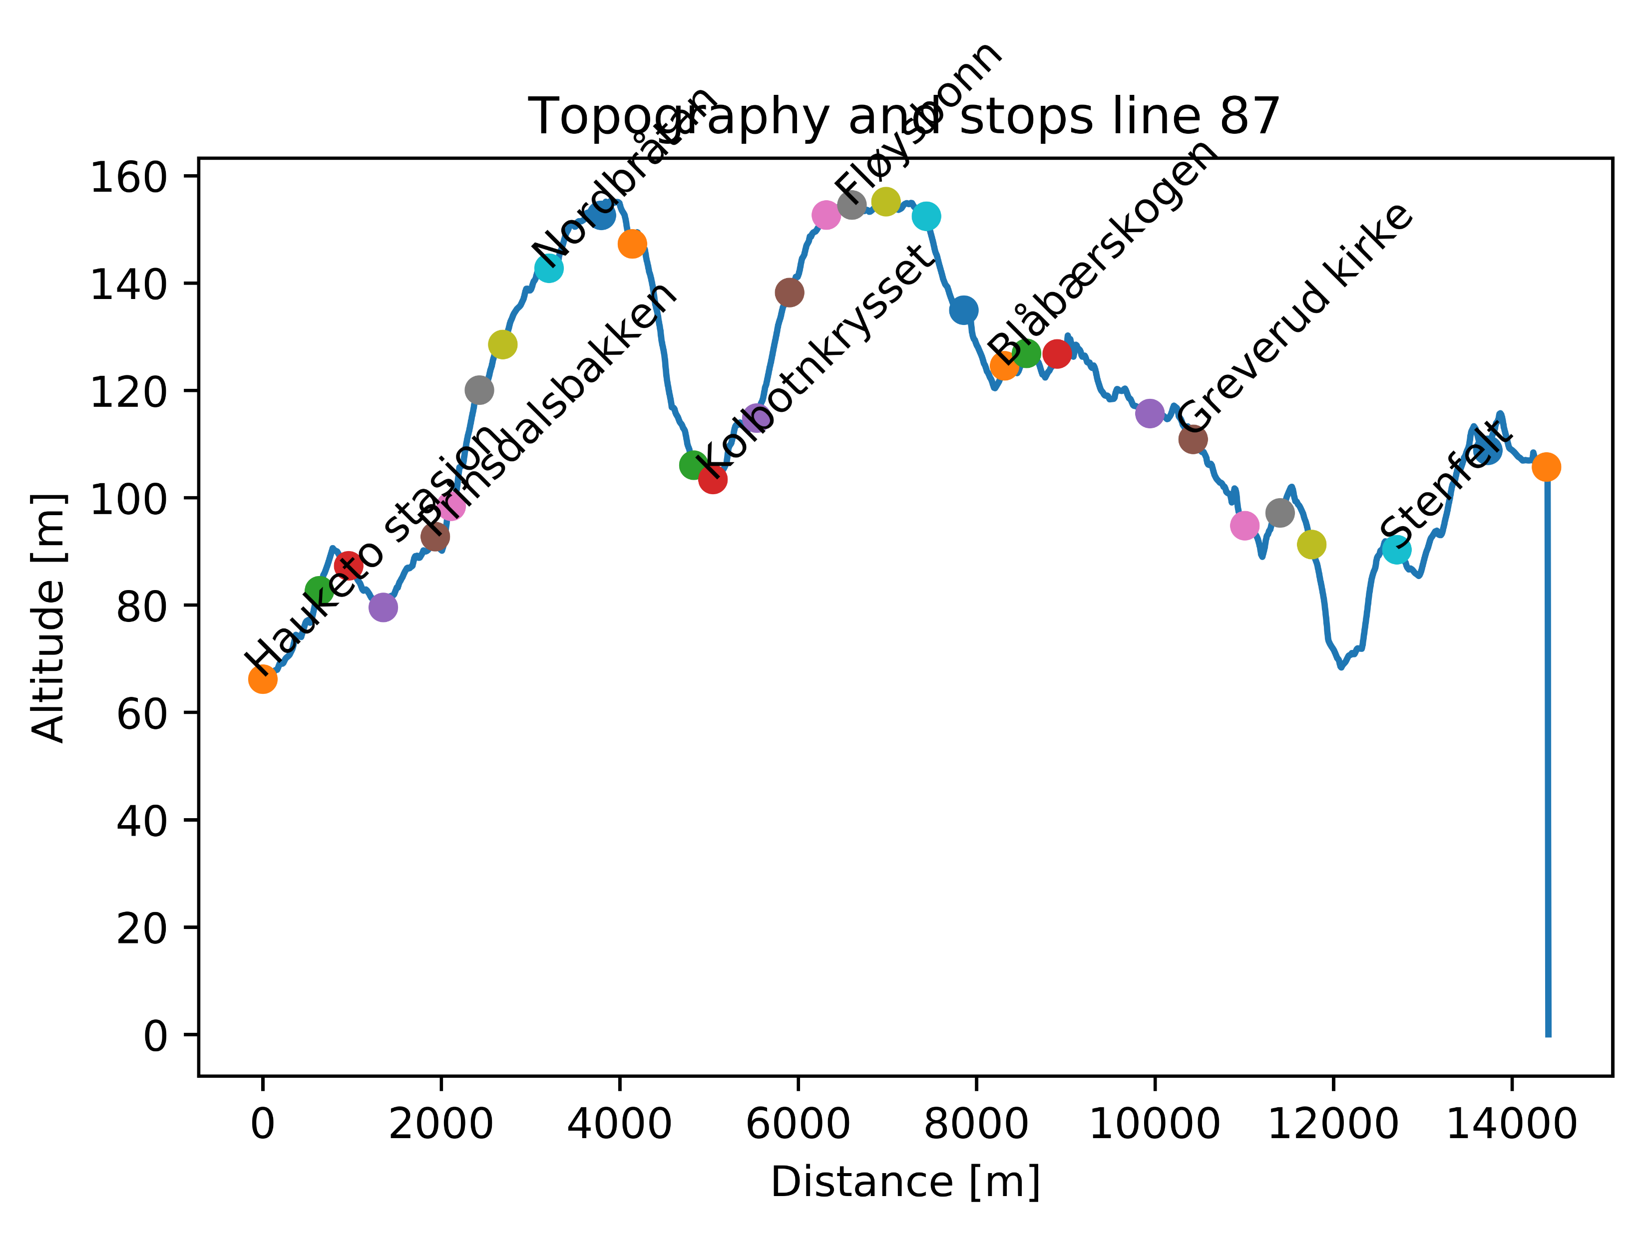

Slide 51
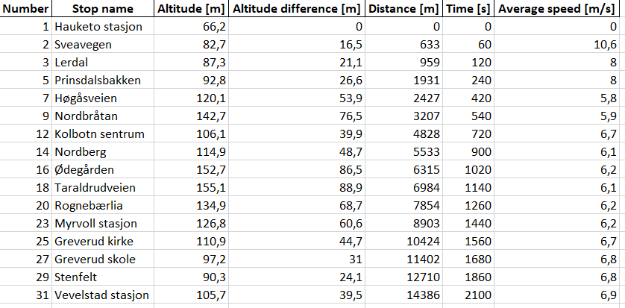
Line 87 – Subset of stops
Table shows subset of stops on line

Slide 52
Line 87 – Energy calculations
Line | Start | Stop | Energy [kWh] | Distance [m] | Energy per distance [kWh/km] | Altitude difference [m] | Time [min]
87 Tur/retur |  |  | 38,2 | 28772 | 1,35 |  | 70
87 Tur | Hauketo stasjon | Vevelstad stasjon | 19,6 | 14386 | 1,4 | 39 | 35
87 Retur | Vevelstad stasjon | Hauketo stasjon | 18,6 | 14386 | 1,3 | -39 | 35
Energy calculations are based on:
- Physics simulation of actual route
- 12 m bus, with total weight of 17,5 tons (including passengers)
- 50 % efficiency of regenerative braking

Slide 53
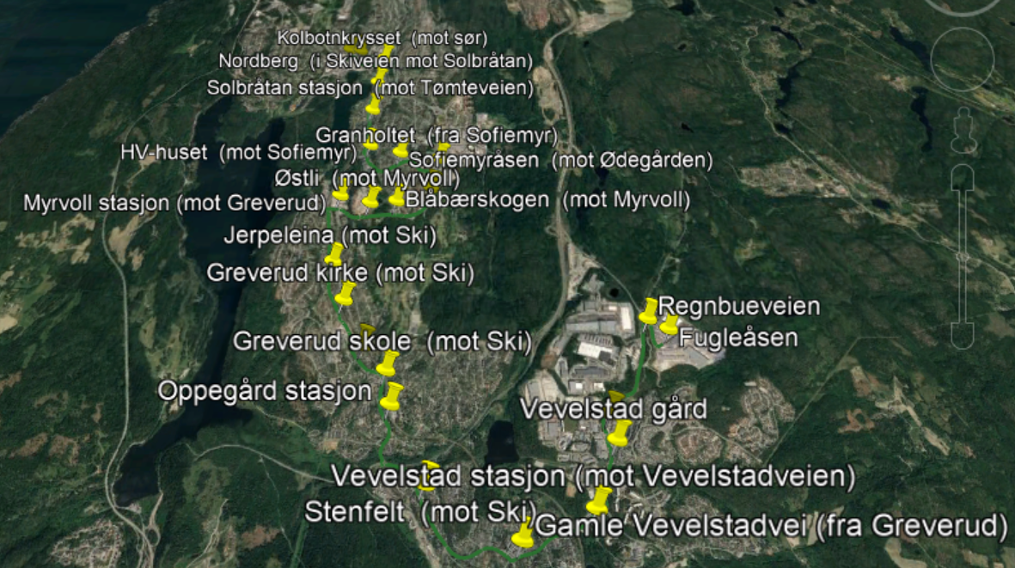
Line 580

Slide 54
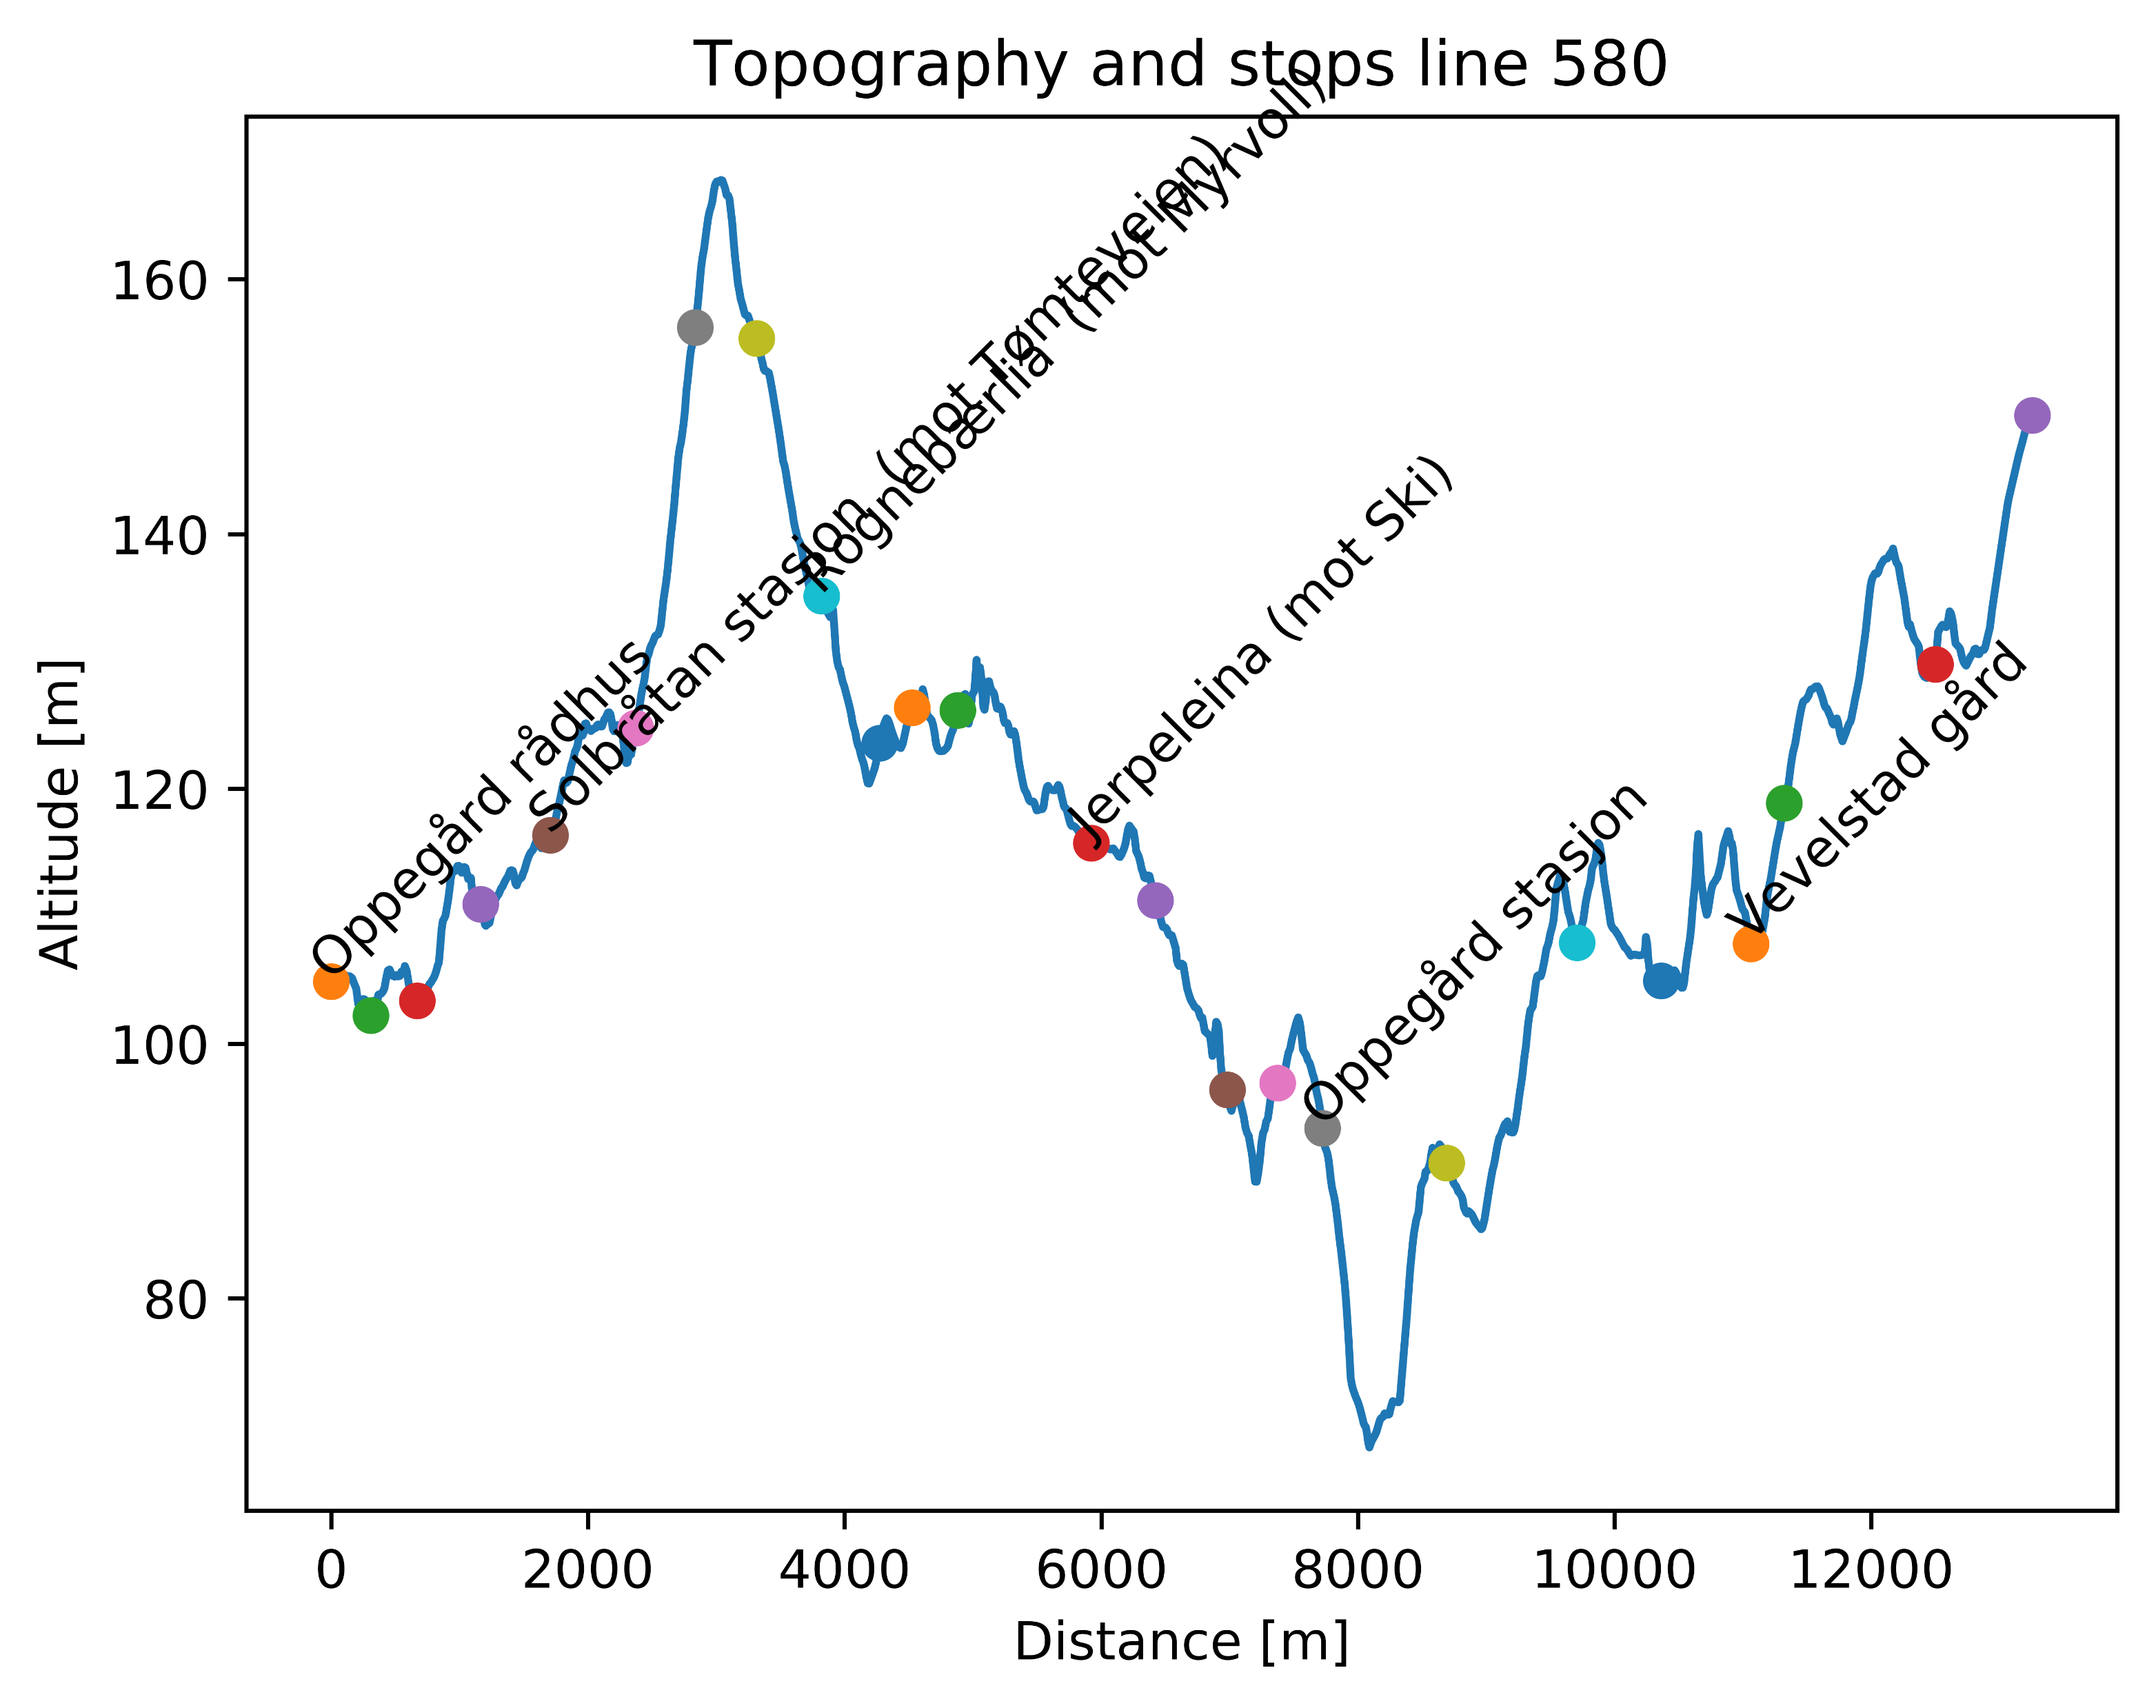

Slide 55
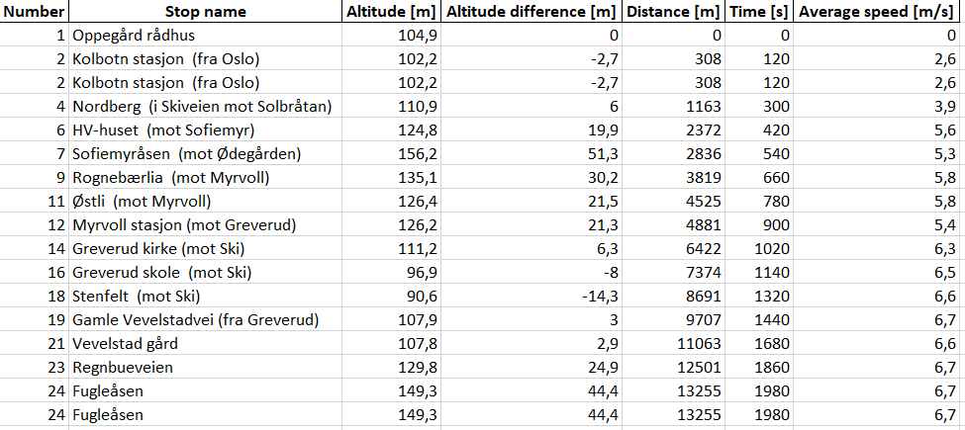
Line 580 – Subset of stops
Table shows subset of stops on line

Slide 56
Line 580 – Energy calculations
Line | Start | Stop | Energy [kWh] | Distance [m] | Energy per distance [kWh/km] | Altitude difference [m] | Time [min]
580 Tur/retur |  |  | 34,1 | 26510 | 1,3 |  | 66
580 Tur | Oppegård rådhus | Fugleåsen | 18,9 | 13255 | 1,4 | 45 | 33
580 Retur | Fugleåsen | Oppegård rådhus | 15,2 | 13255 | 1,2 | -45 | 33
Energy calculations are based on:
- Physics simulation of actual route
- 12 m bus, with total weight of 17,5 tons (including passengers)
- 50 % efficiency of regenerative braking

Slide 57
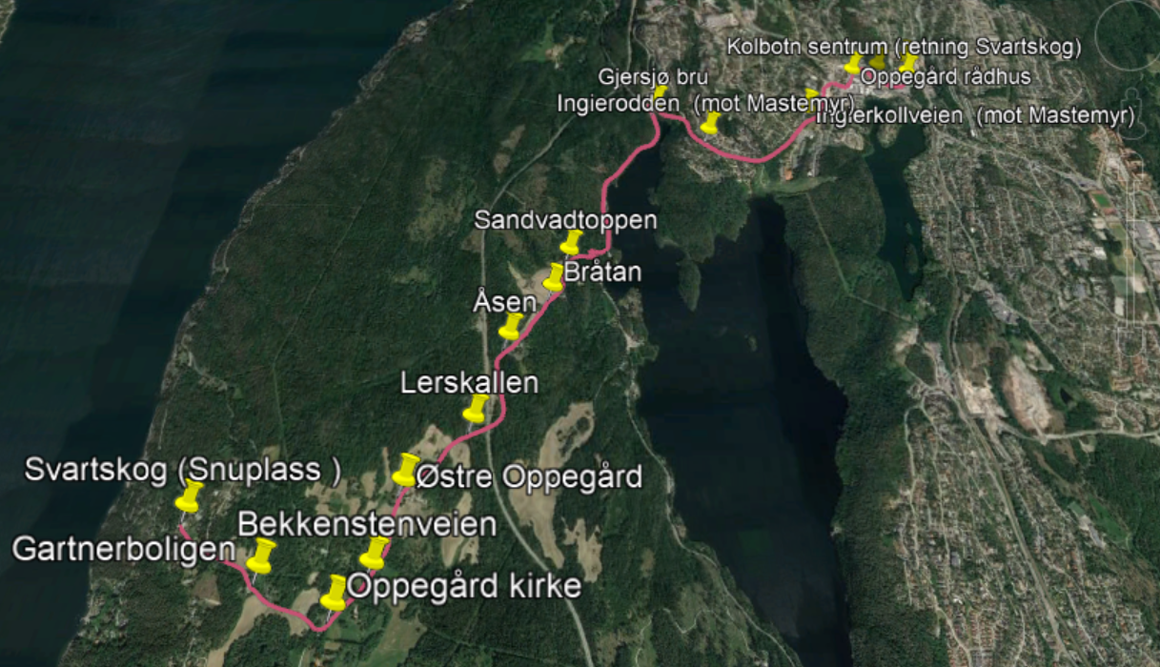
Line 585

Slide 58
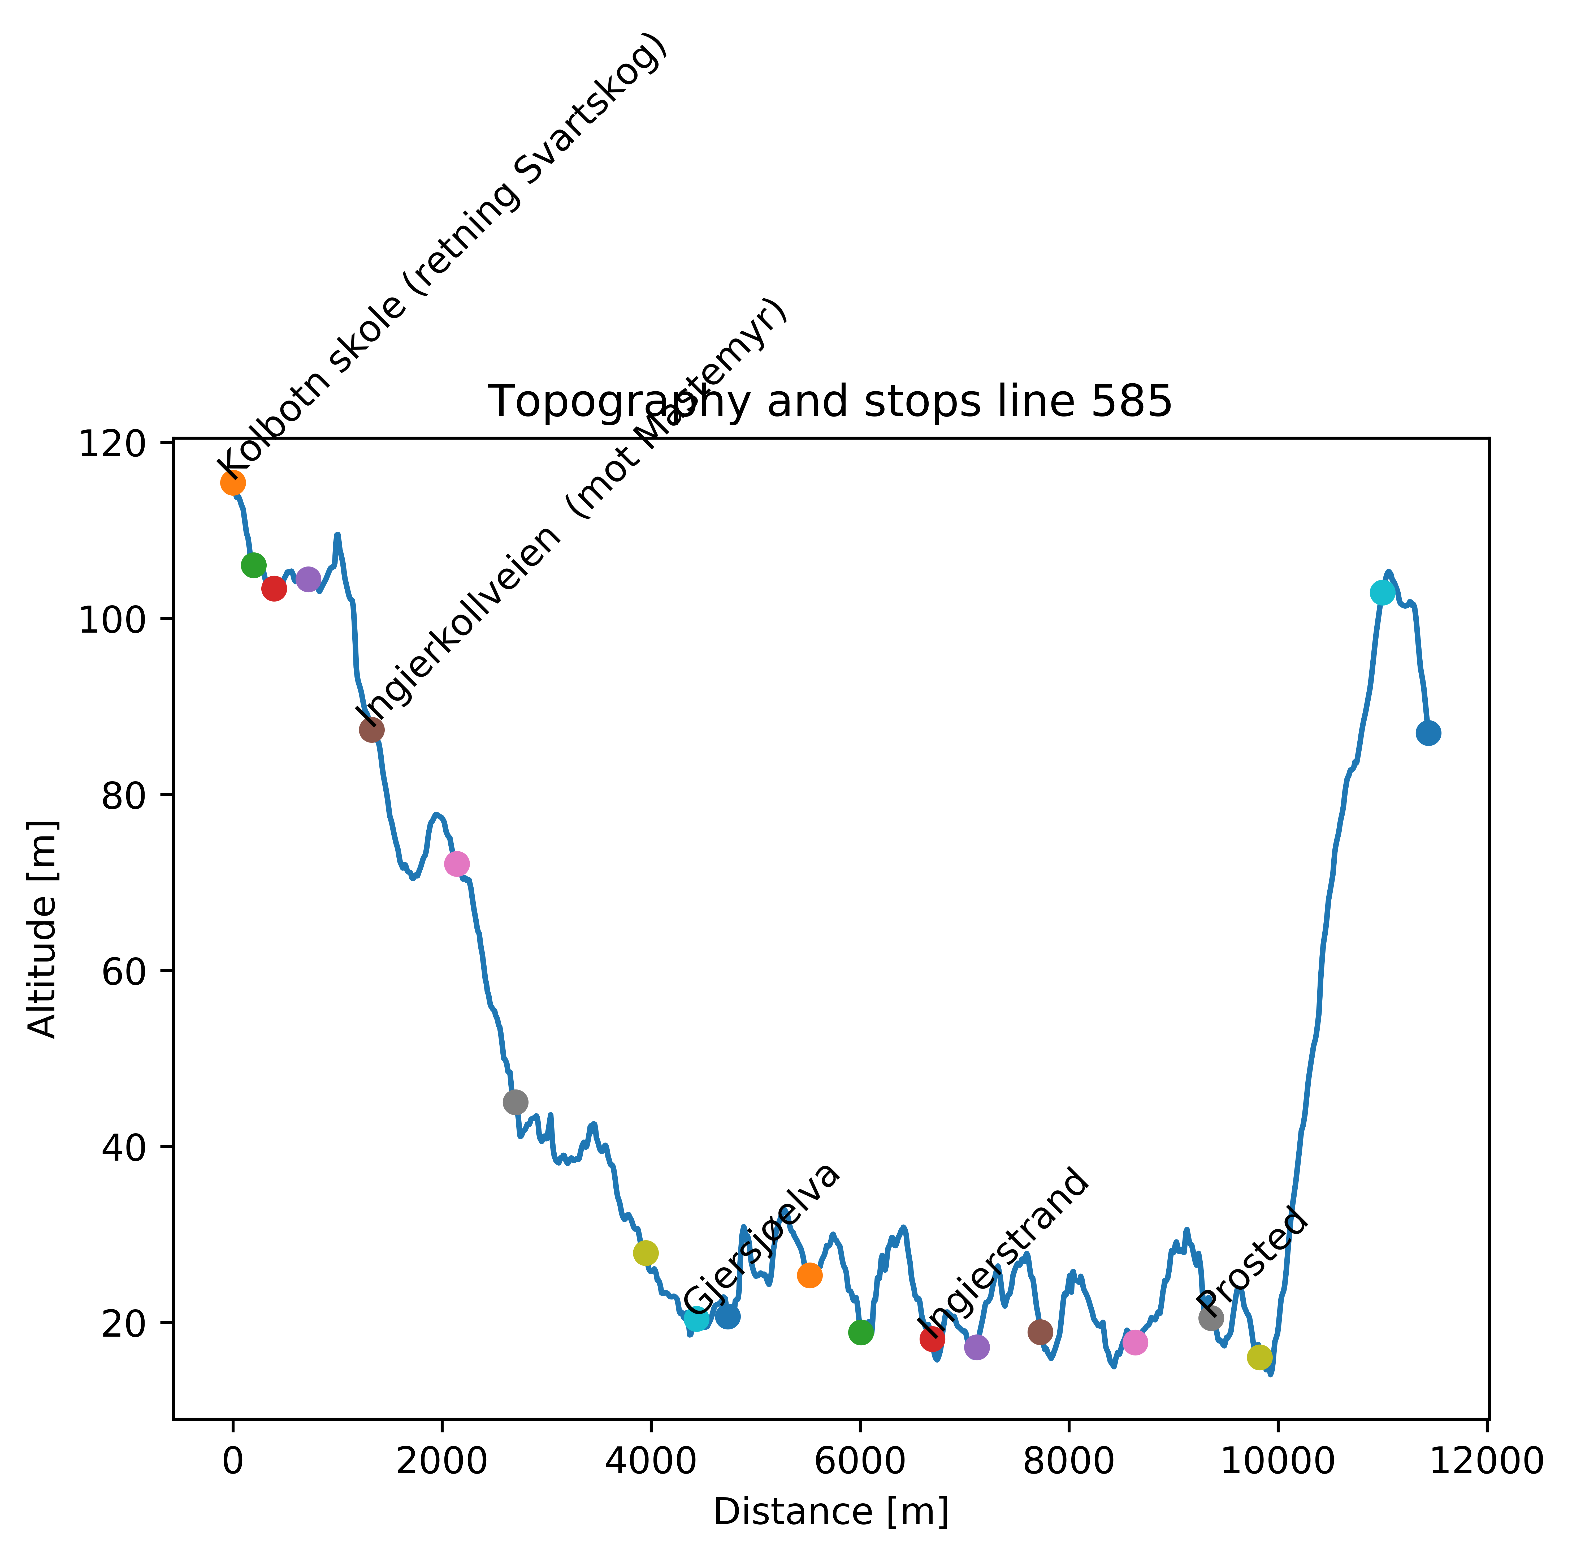

Slide 59
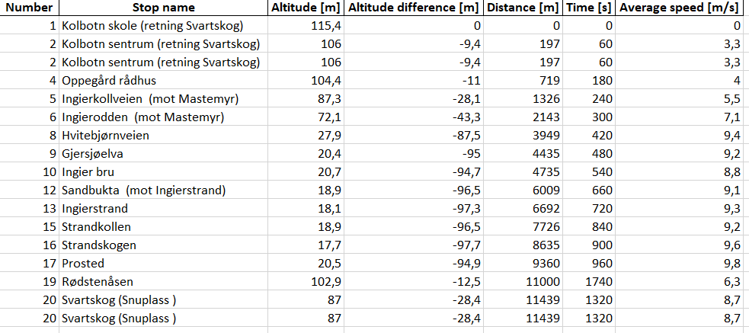
Line 585 – Subset of stops
Table shows subset of stops on line

Slide 60
Line 585 – Energy calculations
Line | Start | Stop | Energy [kWh] | Distance [m] | Energy per distance [kWh/km] | Altitude difference [m] | Time [min]
585 Tur/retur |  |  | 32,3 | 22878 | 1,43 |  | 44
585 Tur | Kolbotn skole | Svartskog | 15,5 | 11439 | 1,4 | -33 | 22
585 Retur | Svartskog | Kolbotn skole | 16,8 | 11439 | 1,5 | 33 | 22
Energy calculations are based on:
- Physics simulation of actual route
- 12 m bus, with total weight of 17,5 tons (including passengers)
- 50 % efficiency of regenerative braking

