Slide 1

Innovating the taxi customer experience
Morten Revsbæk, BNR A/S (morten@bnr.dk)
In collaboration with Oslo Taxi AS og CenCom AS

Slide 2
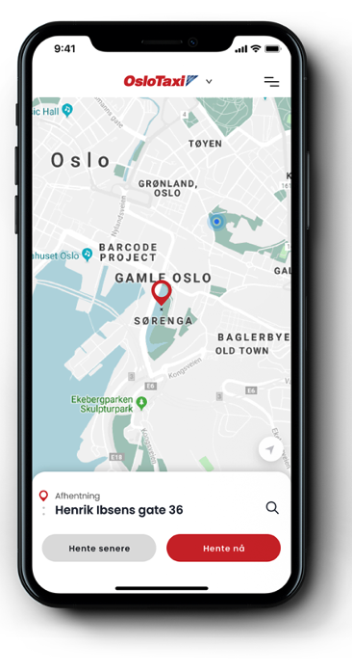
Taxifix – book taxi rides accross Norway
Digitizing the customer experience for taxi companies
  Find your local taxi company
  Make booking
  Couple customer and car
  Receipts
40+ Norwegian Taxi companies
1.000.000+ yearly taxi bookings accross Norway
Launching a fully redesigned app this summer
Can we bring new mobility products to taxi customers?

Slide 3
A new alternative to on-demand taxi
New convenience/price trade-off – new mobility products
Taxi (on-demand)
  Directly from A to B
  Choose time
  High price
Ridesharing (on-demand & shared)
  Directly from A to B
  Choose time span
  Medium pricing
Public transportation (shared)
  Between stops
  Fixed time schedule
  Low price
Taxi
Convenience
Public transportation
Price
Everyday/ consumer
Events /
Business

Slide 4
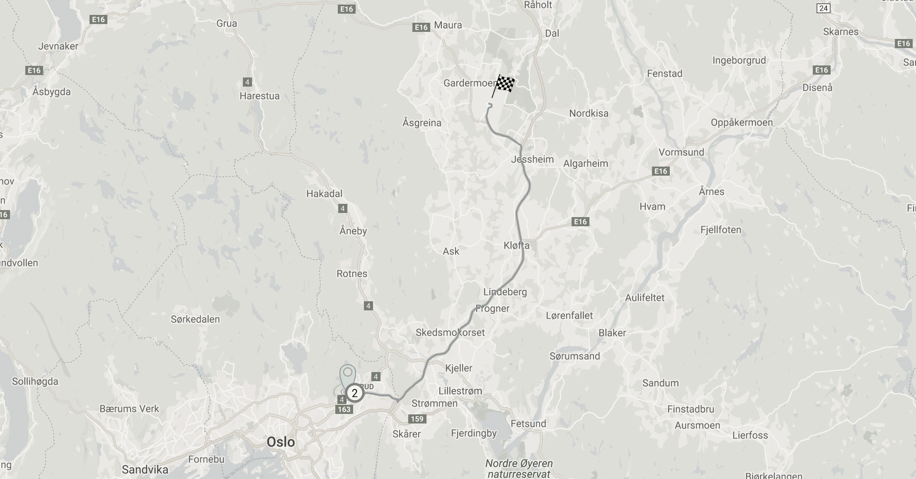
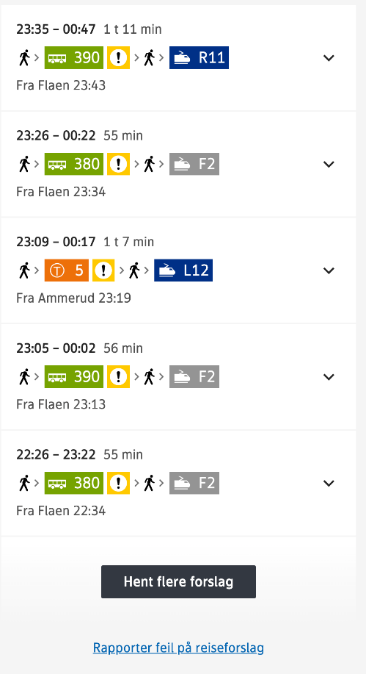
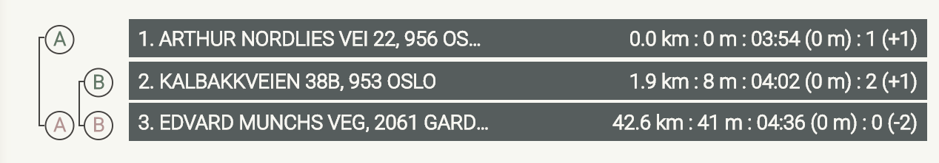
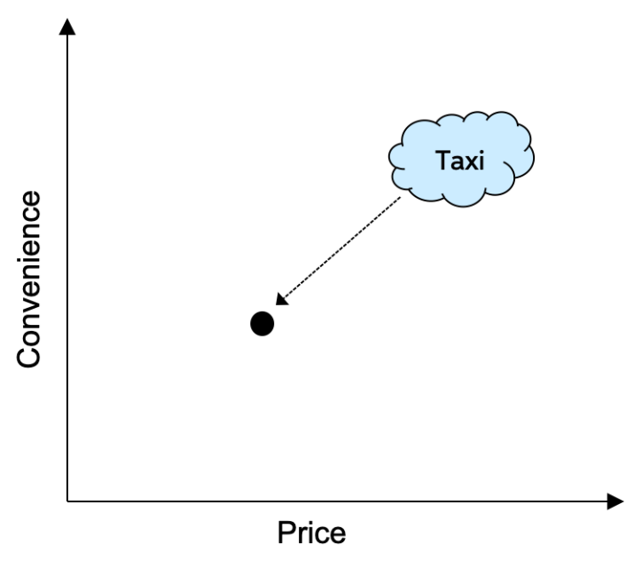
Opportunity: early morning airport (4:30)
From 30 minutes to an hour
Significant (30%) price reduction of on-demand
Make the only alternative more affordable - reach new customer groups

Slide 5
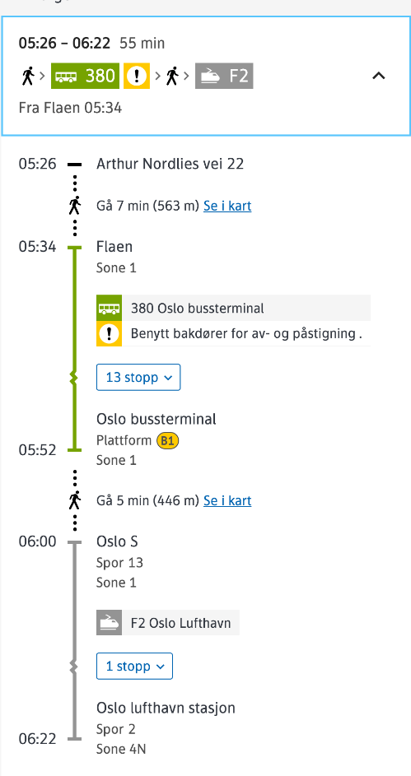
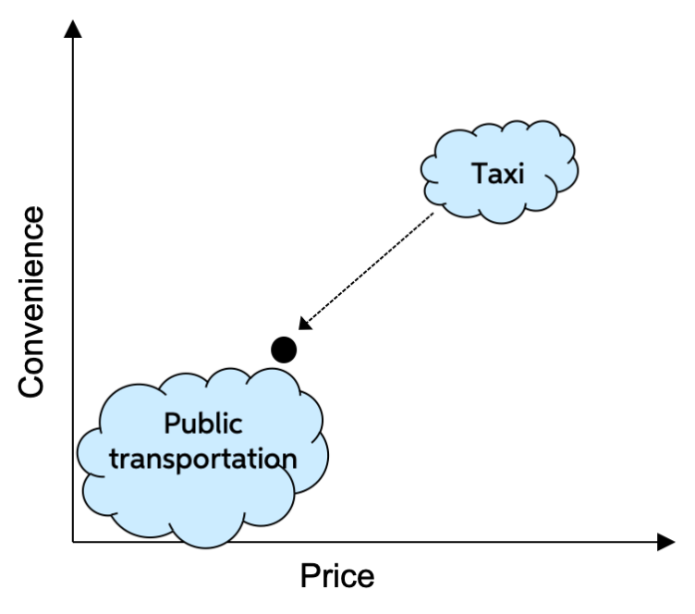
Opportunity: morning convenience (6:30)
Time comparable to public transport but more conveniet with no changing
Price comparable to public transportation
More convenient than public transportation - lower price than traditional taxi?

Slide 6
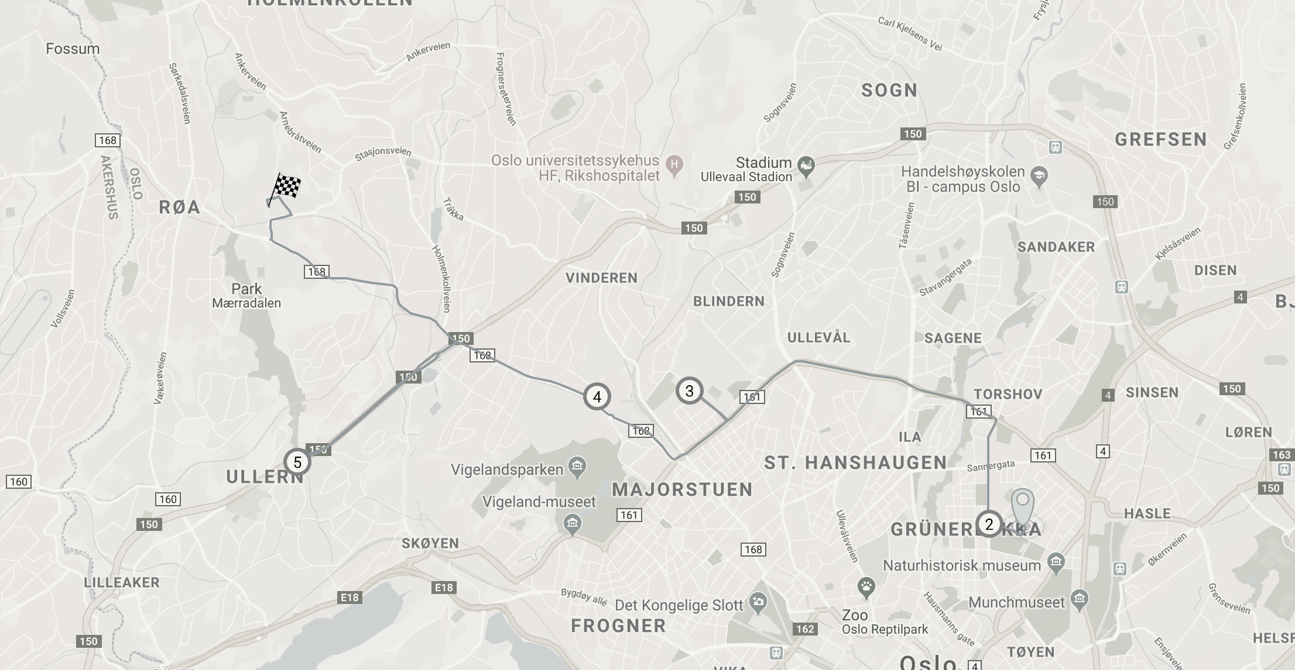
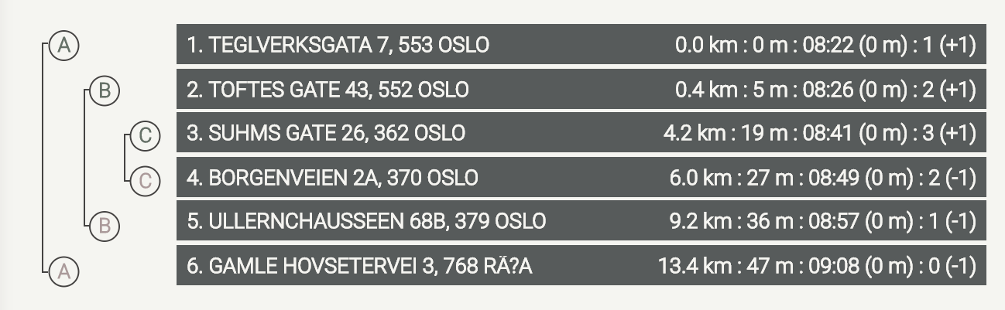
Opportunity: short city center trips

Slide 7
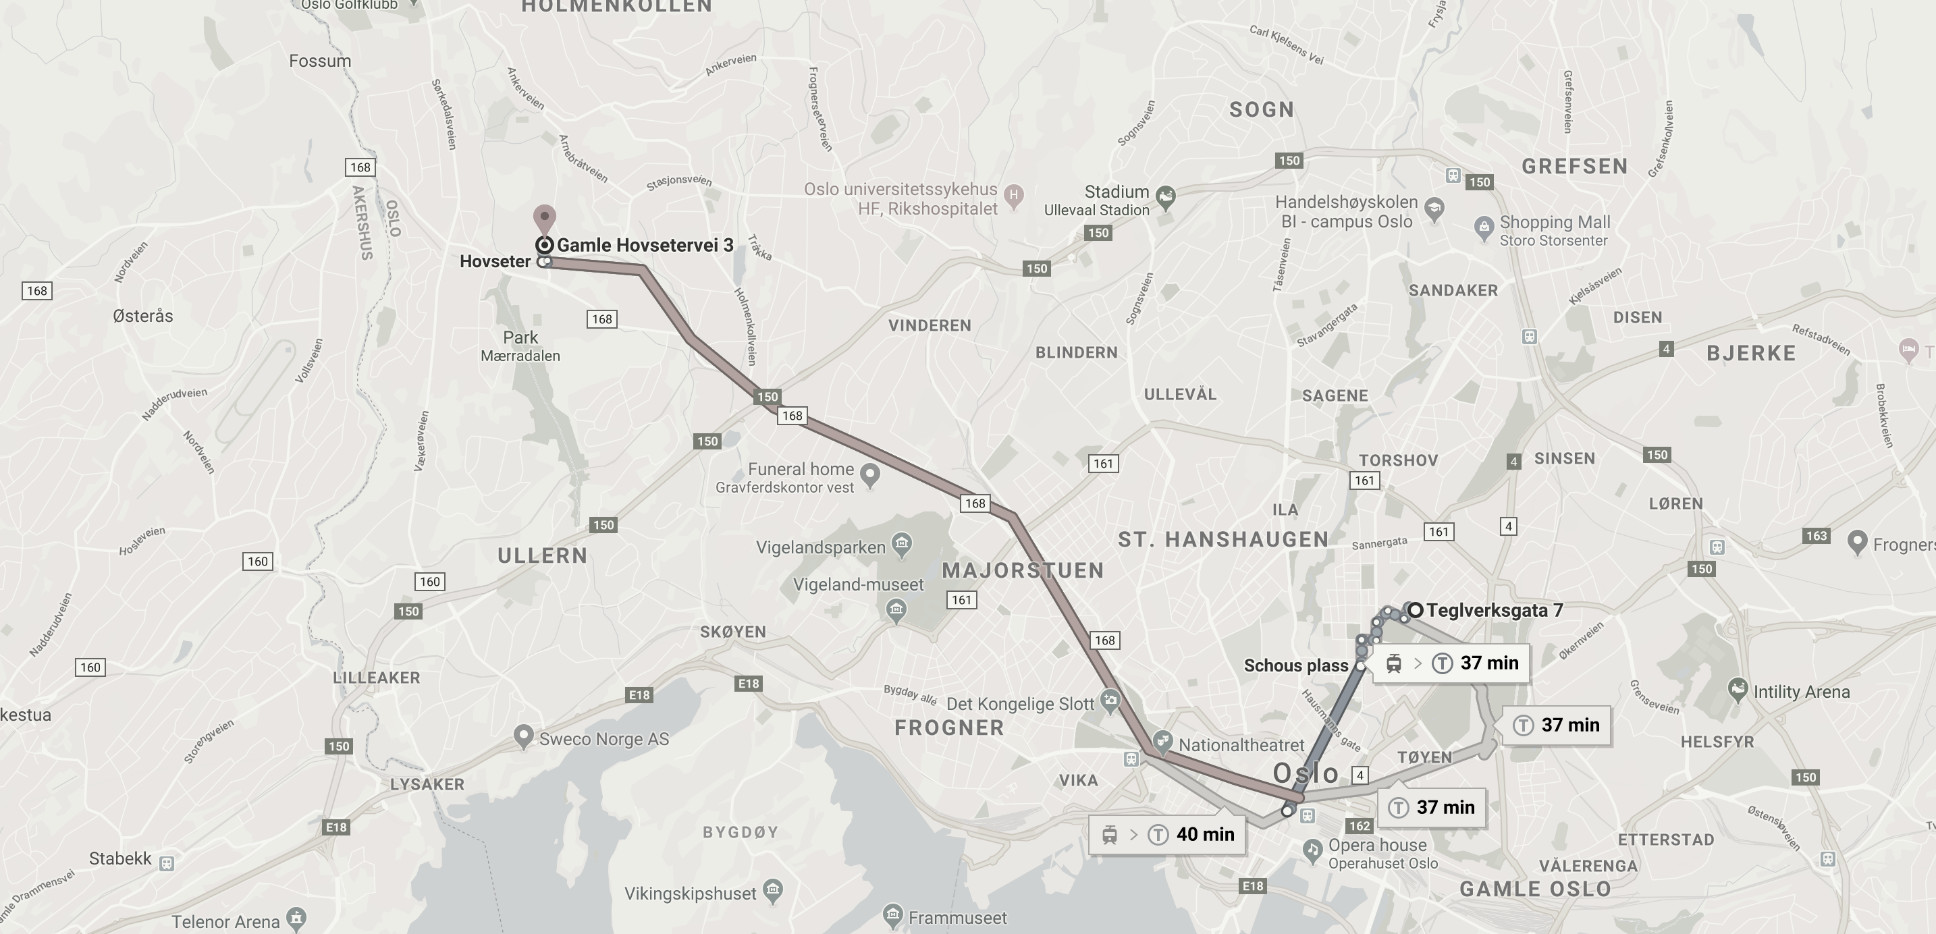
Opportunity: short city center trips
Bus
Metro
Tog
More convenient than public transportation - lower price than traditional taxi?

Slide 8
Many more examples we are looking at
We could look at many more examples
Central station
Events (koncerts and sport)
Weekend nights
Ridesharing in companies
Hotel shuttle
… we need to start learning about customer needs.
How do we get started?

Slide 9
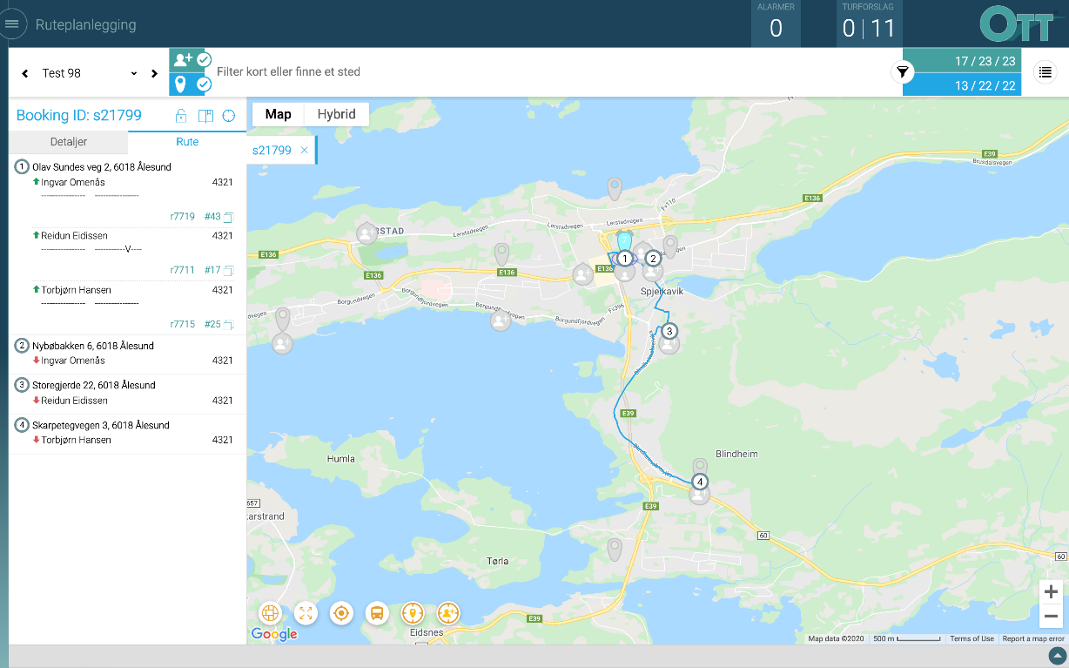
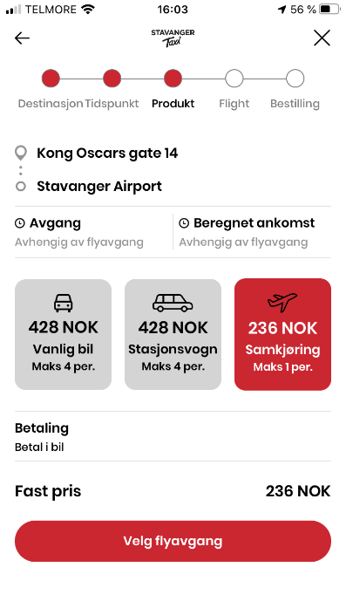

Platform for (experimenting with) ridesharing
Ridesharing offered in a mobile booking application
Fully automated planning of ridesharing and communication with cars
Taxifix
Engine for ride planning
Trips
Traffic management
Car
Taxikunde

Slide 10
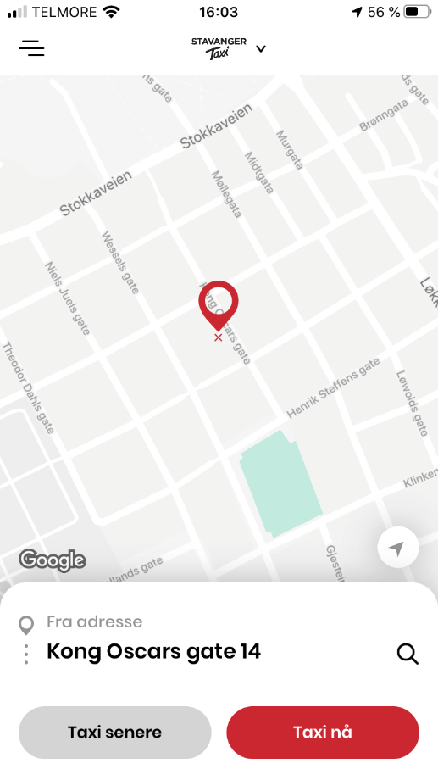
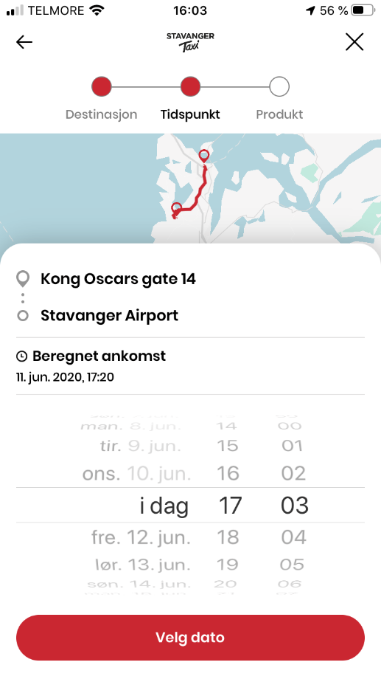

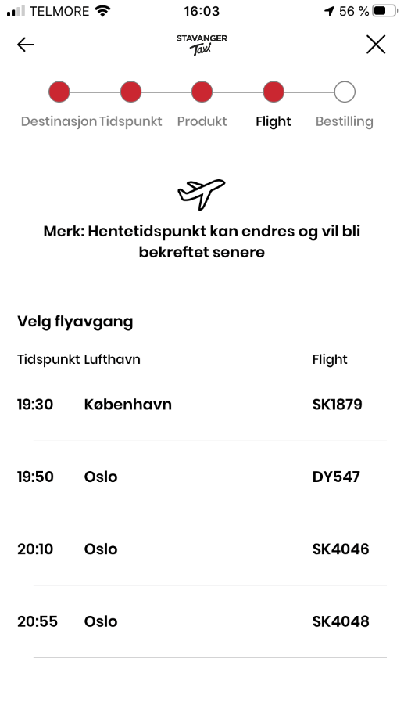
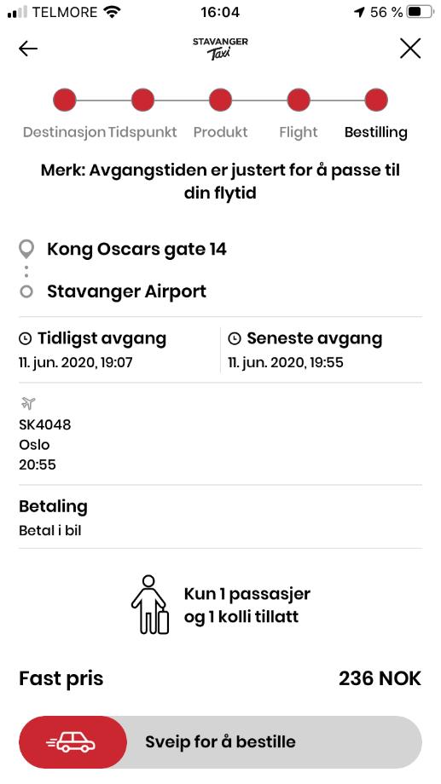
Ridesharing in Taxifix
Goals
Intuitive UI
Make ridesharing ”discoverable”
Exhibit price/convenience tradoff
Target geography and time windows

Slide 11
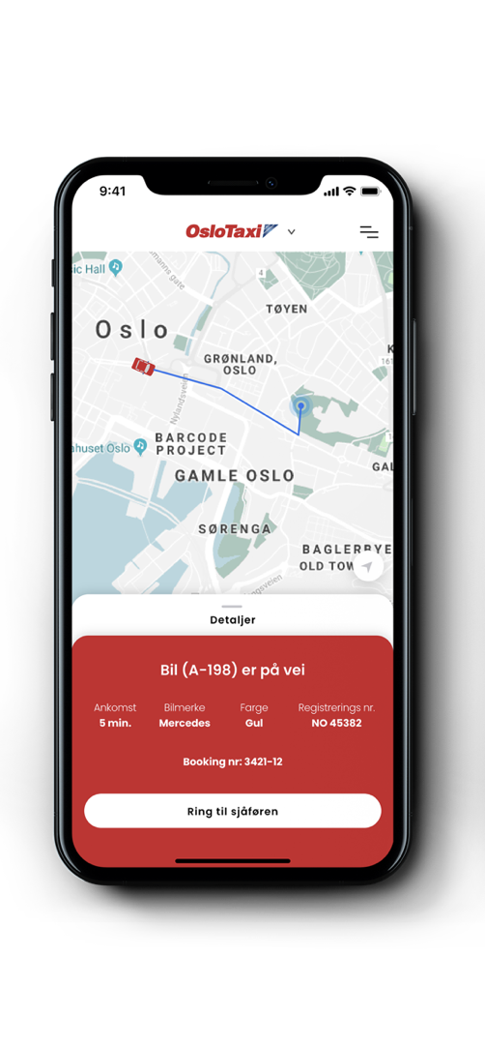

Engine for ride planning
Goals
Automated coupling of users with ridesharing potential (build trips)
Deliver trips to cars
Communicate back to customer (ETA and car approaching)

Slide 12
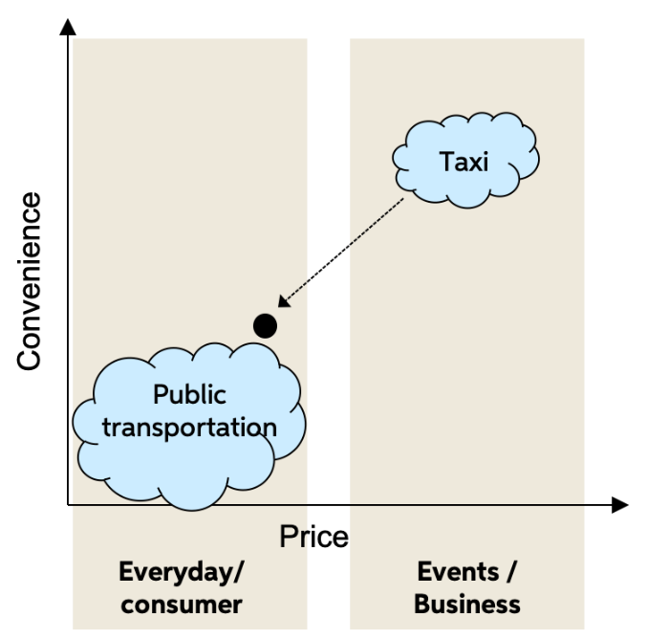

Going forward…
Launch pilots…
First one is ridesharing to Stavanger airport
Potential for PPP with public transportation
Offer a new price/convenience alternative to users of public transportation when they look for transportation.
Ridesharing requests can be made through API
Share a ride

