Slide 1

Towards a sustainable freedom of movement
Bernt Reitan Jenssen
CEO Ruter
06.05.2021
Notes:
Photo credit: Foto: Ruter As / Redink, Fartein Rudjord

Slide 2
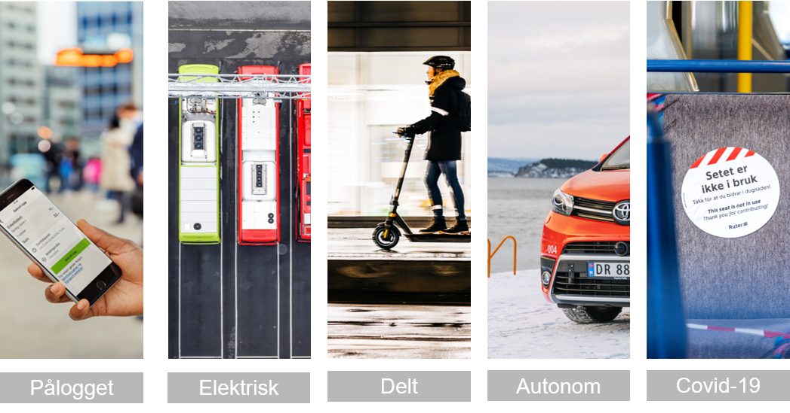
The mobility sector is changing
Logged in
Electric
Shared
Autonomous
Covid-19

Slide 3

We need to work together with our customers
Notes:
All beste praksis viser at det å jobbe sammen med kundene for å utvikle tilbud, produkt og tjenester er essensielt
Foto: Ruter As / Nucleus AS, Peter Gløersen
Foto: Ruter As / Nucleus AS, Daniel Jacobsen
Foto: Ruter As / Redink, Hampus Lundgren
Foto: Ruter As / Redink, Hampus Lundgren

Slide 4
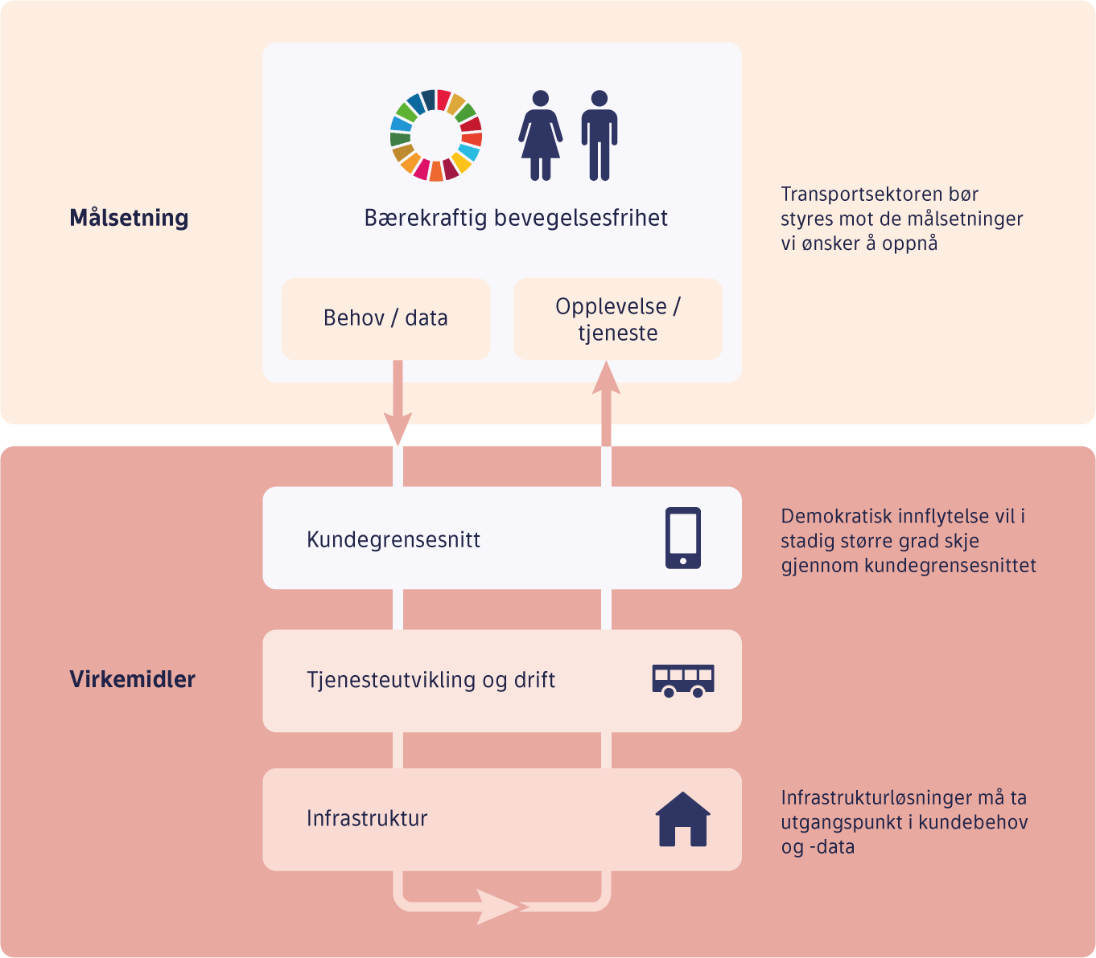
Securing the customer interface is crucial to ensure democratic governance
Goal
A sustainable freedom of movement
The transport sector must be pivoted towards the goals we want to achieve
Needs/data
Experience/service
Customer interface
Democratic influence takes place through the customer interface
Tools
Service development and operation
Infrastructure must be based on customer needs and data
Infrastructure

Slide 6
Understanding our customers’ needs
Notes:
All beste praksis viser at det å jobbe sammen med kundene for å utvikle tilbud, produkt og tjenester er essensielt
Foto: Ruter As / Nucleus AS, Peter Gløersen
Foto: Ruter As / Nucleus AS, Daniel Jacobsen
Foto: Ruter As / Redink, Hampus Lundgren
Foto: Ruter As / Redink, Hampus Lundgren

Slide 7
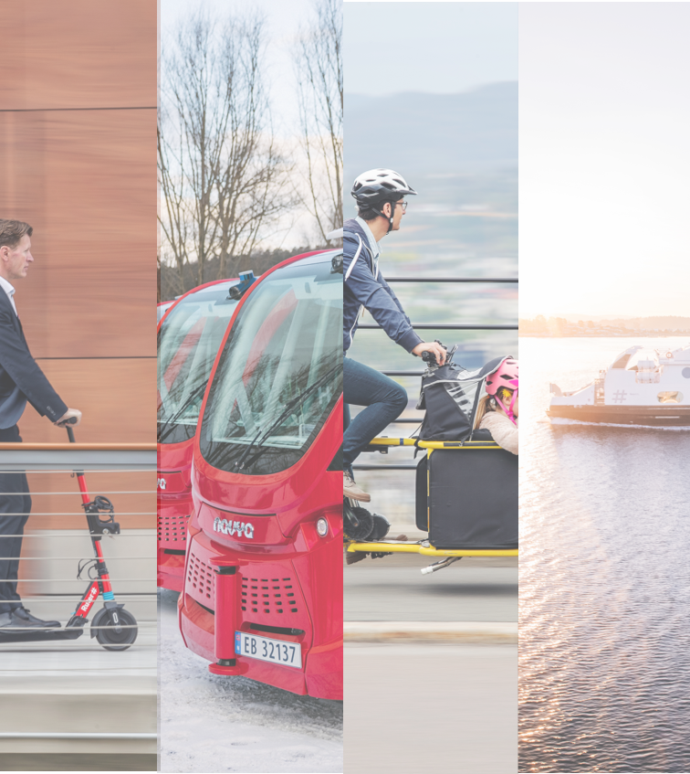
Getting closer to our customers needs
Notes:
Foto: Ruter As / Nucleus AS, Peter Gløersen
Foto: Ruter As / Nucleus AS, Daniel Jacobsen
Foto: Ruter As / Redink, Hampus Lundgren
Foto: Ruter As / Redink, Hampus Lundgren

Slide 8
The mobility sector is changing
Logged in
Electric
Shared
Autonomous
Covid-19
Notes:
Busser: Foto: Ruter As / Redink, Daniel Ashby
Covid: Foto: Ruter As / HyperRedink, Per Christian Lind
Pålogget: Foto: Ruter As / Redink, Hampus Lundgren
Selvkjørende: Foto: Ruter As / Nucleus AS, Daniel Jacobsen
Delt: Foto: Ruter As / Nucleus AS, Peter Gløersen

