Slide 1
Sustainable freedom of movement
Innovation ideas
19 April 2021

Slide 2
Early 2021, Alstom changed significantly with the acquisition of Bombardier.
Small introduction to recap who we are.
Innovation ideas: one or two slides per idea.
But if relevant to Ruter, we can provide more details on each topics.
Finally, a city combining several existing innovations
Hannover’s GUW+ project.
1
2
3

Slide 3
Who is Alstom ?
1

Slide 4
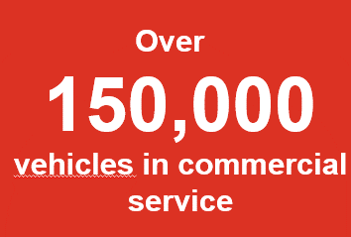
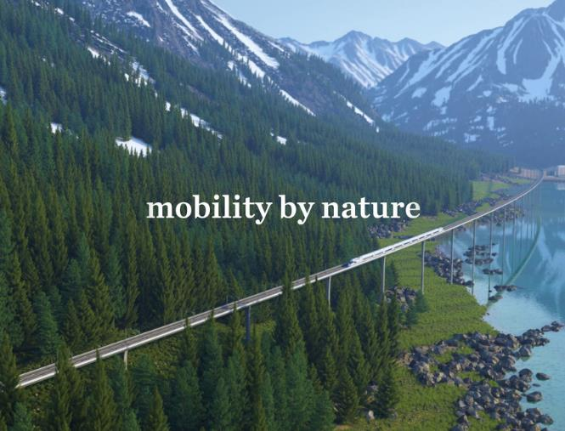

75,000
17,000
Employees worldwide
^{Engineers}
^{Over}
^{Partner to over}
10,000
300
^{patents}
^{cities}

Slide 5

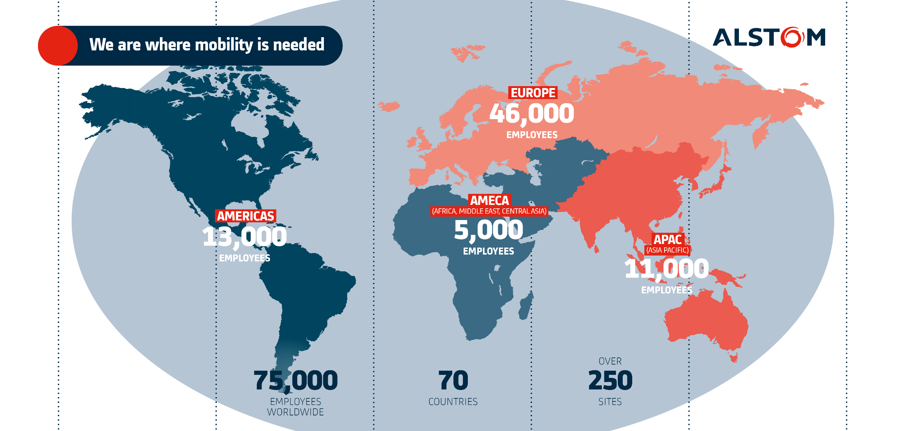
A Strong footprint
Notes:
Mettre en rouge

Slide 6



Nordics & Russia cluster
2000 employees in Nordics & Russia
23 depots (Services)
11 offices
1 Global Test and Technology
center for Propulsion
(Engineering & Manufacturing)
1 Global Innovation Center
for Rail Control Solutions
(Engineering)
Oslo
  2 Offices
Gothenburg
  Office
Copenhagen
  2 Offices
Boxholm
  Depot
In Russia, Alstom owns 22 percent of TMH.
Falköping
  Depot
Fredericia
  Depot
Grorud
  Depot
Helsinki
  Office
Gävle
  Depot
Stockholm – Liljeholmen
  Office/D&IS
Hässleholm
  Depot
Motala
  Depot
Motorvagns-
hallen
  Depot
Västerås
  Depot, Office Manufacturing
Stockholm – Solna
  HQ Office
Kalmar
  Depot
Raus
  Depot
Lidköping
  Depot
Novocherkassk
  Depot
Sävenäs
  2 Depots
Tollarp
  Depot
Moscow
  2 Office
Luleå
  Depot
Nässjö
  Depot
Södertälje
  Depot
Ulvsunda
  Depot
Älvsjö
  Depot
March 2021

Slide 7
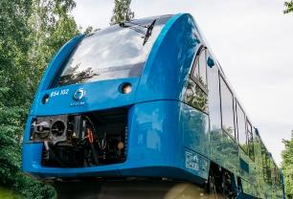
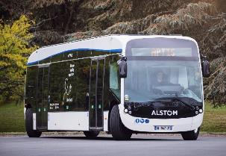
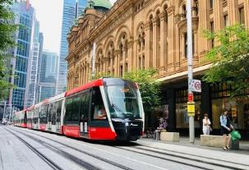

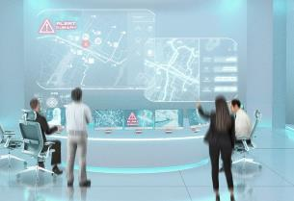
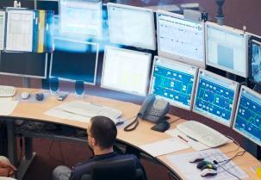
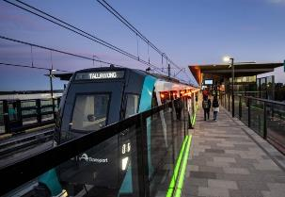

A constant focus on innovation
Green traction
Road electromobility
Eco-design and manufacturing
Green Mobility
Multimodality and Flow management
Data driven rail mobility
Autonomous train
Smart Mobility

Slide 8
Innovation ideas
2

Slide 9
  Platooning of Aptis
  Multimodal orchestration / MaaS
  Video Analytics in Public Transport
  Inclusive Mobility
  Healthy Mobility (Covid for instance)
  Urban Freight
  Green Mobility
9

Slide 10
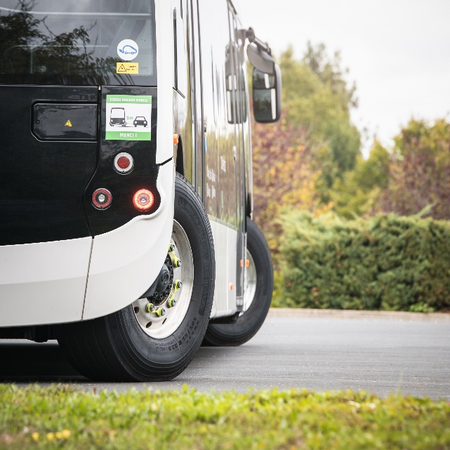
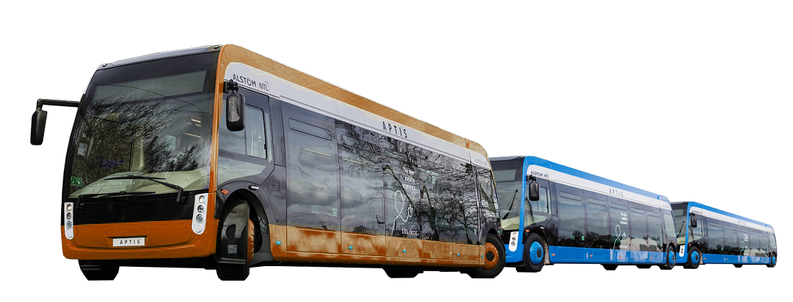
Platooning of Aptis
Aptis is a hybrid between a tram and a bus:
Full low floor
Battery powered
4-wheel drive, and fully orientable: ideal for bus stop lateral approach
and short turn radius
Idea(s)
Make it driverless
Run them in platoons (like a BRT, but with flexibility to revert back to single bus
-> scalability)
First Aptis could be with driver, while the followers can be automated

Slide 11
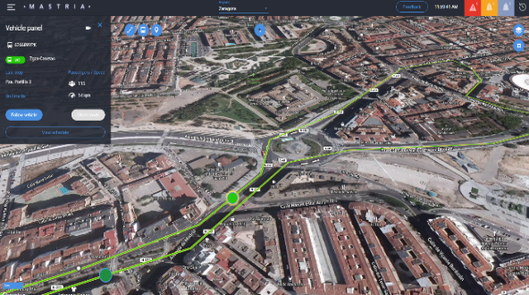
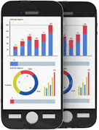
Multimodal orchestration (smart city)
Coordination of all modes
of transport:
Metro
Tram
Buses
Taxis
Uber
Bicycles
Scooters
Roads (car signage)
Link to demand/incident regulation
Football match / concert volumes
Incident/accident disruption
Synchronisation with Fire department/Ambulances/Police
Services to
City/Region coordinators
Users (regardless of mode of transport)
Zaragoza, Spain
  Authority & Operators collaborative platform
  Automatic incident detection
Paris, France
  Multimodal integration
  Incident management
  Prediction and Simulation
  People flow
Montreal, Canada
  Multimodal operator
  Services quality monitoring
  COVID impact
Panama city, Panama
  People flow fluidity, adapt to demand
  COVID impact
  Simulation
Toscan Region, Italy
  Multimodal Hubs including railways
  Modal transfer optimization
  Car Park integration
  Smart CCTV
Barcelona, Spain
  Multimodal operator
  People flow management
  Incidents impact analytics
  COVID impact

Slide 12
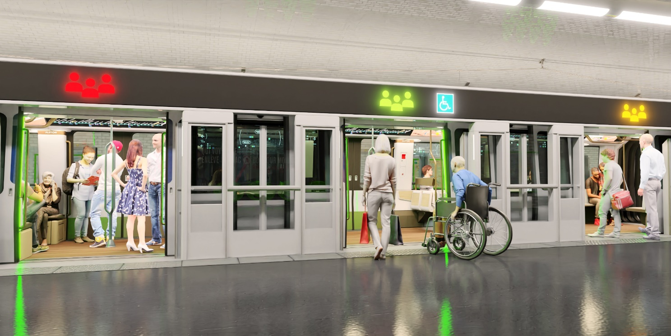
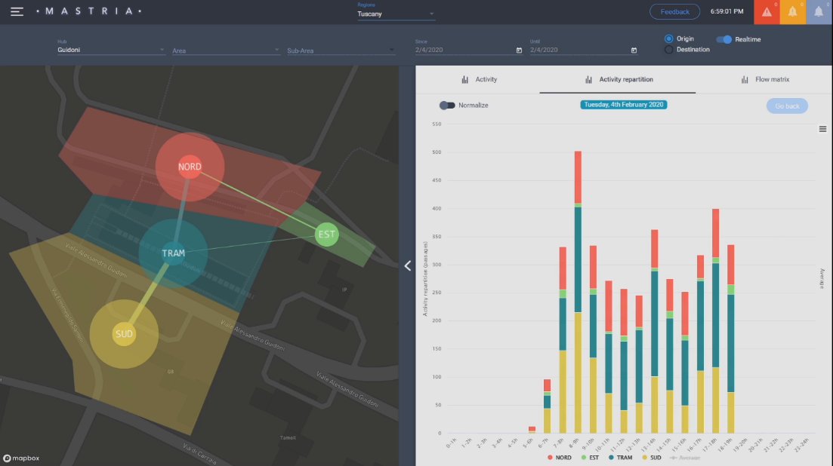



Multimodal orchestration: passenger flow
Train
Occupancy
Distancing
Available
Reduce passenger density inside the train
Optimize dwell time up to 10%
Passenger flow monitoring
Adapting to demand

Slide 13
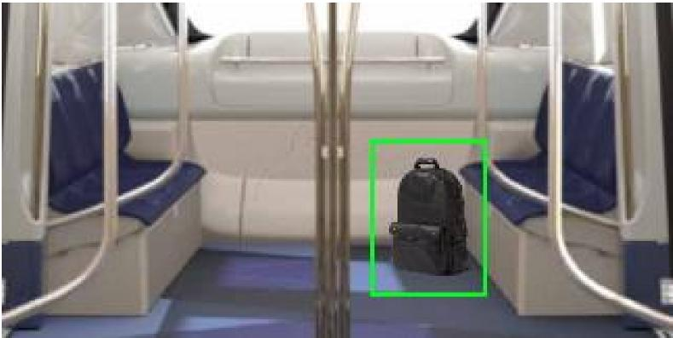
Video analytics 1
integrated security system with fast-tracking and geo-tracking.
real-time and recorded advanced video content analysis.
Key benefits
- Reassurance of passengers
- Real-time situational awareness of incidents
- Improved incident management
- Regulation of passenger flow during and after an
incident
Scenarios
- abandoned or stolen object detection
- people fighting detection

Slide 14
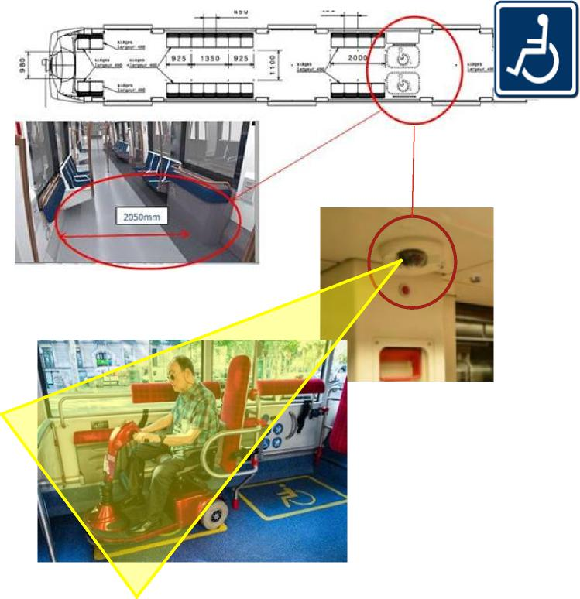
Video analytics 2
detection of wheelchair area availability. User can plan beforehand easily where he can board serenely.
Key benefits
Inform availability of the wheelchair user area
Help wheelchair user to board and limit the anxiety
Optimize onboard timing

Slide 15
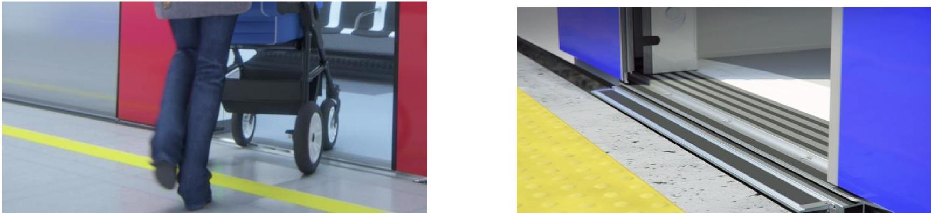
Inclusive Mobility: Leveling System
Reference: REM Montreal metro
Key benefits
Autonomous access for persons with reduced mobility
Fluid flow for way in and out, avoiding step or gap between the train and the platform
Access Height Adaptation
Allows an accurate up and down adjustment of the train to the platform height, within a few seconds, at train arrival.
The system is activated at bogie pneumatic secondary suspension level, applicable to all types of trains.

Slide 16
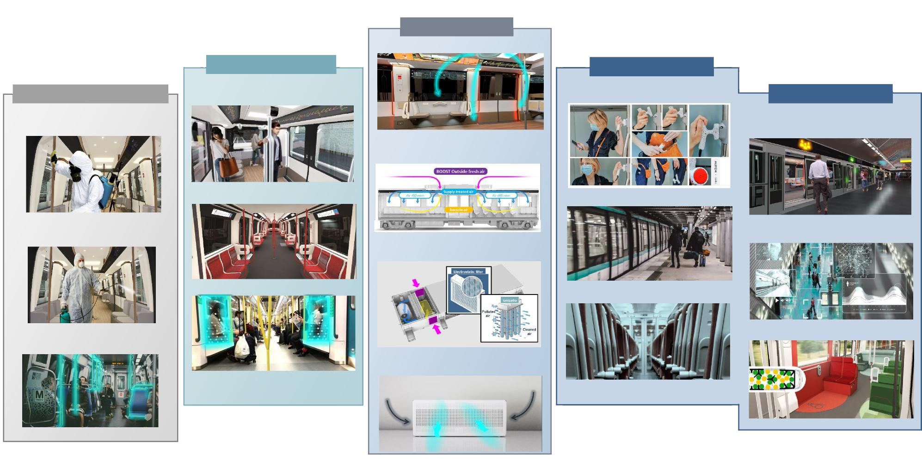
Healthy Mobility
AIR TREATMENT
Air Quality Diagnostic
CONTACT SURFACES
CONTACTLESS
CLEANING & DISINFECTION
Antibacterial powder paint for metallic surfaces
OOKKIT
Personal Anchoring Device
PASSENGER FLOW
Viricidal & Antibacterial cleaning with Spray & Wipe Protocol
OPTIMET
Real time train occupancy
HEALTHY MODE
optimized air renewal with fresh air
Viricidal & Antibacterial Fabrics
Passenger Access Door Centralized Opening
Viricidal & Antibacterial disinfection with Nebulizer Protocol
MASTRIA
Passenger flow and density analytics
Enhanced mechanical air filtration and air treatment within HVAC
Viricidal & Antibacterial Film
Interior Door Infrared Sensor Opening
Viricidal & Antibacterial spray coating lasting 6-12 months
Zoning with digital printing floor
Enhanced mechanical air filtration KIT for driver cabin

Slide 17
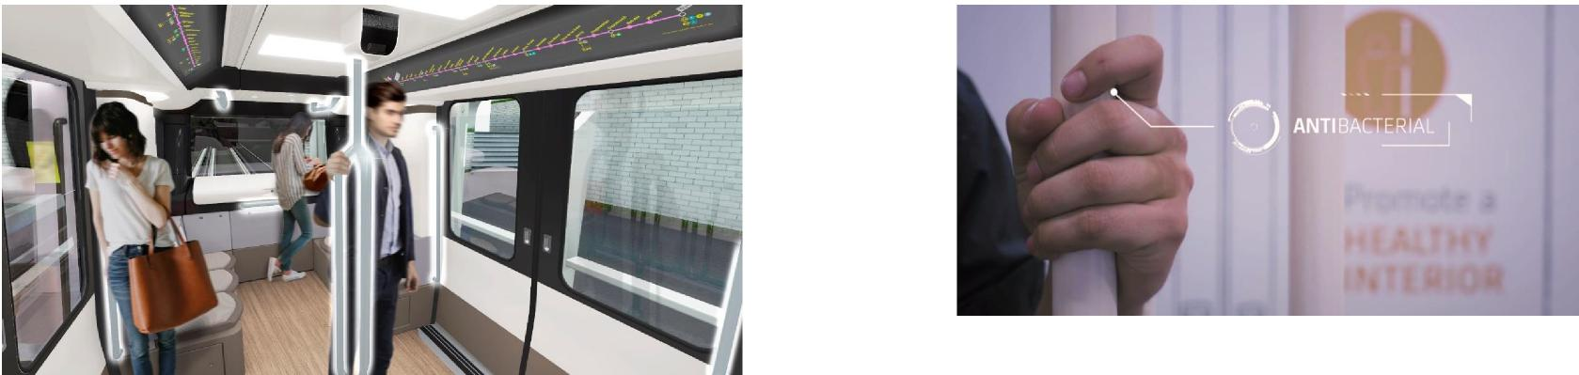
Healthy Mobility: contact surface
Permanent and efficient protection against bacteria and virus contamination.
Specific powder painting process applied on handrail or any metallic surface.
Based on silver ions, this powder paint is resistant to cleaning agents and UV ageing and is already being used in healthcare environment.
It inhibits cell division, damages bacteria cells envelope and contents and prevent transmissible bacteria and fungal infections from being transmitted.
Key benefits
Sanitary interior with over 99,95% bacteria activity reduction
A wide range of colors to allow the necessary contrast for all
No specific cleaning, care or service requested

Slide 18
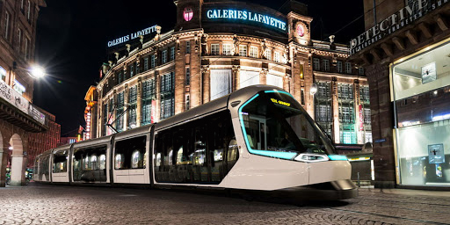
Urban Freight
If (when) city center is banned for cars AND trucks,
Freight trams and even dedicated metro cars can be used to deliver freight right down city center.
Shops can be supplied.
User parcels (Postnor…) could be delivered in T-banen stations
Every single tram stop can be a freight delivery point
Can also be used reversely by disposing of waste
Key benefits
No more Diesel tracks exception,
or even electric trucks
Less vehicles, more pedestrians space

Slide 19
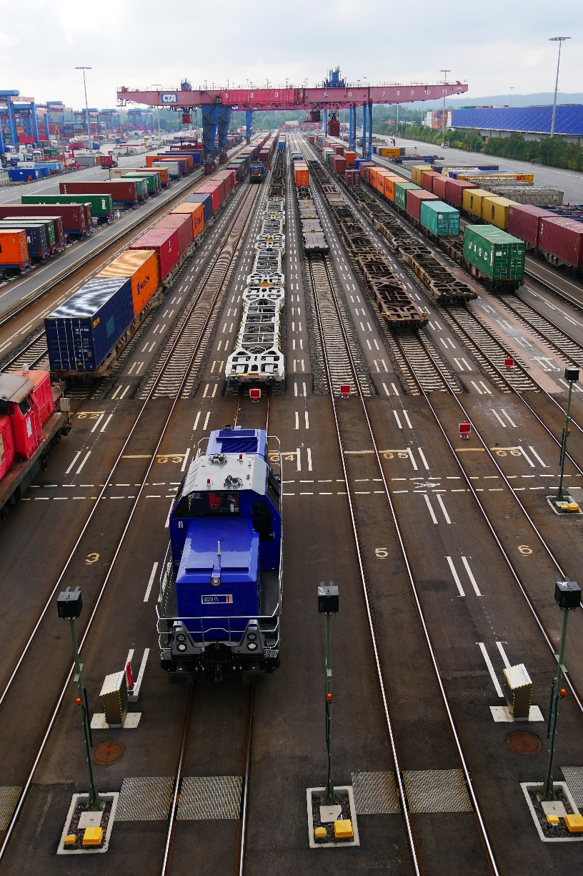
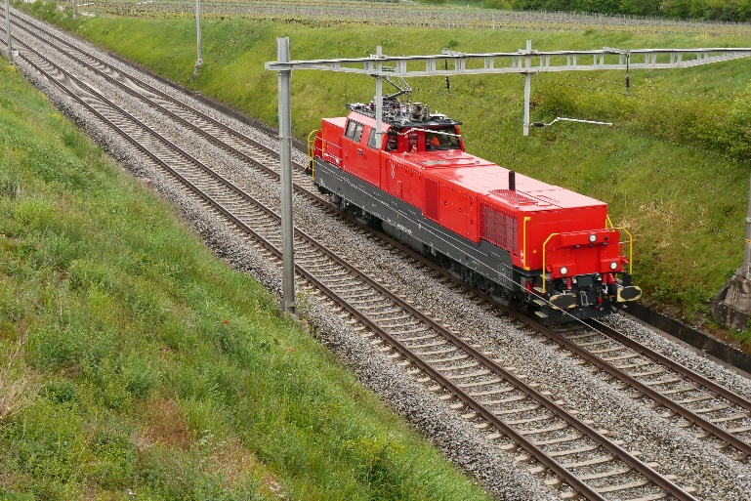
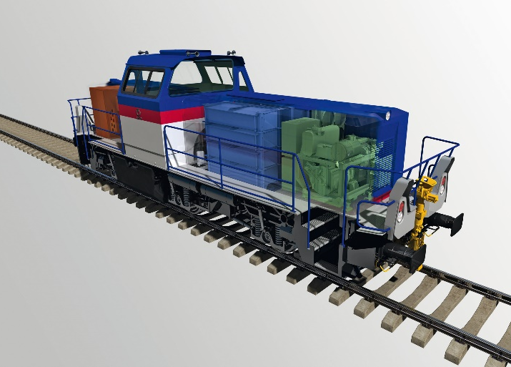
Green Mobility
Beyond Oslo center, green mobility using Battery or H2
for Shunting locomotives in Alnabru
H4 bi-mode locomotive in Switzerland
H3 Hybrid locomotives in the port of Hamburg, Germany
References: 47 in service since 2019
References: 54 in Germany and Switzerland
since 2015

Slide 20
Hannover project as a potential source of inspiration
3

Slide 21
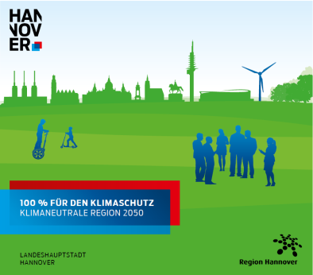
Hannover’s sustainable urban development
Hannover as « the green city »
ÜSTRA, Hannover’s transport company plans convert all city center bus lines to e-buses by end of 2021
Questions raised:
  How to adapt the existing electrical network capacity for charging e-buses ?
  How to smartly integrate the e-bus charging stations in the city’s electrical network, along with sustainable sources of energy ?
  How to optimize infrastructure costs ?

Slide 22
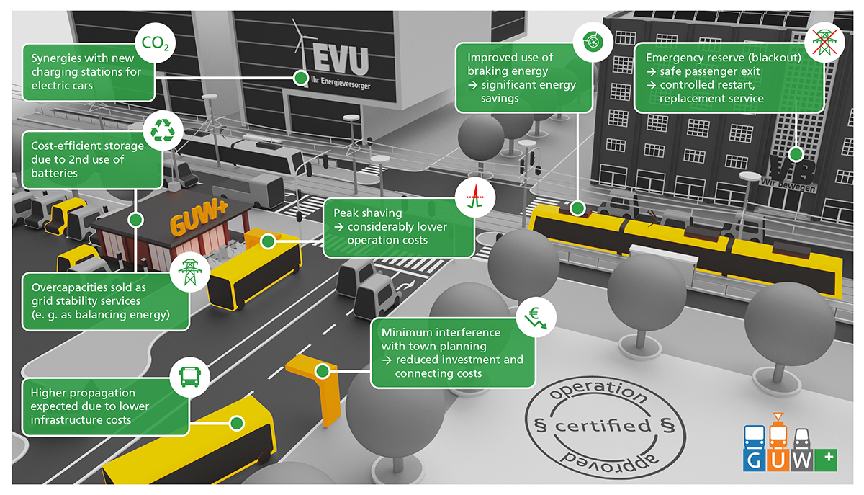
Project is called GUW+, an energy supply concept
See https://www.guwplus.de/

Slide 23
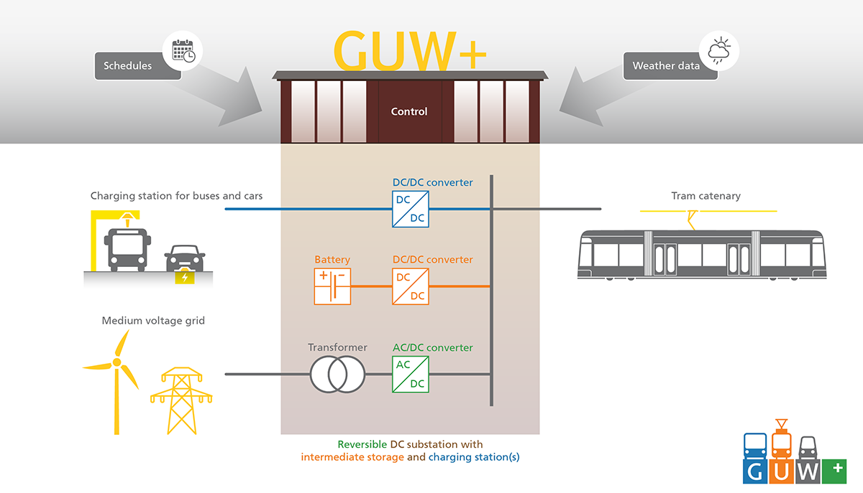

Far more than a DC substation
CHARGING STATION
E-vehicles supply
BATTERY STORAGE
Emergency reserve
SUBSTATION Converter
REVERSIBLE Energy supply
To: trams, e-vehicles and batteries
From: braking trams, batteries, grid
+ Energy Management system:
data from railway network, bus data, grid, time, weather,…

Slide 24






GUW+ consortium
Energy management, programming and network monitoring
DC/DC converters
Traction network (customer)
Substation integration
HESOP = Reversible Substation

