Slide 1
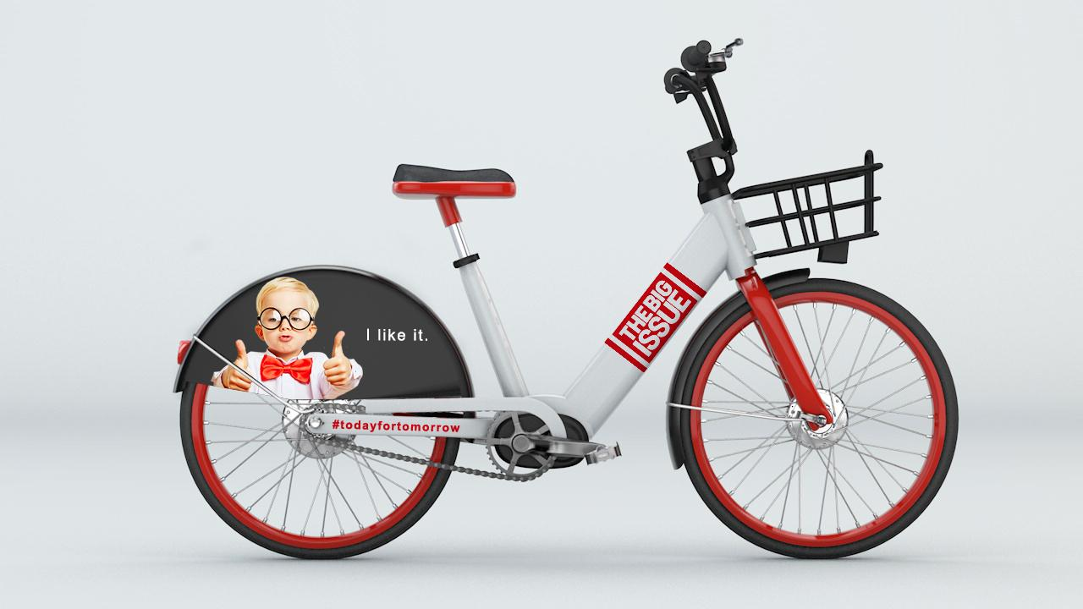

A unique set-up for first/last mile commuting

Slide 2

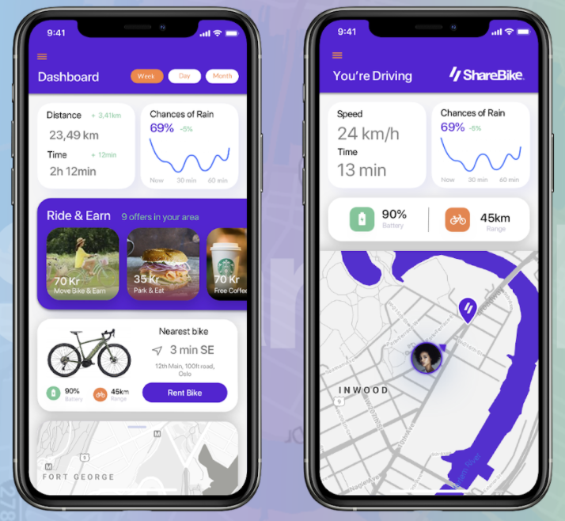

Bikes on Demand for Commuters
The Bike: IoT eBike with local design and long range. Dynamic distribution, means no costly, cumbersone stations are needed
The App: Built in loyalty programmes and incentives as well as dynamic pricing to manage customer behaviour. Platform based on open API philosofy to be integrated with RUTER platform
Bike Hubs: Placed where people live, where they land and where they work. Following travel streams and bikes beeing pre-balanced. Entire system available only for commuters at certain times

Slide 3


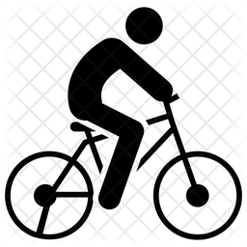

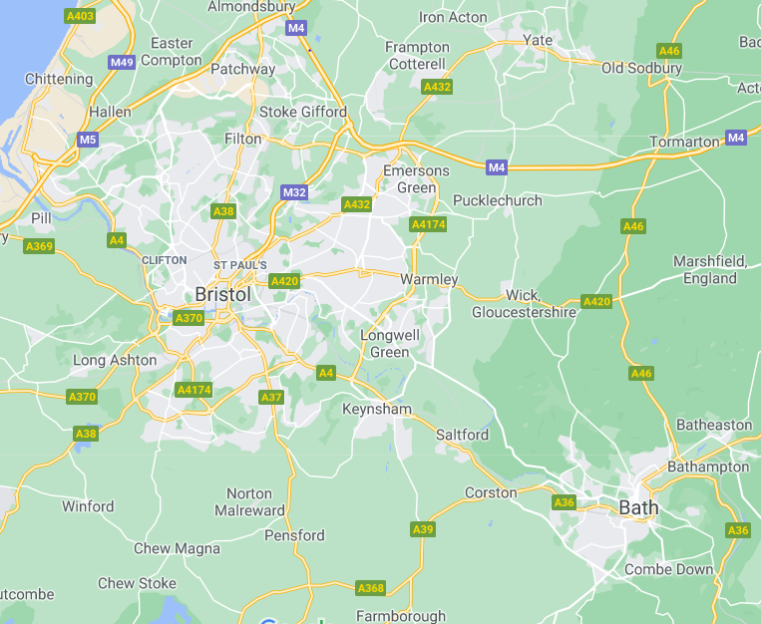
Dynamic distribution, not bike-stations
✗
Station based bike sharing
Dynamic structure, no stations
Bike
station
Bike
station
3-8 min
3-8 min
✓
1 min
1 min
OLD TECHNOLOGY: Stations are expensive to install, maintain and need increased manual balancing to ensure optimum bike availability
USER BEHAVIOUR: People want to ride from where they are, to where they want to go, as opposed to riding from one bike-station to another bike-station
SUCCESS: Because systems without stations are more attractive to users, you see higher utilisation (and revenue), helping contribute to your wider strategies
HOT SPOTS: To ensure bikes are available, hot spots need to be around 2000 feet (max) away from each other in city centres
Example
Designated hot spots –
regulated parking controlled
by app
Border between hot spots
and soft restricted parking
– guided by app
Area for dynamic parking,
return outside hot spot
possible

Slide 4
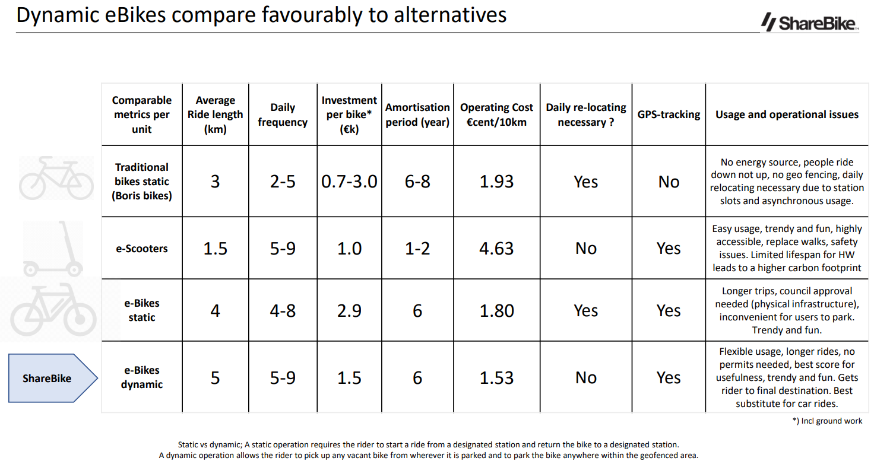

Slide 5
