Slide 1
TheFactory - Accelerator
Nye muligheter gjennom samarbeid

Slide 2



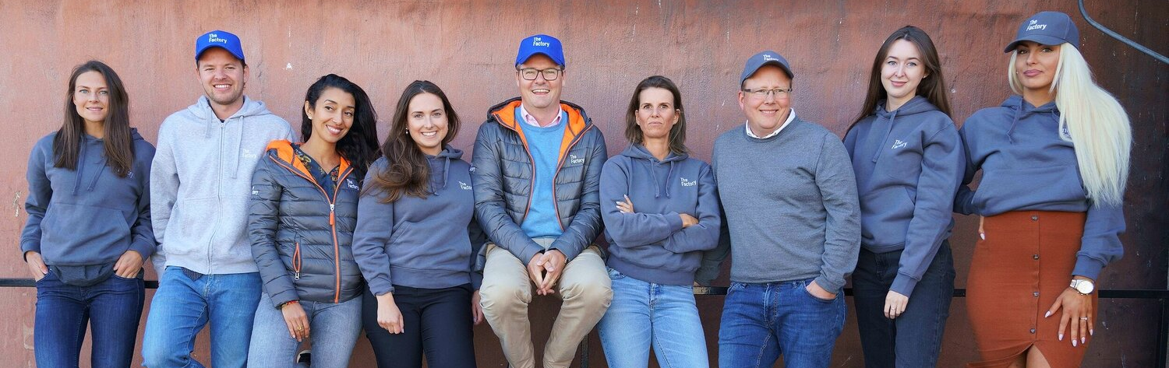
Akselerator
Growth
Partner Innovation
Notes:
Fast forwarding 4 years – and we have a totally different picture!

Slide 3







Siden 2016 har vi...
1.500+
100+
170+
100+
150+
2
1
Startups screened
Startups accelerated
MNOK
Raised
Angel
Investors
Mentor
Network
Exits
TheFactory Norway Fund I
Notes:
Fast forwarding 4 years – and we have a totally different picture!

Slide 4
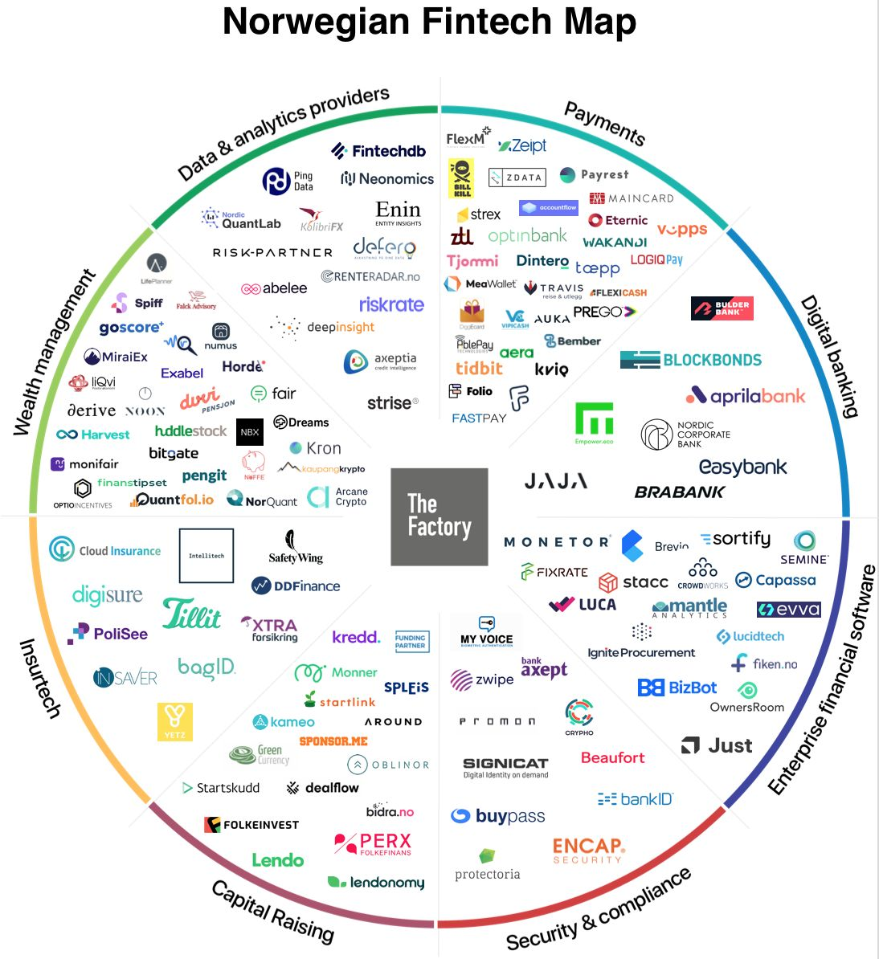
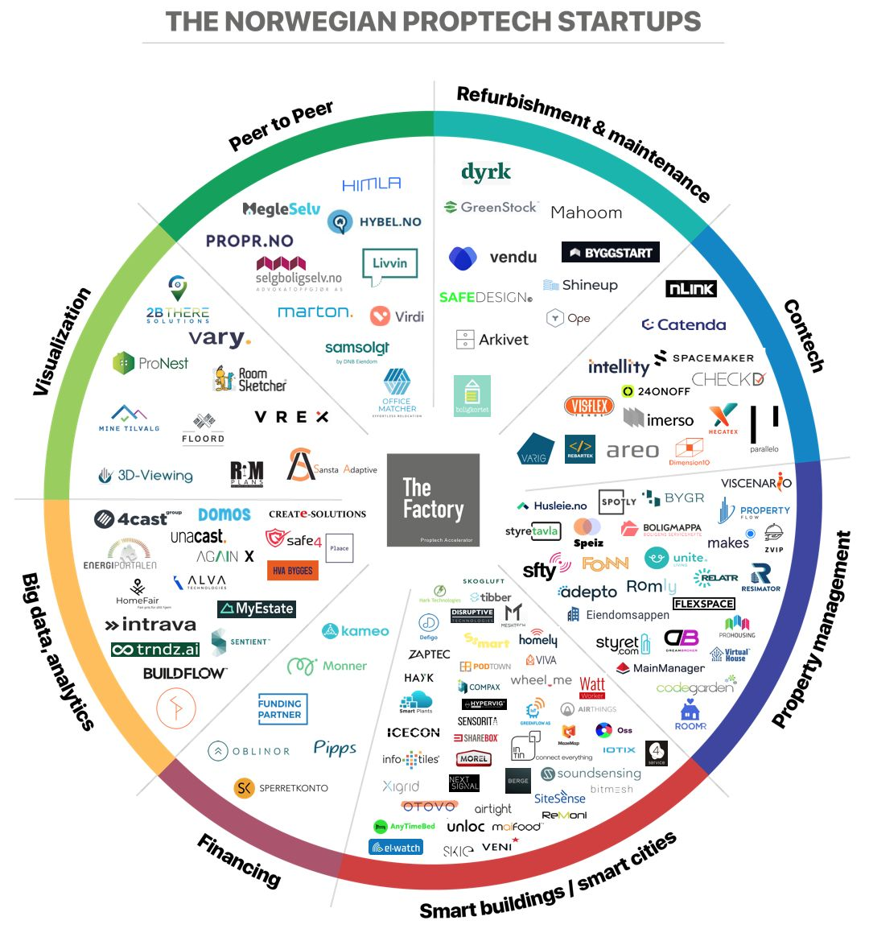
Fintech & Proptech i Norge i 2020
Fintech i Norge
Proptech i Norge
Notes:
But things have changed, in 2020 the opportunities in the Norwegian – and the Nordic – markets are enormous!

Slide 5

Oslo - Bergen - Stavanger - Kristiansand
#FINTECH #PROPTECH #NEW ENERGY #MOBILITY #GREEN #ROBOTICS #RETAIL

Slide 6


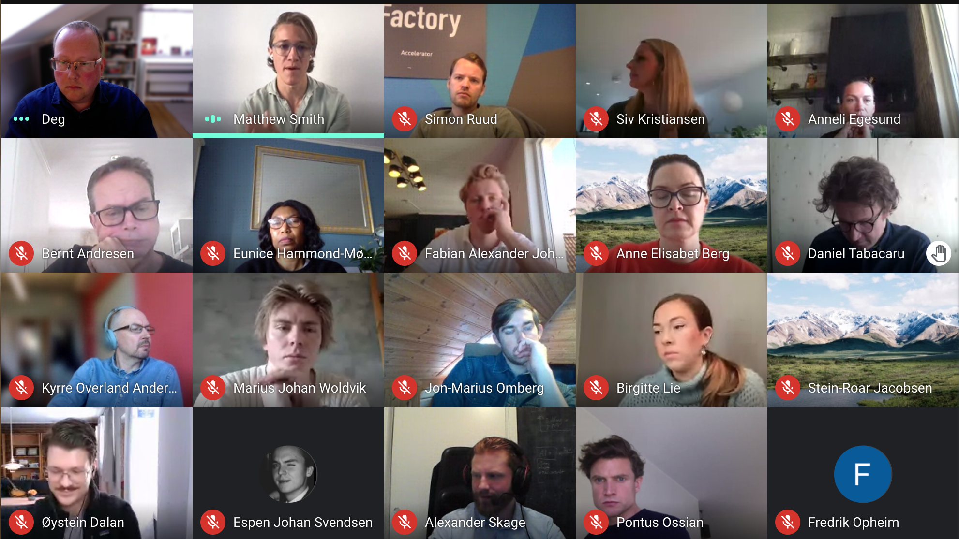
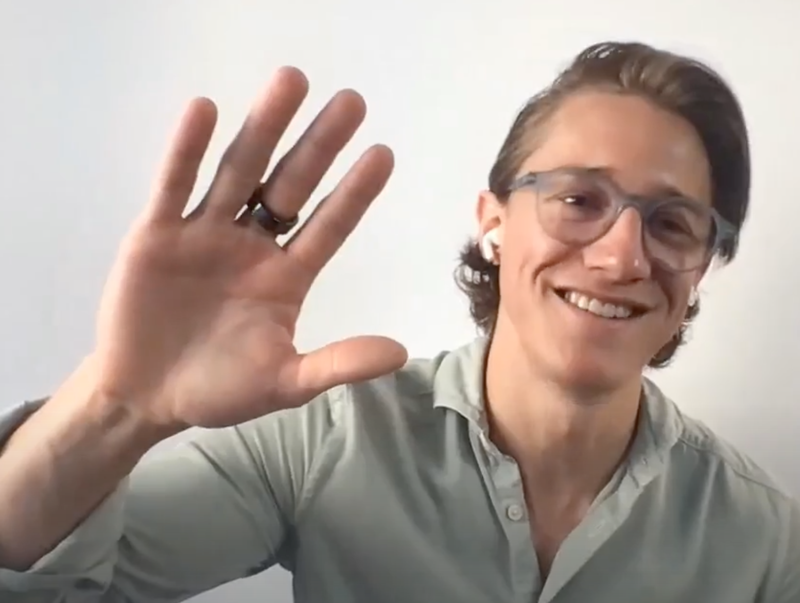





33 New Norwegian Startups!!!
Awesome kick-off for Norway’s largest startup accelerator program GRÜNDER ACADEMY!
#Fintech #Proptech #Retail
#Energy #Logistics #Green
and more...

Slide 7
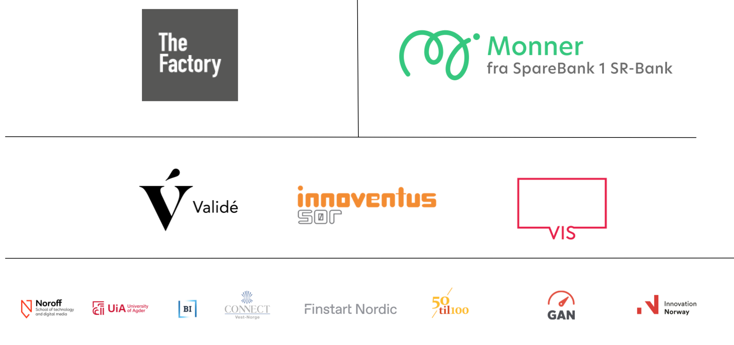
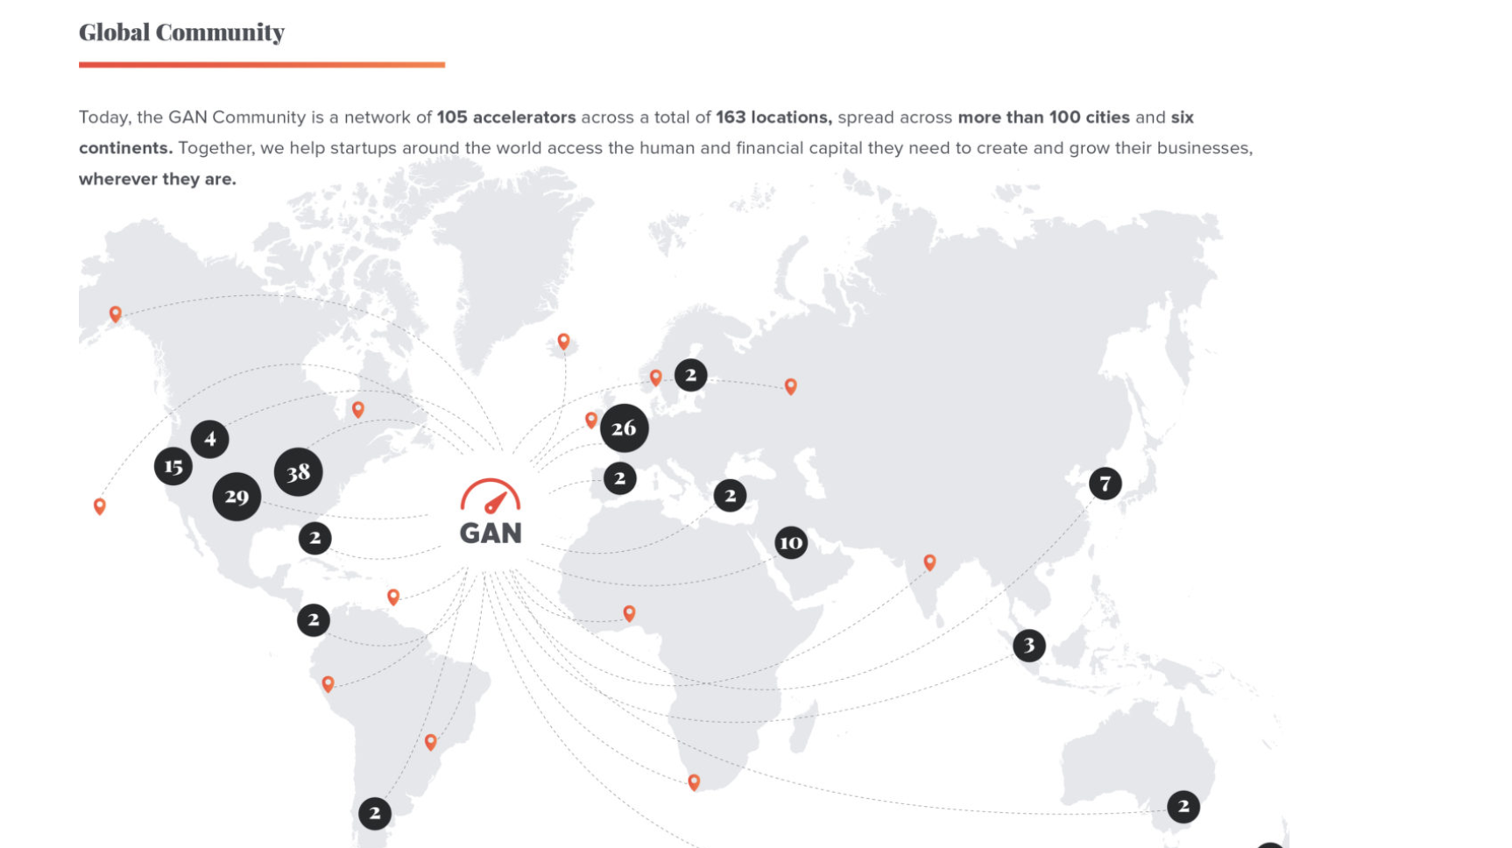










Stort nettverk = stor tilgang på startups & ressurser
#Corporate Partners #Startups #Investors #Mentors
© Copyright - All rights reserved TheFactory 2021

Slide 8
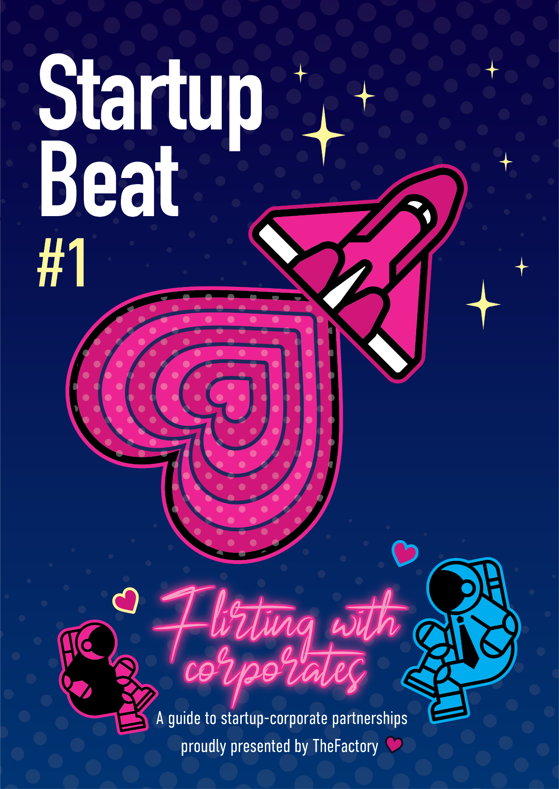
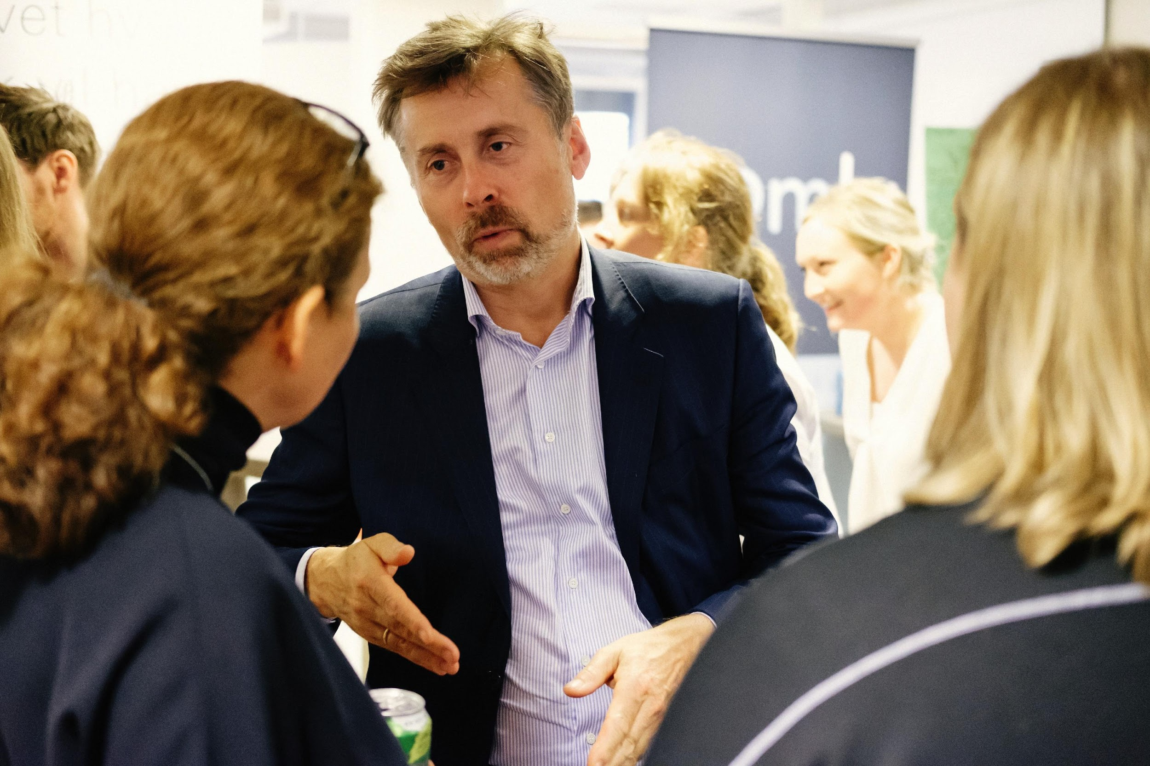
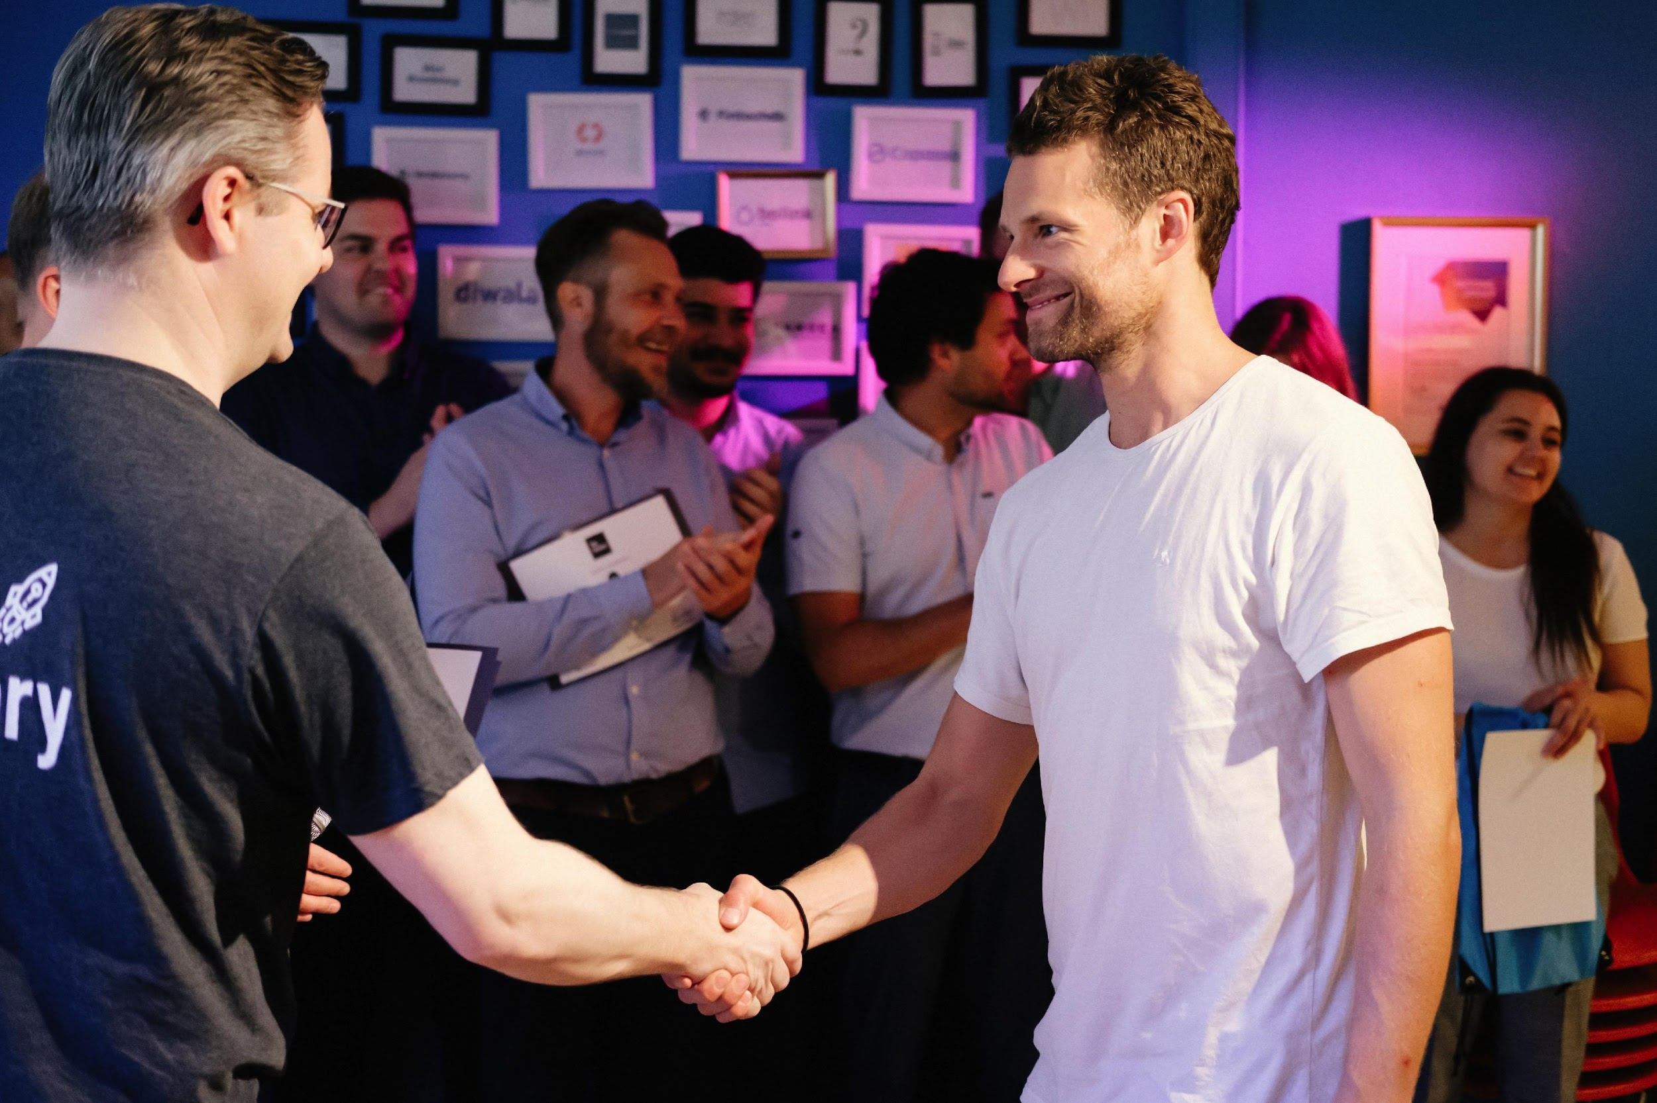
Startup-corporate samarbeid
Rammeverk for startup-corporate samarbeid
Best practice eksempler (Do´s & Dont´s)
Relevante koblinger mellom startups og partnere

Slide 9

Fremtidens Mobilitet = Mer enn hjul...
Kollektivtransport
Kjøretøy (på bestilling)
Smart lading
Smarte bygg & infrastruktur (proptech)
Nye betalingsløsninger (fintech)
Nye forretningsmodeller
Innsikt & data

Slide 10
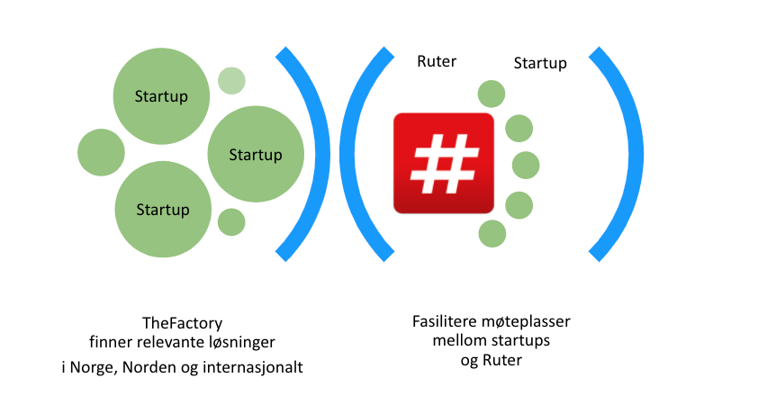
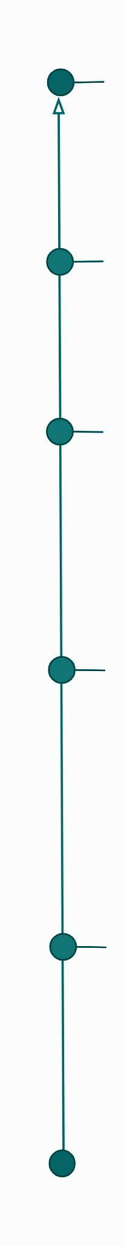
TheFactory x Ruter samarbeidsmuligheter
Future Mobility Program
Speiding etter løsninger
Innovasjonsarenaer
6 måneder, 5-10 startups
Jobbe med Ruters problemstillinger, bidra til innovasjon, nye samarbeid
TheFactory har lang erfaring i å skape innovajonsarenaer og møteplasser mellom ulike aktører.
ETABLERT NÆRINGSLIV
STARTUPS
STUDENTER
SENIORER
Demodag/investordag
Showcase progress
Innovation camp
Showcase progress
Business camp
Kickoff camp, mentor matching

Slide 11

Partner
Takk for tiden!
hc@thefactory.no
Hans Christian Bjørne
Partner
Mentor
Gründer
Investor

