Slide 1
EVRI
Dashboard Guide
(individual sites)

Slide 2
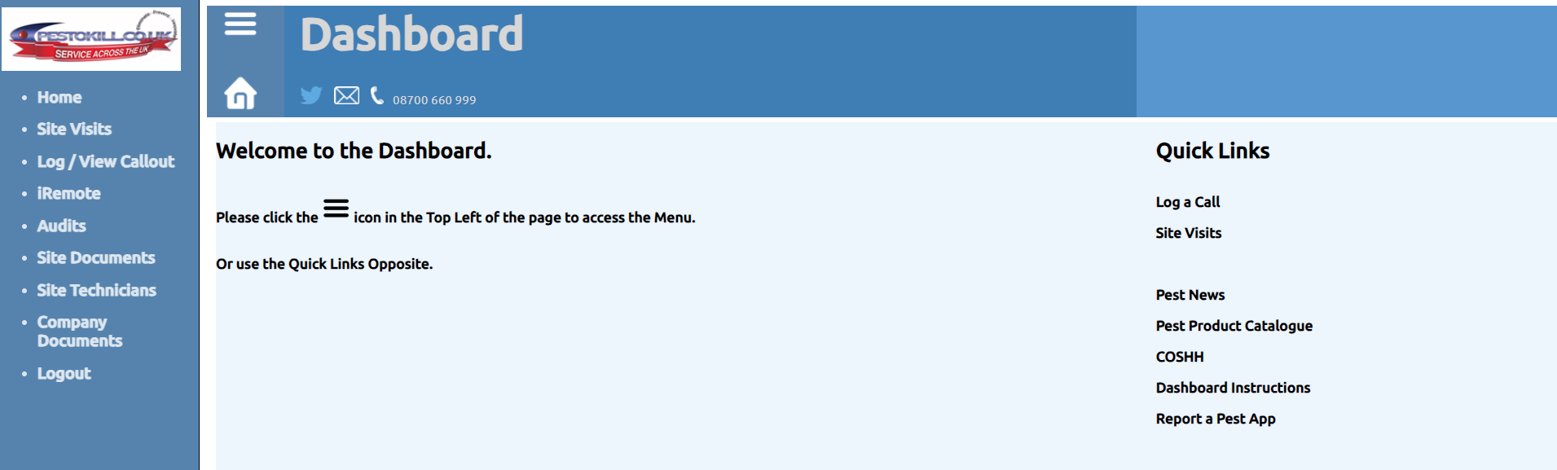
Overview:
Individual Site user login
- Home page
- There is also a master log in for the dashboard which includes all sites across EVRI.
- This guide will detail how each category works and how to run each one.

Slide 3
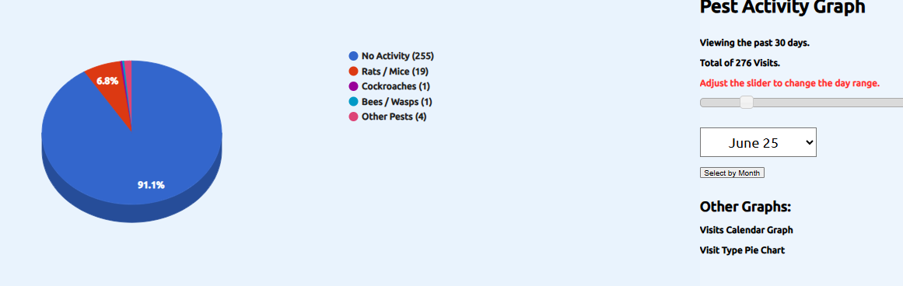
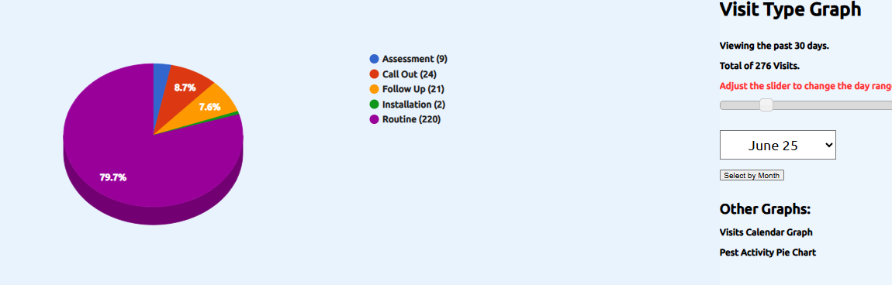
Graphs
This provides an overview of the estates pest activity or visit type. This can be viewed by an individual month or, with the bar increase to a selected amount of days

Slide 4
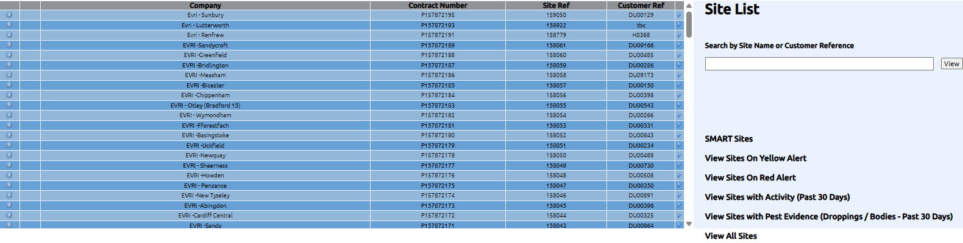
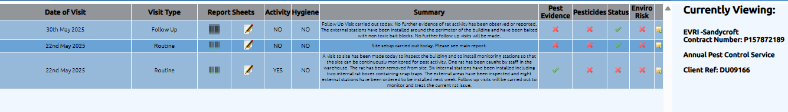
‘Sites’ contains a list of all sites and by clicking the blue arrow at the far end you are then able to see jobs completed at site by Pestokill. This includes routine, call outs, heat treatment and follow up visits.
This tab will take you to the technician's job sheet.
This section will give an idea on the outcome of the visit and if activity was noted.

Slide 5
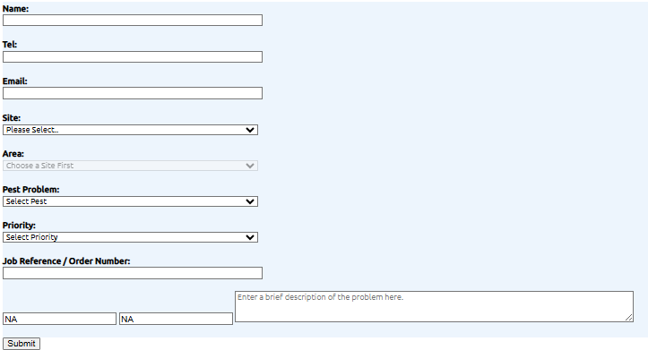
Log/View call out
This page allows you to log a call directly with us for any individual site that is either covered under your contract costs or a PO is provided in the Job Reference/Order Number section where chargeable

Slide 6
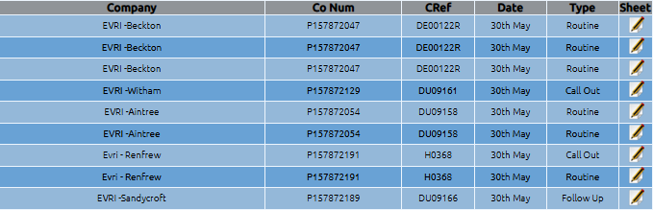
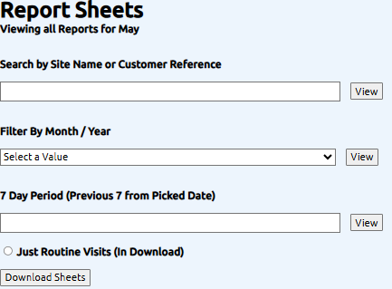
Report sheets
By selecting the symbol this will take you directly to the technician's report sheet – these are uploaded to the dashboard as soon as the technician has completed the job
Here you can download a desired number of reports into an excel document for a specific/required site

Slide 7
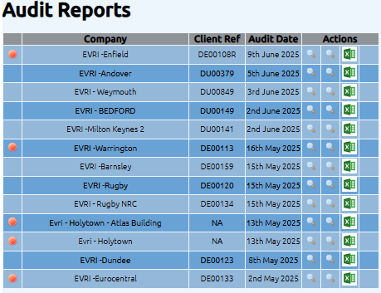


Orange circular symbolys are presented at each side of an audit with issues that have not yet been actioned by either the contractor so client
Clicking on the magnifying glass or excel symbol allows you to see each audit report in either PDF or excel format

Slide 8
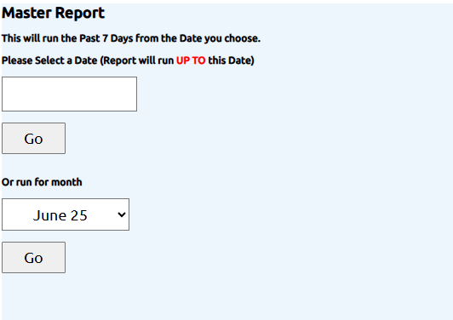
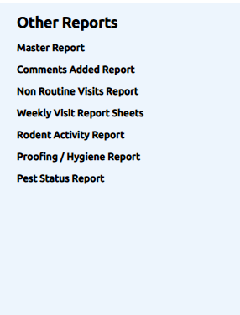
User reports
This provides you a selection of reports you can pull for all sites

Slide 9
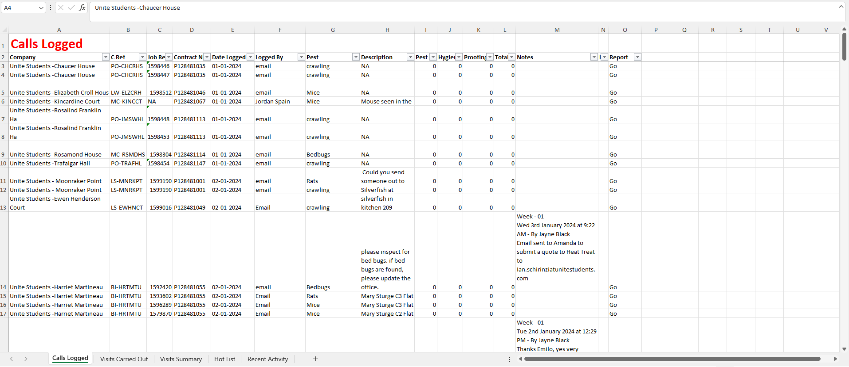

Master Report
This is an example of Januarys master report, this includes every visit at each site by Pestokill in January, this report can be ran off from any required date or week.
This ‘go’ tab takes you straight to the job sheet.
For the hygiene and proofing section, this will give the score briefing the outcome of the visit and what was noted.

Slide 10
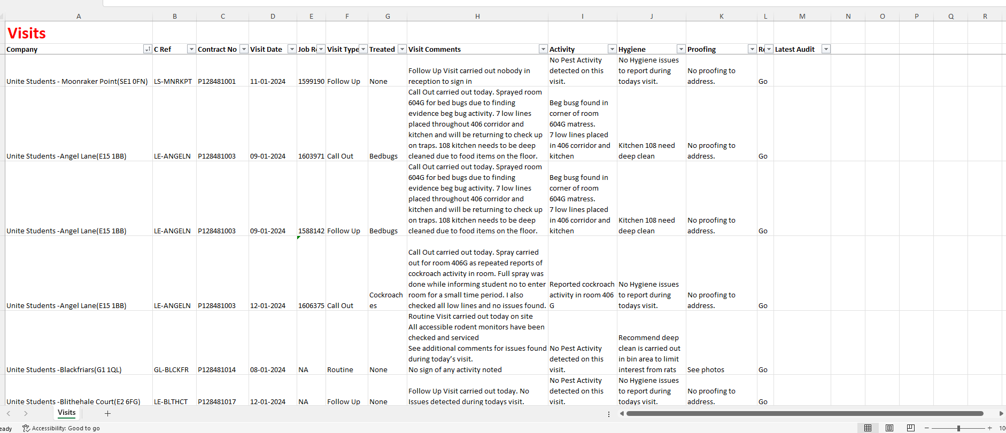


This is and example of the weekly report, this pulls off more info including visit comments & proofing and hygiene comments.

Slide 11
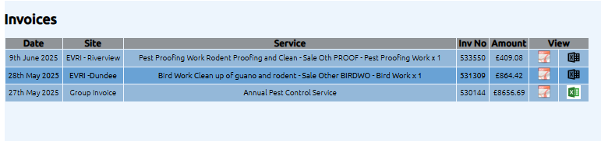
Invoices
On this page you can view all invoices both individual and group invoices in either PDF or excel format

Slide 12
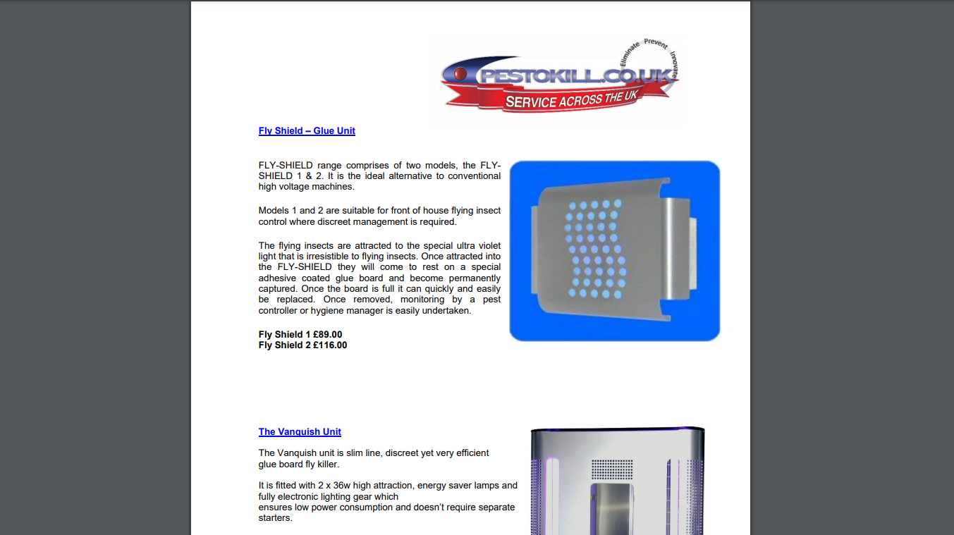

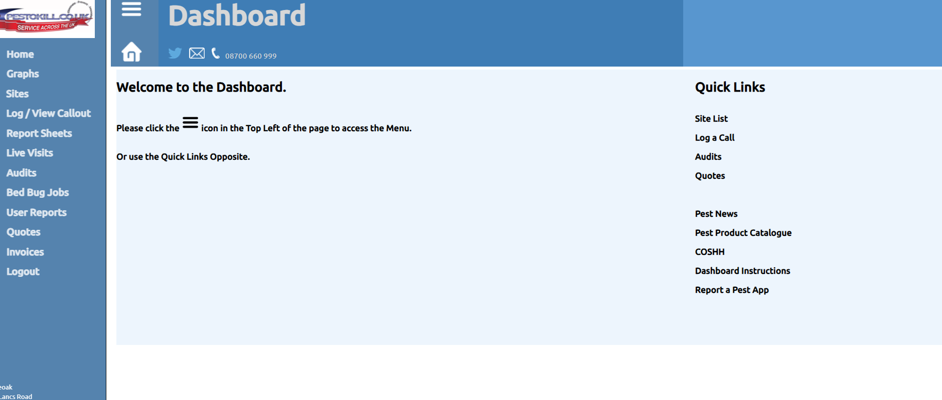
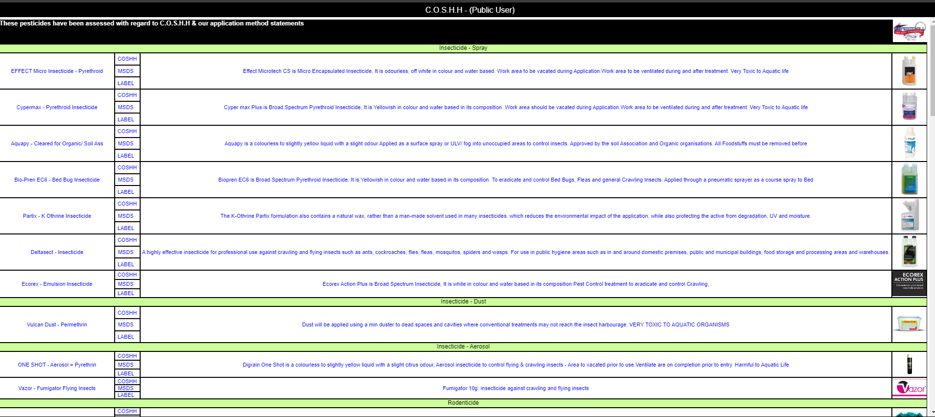



‘Quick links’ can be useful for any pesticide info, products, prevention.

