Slide 1
FUNdamentalz
Terrain specifications and guidelines

Slide 2
Introducing Freestyle Terrain
It is the coaches responsibility to manage access to terrain and do their best to ensure athlete safety!
If the terrain is properly chosen and set up the athlete should be able to ‘learn by doing’
Never choose terrain beyond an athletes skill level – you probably will need to work with resort to build stage appropriate features
An athletes experience safely mastering terrain at this stage will determine whether they have fun and stay in freestyle snowsports!

Slide 3
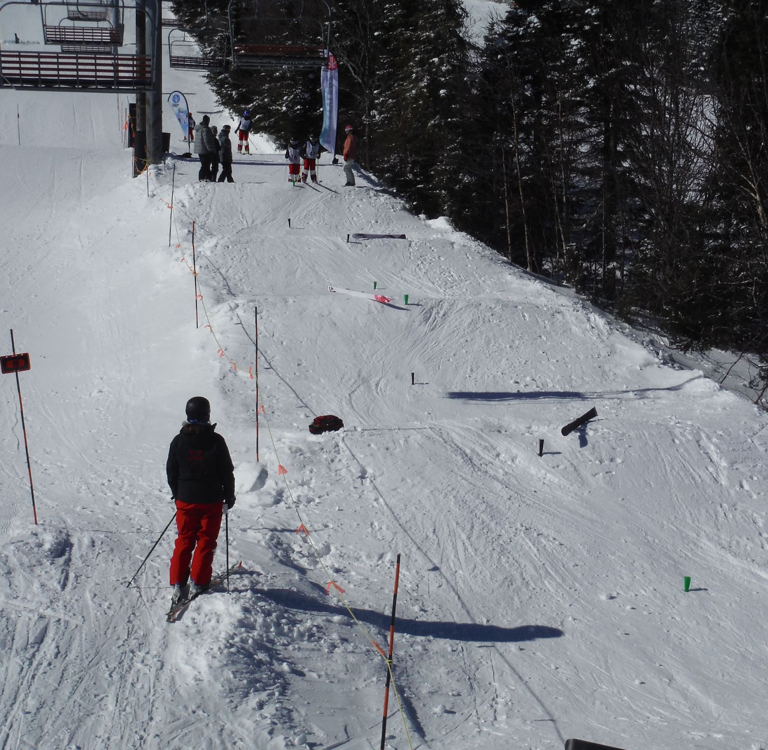
FUNdamentalz Roller Tank
The rollers will be used for the absorption skill and the turn timing skill
Set rollers every 6-7 m or closer if flatter terrain
Every roller should be about 60- 100 cm
Build with a cat on a beginners terrain and make sure rollers are rounded rather than triangular
Finish the shaping with a shovel and some side slipping

Slide 4
FUNdamentalz Jumps
10 ft jump of your choice
Fundamentalz upright and spinning air skills can be taught on a variety of jump shapes, including natural features.
Considerations:
Coach can see landings are clear and safely signal athletes
The landing should not be ‘jarring’ – avoid flat/icy/rutted landings
The area between take-off lip and landing is ideally gently rounded
Choose the right terrain to build success and match the skill level of the athlete
If athletes are not successful - rethink your terrain choice!

Slide 5
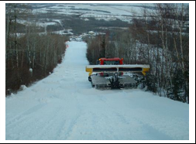
FUNdamentalz Moguls
  Entry level: Course length 80 – 100m (max), Pitch: 12- to 20 degrees – natural or man made round moguls are ideal. 1 mogul turn line is enough for the course but 3 lines is more fun!
  If pushed by Cat care should be taken to make sure moguls are rounded and smooth and there open exit space or safety fencing 10 m width on each side – any obstacles like snowmaking/trees need to be appropriately padded.
  Standard mogul build or less for flatter terrain mogul spacing should be 3.5m - 3.8 m (7m - 7.6m one side push)
  mogul height , 30cm - 40cm
  Course should be kept slipped to prevent ice and jagged formations or ruts from forming over time.
  Courses usually need to be rebuilt every 3-4 weeks. A cat can complete in 30 -40 mins with practice. Slipping/shovel work should happen immediately after snow is pushed and before it sets.
  Refer to Freestyle Canada Resource Centre Guide to Building Mogul Terrain with a groomer http://www.freestylecanada.ski/en/resources/competition/

Slide 6
FUNdamenatalz Box
A butter box or wider dance floor box are great for introducing skills.
Considerations:
Check that the sliding surfaces and any exposed trim are smooth
Entry should slide up to feature with no gap
All supports under the sliding surface should be “skirted”
Side and end exits should be smooth snow and not icy or rutted or ‘catchy’
Make sure you can position yourself for athletes who need spotting

